Slide 1
History and Mission of IA
CSH6 Chapter 1 with supplementary information
“Brief History and Mission of Information System Security”
Seymour Bosworth & Robert V. Jacobson

Slide 2
Topics in CSH6 Chapter 1
Basic concepts
Security
Risks
Risk management
History
Why bother with history
Chronology

Slide 3
Security
What do you think of when someone talks about security?
What is special about information security?
What are the threats to security?
What are the special threats to information security?

Slide 4
Risks
Probabilities
Injury
Damage
Loss
Can we achieve perfect security? Why or why not?

Slide 5
Risk management
What are the goals of risk management?
Steps of risk management
Identification of risks
Mitigation
Evaluation / validation
Can risk management achieve perfection? Why or why not?

Slide 6
Why Bother with History?
Puts security into perspective
Think about changing requirements
Different threats and vulnerabilities
Themes:
Increasing accessibility to unauthorized people
Increasing flexibility for automated attacks
Information security assurance is a process, not a state

Slide 7
Pre-computer INFOSEC
What was the focus of INFOSEC in . . .
Babylon, 500 BCE: abacus
England, 1614 CE: logarithms
1620: Oughtred’s slide rule
1642: Pascal’s adding machine
1671: Liebniz’ Stepped Reckoner for multiplications
1801: Jacquard loom (programmable)

Slide 8
Abacus

Slide 9
Slide Rule

Slide 10
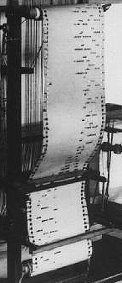
Jacquard Loom

Slide 11
Mechanical Computers
General Purpose Programmable Calculators)
1832: Babbage prototype Difference Engine
1834: Babbage designs Analytical Engine
1889: Felt’s printing desk calculator
1890: First use of Hollerith’s punched cards and tabulating machines
1896: Hollerith founds Tabulating Machine Company (later IBM)

Slide 12
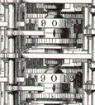
Difference Engine (1832)

Slide 13
Analytical Engine (1934)

Slide 14
Adding Machine (1889)

Slide 15
Hollerith Tabulator (1890)

Slide 16
Hollerith Card (1890)

Slide 17
Early Electric and Electronic Computers: Unique Systems
USA, 1930: Vannevar Bush’s differential analyzer
1935: IBM 601 punch-card calculator achieves 1 multiplication per second
1940: Bell Labs’ Complex Number Calculator
1943: Colossus (2000 vacuum tubes)
1944: Harvard Mark I
51 feet long
3 numbers added per second
1946: ENIAC (Electronic Numerical Integrator and Calculator) – filled entire room

Slide 18
Differential Analyzer (1930)

Slide 19
Harvard Mark I (1944)

Slide 20
ENIAC (1946)

Slide 21
Late 1940s: Stored Programs, Peripherals
1949:
Cambridge University’s EDSAC stores programs on paper tape
EDVAC uses magnetic tape for program storage
Popular Mechanics predicts, “Computers in the future may weigh no more than 1.5 tons.”
1950:
Imperial University Tokyo – invention of floppy disk
Turing Test postulated

Slide 22
Early 1950s: Software and Hardware Become Accessible
1951:
Adm. Grace Hopper invents the macro assembler computer language (2GL)
US Air Defense System receives Whirlwind real-time computer
UNIVAC-1 – 1st general-purpose electronic computer; delivered to US Bureau of Census
1953:
At most 100 computers exist on the planet
No data communications in existence
Magnetic core memory invented

Slide 23
Languages, I/O, Integrated Circuits, Mainframes, Minis
1954: FORTRAN I
1957: 1st dot-matrix printer (IBM)
1958: LISP
1959: COBOL
1960: ALGOL
1961: APL
1964:
PL/1
IBM 360 series released – mass-produced, compatible upgrade paths – 1000s built
DEC PDP-8 – first major mini-computer

Slide 24
PDP-5 (1962)

Slide 25
Late 1960s: More 3GLs, Hardware, Networking
1965:
BASIC (Thomas Kurtz*, John Kemeny – Dartmouth College)
Mouse (Douglas Englebart)
CDC CD6600 supercomputer
1967-71: PASCAL (Wirth)
1968:
Intel Corp founded
LOGO
1969:
ARPANET (US DoD)
RFC0001 Host Software. S. Crocker.

Slide 26
Early 1970s: Mainframes, Glass House, Chips
1970:
1st RAM chip (Intel) 1024 bits
UNIX development starts (Thomson & Ritchie)
FORTH
1971: Intel 4004 microprocessor – the 1st ever
1972:
PONG video game (Atari)
Large Scale Integration (LSI) 500 components per chip
C
1973: HP releases its first minicomputer, CX

Slide 27
CDC 7600 Supercomputer

Slide 28
Cray I (1976) – 75 MHz

Slide 29
Mid 1970s: Databases, Personal Computers
1974: MITS Altair 8800 – 1st personal computer
$397
256 bytes of RAM
I/O – lights and switches only
1975: Bill Gates and Paul Allen form Microsoft, create BASIC for Altair 8800
1976:
Stephen Wozniak & Stephen Jobs design Apple I computer
1st IBM laser printer – size of an SUV
Cray I supercomputer 150 Mflops

Slide 30
Altair Kit (1974)

Slide 31
Apple I Prototype (1976)

Slide 32
Late 1970s: Networking, Microprocessors
1977:
TCP (Transmission Control Protocol) replaces NCP (Network Control Protocol) in ARPANET
Apple II computer introduced
1978:
Intel releases 8086 16-bit microprocessor
1979:
Commodore PET 1MHz clock, 8 KB RAM
Motorola releases 68000 microprocessor

Slide 33
Early 1980s: Minis, Datacomm, EDI
1980:
Microsoft begins work on MS-DOS
HP 3000 minicomputer supports 128 users
Refrigerator-sized
1 MB RAM max
HP7925 disk drives = 120 MB
1981:
Xerox 8010 computer uses WIMP (Windows, Icons, Menus, Pointing Devices) GUI
IBM releases 1st PC @ $2880 w/ 64 KB RAM, monochrome display, optional cassette drive & 160 KB floppies
1982: The Internet defined as internetwork using TCP/IP
1984: DNS invented; Internet has 1000 hosts

Slide 34
HP3000 Series III (c. 1979)
1 MB RAM
$64K
120 MB disk
$25K
CPU
$250K

Slide 35
Mid-1980s: LANs, WANs, MANs, PCs, Viruses
1982-1988: LANs explode
1983: Fred Cohen defines computer viruses
1985:
Intel 80386 chip released with 20 MHz (max 33 MHz) clock
MS-Windows 1 released
1986: Lehigh University hit by virus on floppies
1988:
IBM releases optical WORM drives (“CDs”)
Morris Worm downs 9000 Internet hosts
1989: Tim Berners-Lee invents the WWW

Slide 36
Early 1990s: UNIX, Internet, Web, Microsoft Dominance
1991: Linus Torvalds begins writing LINUX
1993: Internet explodes with opening of .COM
1994:
First major spam explosion (Canter & Siegel)
Intel Pentium runs 100 MHz clock
Netscape browser 1.0
1995:
Windows 95
First macro concept virus released

Slide 37
2000s: Mobile Computing, BYOD, & Moore’s Law
Enormous growth in use of more-portable computers
Smart phones
Tablets
Employees want to access corporate resources via personal mobile devices
Drop in price of laptop computers and workstations leads to insistence on access from personal systems
Continued decrease in costs of disks, flash drives, RAM, other components

Slide 38
2010s: Increasing Interest in Cloud Computing
Return to aspects of 1980s mainframes
Rent resources from “cloud” computing
Much more gradual increase in costs instead of large step-functions
Security issues growing in importance
Questions about QoS, continuity of operations
Overseas services in question -- espionage
US and other government surveillance, data capture – hot topics

Slide 39
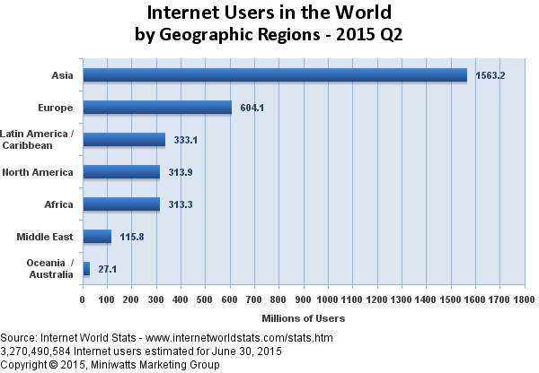
Internet Usage by Region
http://www.internetworldstats.com/images/world2015users.png

Slide 40
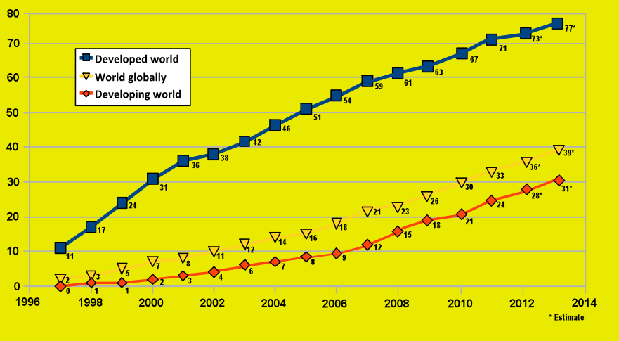
Internet Users /100 Inhabitants 1996-2014
http://upload.wikimedia.org/wikipedia/commons/2/29/Internet_users_per_100_inhabitants_ITU.svg

Slide 41
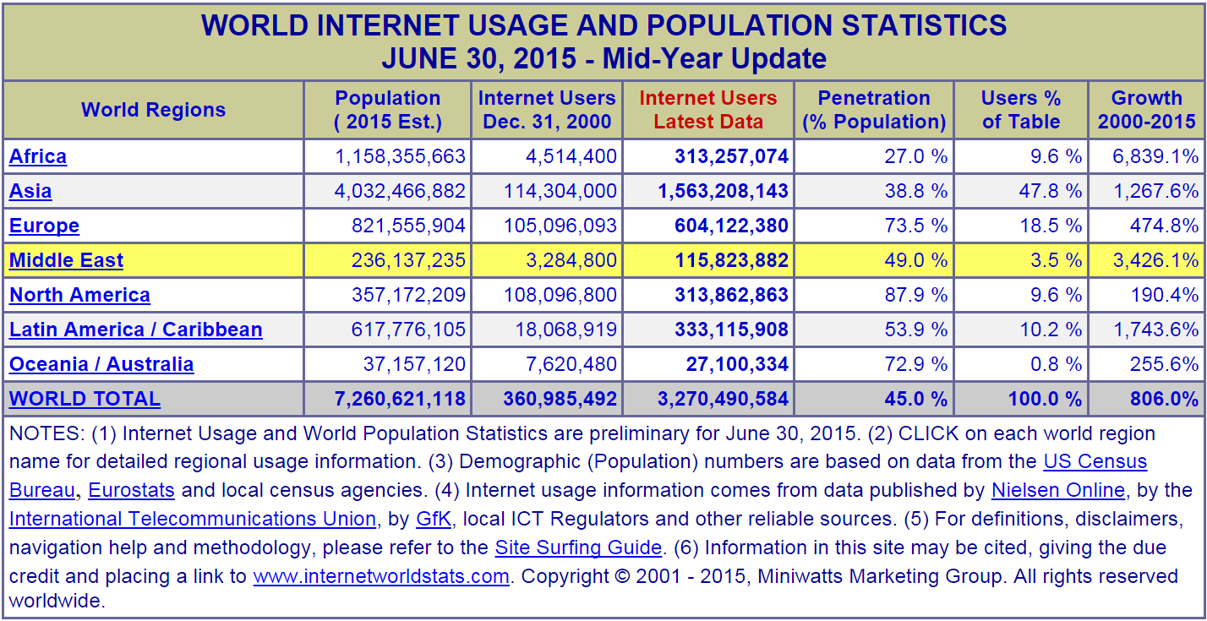
Internet Usage Details
http://www.internetworldstats.com/stats.htm

Slide 42
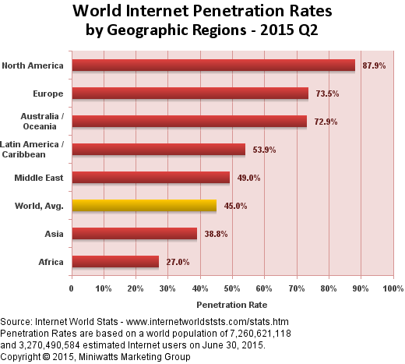
Internet Penetration Rates
http://www.internetworldstats.com/images/world2015pr.png

Slide 43
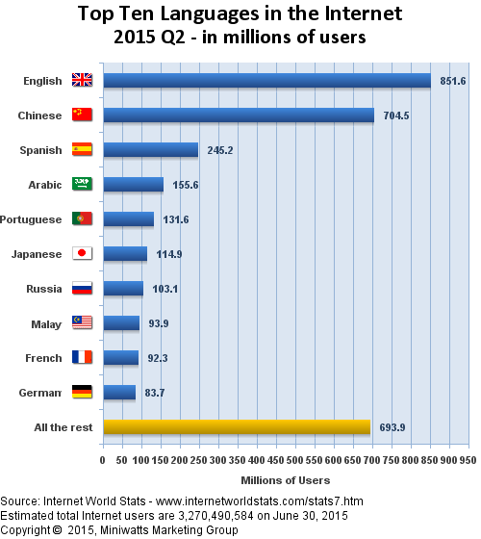
Language on the ‘Net
http://www.internetworldstats.com/images/languages2015.png

Slide 44
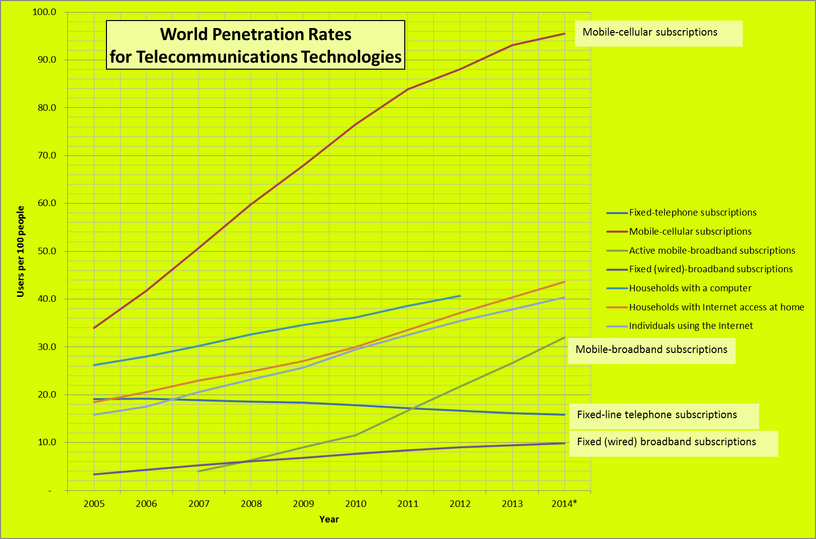
Mobile Phone Usage Growing
http://www.itu.int/en/ITU-D/Statistics/Pages/stat/default.aspx

Slide 45
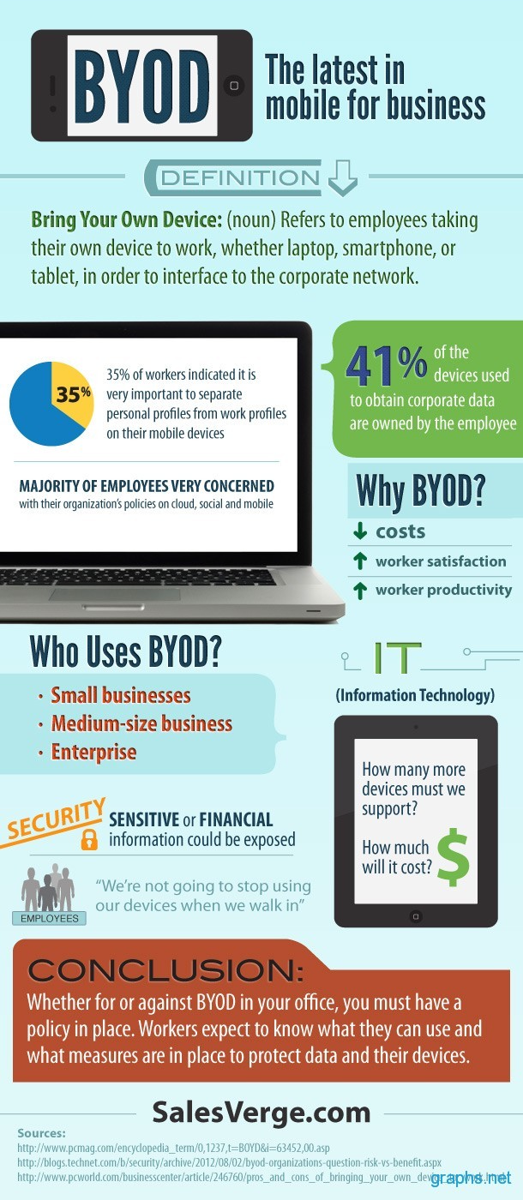
BYOD (1)
http://tinyurl.com/lzq9n7x (graph)
http://www.graphs.net/201208/byod-at-work.html (page)

Slide 46
BYOD (2)
Benefits
User-driven demand
Convenience
Hardware costs can be lowered
Serious questions about security
Individuals generally use poor controls
Loss of devices = compromise corporate information
NAC: Network Access Controls
Compatibility issues
Support

Slide 47
Now go and study

