Slide 1
History of Computer Crime
CSH6 Chapter 2
“History of Computer Crime”
M. E. Kabay
With supplemental updates

Slide 2
Topics
Why study historical records?
Trends
1960s / 70s – Sabotage
Impersonation
Phone Phreaking
Data Diddling
Logic Bombs
Trojan Horses
Notorious Worms and Viruses
Spam
Denial of Service
Hacker Underground
Recent Developments
CSH6
Chapter 2

Slide 3
Why study historical records?
Common body of knowledge
Distinguish amateurs from professionals
Shared history of significant events
What has shaped development of field
Understand references from senior people
Put new events and patterns into perspective

Slide 4
Trends
Early days: sabotage, disgruntled/dishonest employees
Physical damage prominent threat until 1980s
Unauthorized access common
Telecommunications subversion popular in 1960s/70s
Malicious software developed in 1980s
Fax-based fraud developed in 1980s (4-1-9)
Growth of Internet multiplied threats
Financial crime mediated by computers & networks grew in 1990s
New malware types developed in 1990s
Illegitimate uses of e-mail spawned spam, phishing, 4-1-9 e-mail fraud

Slide 5
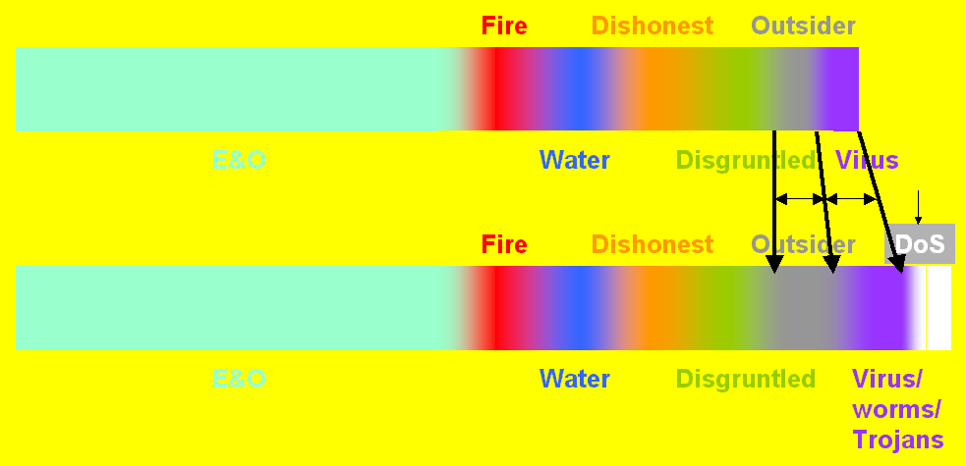
Rough Guesses About Sources of Damage to IT
Before 1993
After 1993
MORAL: remember this fuzzy graph and don’t trust precise statistics about computer crime!

Slide 6
1960s / 70s – Sabotage
Computers can be tools and targets of crime
Also repositories of evidence
1969.02 – fire in computer center during student riot in Montréal, Québec, Canada
Sir George Williams University (now Concordia)
$2M damages & 97 people arrested
In 2001, survey by Novatech showed ~¼ of all computers had been physically assaulted by owner (4,200 respondents)

Slide 7
Albert the Saboteur (1970)
National Farmers Union Service Corporation
1970-1972
Burroughs B3500 mainframe
56 hard disk head crashes in 2 years
8 hours average downtime
$500,000 electrical system repairs
Crashes continued
Suspicion fell on Albert the Operator
Loyal employee
Night shift for many years without letup
Secret video-tape revealed sabotage
Liked the excitement of having all those people around

Slide 8
Impersonation
1970: Jerry Neal Schneider
1980-2003: Kevin Mitnick
1970s-today: Credit Card Fraud
1990s-today: Identity Theft Rises

Slide 9
1970: Jerry Neal Schneider
Born c. 1951
1968: forms Creative Systems Enterprises
Selling electronic communications equipment
Dumpster® Diving for parts at PT&T
Found discarded (unshredded) procedures manuals
1971: Ordered new equipment from PT&T by pretending to be employee involved in repairs
Then sold it -- ~$200K value
1972: Arrested and convicted of grand theft
2 months + $500 fine!

Slide 10
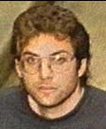
1980-2003: Kevin Mitnick (1)
Born 1963
As young teenager, stole bus rides by using special punch for bus transfers
Phone phreaking, pranks, breakins using social engineering against DEC
1981: social engineering to enter PacBell
Juvenile court ordered psychological study
1 year probation
1987: arrested for penetrating USCA
Stored stolen VAX VMS code on disks
1988: Arrested by FBI; sentenced 1989 to 1 year jail & 6 months rehabilitation

Slide 11
Kevin Mitnick (2)
1992: FBI tried to arrest him for stealing services from phone company computers
Went underground
1994: Insults Tsutomu Shimomura
Physicist & Internet security expert
Mitnick left rude messages on computer, voice-mail
Shimomura helped FBI track Mitnick
1995: FBI arrests Mitnick
1999: Convicted of wire fraud, computer fraud & illegal interception of wire communication
Sentenced to 46 months federal prison

Slide 12
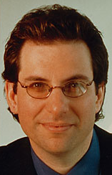
Kevin Mitnick (3)
Became cause célèbre among criminal hackers
FREE KEVIN defacements worldwide
Funniest: FREE KEVIN on Mexican Web site after release of KM
2000: released from prison
3 years parole
Restricted access to computers
Profits from writing and speaking about criminal career used to reimburse victims
Founded own computer-security firm
Wrote books about defending against social engineering

Slide 13
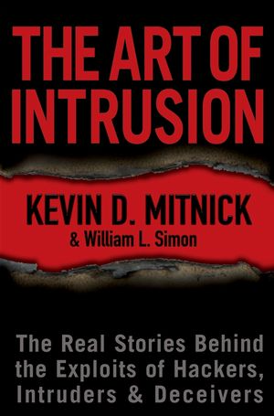
Kevin Mitnick (4)
Readings about the Mitnick case
Goodell, J. (1996). The Cyberthief and the Samurai: The True Story of Kevin Mitnick—and the Man Who Hunted Him Down. Dell (New York). ISBN 0-440-22205-2. xix + 328.
Hafner, K. & J. Markoff (1991). Cyberpunk: Outlaws and Hackers on the Computer Frontier. Touchstone Books, Simon & Schuster (New York). ISBN 0-671-77879-X. 368. Index.
Littman, J. (1996). The Fugitive Game: Online with Kevin Mitnick—The Inside Story of the Great Cyberchase. Little, Brown and Company (Boston). ISBN 0-316-5258-7. x + 383.
Shimomura, T. & J. Markoff (1996). Takedown: The Pursuit and Capture of Kevin Mitnick, America's Most Wanted Computer Outlaw—by the Man Who Did It. Hyperion (New York). ISBN 0-7868-6210-6. xii + 324. Index.

Slide 14
1970s-Today: Credit Card Fraud (1)
Credit cards developed after WWII in USA
1950: Diners Club
1951: BankAmericard & MasterCard
1958: American Express
1960s: aggressive marketing of credit cards
Sending cards to unsuspecting consumers
Mailbox theft → surprise bills on first invoice
1974: Fair Credit Billing Act to reduce abuses
1970s-80s: expansion of electronic confirmation
1980s: Refusal to improve security (no pictures)

Slide 15
Credit Card Fraud (2)
1990s: massive increase in credit card & online fraud
US Visa/MC: $110M in 1980 vs $1,630M in 1995
More recent data*:
Unauthorized general-purpose credit card transactions = 0.037% all card-present credit card transactions in 2012
Fraud = 0.092% value of transactions)
0.118% all card-not-present transactions
0.114% value those transactions)
Global fraud rates across Visa < $0.06/$100
* < http://www.creditcards.com/credit-card-news/credit-card-industry-facts-personal-debt-statistics-1276.php > or < http://tinyurl.com/6hdtv6 >

Slide 16
1990s-now: Identity Theft Rises
One of the fastest growing crimes in USA
Identity Theft Resource Center
http://www.idtheftcenter.org/
Wealth of resources
Victim resources
ID theft protection tips
Scams & alerts
FBI ID Theft Resources
http://www.fbi.gov/about-us/investigate/cyber/identity_theft
Statistic Brain
http://www.statisticbrain.com/identity-theft-fraud-statistics/

Slide 17
What ID Thieves Do
Locate identifying data
Social Security Number
Driver's License
Home address, telephone number
Mother's maiden name
Or just misuse of handle (screen name) for forged messages
Create new credit cards, bank accounts
Default on loans in victim's name
Ruin reputations, credit records

Slide 18
Consequences for Victims
Credit-card expenses relatively easy to correct IFF
Victim checks statement immediately and
Reports questionable transactions within time limit
Bank-account thefts much more difficult to correct
Money stolen is client’s, not bank’s
Client has great difficult recovering funds
Bill-collectors hound victims relentlessly
Bad credit records difficult to correct, ruin plans, cause loss of jobs or interfere with hiring
Criminal accusations put victims at serious risk of erroneous arrest or deportation
Victims may be nailed for child support of total strangers

Slide 19
Preventing ID Theft
Prevent theft: restrict access to your SSN and other personal data
SSN may be required by SSA, IRS employer, financial institution, lender
Corner store or video rental should NOT be given SSN
NEVER give out credit-card or other personal data over the phone to someone who has called you. Ask for written documents.
Shred papers that include confidential info before discarding.
Destroy computer media before discarding.
Don’t use DEBIT cards to buy things

Slide 20
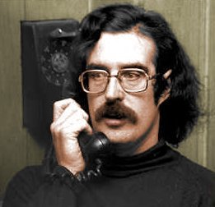
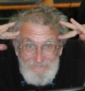
Phone Phreaking
Phone + freak = phreak
1950s: Single-frequency signals communicated control instructions to central switches (computers)
Generating external tone could fool switch
2600 Hz tone generated by whistling, flute or whistle in Captain Crunch cereal box
Hence John Draper phreak became known as Cap’n Crunch
Able to initiate free long-distance
Interviewed by Equire 1971 about phreaking – arrested & convicted
Eventually jailed for wire fraud in 1977
John Draper
then and now

Slide 21
Data Diddling
Unauthorized modification of data
Changes can occur
Before data input
During data input
Before output
Records affected have included
Bank records
Payrolls
Inventory data
Credit records
School transcripts
Telephone switch configurations….

Slide 22
Data Diddling: The Equity Funding Fraud
Equity Funding Corporation of America
From early 1960s to 1973, immensely successful firm
Buy insurance + invest in mutual funds
In 1964, computer problem prevented printing final figures
President ordered head of DP to falsify report with expected profit
Profit failed to materialize
Invented false insurance policies to make up difference
Eventually “killed” nonexistent policy holders to collect payouts ($MILLIONS)
Discovered 1972 by SEC; officers went to jail

Slide 23
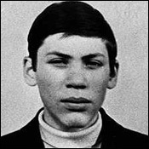
Data Diddling: Vladimir Levin vs Citibank
In 1994, Russian programmer Vladimir Levin broke into Citibank computers
Transferred ~$12M to various international bank accounts
Spotted after 1st $400,000 transferred in July 1994
Citibank cooperated with FBI & Interpol
Levin & gang eventually arrested and tried
Convicted 1998 to 3 years prison
Citibank hired banking industry’s first CISO, Stephen R. Katz

Slide 24
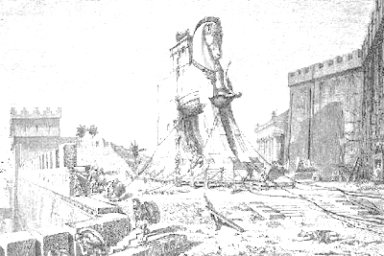
Trojan Horses
Program with apparently useful function
But which has hidden harmful functions
Can be triggered by either
Change of state (logic bombs)
E.g., removal of employee status for programmer
Date/Time (time bombs)
May provide for covert access
Back door
AKA trap door
E.g., BackOrifice & BO2K released by Dildog, criminal hacker in cDC (Cult of the Dead Cow)

Slide 25
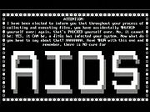
Logic Bombs
Jerusalem Virus of 1988
Duplicated itself every Friday and on 13th of month
On every Friday 13th after May 13, 1988, corrupted all available disks on system
PC Cyborg
AIDS information diskette
Actually encrypted directories, filled C: drive, intercepted commands
Linked to extortion demand for money

Slide 26
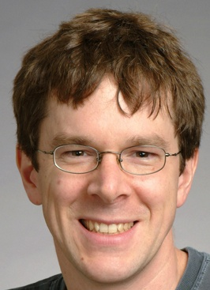
Early Notorious Worms and Viruses
1987: Christmas Tree Worm
December e-mail with EBCDIC version of tree flooded IBM networks
Nov 2, 1988: The Morris Worm
Robert T. Morris studying at Cornell
Released self-replicating autonomous code
Spread through Internet
Crashed systems all over USA (~6,000-9,000)
Led to formation of Computer Emergency Response Team Coordination Center, CERT-CC®
Morris convicted
Violated Computer Fraud & Abuse Act of 1986, 18 USC §1030(a)
3 years probation, $10K fines, expelled from Cornell
Now respected MIT professor http://pdos.csail.mit.edu/~rtm/

Slide 27
Stuxnet Worm
July 2010
Zero-day threat to SCADA
Siemens Simatic WinCC & PCS7
Designed for industrial espionage
Also for sabotage
Thought to have been developed by USA and Israel by 2007
Found in ~100,000 computers
Iran, Indonesia, Inda
Iranian nuclear power program affected
Centrifuges ran too fast

Slide 28
Spam (not SPAM®)
1994: Green Card Lottery spam
Laurence A. Canter & Martha S. Siegel
Attorneys
Posted ad to 6,000 USENET groups
But did not cross-post (1 copy/user)
Posted to EVERY GROUP (1 copy/group)
Response massive
Complaints crashed their e-mail server ISP
Canter disbarred
Never apologized – continue to spam
TODAY: estimates of 75-85% all email = spam

Slide 29
Denial of Service
DoS = interference with availability of service
Resource exhaustion or
Destruction
Unamailer (1996)
johnny [x] chaotic subscribed victims to 100s of e-mail lists
Led to practice of confirming subscriptions
MafiaBoy (2000)
Massive attacks on Yahoo.com, Amazon.com, eBay.com, Buy.com, CNN.com – flooded
15-year-old boy using modem in west end of Montréal did $M of lost business & depressed stock prices

Slide 30
Hacker Underground
Criminal-Hacker Subculture
Chaos Computer Club
Cult of the Dead Cow
2600 The Hacker Quarterly
LOD
Phrack
MOD
Gray-Hat Hackers
Anonymous
Lulz
Web Vandalism Classics

Slide 31
Criminal-Hacker Subculture
Who?
Children (sub-teens, teens)
Adults (fewer after 18 years of age)
Amateurs
“3133T” (elite) hackers
Professionals
Organized crime
What
Publications, USENET groups, lists
Local meetings, conventions
Jargon (133T5p33k)
Notes:
(Cont’d on next page)

Slide 32
Criminal-Hacker Subculture (2)
Why?
Defining peer-group,affiliation, status
Rebellion, power
Curiosity, learning
Ideology, cant
Avoid stereotypes
Not all creepy adolescent geeks
Varying levels of ethical reasoning, emotional development
Notes:
(Cont’d from preceding page)
Shimomura, T. & J. Markoff (1996). Takedown: The Pursuit and Capture of Kevin Mitnick, America's Most Wanted Computer Outlaw--by the Man Who Did It. Hyperion (New York). ISBN 0-7868-6210-6. xii + 324. Index.
Stoll, C. (1989). The Cuckoo's Egg: Tracking a Spy Through the Maze of Computer Espionage. Pocket Books (Simon & Schuster, New York). ISBN 0-671-72688-9. viii + 356.

Slide 33
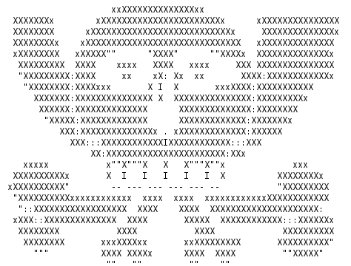
Classic Hacker Group: Chaos Computer Club
1981: German group of computer enthusiasts
Radical politics
Demonstrated vulnerability in Bundespost videotext service
Generally viewed as gray-hat (non-criminal) hackers
1999: Opposed attempts by some computer hacker groups to disable computers in PRC
Chaos Communications Conferences popular with some legitimate security experts

Slide 34
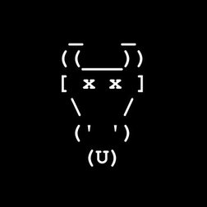
CDC – Cult of the Dead Cow
Founded 1984 in Texas
“Global Domination Through Media Saturation”
Much satire – some very funny
Member Drunkfux founded HoHoCon hacker conference
Political action campaigns
Against censorship (Goolag Campaign against GOOGLE cooperation with PRC)
Attacks on Church of Scientology
Hacking tools
BO & BO2K

Slide 35
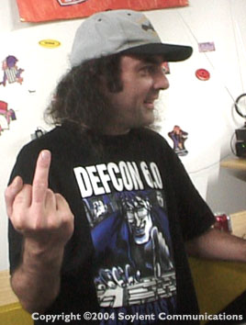
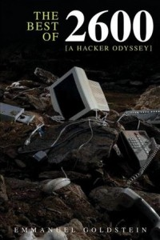
2600 The Hacker Quarterly
Editor Eric Corley aka “Emmanuel Goldstein”
http://www.2600.com/
Founded in 1984
Longest running & most popular hacking ‘zine
Detailed instructions on
Stealing telephone services
Lock-picking
Penetration techniques
Analysis of security issues
History of hacking
Political ideology

Slide 36
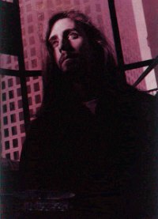
Legion of Doom (LOD)
1984: Phone phreakers and criminal hackers founded LOD
Named after enemies of DC Comics superheroes
Published findings in LOD Technical Journal
Chris Goggans (Eric Bloodaxe) one of best known
Editor of Phrack
Became member of MOD
Mark Abene (Phiber Optik) also member who moved to MOD
Conflict with MOD = The Great Hacker War
Chris Goggans Then & Now

Slide 37
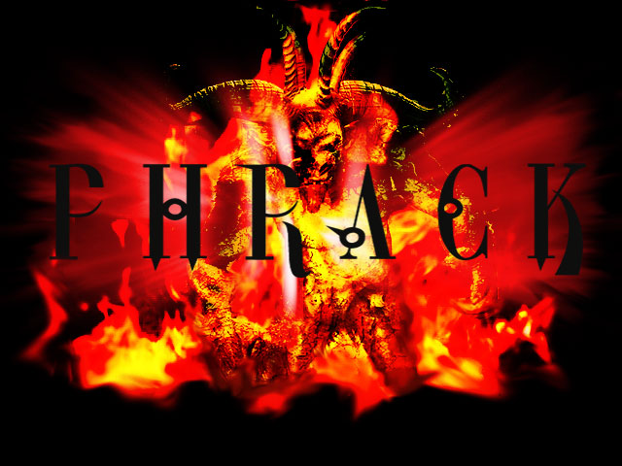
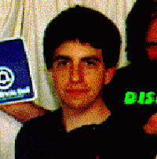
Phrack
http://www.phrack.com/
1st edition Nov 1985
Originally focused on phreaking
Entirely electronic on BBS systems
Eds: Knight Lightning (Craig Neidorf) & Taran King (Randy Tischler)
Phrack 24 involved in Operation Sundevil (1990)
Published E911 docs
Actually public docs!
Craig Neidorf

Slide 38
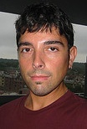
Masters of Deception (MOD)
1989-1992 New York criminal hacker group
Phiber Optik (Mark Abene)
Highly visible in media
Harper’s
Esquire
New York Times
TV (Geraldo)
Eventually arrested,
Tried for violation of CFA [18 USC §1030(a)]
Sentenced to 1 year in prison

Slide 39
Gray-Hat Hackers (1)
Black-Hats: criminal hackers
Ignore laws
Test for and exploit vulnerabilities without authorization
Publicize vulnerabilities without delay for repair
Sometimes amateurish; may be experts
White-Hats: penetration testers
Authorized to test by owners of systems
Maintain confidentiality and professionalism
Sometimes hide-bound; may be imaginative

Slide 40
Gray-Hat Hackers (2)
Gray-Hats: professionals with black-hat backgrounds and attitudes
May have been members of criminal-hacking organizations
May continue to use hacker handles (pseudonyms)
2000-01: L0pht members join @Stake
8 members of L0pht Heavy Industries
Continued to use hacker handles (e.g., Mudge, Weld Pond, Brian Oblivion, Dildog…)
Described in glowing terms by some reputable experts
NTBugtraq's Russ Cooper: "The eight brilliant geniuses down at the L0pht. . . .”
Other commentators not impressed
John Taschek of PC Week: “. . . L0pht's history shows that the group is not ethical, maintained practices that bordered on being illegal and is simply downright scary. . . .”
Notes:
January 17, 2000 -- It gets really scary when hackers join security firms
By John Taschek, PC Week
It's shaping up to be an interesting year, which in some cultures is not necessarily a good thing. First, Lotus President Jeff Papows resigns, though I'm not sure I believe anything from Papows anymore. Then Steve Jobs takes full control over at Apple, which will, of course, trigger a huge sell-off at Apple because, as everyone knows, Jobs works best when he's a front-seat driver with a back-seat title. Then China reportedly bans Windows 2000, presumably so that the country could develop an indigenous operating system based on Linux. (The Chinese government denied the report.)
But by far the oddest thing to happen is that the hackers (or, as the fundamentalist technologists say, crackers) who went by the name L0pht Heavy Industries have now become full-scale security consultants. Does this bode ill for the nation's security, or what? Is everyone off their rocker?
I can't believe what I'm reading. I also can't believe I'm writing about it, since dealing with people who have exhibited criminal tendencies is not a business I want to be in.
L0pht was a highly publicized group of hackers who started out cracking security systems and then, somewhere along the line, became somewhat legitimate because they began to document what they were doing on the L0pht.com Web site. L0pht also develops software that allows users to crack operating system passwords in a matter of hours.
To get an idea how strange it is for a security firm to hire L0pht personnel, you only need to look at the Attrition.org Web site, which highlights L0pht. Attrition's motto is, "We're easy to get along with once you learn to worship us." More damning is that L0pht has also gone on record as saying that "governments and multinational corporations are detrimental to the personal liberties on the Internet." On the other hand, L0pht's new company, called @Stake, is a specialized professional services company that will provide a full range of security solutions for the e-commerce operations of global clients.
(Cont’d on next page)

Slide 41
Web Vandalism Classics
CIA (1996.09)
USAF (1996.12)
NASA (1997.03)
AirTran (1997.09)
UNICEF (1998.01)
US Dept Commerce (1998.02)
New York Times (1998.09)
SETI site (1999)
Fort Monmouth (1999)
Senate of the USA (twice)(1999)
DEFCON 1999 (!)

Slide 42
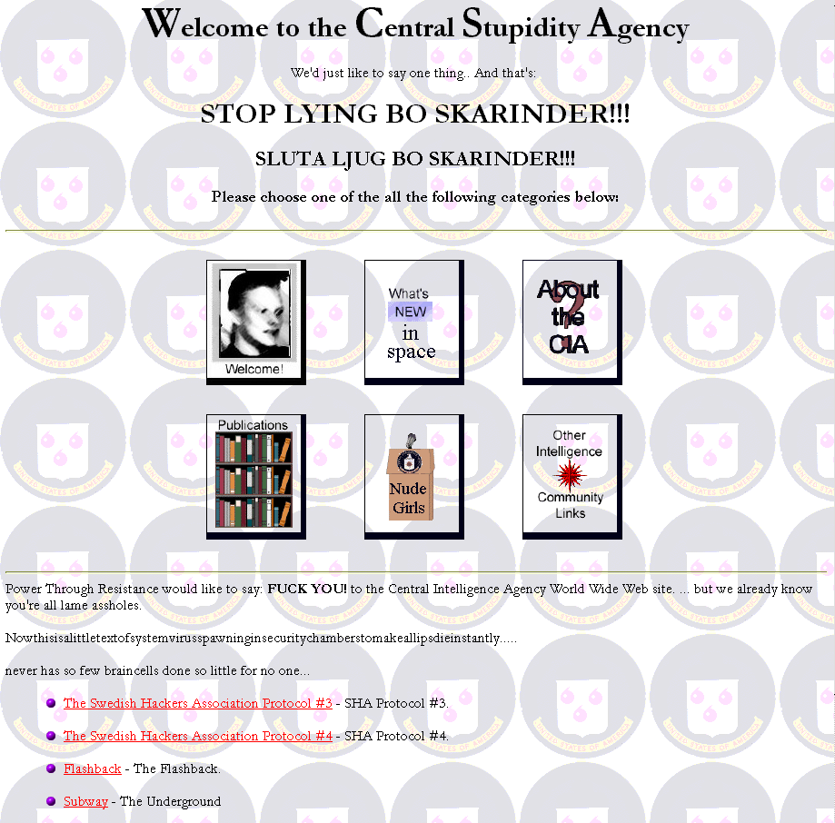
CIA (1996.09)
Notes:
Examples are from <http://www.2600.com> archives unless otherwise noted.

Slide 43
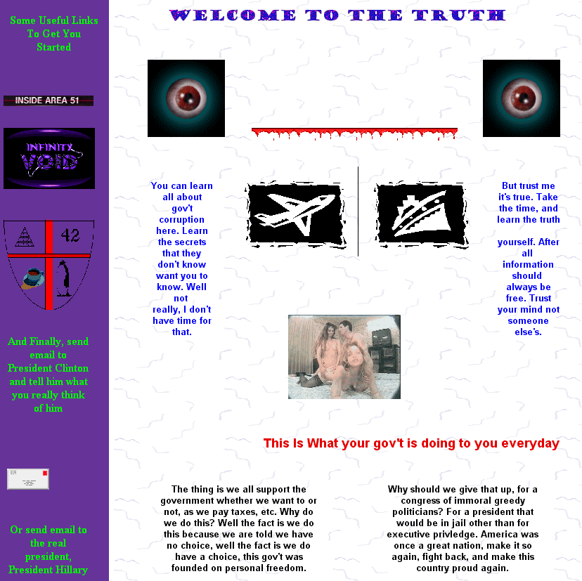
USAF (1996.12)

Slide 44
NASA (1997.03)

Slide 45
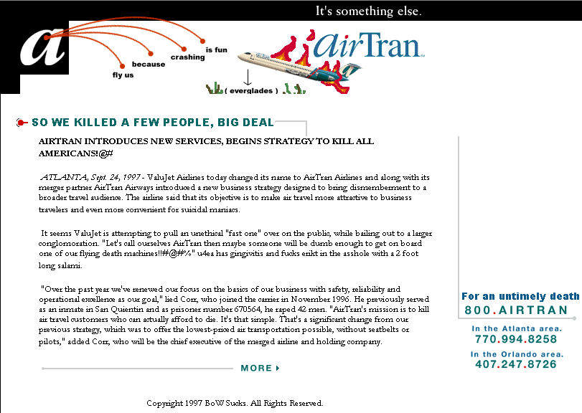
AirTran (1997.09)

Slide 46
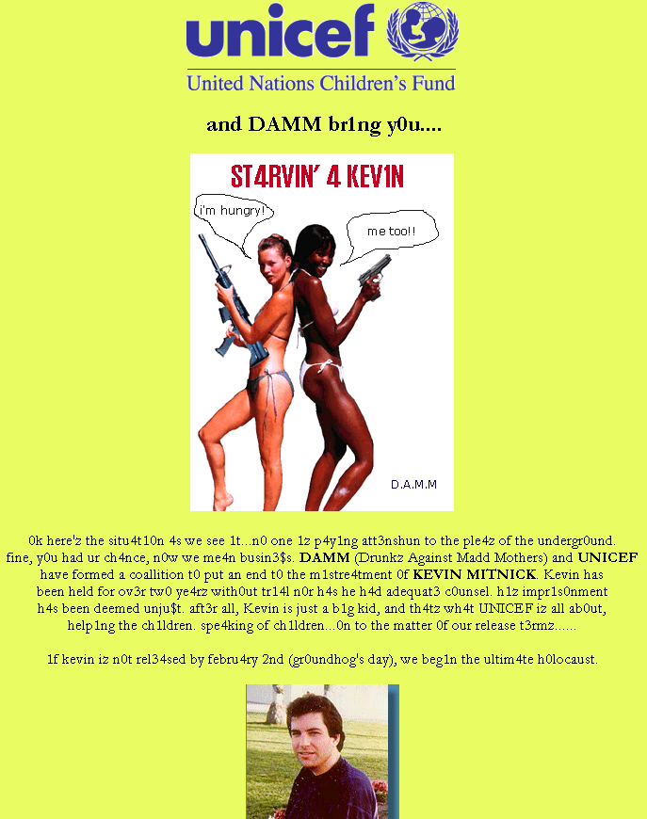
UNICEF (1998.01)

Slide 47
US Dept Commerce (1998.02)

Slide 48
New York Times (1998.09)

Slide 49
SETI (1999)
Notes:
From <http://www.2600.com> archives. 2600 is a publication that encourages and glorifies criminal hacking. If you visit this site, the author recommends that you disable all active content, prevent exchange of cookies, and filter out responses to requests for any identifying information whatsoever. You should also consider accessing any criminal hacker site using an anonymizer such as <http://www.anonymizer.com>.

Slide 50
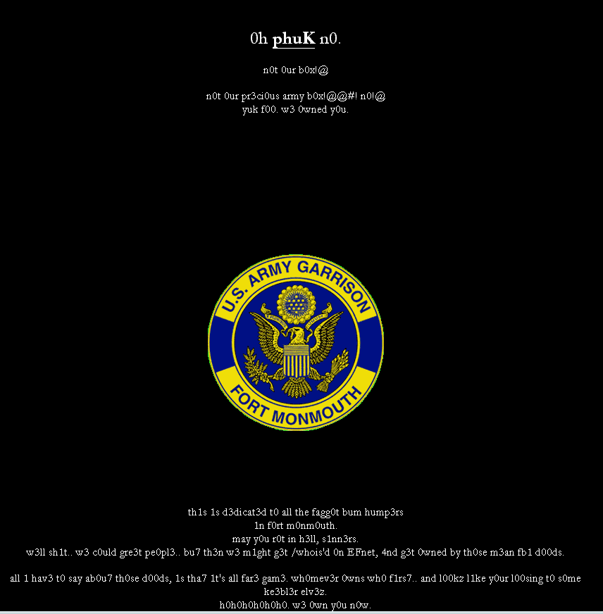
Fort Monmouth (1999)
Notes:
From <http://www.2600.com> archives. 2600 is a publication that encourages and glorifies criminal hacking. If you visit this site, the author recommends that you disable all active content, prevent exchange of cookies, and filter out responses to requests for any identifying information whatsoever. You should also consider accessing any criminal hacker site using an anonymizer such as <http://www.anonymizer.com>.

Slide 51
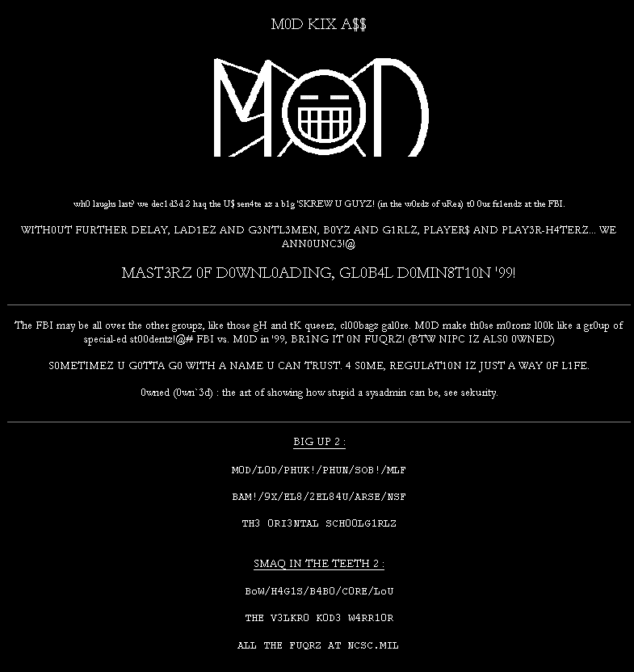
Senate of the USA (1) (1999)
Notes:
From <http://www.2600.com> archives. 2600 is a publication that encourages and glorifies criminal hacking. If you visit this site, the author recommends that you disable all active content, prevent exchange of cookies, and filter out responses to requests for any identifying information whatsoever. You should also consider accessing any criminal hacker site using an anonymizer such as <http://www.anonymizer.com>.

Slide 52
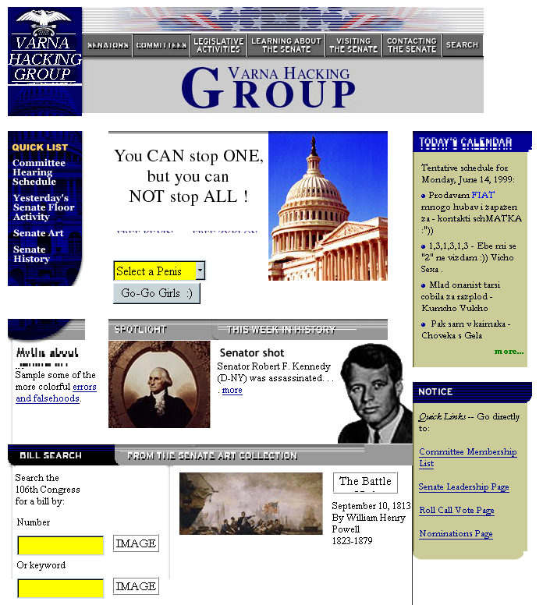
Senate of the USA (2) (1999.06)
Notes:
From <http://www.2600.com> archives. 2600 is a publication that encourages and glorifies criminal hacking. If you visit this site, the author recommends that you disable all active content, prevent exchange of cookies, and filter out responses to requests for any identifying information whatsoever. You should also consider accessing any criminal hacker site using an anonymizer such as <http://www.anonymizer.com>.

Slide 53
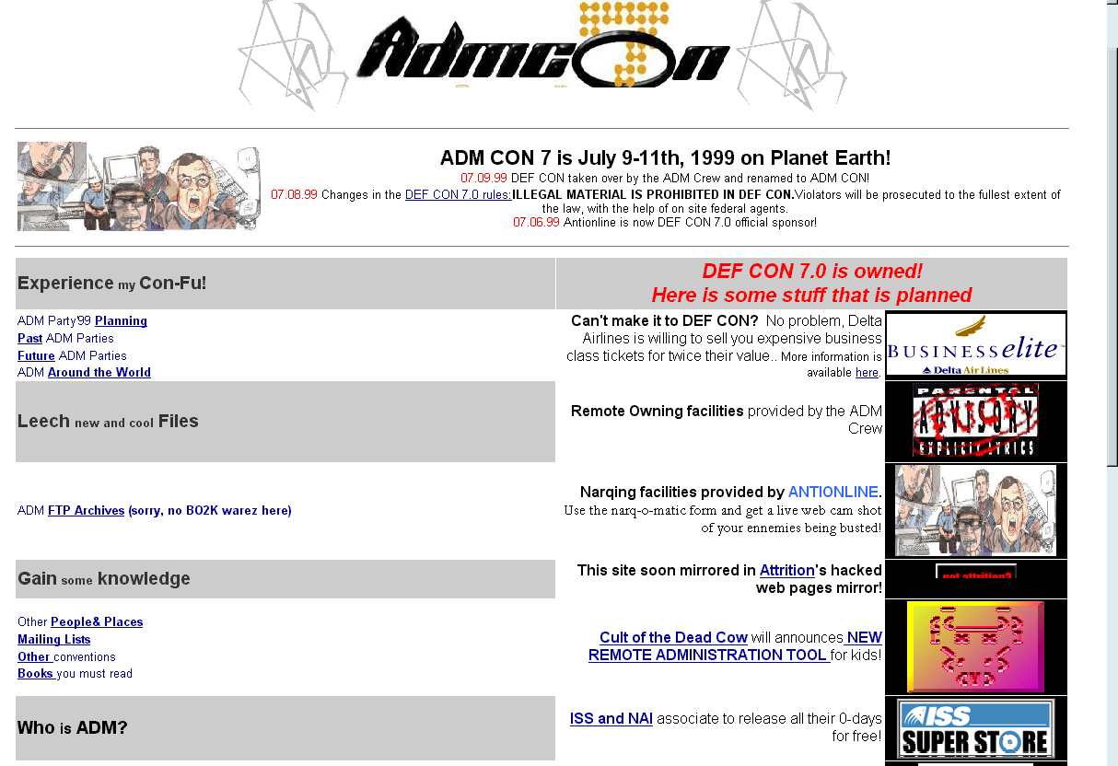
DEFCON (1999.07)
Notes:
From <http://www.antionline.com> archives. Antionline is a site that has an equivocal attitude towards criminal hackers; it provides interviews with some criminal hackers but also espouses anti-hacker defenses.

Slide 54
Hacker Conventions
Blackhat < http://www.blackhat.com/ >
DefCon < http://www.defcon.org/ >
HOPE (Hackers on Planet Earth) < http://www.hopenumbernine.net/ >

Slide 55
Criminal Hacking Gets Organized
Profitable, low risk
International gangs successful
Russian Business Network (RBN)
Bradley Guinen (NU BSCSIA 2013)
CJ341 paper published in Network World Security Strategies with Kabay
http://www.mekabay.com/nwss/866_russian_cybercrime_(guinen)_part_1.pdf
http://www.mekabay.com/nwss/867_russian_cybercrime_(guinen)_part_2.pdf
http://www.mekabay.com/nwss/868_russian_cybercrime_(guinen)_part_3.pdf

Slide 56
Chinese Cyberwar
Significant increase in industrial espionage by PRC
Full-time hackers employed by state
Log off during weekend!
Attacks, penetration, infiltration, IP theft
See Chapter 14 from CSH6.

Slide 57
DISCUSSION

