Slide 1
Hardware
CSH6 Chapter 4
“Hardware Elements of Security”
Sy Bosworth & Stephen Cobb

Slide 2
Topics
Introduction
Binary Design
Parity
Hardware Operations
Interrupts
Memory & Data Storage
Time
Natural Dangers
Data Communications
Cryptography
Backup
Recovery
Microcomputers

Slide 3
Introduction
Other hardware-related chapters of CSH6:
Ch 5 – Data Communications & Information Security
Ch 6 – Network Topologies, Protocols, & Design
Ch 22 – Physical Threats to the Information Infrastructure
Ch 23 – Protecting the Information Infrastructure

Slide 4
Binary Design
Von Neumann Architecture
  John von Neumann, 1946
  Apply binary representation to computer implementation
  Electrical/electronic systems could handle high/low or on/off states to represent binary 0 and binary 1
  Rapid switching = pulses
Pulse characteristics
  Ideally square waves
  But cope with sine waves and other waveforms

Slide 5
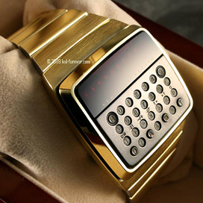
Circuitry
Original 1940s computers used
vacuum tubes
  Relatively large – room-sized
  machines with power of later
  calculator-wristwatches
  Consumed power & ran hot
  Short MTBF (mean time between failures)
Solid-state transistors
  Patented in 1925 (Lilienfeld) & 1934 (Heil) but never developed
  William Shockley & colleagues at Bell Labs developed effective transistors starting in 1947

Slide 6

Coding
Convention for representing data
Early codes include
  Baudot (hence “baud rate”)
  Binary-coded decimal (BCD)
  Extended BCD (EBCDIC, used by IBM)
  American Standard Code for Information Interchange (ASCII)
Bits → bytes (8 bits/byte) → words (n bytes/word)
Prefixes for length of numerical codes (B = bytes & b = bits)
  KB = kilobyte (1024 bytes) (aka kibibyte!)
  MB = megabyte (1024 KB) (aka mebibyte)
  GB = gigabyte (1024 MB) (aka gibibyte)
  TB = terabyte (1024 GB ) (aka tebibyte)

Slide 7
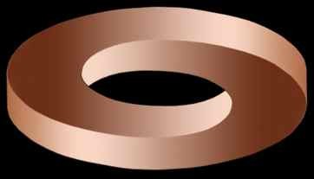
Error-Detecting Codes
Error-detection systems started with parity bits
Write additional bit into hardware storage (e.g., disk, RAM, data-comm, tape…)
  Even parity bit = 0 when sum of bits is even
  Odd parity bit = 0 when sum of bits is odd
  Recompute parity bit when reading data back
  Check to see if computed parity bit = recorded parity bit
Extensions led to
error-correcting codes;
e.g.,
  Cyclical Redundancy
  Checks (CRCs)
  Self-checking codes

Slide 8
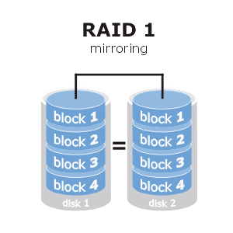
Hardware Operations
Fundamentals ops: Input, Output, Processing
Typical hardware-implemented error-handling
  Read-after write
  Echo
  Overflow errors
  Validation
  Replication (e.g., RAID-1
  arrays of disks)

Slide 9
Interrupts
Changes of state can allow operating system to examine its own integrity as well as integrity of data
Types of interrupts
  I/O
  Supervisor calls
  Program check
  Machine check
  External
For a detailed computer engineering review,
see “Investigating Interrupts” by Garth Wilson
http://tinyurl.com/42dqcuk (← q not g)

Slide 10
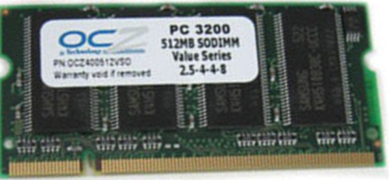
Memory & Data Storage
Memory Hierarchy (of speed)
CPU registers (architectural registers)
  Nanosecond access time
Main memory (primary memory, RAM)
  Microsecond access time
Secondary storage (disk, tape, flash memory …)
  Millisecond access time – on disks, mostly due to head positioning
Hardware safeguards
  Hardware-locking devices can prevent accidental write
  Bad-sector compensation
  Reformatting
  SMART (Self-Monitoring, Analysis, and Reporting Technology)
  Head-withdrawal systems for hard-drives

Slide 11
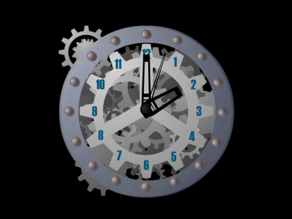
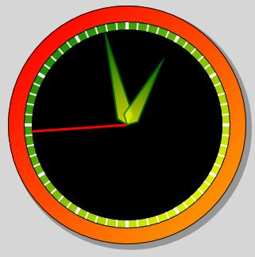
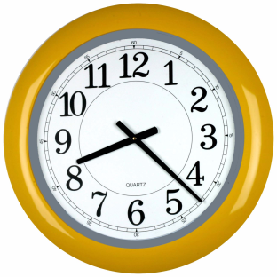
Time
Synchronous processes
  Operate according to
  strict rhythm
    Intrinsic frequency of hardware
    System clock cycles
    Defined # cycles= tick
    Defined # ticks may generate interrupt
  Deviation from clock cycle may indicate error
Asynchronous processes
  No particular rhythm
  E.g., keyboard inputs, packet streams

Slide 12

Natural Dangers
Power failure
Heat
Humidity
Water
Dirt, dust
Radiation
May cause downtime
See CSH6 Chapters 22 & 23

Slide 13
Data Communications
DC hardware can be critical
Terminals must be protected to prevent unauthorized access
Wired facilities
  Dial-up lines (gone to dust heap
  of history)
  Leased lines (nah)
  DSL (Digital Subscriber Lines -- old)
  Cable (still used)
Wireless (yep!)
See CSH6 Chapters 5 & 33

Slide 14
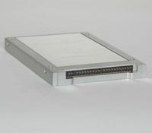
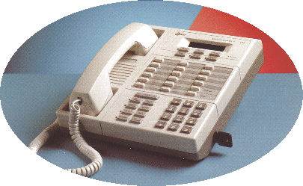
Cryptography
Essential tool for information assurance
Increasingly available in hardware implementations
  Encrypting disk drives
  Encrypting data-communications equipment (e.g., STU-III)
ROCSAFE
See CSH6 Chapter 7
ROCSAFE
http://tinyurl.com/qw36aa
Secure Telephone Unit III

Slide 15
Backup
See CSH6 Chapter 57
All systems may fail
Therefore all systems storing meaningful data should be backed up
Definition: backup is independent copy of data
  Thus must have at least 2 instantiations of data
  Thus cannot backup and then destroy original: would have no backup
Backup also includes operational components for business continuity
  People
  Hardware
  Power
See CSH6 Chapter 58

Slide 16
Recovery
Effective recovery requires planning & testing
Backups
  Test backups at time of creation
    Use verification mode
    Reads data back and compares with original
  Test backup restoration periodically
  Keep in mind that backup media may deteriorate over time
    Archives may become unreadable
    Plan for re-recording if necessary
See CSH6 Chapters 58 & 59

Slide 17
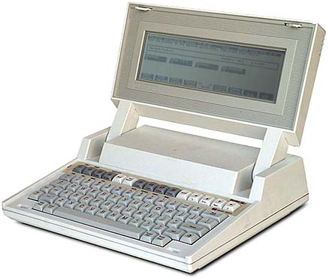
Microcomputers
General threats to microcomputers
  Small size
  Ease of access (e.g., laptops)
  Widespread knowledge
  Strong motivation to steal information
  Lots of opportunity
Specific threats
  Physical damage
  Theft
  Bad electrical power & static
  discharge
  Data communications
  Maintenance and repair
See also following slides
HP110 from c. 1982

Slide 18

Physical Damage
Susceptibility to shock
  Disk drives in particular
Damage from liquids and grease
  Spilled beverages into keyboards
  Dirty fingers on connectors
Obstructed cooling vents
  Dirt
  Blockage
  by papers,
  books,
  other
  equipment

Slide 19
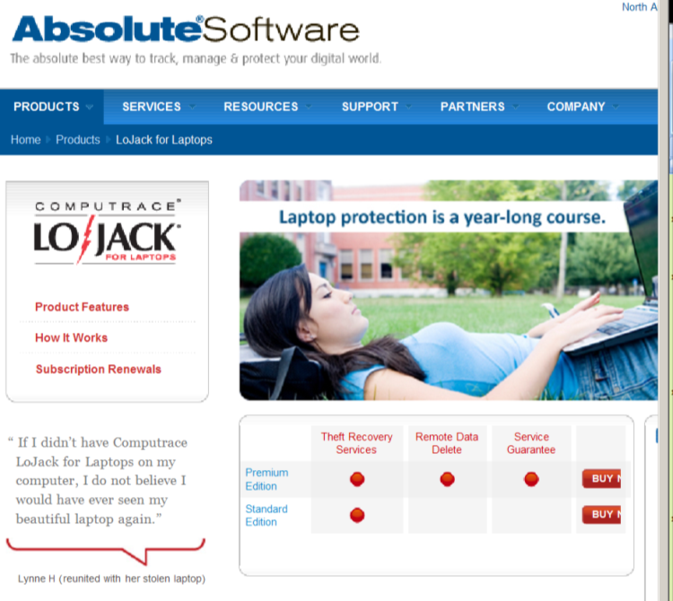
Theft
Theft of laptops → loss of control over confidential data
  Confidential data must be encrypted
  Personally identifiable information (PII) in particular must be encrypted
  Use whole-disk encryption for simplicity
Computer lo-jack systems available
http://www.absolute.com/products/lojack

Slide 20
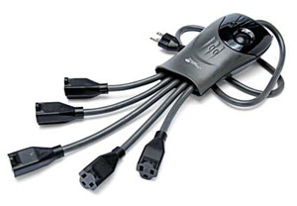
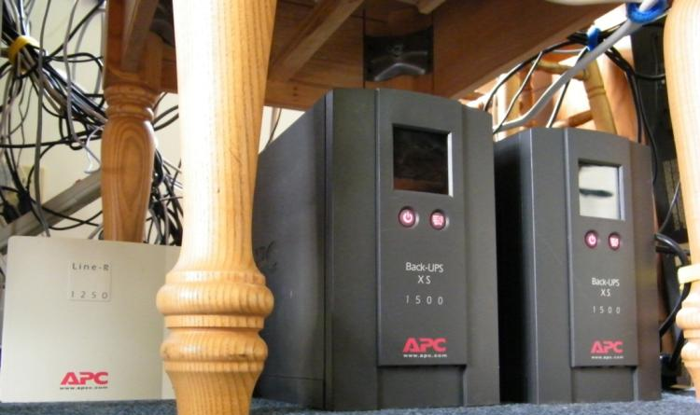
Bad Electrical Power & Static Discharge
Reduce or eliminate use of
multiple-access to power outlets
Add voltage-regulators
  Prevent spikes and brownouts
  Many UPSs include voltage
  regulation
Don’t allow vacuum
cleaners (etc) on
same circuit as
computer systems
See Kabay (2009) “Preparing for the Next Solar Max”
http://www.mekabay.com/infosecmgmt/solarmax.pdf

Slide 21
Data Communications
Explosion of interconnectivity
  <1980 almost all computer networks were local
    Simple terminals hardwired to mainframes
    Smart terminals with some local processing
  In 1980s LANs interconnected PCs locally
    WANs and MANs implemented internetworking
    Internet grew to 1.1M nodes by 1991
  1990s saw explosion in size of Internet
    .com TLD (top-level domain) opened ~1993
    WWW established early 1990s

Slide 22
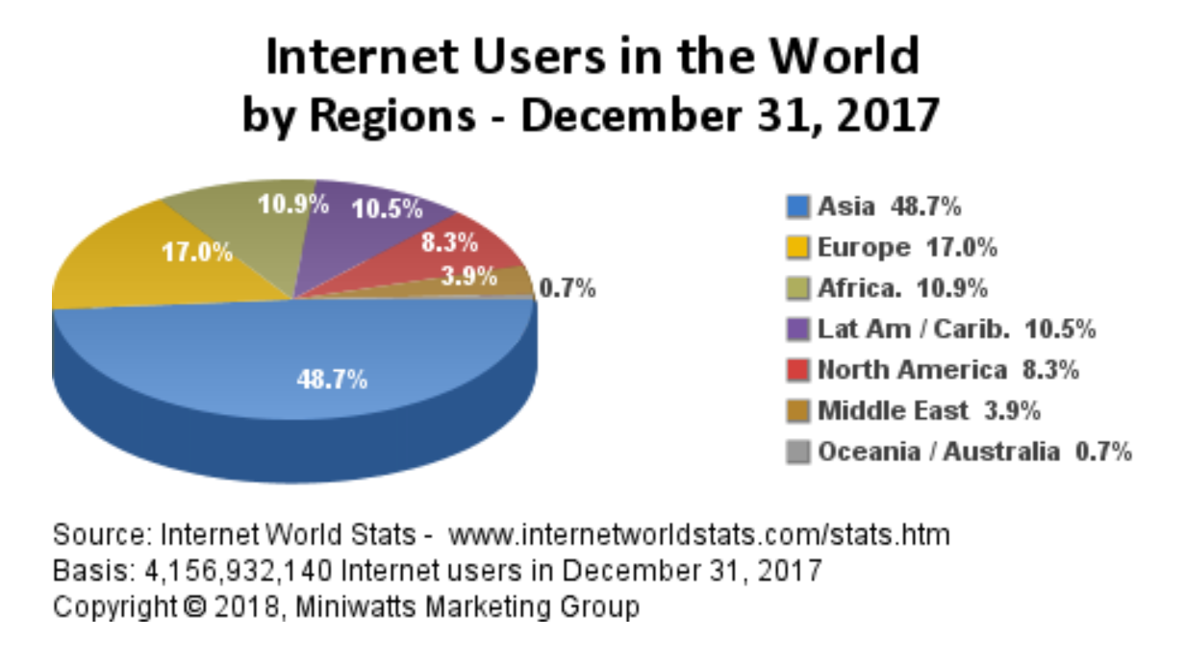
Current Data about Internet (1)
Regularly updated data @ http://www.internetworldstats.com/stats.htm

Slide 23
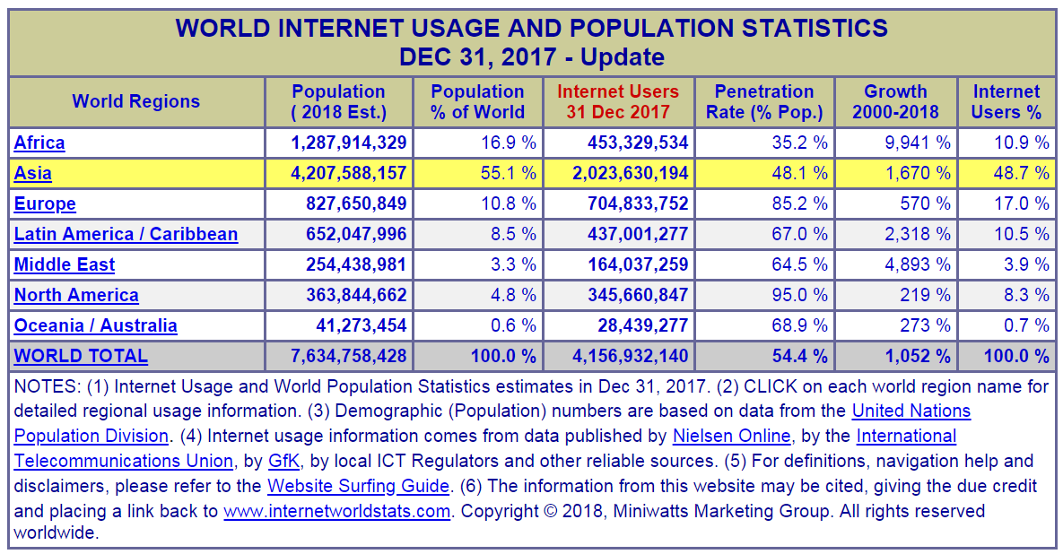
Current Data about Internet (2)

Slide 24

Current Data about Internet (3)

Slide 25
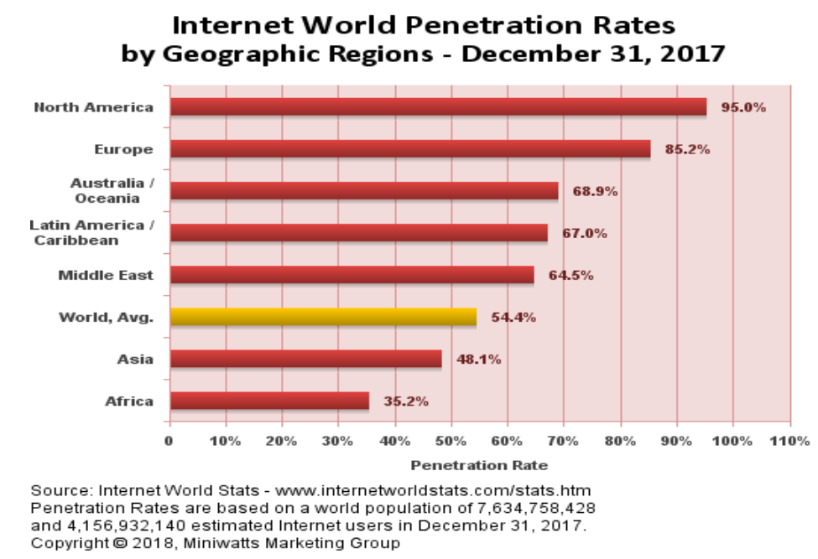
Current Data about Internet (4)

Slide 26
Maintenance and Repair
Organizations must establish official program of maintenance and repair for PCs
  On-site by employees
  On-site by contractors
  On-call repair
  Carry-in service to repair centers
  Remote repair using shipping
Have loaners on standby for immediate replacement of damaged units
Consider
security
implications

Slide 27
Now go and study

