Slide 1
DATACOMM
CSH6 Chapter 5
“Data Communications & Information Security”
Raymond Panko

Slide 2
Topics
Sampling of Networks
Network Protocols & Vulnerabilities
Standards
Internet Protocol (IP)
Transmission Control Protocol (TCP)
User Datagram Protocol (UDP)
TCP/IP Supervisory Standards
Application Standards

Slide 3
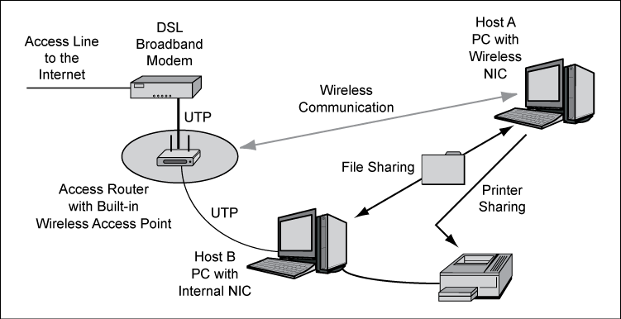
Sampling of Networks
Simple Home Network

Slide 4
Sampling of Networks (2)
Building LAN

Slide 5
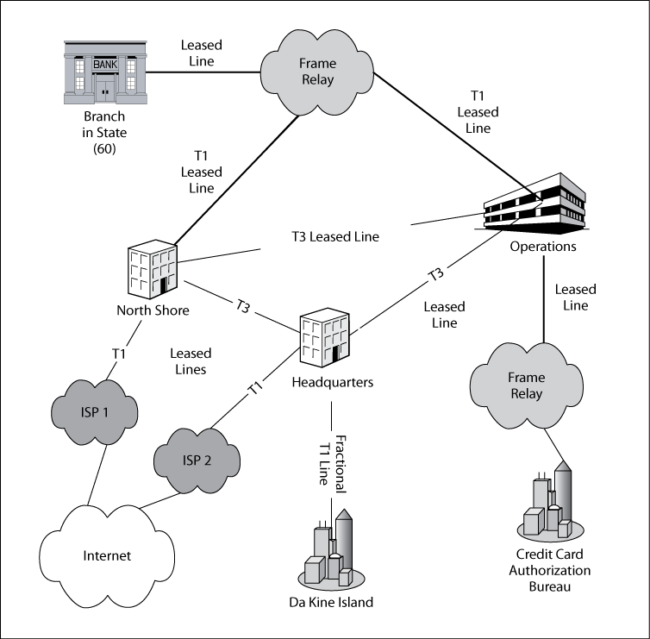
Sampling of Networks (3)
WANs

Slide 6
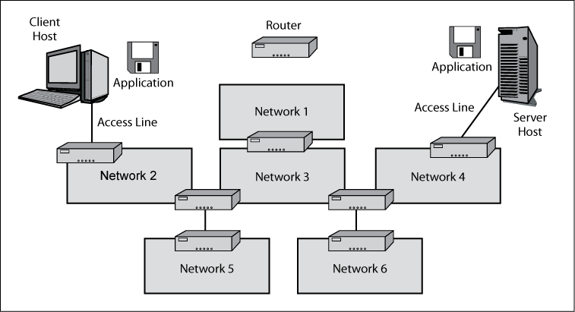
Sampling of Networks (4)
Internet

Slide 7
Network Protocols & Vulnerabilities
Standards allow interconnection
  Otherwise we would suffer
  combinatorial explosion →
Security implications of standards
  Inherent design of the standard itself
  Degree to which security considerations are built into the standard (or not)
  Effectiveness of implementation of standards in vendor products
^{n}C₂ = ½n(n-1)

Slide 8

Standards
Core Layers
Layered Standards Architectures
Single-Network Standards
Internetworking Standards

Slide 9
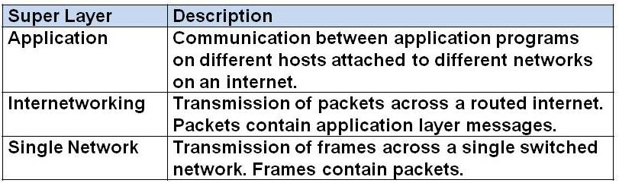
Core Layers

Slide 10
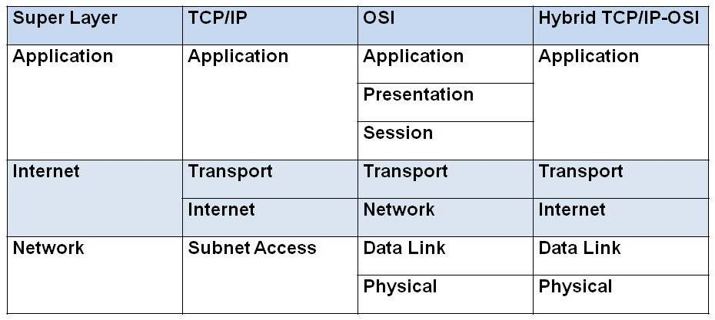
Layered Standards Architectures

Slide 11
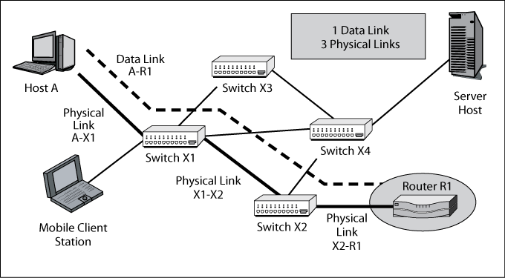
Single-Network Standards

Slide 12
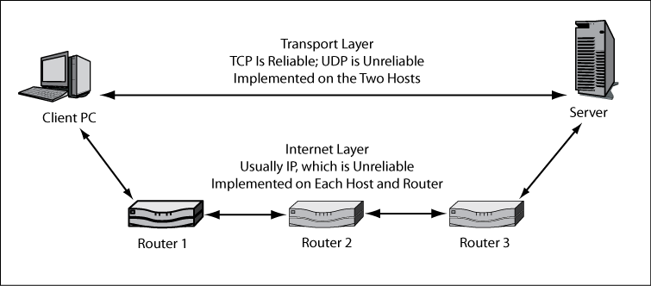
Internetworking Standards

Slide 13
Internet Protocol (IP)
Basic functions of IP
  Organizes packets
  Determines how routers move packets
IPv4 main protocol of today’s Internet
  Descriptive portion = header
    Consists of fields
  Packets can be split into smaller fragments
    All have same identification field
    Assigned fragment offset value (sequence #)
    Reassembled on receiving side
    Source & destination addresses
  Running out of IPv4 address space!

Slide 14
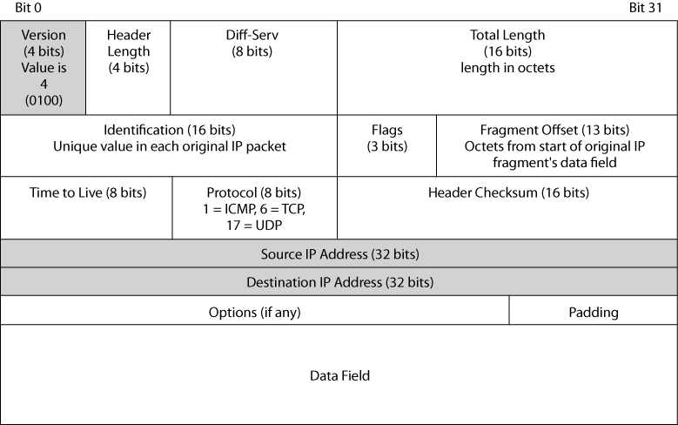
IPv4 Packet Structure

Slide 15
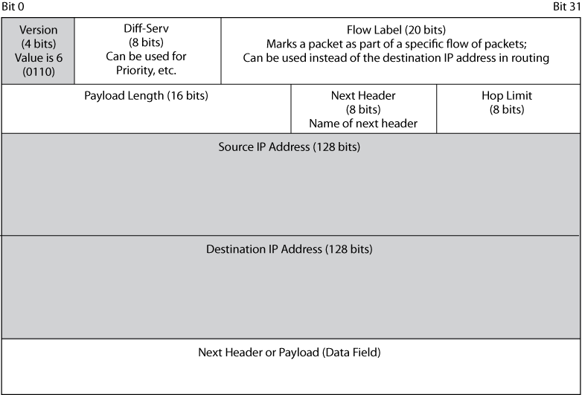
IPv6 Packet Structure
IPsec uses a security header to implement security w/ IPv6

Slide 16
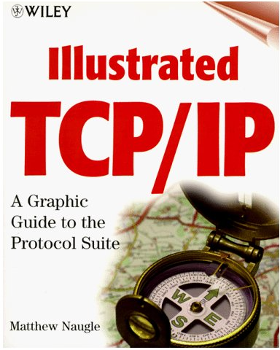
Transmission Control Protocol (TCP)
Connection-Oriented & Reliable Protocol
Reliability
Flag Fields
Octets & Sequence Number
Acknowledgement Numbers
Window Field
Options
Port Numbers
TCP Security

Slide 17

Connection-Oriented & Reliable Protocol
Connection-oriented protocols
  Initiate session of continued interaction
  E.g., telephone call between two people using POTS (plain old telephone system)
  Protocols for initiating and terminating session (e.g., ringing, “Hello,” “Bye,” hanging up)
Connectionless protocols
  No session initiated
  Message sent without
  necessarily having
  indication of receipt
  E.g., radio, TV broadcast,
  Web, & e-mail

Slide 18
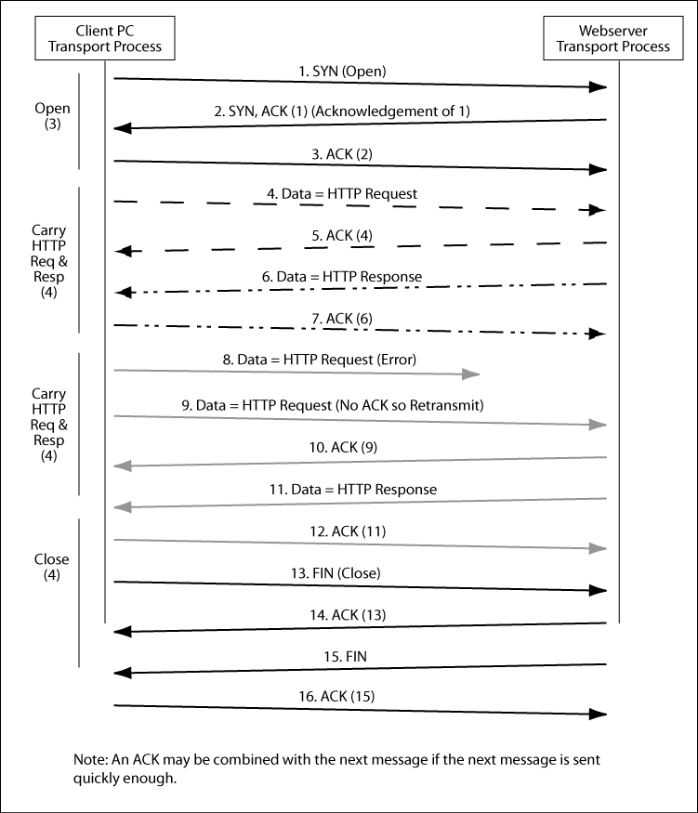
TCP Session Elements

Slide 19
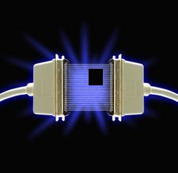
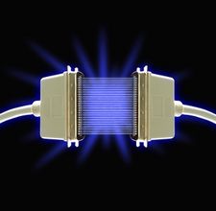
Reliability
Unreliable protocol
  Does not detect or correct errors
TCP is reliable protocol
  TCP checksum field
  Recipient uses same algorithm to recompute checksum value
  Discrepancy results in dropping packet
Sender waits for ACK
  After specified wait time, resends
  same packet
Image Copyright © eHow. All rights reserved. URL: http://tinyurl.com/3k86vkj
Permission received 2011-09-12 for use of copyrighted material.

Slide 20
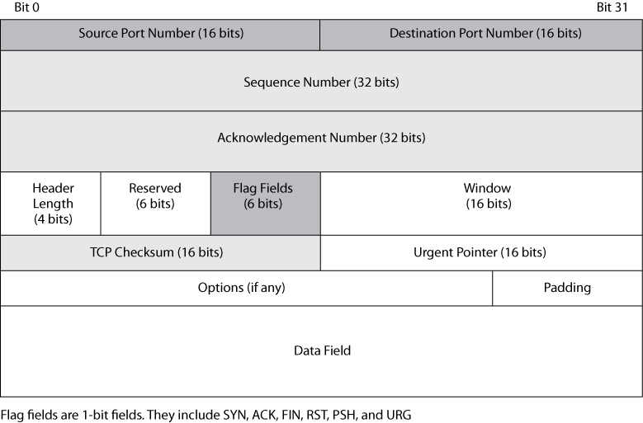
TCP Segment

Slide 21
Flag Fields
See “TCP Analysis - Section 4:
TCP Flag Options”
http://www.firewall.cx/tcp-analysis-section-4.php
General term for any
single bit variable
  Bit = 0 → flag is not set
  Bit = 1 → flag is set
6 flags used by TCP header
  URG – urgent (e.g., to abort data transfer)
  ACK – acknowledgement of receipt
  PSH – push (establish priorities)
  RST – reset (reject packet / reset connection)
  SYN – synchronization (request)
  FIN – finished (last packets – terminate)

Slide 22
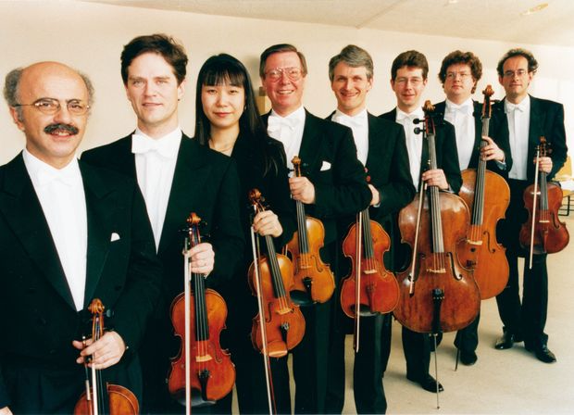
Octets & Sequence Number
Sequence number field keeps packets in order
TCP counts all octets (bytes) sent
3 different rules for assigning sequence number (seq#)
  1st segment receives random initial seq# (ISN)
  Segment containing data assigned seq# = 1st octet in the data
  Supervisory packet with no data (e.g., ACK) assigned seq# = 1+seq# of previous packet
Session hijacking is MIMA (man-in-the-middle attack)
  Defeated by ensuring that ISN is random

Slide 23

Port Numbers
1st two fields use
TCP port numbers (P#)
Servers
  P# specifies service
  (application)
  E.g., TCP 80 → HTTP;
  TCP 25 → SMTP;
  TCP 20 & 21 → FTP
Clients
  Random ephemeral P# generated when connecting to server
  Windows uses TCP P# ∈ {1024,4999}
  IETF standard range is TCP P# ∈ {5000,65534}
  Difference causes problems for firewalls

Slide 24
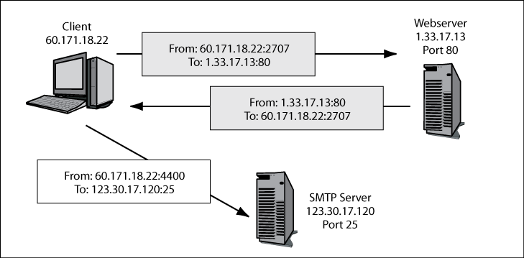
Sockets
Socket = IP address & TCP Port #
  Written nnn.nnn.nn.nn:nn
Socket spoofing
  Generate packets with socket data matching existing connection
  Insert spoofed packets into data stream

Slide 25
TCP Security
TCP originally designed without security
  And continues without it
IPsec center of IETF efforts for Internet security
  But few users have moved to IPsec
  Therefore some pairs of users apply electronic signature
RFC 2385, “Protection of BGP Sessions via the TCP MD5 Signature Option”
  Border Gateway Protocol used for exchange among administrative systems
  Long-term relationships (like leased lines in old days)
  Viewed as relatively weak security
http://tools.ietf.org/html/rfc2385

Slide 26
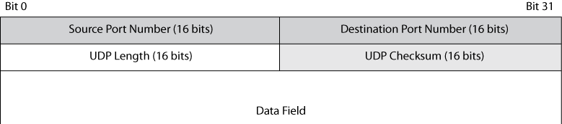
User Datagram Protocol (UDP)
Some services do not require reliability
  VoIP (Voice over IP)
  SNMP (Simple Network Management Protocol)
UDP: connectionless & unreliable – & simple
UDP & TCP both use port #s – but are different types of ports
  So always specify which kind of port #
  E.g., “TCP port 80” for HTTP
UDP even weaker than TCP

Slide 27
TCP/IP Supervisory Standards
ICMP
DNS
DHCP
DRP
SNMP

Slide 28

ICMP
Internet Control Message Protocol
  E.g., echo & echo reply
  Check for activity/existence of host
  Ping is program that “pings” using
  echo/echo reply sequence
  Attackers often ping hosts to map
  network
Traceroute (tracert)
  Also lists routers on path between
  sender and responder
  Firewalls often drop echo reply messages
ICMP also used for error messages
  E.g., response to malformed packet
  Reveals IP address of router – useful for attacker

Slide 29
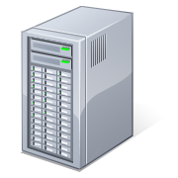
DNS
Domain Name System
  Resolve alphanumeric domain name (e.g., norwich.edu) into numeric address (e.g., 192.149.109.19)
  Network of DNS root servers exchange info
DNS cache poisoning
  Attacker inserts incorrect data about host name – IP address relation
  Subsequent users are misdirected to a wrong site
DNS security complex & unresolved issue

Slide 30

IPv4 Address Space Exhaustion (1)
IPv4 uses 32 bits ≅ 4.29e9 addresses
  Being eaten up fast by mobile devices
  IPv6 uses 128 bits ≅ 1.70e38 addresses (~10²⁸ times larger)
  Same ratio as surface of a
  1.6” square vs area of solar system
Report & graphs
  http://www.potaroo.net/tools/ipv4/index.html
  Images on next slides…

Slide 31
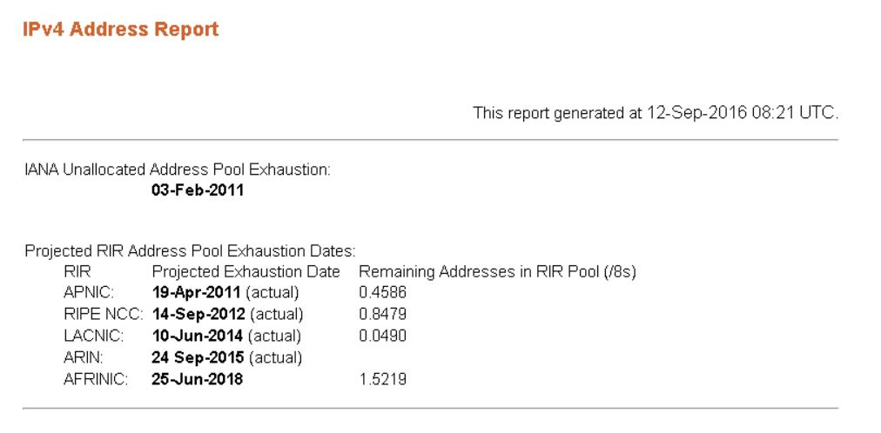
IPv4 Address Space Exhaustion (2)
See also RIPE Network Coordination Center reports:
http://www.ripe.net/internet-coordination/ipv4-exhaustion

Slide 32
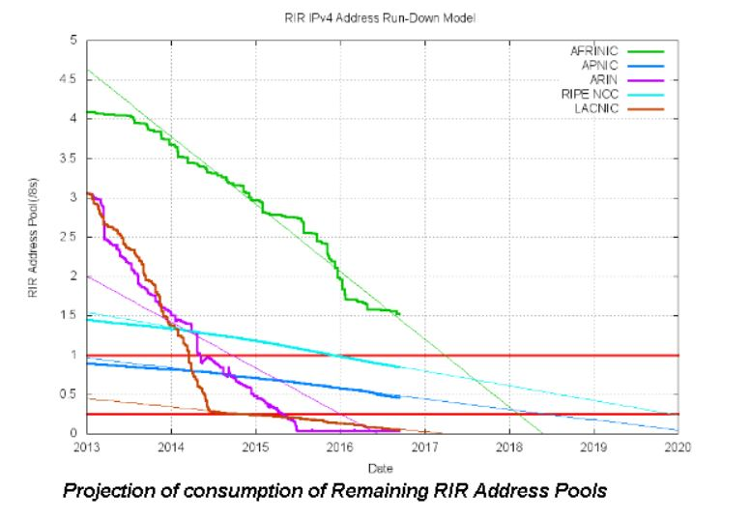
IPv4 Address Space Exhaustion (3)

Slide 33
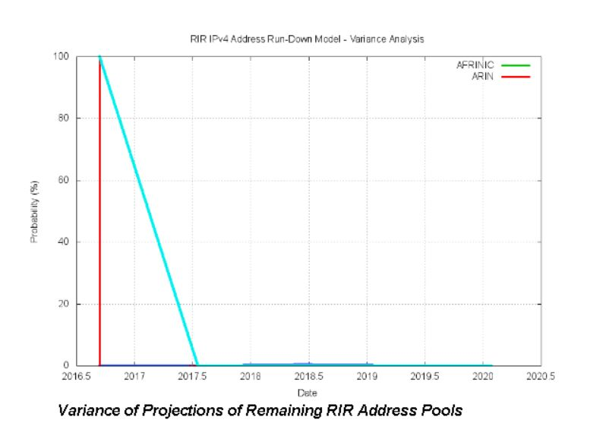
IPv4 Address Space Exhaustion (4)

Slide 34
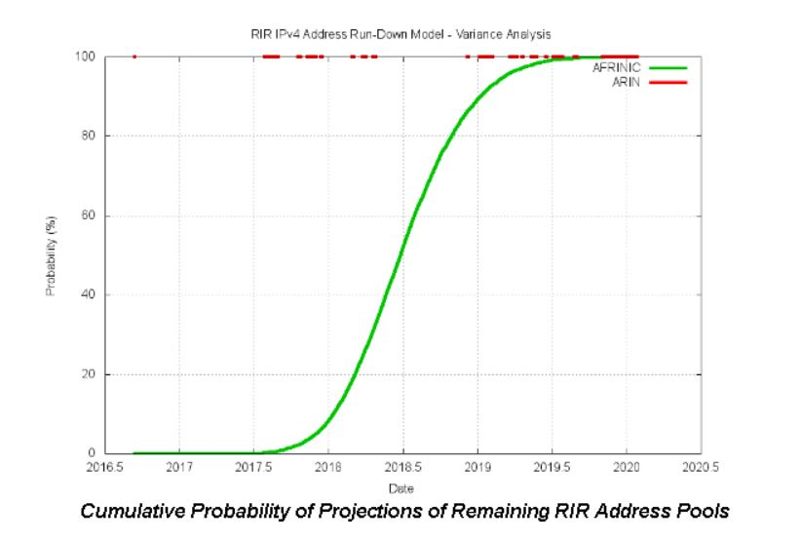
IPv4 Address Space Exhaustion (5)

Slide 35
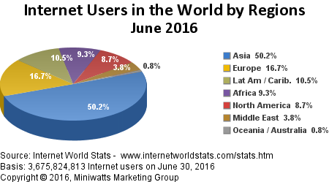
Current Data about Internet (1)
Regularly updated data @ http://www.internetworldstats.com/stats.htm

Slide 36
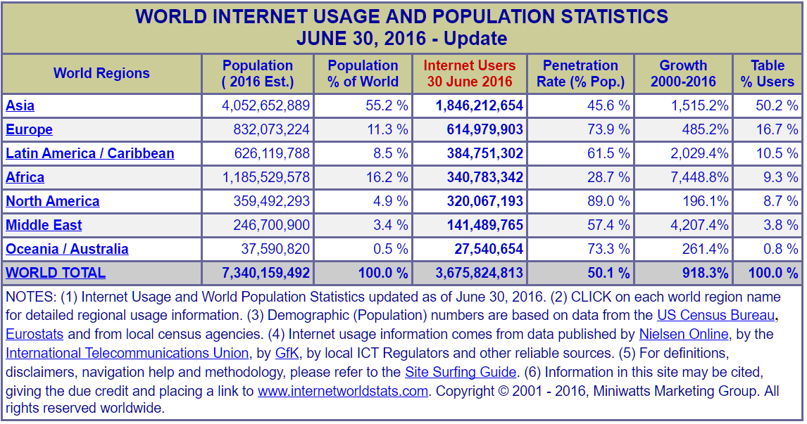
Current Data about Internet (2)

Slide 37
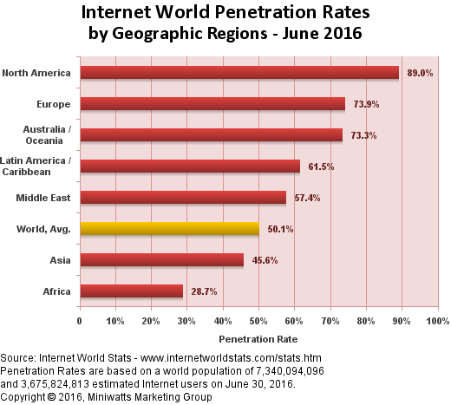
Current Data about Internet (3)

Slide 38
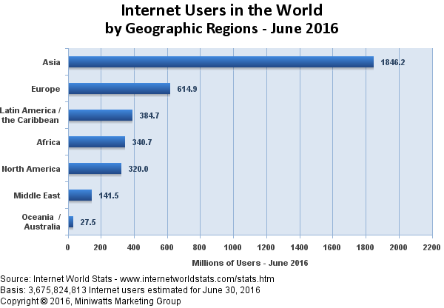
Current Data about Internet (4)

Slide 39
DHCP
Dynamic Host Configuration Protocol
  Servers have fixed IP addresses
  Client PCs and other devices on internal networks have dynamic (temporary) addresses on Internet
  Problems arise because DHCP may assign different IP addresses on subsequent uses
P2P (peer-to-peer) applications less secure
  Need to locate peer despite change of IP address
  Exploited by P2P software used for illegal file sharing

Slide 40
Dynamic Routing Protocols
Routers exchange information about available routes
  Traffic data
  Broken links
Many dynamic routing protocols available
  RIP – Routing Information Protocol
  OSPF – Open Shortest Path First
  BGP – Border Gateway Protocol
  EIGRP® – Cisco Systems’ Enhanced Interior Gateway Routing Protocol
Attacker may be able to insert false packets into protocols to misdirect packets
  Could lead to MIMA

Slide 41
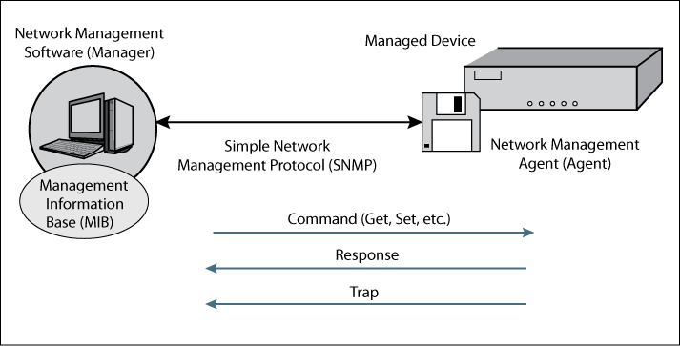
SNMP
Simple Network Management Protocol
  Control devices such as routers, switches, gateways, hosts…
  IETF SNMP allows control of devices
  May reconfigure devices
Attackers can use remote reconfiguration
  Many system managers disable remote configuration capabilities

Slide 42
Application Standards
Application layer standards have their own security issues – discussed in other chapters
HTTP (HyperText Transfer Protocol) & HTML (HyperText Markup Language)
E-mail: SMTP (Simple Mail Transfer Protocol), POP (Post Office Protocol), IMAP (Internet Message Access Protocol), MIME (Multipurpose Internet Mail Extensions), S/MIME (Secure MIME)
Telnet, FTP (File Transfer Protocol), SSH (Secure Shell)
VoIP (Voice over IP), P2P, SOA (Service-Oriented Architecture), Web services

Slide 43
Now go and study

