Slide 1
Introduction to Cryptography
CSH6 Chapter 7
“Encryption”
Stephen Cobb &
Corinne Lefrançois

Slide 2

Topics
Basic Concepts & Terminology
Types of Algorithm
Cryptanalysis
CSH6 Chapter 7 pp 7.1-7.16

Slide 3
Encryption in INFOSEC
Foundation technology
Underlies almost everything in INFOSEC
Ensures or supports
  Confidentiality
  Control and
  possession
  Integrity
  Authenticity
  Non-repudiation

Slide 4
Basic Concepts & Terminology (1)
Plaintext (aka cleartext): original, readable data
Ciphertext: scrambled form of plaintext
Encryption: reversible conversion of plaintext into ciphertext
Decryption: conversion of ciphertext back into plaintext
Crack (aka break) code: decrypt ciphertext without knowing key

Slide 5
Basic Concepts & Terminology (2)
Key: secret allowing
encryption and decryption
to be restricted to
possessors of key
Symmetric encryption: encryption requiring a shared key for both encryption and decryption
Asymmetric encryption: algorithm using a different key for decryption than for encryption

Slide 6
Basic Concepts & Terminology (3)
Keylength: number of bits in key
Keyspace: number of possible keys
Keyspace = 2^{keylength}
2^{n} ≈ 10 ^{n(log}₁₀²⁾
≈ 10 ^{0.30103n}
Keylength in bits

Slide 7

Topics
Basic Concepts & Terminology
Types of Algorithm
Cryptanalysis

Slide 8
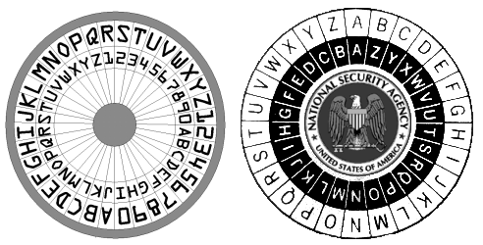
Monoalphabetic Substitution Ciphers (1)
“Secret decoder ring” or Caesar cipher
Algorithm uses key = offset and algorithm = transposition;
  e.g., if offset = 3, then A becomes D, B = E etc.
Subject to cryptanalysis using known letter frequencies in specific languages
  English: etaionshrdlu. . . .
  For English alphabet, only 25 possible offsets; therefore maximum 25 tries to find the “key”

Slide 9
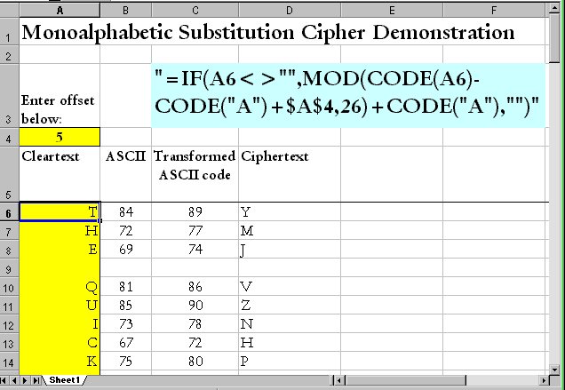
Monoalphabetic Substitution Cipher: Example

Slide 10
Polyalphabetic Substitution Ciphers
Can use different offsets for each position in plaintext
  E.g., Vigenère cipher is like 26 Caesar ciphers
  Use key indicating which offset to use for which position in sequence of 26 letters
See
http://www.trincoll.edu/depts/cpsc/cryptography/vigenere.html
Or
http://en.wikipedia.org/wiki/Vigen%e8re_Cipher
for detailed illustrations of how to perform the Vigenère cipher with a particular key on a specific plaintext

Slide 11
One-Time Pad
Use a fixed and shared secret to determine offsets
In theory, is only cipher impossible
to break IFF
  Pad kept secret
  Key data truly random
  Key data never re-used
In practice, people use natural
language (e.g., novels) and reduce
strength of algorithm
Major problem: how to distribute the pad securely?
  Explain the problem.
IFF means “if and only if”

Slide 12
Secure Key Distribution
The problem of distributing a key securely is completely general to all secret-key algorithms
  Shared secret essential for
  both enciphering and
  deciphering data
Therefore both sender and
receiver must share the
secret securely
But if it were secure to
transmit the key, you could transmit the plaintext message too
So how do you get the secret from one to the other securely?
Need an alternate communications channel with higher security

Slide 13
Example of Linear Congruential Pseudo-Random Number Generator
n_{i+1}=frac(π^{ni})

Slide 14
Linear Congruential Pseudo-Random Number Generators
Amateurs assume that RAND() function can be used as basis of one-time pad
  But in fact such functions are NOT truly random
For one thing, use floating-point data with specific number (e.g., 17) of significant figures
  Thus must inevitably repeat (WHY?)
Therefore ciphers with natural-language plaintext are subject to frequency analysis
  WHY?
Nonetheless, can be useful for simulations and demonstrations

Slide 15

Topics
Basic Concepts & Terminology
Types of Algorithm
Cryptanalysis

Slide 16
Cryptanalysis
Kerckhoffs’ Principle
Cryptanalytical Methods
Types of Cryptanalytical Attacks

Slide 17
Kerckhoffs’ Principle*
The strength of an encryption algorithm does not reside in the secrecy of the algorithm
Corollary:
The strength of an encryption algorithm is not measurable unless the algorithm is known
* Published in 1883. Not to be confused with Kirchoff’s Laws (physics)

Slide 18
Dangers of Proprietary Algorithms
Therefore beware of secret, proprietary algorithms
Many amateurs have failed utterly to defeat cryptanalysis
Must demonstrate that even with knowledge of the algorithm and even knowledge of a plaintext & ciphertext sample, still too expensive to decrypt general ciphertext to make cryptanalysis worthwhile
®

Slide 19
Cryptanalytical Methods
Frequency-Based Cryptanalysis
Brute-Force Cracking
Attacking Weak Algorithms

Slide 20
Frequency-Based Cryptanalysis
Possible to use frequency of single letters and digraphs (pairs of letters) to analyze ciphertext
  But this technique works only for plaintext based on natural language
  Must know (or guess) which language is used*
  Need large amounts of data
Does not help with cryptanalysis of purely numerical data unless there are regularities in the plaintext**
* e.g., frequency of single letters in plain English follows sequence approx like ETAOINSHRDLU
** But in detecting accounting fraud, Benford’s Law can help. See for example
http://www.usfsp.edu/gkearns/Articles_Fraud/Benford%2520Analysis%2520Article.pdf

Slide 21
Frequency-Based Analysis:
A Bit More Detail
Ciphertext only: Study patterns in ciphertext
  Digraphs: pairs of symbols in sequence
  Trigraphs: sets of three symbols in a row
Plot frequencies of digraphs, trigraphs etc.
Tables exist of known frequencies of transition probabilities for letters in natural language
  E.g., in English th more common than tx
  AKA Markoff Chain probabilities
Use transition probabilities to spot likely transformed ciphertext
See chart on next slide
from Cornell University’s
“Math Explorer’s Club”
http://www.math.cornell.edu/~mec/
(Used witih permission)

Slide 22
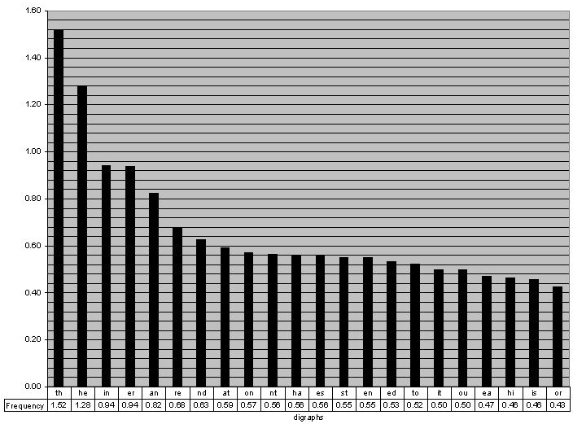
English Digraph Frequencies
http://www.math.cornell.edu/~mec/2003-2004/cryptography/subs/digraphs.jpg

Slide 23

Brute-Force Cracking
Try every possible key
  Facilitated by massively
  parallel computing
Dictionary attacks narrow the
range of keys
  Helpful when one suspects that the target user has chosen bad key
    Names of pets, friends, sports teams, hobbies, objects on desk
  Password-cracking programs use dictionaries
    Try every word and combination
    Can also introduce numbers and symbols

Slide 24

Password-Cracking Programs
Most systems store one-way encrypted passwords in a file
  E.g., /password/etc. file in UNIX systems
  One-way because cannot deduce original password from knowing ciphertext
    Why not?
Password encryption algorithm is known
  Encrypt all possible passwords
  Compare ciphertexts against stored values
  Hits indicate valid passwords or equivalents (WHY?)

Slide 25
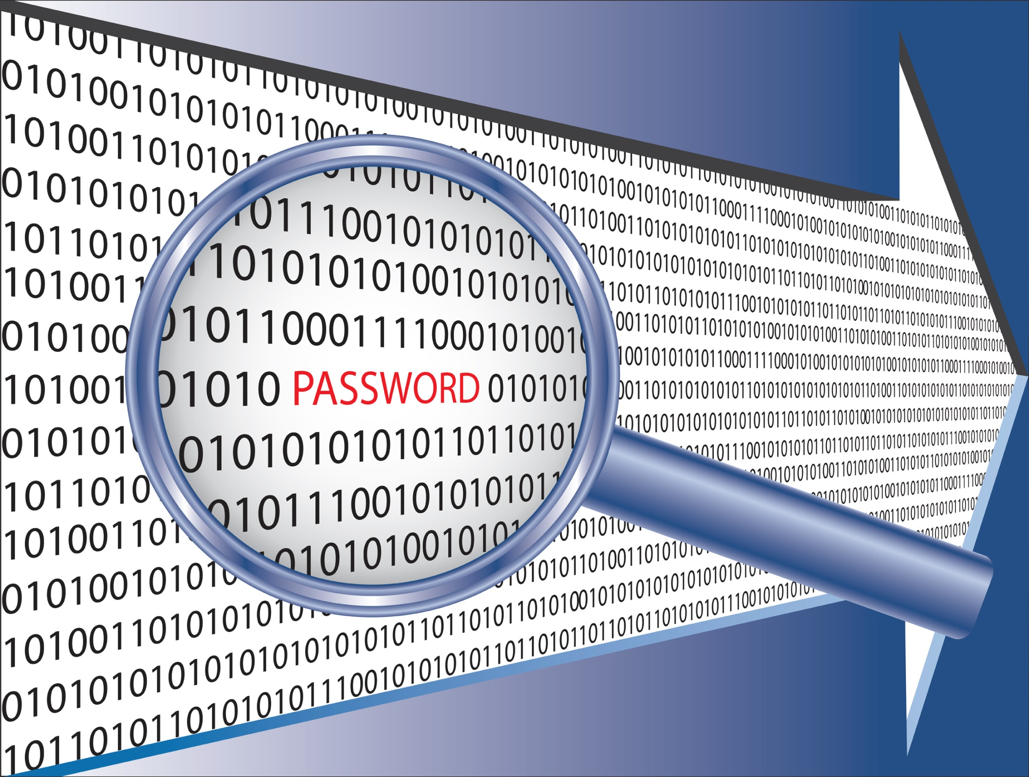
Defending Against Password-Cracking Programs
How can you choose passwords that are hard to crack?
Don’t use real words
  Why?
Introduce numbers and symbols into the password sequence
  Why?
Change your password periodically
  Why?
Don’t use the same password on public Web sites as on important / secure production sites
  Why?

Slide 26
Interfering with Brute-Force Cracking
Need to know the algorithm used for encryption
  Why?
Must be able to recognize successful decryption
  Why?
Superencryption of plaintext makes brute-force cracking more difficult but not impossible
  Suppose adversary uses two algorithms, E₁ and E₂ using keys k₁ and k₂ respectively
  Thus must crack E_{2k2}((E_{1k1}(P)) which has a keyspace that is the product of k1 and k2
Using different data encoding schemes can confuse cryptanalyst (e.g., use EBCDIC & ASCII)

Slide 27

Attacking Weak Algorithms
Find methods of deducing key due to bad algorithms
  But may be able to find key only one message at a time
  May be able to demonstrate that algorithm is fundamentally flawed – may not successfully protect ciphertext against analysis (e.g., Knapsack algorithm)
Fundamental principle: strength of encryption measured by time and cost of cryptanalysis for specific application

Slide 28

Types of Cryptanalytical Attacks
Ciphertext only:
  No idea of plaintext at all
Known plaintext:
  Examine plaintext + ciphertext
Chosen plaintext:
  Choose plaintext and examine ciphertext
Adaptive chosen plaintext (aka differential cryptanalysis):
  Repeatedly choose plaintext and examine results of encryption

Slide 29
Start here Monday

Slide 30
Stronger Encryption
& the PKC
Stronger Encryption
  Transposition Ciphers
  Block Ciphers & Chaining
  Product Ciphers
  DES: Data Encryption Standard
  Triple DES (3DES)
  AES: Advanced Encryption Standard
Public Key Cryptosystem (PKC)
CSH6 Chapter 7
pp 7.16-7.43

Slide 31
Stronger Encryption
Substitution ciphers are generally weak (i.e., cheap or quick to crack)
Stronger ciphers include
  Transposition ciphers
  Block ciphers & chaining
  Product ciphers

Slide 32
Transposition Ciphers
Change order of plaintext
  Use specific algorithm (rule)
Example: matrix rotation
  Matrix dimensions can serve as key;
  e.g., 6 x 8 then read as 8 x 6
  Read text in opposite direction of matrix
  See next slide for illustration
Interferes with expected frequencies of digraphs, trigraphs etc.

Slide 33
Transposition Ciphers: Example
The quick brown fox jumped over the lazy dogs.
Tioxerlohcw d ageeknj tzs uohy.qbfmve urope d

Slide 34
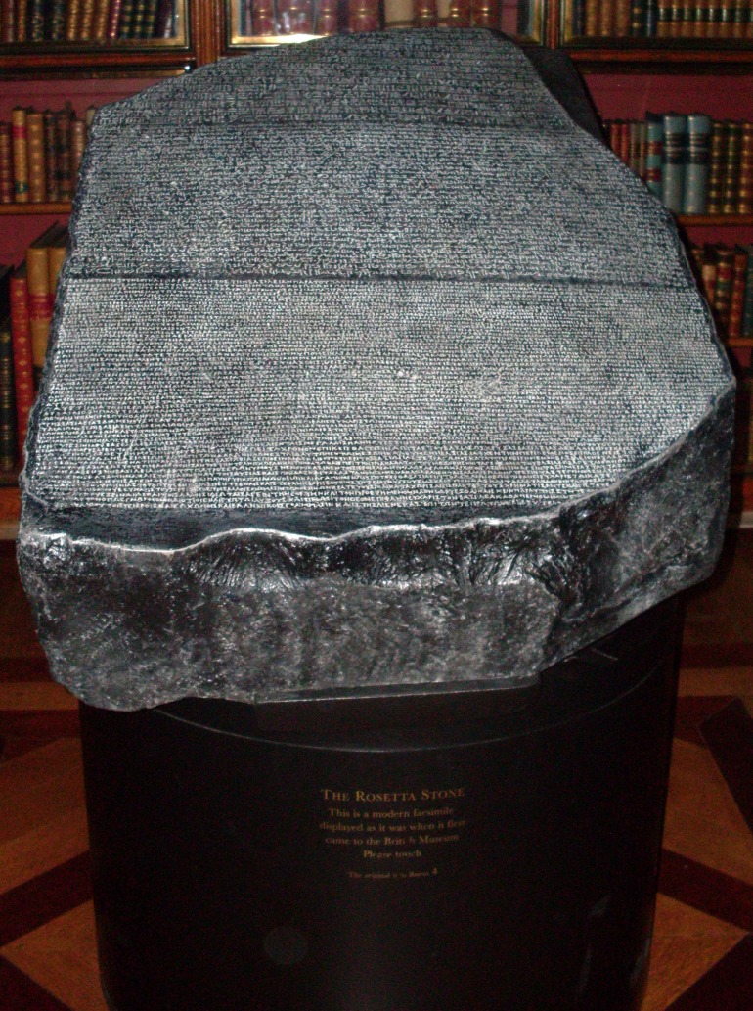
Cryptanalytical Attacks on Transposition Ciphers
Susceptible to combination of brute-force and frequency-based analysis
  Try different offsets looking for familiar / frequent digraphs
  This helps to determine the original matrix and its rotation
Nonetheless, transposition is an important part of more complex encryption schemes
Copy of the Rosetta Stone
(Create Commons License)

Slide 35
Block Ciphers & Chaining
Introduce additional complexity:
  Break plaintext into blocks
  Apply transposition and substitution ciphers to each block
Chaining
  Introduce an element from previous block into next block
  Thus specific ciphertext becomes context dependent
  Risk: transmission error may render ciphertext unrecoverable

Slide 36
Product Ciphers
Use all methods at once
  Blocks
  Chaining
  Transpositions
Problem: no mathematical way of proving that a product cipher is actually strong
  Therefore try to look at degree of randomness
  Measure frequencies of symbols
  Also 1st, 2nd, 3rd. . . n^{th}-order correlations
A B C D E F G H I J K L M N

Slide 37
DES: Data Encryption Standard
1971: IBM created “Lucifer”
  Used in financial transactions
  Single-key symmetric algorithm using 56-bit keys
NIST selected Lucifer to be the DES
  1977: Federal Information Processing Standard (FIPS) 46
  US government standard for unclassified use
Widely adopted in commercial banking
Originally defined in hardware
  Increased general computer speed led to approval for software implementations

Slide 38
Encryption: DES
Data Encryption Standard
  example of symmetric encryption algorithm
Key: 7dhHG0(Jd*/89f-0ejf-pt2@...
plaintext
ENCRYPT
Ciphertext
plaintext
DECRYPT
Ciphertext
Key: 7dhHG0(Jd*/89f-0ejf-pt2@...

Slide 39
Triple DES (3DES)
C = E_{k1}[D_{k2}[E_{k1}(P)]]
Where
E_{k1}(P) means “encrypt plaintext using key 1”
C means “ciphertext”
Keylength 110 bits
Keyspace 2¹¹⁰ ≈ 10³⁶
Much used for key management (see next lecture)

Slide 40
AES: Advanced
Encryption Standard
1997: NIST requested new encryption algorithm
  Protect sensitive unclassified US government information
Competition among candidate algorithms
  Winner: Rijndael (“Rhine doll”)
  Drs Joan Daeman & Vincent Rijmen from Belgium
Block cipher w/ variable block length & variable key length (easily extendible)
  Easy to implement in hardware (e.g., smart cards) as well as software

Slide 41
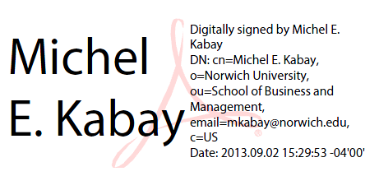
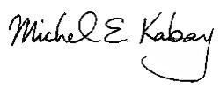

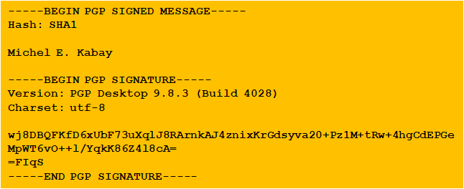
Public Key Cryptosystem (PKC) Topics
History
Functions
Illustrations of Digital
Signatures

Slide 42

Functions of the PKC
Protecting confidentiality
Assuring integrity
Demonstrating authenticity

Slide 43
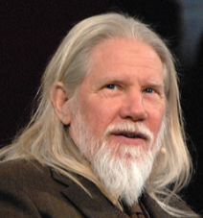
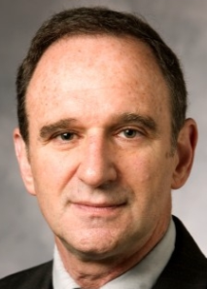
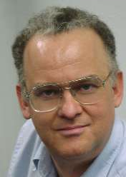
PKC: Public Key Cryptosystem (1)
Discoverers / Inventors – 1974-1975
  Stanford University
    Whitfield Diffie
    Martin Hellman
  UC Berkeley
    Ralph Merkle
Radically new concept at the time
  Create 2 complementary keys
  Make one of them public
  Dispense with problems of secure key distribution for decryption
Diffie, Hellman,
Merkle
Notes:
See, for example,
Diffie, W. & M. E. Hellman (1976). Multiuser cryptographic techniques. In AFIPS Conference Proceedings, vol 45: National Computer Conference, New York, June 7-10, 1976. AFIPS Press (Montvale, NJ), pp. 109-112
Merkle, R. C. (1978). Secure communications over insecure channels. Communications of the ACM 21(4):294-299 (April 1978).

Slide 44
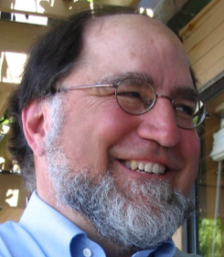
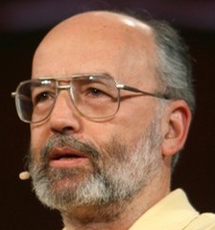
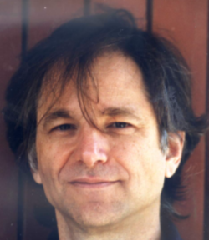
PKC History (2)
Idea developed into the Public Key Cryptosystem (PKC) by three scientists
  Ron Rivest
  Adi Shamir
  Len Adleman
Founded RSA Data Security Inc. (RSADSI)
  Now one of best-known security firms
  Sponsor highly-regarded annual conference
  Web site has much useful information
  http://www.rsa.com
Rivest, Shamir,
Adleman

Slide 45
Encryption Using PKC (1)
Key generation produces 2 keys
  Each can decrypt the ciphertext produced by the other
  One is defined as public
  Other is kept as private
Choose passphrase
Use random data
Create complementary keys
Key: 7dhHG0(Jd*/89f-0ejf-pt2@...
Key: fu3f93jgf912=kjh#1sdfjdh1&...

Slide 46
Encryption Using PKC (2)
Key generation produces 2 keys
  Each can decrypt the ciphertext produced by the other
  One is defined as public
  Other is kept as private
Key: 7dhHG0(Jd*/89f-0ejf-pt2@...
Cleartext
ENCRYPT
Ciphertext
Cleartext
DECRYPT
Ciphertext
Key: fu3f93jgf912=kjh#1sdfjdh1&...

Slide 47
Using the PKC for Encryption (1)
How can we send a message so only the desired recipient can read it? Select the correct answers in the following description.
First, encrypt the plaintext using the
  Sender’s Public
  or or Key
  Recipient’s Private

Slide 48
Using the PKC for Encryption (2)
Send the ciphertext to the recipient
Next, decrypt the ciphertext using the
  Sender’s Public
  or or Key
  Recipient’s Private

Slide 49
Sending a Ciphertext to Multiple Recipients
What if you have to send a message securely to many people?
  Obvious way is to encrypt the message separately for each recipient
  Thus generate as many ciphertexts as recipients
Public Key for Recipient 1
Cleartext
ENCRYPT
Ciphertext for Recipient 1
Cleartext
ENCRYPT
Ciphertext for Recipient 2
Public Key for Recipient 2

Slide 50
Multiple Recipients (2)
However, e-mail normally makes it easy to send one message to multiple recipients
  Don’t want to send a different ciphertext to each recipient
PKC algorithms are computationally demanding
  Can take significant time to encrypt messages
  Encrypting same message n times could take a long time

Slide 51
Multiple Recipients (3)
Use a one-time symmetric key to create ciphertext -- the session key
Prepare as many copies of this symmetric key as necessary to reach all the recipients
Encrypt a copy of the symmetric key with the public key of a specific recipient
  Do this step for each recipient
Ciphertext
Session Key
encrypted for
each recipient

Slide 52
Multiple Recipients (4)
Send both the ciphertext and the encrypted decryption keys to all the recipients
Cleartext
ENCRYPT
Ciphertext
Symmetric
Session Key
Encrypted
Symmetric
Session Key
ENCRYPT
Key: 7dhHG0(Jd*/89f-0ejf-pt2@...
Recipient’s Public Key

Slide 53
Multiple Recipients (5)
Each recipient decrypts the asymmetric key using their own private key
Ciphertext
Cleartext
DECRYPT
Symmetric
Session Key
Encrypted
Symmetric
Session Key
Symmetric
Session Key
DECRYPT
Key: fu3f93jgf912=kjh#1sdfjdh1&...
Recipient’s Private Key

Slide 54
Digital Signature Using
PKC (1)
Signing a document using PKC
This is the original text.
This is the original text.
8u3ofdjgh
djc9d_j3$
83502758
Create message hash;
encrypt only hash with
sender’s private key.
Unencrypted
hash of message
Encrypted
hash of message

Slide 55
Digital Signature Using
PKC (2)
Verifying the signature using PKC
Decrypted
hash of message
This is the original text.
8u3ofdjghdjc9d_j3$
83502758
Decrypt hash with
public key; compute hash
again and compare
83502758
Newly computed
hash of message
Encrypted
hash of message
. . . and now compare
the two hashes

Slide 56
Digital Signature Using
PKC (3)
IF (decrypted hash = newly computed hash)
THEN
  The message has not been modified in transit
  The message was signed by the owner of the private key corresponding to the public key*
  * Or by someone who has compromised that key!

Slide 57

PGP & GPG
Screenshots illustrating use of popular PKC encryption and digital signature tools
Creating a new key
Signing a document
Effects of corrupting a document
Encrypting a document
Decrypting a document
Establishing the Web of Trust

Slide 58
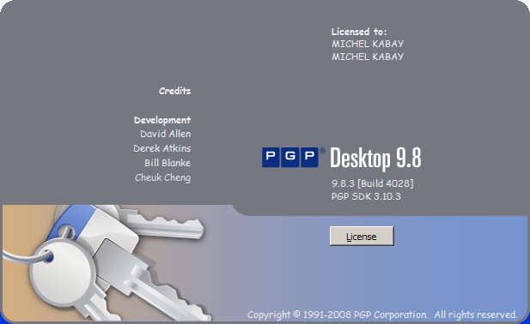
PGP
Tool for applying PKC
Supports
  File encryption /
  decryption
  Message encryption /
  decryption
  Disk encryption / decryption
  Authentication through digital signatures
Provides facilities for establishing web of trust (see lecture on PKI) among users
  Key distribution
  Key signing
  Key revocation & expiration

Slide 59
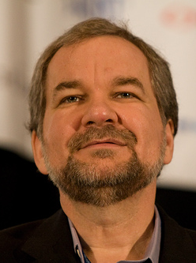
PGP: Pretty Good Privacy
Phil Zimmermann
  Computer programmer
  Civil libertarian
Released Pretty Good Privacy*
  June 1991 – worldwide
  distribution
  Became most widely-used
  encryption program in world
PZ worked with Viacrypt to create PGP 3
(renamed PGP 5) in 1997
Developed OpenPGP (RFC 4880)
Free Software Foundation developed GNU Privacy Guard (GPG) in compliance with OpenPGP
_____
* Reference to Garrison Keillor’s Prairie Home Companion radio show, where a mythical sponsor was “Ralph’s Pretty Good Grocery.”

Slide 60
PGP (cont’d)
Zimmermann investigated by grand jury for supposedly violating ITAR (Intl Traffic in Arms Regulations)
  Much protest (cypherpunks & also Prof Kabay writing vehemently in Network World!)
  PZ responded by publishing entire code in a book – not subject to ITAR
  Prosecution abandoned after several years
Bought by Network Associates (NAI) in 1997
New PGP company created 2002 & bought code from NAI
Now PGP Corporation; see FAQ for more info
http://www.pgp.com/company/faqs.html

Slide 61
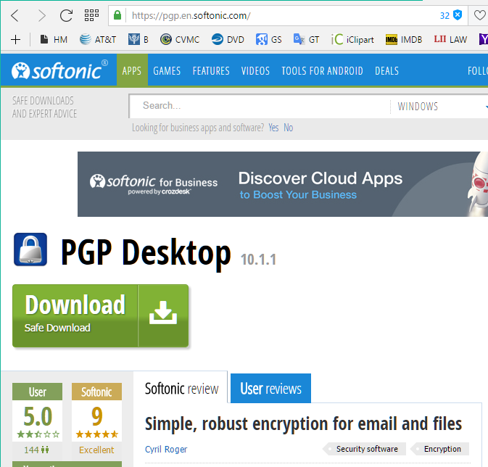
PGP Desktop*
* In Aug 2016 the current version was PGP Desktop v 10.1.1

Slide 62
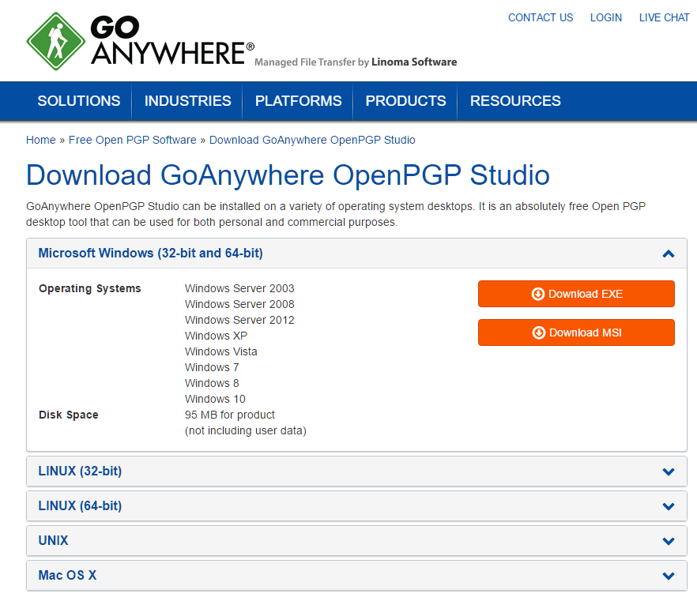
Getting PGP Free
https://www.goanywhere.com/openpgp-studio/download

Slide 63
Encryption: PGP Demo
Screenshots of old commercial version 8.1:
Creating a private key / public key pair
Signing a document with a private key
Validating a signature with a public key
Effect of a single-byte change on validity of a digital signature
Encrypting a document using a public key
Decrypting a document using a private key
Effect of a single-byte change on decryption
Signing someone’s public key
GPG
*Using screen captures

Slide 64
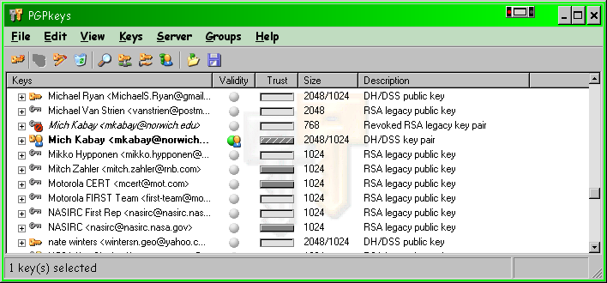
PGP: Creating a Private Key / Public Key Pair

Slide 65
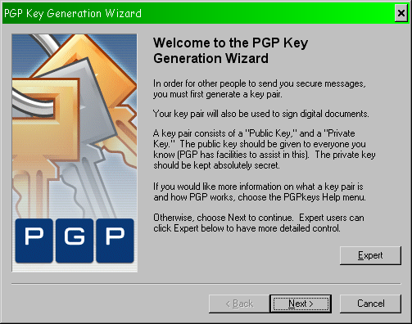
New Key (cont’d)

Slide 66
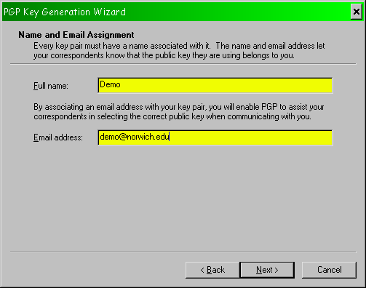
New Key (cont’d)

Slide 67
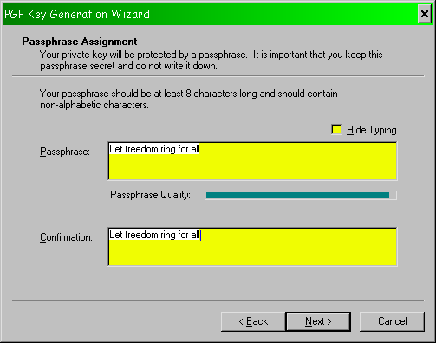
New Key (cont’d)
Usually checked

Slide 68
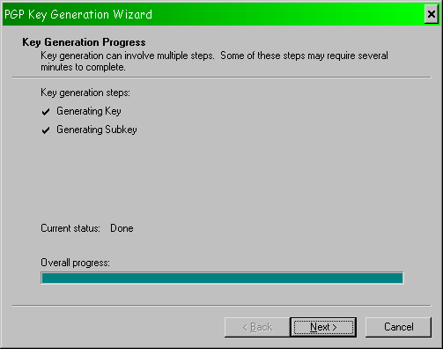
New Key (cont’d)

Slide 69
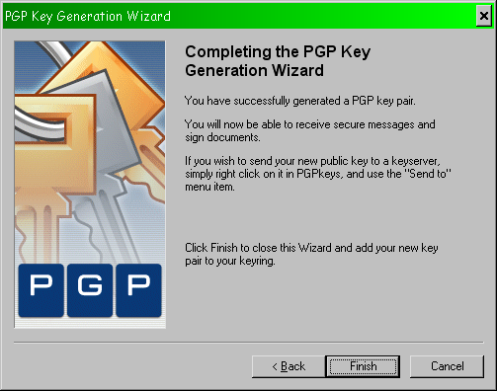
New Key (cont’d)

Slide 70
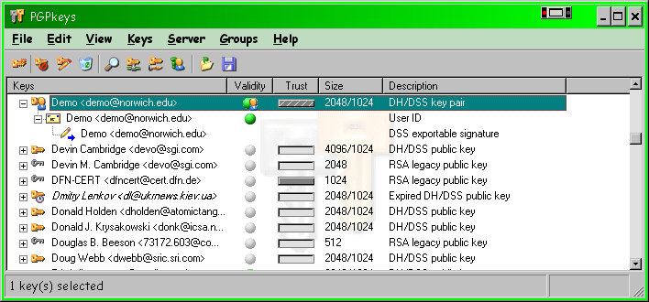
New Key (cont’d)

Slide 71
PGP: Signing a Document With a Private Key
-----BEGIN PGP SIGNED MESSAGE-----
This is the original text.
-----BEGIN PGP SIGNATURE-----
Version: PGP Personal Privacy 6.5.8
Comment: Digital signatures increase security for everyone.
iQB1AwUBO+dfOzPd6/an40lzAQF7rQL+MPLG+V/J8H0QhDLE3JUDo4tYqPOJ682r
zv457NmbycGz05hlq6TtNuLCWRbashcQZ7eWiwHybgLwhgbYY8G4HnAYFHh6vKyb
3csmoTm29uHD+/4av98awA23Bf1aEW+t
=WhgQ
-----END PGP SIGNATURE-----

Slide 72
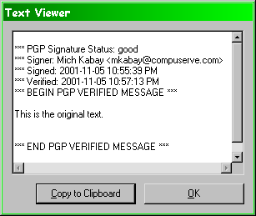
PGP: Validating a Signature With a Public Key

Slide 73
PGP: Single-byte Change Alters Digital Signature
-----BEGIN PGP SIGNED MESSAGE-----
This is the original text!
-----BEGIN PGP SIGNATURE-----
Version: PGP Personal Privacy 6.5.8
Comment: Digital signatures increase security for everyone.
iQB1AwUBO+dfOzPd6/an40lzAQF7rQL+MPLG+V/J8H0QhDLE3JUDo4tYqPOJ682r
zv457NmbycGz05hlq6TtNuLCWRbashcQZ7eWiwHybgLwhgbYY8G4HnAYFHh6vKyb
3csmoTm29uHD+/4av98awA23Bf1aEW+t
=WhgQ
-----END PGP SIGNATURE-----

Slide 74
Single-byte Change Alters Digital Signature (cont’d)
Everything from here on
is different
iQB1AwUBO+dfOzPd6/an40lzAQF7rQL+MPLG+V/J8H0QhDLE3JUDo4tYqPOJ682r
zv457NmbycGz05hlq6TtNuLCWRbashcQZ7eWiwHybgLwhgbYY8G4HnAYFHh6vKyb
3csmoTm29uHD+/4av98awA23Bf1aEW+t
=WhgQ
iQB1AwUBO+fETTPd6/an40lzAQFagQL/Thfw3DAJA/KRgoH+kSFcoRL39eJp4s5h
v3zeHUesOkgQk2zSUF+evbRhw5cxZJkUA1Qid6cg58tEaP9jI+7J3wILmJrFPF/K
L42qO9yjxalNssnflUaSf7ry7xXV3blK
=svYa
This is the original text.
This is the modified text!
Remember, exclamation
mark is different from original

Slide 75
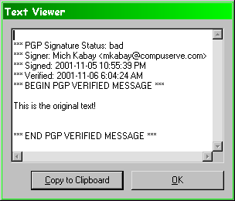
Single-byte Change (cont’d)

Slide 76
PGP: Encrypting a Document Using a Public Key
Exit
Help
Options…
PGPnet
PGPdisk
PGPkeys
PGPtools
Current Window >
Clipboard >
Empty
Edit
Decrypt & Verify
Encrypt & Sign
Sign
Encrypt

Slide 77
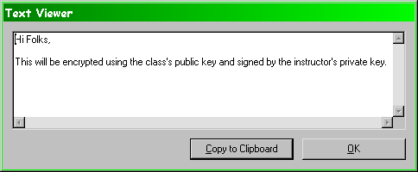
Encryption (cont’d)
Cleartext
Note that the sender should ALWAYS encrypt using the
sender’s public key as well as the recipient’s public key
to allow decryption by the sender.

Slide 78
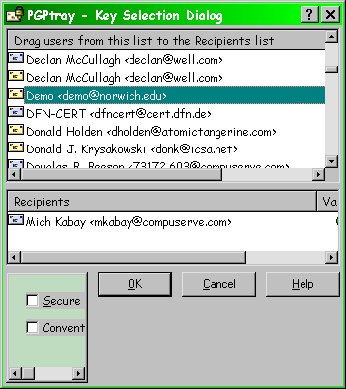
Encryption (cont’d)
Public
Keys
Selected
Public
Keys

Slide 79
Encryption (cont’d)
Ciphertext
-----BEGIN PGP MESSAGE-----
Version: PGP Personal Privacy 6.5.8
Comment: Digital signatures increase security for everyone.
hQIOA8BxvYx90+tvEAf/eXW8I9vY45PwN27gd4kzg0DyoCJiucXXA4eDtzHqBUJm
nWadsATpcspqQNaZwgp8d5FwxRhafOtG2WqSXI2SgsFUIjraYgXdlRBm2qeU/dKh
8+NfNZv2ol5bPaDAg9oiYDRV7KcFAMm3RfIiSTRv6f72mE+Y6VPAvQmL6zjLAe0D
i/9n7Sh0UyM+71YuNeY0V+EZ88rTBa7JP4xr/GfAVKwwSHIWEhOfiwe82LMxOnSg
t8vj6amULTYp4daULqDt+qewULR4XWLhQ73zVT9578BSaUmgSnlRXveIsHj4fj9n
2+Ry7QZZL7k2XDybIjAw8QfLcShDgC3n5Wlt+mWLwwgA8zJSyzTdKYtVh0kuo3CP
9kkGpkgqyqitVFhua+J4bvQrrhLCLBzCWXBl6RSdFvChJ7JNhtgzajV16L5SepDS
tHMcahPvGoE1e+uG5P80xqngbc5Sl7BY0jfsUjGBlyfVRpt+oC37l4W2ZKZ6mgRU
4yY+H2NTi28gC0SfXjzwRwS4qARSicjIuUkYVUuRqSDfeK4slaV8FVs/xg+Ra7U3
HuyD8VmBi0/uO3RSsyPldbh2FqA1+raqeL2yuoUXLe8DI1CToLQ595/4s0wiNIzT
Ys2W5ZbOT+P2gjoVfNaRQlWFzntkRXBcs/Kx9R8pu+NMTdpjJsip0oqiGfH2jtqk
2IUAbAMz3ev2p+NJcwEC/i8eoq7FornXxjxzB5/hQ3Ie0Ww+Vxk2LZVHdT07eqiz
8eN9e2XSxt4cr216MFCPOf1Wj8j3suYvX7mnJa7hu0mvJvxalHawEq3U+r4ZczcC
e+q9YAukL9iXyRHYCrWZWqT6dj1Bynmi6hzgLfApq+270u8QwaGud1d/aOHGlhD7
+9JcSC1AkXoVZsA3ltaOMPP7frIOOZfdyFzr874mhG+Lru9sBFUy1S7h3gNQfUwx
ZEe9uGnDfNUth33VrrtMqjIvUjh9gZN8BOXdkKOk0WGkVvJDy6D8bSphSaQR+vvP
V83K4BaD24kiAJ70NLbeQXPx2H5j0HYT+4bD0RTt4RQgbeRLhqgwZfKpVdldXC13
P06+MTFlIiqcs+p4OJo/Mj67H6x877KWU3G7SKG4pBpgmy6KwKeUW8j9EpcKTgh+
+8/tgDZNAzcm8vnCQ9HEAAsN6KM9V0qoCiyDDA==
=IIr+
-----END PGP MESSAGE-----

Slide 80
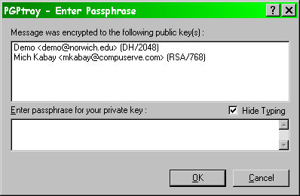
PGP: Decrypting a Document Using a Private Key
This is a demo for the intro INFOSEC course

Slide 81
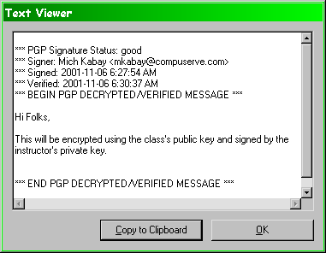
Decryption (cont’d)

Slide 82
PGP: Effect of a Single-byte Change on Decryption
-----BEGIN PGP MESSAGE-----
Version: PGP Personal Privacy 6.5.8
Comment: Digital signatures increase security for everyone.
hQIOA8BxvYx90+tvEAf/eXW8I9vY45PwN27gd4kzg0DyoCJiucXXA4eDtzHqBUJm
nWadsATpcspqQNaZwgp8d5FwxRhafOtG2WqSXI2SgsFUIjraYgXdlRBm2qeU/dKh
8+NfNZv2ol5bPaDAg9oiYDRV7KcFAMm3RfIiSTRv6f72mE+Y6VPAvQmL6zjLAe0D
i/9n7Sh0UyM+71YuNeY0V+EZ88rTBa7JP4xr/GfAVKwwSHIWEhOfiwe82LMxOnSg
t8vj6amULTYp4daULqDt+qewULR4XWLhQ73zVT9578BSaUmgSnlRXveIsHj4fj9n
2+Ry7QZZL7k2XDybIjAw8QfLcShDgC3n5Wlt+mWLwwgA8zJSyzTdKYtVh0kuo3CP
9kkGpkgqyqitVFhua+J4bvQrrhLXLBzCWXBl6RSdFvChJ7JNhtgzajV16L5SepDS
tHMcahPvGoE1e+uG5P80xqngbc5Sl7BY0jfsUjGBlyfVRpt+oC37l4W2ZKZ6mgRU
4yY+H2NTi28gC0SfXjzwRwS4qARSicjIuUkYVUuRqSDfeK4slaV8FVs/xg+Ra7U3
HuyD8VmBi0/uO3RSsyPldbh2FqA1+raqeL2yuoUXLe8DI1CToLQ595/4s0wiNIzT
Ys2W5ZbOT+P2gjoVfNaRQlWFzntkRXBcs/Kx9R8pu+NMTdpjJsip0oqiGfH2jtqk
2IUAbAMz3ev2p+NJcwEC/i8eoq7FornXxjxzB5/hQ3Ie0Ww+Vxk2LZVHdT07eqiz
8eN9e2XSxt4cr216MFCPOf1Wj8j3suYvX7mnJa7hu0mvJvxalHawEq3U+r4ZczcC
e+q9YAukL9iXyRHYCrWZWqT6dj1Bynmi6hzgLfApq+270u8QwaGud1d/aOHGlhD7
+9JcSC1AkXoVZsA3ltaOMPP7frIOOZfdyFzr874mhG+Lru9sBFUy1S7h3gNQfUwx
ZEe9uGnDfNUth33VrrtMqjIvUjh9gZN8BOXdkKOk0WGkVvJDy6D8bSphSaQR+vvP
V83K4BaD24kiAJ70NLbeQXPx2H5j0HYT+4bD0RTt4RQgbeRLhqgwZfKpVdldXC13
P06+MTFlIiqcs+p4OJo/Mj67H6x877KWU3G7SKG4pBpgmy6KwKeUW8j9EpcKTgh+
+8/tgDZNAzcm8vnCQ9HEAAsN6KM9V0qoCiyDDA==
=IIr+
-----END PGP MESSAGE-----
Changed a C to
X in this position

Slide 83
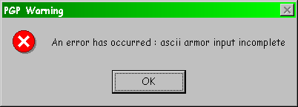
Single-byte Change & Decryption

Slide 84
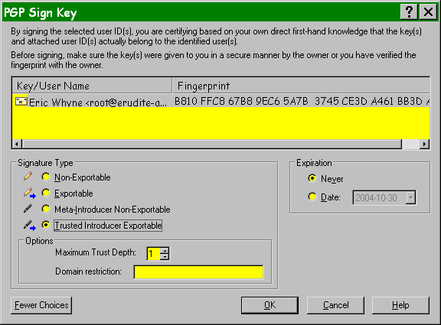
Signing Someone’s Public Key

Slide 85
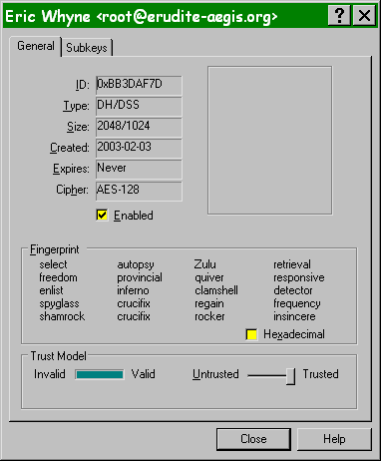
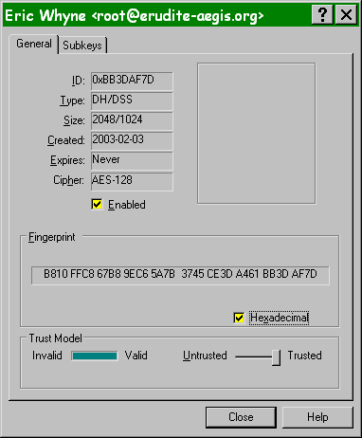
Checking the Public Key Fingerprint

Slide 86
GPG: GNU Privacy Guard
From http://www.gnu.org/software/gnupg/gnupg.html :
Implements OpenPGP Internet standard (RFC4880)
Full interoperability with other modern encryption programs
Meets all requirements of a standard Unix utility
Uses DSA, ElGamal, 3DES and Twofish as encryption algorithms and more
Easy implementation of new algorithms using extension modules
Portuguese, French, German, Italian, Polish, Russian and Spanish language support
Online help system
Optional anonymous message receivers
Integrated support for HKP keyservers
Runs on most Unix platforms and support for other platforms is coming soon

Slide 87
Now go and study

