Slide 1
Taxonomy of Computer Security Breaches
CSH6 Chapter 8
“Using a Common Language for Computer Security Incident Information”
John D. Howard

Slide 2
Topics
What is a Common Descriptive Language?
What is a Taxonomy?
Why a Language/Taxonomy for Computer Crime?
The Model as a Whole
Actions
Targets
Events
Vulnerability
Tool
Unauthorized Result
Objectives
Attackers
CSH6 Chapter 8:
“Using a Common Language for Computer Security Incident Information”

Slide 3
What is a Common Descriptive Language?
Set of terms that experts agree on in a field
Clear definitions to the extent possible
Precise
Unambiguous
Easy to determine in the field
A common language does not necessarily imply a causal or structural model
Provides means of communication among experts
Supports analysis

Slide 4
What is a Taxonomy?
Structure relating terms in the common language
Permits classification of phenomena
Expresses (a) model(s) of the underlying phenomena
Supports hypothesis-building
Supports collection and analysis of statistical information

Slide 5
Why a Language/Taxonomy for Computer Crime?
Field of information assurance growing
More people
Less common experience
Growing variability in meaning of terms
What’s wrong with ambiguous terminology?
Can cause confusion – talking at cross-purposes
Can mislead investigators and others
Wastes time in clarification time after time
Interferes with data-gathering
Makes comparisons and tests difficult or impossible

Slide 6
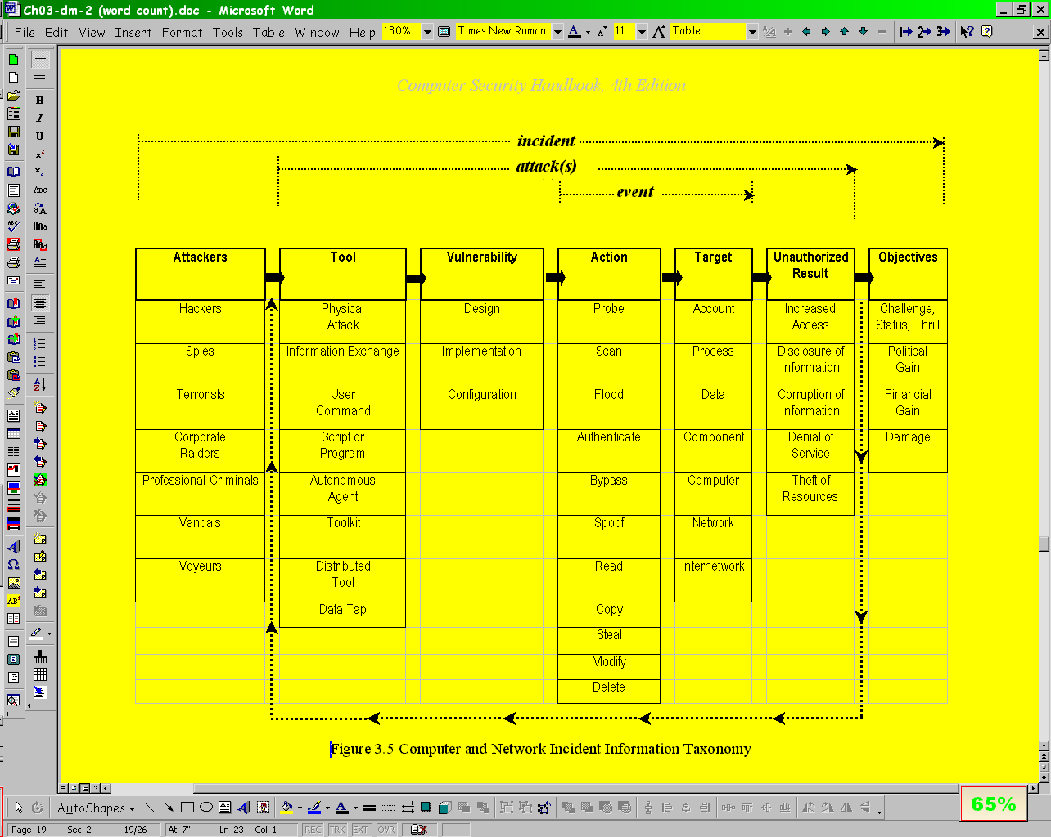
The Model as a Whole

Slide 7
Actions
Probe / scan
Flood
Authenticate / Bypass / Spoof
Read / Copy / Steal
Modify / Delete

Slide 8
Targets
Analyze the following real cases and identify the target(s) in the events:
A criminal inserts a Trojan Horse into a production system; it logs keystrokes
A criminal hacker defaces a Web page
An attacker launches millions of spurious packets addressed to a particular e-commerce server
The Morris Worm of November 1988 takes down 9,000 computers on the Internet

Slide 9
Events
An event consists of an action taken against a target
Analyze the following events in these terms:
An 8-year-old kid examines all the ports on a Web server to see if any are unprotected
A dishonest employee makes copies on a Zip disk of secret formulas for a new product
A saboteur cuts the cables linking a company network to the Internet

Slide 10
Vulnerability
Vulnerability = a weakness
Distinguish among vulnerabilities due to
Design
Implementation
Configuration

Slide 11
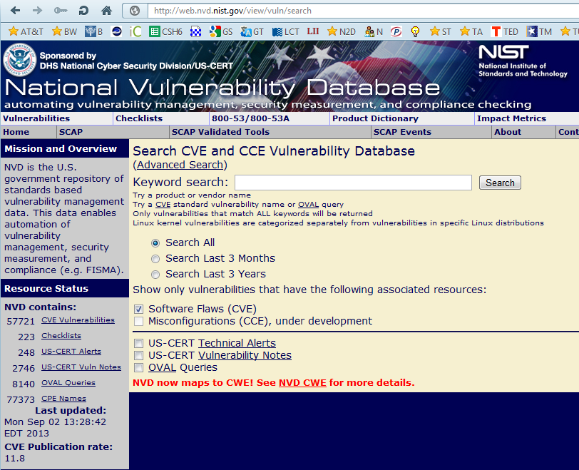
Common Vulnerabilities and Exposures Dictionary

Slide 12
Tool
Means of exploiting a vulnerability
Widely available on Internet
Exchanged at hacker meetings
2600
L0pht (defunct)
Discussed and demonstrated at black-hat and gray-hat conferences
DEFCON – Las Vegas
HACTIC – Netherlands
Many exploits usable by script kiddies and other poorly-trained hackers

Slide 13
Unauthorized Result
Analyze the results of the following attacks:
Someone installs a Remote Access Trojan called BO2K on a target system
An e-mail-enabled worm (e.g., KLEZ) sends a copy of a confidential document to 592 strangers
The Stacheldraht DDoS tool completely interdicts access to an e-commerce site
A secret program installed by an employee uses all the “excess” CPU cycles in a corporate network for prime-number calculations

Slide 14
Objectives
Characteristics of the human beings involved in the attack
Different objectives and define different labels
Criminal hacking
Industrial espionage
Industrial sabotage
Information warfare

Slide 15
Attackers
Wide range of attributes
Subject of later chapter (6)
Gain
Ideology
Skill

Slide 16
The Model as a Whole (again)

Slide 17
Now go and study

