Slide 1
Security Models
CSH6 Chapter 9
“Mathematical Models of Computer Security”
Matt Bishop

Slide 2
Topics
Why Models are Important
Models & Security
Models & Controls
Classic Models
Other Models
Conclusion

Slide 3
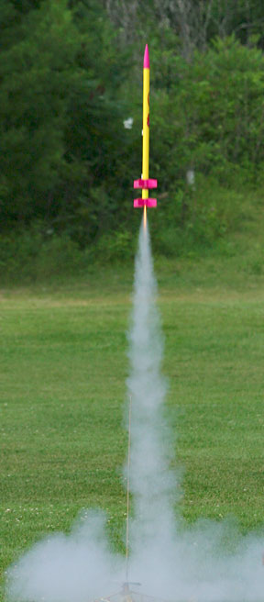
Why Models are Important
General description of system
Definition of protection
Conditions for protection
Mathematical models allow proof
(Assuming model properly implemented)
Assumptions are critically important
Must verify assumptions to validate applicability of model
Chapter 9 presents different types of model
See next slides

Slide 4
Types of Model
Deciding if a system can be proved to be secure
Describing how computer system applies controls
Describing confidentiality & integrity
Hybrid model mixes requirements
Goals of this chapter
Study main models in information security
Meaning
Applicability
Become sensitive to assumptions underlying information assurance

Slide 5
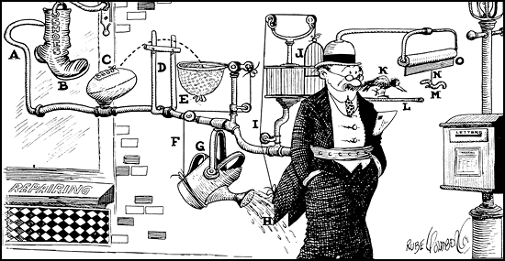
So Why are Models Important?
Provide framework for
Analyzing systems
Focusing security efforts in right place
Validating assumptions; or
Ensuring assumptions are met in reality
Mechanisms
Technical
Procedural
Quality of mechanisms determines security of system
Overall: model provides basis for confidence in possibility of effective security

Slide 6
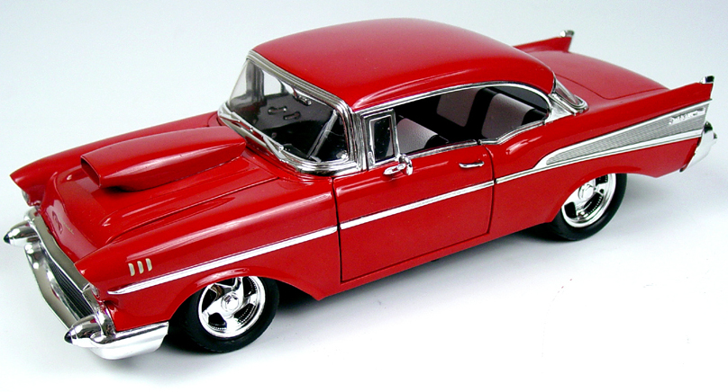
Models & Security
Terminology
Access-Control Matrix Model
Harrison, Ruzzo & Ullman et al.
Typed Access-Control Model

Slide 7
Terminology
Subject: active entity
Subject
User
Object: passive entity
File
Device
Right: relation between subject & object
OPEN → subject can establish path for I/O
READ → I/O from file to subject
Protection State: {rights(subject)}
Instantiation: specific case realizing model

Slide 8
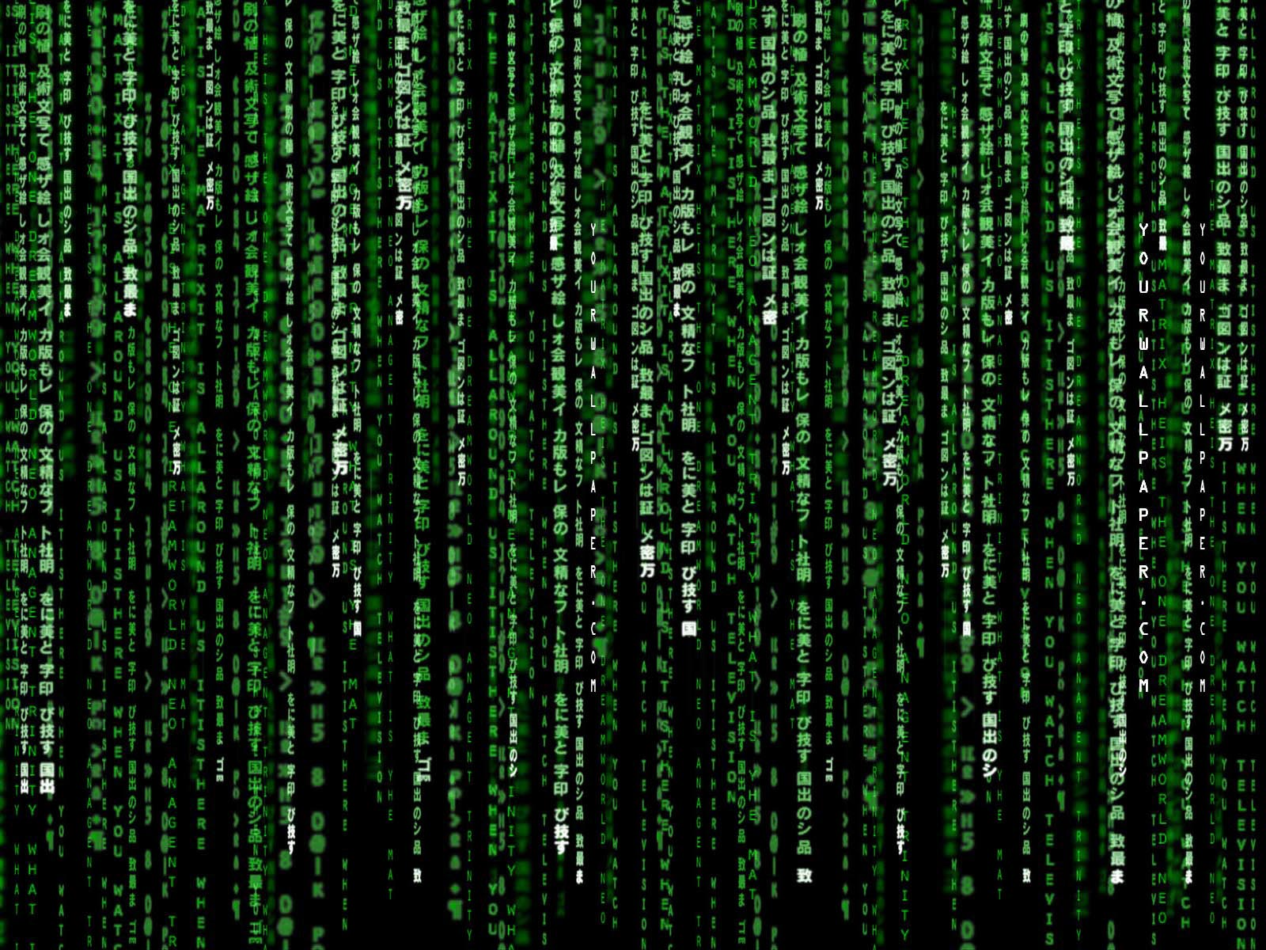
Access-Control Matrix Model (1)
Model captures protection state
Evolution requires primitive operations
Primitives are rules for changing matrix
Describe how one adds, changes and removes rights and relations
See next slides
CSH6 p 9.4

Slide 9
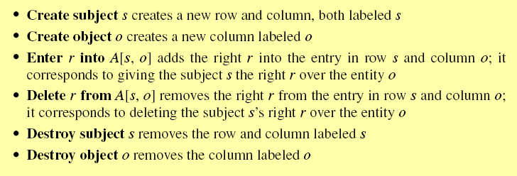
Access-Control Matrix Model (2)
Primitives
CSH6 p 9.4

Slide 10
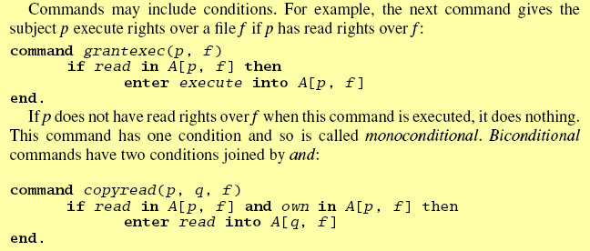
Access-Control Matrix Model (3)
Commands
Mono-operational: 1 primitive
Conditional
CSH6 p 9.4
CSH6 p 9.5

Slide 11
Access-Control Matrix Model (4)
Applicability
Theoretical basis for 2 widely-used mechanisms:
Access-control lists (ACLs)
Capability lists
For modeling
Tool
Analyze difficulty of determining level of security

Slide 12
Access-Control Matrix Model (5)
A few more definitions
Command may consist of single primitive operation
Called Mono-operational command
Command with only 1 condition: monoconditional
Command with 2 conditions joined by and: biconditional
System has no commands using delete or destroy* primitives = monotonic
* Remember, these operations apply to rules in the matrix, not to data.

Slide 13
Harrison, Ruzzo & Ullman (1)
How can we test to determine if system is secure?
Consider
Generic right r for specific entity
Access-control matrix
So system is secure with respect to r iff
r cannot be added to an entity in matrix
Unless particular subject-object relation includes r as permitted
Theorems elaborated to establish bounds of provability (see next slide)
iff means if and only if

Slide 14
Harrison, Ruzzo & Ullman (2)
Safety Question: Is there an algorithm to determine whether a given system with initial state σ is secure with respect to a given right?
Theorem (HRU Result):
Safety question undecidable
Reduce halting problem to safety question
Given a description of a program, decide if it will run forever or terminate
Alan Turing proved impossibility of finding general algorithm for this problem
Therefore safety question is also undecidable
Many other undecidable questions
And a few decidable ones

Slide 15
Typed Access-Control Model
Adding types to access-control model
Define types of data
Modify rules to allow for finer categories
Model called TAM
Definition: acyclic rule set
Entity E or descendents cannot create new entity of same type as E
Theorem: it is possible to construct an algorithm that will determine if acyclic, monotonic TAMs are secure with respect to generic right r
But there’s no guarantee of finding such an algorithm

Slide 16
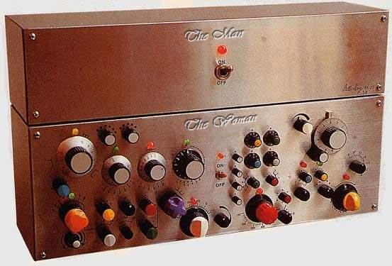
Models & Controls
Mandatory Access-Control Model
Discretionary Access-Control Model
Originator-Controlled Access-Control Model
Digital Rights Management
Role-Based Access-Control Models & Groups
Summary of Models & Controls

Slide 17
Mandatory Access-Control Model
MAC sets and enforces access-control rules using a hierarchy of controllers
US government classification is a MAC
Mandatory because rules must always be followed
Authorities (e.g., ISSO = Information Systems Security Officer) determine rules
System enforces rules
Other examples
MULTICS OS ring-based access-control
Public Key Infrastructure

Slide 18
Discretionary Access-Control Model
Owners of data have power to determine access controls
DAC
Most common access control on computers
Combinations
Often see both MAC & DAC
MAC must be applied first
Thus if MAC denies access, no further access or consideration of DAC
But once access granted by MAC, DAC can modify (restrict) further

Slide 19
Originator-Controlled Access-Control Model (1)
ORCON
Originator of data determines access rights
Example
Medical record must be provided to other health-care specialists involved in treatment
But must not be accessible to their staff
Formal statement
CSH6 p 9.7

Slide 20
ORCON (2)
MAC doesn’t work for these situations
Would need to define all possible organizations receiving information
To include them in access-control matrix
DAC doesn’t work either
Originator has no control over granting of access privileges
But combination of MAC & DAC works
MAC sets limits
DAC allows access within limits

Slide 21
ORCON & DRM
Digital rights management illustrates ORCON
Copyright owners want to control distribution after they sell license to use materials
Music, video, software….
Fundamental problem
Access controls apply to entities (files, devices, music…)
ORCON applies to information
Once information has been accessed, it is not possible to control distribution through alternate channels
E.g., CSH6 electronic copy is protected against data extraction…
…but not against screen shots, as you can see in this presentation…. ☺

Slide 22
Role-Based Access-Control (RBAC) Models & Groups
Situations often require access controls defined for functional groups
Bookkeepers, doctors, nurses, engineers, researchers, administrators….
So define
Authorized roles for each subject
One active role per subject at any 1 time
Example: separation of duties
Multiple roles must combine efforts to perform task signing check for >$50K
RBAC defines rule preventing same subject from having same role at same time

Slide 23
Summary of Models & Controls
Fundamental difference in orientation
MAC, DAC, & ORCON are data-centric
RBAC is focused on subject’s needs
Principle of least privilege
Assign minimum set of privileges for successful work
RBAC constrains set of commands for each subject
MAC, DAC, & ORCON set attributes on data
Several models have been created that apply combinations of these approaches (see following)

Slide 24
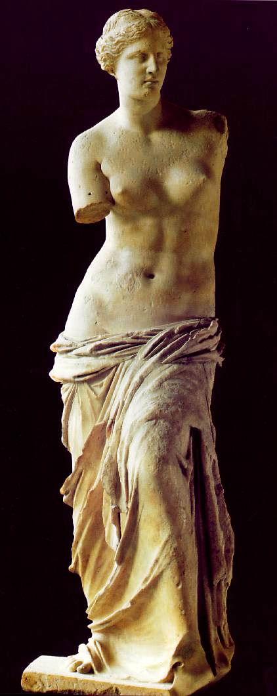
Classic Models
Bell-LaPadula Model
Biba’s Strict Integrity Policy Model
Clark-Wilson Model
Chinese Wall Model
Summary of Classic Models

Slide 25
Bell-LaPadula Model (1)
Formalization of government system
Looks at confidentiality
UNCLASSIFIED, CONFIDENTIAL, SECRET, & TOP SECRET levels for information
Example of multilevel security model
Terminology
UNCLASSIFIED = lowest security level
Subject cleared into level → security clearance = level(s)
Object classified at level → security classification = level(o)
Goal: prevent leakage (information flow from high security classification to lower)

Slide 26
Bell-LaPadula Model (2)
Example
Documents are classified
Paper on Norwich U is CONFIDENTIAL
Article on Ecoterrorists is SECRET
Book on Al Qaeda is TOP SECRET
Tom cleared to SECRET level
Then
Tom can read WHAT?
And Tom cannot read WHAT?

Slide 27
Bell-LaPadula Model (3)
Simple security property
Subject s can read object o iff level(o) ≤ level(s)
AKA no-reads-up rule
Cannot stop leakage if higher-clearance writes to lower-classification medium
*-property (pronounced star property)
s can write o iff level(s) ≤ level(o)
AKA no-writes-down rule
Discretionary Security Property
s can read o iff access-control matrix entry for s & o contains READ right

Slide 28
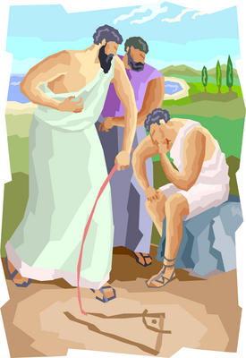
Bell-LaPadula Model (4)
Basic Security Theorem
If a system starts in a secure state
And if every command obeys all of these:
Simple security property
*-property
Discretionary security property
Then the system will remain secure
CSH6 p 9.10

Slide 29
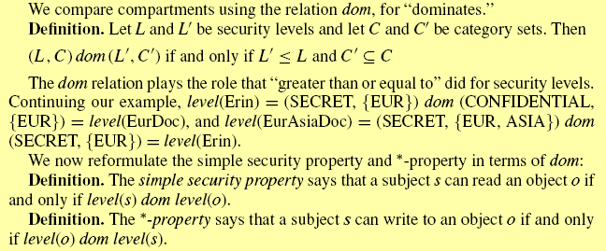
Bell-LaPadula Model (5)
Compartments
Category = expansion of security level
Security compartment = (level, category set)
E.g., level(EurDoc)=(CONFIDENTIAL, {EUR})
level(EurAsiaDoc)=(SECRET,{EUR, ASIA})
Cannot talk about > or < because categories no longer linearly ordered
Define relation dominates = dom

Slide 30
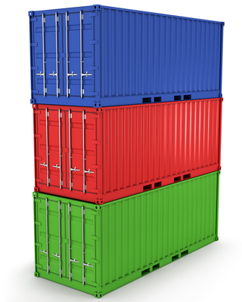
Bell-LaPadula Model (6)
Determining highest security compartment that two subjects can read and lowest they can both write
Properties of compartments
Reflexive property: level(s) dom level(s)
Antisymmetric property:
If both level(s) dom level(o) & level(o) dom level(s) are true, then level(s)=level(o)
Transitive property:
If level(s1) dom level(o) & level(o) dom level(s2), then level(s1) dom level(s2)

Slide 31
Bell-LaPadula Model (7)
Turning it into plain English
Reflexive: If accounting files are confidential
Then any accounting file is confidential
Antisymmetric: If Alice can access the accounting files
And accounting files are at the security level of Alice,
Then Alice’s security level and the accounting files’ security level are equivalent
Transitive:
If Alice can access the accounting files
And the accounting files are of higher security than the personnel files
Then Alice can access the personnel files

Slide 32
Bell-LaPadula Model (8)
Prof Matt Bishop writes:
The influence of the Bell-LaPadula Model permeates all policy modeling in computer security.
It was the first mathematical model to capture attributes of a real system in its rules.
It formed the basis for several standards, including the [DoD’s] Trusted Computer System Evaluation Criteria (the TCSEC or the “Orange Book”….)
Even in controversy, the model spurred further studies in the foundations of computer security.
Bishop, M. (2003). Computer Security: Art and Science. Addison-Wesley (ISBN 0-201-44099-7). xli + 1084. Index. P 148.

Slide 33
Biba’s Strict Integrity Policy Model (1)
Instead of confidentiality, consider trustworthiness
Define integrity classes i-level(s)
Simple integrity property:
Subject s can read object o iff i-level-(o) dom i-level(s)
Allows reads up and disallows reads down
*-integrity property
Subject s can write to object o iff i-level(s) dom i-level-o
Allows writes down and disallows writes up
WHY?
Explain.
WHY?
Explain.

Slide 34
Biba’s Model (2)
Execution integrity property
Subject s can execute subject s’ iff i-level(s’) dom i-level(s)
So process can pass data only to less trustworthy (or equally trustworthy) process
Cannot pass data to more trustworthy process
WHY?
Explain.
CSH6 p 9.13

Slide 35
Biba’s Model (3)
Suggests method for testing programs
Label all data with tags indicating level of trust
Logic in program keeps track of trustworthiness
Changes label according to Biba’s model
Violations of rules → exceptions
Abort
Log warning
Error message
Useful in improving security of programming

Slide 36
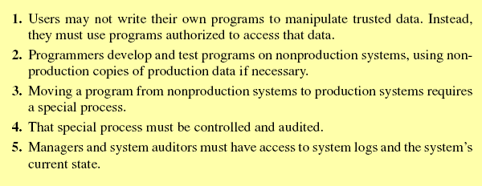
Clark-Wilson Model (1)
Lipner’s Rules for Commercial Integrity Models
CSH6 p 9.14

Slide 37
Clark-Wilson Model (2)
Concepts and terminology
Integrity constraints: rules about data relations (e.g., grades in gradebook must match grades on tests)
Consistent state: all integrity constraints met
Well-formed transactions (WFTs): moving from one consistent state to another (e.g., filling in all the grades from a test, not just some)
Integrity verification procedures (IVPs): methods for checking that integrity constraints are met
Constrained data items (CDIs): data subject to integrity constraints (all others are unconstrained data items – UDIs)
Transformation procedures (TPs): Functions defining WFTs must be certified to be well formed and correctly implemented

Slide 38
Clark-Wilson Model (3)
Nine rules
5 for certification of data & TPs
4 for enforcement of certifications
Certification Rule 1: IVP ensures consistent state at all times
Certification Rule 2: TP maintain valid states
Enforcement Rule 1: Only certified TPs may manipulate associated CDIs
Enforcement Rule 2: Every user must be associated with specific TPs and CDIs to be granted access – implies identification & authentication

Slide 39
Clark-Wilson Model (4)
Enforcement Rule 3: Every user must be authenticated before executing a TP
Certification Rule 3: Separation of duty is essential
Certification Rules 4: Logging is essential and must allow reconstruction of transactions
Certification Rule 5: Any TP working with UDI must either reject the UDI or transform it into a CDI
Enforcement Rule 4: As part of the separation of duties principle, only the certifier of a TP may modify its scope; and no certifier may execute the TP.
The Clark-Wilson model reflects real-world security policies
But a certifier may fraudulently claim to have applied proper certification procedures

Slide 40
Chinese Wall Model
AKA Brewer-Nash model
Goal: prevent conflicts of interest
How?
Group data into company data sets
Group company data sets into conflict-of-interest classes
Rule: if entities are in same conflict-of-interest class, subject cannot read both classes
Typical application: attorneys
Sanitized class has all confidential content removed

Slide 41
Summary of Classic Models
Bell LaPadula model describes widely-used scheme for protecting confidentiality
Biba model focuses on trustworthiness and trust
Clark-Wilson model incorporates process integrity
Chinese Wall model includes conflicts of interest
The Birth of Venus
(Nascita di Venere)
Sandro Botticelli
c. 1486
Uffizi Gallery, Florence, Italy

Slide 42
Other Models
Specific models applied in specific contexts
Clinical Information Systems Security Model
Traducement model for real estate
Noninterference security – prevent LOW subject from acquiring HIGH data at particular time – but allow HIGH subject to choose to send HIGH data later
Deducibility security – prevent inference by LOW subjects

Slide 43
Conclusions
Usefulness of the models depends on thoroughness of systems analysis
Missing details may invalidate application of model
Crucial role in advanced theoretical research in today’s information security
Especially important for mathematical proof of security in specific well-defined systems

Slide 44
DISCUSSION

