Slide 1
Psychology of Computer Criminals &
Insider Crime
CSH6 Chapter 12: “The Psychology of Computer Criminals.”
Q. Campbell & D. M. Kennedy
CSH6 Chapter 13: “The Dangerous Information Technology Insider: Psychological Characteristics and Career Patterns.”
J. M. Post

Slide 2
Topics
Hacker Psychology
Moral Development
Why Study Perpetrators?
Social Engineering
Self-Reported Motivations
Psychological Perspectives on Computer Crime
Social Distance, Anonymity, and Aggression
Individual Differences and Computer Criminals
Classifications of Computer Criminals
The Dangerous Insider
Stress and Attacks on Computer Systems
Typology of Computer Criminals
Conclusions & Implications
CSH6:
Chapter 12: Campbell, Q. & D. M. Kennedy (2014). “The Psychology of Computer Criminals.”
Chapter 13: Post, J. M. (2014). “The Dangerous Information Technology Insider: Psychological Characteristics and Career Patterns.”

Slide 3
Why Study Perpetrators?
Detection
  Knowing how criminals function (modus operandi, “m.o.”) helps teach us how to spot attacks
  E.g., recognize social engineering
Response
  Know what to avoid
  E.g., baiting / insulting hackers
Investigation
  Focus on likely patterns
  E.g., look for boasting in hacker groups

Slide 4
Why Study Perps (cont’d)
Prevention
  Identify and reduce childhood factors likely to twist children into hackers
  Spot pre-criminal attitudes and behaviors leading to involvement in hacker groups and provide counseling
  Challenge hacker propaganda
  Provide attractive alternatives to hacking

Slide 5
Social Engineering
Detection
  Knowing how criminals function (m.o.) helps teach us how to spot attacks
  E.g., recognize social engineering by providing role-playing games
Response
  Know what to avoid
Investigation
  Focus on likely patterns
  E.g., look for boasting in hacker groups

Slide 6
Self-Reported Motivations
Paul Taylor’s research:
  Addiction
  Curiosity
  Boredom
  Power
  Recognition
  Politics
Orly Turgeman-Goldschmidt’s findings:
  Curiosity
  Thrill seeking
  Need for power
  Ideological opposition to information restrictions

Slide 7
Psychological Perspectives on Computer Crime
Self-reported motivations may be incomplete or inaccurate
Behavior often controlled by unconscious factors
So beware facile explanations and generalizations about criminal hacking

Slide 8
Social Distance,
Anonymity, and Aggression
Many criminal hacking activities are aggressive
  Likelihood increases when perpetrators can remain anonymous and
  When likelihood of retaliation low
Milgram’s landmark work on
depersonalized obedience showed
how powerful deindividuation could
be in fostering unethical, immoral
or illegal behavior
Bandura showed that criminals justify their acts by minimizing their significance and blaming their victims
  Thus some hackers blame people they hack

Slide 9
Individual Differences and Computer Criminals
DSM IV suggests possibility that some computer criminals have personality disorders (PD)
Antisocial PD
  Insincerity, dishonesty
  Superficial charm, enhanced
  intellect
  Require little or no reward
  Ignore threats of punishment
  Self-justification, blaming victims
NOT A UNIVERSAL DIAGNOSIS – JUST THAT SOME OF THE CRIMINALS MAY FIT PROFILE

Slide 10
More About Personality Disorders
Narcissistic PD
  Attention seekers
  Inflated sense of entitlement
  Lack of empathy for victims
  Rationalization to justify behavior
AGAIN: NOT A UNIVERSAL DIAGNOSIS – JUST THAT SOME OF THE CRIMINALS MAY FIT PROFILE

Slide 11

Asperger's Syndrome
Mild form autism
Reduced social relations and skills
  Low affect,
  Reduced interest in interaction, awkward interactions
  Prone to repetitive, intense interests & behaviors
  Obsessive or extremely focused area of intellectual interest
NO EMPIRICAL EVIDENCE LINKING CRIMINAL HACKING TO ASPERGER SYNDROME
  Most Asperger victims extremely honest
  Asperger may be higher in computer enthusiasts than in general population

Slide 12
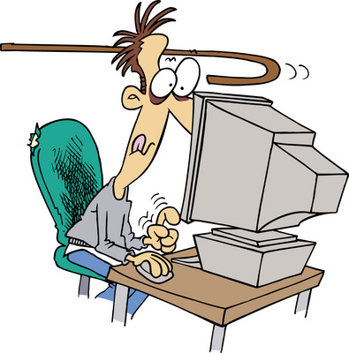
Computer Addiction and Computer Crime
Some computer criminals may
have behaviors akin to addiction
  Concentration on computer
  use
  Mood dependence on usage /
  hacking
  Increased dependence over time
  Withdrawal effects upon deprivation
  Conflict over habits
  Relapse when attempting to stop
Some computer criminals report intense feelings (“rush”) when engaging in criminal hacking – and depression when stopped

Slide 13

Ethics and Computer Crime
Some researchers suggest computer criminals have underdeveloped moral
maturity
“Information Wants to be Free”
Deviant attitudes toward
unauthorized use of computing /
network resources
Justifications of intellectual-
property theft highly deviant if
applied to physical property
Blaming victim commonplace
Frequently unaware of consequences of actions
May see actions as entertainment in a playground: deny existence of real victims or real effects

Slide 14
Moral Development
Kohlberg’s Stages of Moral Reasoning

Slide 15
Moral Reasoning By Age
(Kohlberg, 1963)

Slide 16
Classifications of Computer Criminals
Many different frameworks used over years
  Novices / Students / Tourists / Crashers / Thieves
  Lamers / Neophytes / Elite
  Pranksters / Hacksters / Malicious Hackers / Personal Problem Solvers / Career Criminals / Extreme Advocates / Malcontents, Addicts & Irrational Individuals
Roger’ New Taxonomy
  Newbie / Cyber-punk / Internals / Coders / Old Guard / Professional Criminals
Class Apart: Virus Creators

Slide 17

The Dangerous Insider
Predominantly introverts
  More interested in ideas than in social relationships
  Internalize stress
  Express themselves online
Research by Dr Jerrold Post on computer technology insiders
  Reviewed > 100 cases computer crime
  Interviewed many security professionals
  Results follow on next slides

Slide 18

Characteristics of Dangerous Computer IT Insiders
Social & Personal Frustrations
Computer Dependency
Ethical Flexibility
Reduced Loyalty
Entitlement
Lack of Empathy

Slide 19

Social & Personal Frustrations
History of frustrations in relationships
  Personal
  With coworkers
Prefer predictability &
structure of work
  Like computers
Propensity for anger toward
authorities
Some display revenge
syndrome
  Getting even for perceived injury
  May have chosen computer work with explicit or implicit intention of striking back at unfair society

Slide 20

Computer Dependency
Unusual emphasis on computer-mediated activity
May replace face-to-face
interactions by virtual-
world contacts
May use online persona
as mechanism for
  Influence
  Manipulation
  Recruitment
May become so involved
in computer work as to
be classified as addicted

Slide 21
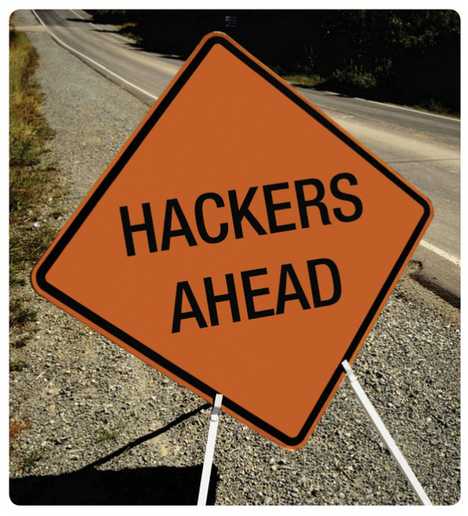
Ethical Flexibility
Small proportion (<10%) approve of illegal acts
  Criminal hacking
  Sabotage
  Espionage
Believe that
  Inadequate security fully
  justifies penetration,
  unauthorized exploitation
  Computers = toys
  Data not real
  Consequences not serious

Slide 22
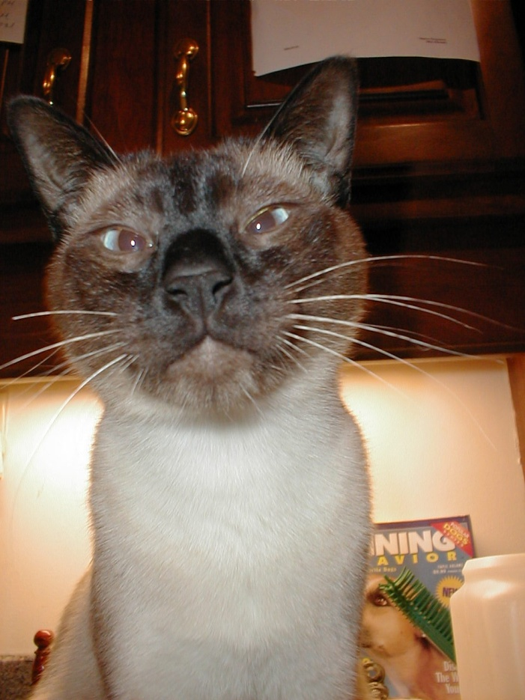
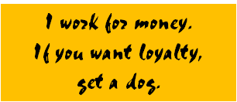
Reduced Loyalty
Little sense of long-term involvement
  High turnover in field
  Sense of being peons rather
  than collaborators
  Ties into sense of
  entitlement (see next slide)
Loyalty more towards peers
  IT professionals
  Non-criminal hackers
  Criminal hackers

Slide 23

Entitlement
Feeling of being special
Entitled to corresponding
  Recognition
  Privileges
  Exceptions
Fragile egos
  Easily offended
Prone to anger
  Enraged by failure to recognize them as special
  Seek revenge for slights

Slide 24

Lack of Empathy
Little or no regard for effects
of their actions on others
Incapable of recognizing
consequences of their actions
Overall, the entire set of
observations fit two related
personality disorders:
  Avoidant/schizoid
  Antisocial/narcissistic/paranoid

Slide 25
Stress and Attacks on Computer Systems
Course of insider computer crime shows gradual increase in severity of incidents
Starts with minor infraction
  Often overlooked
  Fear of upsetting valuable
  employee
  But intervention could prevent
  slide into further infractions
Moderate infraction is next
  Again, often not dealt with by management
  Should take appropriate action
    Suspension or termination of employment

Slide 26
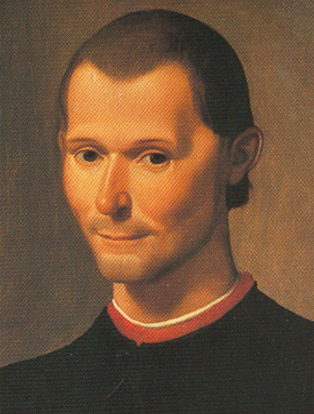
Typology of Computer Criminals
See CSH6 §13.6 for full detail;
only a few types discussed here.
Machiavellians
  Hack to advance careers
  Frame rivals or superiors to rise
  in status
  E.g., consultants who plant time
  bombs; one case where
  specialist caused problems in
  systems around world to get
  free travel to exotic locations
Proprietors
  Feel that they own the systems
  they work on
  Sequester information to maintain power
Niccolò Machiavelli
(1469-1527)
Image from Wikipedia

Slide 27
Conclusions & Implications
Use effective hiring practices
  See CSH6 Chapter 45 on “Employment Practices and Policies”
  Background checks
Effective monitoring &
detection systems
Provide online support
services as part of Employee
Assistance Program
Formal termination procedures
Include human factors in IT security audits

Slide 28
Now go and study

