Slide 1
Information Warfare
CSH6 Chapter 14
“Information Warfare”
Seymour Bosworth

Slide 2
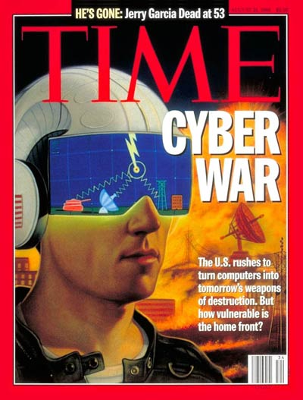
Topics
Introduction
Vulnerabilities
Goals and Objectives
Sources of Threats and Attacks
Weapons of Cyberwar
Defenses
CSH6 Chapter 14:
“Information Warfare”

Slide 3

Introduction
Definition*
  Offensive and defensive use
  of information & information
  systems
  To deny, exploit, corrupt or
  destroy
  An adversary’s information,
  information-based processes,
  information systems, and
  computer-based networks
  While protecting one’s own.
  Designed to achieve
  advantages over military or business adversaries.
Used with permission of
Robert Duffy, Avalon5.com
_____________
*Dr Ivan Goldberg, Institute for Advanced Study of Information Warfare

Slide 4
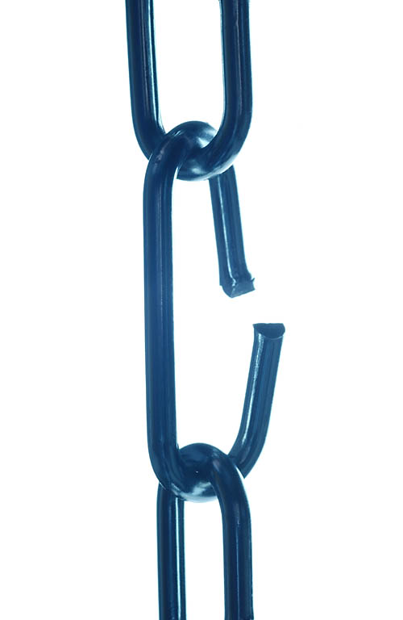
Vulnerabilities
Critical Infrastructure
COTS Software
Dissenting Views
Rebuttal

Slide 5

Critical Infrastructure
Presidential Decision Directive 63 (PDD-63)
  President Clinton (1998)
  http://www.fas.org/irp/offdocs/pdd-63.htm
  Defined US critical infrastructure includes
    Telecommunications
    Energy
    Banking and finance
    Transportation
    Water systems
    Emergency services
These systems are vulnerable to asymmetric warfare – effective attack by much weaker adversaries (e.g., Mafia Boy vs AMAZON & eBAY in 2000)

Slide 6
COTS Software
Military and civilian sectors both depend on COTS (commercial off-the-shelf ) software
  Microsoft OS has become
  monoculture
  Continues to be vulnerable to
  subversion
  Allows study and exploitation by
  adversaries
Some hardware being manufactured
in potentially hostile nations
  Much manufacturing in PRC
  Some claims of hardware Trojans (e.g., keyboard equipped with keylogger)

Slide 7
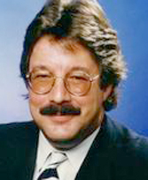
Dissenting Views
Some critics dismiss discussion of cyberwar as FUD
  Fear, Uncertainty and Doubt
  Designed to increase sales of hardware, software and consulting services
Personal attacks on early promulgators of information warfare doctrine
  Controversial figure: Winn Schwartau
  Author of novel Terminal Compromise
  Nonfiction Information Warfare and
  Cybershock texts
  Lampooned as wild-eyed
  self-publicist
  Actually a committed security expert

Slide 8
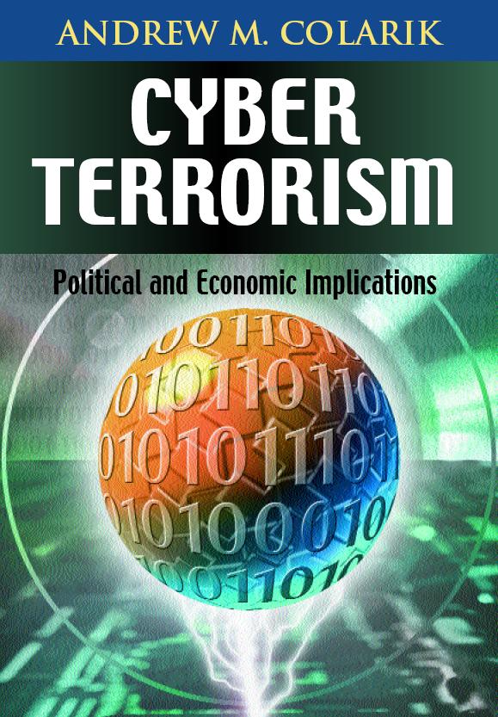
Rebuttal to FUD claims
Growing evidence of asymmetric use of information systems in conflicts
Industrial espionage from PRC
growing
Conflicts around world
demonstrate role of Internet as
tool and target
  India/Pakistan
  Bosnia
  Koreas
  Iranian unrest in June 2009 –
  role of Internet and Twitter crucial
Potential remains high – e.g., PSYOP using flash crowds to obstruct emergency personnel or create targets for terrorists

Slide 9
Goals and Objectives
Military
Government
Transportation
Commerce
Financial Disruptions
Medical Security
Law Enforcement
International &
Corporate Espionage
Communications
Economic Infrastructure

Slide 10

Military Perspective
US Joint Doctrine for Operations Security (OPSEC)
  Identifying critical information
  Analyzing friendly actions in military ops
  Identify which ops can be
  observed by adversaries
  Determine what adversaries
  could learn
  Select and apply measures
  to control vulnerabilities to
  minimize adversarial
  exploitation
Some discussion of potential offensive cyberoperations
  US Air Force established AF Cyber Operations Command to be stood up June 2009
  US Army established 2009 Army Posture Statement on Cyber Operations

Slide 11
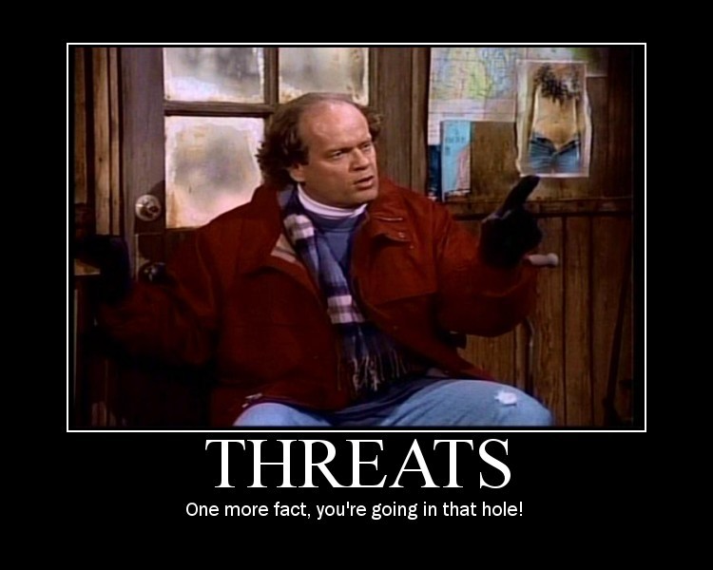
Sources of Threats and Attacks
Nation-States
Cyberterrorists
Corporations
Activists
Criminals
Hobbyists
Image © 2009 Beatrix Kiddoe. Used under terms of service of Photobucket.
http://media.photobucket.com/image/threats/BeatrixKiddoe/motivator639310.jpg?o=19

Slide 12

Nation-States: China
People’s Republic of China major actor
  People’s Liberation Army doctrine explicitly includes information warfare
  Widespread evidence of
  massive probes and attacks
  originating from China
  through state sponsorship
  Formal training for cadres
Other countries involved in information warfare
  ECHELON (SIGINT) organized by UK-USA Security Agreement (Australia, Canada, New Zealand, the United Kingdom, and the United States)

Slide 13
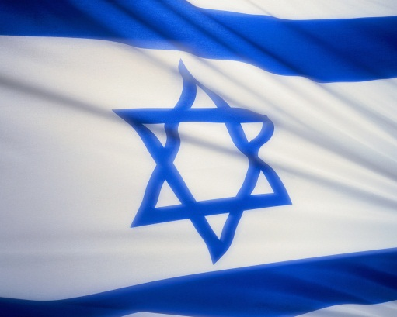
Nation-States: Stuxnet (2010)
Written to subvert SCADA for
Siemens centrifuge programmable
logic controllers (PLCs)
  Damaged Uranium-enrichment
  centrifuges in Iran
  Spun too fast – crashed physically
60% of Stuxnet infections were in Iran
Speculations that US & Israel
wrote Stuxnet Worm
  No direct proof
  Circumstantial evidence includes codes and dates that might be related to Israel
  Documents supporting view that US involved were released by Edward Snowden in July 2013

Slide 14

Cyberterrorists
Remains a theoretical possibility
Individual criminal-hacker /
hobbyist attacks raise concerns
  Documented interference
  (mostly pranks) with
    Ground traffic
    Emergency 911 systems
    Air-traffic control
    Hospital systems….
Pranksters have been spreading
false news via Twitter (deaths of
celebrities….)
Growing use of insecure wireless
systems raises additional concerns for PSYOP

Slide 15



Corporations (1)
Potential for sabotage against rivals
  Documented cases of interference using computers and networks
1999 – BUY.COM underpriced its $588
Hitachi monitors at $164 – perhaps
through effects of competing knowbots
2000 – Sun accused Microsoft of corrupting Java
to interfere with platform independence
2000 – Steptoe & Johnson employee accused of denial-of-service attack on Moore Publishing
2000 – AOL accused of interfering with other
ISPs by tampering with Internet settings

Slide 16
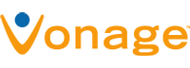
Corporations (2)
2005 – FCC investigated phone
company ISP interference with Vonage VoIP
2006 – Businessman selling t-shirts hired hacker to damage competitors using DDoS
  Infected 2000 PCs with slave programs in botnet
  Disabled Websites and online sales
  Jason Arabo (19 years old) sentenced to 30 months prison & $500K
  restitution
  Hacker (16 years old)
  sentenced to 5 years
  prison & $35K restitution

Slide 17
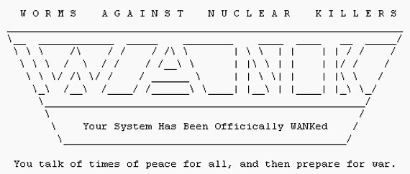

Hacktivists (1)
Hacktivists use criminal hacking in support of politics or ideology
1989: WANK (Worms
Against Nuclear
Killers)
  Infected DOE,
  HEPNET & NASA
  networks
  “You talk of times of peace for all, and then prepare for war.”
1998: Electronic Disturbance Theater
  Indigenous peoples’ rights in Chiapas, Mexico

Slide 18

Hacktivists (2)
1998: Free East Timor (Indonesian Web sites)
1998: Legions of the Underground declared cyberwar on Iraq and China
1999: Jam Echelon Day: traffic with many keywords thought to spark capture by spy network
2000: World Trade Organization
  Hackers probed Web sites
  700 times
  Tried to penetrate barriers
  54 times
  Electrohippies launched
  DoS attack

Slide 19


Hacktivists (3)
2004: Electronic Disturbance Theater launched DoS on conservative Web sites during Republican National Convention
2008: Project Chanology launched against Church of Scientology
2008: Chinese hackers attacked CNN Web sites to protest Western media bias
2009: much Web-defacement activity during attack by Israel on Gaza

Slide 20
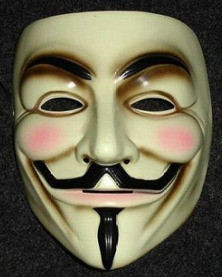
Hacktivists (4)
Anonymous (Anon)
  2003 – 4chan board
  No leaders
  Focus on defending Wikileaks in 2010-2011
  Attacked Church of Scientology
  QUESTION: doing good or not?
Guy Fawkes Mask

Slide 21
Criminals (1)
Stock manipulation: pump ‘n’ dump schemes
  NEI Webworld pump-and-dump (Nov 1999)
  2 UCLA grad students & associate bought almost all shares of bankrupt NEI Webworld company
  Using many different pseudonyms, posted >500 messages praising company
  Also pretended to be company interested in acquisition
  Within 1 day stock value increased from $0.13 to $15 per share
  Made ~$364K profit

Slide 22

Criminals (2)
Los Angeles gasoline-pump fraud (1998)
  New computer chips in gasoline pumps
    Cheated consumers
    Overstated amounts 7%-25%
  Complaints about buying more
  gasoline than capacity of fuel tank
    Difficult to prove initially
    Programmed chips to spot 5 & 10
    gallon tests by inspectors
    Delivered exactly right amount for
    them!
Organized crime (esp. Russian, Eastern
European) involved in identity theft
Methods and targets could be used in organized state-sponsored information warfare, especially if SCADA (supervisory control and data acquisition) systems targeted

Slide 23
Weapons of Cyberwar
Denial of Service
Malicious Code
Cryptography
PSYOP
Physical Attacks
Biological & Chemical WMD
Weapons Inadvertently Provided

Slide 24
Denial of Service
Attacks preventing systems from reaching normal levels of function or service
Terminology:
  DoS – denial of service
  DDoS – distributed denial of service
    Launching attacks from many sources
    Botnets – compromised computers under control of master computer program
Excellent example of asymmetric warfare
Simple example: pressing key on HP3000 computer console without ENTER → progressive hang due to saturation of system buffers
See CSH6 Chapter 18 for ample details

Slide 25
Malicious Code
Terminology:
  Viruses, worms, Trojan horses
    See CSH6 Chapter 16
  Mobile code such as Java, ActiveX, VBscript
    See CSH6 Chapter 17
Malware widespread
  In 1980s & 1990s used by individuals
  In 1990s & 2000s increasingly used by organized crime
  Significant evidence of state-run malware research and development

Slide 26
Cryptography
Cryptography used in military operations for millennia
Cracking ciphertext top priority for governments and criminals
  Parallel processing
  Ultra-high-speed computers (teraflops)
Debate about international traffic in strong cryptography
  International Traffic in Arms Regulation (ITAR) of US restricts export
  Critics regard ITAR application to cryptography as pointless

Slide 27
PSYOP (1)
Psychological operations = PSYOP
  Planned psychological activities
  Directed to enemy, friendly, neutral audiences
  To influence emotions, motives, attitudes, objective reasoning & behaviors
  In ways favorable to originator
Targets at all levels (individuals, groups, organizations, military, civilian)
Goals
  Reduce morale & combat efficiency among enemy
  Promote dissension & defection among enemy
  Support deception operations by friendlies
  Promote cooperation, unit, morale in friendlies

Slide 28
PSYOP (2)
Classic example of PSYOP: preparation for Normandy invasion
  Allies fabricated & planted leaks about supposed invasion at Pas de Calais
  Nazis believed that General George S. Patton was leading invasion
  Concentrated Nazi troops away from actual Normandy landing areas
Sep 11, 2001 WTC bombing & subsequent anthrax-spore scare illustrate effects similar to PSYOP – demoralization, economic consequences, changes in culture

Slide 29
Physical Attacks
Sep 11, 2001 attacks had noticeable effects on information infrastructure
Backhoe attacks facilitated by warning signs about where not to dig – indicate communications trunks
Undersea cables susceptible to sabotage
International prevalence of car bombings, suicide bombings & IEDs (improvised explosive devices) causing rethinking about weapons of cyberwar
Increased attempts to secure civilian infrastructure
But much of public policy described as security theater (after Bruce Schneier) by critics

Slide 30
Biological & Chemical WMD
Weapons of Mass Destruction (WMD)
  Direct effects can be devastating
  Fear (PSYOP) caused by such attacks a serious issue – causes damage through shutdown of critical infrastructure
Tokyo 1995
  Sarin nerve gas released in Tokyo subway system
  Killed at least 6 people, sickened 1000s
  Released by members of Aum Shinrikyo cult
Anthrax in US mail 2001
  Sent to offices of 2 US Senators, various media HQ in NY & FL
  Killed 5 people and infected more than dozen others

Slide 31
Weapons Inadvertently Provided
Vulnerabilities in software systems open nation to cyberwar
  Bad software design (see RISKS FORUM DIGEST)
  Poor software quality assurance
  Rush to market of incompletely tested software
See CSH6 Chapters
  38 Writing Secure Code
  39 Software Development & Quality Assurance
  40 Managing Software Patches & Vulnerabilities

Slide 32
Defenses
Legal Defenses
Forceful Defenses
Technical Defenses
In-Kind Counterattacks
  Problematic because of address spoofing
  Not certain where attacks originate
  Could attack wrong target
Cooperative Efforts

Slide 33
Legal Defenses
International legal system ineffective vs infowar
  Information warfare not prohibited under UN charter (except if it causes death or property damage)
  Little or no police power to enforce few laws that exist governing infowar
  Sovereignty trumps law in cross-border communications
  No major powers have pressed to international laws or treaties to govern infowar
  Politics may override legal judgement
  Power of criminals supersedes legal systems
  Identifying source of attacks difficult
  Technology advances faster than laws
Not likely to see legal defenses used against cyberattack

Slide 34
Forceful Defenses
Barriers to the use of force
  US increasingly reluctant to use force without international support
  Identity of attackers may be unclear
  Spoofing may lead to misidentification
  Difficult to characterize specific incident as cyberattack, error, accident, or malfunction
  Attackers may not be state actors – cannot launch war against criminals, activists, individuals
  UN doctrine limits reactions to proportional response
Thus unlikely to see forceful response to cyberattack

Slide 35
Technical Defenses
All the technical defenses used in protecting computers and networks against individual attack can be used in cyberdefense
Entire contents of CSH6 apply to cyberwarfare defense
Constant attention to evolving vulnerabilities and threats
Special value for INTEL and COINTEL activities
  Intelligence to track state and non-state actors; e.g., infiltration, monitoring Internet chatter
  Counterintelligence to identify spies and saboteurs

Slide 36
In-Kind Counterattacks
Problematic because of address spoofing
  Not certain where attacks originate
  Could attack wrong target
Recent incidents have been inconclusive
  Israelis vs Arabs
  Taiwan vs PRC
  Kashmir vs India
  Serbs vs Albanians
  PRC vs USA
Fundamental asymmetry of attacker/defender makes counterattacks in kind futile

Slide 37

Cooperative Efforts
Little evidence of international cooperation to fight cyberterrorism or limit cyberwarfare
Strong efforts by US military to increase cyberwarfare capabilities

Slide 38
DISCUSSION

