Slide 1
Penetrating Computer Systems & Networks
CSH6 Chapter 15
“Penetrating Computer Systems & Networks”
Chey Cobb, Stephen Cobb &
M. E. Kabay

Slide 2
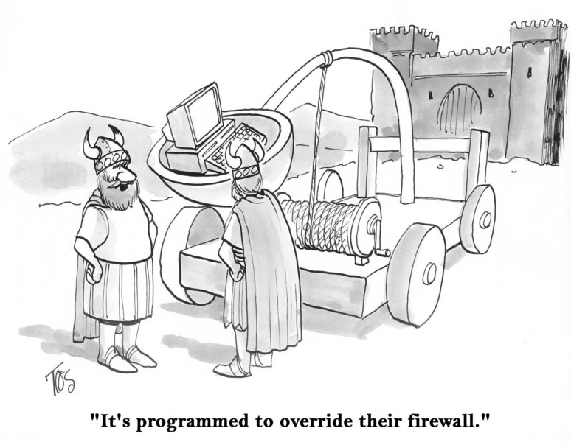
Topics
CSH6 Chapter 15
“Penetrating Computer Systems and Networks”
Multiple Factors in System Penetration
Nontechnical Penetration Techniques
Technical Penetration Techniques
Political and Legal Issues

Slide 3
Multiple Factors in
System Penetration
System security is much more than technical safeguards
Human behavior key weakness in all systems
  Social engineering attacks exploit normal human / social expectations
Organizational culture critically important
  Clear explanations of reasons behind policies support security rules
  Reward – not only punishment – helpful
  Consistent monitoring and enforcement required for effectiveness and legal protection
Technical safeguards must constantly evolve and adapt to changing threats

Slide 4
Nontechnical Penetration (1): Social Engineering
Lying
Impersonation
Intimidation
Subversion
Bribery
Seduction
Extortion
Blackmail
Insiders
Wide range of human targets
See CSH6 Chapter 19
Social Engineering & Low-Tech Attacks

Slide 5
Nontechnical Penetration (2):
Incremental Information Leveraging
Collecting information from wide range of sources
Potentially long time for collection
Piecing together aggregated
valuable information; e.g.,
internal jargon
Making inferences about
security implications
Applying information for penetration
E.g., Mitnick used internal bits and pieces to build personae for impersonation in social engineering

Slide 6
Technical Penetration Techniques
Data Leakage
Intercepting Communications
Breaching Access Controls
Spying
Penetration Testing, Toolkits
& Techniques
Basic Exploits
Penetration via Web Sites
Role of Malware and Botnets

Slide 7
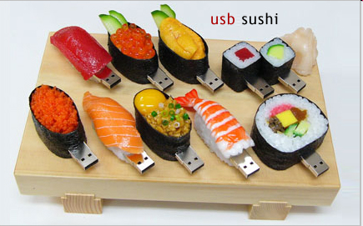
Data Leakage
Definition:
  Imperceptible transfer of data without authorization
  Concealed, hard-to-detect copying or transmission of confidential data using covert channels
  Alternative channels can be entirely independent of normal system (e.g., photography, human memory)
  Impossible to stop transfer of information from secure to non-secure region
  E.g., encrypted messaging, steganography
Data loss from lost / stolen
unencrypted portable devices
Copying to portable devices
(laptops, USB flash drives, CDs,
DVDs, iPods….)

Slide 8
Intercepting Communications
Transmission Media
Protocols
Applications

Slide 9
Transmission Media
Asynchronous links
Microwave
Leased lines
Fiber optics
Satellites
Emanations

Slide 10
Asynchronous Links
Easy to tap
  Twisted-pair accessible via alligator clips, splices
  Most cabling clearly labeled, identifiable
  Wiring closets, patch panels unlocked
Defenses
  Shielded cables
  Locked cabinets
  Encryption of data stream

Slide 11
Microwave
Predominant method for long-distance phone lines
  2/3 phone calls
  Line-of-sight: towers spaced every 25 miles
  Vulnerable to denial-of-service attacks (topple towers)
Footprint expands over distance
  Can intercept data, decode using standard equipment
  But volume of high-bandwidth lines makes specific taps difficult
Encryption the only protective mechanism

Slide 12
Leased Lines
Phone lines normally switched
Can fix circuit in place, improve quality
Used for critical, high-volume data communications
Increased vulnerability to tapping
Beware off-premises extension
  Easy to order extension
  without authorization
  Use phone services of victim
  without paying
  Check your phone bills for
  unauthorized extensions

Slide 13
Fiber Optics
High bandwidth
  Hard to make sense of enormous data flows
Expensive to tap
  But folding denuded cable allows part of light to be captured without breaking cable
  For high-security applications, use armored cable
Identify breaks, taps using time-domain reflectometry
  Light travels 0.3m/μsec
  Measure time to reflect from break, interference

Slide 14
Satellites
Geosynchronous satellites appear to hover over specific spot
Can tap into uplink, override
broadcast data
Can tap downlink
  50 mile diameter
  footprint
  Ordinary electronic
  gear
  But volume considerations
  make tapping difficult to use
Encryption is only defense

Slide 15

Emanations
Electronic equipment radiates carrier waves
Operations of CPU, display, keyboard, modems modulate the carrier
Can demodulate captured
emanations
  Demonstration using shortwave
  radio
  Tuned to 25m band (~12.4MHz)
Van Eck Freaking
  Reconstituting appearance of
  VDT
  Said to use $200 worth of simple
  electronic parts
TEMPEST US DoD standard for minimizing emanations
  Hardware (x cost by 10)
  Software (generates lots of noise)

Slide 16
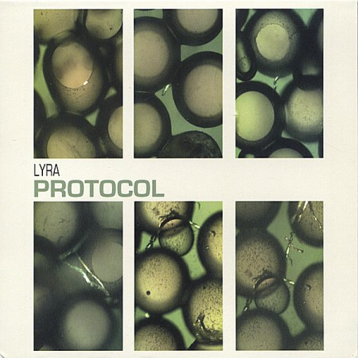
Protocols
Packet-switching networks
LANs
Wireless LANs
Spread-spectrum LANs

Slide 17
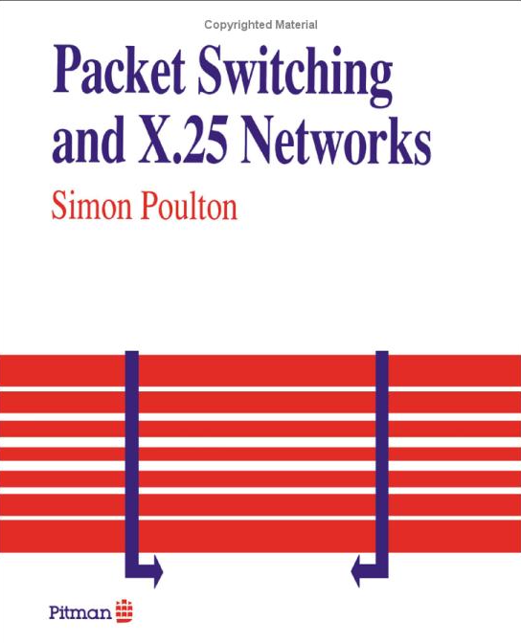
Packet-Switching Networks
Used in telephony, data communications
  X.25 (Tymnet, Telenet, Datapac)
  TCP/IP
Generically called datagram protocols
  Split messages into packets
    Headers of packets include origin,
    destination, sequence number
  Routers determine which path to use
  msec by msec
    Result of local traffic on outbound
    potential routes for packet
Interception possible but generally
useless except at end-points
  Huge volumes
  Only some of the packets of any given message likely to be captured

Slide 18
LANs
Also datagram protocols – use packets
  But architectures are generally rings, buses or stars – know where to look for data stream
Coaxial or twisted-pair cabling
  Easy to tap
  LAN I/F card (aka NIC = Network Interface Card) generally captures only those packets directed at it
Network monitors (aka sniffers) a major problem
  Do not generally announce their presence on network
  Software available to convert any NIC into promiscuous mode
    Can see any packet, not just those directed at particular NIC
Enable encryption as best defense
See CSH6 Chapter 25
Local Area Networks

Slide 19
Wireless LANs
All the vulnerabilities of wired LANs
Plus emanations, eavesdropping
Must configure mandatory encryption
On related topics
  Be careful not to use pagers as if they are secure: they aren’t
  Cellular phone calls are not secure
  Even GSM (European cell phone standard) encryption cracked quickly
See CSH6 Chapter 33
Wireless LAN Security

Slide 20
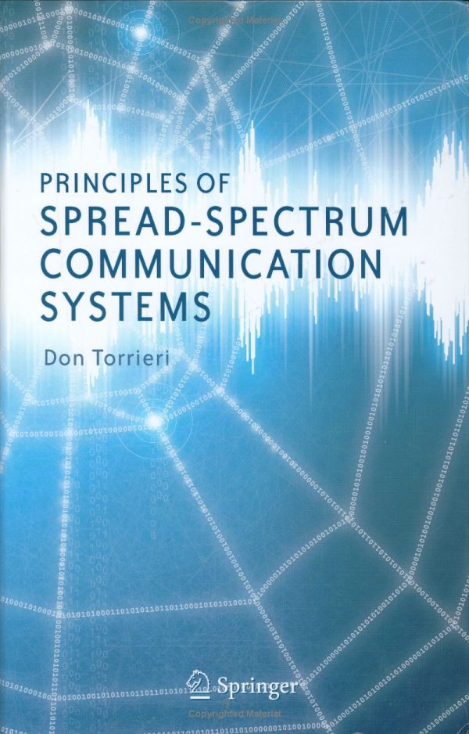

Spread-Spectrum LANs
Use electrical system as wiring network
Split data over many randomly-changed frequencies
Extremely difficult to tap
Beware unauthorized nodes
Invented by actress Hedy Lamarr in 1940 & composer George Antheil

Slide 21
Applications
Toll fraud
Voice mail
E-mail
Internet
Intranet
Extranet
Firewalls
Intrusion Detection

Slide 22
Toll Fraud
Severe problem for businesses
Use CDAR (Call Detail Accounting Reporting) to stop internal fraud
Thriving black market in telephone access codes
    Some poor neighborhoods have had phone booths removed
    Lines of people waiting to use stolen access codes for cheap overseas calls

Slide 23
Toll Fraud (cont’d)
Must train staff
  PBX managers must disable
  DISA
    Direct Inward Services
    Access
    Allows access to long-
    distance, external lines
  Protect PBXs with same
  security as mainframes,
  servers
  Receptionists, secretaries,
  employees: Do not allow access
  to outside line by strangers

Slide 24
Voice mail
Easy target
  Canonical passwords on voice-mailboxes
  Former employees use old passwords
  Sensitive information
Attacks have included
  Espionage
  sabotage

Slide 25
E-mail
Primary problem is concept of privacy
Generally e-mail is difficult
to intercept in transit
Loss of control over
published information
Damage to organization’s
reputation
Waste of time if
uncontrolled

Slide 26
Internet
Most important communications component for most organizations today
  Intranet: TCP/IP network for
  internal use
  Extranet: TCP/IP network
  for clients or partners
Highly vulnerable
  IPv4 has no packet
  authentication – therefore
  spoofing easy
  Many weaknesses in software

Slide 27
Penetration Tools
Almost all successful attacks exploit known vulnerabilities
  Most vulnerabilities
  used have been known
  for years
Port & vulnerability
scanners
Buffer overflow exploits
very common
War dialers used to be
important to locate modem lines
Brute-force password crackers useful if system allows access to password file for offline testing
Rainbow tables store precalculated encrypted values for testing against password files

Slide 28
Firewalls
Key component of today’s security architecture
Devices that filter inbound and outbound packets
Apply rules reflecting policy
Useless to install firewall without policy – generally pass-through
See CSH6 Chapter 26
Gateway Security Devices

Slide 29
Intrusion Detection
No security perimeter should be expected to reach perfection
Must be able to spot
intrusions quickly
Essential component of
effective security
Allows measured, planned
response
  Stop or monitor, collect
  evidence
  Valuable in forensic work

Slide 30
Breaching Access Controls
Brute-force attacks
Demon (war) dialing
Exhaustive search
Keyspace issues
Login speed
Scavenging RAM
Scavenging swap & cache files
Dictionary-based guessing
Stealing
Scavenging (including discarded media)

Slide 31
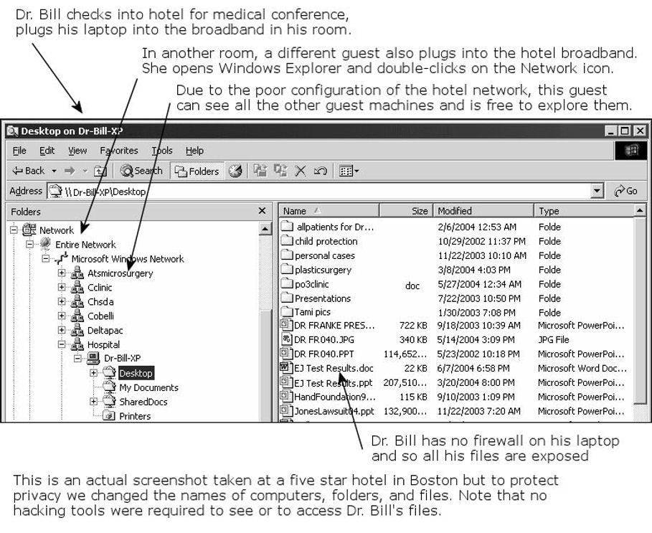
Spying
Laser interferometry (bouncing lasers off windows)
Shoulder surfing
War-driving
Keyloggers
Exploiting insecure public networks (e.g., hotels) – see Fig 15.2
CSH6 Figure 15.2
Poorly configured hotel room Internet connectivity

Slide 32
Penetration Testing,
Toolkits & Techniques
System administrators and security experts commonly use vulnerability analysis and automated penetration tools to test system security
  So do criminal hackers
Scanners serve several functions
  Laying out network architecture
  Determining which protocols are
  in use
  Mapping firewall rule sets
  Determining which operating systems are in use

Slide 33

Basic Exploits (1)
Buffer Overflow
  Most common exploit of
  poor coding
  Insert data beyond
  expected end of input
  Interpret extra data as
  instructions
Password Cracking
  Steal encrypted password file
  Run crack program on other computer
  Or try rainbow tables of predetermined passwords vs one-way encrypted codes
Image from http://bildbevis.se/images/20060112000555_overflow.jpg used with kind permission of author

Slide 34
Basic Exploits (2)
Rootkits
  Once system has been cracked, apply rootkit
  Ensures that criminal can
  re-enter system at will
  Installs a backdoor
  Hides itself from discovery
  (invisible, wipes log records….)
Trojan Code: often part of rootkits
Back Doors: beware utilities that have
been converted to Trojans with back doors

Slide 35
Penetration via Web Sites
Many Web sites are interactive:
receive user input such as name,
e-mail address etc.
Attackers enter long or random inputs (“fuzzing”) to see what happens
Can cause buffer overflows and improper actions by Web server (“executing arbitrary code”)
Use of special characters in input strings (.., /, \, metacharacters)
Server-side includes – special commands interpreted by Web server – including exec for execution of code
See CSH6 Chapter 21
Web-Based Vulnerabilities

Slide 36
Role of Malware and Botnets
Viruses and worms may communicate confidential data to external Internet addresses
Bots are malware that wait for
instructions from controllers
Botnets are collections of infected
computers
Botmasters can tell thousands of
infected computers to launch
attacks (especially DDoS)
Google research suggests that
10% of all Web pages are
infected with malware that can
infect target computer upon
viewing

Slide 37

Political and Legal Issues
Exchange of system penetration information
  Should such information
  be exchanged or not?
  InfraGard is specific
  organization with FBI
  vetting of members to
  facilitate information
  sharing
Full disclosure
  How should vulnerability
  information be disclosed?
  Should it be sent to manufacturer only?
  Or posted in public to pressure / shame firms?

Slide 38
Now go and study

