Slide 1
Malicious Code
CSH6 Chapter 16
“Malicious Code”
Robert Guess & Eric Salveggio

Slide 2
Topics
Introduction
Malicious Code Threat Model
Survey of Malicious Code
Prevention of Malicious Code Attacks
CSH6 Chapter 16: “Malicious Code”

Slide 3
Introduction
Malicious code / logic
  Malware
  Hardware, software or firmware
  intentionally included or inserted
  in system for unauthorized purpose
Classification may be difficult
  Categories overlap because malware may have multiple functions and attributes
    E.g., virus / worm / Trojan horse / spyware
Some code may not be intended as malware by creators
  Context and intent determine whether code is viewed as malicious

Slide 4
Malicious-Code Threat Model (1)
ACCESS
ACTION
ACTOR
ASSET
OUTCOME
Actor: structured or unstructured threats
  Individuals, organizations, nation-states
Access: allowed physical or logical path
Asset: resource of interest
Action: execution of malicious code or logic
Outcome
  Intelligence, surveillance, reconnaissance
  Disruption of operations
  Destruction of assets
  Publicity for cause
  Negative publicity against victim

Slide 5
Malicious Code Threat Model (2)
Self-replicating Code
Actors: Origin of Malicious Code Threats
Actors: Structured Threats
Actors: Unstructured Threats
Access vs Action: Vector vs Payload

Slide 6
Self-replicating Code
Not inherently malicious
Early experiments (1960s) had no evil intent
  Darwin (1961) involved memory worms
  Self-replicating code
  Competition → resource exhaustion

Slide 7
Is a Beneficial Virus Possible?
Ideas for beneficial self-propagating code:
  Distribute antivirus programs automatically through Internet
  Install patches on servers in networks
  Distribute useful information automatically
Consensus on Problems Preventing Use:
  What if there’s a bug or incompatibility in the self-propagating code?
  What if the patches are not
  appropriate for a specific
  server or network?
  What if the owner/user does
  not see the patch as useful?

Slide 8
Is Writing Malware Illegal in US?
No explicit law against writing malicious code
No illegality even in sharing such code among willing recipients
Current efforts to define statutes
  Based on laws banning
  possession of burglary tools
  (e.g., lock picks)
  Require registration and
  licensing of locksmiths
  Would treat malware and Trojans in same way
  No significant progress to date

Slide 9
Actors: Origin of
Malicious Code Threats
Structured threats
  Nation-states
  Corporate criminals
  Organized crime
Unstructured threats
  Rogue actors; e.g.,
    Individuals
    Script kiddies

Slide 10
Actors: Structured Threats
Well-funded, systematic
Industrial espionage, information operations, large-scale fraud & theft
Organized crime responsible for 90% malware
  Extortionists target online gambling
  Pump ‘n’ dump schemes cost $B
  Industrial espionage using spyware growing
China major player
  Major source of attacks
  PRC PLA doctrine emphasizes
  asymmetric warfare using
  information technology
  Total government control over hacking

Slide 11
Actors: Unstructured Threats
Random
Relatively limited
Does not target national
security
Relatively minor

Slide 12
Access vs Action:
Vector vs Payload
Vector
  Agent is avenue of access
  Physical access via people who can enter premises
  Network access via Web server, client systems, e-mail attachment, portable device (e.g., infected USB flash drive)
Payload
  Function (action) inserted in system
  Malicious logic, remote access software, remote control software

Slide 13
Survey of Malicious Code
Viruses
Worms
Trojans
Spyware & Adware
Rootkits
Bots & Botnets
Malicious Mobile Code

Slide 14
Virus Mechanisms
Boot sector: sector 0 of disk
File infector: inserts JUMP instruction, adds code, returns to original location and continues loading
Macro virus: exploits weakness of MS scripting language in Word,
PowerPoint, Excel, Access
etc.

Slide 15
Viruses (1)
Boot sector

Slide 16
Viruses (2)
Program infectors

Slide 17
Viruses (3)
Macro

Slide 18
1995-1996: Early Macro Viruses
MS-Word macro virus (concept) released Aug 95
  MS-Word macro viruses reached more than half all infections in the wild by 2009
About 1000 types of macro viruses of all types known to date (Sep 2013)
MS-Excel virus discovered June 96
  Anti-virus available within days
  Spreading more slowly than Word macro viruses because of lower rate of exchange of spreadsheets
Notes:
For a detailed discussion of Word Macro viruses see
http://www.drsolomon.com/vircen/Macrovir.html
The following text is from that document (with permission of Dr Solomon’s):
XM.Laroux
Description XM.Laroux (a Microsoft for Excel macro virus) is the first macro virus for Microsoft Excel which actually works.
So far (July 1996) there have been only two reported cases of the virus, on different continents (one in Africa, another in Alaska). This virus is not currently considered to be widespread.
The virus intercepts Excel's Auto_Open automacro. When an infected spreadsheet is opened, the virus activates and checks whether the system is already infected. If not, the virus creates an Excel file named PERSONAL.XLS in the Excel default startup directory, XLSTART (for example, C:\MSOFFICE\EXCEL\XLSTART) and copies itself there. The spreadsheets and macros from that directory are automatically loaded whenever Excel is run. From then on, every spreadsheet being opened, or created, on an infected system will become infected with the virus.
XM.Laroux does not have any intentional payload; it just replicates. The virus works under Excel for Windows, versions 5 and 7; running under Windows 3.x, Windows 95 and Windows NT. It does not work on Macintosh. . . .

Slide 19
1999-03: Melissa Virus
Friday 26 March: CERT-CC initial reports of fast-spreading new MS-Word macro virus
Melissa written to infect Word documents
Uses victim's MAPI-standard e-mail address book
Sends copies of itself to first 50 people on list
E-mail message w/ subject line "Important Message From <name>”
Spread faster than any previous virus
Followed by similar e-mail-enabled viruses
Notes:
——-BEGIN PGP SIGNED MESSAGE——-
CERT Advisory CA-99-04-Melissa-Macro-Virus
Original issue date: Saturday March 27 1999
Last Revised: Saturday March 27, 1999
Systems Affected
* Machines with Microsoft Word 97 or Word 2000
* Any mail handling system could experience performance problems or
a denial of service as a result of the propagation of this macro
virus.
Overview
At approximately 2:00 PM GMT-5 on Friday March 26 1999 we began
receiving reports of a Microsoft Word 97 and Word 2000 macro virus
which is propagating via email attachments. The number and variety of
reports we have received indicate that this is a widespread attack
affecting a variety of sites.
Our analysis of this macro virus indicates that human action (in the
form of a user opening an infected Word document) is required for this
virus to propagate. It is possible that under some mailer
configurations, a user might automatically open an infected document
received in the form of an email attachment. This macro virus is not
known to exploit any new vulnerabilities. While the primary transport
mechanism of this virus is via email, any way of transferring files
can also propagate the virus.
Anti-virus software vendors have called this macro virus the Melissa
macro or W97M_Melissa virus.
(See original document for remainder)

Slide 20
Viruses (4)
Logic Bombs
  Any malicious code,
  replicating or not, that
  delivers a payload as a result of a logic test (e.g., specific date, absence of employee record)
  Time bombs (set off on a date or category of date) are a subset of logic bombs
Cross-site scripting malware
  Exploit flaws in Web application servers & client code
  In 2005, “Samy” created script that generated >1M “friends” on MySpace using flaw in Internet Explorer to use JavaScript insertion exploit
  Sentenced to 3 years probation, 90 days community service

Slide 21
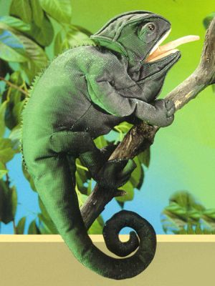
Viruses (5)
Polymorphic viruses
  Intended to defeat signature-
  based antivirus tools
  Modify themselves at time of
  replication
Polymorphic Engine
  Encrypts code
  Includes self-decryption
  capability
  Dark Avenger wrote MtE (aka
  Mutation Engine) in late 1980s
    Programmer from Sofia, Bulgaria
    Detested Vesselin Bontchev, famous AV expert
    Also attacked researcher Sarah Gordon by name

Slide 22
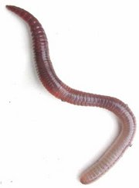
Viruses vs Worms
Viruses integrate into host code
  Replicate upon execution of infected code
Worms are free-standing code
  Replicate via networks
  E-mail (e.g., Outlook) especially
  common vector
Some worms have viral properties
  Integrate themselves into e-mail
  messages and convert them to
  executable files
  Frequently conceal executable file type
  Depend on default suppression of file suffix (e.g., AnnaKournikova.jpg.vbs.txt)

Slide 23
1987: IBM Christmas Tree Worm
E-mail sent via IBM internal e-mail network
Included program to draw ASCII Christmas tree on screen
Used recipient’s e-mail address book to
mail itself to everyone on the network
No mechanism to prevent
superinfection
Overloaded worldwide IBM networks
Messages escaped from IBM into
BITNET

Slide 24


1988: The Morris Worm
Robert T. Morris
(not a “Robert T. Morris, Jr”!)
  Cornell University grad student
  Son of famed NSA cryptographer
  Robert H. Morris
  Wrote paper on sendmail and fingerd vulnerabilities on UNIX systems
  Seems to have intended to
  demonstrate significance
Released a defective version of his demo worm
  Originally intended to replicate slowly, avoid superinfection
  In fact grew fast and superinfected systems worldwide

Slide 25
Morris Worm (cont’d)
Launched Worm at 17:00 on 2 November 1988
By 06:00 next morning the Internet was effectively down
  ~6,000-9,000 systems crashed or taken offline
Computer scientists worked feverishly all night analyzing the Worm
  Distributed fixes by telephone and fax (no ‘Net)
  Led to formation of CERT-CC® in Dec 1988
Morris convicted of violating 1986 Computer Fraud and Abuse Act (18 USC §1030)
  400 hours community service + $10K fine

Slide 26
1999-12 W.95.Babylonia Virus/Worm
Extensible virus
Payload modified remotely
Trojan virus-dropper
  Disguised as Y2K bug fix for internet relay chat (IRC) users
Sent itself other users
Polled Internet site in Japan
  Looked for updated plugins
Notes:
Computer Associates Warns of New Class of Extensible Computer Virus: Disguised as a Y2K Bug Fix, W95.Babylonia First Worm Virus Controlled by Virus Writer
ISLANDIA, N.Y., Dec. 7 /PRNewswire/ — Computer Associates International, Inc. (NYSE: CA) today warned of a new virus called "W95.Babylonia" (Babylonia), the first extensible worm computer virus of its kind. This new worm has been confirmed as being "in the wild."
An extensible virus lets the author remotely update the virus's payload at anytime in the future. Babylonia is currently disguised as a Y2K Bug fix for Internet Relay Chat (MIRC) users — one of the largest and most well-known online Internet chat communities in the world. Babylonia automatically sends itself to MIRC users and begins polling a hacker's Internet web site in Japan every 60 seconds looking for new "plug-ins." Some potential damaging plug-ins that the virus author could send remotely are formatting or deleting a user's hard drive, collecting and sending sensitive credit card information, or installing a Y2K specific attack.
There are currently four "plug-ins" that the virus downloads. Each plug-in can be changed by the author at anytime, creating a very dangerous scenario in which the damage and/or information collected by the virus author could change daily. This is the first time a virus has the capability of altering its instructions from the virus author remotely and on demand.
This virus infects Windows platforms and can be spread by executing a downloaded file or by another infected machine via MIRC. Once a user's machine is infected, Babylonia will attempt to infect every executable and help file in the users Windows environment.
Users can protect their information immediately by downloading the latest signature file of InoculateIT, CA's premier antivirus solution, at http://www.cai.com. CA also offers a free virus solution for home users online at http://www.antivirus.cai.com.
"This virus represents a new level of virus capability," said Simon Perry, business manager for CA Security Solutions. "It is particularly dangerous due to the virus writer's ability to change the virus's payload remotely and after infection. CA is recommending that both business and home users update their antivirus software immediately."
"CA's anti-virus teams are on high alert as we approach the new millennium, identifying new viruses and providing protection for our clients proactively," added Perry. . . .

Slide 27

2000-05: ILOVEYOU
Worm
E-mail subject ILOVEYOU
E-mail attachment
LOVE-LETTER-FOR-YOU.TEXT.vbs
Used all addresses in address book
Became #1 infectious code in Europe, Asia, USA
Variants appeared quickly
Created by 27-yr-old Filipino computer student Onel de Guzman
  No local laws against spreading viruses
  Creator given job as programmer! ☹
Notes:
NewsScan:
[The I LOVE YOU computer worm struck computers all over the world, starting in Asia, then Europe. The malicious software spread as an e-mail attachment, sending itself to all the recipients in standard e-mail address books.] Within days, there . . .[were] new variations of the destructive software program popularly known as the Love Bug because it's sent as an attachment with the words "I love you" in the subject line. In one variation, the subject line purports that the message you're receiving contains a joke, and in another you're told that the message is a confirmation notice for a Mother's Day gift order. To avoid being affected by the bug, do NOT open attachments to suspicious e-mail messages. (ZDNet 5 May 2000)
[On 11 May,] Filipino computer science student Onel de Guzman of AMA Computer College in Manila . . . told authorities that he may accidentally have launched the destructive "Love Bug" virus out of "youthful exuberance." However, he would not admit that he had himself created it, saying in Tagalog: "It is one of the questions we would rather leave for the future." The name GRAMMERSoft, a computer group to which the 23-year-old man belongs, appears in the computer code of the virus, and reporters have learned that de Guzman's thesis project was rejected by AMA officials because it described a way of illegally obtaining passwords from other computer users. But investigators have not charged either de Guzman or his friend Michael Buen of any crime, nor identified them as suspects. Asked what he felt about the massive amount of damage caused around the world by the virus, de Guzman's reply was: "Nothing." (AP/San Jose Mercury News 11 May 2000)

Slide 28
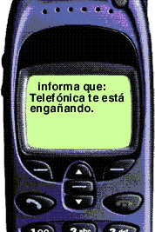
2000-06: Timofonica Worm
E-mail enabled malware
Automatically sent pager message to block of Telefonica cell phones
Tried to delete all data on hard disk
Notes:
NewsScan:
The first-ever computer . . . [worm] targeting cell phones is causing anxiety in Spain, where about 100 infections have been reported so far. The "I-Worm.Timofonica" virus works in much the same way as the ILOVEYOU . . . [worm] that wreaked havoc on computer systems last month -- it arrives as an e-mail attachment that, when opened, sends a copy of itself to everyone in the victim's Microsoft Outlook address book. For each one of those messages, it generates a random cell phone number from a block of numbers known to be used by Spanish telecom carrier Telefonica. A short message is then sent to each mobile phone, castigating Telefonica for alleged monopolistic tendencies and questionable corporate practices. As a final insult, it also attempts to delete all files on the victim's hard drive and performs several other operations that makes restoration difficult. "Two or three viruses down the road we might see these things taking out phones," warns one security specialist. (MSNBC 6 Jun 2000)
<http://www.msnbc.com/news/417066.asp>

Slide 29
2001-03: SirCam Worm
Propagated on Windows systems
Used standard e-mail address books
Infected document, converts to executable
  Most naïve users turn off suffix display
  So myfile.doc.exe looks like myfile.doc
Created e-mail message with random subject and randomized text asking for comment
Sent infected file to everyone on e-mail list
Documents may contain confidential info
See
http://www.cert.org/advisories/CA-2001-22.html

Slide 30
2001-06: CodeRed Worm
Infected vulnerable Web servers
  Windows NT or Windows 2000 or CISCO equipment
  running MS-IIS software that has not been patched
Showed message on Web home page:
HELLO! Welcome to http://www.worm.com! Hacked By Chinese!
Sent copies of itself to computers in list of IP addresses
On 20th through 28th of month, tried to swamp specific target with DoS (denial-of-service) attack
  Original worm attacked numerical address of White House
  Later versions received instructions from remote master computer program controlled by criminal hacker
See
http://www.cert.org/advisories/CA-2001-19.html

Slide 31
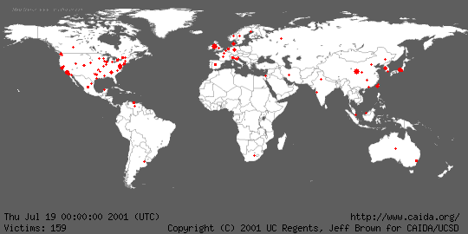
Spread of the CodeRed Worm

Slide 32
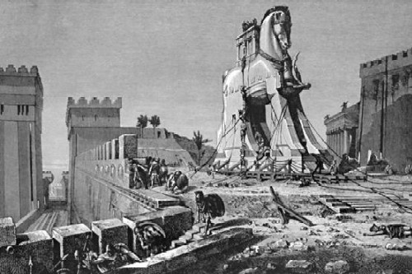
Trojans
Named for the Trojan Horse in
the Iliad
Overt function useful or
harmless
Covert function unauthorized,
usually harmful
Functionality may be associated
with all types of malware
  Worms
  Standalone programs
Early Trojans included PC-Cyborg (“AIDS Information Disk”) of 1989
  Replaced autoexec.bat to count boots
  On 90th boot, encrypted file/directory names
  Author, Dr Joseph Popp arrested, extradited to US from UK, but never convicted due to mental incompetence

Slide 33
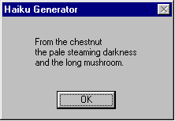
2000-01: Haiku Worm
(Trojan)
F-Secure (formerly Data
Fellows)
E-mail enabled virus/worm
Carrier: detailed e-mail
message about Haiku
generator
  Actually works — Haiku in Windows box
Worm code spreads through victim's e-mail address list
Occasionally downloads and plays a .wav file from a Web site
Notes:
< http://www.f-secure.com/v-descs/haiku.htm >
F-Secure Virus Information Pages
NAME: Haiku
ALIAS: I-Worm.Haiku, W95.Haiku.16384.worm
The Haiku worm usually arrives as a HAIKU.EXE file attached to an e-mail message. The message looks like it was forwarded from the original recipient with the subject 'Fw: Compose your own haikus'. The message body advertises the attached file as a Haiku (oriental poetry style) generator which it actually is. But along with Haiku generation routine the file contains worm code.
. . . .
When the worm is run it first installs itself as HAIKUG.EXE into root Windows directory and modifies WIN.INI to be run during all further Windows sessions. After that the worm displays a message box with a randomly generated Haiku:
. . . .
After system restart the worm gets control, checks if Internet connection is available and starts to look for e-mail addresses by scanning DOC, EML, HTM, HTML, RTF and TXT files. After the suitable e-mail address is found, the worm decrypts its internal message text, connects to a remote SMTP server that allows sending anonymous e-mail and sends its body MIME-encoded with the decrypted message to a found e-mail address. Then the worm displays its copyright message box. . . .
From time to time the worm connects to a free web hosting provider Xoom and gets a WAV file from one of user accounts. The worm writes the downloaded file as C:\HAIKU.WAV, plays it and deletes it afterwards. The WAV file has a copyright string of Sandman. . . .

Slide 34
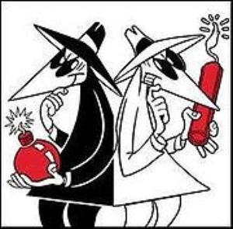
Spyware & Adware
Software that collects user information without permission
  Tracking & reporting Web usage
  Monitoring use of licensed programs
  Monitoring or blocking copying of
  music
  Click-fraud (automatically clicks on
  ads for profit)
Spyware serving unwanted ads = adware
Legal issue is EULA (end-user license agreement)
  If no clear statement of functions, spyware/adware may be violation of 18 US1030(a) (Computer Fraud & Abuse Act of 1986)
  If EULA is clear and user agrees, matter of contract law
  But many users never read EULA at all…
Some spyware/adware difficult to uninstall (hides itself)

Slide 35
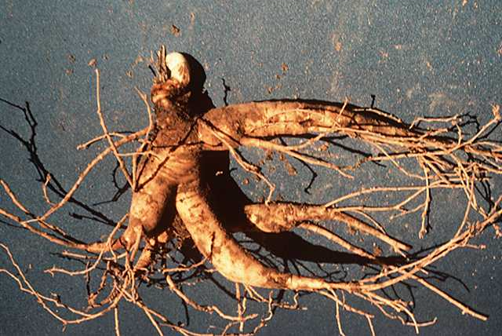
Rootkits
Program that allows covert access after installation
  Compromise application, library, kernel, hypervisor & hardware levels
  Early versions replaced Unix components
  Kernel-level rootkits run as device drivers
Classic examples: BO & BO2K
  Back Orifice by Sir Dystic of Cult of the Dead Cow (cDc) presented at DEF CON 6 in 1998
  Back Orifice 2000 by Dildog of cDc presented at DEF CON 7 in 1999
  Both provide “remote systems administration”
  Both used by Trojan droppers
  BO2K hides itself from discovery

Slide 36

Bots & Botnets (1)
Bots
  Automated processes on the
  Internet & WWW
  Carry out specific tasks;
  e.g.,
    Web spidering: collecting
    files from Web (e.g., GOOGLE engine bots)
    Monitoring conversations on talk channels (e.g., for suppression of profanity or automated responses to questions)
IRC Bots
  Internet Relay Chat used for communications
  IRC bots widespread for criminal activity
Bot Herders control 100K bots for commercial (criminal) activity such as DDoS, spam

Slide 37
Bots & Botnets (2)
Nov 15, 2012
Grum: 18 billion spam messages per day
Lethic: 28% of all spam in 2012
Festi: infected 250,000 unique IP addresses
Cutwail: DDoS attacks vs 100s Websites
Zeus: 944 Zeus command and control (C&C) servers – botnets steal banking info
SpyEye: steal consumer banking data (~278 SpyEye C&C servers in use
Citadel: “…social network allowing users to report bugs and even suggest new features. 2012 has seen a 20 % increase in Citadel Trojan attacks”
Morgan, C. “The Worst Botnets of 2012.” Storagecraft (2012-11-15).
http://www.storagecraft.com/blog/the-worst-botnets-of-2012/

Slide 38
Bots & Botnets (3)
ZeroAccess: fastest growing botnet: 2M nodes – ad-click fraud
TDL-4: “…removes competing malware, hides from detection and installs a master boot record. The newest variant of TDL-4 has infected approximately 250,000 unique victims.”
Flashback: 100k Mac computers infected –collects passwords (e.g., Google, Paypal) … infected 10 percent of home networks with Mac computers by Apr 2012
Morgan, C. “The Worst Botnets of 2012.” Storagecraft (2012-11-15).
http://www.storagecraft.com/blog/the-worst-botnets-of-2012/

Slide 39
Malicious Mobile Code
Web servers host pages with active content
Mobile code may be written in (e.g.)
  ActiveX controls
  Java applets
  JavaScript
  Adobe Flash
Often involved in phishing
attacks
See CSH6 Chapter 17, Mobile Code.

Slide 40
Detection of Malicious Code
Signature-Based
Network-Based
Behavioral
Heuristic

Slide 41
Signature-Based Malware Detection
Oldest method of recognizing malware
  Identify known strings of code/text
  Defeated by polymorphism
Hashes
  Compute cryptographic hash of all executables on system; e.g.,
    MD5
    SHA-1
    Digital signature using public key cryptosystem
  Identify unauthorized changes (caused by malware) by checking table of hash values

Slide 42
Network-Based Malware Detection
Look for effects of running malware; e.g.,
  Connection to unusual / characteristic server (like IRC)
  Unusual protocols (not normal
  for system)
  Peculiar packets (nor normal for
  protocol)
Can establish baseline for behavior
  Monitor KNOWN-CLEAN system
    Critically important not to include malicious code in baseline
  Compare observed behavior with baseline
  Look for outliers & investigate deviations

Slide 43
Behavioral Malware Detection
Monitor behavior of code
  Look for violations of security standards; e.g.,
  Attempting to modify areas of memory outside local stack of process
  Attempting to raise privilege level
Sandboxes
  Run code in restricted environment
  E.g., Java sandbox
Virtual machines a form of sandbox
  Increasingly popular

Slide 44
Heuristic Malware Detection
Heuristic in this context means able to change / learn
Apply statistical modeling & theoretical behavioral models
  Computer score / metric to
  evaluate likelihood that
  program is legitimate
  Can detect new variations of
  malware
    Even if signature not yet registered by conventional scanners
Modern antimalware products include option for heuristic scanning
  Should enable it!

Slide 45
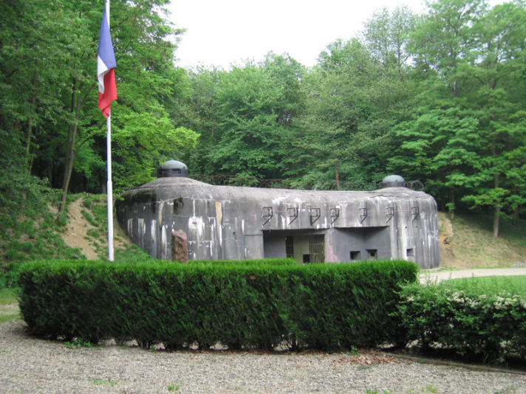
Prevention of Malicious Code Attacks
Defense in Depth vs Malware
Operational Controls
vs Malware
Human Controls vs
Malware
Technical Controls vs
Malware

Slide 46

Defense in Depth vs Malware
No one AV program can protect against all malware
Defense in depth uses multiple concurrent strategies
  Operational controls
  Human controls
  Technical controls
Different approach is to define orthogonal systems
  Function in only one demonstrably correct way
  But no one wants single-purpose, rigid systems

Slide 47
Operational Controls vs Malware
Written policies and procedures
  Govern introduction of programs into production environment
  Who can install programs?
  Acceptable use policies for Internet and e-mail use (CSH6 Chapter 48, “E-mail and Internet Use Policies”)
  How to respond to suspected attack
  See CSH6 Chapter 47, “Operations Security & Production Controls”
Employment policies & procedures
  CSH6 Chapter 45, “Employment Practices & Policies”

Slide 48

Human Controls vs Malware
Provide training on malware policies & procedures
Topics
  Current threats; e.g.,
    Advance-fee fraud (Nigerian 419 fraud)
    Social engineering (see CSH6 Chapter 29, “Social Engineering & Low-Tech Attacks”)
    Malicious attachments
  Detecting the threats – not
  ignoring AV popups!
  Proper response
    Contact Help Desk at once

Slide 49
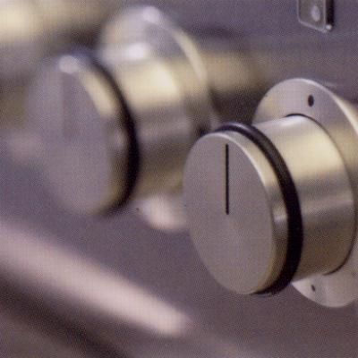
Technical Controls vs Malware
Implementing Antivirus Systems
Host Configuration Controls & Security
Network-Based Security Controls
Network Monitoring
See CSH6
Chapter 41, “Antivirus Technology”

Slide 50

Implementing Antivirus Systems
Use both network-based & host-based systems
Choose products from different vendors to run concurrently
Run updates automatically on all systems daily at least
E-mail may require
separate appliance/
system to control
malware attachments,
spam, fraud, phishing….

Slide 51
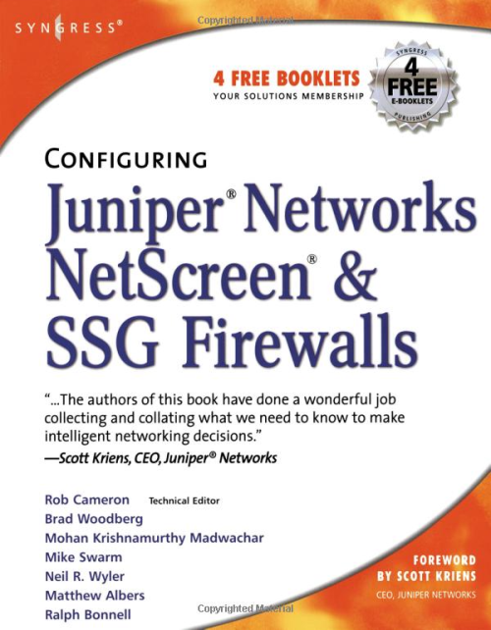
Host Configuration
Controls & Security
Automatic updates / patches essential
Eliminate non-critical software & services
  Minimize threats that target growing complexity of
  environment
  Current software development
  introduces average of 4.5 errors per
  1000 lines of code
  Inevitably, more code means more
  errors
  Simplify environment to degree
  possible
Browsers
  Eliminate if possible
  Otherwise, apply tight security
  Use secure Web proxy

Slide 52
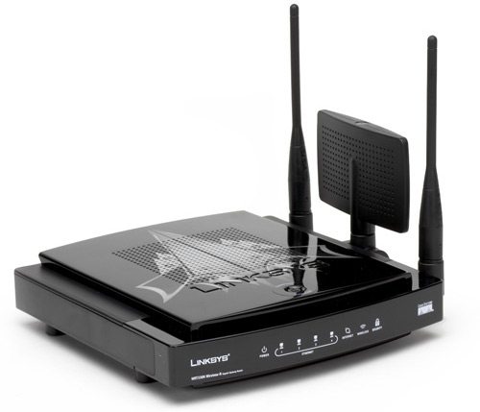
Network-Based Security Controls
Configure layered defense to interfere with malware propagation
  Routers
  Firewalls
  Proxies
  Switched virtual local area
  networks (VLANs)
Filter aggressively
  Bogus inbound network addresses (BOGONs)
    Packet from an unassigned region of IP address space
  Spoofed internal addresses
    Claim to be from inside the target system
  Packets from hostile countries (e.g., PRC) with whom you need no communications

Slide 53
Network Monitoring
Monitor & aggregate data from sensors
  Device logs
  Server logs
  Host logs
  Intrusion detection alerts
  Network flow data
Define historical database of
normal behavior
Look for anomalies – statistical outliers

Slide 54





Awareness Tools
ICSA Labs
  https://www.icsalabs.com/products
Virus Bulletin
  http://www.virusbtn.com/index
Avast!
  http://www.avast.com/virus-monitor
McAfee Virus Information
  http://home.mcafee.com/virusinfo
Microsoft Malware Protection Center
  http://www.microsoft.com/security/portal/
Sophos
  http://www.sophos.com/en-us/security-news-trends.aspx
Trend Micro
  http://us.trendmicro.com/us/trendwatch/

Slide 55
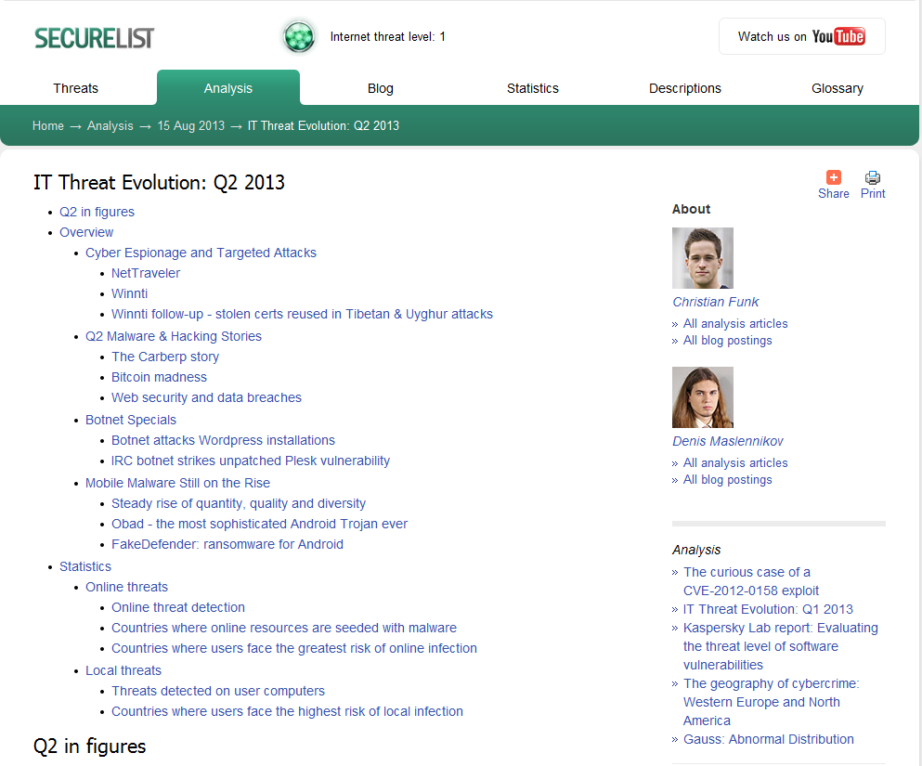
Recent Statistics (Q2 2013)
Quarterly & monthly
reports always online
Details available
through all the links
Lots more info
below
http://www.securelist.com/en/analysis/204792299/IT_Threat_Evolution_Q2_2013

Slide 56
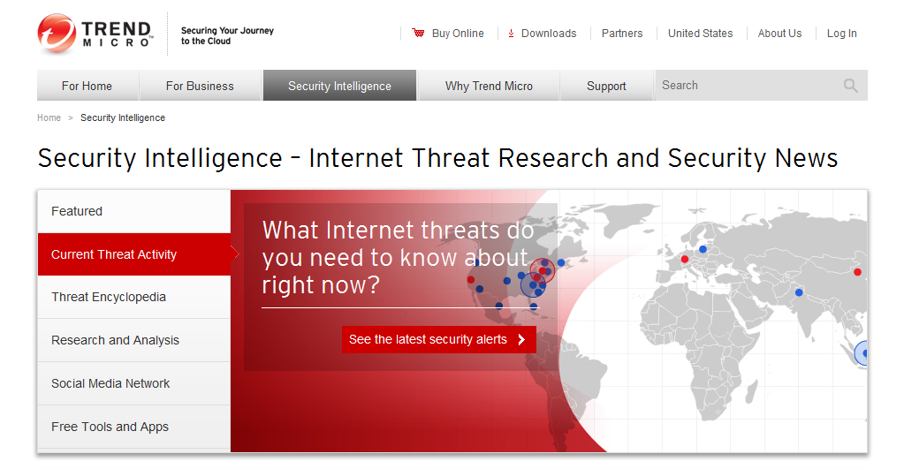
Recent Statistics (24 Sep 2013)
Up to date details available online anytime.
http://www.trendmicro.com/us/security-intelligence/index.html

Slide 57
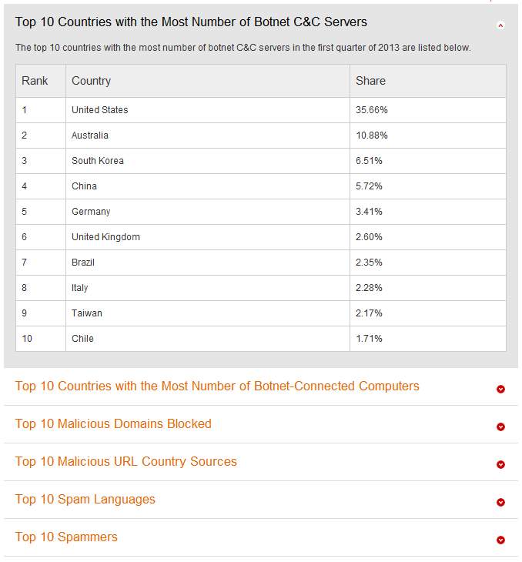
Current Situation (Sep 2013)
http://www.trendmicro.com/us/security-intelligence/current-threat-activity/malicious-top-ten/index.html

Slide 58
DISCUSSION

