Slide 1
Mobile Code
CSH6 Chapter 17
“Mobile Code”
Robert Gezelter

Slide 2
Topics
Introduction to Mobile Code
Mobile Code from the Web
Motivations and Goals
Design and Implementation Errors
CSH6 Chapter 17
Mobile Code

Slide 3
Mobile Code Defined
Instructions delivered to remote computer from outside an enclave
Enclave is system under unitary control by single authority
Dynamic execution (execution
on demand)
Fundamental problems
  Mobile code may perform
  unauthorized functions
  Growing spectrum of
  devices using mobile code
    PDAs
    Mobile phones
    Tablets

Slide 4
Mobile Code from the WWW
Definition
  Executable code delivered by Web server
  Or by e-mail
  For execution on client computer
  Not including HTML or XML
Typical languages
  ActiveX
  Java
  JavaScript
Examples of problematic content
  HTML-enabled e-mail with embedded code
  Pop-ups in browsers
    May access unexpected Web pages
    Julie Amero, CT teacher, convicted of using classroom computer for inappropriate content due to popups

Slide 5
Effects of Mobile Code
System / application crashes
  Obvious effects include
    Denial of service
    Corruption (integrity
    problems)
Covert effects more dangerous
  Access to e-mail addresses → spam
  Keyloggers
  Rootkits
Hephrati case in Israel (2005) showed how mobile code could be used for industrial espionage
  Varda Raziel-Jacont & Amnon Jacont’s MS for “L is for Lies” appeared on Internet sites
  Former son-in-law Michael Hephrati responsible using implanted mobile code

Slide 6
Motivations & Goals
Shift in motivations
  Pranks → vengeful → vindictive → criminal
Goals differ
  Amusement
  Blackmail
  Corporate espionage
  Financial fraud/theft
Misappropriation of computer resources
  Creation of botnets
  Applications to DDoS & spam
  Involvement in information warfare

Slide 7
Design & Implementation Errors
Range of errors
  Simple design/coding errors cause mistakes in function
    Usually predictable
    Often noticeable
  But mistakes in security architecture particularly serious
Security architectures for mobile code
may be flawed in
  Creation of sandbox
  Method of code authentication

Slide 8
Signed Code
Principle (belief):
  If you know and trust who wrote
  code it must be OK
  Use digital signatures based on
  Public Key Cryptosystem
  Apply ANSI X.509 Certificates
But signing bad code doesn’t
remove the flaws
Topics discussed below:
  Authenticode
  Limitations of Signed Code
  Problems with ActiveX Security Model
  Case Studies

Slide 9
Authenticode
Microsoft method
  Developers obtain digital certificate from Microsoft Certificate Authority (CA)
  Sign their code with their private key
  Users (systems) check validity of
  code at execution time using
  public key
Components
  PKI, X.509, CA
  Control over private keys used to sign
  code
    Known as the Software Publishing
    Certificate
  Valid method for verifying digital signatures
No protection against bad code

Slide 10
Limitations of Signed Code
All-or-nothing approach to trust
  Signed items assumed to be perfect
  No concept of partial trust
  “Digital signature does not … provide
  any guarantee of benevolence or
  competence.” – CERT/CC®
Organizations signing their code must
strictly control access to the signing
key
  But widespread practice in software development shops tolerates shared accounts and passwords
  Serious question about value of signing code

Slide 11

Problems with ActiveX Security Model
Importing and installing controls
  Signing does not guarantee safety
  or trustworthiness
Running controls
  ActiveX control has no limitations on actions
  Runs with same privileges as user
  Typically users run as root on their Windows PCs
  No basis for deciding whether particular control is safe or not in specific context
Scripting concerns
  Individual developers have no systematic method for evaluating safety of their code
  No equivalent to a sandbox for testing

Slide 12
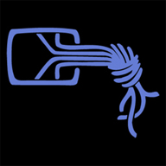
Case Studies (1)
Internet Exploder (1996)
  Fred McLain wrote demonstrate
  ActiveX control to illustrate excessive control of systems
  Shut down user’s computer (with permission of user!)
Chaos Computer Club Demo (1997)
  ActiveX control subverted
  Quicken accounting package
  Made Quicken create transfer
  order for money
  Filmed demonstration for German television

Slide 13

Case Studies (2)
VeriSign Issues Certificates to Imposters (2001)
  Class 3 Digital Certificates for signing ActiveX controls
  Issued to someone impersonating MS employee
  Allowed signing code as if it came from MS
Problems
  No Certificate Revocation List (CRL)
  Would need to verify date of every MS certificate to identity fraudulent issued ones
Caution to avoid overreacting
  1st error discovered in
  >500,000 issued
  certificates

Slide 14

Restricted Operating Environments
At simplest level, users should not execute code that affects entire system – restricted to their own processes
  Process is unique instance of execution of particular code by specific user on particular machine at specific instant
Concept of privileges determines
what a process can accomplish
  Supervisory or root privileges
  allow full access
Restricted operating environment
  Developed since earliest
  multi-user systems
    MULTICS, OS/360, UNIX…
  See CSH6 Chapter 24, Operating System Security
  Sandbox is an example of restricted operating environment

Slide 15

Java
Programming language developed
by Sun Microsystems
  Platform independence
  Typically used in Web browser
Includes virtual machine (JVM)
  Plus Java Run Time Environment
Code known as applets
  May be signed
  Restricted access to system resources
    Known as the Java sandbox
But bugs have allowed Java applets to leave sandbox on occasion

Slide 16
Asymmetric & Transitive Trust
Asymmetry in power can cause opportunity
for mass infection
  E.g., large customer can force small
  suppliers to conform to its standards
  Force use of unsafe mobile code
  Can resist damage by enforcing principle of least privilege in execution of all code
Transitive trust results from assumption that trusted sites must have trustworthy code
  Essential to enforce tight security on all mobile code regardless of source
  ActiveX security model thus fundamentally flawed because it relies solely on transitive trust

Slide 17
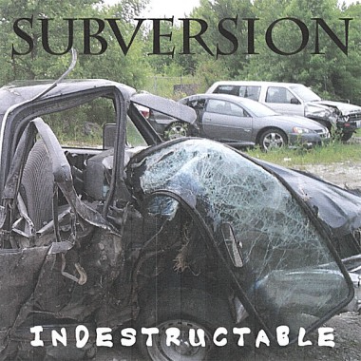
Misappropriation & Subversion
Mobile code targets have changed
  From individual target machines
  To entire populations of targets
John Schiefer (“acidstorm”)
  Caught by Bot Roast II, FBI
  operation against botnet
  operators in 2007
  250,000 systems infected with
  spybots for capture of userID and passwords
    Used to subvert PayPal & other accounts
  150,000 systems infected to support Dutch criminal Internet advertising company
  Pled guilty
  Sentenced to 4 years in US federal prison

Slide 18
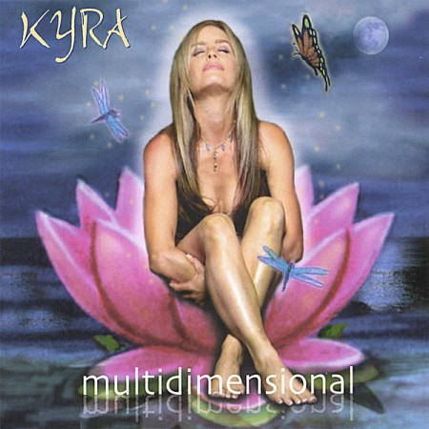
Multidimensional Threat
Signing code leaves other issues
  Integrity of signing process
  Integrity of the PKI
  Safety or validity of code not addressed
Individual controls or applets may function correctly BUT
  Interactions that were not or
  could not be tested may
  cause failures
  E.g., attempts to use same
  Windows registry key in
  conflicting ways
  Complexity of operating
  environment may preclude
  provable safety

Slide 19
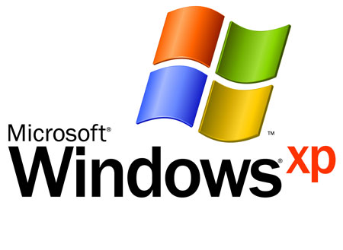
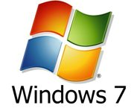
Client Responsibilities (1)
Fundamental issue: Browser running mobile code may allow change to persistent state of operating system
Use nonprivileged account wherever possible when browsing Web
  Windows XP SP2 offers
  Data Execution Prevention™ (DEP)
    Monitors use of memory to
    restrict access to protected areas
  Windows 7
    Stronger partition between administrator privileges and normal user mode
    AppLocker™ allows admin control over allowable execution of code

Slide 20
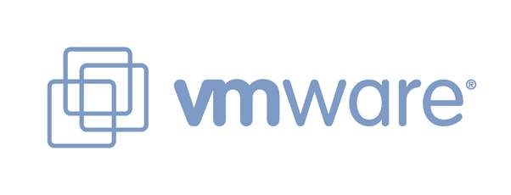
Client Responsibilities (2)
Virtual Machine (VM) technology
  Significant potential for security improvement
  Can instantiate a
  desktop for specific
  purpose
  Complete isolation
  from rest of system
Expendable WWW browser
  Run on VM desktop
  Delete when finished
  Bad effects of harmful code could be
    Isolated
    Evanescent

Slide 21

Server Responsibilities
Avoid use of active code for trivial purposes
Minimize use of ActiveX in favor of Java, JavaScript and other less dangerous tools
  E.g., for shopping carts, changing appearance of screen
  But updating Windows client will likely required ActiveX
Apply standards of secure
programming to all mobile code
  See CSH6 Chapter 38,
  “Writing Secure Code”

Slide 22
Recommendations for
Mobile Code Security
Client systems
  Bar acceptance of unsigned
  controls and applets
  Restrict use of ActiveX
  Restrict acceptance of pop-ups
Developers
  Follow good software engineering practices
  Grant minimum necessary privileges & access
  Use defensive programming
  Limit privileged access
  Ensure integrity of code-signing process
  Protect signing keys against compromise

Slide 23
Now go and study

