Slide 1
Denial-of-Service Attacks
CSH6 Chapter 18
“Denial-of-Service Attacks”
Gary C. Kessler &
Diane E. Levine

Slide 2

Topics
Introduction
DoS
DDoS
Management Issues

Slide 3

Introduction
Fundamentals of DoS
  “Denial of service” (no hyphens)
  “Denial-of-service” attacks (adj)
  Intruder attacks victim
  Uses up scarce or
  non-renewable resources
    Bandwidth
    System elements (e.g., buffers, flags, counters)
  Often attacker uses daemons for attacks
Other types of DoS include user errors or physical attacks
  Misconfiguration (e.g., bad parameters → catastrophe)
  Malfunction (e.g., disk drive failure)
  Destruction (e.g., physical damage such as e.g., backhoe attack)

Slide 4
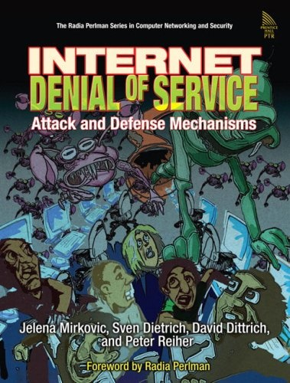
DoS
Overview
History of DoS
Costs of DoS
Types of DoS
Specific DoS Attacks
Preventing & Responding to DoS

Slide 5

Overview (1)
Denial-of-service attacks (DoS) & DDoS (Distributed DoS) attacks
  Render target systems / networks unusable or inaccessible
  Saturate resources or cause catastrophic errors
  Difficult to prevent without widespread cooperation among ISPs
DoS & DDoS attacks powerful tool for asymmetric warfare
  Attacker resources can be modest
  Consequences can be severe

Slide 6
Overview (2)
Can also occur by mistakes causing
positive feedback loops; e.g.,
Autoforwarding between 2 e-mail
accounts
  When target fills up, sends bounce
  to original address which forwards
  bounce to full account which generates
  new bounce which… until mailbox fills up
Out-of-office replies to lists
  Message sent to everyone on list
  Including absent person…
  …whose e-mail sends out-of-office reply to entire list including same absent person….
Competing Web-bots
  E.g., automatically reducing price below each other’s sale price….

Slide 7

History of DoS (1)
Early systems subject to resource exhaustion
  HP3000 console (early 1980s) received all system messages
    Logons, logoffs, requests for paper & tape
  Pressing any key on console without pressing  key blocked incoming system messages
  System buffers filled up with messages
  No further actions requiring notifications
    No one could finish logging on or off
    Anyone asking for tape/paper froze
All systems that use obligatory user lockout at risk of DoS
  Attacker need only log on to all userIDs with bogus password – locks everyone out

Slide 8

History of DoS (2)
1987-12: Christmas-Tree Worm
  IBM internal networks
  Grew explosively
  Self-mailing graphic
  Escaped into BITNET
  Crashed systems
1988-11: Morris Worm
  Probably launched by mistake
  Demonstration program
  Replicated through Internet
  ~9,000 systems crashed or were deliberately taken off-line
  Was about ½ to ¾ of Internet as it was then

Slide 9

History of DoS (3)
Panix Attacks of September 1996
Unknown criminal hacker attacked the PANIX Internet Service Provider
"SYN-flooding attack"
  Stream of fraudulent TCP/IP requests for connections
  Non-existent Internet addresses
  Overwhelmed server
  Denied service to legitimate users
TCP/IP specialists immediately developed patches to prevent recurrence

Slide 10

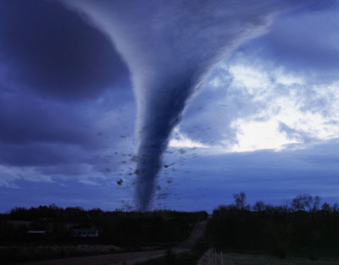
History of DoS (4)
Forbes (Feb 1997)
  Disgruntled employee George Parente
  deleted budgets, salary data
  Crashed 5 of 8 network servers
  Systems down 2 days – costs >$100K
  Arrested by FBI – pled guilty
Windows NT servers attacked (Mar 1998)
  Repeated crashes
  Included NASA, .mil, UCAL sites
Australian mailstorm (May 1998)
  Bureaucrat set autoreply +
  autoconfirmation to be sent to 2,000
  users in network
  Generated 150,000 messages in
  4 hours
  His own mailbox had 48,000 e-mails
  + 1,500/day arriving

Slide 11


History of DoS (5)
Melissa Virus (Mar 1999)
CERT-CC reported fast-spreading new MS-Word macro virus
  Melissa written by “Kwyjibo/VicodenES/ALT-F11”
  to infect Word documents
  Uses victim's MAPI-standard e-mail address book
  Sent copies of itself to 50 most e-mailed people
  E-mail message w/ subject line
  "Important Message From <name>”
Spread by David L. Smith (Aberdeen, NJ)
  Spread faster than any previous virus
  Took down ~100,000 e-mail servers
  Estimated $80M damages
  Convicted in 2002 of knowingly spreading computer virus
  Sentenced to 20 months in federal prison + 100 hrs community service

Slide 12
Costs of DoS
Direct costs often difficult to compute
Indirect costs involve
  Loss of immediate business
    Consumers switch to another Website if a vendor’s system is too slow
  Loss of customer confidence
    Many customers stay with latest supplier
  Potential legal liability under SLAs (Service Level Agreements)
  Costs of recovery
  National security issues
$$$

Slide 13
Damages from DoS and DDoS: Tort
Potential tort liability from allowing system to be used for harmful activities
  Possible that victims of DoS and DDoS will sue intermediate hosts for contributory negligence
Existing law in USA establishes requirements for best practices in preventing harm
  Industry standards are common basis
  Competitive pressures may move corporations to prevent misuse of their systems by DoS and DDoS tools
Notes:
Radin, M. J. (2001). Potential tort liability for damages due to DDoS attacks. Part II of “Distributed Denial of Service Attacks: Who Pays?” http://www.mazunetworks.com/radin-2.html

Slide 14
Specific DoS Attacks
Destructive Devices (Malicious software)
  Logic bombs
  Viruses, worms, Trojans
  Exploits of known vulnerabilities
E-mail Bombing & E-mail Subscription-list Bombing
Buffer Overflows
Bandwidth Consumption
Routing & DNS Attacks
SYN Flooding
Resource Starvation
Java
Router Attacks
Other Resources
See CSH6 Chapter 16,
Malicious Code

Slide 15
E-mail-Bombing (1)
In early days of e-mail (1980s), anyone could flood mailboxes
  ISPs imposed strict limits on number of outbound e-mails
  EULAs / Terms of Service explicitly
  forbid flooding
  But could still use e-mail lists to flood
  victims
1996-08 — “Johnny [x]chaotic”
  Subscribed dozens of people to hundreds
  of lists
  Victims received up to 20,000 e-mail
  msg/day
  Published rambling, incoherent manifesto
  Became known as “UNAMAILER”
  Struck again in December
Caused serious re-evaluation of e-mail list management

Slide 16

E-mail Bombing (2)
Root problem
  Some list managers automatically subscribed people without verification
  But now almost all lists verify authenticity of request
  Send request for confirmation to supposed recipient
But can still flood victim using automated
subscription requests
  Thus many list managers
  now use CAPTCHAs*
*Completely Automated Public Turing
test to tell Computers and Humans Apart

Slide 17
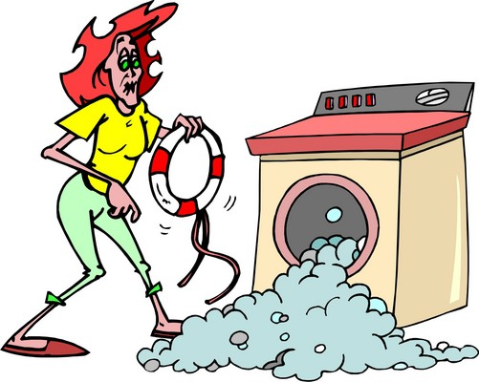
Buffer Overflows
What is a Buffer Overflow?
Origin of Buffer Overflow Vulnerabilities
Statistics on Overflows
Consequences of Bounds Violations
Bounds Violations in Interpreters
Buffer Overflows Common Security Problem
Example of Buffer Overflow Security Vulnerability
Blaster as Example
Fighting Buffer Overflows

Slide 18
What Is a Buffer Overflow?
double array[8]
Programming concept:
Define (declare, dimension)
  list (array, indexed variable, string)
  of certain size
To reserve area of memory for specific use during execution
array(0)
array(1)
array(7)
}
Other data

Slide 19
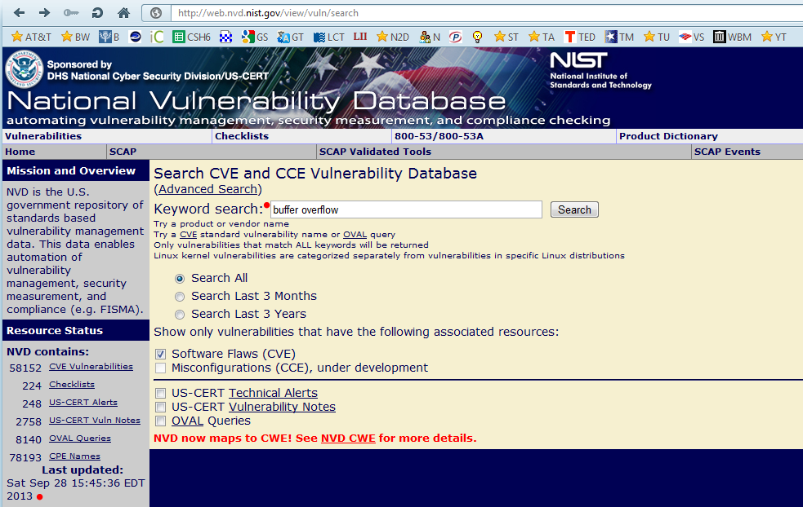
Natl Vulnerability DB (1)
Notes:
ICAT is a searchable index of information on computer vulnerabilities. It provides search capability at a fine granularity and links users to vulnerability and patch information.
See also information about the Common Vulnerabilities and Exposures (CVE) Database at http://cve.mitre.org

Slide 20
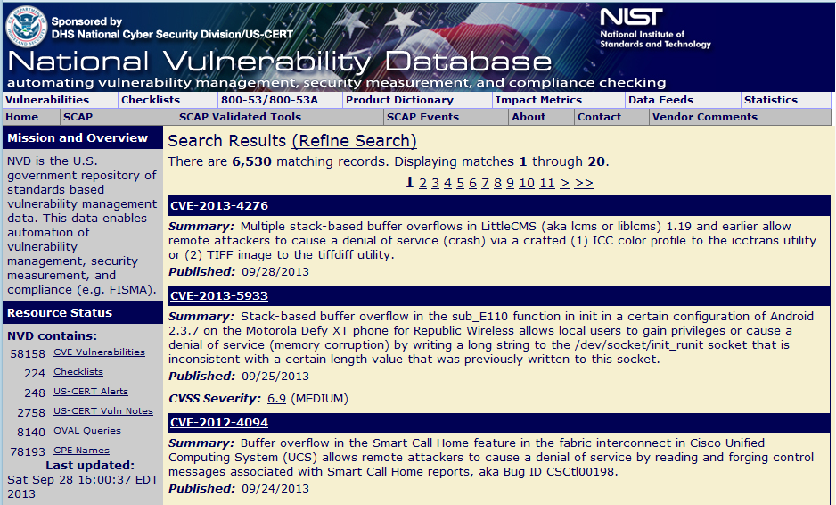
Natl Vulnerability DB (2)
Total 57,588 records;
buffer overflows = 11.3%

Slide 21

Buffer Overflows Declining Security Problem (2)

Slide 22
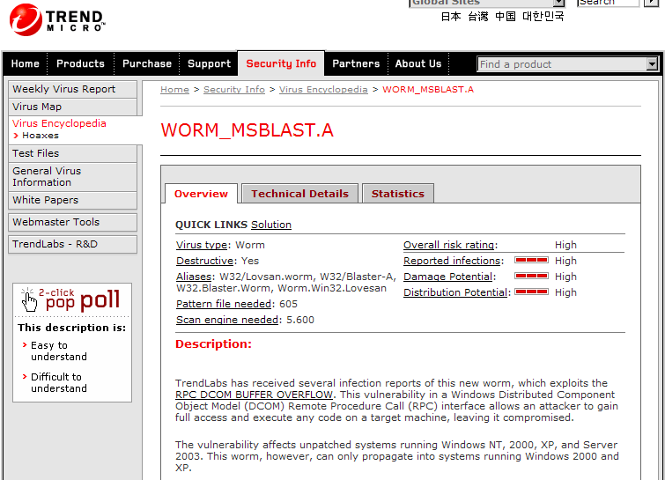
Blaster (1)

Slide 23
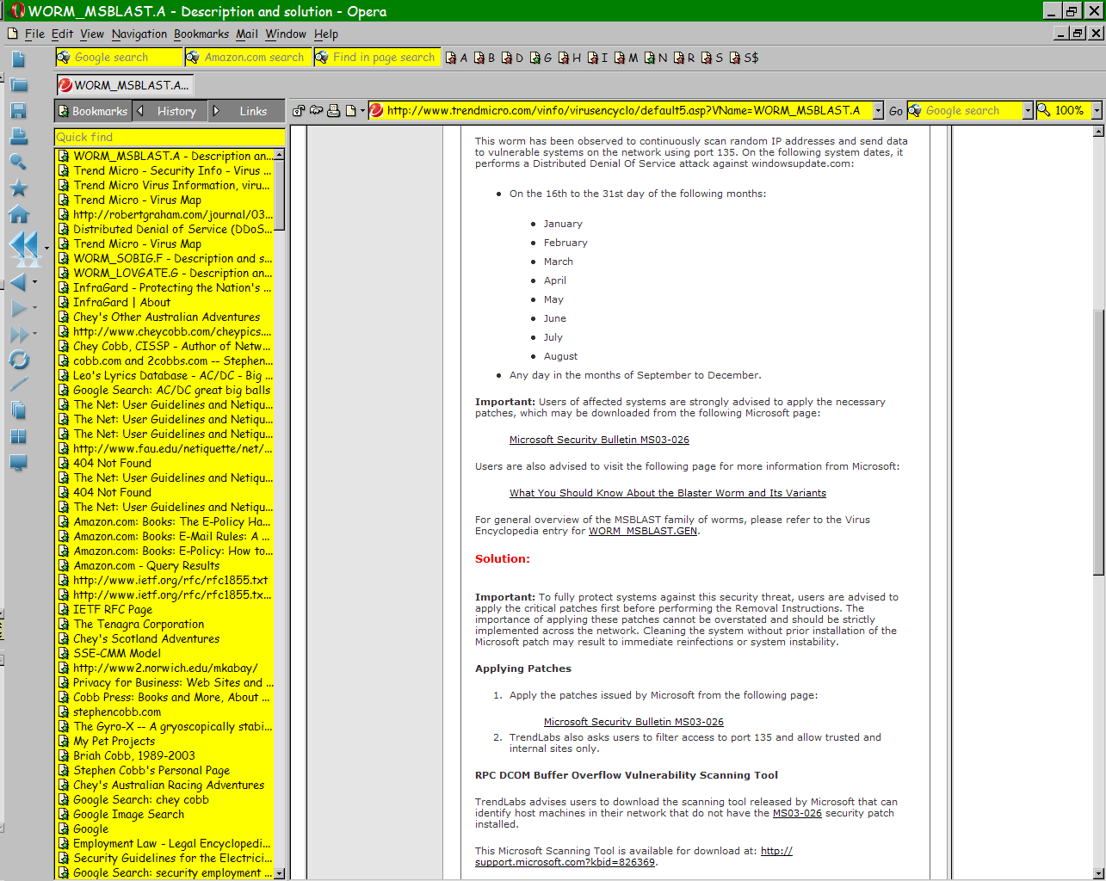
Blaster (2)

Slide 24
Blaster (3)

Slide 25
Origin of Buffer Overflow Vulnerabilities
double array[8]
In using a member of an array (an indexed variable), it is critically important to avoid addressing out of bounds
Doing so is called a bounds violation
Can corrupt data of other variables
array(0)
array(1)
array(7)
array(8)
}
Other data

Slide 26
Consequences of Bounds Violations
Possible to see
Compiler error
Run-time error
Program errors – bad results
Program crash
System crash
But most dangerous problem occurs in interpreters
Programs that dynamically interpret instructions
E.g., browsers, Web server programs

Slide 27
Bounds Violations in Interpreters
double array[8]
Some interpreters read areas of data as instructions (code)
Bounds violation can put data into code areas of working memory
Thus bad data can become equivalent to bad code
Can sometimes execute arbitrary code
Obtain unauthorized privileges
array(0)
array(1)
array(7)
}
CODE for
interpreter

Slide 28

Ping of Death
IPv4 limits data block to
65,636 bytes
Ping of Death attack uses
this limit
Break up data block into
normal sized packets
But these packets have sizes that add up to more than limit
Get packets through gateway security because each packet seems acceptable
But then packets are assembled into unacceptably large message
Causes overflow in IP kernel
System crashes

Slide 29
Fighting Buffer Overflows
Programmers need to use good quality assurance techniques
  Test long input strings
  Test below, at and above boundary conditions
System / network / security staff: check for new buffer overflows & install patches
  Use NVD frequently to find new vulnerabilities and remediation: http://nvd.nist.gov
  Subscribe to CERT-CC alerts from
  http://www.cert.org

Slide 30
Fighting Buffer Overflows (cont’d)
Managers need to understand that every buffer overflow is a failure of quality assurance
Stop allowing manufacturers to publish inadequately tested software as production versions
Stop letting manufacturers push quality assurance onto the client base
Complain loudly to manufacturers when there are buffer overflows in their software – and, if possible, buy competing products with better quality assurance

Slide 31
Bandwidth Consumption (1)
Generating huge # packets directed to target
  Local network; or
  Generated remotely
Key issue: does attacker have larger bandwidth available than victim?
  If yes, can flood victim’s input channels
  Slow or block legitimate traffic
Most common packet flooding uses ICMP
  Internet Control Message Protocol
  ICMP used for error & control messages
  E.g., router notifies sender that destination node not available using ICMP*
*Example from
Computer Desktop Encyclopedia
http://computerlanguage.com/

Slide 32
Bandwidth Consumption (2)
Bandwidth saturation (flooding)
  SMURF
  Fraggle
  Kernel panic
    Land
    Teardrop

Slide 33
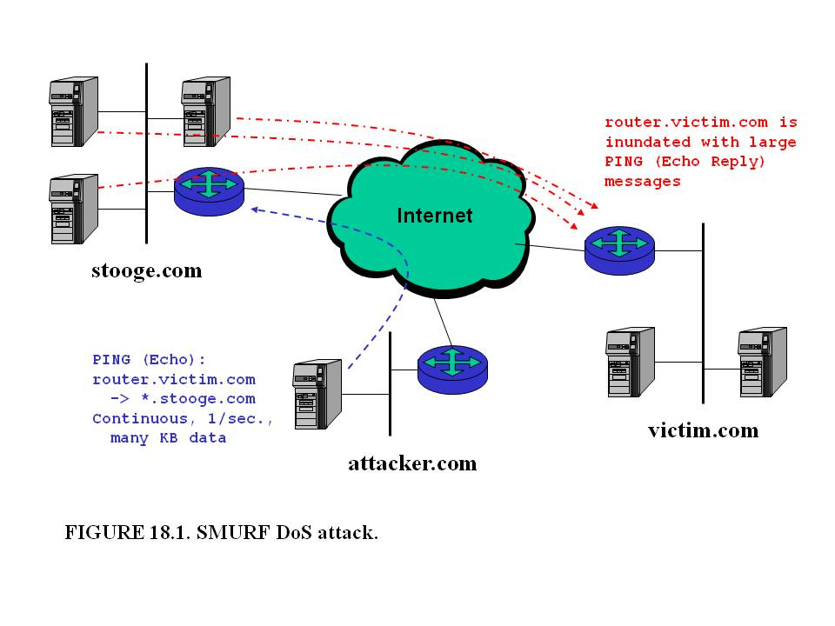

SMURF Attacks

Slide 34

Fraggle Attacks
Analogous to SMURF attack but using UDP instead of ICMP
Attacker sends spoofed UDP
packets
  User Datagram Protocol
  Usually used for
  communicating over
  unreliable channels
  Widely used for streaming
  audio, video, VoIP
Bad UDP packets sent to
broadcast address of amplifying network
  Every responding node on system responds to victim address
  Floods victim

Slide 35
Kernel-Panic Attacks
Impossible (illogical) condition causes code to fail
  Different from bad coding
  Condition should never naturally
  occur
  Exploiting failure to include
  error handling for unexpected
  inputs
Linux kernel v.2.2.0
  Program normally used for
  printing shared-library info
  If used to print core (memory-resident) files
  Can overwrite areas of memory & cause reboot
Ping of Death is classified as kernel panic attack

Slide 36
Land Attacks
Bad TCP/IP packet parameters
  SOURCE and DESTINATION ports set to same value
  IP source address = destination address
Causes 100% CPU utilization as impossible conditions are parsed by code
Leads to system halt
Successfully directed at “just about all operating systems” [CSH6 p 18.9]

Slide 37
Teardrop Attacks
Result of receiving impossible packets
  Normally, large packets broken into smaller pieces
  Reassembled upon receipt
But Teardrop IP packets overlap
when reassembled
  Cause system crash
  Directed against Microsoft OSs
  & *nix

Slide 38
Resource Locking &
Race Conditions
See CSH6 Chapter 52
Application Controls
Poor programming practices can lead to deadlock for local processes
  Process A puts unconditional lock on Resource 1
  Process B puts unconditional lock on Resource 2
  Process A puts unconditional lock on Resource 2
  Process B puts unconditional lock on Resource 1
Bye bye! No way out except by aborting one process
Race condition refers to dependency on specific timing
  If Process B happens to lock R1 after Process A has unlocked R1 and R2, there is no hang
  Thus the bad locking design causes an intermittent problem (tech support nightmare)

Slide 39

Routing & DNS Attacks
Insert fraudulent data into Domain
Name System
  So domain name resolves to wrong
  IP address
Eugene Kashpureff (1997)
  Filed bad data with InterNIC causing
  recognition of fake TLDs .xxx, .mall,
  .nic, .per
  Later inserted fake data to redirect
  browsers from networksolutions.com
  to his own Alternic site
  Sentenced to 5 years probation
Gary Hoke (1999)
  Redirected traffic to fake Bloomberg News Service page
  Pump ‘n’ dump scheme to boost price of PairGain stock, then crash
Eugene Kashpureff

Slide 40
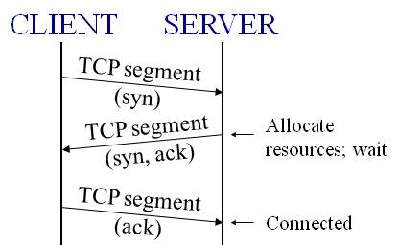
SYN Flooding
Exploits 3-way handshake
for TCP hosts to establish
connection
SYN Flood sequence
  Attacker initiates
  connection with fake
  origin on SYN packet
  Server responds w/ usual SYN/ACK
  Server waits for ACKnowledge response
  But never comes – uses up finite resource for timeout (e.g., 10 seconds)
Attacker launches barrage of these fake connection requests, saturating TCP stack
Thus no one can connect

Slide 41
Resource Starvation
Catch-all category for DoS attacks (or mistakes)
  Any sequence that consumes resources & prevents authorized use qualifies
Local inadvertent DoS by uninformed / careless users
  In 1970s & 1980s, users would sometimes misconfigure their modems & eliminate timeout
    Thus modem could stay connected to phone line for days – block access to that line
  Users can exceed their disk quotas and shut down processing if disk free space falls below critical levels
    In 1985, programmer at company where Prof Kabay was Dir Tech Services REMmed out PURGE command in JCL for temporary files
    Left so many TEMPnnnn files on disk that customer’s account was frozen for exceeding disk quota

Slide 42
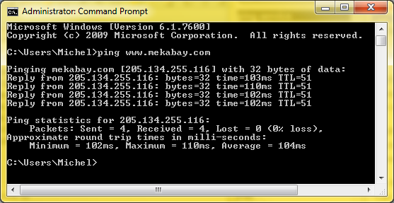
Ping Basics
Invented in 1983 by Mike Muuss http://ftp.arl.mil/~mike/
See http://ftp.arl.mil/~mike/ping.html
ping xx.xx.xx.xx where xx are the IP address or the URL
  Command-line command
  “Are you there?” returns reply & lag time

Slide 43

Ping Flooding
Send enormous number of normally-formatted ping packets to target
Consume system resources trying to respond
Slow down or stop responses to other requests

Slide 44

Java
Java applets have been used for DoS
  Exploits built on Java have caused browser internal errors to hang process
  Others have caused endless loops of CPU and excessive use of RAM – hang browser
Some attacks have rerouted DNS queries to fake DNS server
  Phishing
  Root compromise
Java malformed code (e.g., Exploder) can cause reboot of Windows 9x system
See also “Mobile Code” in CSH6 Ch 17

Slide 45
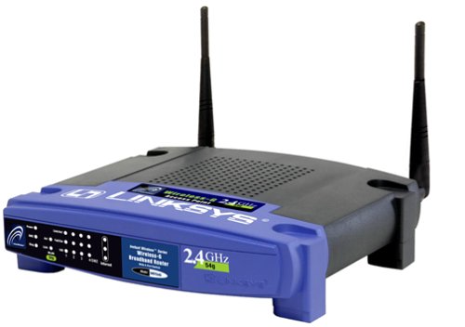
Router Attacks
Routers link organization to the Internet
Attack on router blocks all ‘Net access for all systems dependent on the router
  National Vulnerability Database (NVD) reports 404 router vulnerabilities as of Sep 2013
  http://nvd.nist.gov/
Routers that have been exploited:
  AlaxalA, Avici, AzTech,
  Century, Cisco,
  Hitachi, Linksys,
  Neostrada, Netgear,
  Proxim, Sweex,
  ZyXEL….

Slide 46
Other Resources
See
  Householder, A., A. Manion, L. Pesante, & G. M. Weaver (2001). “Managing the Threat of Denial-of-Service Attacks, v10.0” CERT/CC®
  http://www.cert.org/archive/pdf/Managing_DoS.pdf
  Meadows, C. (2000). “A Framework for Denial of Service Analysis.” Paper presented at the Information Survivability Workshop 2000 (Oct 24-26, 2000).
  http://www.cert.org/research/isw/isw2000/papers/37.pdf

Slide 47
Preventing & Responding to DoS (1)
Prevent in preference to respond
Harden operating system
  Keep security in mind when choosing parameters for configuration
  Monitor for vulnerabilities
  Use latest revisions of software
  Keep patches up to date
Critical: packet filtering at network routers
  Apply egress filtering & ingress filtering to block fraudulent origination and destination addresses (respectively)
Block all broadcast messages & most ICMP traffic

Slide 48
Preventing & Responding to DoS (2)
Reject Ping and traceroute
Do not respond by flooding attacker address
  Usually faked
  May be attacking innocent victim
If actual compromised system identifiable
  Request intervention by service provider
  Contact CERT/CC®
  US victims may coordinate with law enforcement, including FBI
More information after discussion of DDoS

Slide 49
DDoS
Overview
History of DDoS
DDoS Terminology & Overview
DDoS Tools
Defenses Against DDoS

Slide 50
Overview of DDoS
Attacker subverts poorly secured system
Controls tools to send large volumes of coordinated traffic against target
Massive multiplier effect
Packets arrive from many different sources
  Makes packet filtering by source impossible
Sources can be manipulated for PSYOP in information warfare – misleading impressions
Techniques developed for DoS applied to DDoS

Slide 51
History of DDoS (1)
Jun & Jul 1999: Trin00 (aka Trinoo)
  Thought to be 1st DDoS tool
  Tested on 2,000 systems worldwide
Aug 1999: large-scale deployment of Trin00
  >227 systems used as sources
  Attacked 1 University of Minnesota computer – down 2 days
Dec 1999: CERT/CC® issued CA-1999-17 discussing DDoS for 1st time
Feb 2000: Mafiaboy attacks multiple e-commerce sites (see next slide)

Slide 52

History of DDoS (2)
February 7, 2000 attack from “Mafiaboy”
  Michael Calce, 15 year-old boy from Montréal area, Canada
  Used a dial-up modem to control DDoS
Effects
  Yahoo.com inaccessible 3 hours
  Est. $500,000 loss in revenue
  Stock value fell 15%
Feb 8:
  Amazon.com 10 hours – $600,000 loss
  Buy.com – 9.4% availability; stock lost
  44% of value
  CNN – user count fell to 5% of normal
  eBay stock value fell 24%
Feb 9:
  E*Trade & ZDNet – completely unreachable
  Charles Schwab – brokerage down – no exact figures
Notes:
Mazu Networks (2000). White Paper: The Denial of Serfice Problem. http://www.mazunetworks.com/wp_ddos.html
Radin, M. J. (2001). Distributed Denial of Service Attacks: Who Pays? http://www.mazunetworks.com/radin-toc.html
Costello, S. (2001). NIPC warns against increased DDoS attacks. http://www.nwfusion.com/news/2001/1105nipc.html

Slide 53

History of DDoS (3)
May 2001: Attacks on
Steve Gibson’s GRC.com
  Well-known security
  expert, writer, programmer
  13-year-old attacker used
  IRC bot
Oct 2002: DNS servers
attacked
  All 13 top-level Domain
  Name System root servers
  swamped by DDoS for 2 hours
  9 servers went down – only 4 continued working
  A few more hours might have knocked all the root servers off the ‘Net – stopped Web

Slide 54
History of DDoS (4)
DDoS as tool for extortion
  Growing number of criminals (and criminal organizations) threaten DDoS attacks unless paid ransom
  Demonstrate power by interrupting service
  Most victims stay quiet about extortion
Jan 2009: TechWatch digital TV site down
  DDoS allegedly using 9,000 bots for SYN flood
  446Mbps avalanche of packets rose to 2 Gbps
  Victim applied advanced traffic filters
  Attackers demanded ransom
Notes:
Pappalardo, Denise and Ellen Messmer (1995). Extortion via DDoS on the rise: Criminals are using the attacks to extort money from victimized companies. Computerworld (May 16, 2005). < http://www.computerworld.com/s/article/101761/Extortion_via_DDoS_on_the_rise >
Leyden, J. (2009). Techwatch weathers DDoS extortion attack: Botnet blackmail. The Register (Jan 30, 2009). < http://www.theregister.co.uk/2009/01/30/techwatch_ddos/ >

Slide 55

DDoS Attack on Social Networking Sites – Aug 2009
Aug 6-8, 2009 – SNS under attack
  Twitter down
  LiveJournal down and up
  Facebook slow
  Gawker affected
  Xbox Live
  Some Google services
Analysts believe attack was aimed at 1 blogger
  Cyxymu outspoken critic of South Ossetia war
  Writes in “Georgianised Russian”
  DDoS attack blamed on Russian hackers*
*Example of
hacktivism
Notes:
Rosenberg, D. (2009). Denial-of-service got Twitter. Is your network next? Cnet News (Aug 6, 2009). < http://news.cnet.com/8301-13846_3-10305241-62.html >
Anderson, K. (2009). Twitter and Facebook attacks: why your computer might have been involved. Guardian Technology Blog (Aug 7, 2009). < http://www.guardian.co.uk/technology/blog/2009/aug/07/facebook-twitter >
Mah, P. (2009). Twitter DDoS a somber reminder about the malice of botnets. FierceCIO TechWatch (Aug 7, 2009). < http://www.fiercecio.com/techwatch/story/twitter-ddos-somber-reminder-about-malice-botnets/2009-08-07 >

Slide 56

DDoS Terminology & Overview
Terms (synonyms)
  Intruder (attacker, client)
  Master (handler)
  Daemon (agent, beast,
  bcast program, zombie)
  Victim (target)
Process
  Intruder compromises insecure systems
  Installs master program
  Scans for thousands of weak systems
  Installs daemon code to listen for instructions
  Instructs owned systems to launch DDoS
Permission requested from Frans Charming
for permanent use of image

Slide 57

DDoS Tools
Trin00
Tribe Flood Network
Stacheldraht
TFN2K
Trinity
Code Red Worm
NIMDA
Hidden Links in
Web Pages or
Programs

Slide 58
Trin00
Appeared ~Jun/Jul 1999
Distributed SYN flood
TCP & UDP ports used
  Masters listen on TCP port 27665 for instructions
  Daemons listen on UDP port 27444 for masters
  Masters listen on UDP port 31335 for daemons
Intruder uses password (original: betaalmostdone)
Programs
  Master master.c
  Daemon ns.c
Operations
  Specific commands and passwords for protocol
  Characteristic traffic on specific ports – useful for detection

Slide 59
Tribe Flood Network (TFN)
Appeared mid-1999
Multi-attack DDoS system: ICMP flood, SYN flood, UDP flood, SMURF-like attacks
Uses only ICMP traffic – difficult to detect
Intruder supplies master with
  IP address list of daemons
  Type of attack
  IP addresses of targets
  Port number for SYN attack
Programs
  Tribe.c, td.c

Slide 60
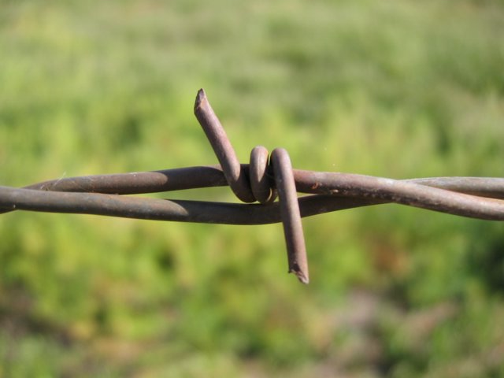
Stacheldraht
“Barbed wire” in German
Appeared Aug 1999
Similar to Trin00 & TFN
Advances
  Encrypted communication between Intruder & master
  Automated daemon updates
Programs
  Intruder uses telnetc/client.c
  Master is mserv.c
  Daemons are leaf/td.c

Slide 61
TFN2K
Tribe Flood Network 2K released Dec 1999
Targets Unix & Windows NT servers
More complex variant of TFN
  Traffic harder to recognize & filter
  Supports remote execution of commands
  Hides source of attack using IP address spoofing
  Transports traffic over many protocols
  Sends decoy packets to conceal nodes
Can also crash systems using malformed packets as in Teardrop & Land attacks

Slide 62

Trinity
Sep 2000
Also multi-tool
Daemon installed on Linux machines using buffer overflow
Communications with daemon via IRC or AOL ICQ instant messaging
  Used chat room for communications
Carrie-Anne Moss as Trinity
in Matrix films trilogy

Slide 63
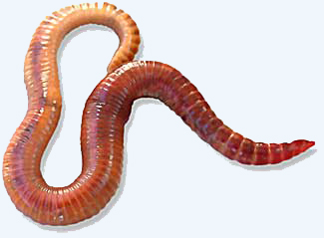
Code Red Worm
May 2001: buffer overflow discovered in Microsoft Internet Information Service (IIS) Indexing Service
  Few IIS Servers were patched
  Became DDoS daemons
July 2001: Code Red Worm appeared
  HTTP GET request to exploit buffer overflow
  Spawns 99 daemon processes to attack “quasi-random” set of IP addresses
  Displayed defaced Web page “…Hacked by Chinese!”
  Days 20-27: flood phase – attacks old address of whitehouse.gov (IP 198.137.240.91)
  On days 28-31 of each month, dormant
Other variants followed (Code Red II, NIMDA)

Slide 64
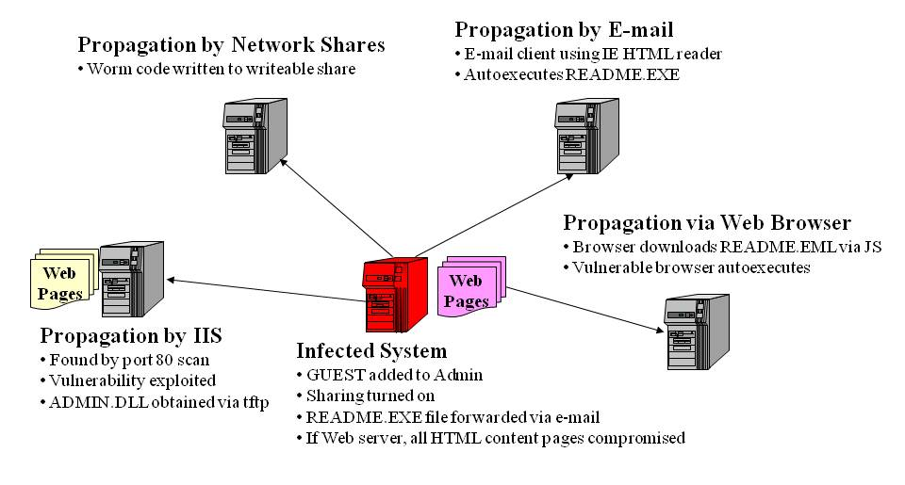
NIMDA
Sep 2001 – “Admin” backwards
Exploited multiple vulnerabilities in MS code

Slide 65
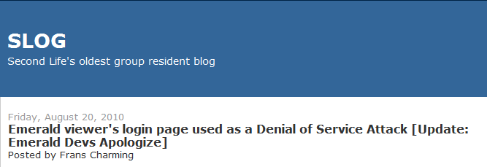
Hidden Links in Web Pages or Program
Website iheartanime.com
  Aug 2010: DDoS from all users of Emerald Viewer (EV)*
  Open-source viewer for Second Life virtual world
SLOG Second Life
blog reported analysis
  EV code modified to
  pull down 20 pages
  and 12 images from
  target servers
  Massive interference in availability
Developers “apologized” for their stupidity
  Explained they were trying to lie about traffic to their site
  Did not acknowledge illegality of attacks
http://secondslog.blogspot.com/2010/08/emerald-uses-loginpage-as-denial-of.html

Slide 66
Fighting DoS and DDoS
Users
System administrators
Local Network Actions
ISPs
New Anti DoS Tools
Notes:
http://www.acm.org/ubiquity/views/m_kabay_1.html
Yasin, R. (2001). Techniques thwart DoS Attacks. http://www.internetwk.com/story/INW20010621S0003

Slide 67
Users
Keep system up to date with updates, patches
Use personal firewall and think before accepting outbound connection to Internet
Verify that open ports are for known applications
Don’t accept executables from friends and colleagues – get valid version from trustworthy Web site yourself
Don’t download executables from untrustworthy sites
Don’t open any unexpected e-mail attachments
  Be sure a human being sent it for specific, known reason
Turn off “Hide file extension for known file types” in Windows options
Use up-to-date browsers

Slide 68
System Administrators
Maintain and examine log files
Audit servers to ensure known-good status for all software
Never install code from unknown or untrusted sources – and compile examined source if possible
Subscribe to and follow best practices from
  NIST CSRC http://csrc.nist.gov/publications/PubsSPs.html
  CERT/CC http://www.cert.org
  SANS http://www.sans.org
  Computer Security Handbook! ☺
  Bundesamt für Sicherheit in der Informationstechnik (BSI)
    http://www.bsi.de/english/gshb/index.htm
Notes:
SANS (2000). Help defeat denial of service attacks: Step-by-Step. http://www.sans.org/dosstep/index.htm

Slide 69
Local Network Actions
Enable egress filtering to prevent any packet from passing if it uses forged IP headers
Block all incoming packets addressed
to a network broadcast address
Turn off Directed Broadcast capability
at router if feasible
Discard any packet directed to
RFC1918 private addresses
Disable all unused application ports
(esp. IRC or others known to be
used by DDoS tools)
Monitor network activity in real time
to spot anomalies quickly
Notes:
From Levine, D. E. & G. C. Kessler (2002). Denial of Service Attacks. Chapter 11 of Bosworth, S. & M. E. Kabay, eds (2002). Computer Security Handbook, 4th Edition. Wiley (New York); in press – publication date March 2002.
RFC 1918 defines a set of private IP addresses that are not to be routed on the Internet. These addresses include:
10.0.0.0/8 10.0.0.0-10.255.255.255 One Class A address
172.16.0.0/12 172.16.0.0-172.31.255.255 16 Class B addresses
192.168.0.0/16 192.168.0.0-192.168.255.255 256 Class C addresses
In addition, there are a number of reserved IP addresses that are never assigned to "public" networks, including:
0.0.0.0/32 Historical broadcast address
127.0.0.0/8 Loopback
169.254.0.0/16 Link-local Networks
192.0.2.0/24 TEST-NET
224.0.0.0/4 Class D Multicast address range
240.0.0.0/5 Class E Experimental address range
248.0.0.0/5 Unallocated
255.255.255.255/32 Broadcast

Slide 70
ISPs
Ingress filtering – discard all packets from client if packet header shows wrong NET_ID
Egress filtering – same rule to bar
fraudulent packets
Discard all inbound or outbound
packets containing RFC1918
private addresses or other
reserved addresses
Disable IP directed broadcasts
Monitor high-volume customers
Join ISPSec Consortium – apply methods for cooperating to stop DoS and DDoS
http://www.icsalabs.com/html/communities/ispsec/index.shtml

Slide 71
New Anti-DoS Tools
Network traffic monitors
  Track normal patterns of traffic
  Identify abnormal DDoS patterns
  Shut down sources of fraudulent traffic
RSA client puzzle
  When connection flood detected, responds with cryptographic puzzle for client
  Accept connections only given proper response
IP Traceback
  Mark some of the packets with path info
  Or define ICMP Traceback message to victims
Modify IP to stop address spoofing
  Host Identity Payload
Upgrade browsers to later versions

Slide 72
Commercial Products (1)
These are EXAMPLES, not ENDORSEMENTS
ApplicCure dotDefender
  Web application firewall
  Session protection security engine
  Blocks impersonation, high-volume traffic
  http://tinyurl.com/m9q26s
Arbor Networks
  Peakflow DoS managed service
  Gathers data from ISP networks
  Establishes baseline to detect problems
  Reconfigures routers to shut down flood
  http://tinyurl.com/6g2z9f
Notes:
Hardesty, L. (2001). Stemming the flood. http://www.techreview.com/magazine/sep01/innovation5.asp
Hartje, R. (2001). Captus firewall/switch combo breaks new ground. http://techupdate.zdnet.com/techupdate/stories/main/0,14179,2705626,00.html
http://www.captusnetworks.com/products.htm
http://www.mazunetworks.com/howitworks.html
http://biz.yahoo.com/prnews/011022/nem037_1.html
Andress, M. (2001). Get a positive ID on DDoS attackers. http://www.nwfusion.com/reviews/2001/0827rev.html
Messmer, E. (2001). Users put early anti-DDoS tools to test. http://www.nwfusion.com/archive/2001/126594_10-22-2001.html

Slide 73
Commercial Products (2)
Lancope StealthWatch
  Intrusion Detection System (IDS)
  Includes DoS monitoring and response
    Detection
    Notification
    Traceback
    Forensics
  http://www.lancope.com/
Cisco Routers: “Configuring DoS Protection”
  Detailed White Paper
  http://tinyurl.com/5e8mvu
Notes:
Fonseca, B. (2001). N+I: Arbor Networks readies anti-DDoS package. http://www.infoworld.com/articles/hn/xml/01/05/08/010508hndos.xml
Arbor Networks
--in the news. http://www.arbornetworks.com/news?cid=5&tid=10
--product descriptions. http://www.arbornetworks.com/standard?cid=4&tid=8
Messmer, E. (2001). Start-ups go on attack vs. denial-of-service threat. http://www.nwfusion.com/news/2001/0618antidos.html
Lancope Stealthwatch
--overview. http://www.lancope.com/products/index.htm
--DoS features. http://www.lancope.com/products/denial_service.htm

Slide 74
Management Issues
Upper management discounts threat of DoS
  Attacks must be targeted
  “No one would attack us”
But any site can become a host for daemons
  Potential performance degradation
  Damage to system integrity & reliability
  Theoretical legal liability
Failure to protect systems against exploitation increases power of DoS and DDoS attackers

Slide 75
Now go and study

