Slide 1
Social-Engineering & Low-Tech Attacks
CSH6 Chapter 19
“Social Engineering &
Low-Tech Attacks”
Karthik Raman, Susan Baumes, Kevin Beets & Carl Ness

Slide 2
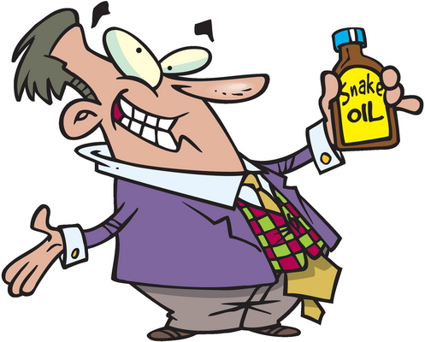
Topics
Background & History
Social Engineering Methods
Psychology and Social Psychology of Social Engineering
Dangers & Impact
Detection
Response
Defense & Mitigation
Spam, Phishing & Trojans
E-mail Basics
Spam (not SPAM™)
Fighting Spam
Phishing
Trojan Code
CSH6 Chapter 19
CSH6 Chapter 20

Slide 3
Background & History (1)
Trojan Horse
  Trojan War
    Greek mythology
    C. 1200-1300 BCE
    Iliad & Odyssey of Homer
    Virgil’s Aeneid
  Greeks sailed to island of Tenedos
    Pretended to abandon war
    Left giant hollow horse with soldiers inside
    Sinon, who convinced Trojans it was offering to Athena
    Lacoon & Cassandra warned of danger
  Greeks opened gates from inside, slaughtered Trojans, won war

Slide 4

Background & History (2)
Definition: social engineering is obtaining information or resources using coercion or deceit
Manipulate trust or gullibility of people
Often piece together information
  Random order
  Multiple victims / enablers
Purposes vary but results often
loss of
  Intellectual property
  Money
  Business advantage
  Credibility….

Slide 5

Some Notorious Social Engineers
Frank Abagnale, Jr.
  See Catch Me If You Can movie
  Impersonated pilot, attorney, teacher, doctor…
  Passed phony checks
  Became expert for FBI
Kevin Mitnick
  Many exploits
  See earlier lecture on History of Computer Crime

Slide 6
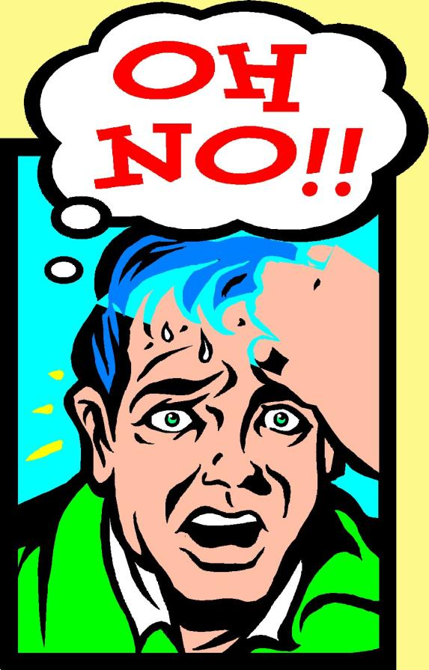
Social Engineering Methods
Impersonation
Seduction
Low-Tech Attacks
Network and Voice Methods
Reverse Social Engineering

Slide 7
Impersonation
Criminals wear uniforms, badges, use right terms
Adopt confident air of entitlement
Pretending to be HelpDesk employees
  Employees conditioned to cooperate
  Technical knowledge reduces
  questions
  Some HelpDesks violate standards
  by habitually asking for passwords
  (BAD)
HelpDesk employees can be victims
  Criminals pretend to be employees
  Often assume identity of high-ranking executives
  Sometimes bully HelpDesk staff into violating standard operating procedures

Slide 8

Seduction
Long-term strategy
  May study victim to learn background, habits, likes, dislikes, weaknesses
Form bond with victim
  Apparent friendship
  Exploit good will to ask for
  favors
  May use sexual relationship
  as lever to develop trust
Foot-in-the-door technique
especially useful
  Ask for tiny deviation from
  standards
  Gradually increase demands

Slide 9
Low-Tech Attacks
Exploit physical weaknesses in defenses
Often support social engineering
Examples
  Dumpster® Diving
  Theft
  Leveraging Social Settings
  Exploiting Curiosity or Naïveté
  Bribery
  Data Mining & Data Grinding
  Piggybacking / Tailgating
  Phishing & Pharming
  Spim, Spit, & Vishing
  Trojan Code and Viruses

Slide 10
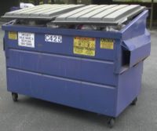
Dumpster® Diving
Dumpster® is registered trademark of Dempster Brothers for mobile trash receptacles
Discarded materials are not protected by law unless on private property
Many organizations sloppily
throw away confidential info
  Papers
  Magnetic media
Criminals derive value from
  Internal organization charts
  Memoranda
  Vacation schedules
Use info for industrial espionage and impersonation

Slide 11
Theft
Outright theft of confidential information
  Paper
  CD-ROMs
  USB flash drives and disk drives
  Backups
  Entire laptop computers
  Purses, wallets, briefcases
  Trash bags
Information used directly or for impersonation

Slide 12
Leveraging Social Situations
Employees relaxing or traveling may let down guard
Social engineers may deliberately eavesdrop
  Company parties
  Clubs, trains, coffee shops
Classic errors
  Talking about confidential matters
    In public amongst themselves
    To friendly strangers
    Loudly on mobile phones
  Letting strangers view computer screens
  Leaving portable computers unlocked

Slide 13
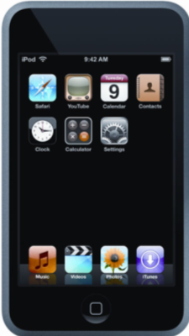
Exploiting Curiosity or Naïveté
Criminals (and researchers) have left media lying around
  CD-ROMs
  USB flash drives
  iPod music players
  Music CDs
Victims routinely insert media
into company computers
Unknowingly load malicious software; e.g.,
  Keyloggers – capture keystrokes and send them to criminals
  Backdoors – allow criminals to seize control of compromised computer behind firewall

Slide 14
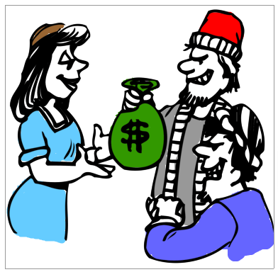
Bribery
Exchange of value in return for violation of policy
Dangerous for social engineer
  Obviously wrong
  Honest employees (or one
  with second thoughts) will
  report attempt to management
  May lead to police involvement,
  arrest
Success depends in part on
employee attitude
  Disgruntled, unhappy employees better
  Contractors
  Those about to quit or be fired anyway
  Criminal may probe for attitudes using negative comments

Slide 15
Data Mining & Data Grinding
Search engines
  Reveal confidential information
  Mine information about
  organizations
  Use caches or WayBack Machine
  for pages that have been removed
  Web history for older versions
  Search-engine APIs provide special tools
  See references to “Google hacking” using any search engine
Data grinding
  Extracting metadata from published docs
  Unprotected DOC & HTML files may contain valuable info (e.g., author, e-mail address, ….)

Slide 16
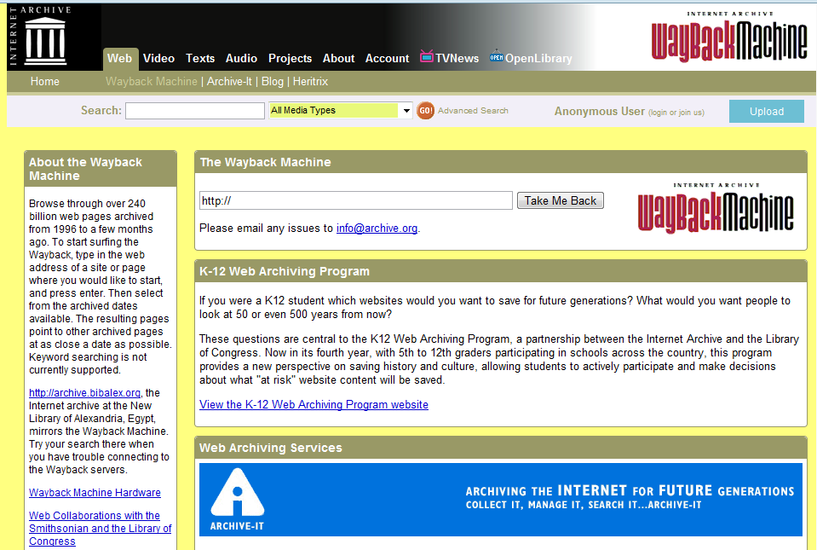
WayBack Machine
(Internet Archives)
http://archive.org/web/web.php

Slide 17
Network and Voice Methods
Piggybacking / Tailgating
Phishing & Pharming
Spim, Spit, & Vishing
Trojan Code and Viruses

Slide 18

Piggybacking / Tailgating
Follow authorized employee into secured location
  Using social expectations of victim
  What is polite in normal society may be insecure and unwise for security
Preparations
  Dress like any other employee
  Have excuse ready (“Forgot my
  card….”)
Defenses
  Explicitly forbid piggybacking & explain why
  Teach employees using role-playing

Slide 19

Phishing & Pharming
Phishing
  Sending e-mail to trick
  user into providing
  personal information
  Try to copy official
  correspondence
  Paste logos
  Often bad grammar,
  spelling mistakes
Pharming
  Fake Websites imitate real sites (banks, stores)
  Collect login, financial information

Slide 20


Spim, Spit, & Vishing
Spim
  Instant messaging carrying
  spam
  Try to trick victim by sending
  link to fake Website via IM
  Bypass normal Web/e-mail content controls
Spit
  Spam over Internet telephony
  Limited controls over such spam
Vishing
  Voice fishing: spam using phone & e-mail
  Trick victim into answering questions about personal information

Slide 21
Trojan Code and Viruses
Discussed above in slide “Exploiting Curiosity or Naïveté”
Attackers insert malware on victim’s computer
Malware silently installed
Collects or transmits confidential information
Provides backdoor code to allow unauthorized access

Slide 22
Reverse Social Engineering
Aka knight-in-shining-armor attack
Social engineer creates a problem
  E.g., a denial-of-service attack
  Rename or move of critical file
Arranges to seem to be only
person who can solve problem
Fixes the problem (easy if
attacker caused it)
  Gather information during solution
    “I need to log on as you.”
  Victim may even forget that security policy has been violated
  Gains trust for future exploitation

Slide 23
Psychology & Social Psychology of Social Engineering
Psychology of Victim
Social Psychology
Social Engineer Profile

Slide 24
Psychology of Victim
Cognitive biases aid criminals
Choice-supportive bias
  Go with the flow
  Use what works most of time
Confirmation bias
  Remember what fits
  See person in janitor outfit as
  janitor – regardless of rules
Exposure effect
  What is familiar is comfortable
  Gain trust by referring to familiar topics
Anchoring
  Focus on one trait at a time
  Soothing, friendly demeanor covers intrusive questions

Slide 25

Social Psychology
Schema is picture of reality
  Defines normal ways of making
  judgements and decisions
Many cognitive errors
  Fundamental attribution error: assuming that behavior indicates stable, internal attributes
    Therefore a pleasant, friendly social engineer cannot possibly be a criminal
  Salience: people notice outliers
    So social engineers try to blend in
  Conformity, compliance & obedience
    Social engineers exert (false) authority
There’s an entire lecture
on social psychology and security
in IS342 with a chapter in CSH6.

Slide 26
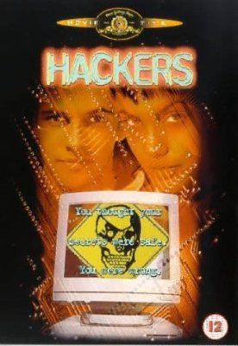
Social Engineer Profile
Not as in movies: may be
  Outgoing
  Confident
  Well educated
  Blend into environment
  (clothing, style, speech)
  Good actor
  Quick reactions to changing
  circumstances
Dark side
  Exploits relationships
  Little or no empathy for victims (instrumental)
  Increasingly, they are involved in criminal gangs
Especially bad stereotypes

Slide 27
Dangers & Impact
Consequences
Success Rate
Small Businesses vs Large Organizations

Slide 28
Consequences
Loss of control over internal
documents
  Advantage to competitors –
  loss of market share
  Stock manipulation – SEC
  investigations
  Bankrupt company
  Possible criminal proceedings against officers
Loss of control over customer personally identifiable information (PII)
  Legal ramifications including $$$ liability
  Embarrassment
  Human consequences of identity theft
Difficulty tracking down how crime was committed
  Destroy trust among employees

Slide 29

Success Rate
Poor statistical base
  Difficult to detect
  Difficult to find documentation
Anecdotal evidence from security
experts
  Social engineering works
  Consensus that methods are
  often used…
  … and highly successful
Organizations must prepare to defend themselves against these methods (see below)

Slide 30
Small vs Large Organizations
Small Organizations
Less prepared & more vulnerable
People know each other
More likely to suspect and challenge strangers
Better communication – may report suspicions quickly to people they know
Smaller workforce to train
Large Organizations
More fragmented: many strangers anyway
Concern about embarrassment if stranger is executive from afar
Bystander effect: let someone else deal with it
Poorer communications: may never have met security officers

Slide 31
Detection
People
Audit Controls
Technology for Detection

Slide 32
People (1)
Train employees to remember details of phone calls they receive when caller asks questions
  Gender?
  Caller ID?
  Noise in background?
  Accent?
  What questions?
  What answers?
Beware questions about names of managers
No employee should ask (let alone give) password

Slide 33
People (2)
Social engineers may use intimidation
Ensure that employees know they will not be
punished for enforcing security policies
  No legitimate manager would threaten them
  for NOT violating security rules
  Explicitly provide script for responding to
  threats – instant sign of potential fraud
    “Yes, I’ll be glad to help you – please
    hold the line.”
    Employee immediately notifies
    appropriate contact in security team
Provide employees with notification procedure
  Whom should they call?
  What information is most helpful (see previous slide)?

Slide 34
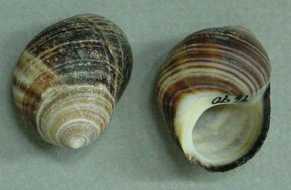
Audit Controls
Real-time audits of log files may detect social-engineering attack in progress
  But no guarantees
  Human manipulation may use no
  technical exploits until later in crime
  Actual exploit may be very fast
Post hoc audits may be useful
in reconstructing crime
  Trace how criminal used
  information winkled out of
  employees
Log
Log file*
*Grooooaaaaannnnn
Winkle
Littorina spp.

Slide 35
Technology for Detection
Content-blocking technology
  E-mail
  Web pages
  Make such monitoring
  part of documented & signed security policies
Social Engineering Defense Architecture (SEDA)
  Voice-recognition technology
  Provides better logging of phone calls

Slide 36
Response
Integrate social-engineering attacks into computer security incident response team processes
Collect forensic evidence
  In real time if possible
  At minimum ASAP
  Interview human victims
    Right away
    Humanely – do not give
    impression of looking for
    scapegoats
    Keep meticulous records

Slide 37
Defense & Mitigation
Training & Awareness
Technology for Prevention
Physical Security & Encryption

Slide 38
Awareness, Training, Education*
Raise awareness of problems
  Why employees should care
Explain social engineering techniques to employees
  Real case studies
  Demonstrations
Encourage and support challenges
  Asking reasons for questions
  Asking for employee identification
  Checking for authorization for unusual requests
Provide role-playing exercises to reduce reluctance
Provide emergency response contact info
*ATE

Slide 39
Technology for Prevention
Effective antimalware tools
  Block viruses, Trojans
  Block dangerous Web sites
  Block dangerous phishing spam
  Block popups, ActiveX controls
  Restrict types of cookies
  Use digital certificates to authenticate internal e-mail
Control over software installation
Cleanse documents of hidden metadata
Check Web for unauthorized posting of confidential documents or information

Slide 40
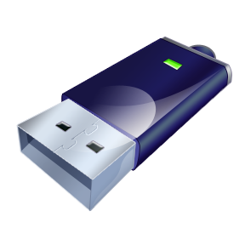
Physical Security, Encryption, & DLP
Prevent theft of confidential information
  Lock filing cabinets after hours
  Shred discarded documents & disks
  Protect Dumpsters® against divers
Use data encryption
  Computers – whole-disk encryption
  Peripherals such as USB drives
  Virtual private networks (VPNs)
  for remote access
Data-loss prevention (DLP)
  Prevent unauthorized devices from connecting to organization’s networks

Slide 41
Now go and study

