Slide 1
Spam, Phishing & Trojans
CSH6 Chapter 20
“Spam, Phishing & Trojans:
Attacks Meant to Fool”
Stephen Cobb

Slide 2
Topics
CSH6 Chapter 20
Introduction
Email Basics
Spam (not SPAM™)
Fighting Spam
Phishing
Trojan Code
Supplementary material added in June 2018 to update older statistics

Slide 3
Introduction
Definitions
  Spam = unsolicited commercial email
  Phishing = use of deceptive spam to trick victims into clicking on dangerous links
  Spear-phishing = use of targeted email to obtain confidential personal information
  Trojan code = programs that have covert unauthorized functions (usually malicious)
Serious consequences
  Degradation in trustworthiness of
  email
  High volume of spam uses bandwidth
  Email has become vector for technological & social harm

Slide 4
Common Elements
All use deception
  Prey on gullibility
  Some exploit greed
  All depend on ignorance
Enabled by system services
Run at the application layer
Often combined for additional power & harm
Consistently underestimated at time of emergence – warnings met with skepticism & hostility
Rapid proliferation
Enormous social & technological costs
Associated with growth of financial gain as
prime motivator for malware & Internet abuse
Some spammers trick companies into thinking
they are sending legitimate publicity

Slide 5
Email Basics
Email at core of delivery method
  SMTP – Simple Mail Transport Protocol
  No process for verifying validity of FROM and TO data
Attempts to add security to email transmission
  Whitelist: allowable senders
    Difficult to maintain
    Slows processing significantly
  Blacklist: forbidden senders
    Often wrong
    Can be fooled by bad actors into adding legitimate sites (e.g., University email being auto-forwarded to external email system)

Slide 6
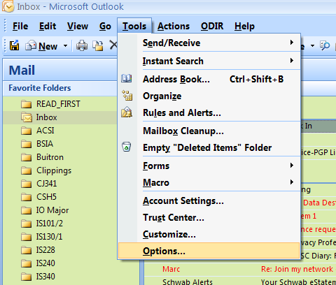
Email Headers (1)
Every step in multistage transmission of email adds information to
the header
Email programs
usually
  Suppress header
  but
  Allow user to
  examine header
  on demand
  No guarantee of
  locating original
  sender

Slide 7
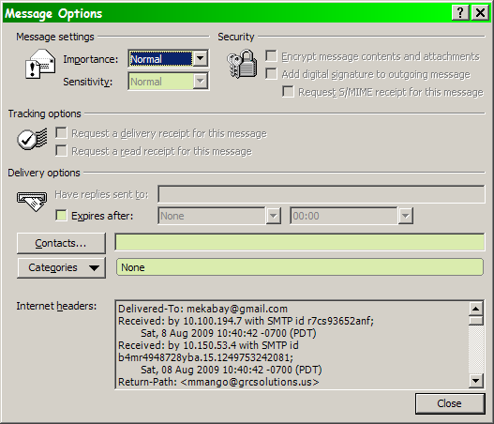
Email Headers (2)

Slide 8
Email Headers (3)
Delivered-To: mekabay@gmail.com
Received: by 10.100.194.7 with SMTP id r7cs31769anf;
Fri, 7 Aug 2009 08:37:11 -0700 (PDT)
Received: by 10.210.59.5 with SMTP id h5mr1550646eba.48.1249659430313;
Fri, 07 Aug 2009 08:37:10 -0700 (PDT)
Return-Path: <register@caloga.com>
Received: from xb73.caloga.com (xb73.caloga.com [195.154.149.73])
by mx.google.com with ESMTP id 5si9030773ewy.76.2009.08.07.08.37.08;
Fri, 07 Aug 2009 08:37:09 -0700 (PDT)
Received-SPF: pass (google.com: domain of register@caloga.com designates 195.154.149.73 as permitted sender) client-ip=195.154.149.73;
Authentication-Results: mx.google.com; spf=pass (google.com: domain of register@caloga.com designates 195.154.149.73 as permitted sender) smtp.mail=register@caloga.com; dkim=pass header.i=@caloga.com
DKIM-Signature: v=1; a=rsa-sha256; c=relaxed/relaxed;
d=caloga.com; s=b; h=To:Subject:From:Reply-To:Mime-Version:
Content-Type:Message-Id:Date; bh=bJnEbQ995zW/silLnUF/1gdmA+VT9cP
VDv3YTFIT6HM=; b=Nf5f1SEZsZymFZFJzqJE+LDcl2bENbAf0rs9yBwyuBaOVne
epBUZJY2sVa505th4NdFkSkg2lt6YM5AhAvM+8VtowOt6htpvWkyyf8KXcDNzliB
LAnEnBDEapmQxu+X/1JP2iHqHZdwrpygHWvNh0zdFh0TjvrQiQ4pQ3EdTdjc=

Slide 9
Email Headers (4)
DomainKey-Signature: a=rsa-sha1; q=dns; c=simple; s=a; d=caloga.com;
h=Received:To:Subject:From:Reply-To:Mime-Version:Content-Type:Message-Id:Date;
b=IchDBRKGQyNhQ4rUhJM6OXsRYZ7UlJkzYByQfPtzj7D8asqfE1kI/DjuAlPQOJ5WuiR2c99CpmN2hSTRPCIlEsbRqDGZ9rVs5Y2ZjedCbblCMvevENZq2stmynTb0ISb;
Received: from www-data by caloga-deux.caloga.com with local (Exim 4.69)
(envelope-from <register@caloga.com>)
id 1MZRUd-0IAMxj-F9
for mekabay@gmail.com; Fri, 07 Aug 2009 17:36:31 +0200
To: mekabay@gmail.com
Subject: Profitez de 30 euros offerts pour en gagner plus
From: PMU par Caloga <register@caloga.com>
Reply-To: PMU par Caloga <register@caloga.com>
Mime-Version: 1.0
Content-Type: multipart/alternative; boundary="Part4a7bdac8ac973";charset="iso-8859-1"
Message-Id: <E1MZRUd-0IAMxj-F9>
Date: Fri, 07 Aug 2009 17:36:31 +0200
Visible in
usual short
header

Slide 10
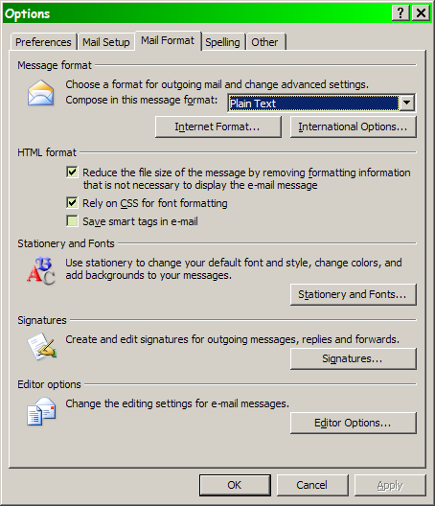
Email Source Code (1)
Early email systems transmitted plaintext messages
  EBCDIC for IBM systems
  ASCII for everything else
HTML email
  Supports formatting, stationery, visual signatures
  Also supports malware, phishing

Slide 11
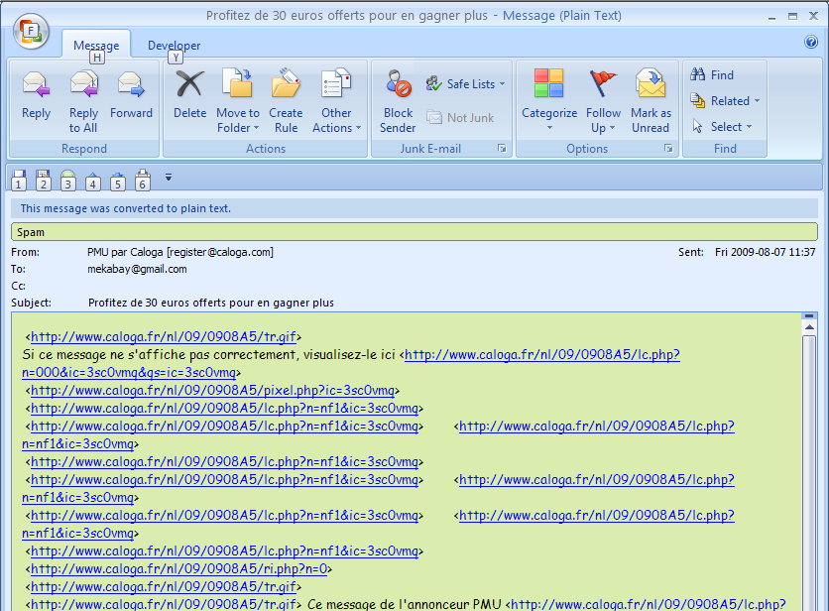
Email Source Code (2)

Slide 12
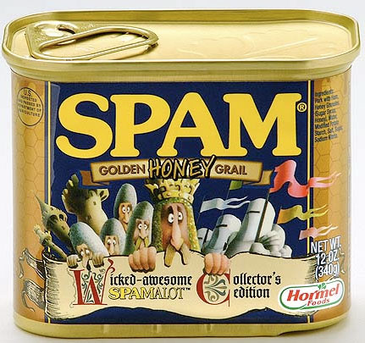
Spam Topics
Origins & meaning
of Spam
(not SPAM™)
Digging into Spam
Spam’s Two–Sided
Threat
Fighting Spam

Slide 13
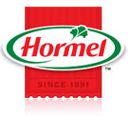
Spam (not SPAM™)
SPAM™ is a trademark of the Hormel Corporation for a canned meat product
  Do NOT use SPAM in all uppercase to refer to unsolicited commercial email…
  … except if entire text is
  uppercase, as in a title
  May use “Spam” as first word in a
  sentence or “spam” elsewhere
  (Hormel does not object to these
  usages)
Origin is the Monty Python skit about a restaurant where almost all the dishes have SPAM™ in them
  http://pythonline.com/node/18297641
Applied 1st to MUDs, then BBS, then USENET

Slide 14
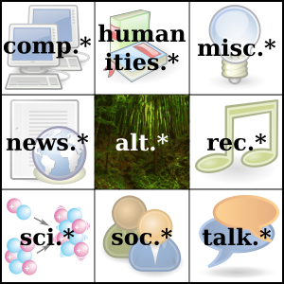
Spam & the USENET
USENET is early form of social networking
  Vast array of special-interest discussion groups
  Spammers ruined USENET as
  medium of exchange – barrage
  of repetitious, unwanted
  commercial messages
Spammers harvested email
addresses from USENET posts
  Was the custom to include
  email address in postings
  Custom declined after mid-1990s due to abuse by spammers
Spam volume reached 85% of all email by 2005

Slide 15
Digging Into Spam
Definitions
Get Rich Quick
Crime & Punishment
Wasteful Game
Magnitude of the Problem

Slide 16
Defining Spam
Unsolicited Commercial Email (UCE)
  Early definition
  Emphasized types of unwanted email that involved money
Other forms of unsolicited email
criticized or defended
  Political messages
  Announcements of noncommercial
  events (conferences, art shows….)
  Charity requests
Questions about meaning of “unsolicited”
  Spammers use any excuse to weasel around definitions of unsolicited
Even legitimate companies tempted to spam

Slide 17
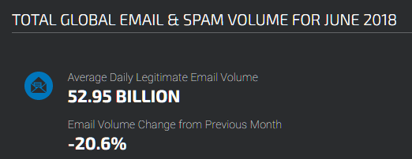
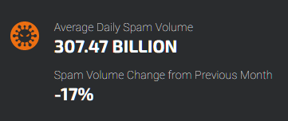
Spam Statistics (1)
https://www.talosintelligence.com/reputation_center/email_rep
307.47/(307.47 + 52.95) = 85%
i.e., 85% of all email sent/rec’d in June 2018 was spam
--according to talosintelligence.com

Slide 18
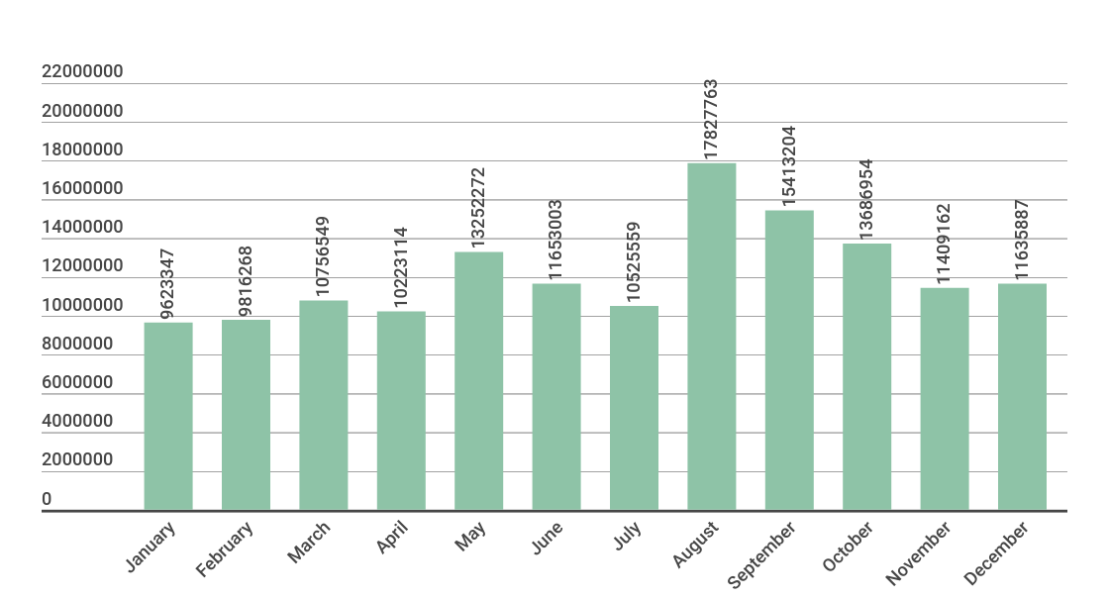
Spam Statistics (2)
https://securelist.com/spam-and-phishing-in-2017/83833/
Spam with malware as reported by clients of Kaspersky Labs in 2017
-- 62% lower than in 2016

Slide 19

Get Rich Quick (1)
Spamming can be profitable
  Costs low or zero (esp. for pirate users of open spam relays – SMTP servers without security and botnet herders)
  Even tiny % of responses from suckers can generate significant profit through fraud/theft
C. P. Direct (spammers in Arizona) shut
down 2002
  Sold $70M worthless anatomy-
  expanding pills
  Refused to grant refunds when
  victims complained
  Significant assets found by FBI
    $3M cash + jewelry
    Bank account balances totaled >$20M
    12 imported luxury cars (e.g., Lamborghini)
    Owned office building + luxury real estate

Slide 20
Get Rich Quick (2)
Selling spam also source of profit for criminals
  Approach naïve companies
  Claim to have huge lists of
  highly tailored opt-in targets
  Charge for spam sent
  indiscriminately to anyone
  on lists
Victims typically businesses in developing world
  Growing frequency of such cases from PRC
  Exacerbated by language difficulties
  Hardworking people are primary victims; recipients are secondary victims

Slide 21

Crime & Punishment
Risk of prosecution and severity of punishment are minor
C. P. Direct perpetrators
  Michael Consoli & Vincent Passafiume pled guilty Aug 2003
  Out of jail before May 2004
  Petitioned Arizona Court of Appeals
  to overturn convictions and return
  their loot
Jeremy Jaynes: a Top-Ten Spammer in
2003
  Sent out 10M spam msg/day for
  $750K/mo profit
  Convicted 2004, sentenced to 9 years
  prison
  Appealed conviction on constitutional
  grounds (see next slide)

Slide 22
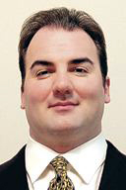
Jeremy Jaynes Absolved
Basis from litigants for case before VA Court of Appeals (2006)
  Claim: VA anti-spam law violates Commerce Clause by regulating email sent outside state
  Claim: Violates First Amendment because spam is form of free speech
  Court of Appeals rejected both arguments
VA Supreme Court first round (Feb 2008)
  Rejected standing to raise 1st amendment defense
VA Supreme Court second round (Sep 2008)
  Rehearing: accepted standing for 1st Amendment
  Reversed its earlier ruling and vacated convictions on grounds that anti-spam statue did violate 1st Amendment by being overbroad (!)
SCOTUS refused writ of certiori and declined to review case – ruling stands as a precedent

Slide 23
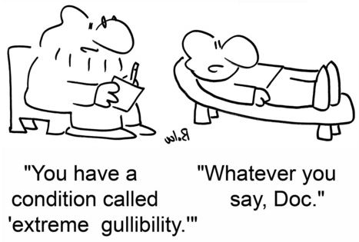
Spam a Wasteful Game (1)
Play on gullibility
  Send money to learn how to earn money easily
  Sometimes response is to send spam teaching how to earn money by sending spam….
Other widespread scams
  Pump ‘n’ dump schemes (raise/lower value of stock through spammed
  lies)
  Phishing schemes
  discussed later
  Nigerian 419 fraud &
  fake lottery winnings
  (advance-fee fraud)

Slide 24
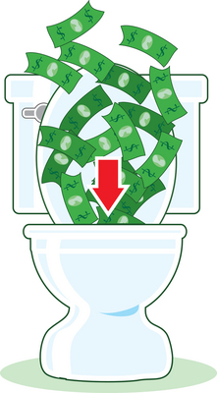
Wasteful Game (2)
Costs borne by
Email recipients
  Waste time sorting through spam to find good email
  Pays to receive email (someone always pays for Internet connection)
Enterprises
  Lost productivity due to delay in finding real email
  Costs of anti-spam measures
  Wasted resources (bandwidth, disk space, CPU)

Slide 25

Wasteful Game (3)
ISPs
  Wasted resources (bandwidth, disk space, CPU)
  Spam filtering costs, |
  administration
  Policing users to prevent
  blacklisting
Other economic factors
  Depressed economy seems to
  increase gullibility & therefore
  spam
  Spammers use as much
  bandwidth as they can get, so
  battle is never-ending

Slide 26
Magnitude of the Problem (1)
Misperception that spam is not significant
  Newbies
  Office-only users whose email is filtered before they see it – thus little spam in their inbox
Proportion of all email that is spam has grown rapidly
  1994 – 0%
  2002 – 50%
  2013 & later – 80-90% depending on source of statistics
Major effects on ISP infrastructure
  Disk storage
  Bandwidth
See graphs from Symantec on next 2 slides

Slide 27
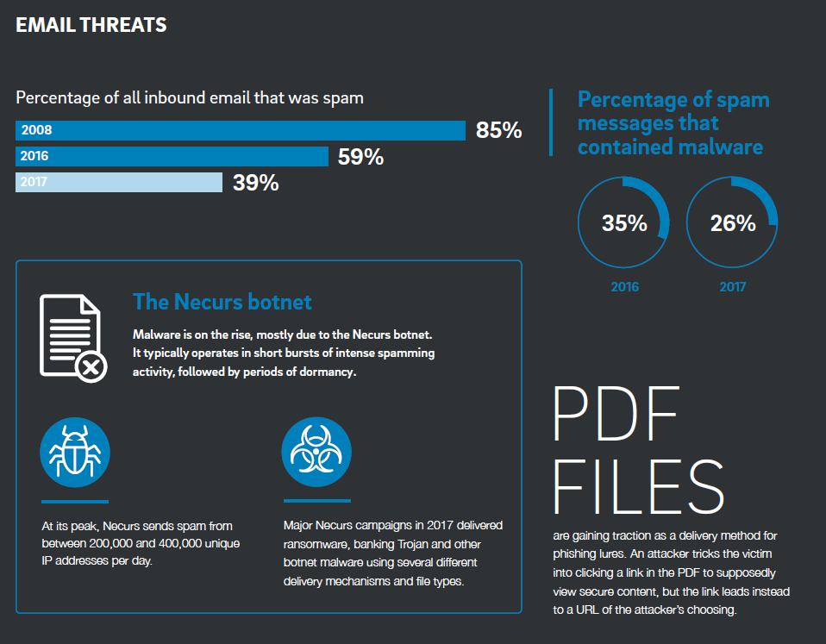
Magnitude of the Problem (2)
https://www2.trustwave.com/GlobalSecurityReport.html

Slide 28
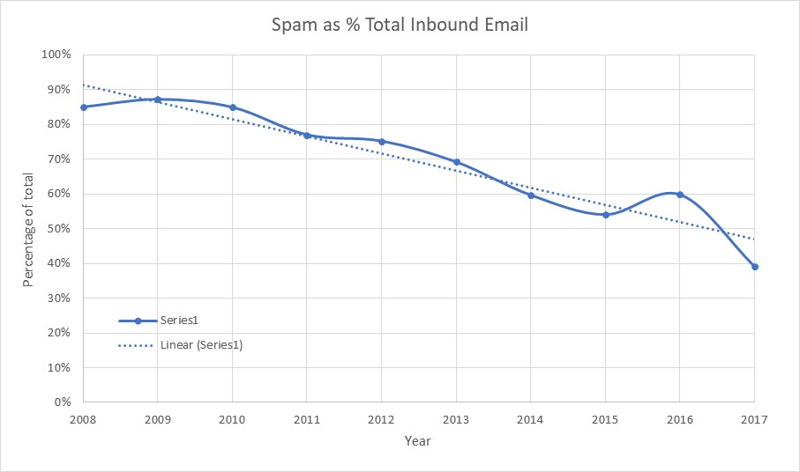
Magnitude of the Problem (3)
Graph generated from data in original but with zero ordinate to comply with professional standards of graph presentation.
https://www2.trustwave.com/GlobalSecurityReport.html

Slide 29
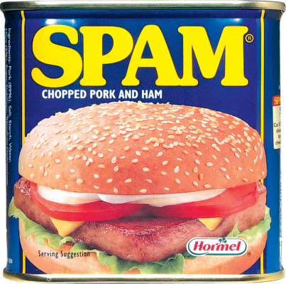
Spam’s Two–Sided Threat
Threat to resources well documented
  As discussed in previous sections
  Damages to a modest company can easily be counted in $M/year
But other side is risk that employee will involve organization in sending spam
Topics of following slides:
  Threat of Outbound Spam
  Mass E-Mail Precautions
  Appending & Permission Issues

Slide 30
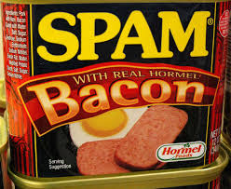
Threat of Outbound Spam
Rogue marketeers can be tempted to spam
for what they hope will be cheap, quick
results
Damage to organization
  Damage relations with existing
  customers
  Alienate potential customers
  Tarnish reputation
  All outbound email may be blocked
  once company associated with spamming
  Retaliation (see next slide)

Slide 31

NW World (Dec 1994)
Anonymous executive – USETNET spam
Posted advertising to 20 USENET news groups
  Stupidly posted message 20 times instead of once to 20 groups – readers received multiple copies of spam
Thought people would be interested
Consequences
  Email bombs sent to company email addresses
  Toll-free number posted in alt.sex groups
    Thousands of obscene phone calls
    One receptionist quit in disgust
    Other sent all toll-free calls directly to his phone
  Nearly destroyed his career
Urged readers never to do such a stupid thing!

Slide 32
Mass E-Mail Precautions
Never send email unless you are sure you know what it will look like to recipient
  Don’t assume formatted email accepted
  Perhaps append a PDF formatted document
Address field
  Use TO: only for few people directly involved
  Use CC: only for few people who may want to respond to each other
  OTHERWISE, use BCC to hide all the addressees
    Reduce wasted email from REPLY ALL
    Protect confidentiality of recipients
    Reduce access to addresses by spammers

Slide 33

Six Resolutions for Responsible E-Mailers
Don’t falsify origin or use dummy IP address
Don’t use misleading/false SUBJECT line
Include option in message for
unsubscribing
Inform respondent of purpose of
collecting email address
Don’t harvest email addresses to spam
people
Do not send bulk unsolicited email to people who do not have a prior established business or personal relationship to the sender
I
II
III
IV
V
VI
Council for Responsible E-Mail
Association for Interactive Marketing
Direct Market Association

Slide 34
Appending & Permission Issues
Companies called email appenders offer to find email addresses for customers who have not provided them
Some of the email addresses are wrong: not right person – raises privacy issues
Some recipients object to harvesting and use of their email address without permission
May violate written privacy policy: legal liability

Slide 35
Fighting Spam
Spam Fighters
Good Reputation
Relaying Trouble
Black Holes &
Block Lists
Spam Filters
Network Devices
Email Authentication
Industry Initiatives
Legal Remedies

Slide 36

Spam Fighters: CAUCE
Coalition Against Unsolicited Commercial Email
http://cauce.org
CAUCE US founded 1997 by USENET members in news.admin.net-abuse.email & SPAM-L mailing list
CAUCE North America joined CAUCE US & CAUCE Canada.
Instrumental in passing antispam laws

Slide 37

Spam Fighters: Spamhaus (1)
Spamhaus Project founded 1998 by Steve Linford
http://www.spamhaus.org
Goals
  Tracks the Internet's spammers, spam gangs & spam services
  Provides dependable real-time anti-spam protection for Internet networks
  Works with law enforcement to identify and pursue spammers worldwide
(cont’d on next slide)

Slide 38



Spam Fighters: Spamhaus (2)
SBL: Spamhaus Block List
  http://www.spamhaus.org/sbl/index.lasso
  Real-time database of IP addresses
    Verified spam sources & operations
    Free for email administrators
XBL: Exploits Block List
  http://www.spamhaus.org/xbl/index.lasso
  Real-time database of IP addresses of hijacked PCs
  Including open proxies, worms/viruses with spam engines…
PBL: Policy Block List
  http://www.spamhaus.org/pbl/index.lasso
  Database of IP address ranges that should never deliver SMTP email to Internet mail server except their own
  Maintained in collaboration from ISPs and network admins

Slide 39
Commercial Antispam Products
Began in late 1990s as filters for individuals
Some well-known appliances & services
  Brightmail (Symantec) http://tinyurl.com/lcyl33
  Postini (Google) http://tinyurl.com/r77p7v
  IronPort (Cisco) http://www.ironport.com/
  Cloudmark http://www.cloudmark.com/
  SPAMfighter http://www.spamfighter.com/
Open-source: Apache SpamAssassin Project
  http://spamassassin.apache.org/
These references are not endorsements.

Slide 40
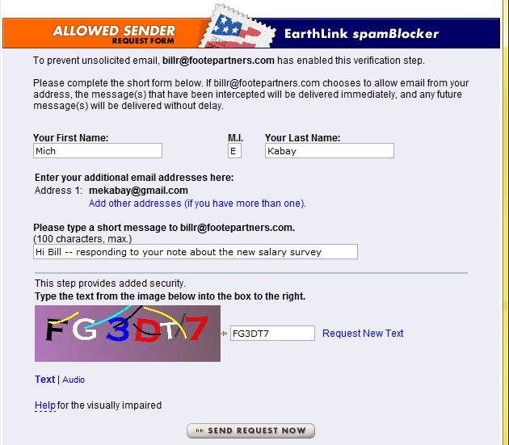
Whitelisting
Respond to unknown senders
Ask for human interaction
Approve once forever
Use CAPTCHA* to prevent automated response
*Completely Automated Public Turing test
to tell Computers and Humans Apart

Slide 41
Good Reputation
Theory: recognize reliable/trustworthy sources
Challenge-response
  EarthLink ISP rolled out system in 2003
  First time one sends email to EarthLink customer, must respond to query email before being allowed through
  But some legitimate sources have no-response return addresses
Whitelist
  Maintain list of sources that are deemed reliable
Cryptographic seal
  Establish authentic origin
  ePrivacy Group project failed to win sufficient market share to be effective
  S/MIME digital signatures might also work

Slide 42
Relaying Trouble
ISPs almost universally ban
spamming
  Exceptions are criminal
  organizations providing spam services
Open spam relays
  SMTP servers that do not require identification & authentication to send mail
  Grounds for black-holing
  Still some open relays left on the ‘Net due to administrative laziness / irresponsibility
Botnets create their own SMTP servers (daemons) on compromised computers

Slide 43

Black Holes & Block Lists
Catalog IP addresses that have sent out significant volumes of spam
  Direct originators
  Open spam relays
  Compromised by botnet daemons
User systems check list before
passing on email – or drop packets
Original black hole list: MAPS RBL
  Mail Abuse Prevention System
  Realtime Blackhole List (1997, Paul Vixie)
  Sold to TREND Micro in 2005
  Renamed Email Reputation Services
  http://tinyurl.com/43q9dp
Other products also include black holes (see earlier slides)

Slide 44
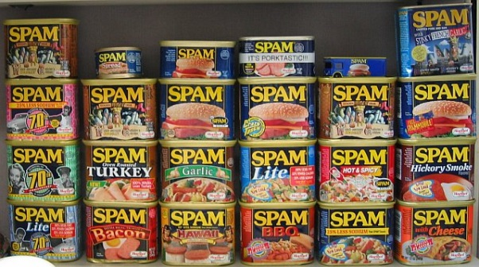
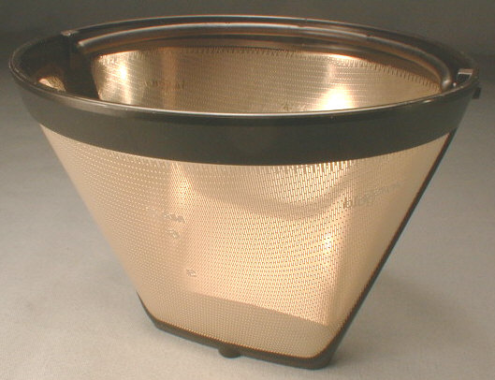
Spam Filters
Content filtering another approach
End-user Filters
ISP Filtering
Filtering Services
Collateral Damage

Slide 45
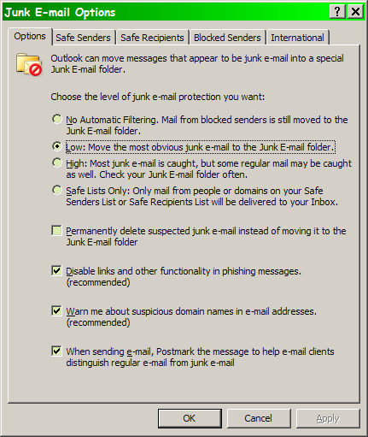
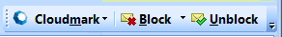
End-user Filters
Individual email client settings available
  Can automatically file email from known correspondents into separate mailboxes
  Rest can be examined more quickly
Commercial products compile databases of signatures
  Anything missed can be reported by user

Slide 46

ISP Filtering (1)
Concern about content-based
filtering
  Construed as privacy
  invasion
  Risks of false-positives
Formerly focused on
SUBJECT field
  Hence spammers use variant spellings & bizarre punctuation to avoid filters
Public ISPs face legal issues
  Status as equivalent of common carriers at risk if they filter too aggressively
Individual corporations have no legal constraints
  No privacy rights involved
  No legal obligation to deliver unwanted email

Slide 47
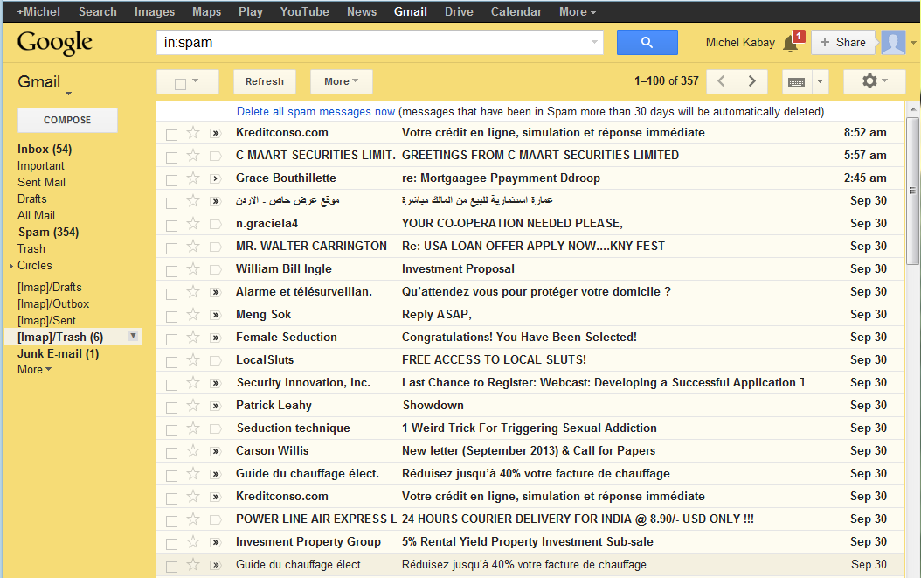
ISP Filtering (2)
Filtering getting better
  Using user intervention (“not spam” & “is spam”) to tighten filtering
  Origination filters; e.g., block all .RU or .CN
  Language
  filters; e.g.,
  block all
  non-Western
  language
  sets

Slide 48

Filtering Services
Redirect all client’s email to their servers
Use wide range of spam-spotting techniques
  Block lists
  Header analysis
  Content analysis
  Known-spam signature comparisons
  Heuristic filtering for spam-like features
  Whitelisting
Enormous volumes allow refinements in filtering algorithms
Collective intelligence schemes rely on users to vote on whether message is spam
  E.g., Cloudmark
  Reliability of voter determines weight (thus eliminating spammers’ votes for their own spam)

Slide 49
Collateral Damage
Spammers can keep spamming
  Costs of resources fall on the
  victims, not the spammers
  Nothing prevents spammers
  from trying new methods
  Overall resource utilization slows email, uses processing & other resources on many systems
Type I & Type II errors
  Type I error: false positive – mistakenly classifying legitimate email as spam
  Type II error: false negative – failing to recognize spam

Slide 50
Network Devices
One approach to attacking spammers is to track the money
Most spam designed to generate revenue
  Therefore always some legitimate response address
    Email
    Web site
But Web addresses for spammers
disappear / mutate rapidly
Therefore key response is to slow spam down
  Delay spam (or spam suspects) using antispam router and traffic shaping
  Delay is disaster for spammer, negligible for legitimate traffic

Slide 51
Email Authentication
If real sender of email were known, would greatly interfere with spammers’ spoofing
  Several attempts to add authentication of sender’s domain name to email
Sender Policy Framework (SFP)
http://www.openspf.org/
Certified Server Validation (CSV)
http://mipassoc.org/csv/
SenderID (Microsoft)
http://tinyurl.com/9rs9b
DomainKeys Identified Mail (DKIM)
http://www.dkim.org/

Slide 52
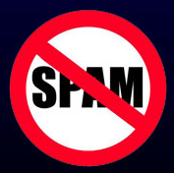
Legal Remedies
US CAN-SPAM Act of 2003
  Controlling the Assault of Non-Solicited Pornography and Marketing Act
  Enforced by FTC
  Bans false / misleading header info
  Prohibits deceptive subject lines
  Requires inclusion of opt-out method
  Requires self-labeling as advertisement & valid physical postal address
Complete failure – no visible effect whatsoever
Led to Prof Kabay’s all-time favorite Network World Security Strategies column title: “CAN CAN-SPAM CAN SPAM?”

Slide 53
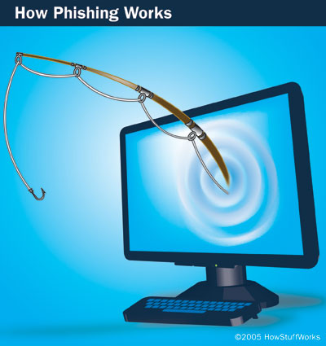
Phishing
Defining Phishing
What Phish
Look Like
Growth & Extent of Phishing
Where is the Threat?
Phish Fighting
Image provided courtesy of
How Stuff Works.com
http://computer.howstuffworks.com

Slide 54

Defining Phishing
Use of spam to fish for personally identifiable information (PII)
Try to simulate official-looking email to fool victims into cooperating
Aim is financial fraud
Began ~2004
Has grown steadily & become major problem
Variants include spear phishing
  Claiming that email comes from recognizable origin; e.g., HelpDesk at specific company
  Targets employees in specific organization

Slide 55
What Phish Look Like (1)
Simulate appearance of legitimate-looking email
  Logos
  Typefaces
  Links labeled with credible URLs
Glaring errors
  Many phishing scams run by non-native English speakers
  Full of spelling & grammar mistakes
Logic errors that should be caught by recipients (but are often overlooked)
  Why would anyone sign into a Web site to confirm a compromised userID/password combo? Doesn’t make sense!

Slide 56
What Phish Look Like (2)
Clues that a message is bogus
  Deceptive links – check source of email
  Descriptions don’t match underlying URLs
  Numerical IP addresses conceal foreign sites
Request to change PIN or password
  As described in previous slide, does not make sense
  No legitimate agency/bank would
  request such a thing
Generic greetings (Dear Customer –
or “Cutsomer”)
Bad spelling and grammar
Masking specific details (e.g., no name of bank)

Slide 57
Examples of Attacks
In examples shown in next slides, pay attention to details
Look for
  Bad spelling
  Poor grammar
  Logos
  Bad links
  Nonsensical offers
  Illogical demands

Slide 58
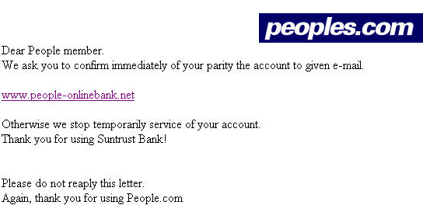
People's Bank
Eh???
Not the proper domain for peoples.com
Duhhh…

Slide 59
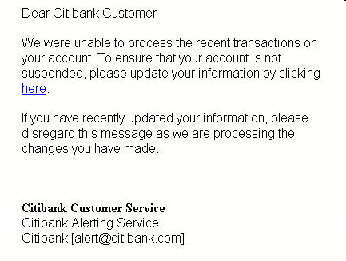
Citibank (Nov 10)
Links to
http://82.90.165.65/citi

Slide 60
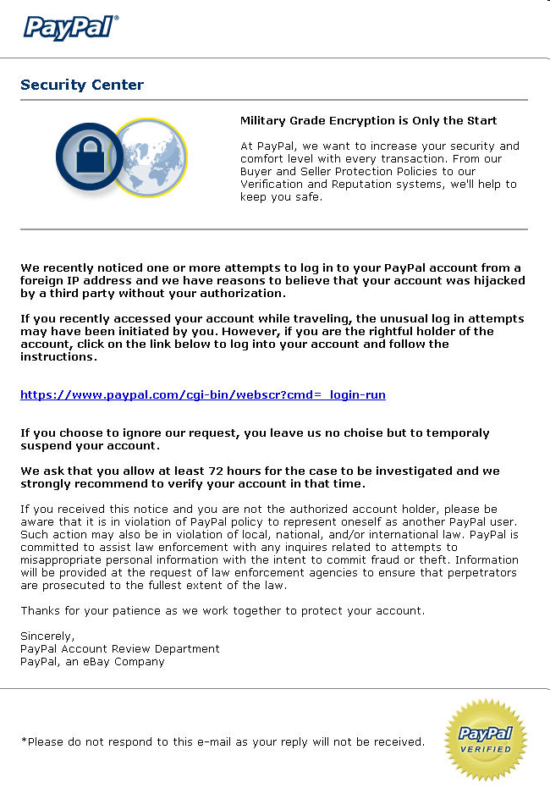
PayPal (1)
Why would we do this if our account is compromised?

Slide 61
PayPal (2)
Actually links to
http://212.45.13.185/.paypal/index.php

Slide 62
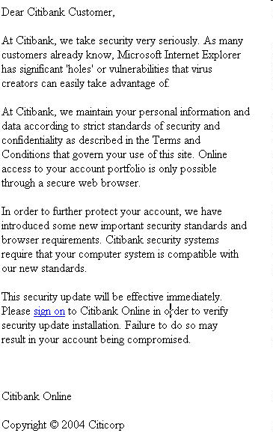
Citibank (Nov 1, 2004)
Links to
http://200.189.70.90/citi/

Slide 63
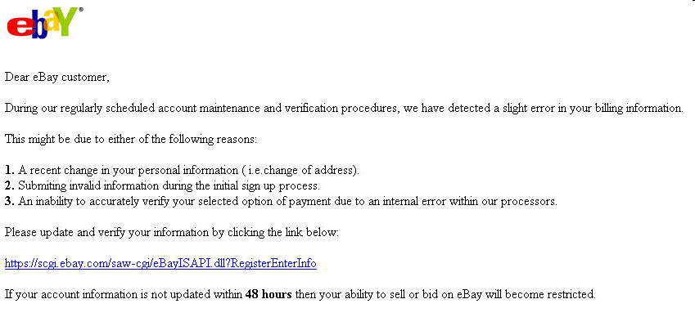
eBay (1)
http://signin-ebay.com-cgi-bin.tk/eBaydll.php which is in TOKELAU, South Pacific

Slide 64
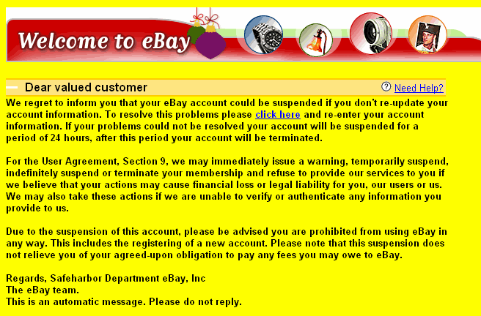

eBay (2) – Detailed Analysis
Received by MK 2004-11-17

Slide 65
eBay(2) Source Code
Extract of relevant section:
<p><STRONG><FONT face=arial>We regret to inform you that your eBay account could be suspended if you don't re-update your account information. To resolve this problems please </FONT><A
href="http://203.251.21.2/signin.ebay.com/ws2/eBayISAPI.dll/b2baf0b6a57d39abd6c44b48d6fe3559112c21e54b7e705ecc5116b3c7c38c37949e8aa81848934faf0821be04210e8c2ded3c4159edbee3ee1439f3892a3e91/"
target=_blank><FONT face=arial color=#0000ff>click here</FONT></A></STRONG><FONT face=arial> and re-enter your account information. If your problems could not be resolved your account will be suspended for a period of 24 hours, after this period your account will be terminated.<BR>

Slide 66
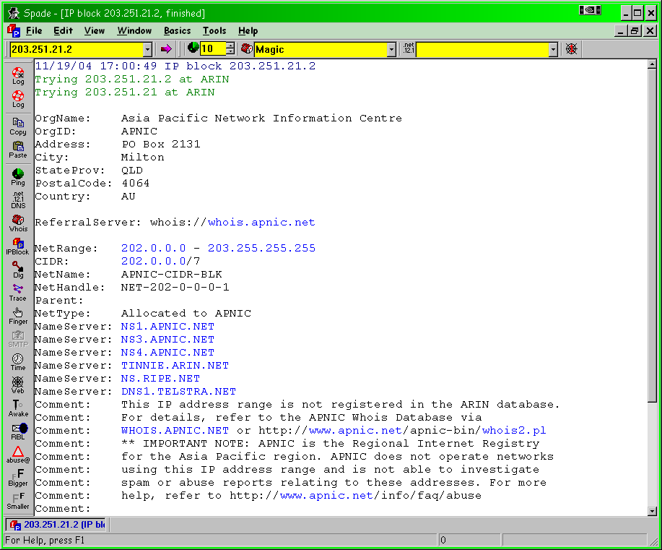
eBay (2) Reverse IP Lookup
Using SamSpade for Windows v1.4
Available free from
http://www.samspade.org/ssw/

Slide 67
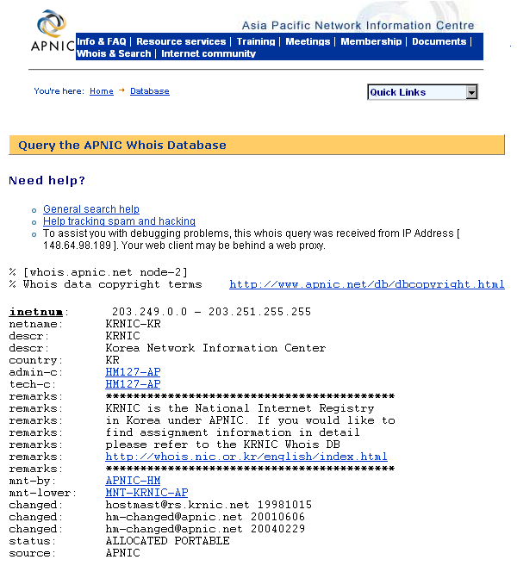
eBay (2) APNIC R-IP Lookup
Asia-Pacific Network
Information Center
Routes to KoreaNIC

Slide 68
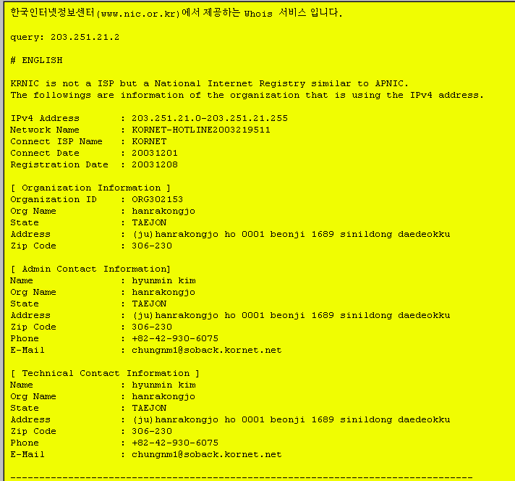
eBay (2) KRNIC R-IP Lookup
KOREA!
Email addresses
not always valid

Slide 69

Growth & Extent of Phishing
Anti Phishing Working Group (APWG) documents phenomenon
  http://apwg.org/
  Extensive reports with graphs & analysis
See extracts from most recent quarterly report on next slides: Phishing Activity Trends Report

Slide 70


Keyloggers & Redirectors
Keyloggers record and upload your passwords (and everything else) typed on keyboard
Redirectors send compromised users to dangerous Web pages
  Can modify Domain Name System (DNS) servers to pass back wrong addresses
  Or install local drivers on infected workstations to send traffic to
  fraudulent DNS servers
  Or filter lookups for specific
  redirection to criminal sites

Slide 71
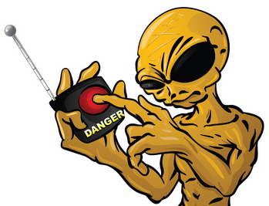
Where is the Threat?
Individuals
  Victimized by gullibility,
  ignorance
  FTC & others trying to
  teach public wariness
  Not working very well
Companies & e-commerce
  Too many people use same password / PIN on all their accounts
  Compromise using phishing on personal info may open up corporate systems, national security assets
  Undermine consumer trust in vendor

Slide 72
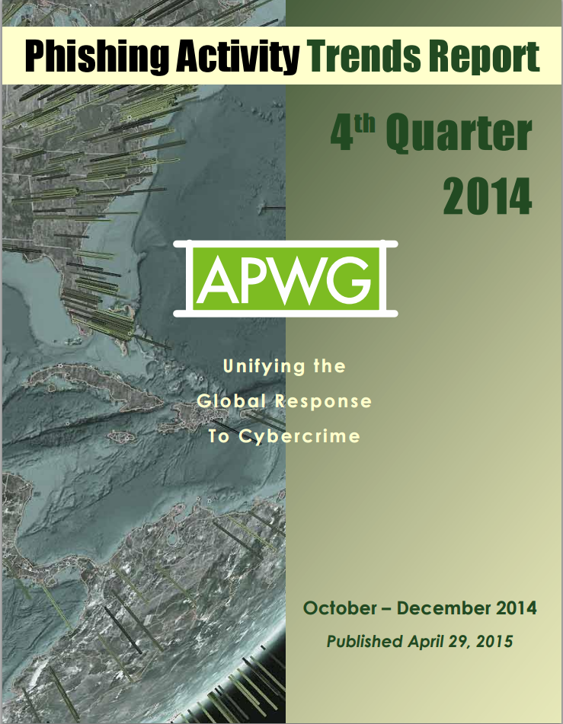
APWG Phishing Activity Trends (2014)
Anti-Phishing Working Group (APWG)
  http://apwg.org/
APWG Phishing Attack Trends Reports
Started 2004-01
Valuable resources for term paper!
https://apwg.org/resources/apwg-reports/

Slide 73
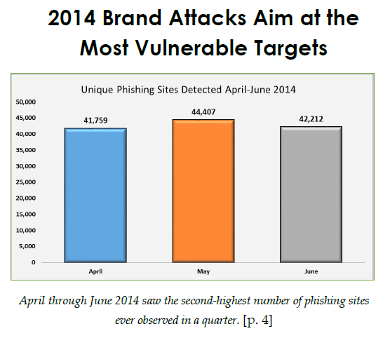
APWG Phishing Activity Trends (2014)

Slide 74
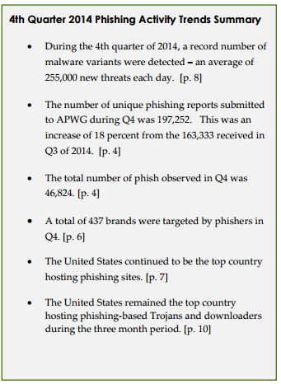
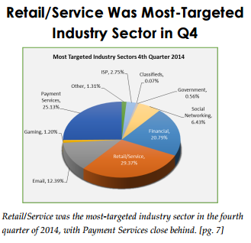
APWG Phishing Activity Trends (2014)

Slide 75
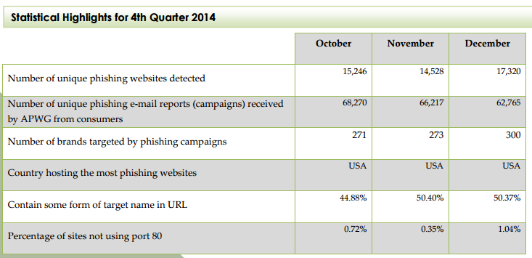
APWG Phishing Activity Trends (2014)

Slide 76
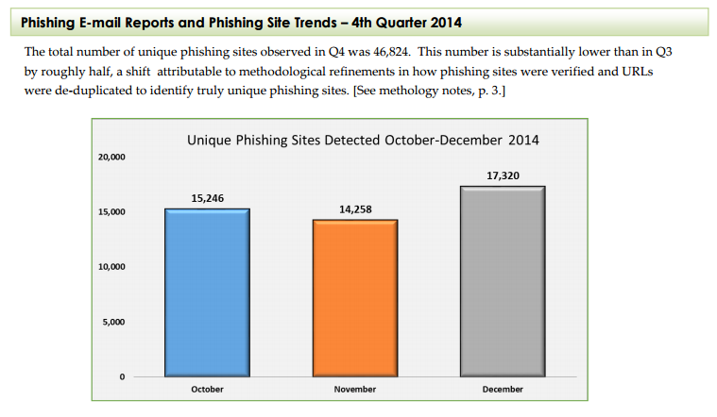
APWG Phishing Activity Trends (2014)

Slide 77
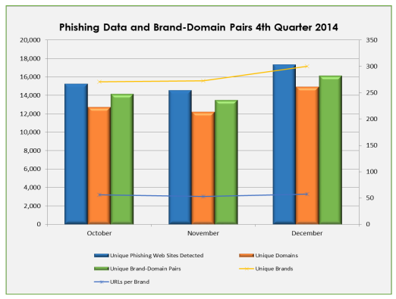
APWG Phishing Activity Trends (2014)

Slide 78
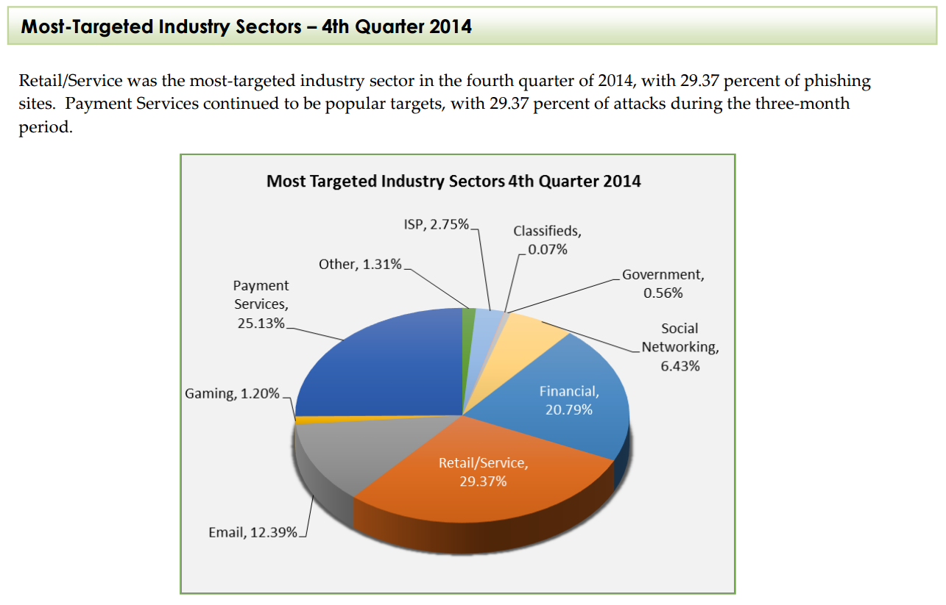
APWG Phishing Activity Trends (2014)

Slide 79
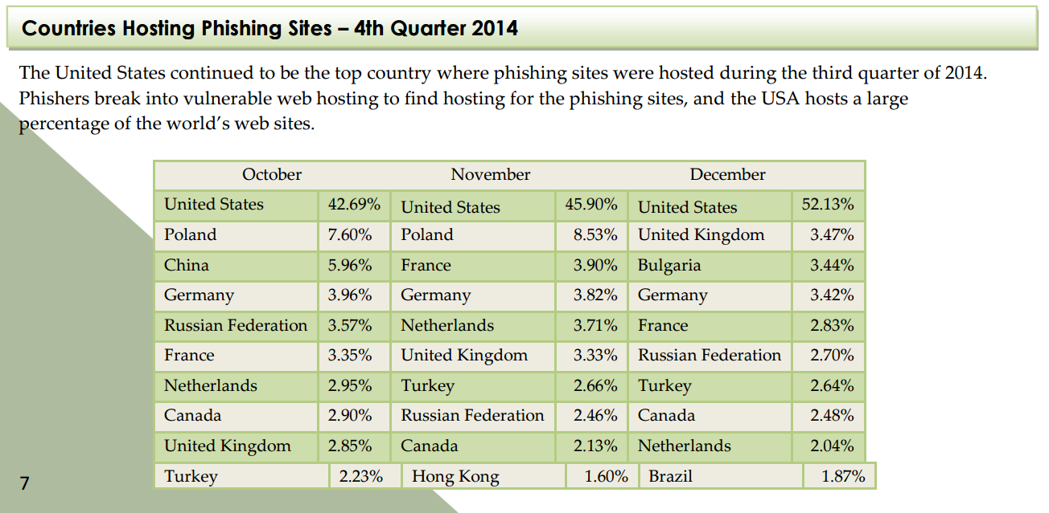
APWG Phishing Activity Trends (2014)

Slide 80
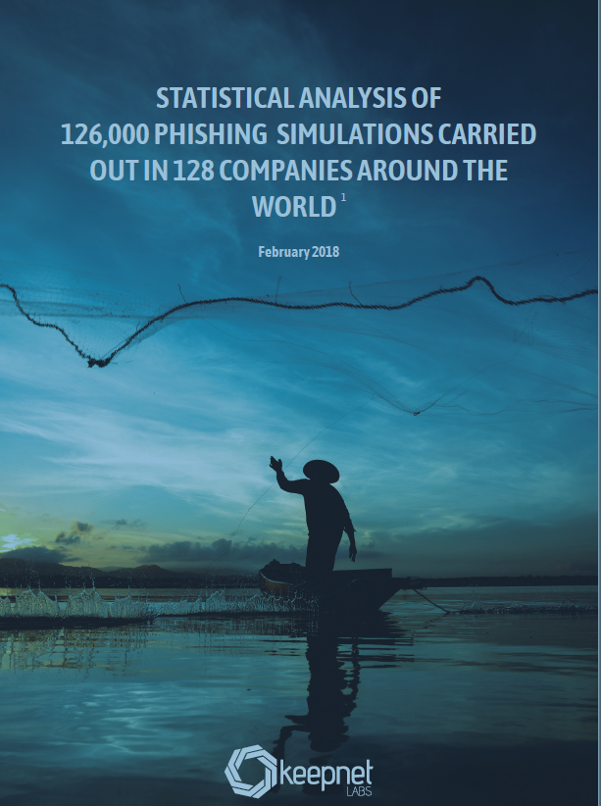
Keepnet Labs Phishing Simulation Study (2017) -- 1
~50% of employees in Legal, Audit, Internal Control, Mgmt, & IT will open & read phishing emails
~33% employees in Mgmt, in Legal, Audit, Internal Control, & R&D will click a link in phishing emails
~20% employees from R&D, Quality Mgmt, Health, & Sales will respond to phishing emails by providing requested info
http://tinyurl.com/yazv6cx6

Slide 81
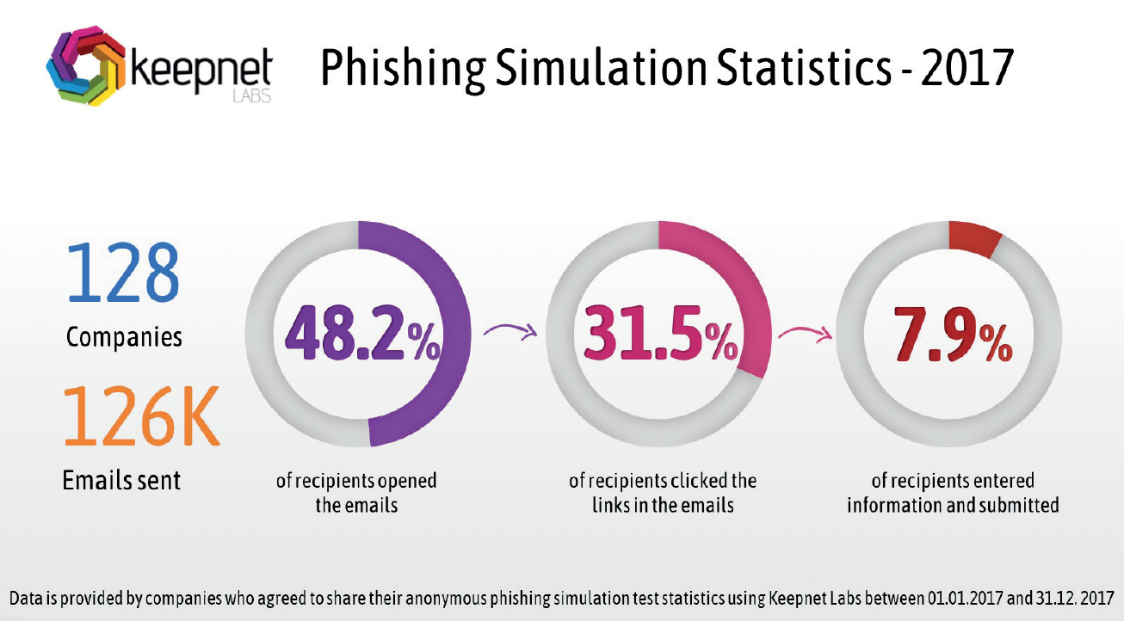
Keepnet Labs Phishing Simulation Study (2017) -- 2
Overall results for all departments
http://tinyurl.com/yazv6cx6

Slide 82

Phish Fighting
Consumer education
  E.g., Phishing Education Landing Page Program
    Simple method to put educational page in place of 404 when phishing page taken down
    http://education.apwg.org/r/about.html
Fix email (will be a while)
Blacklisting through browser
Authenticate Web sites
  SiteKey
  (see http://tinyurl.com/3mepsz )
  SafePass mobile phone text
  messaging
  (see http://tinyurl.com/kneqax )
  Token-based authentication
  instead of shared secrets
  (passwords & PINs)

Slide 83
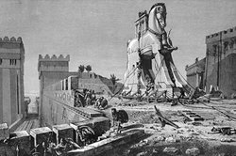
Trojans
Trojan Code
Basic Anti-Trojan Tactics
Lockdown & Quarantine

Slide 84
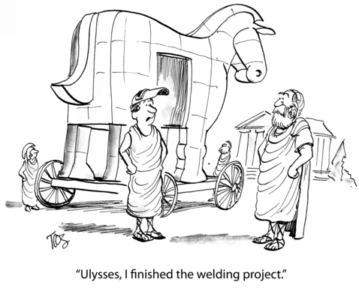
Trojan Code
Trojan horse used by Greeks to
trick Trojans into allowing
soldiers hidden in belly of
wooden statue into city
Common Trojans include
  Screensavers
  Pornography
Trojan droppers are programs
that bundle Trojans along with
harmless code
  Typically in compressed archive
  Created by joiner programs
  May install components directly into RAM
  Often used to install spyware / adware / viruses
  See F-SECURE page at http://tinyurl.com/lgcblc

Slide 85
Basic Anti-Trojan Tactics
Well-educated users who don’t
  Execute random code
  Open attachments from strangers
  Open unexpected attachments even from known sources
Keep operating systems and applications up to date: versions & patches
Run good antimalware/antivirus (“AV”) software at all times
Scan system regularly using AV
Beware messages claiming to be malware alerts – classic scam to trick users
Don’t fall for “scan-your-system-for-malware” ads

Slide 86

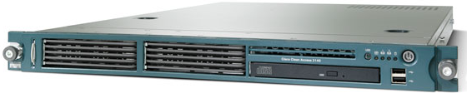
Lockdown & Quarantine
Prevent unauthorized changes to code
Prevent connections to unauthorized networks
Scan all systems for safety before allowing connection; e.g., Cisco Clean Access Agent
  Now called Cisco NAC (Network Admission Control) Appliance
  http://www.cisco.com/en/US/products/ps6128/
  Evaluates & remediates compliance with security policies; e.g.,
    Up-to-date AV strings
    Current patches
  Blocks non-compliant systems

Slide 87
Now go and study

