Slide 1
Web-Based Vulnerabilities
CSH6 Chapter 21
“Web-Based Vulnerabilities”
Anup K. Ghosh, Kurt Baumgarten, Jennifer Hadley & Steven Lovaas

Slide 2
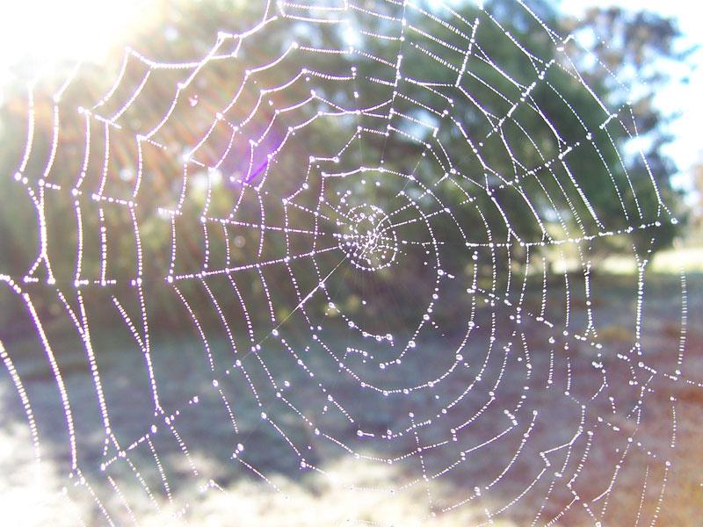
Topics
Breaking E-Commerce Systems
Case Study of Breaking an E-Business
Web-Application System Security
Protecting Web Applications
Components & Vulnerabilities in E-Commerce Systems

Slide 3
Breaking E-Commerce Systems
Thinking about how criminal hackers think
Attack weakest link
Look for monetary gain
Low-hanging fruit
Attack servers when possible
Must harden not only perimeter but also core
Asymmetric attacks
Defense harder & more costly than offense
Script kiddies have caused $M damage
E.g., MafiaBoy 2000 vs eBay, Amazon, Schwab….

Slide 4
Case Study of Breaking an E-Business (1)

Slide 5
Case Study of Breaking an E-Business (2)

Slide 6
Web-Application System Security
Absolutely require corporate security policy
Informs decisions on specific security configurations
Inconsistencies can doom security
Security systems should be independently evaluated
System audits (do measures conform with policy?)
Vulnerability analysis (can we locate obvious gaps in security?)
Penetration testing (can we break through the barriers using criminal hacker methods?)

Slide 7
Protecting Web Applications
Layered view of systems
Network, OS flaws usually documented
Alerts
National Vulnerability Database http://nvd.nist.gov/
Vulnerability scanners available (see CSH6 Ch 46)
Firewalls critical element
Application servers (Java etc) must be secured
Application security = function of how programs are configured & used (not just of patches)

Slide 8
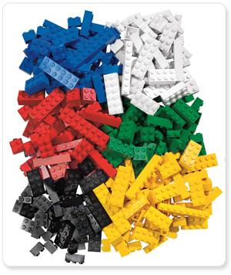
Components & Vulnerabilities in E-Commerce Systems
Client-Side Risks
Network-Protocol Risks
Business-Application Logic
CGI-Script Vulnerabilities
Application Subversion
Web-Server Exploits
Database Security
Platform Security

Slide 9
Client-Side Risks
Most e-commerce uses browsers
Also extending to hand-held devices
Threats from malicious mobile code (CSH6 Ch 16 & 17); e.g., Web scripts, Java applets, ActiveX controls, Trojan horse programs
Serious risk from loss of privacy
Identity theft against data subjects
Business & legal consequences for corporate victims
Browsers typically convey much private info
Spyware tracks computer usage

Slide 10
Network-Protocol Risks
Primarily result from sending unencrypted data over the ‘Net
Several protocols preserve confidentiality by using encryption
SET (Secure Electronic Transaction)
SSL (Secure Sockets Layer)
S/HTTP (Secure HTTP)(superseded)
S/MIME (Secure Multipurpose Internet Mail Extensions)
CyberCash (proprietary credit-card system)(bankrupt 2001, bought by VeriSign & First Data Merchant Services Corp.)
See CSH6 Ch 30

Slide 11
Network-Protocol Attacks
Man-in-the-middle (intercepting, inserting)
DNS attacks (altering tables to misdirect users)
War dialing (scanning all phone numbers in block for modems) – equivalent today is scanning for unsecured Wireless Access Points
Exploiting software holes (FTP, Bind, SMTP, HTTP)
Internal access (unauthorized behavior by authorized personnel)
Leveraging trusted hosts (attack from linked system)
Brute-force decryption (test all possible keys)

Slide 12
Business-Application Logic
Key area of vulnerability
Usually custom SW
Complex
May not be tested as thoroughly as COTS
Critical elements include
Common Gateway Interface (CGI)
Hypertext Processor (PHP)
Component-based software (CBS)
Enterprise JavaBeans (EJB)
Java 2 Enterprise Edition (J2EE)
Common Object Request Broker Architecture (CORBA)
Common Object Model (COM & DCOM)

Slide 13
CGI-Script Vulnerabilities
Frequent object of attack
Inputs not under control of programmer
Misconfiguration common problem
Individuals can add CGI to Web pages
Can go out of control – introduce holes
Best to limit execution of CGI to central directory under control of admin
Protect cgi-script directories (cgi-bin)
Languages create weaknesses
Perl, JavaScript, Python
Don’t include Perl interpreter in cgi-bin
Could allow unauthorized execution of commands

Slide 14
Application Subversion
Program misuse
Exploit program logic
Raise user privileges
Gain unauthorized data access
Attacker may discover unauthorized ways of using system
Send malformed input including commands
Redirect program output
Beware of amateurs
Apply strict software quality assurance to production code

Slide 15
Web Server Exploits
Configuration
Default = max function, min security
HTML Coding & Server-Side Includes
Disallow SSI to prevent insertion of unauthorized commands
Private Documents in Public Directories
Disallow directory browsing
Cookies & Other Client-Side Risks
Users can alter cookies created by Web site
Cookie poisoning can exploit authentication tokens
E.g., alteration of discount codes → losses

Slide 16
Database Security
Web interfaces too often added to formerly closed systems without proper analysis
Most users do not encrypt their databases
Buffer-overflow attacks can grant root access to intruder
Some programmers hard-code passwords into programs (!!) NO NO NO!
Default DB settings often weak
Audit DB log files for anomalies

Slide 17
Platform Security
Operating system security essential
See CSH6 Ch 24
Must not count solely on perimeter security
Harden OS configuration to resist attack even if perimeter is breached
Maintain up-to-date patches (see CSH6 Ch 40)
Vulnerability assessments
Penetration testing

Slide 18
Now go and study

