Slide 1
Physical Threats & Protecting the Information Infrastructure
CSH6 Chapters 22 & 23
“Physical Threats to the Information Infrastructure” & Protecting the Information Infrastructure”
Franklin Platt

Slide 2
Selected Topics in
Facilities Security (1)
Location of building
Location within building
Layout
Doors
Windows
Electrical power supply
Air conditioning
Electromagnetic radiation
Fire detection and prevention
Water damage
NOTE:
These lecture notes do not
correspond to the sequence
of material in CSH6
Chapters 22 & 23.

Slide 3
Location of Building
If possible, safe area: avoid
Earthquakes
Tornadoes
Hurricanes
Civil unrest
Gasoline storage
Aircraft flyways
Train tracks
Heavily-traveled highways (esp. raised)

Slide 4
Location of Building (cont’d)
Ensure dual access paths
  Fire emergency teams
  Ambulances
  Police
If possible, avoid labeling building function
Avoid forcing outside lineups of staff at starting time

Slide 5
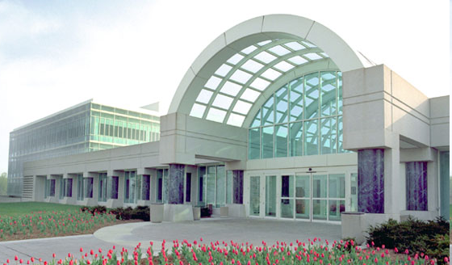
Building Design (1)
Defend against car/truck bombs
  Avoid large areas of unprotected glass at ground level
  Place solid obstructions at entranceways to prevent access by vehicles
    Bollards
    Anchored
    planters
    Reinforced
    seats
New CIA HQ finished 1991

Slide 6
Building Design (2)
Provide for entry of large
equipment
  Roof cranes
  Wide or double doors for
  technical areas
Eliminate large chases
(indents on side of building)
  Make it harder to climb
  building using climbing
  equipment / techniques

Slide 7
Location Within Building
Access to building affects computer room security
Involve EDP security staff in design of new building
No external walls
Inconspicuous yet allowing easy access for fire department
Far from hazardous areas

Slide 8
Layout
Separate functions
Tape vaults/safes
Security equipment in secure, separate room
Rest rooms, food areas near center
Substantial walls
Avoid closets in common walls
Slab‑to‑slab construction:
Make provision for secure
but effective maintenance
access

Slide 9
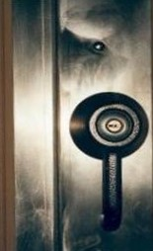
Doors
As few as possible
Formal exiting study to set minimum
Put alarms and signs on doors which are not essential during normal work
Solid wood or metal (avoid glass: 64% burglaries through glass)
Secure frames
Hidden or inward hinges
Non‑removable hinge pins
Astragals (protector on door edge)

Slide 10
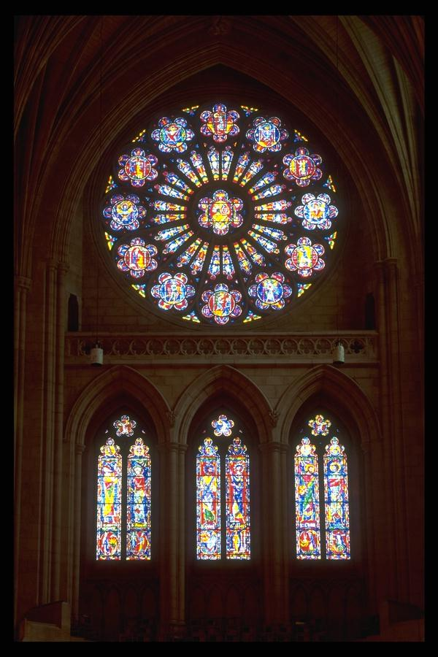
Windows
None! Cover with bricks if facing
outside
Eliminate internal vision panels
If impossible, at least move
security equipment out of sight
Cover sensors in room during
visitor tours
Security glazing
Gratings, bars, fastenings
Breakage sensors connected to alarm system
Closed circuit TV monitoring motion sensors

Slide 11
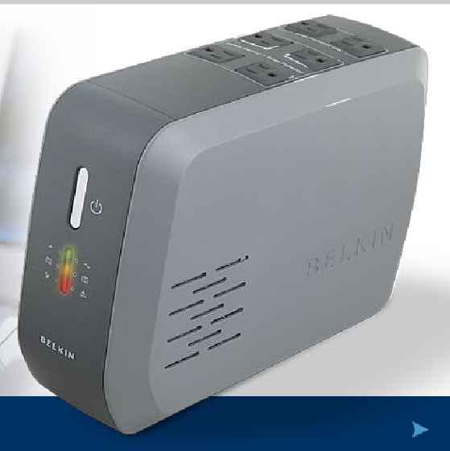
Electrical power supply
Disturbances: monitors, power conditioners
Outages: UPS, motor alternator w/ flywheel, battery/rectifier, diesel generators (fuel)
Plan for peak load,
minimum time required,
graceful shutdown
Emergency lighting
(fixed, portable)
Protect electrical
equipment from
tampering
BELKIN UPS

Slide 12
Air Conditioning
Protect external air intakes for
air conditioners
  Susceptible to gas attack
  ¨or disabling
Temperature ~21C +/‑ 2C
Humidity ~50% +/‑ 5%
Positive pressure
Risks: dust, condensation, curling paper, static charge
Keep computer air conditioning separate from that of rest of building
Non‑combustible ducts
Link to fire suppression system (auto shutoff)

Slide 13
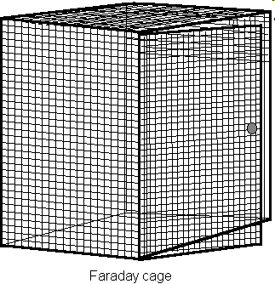
Electromagnetic Radiation
Magnets
  Bulk tape erasers
  Speakers on sound systems
Radio transmitters
  (e.g., nearby public radio or
  TV stations)
  Walkie‑talkies
  Cellular (mobile) phones
  are a threat
Aluminum mesh if needed on
windows (if any) to create
Faraday cage

Slide 14
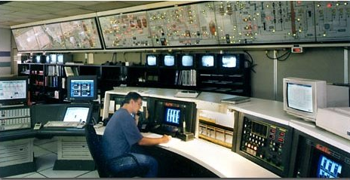
Fire Prevention & Detection (1)
Keep IT separate from rest of building
if possible
Non‑combustible materials in walls
Restrict openings in walls
Self‑closing fire exclosures
Duct work, cables to be cemented into walls w/ fire‑resistant materials
Appropriately placed
smoke, heat detectors
Full-time monitoring
and alerts by
trained people

Slide 15
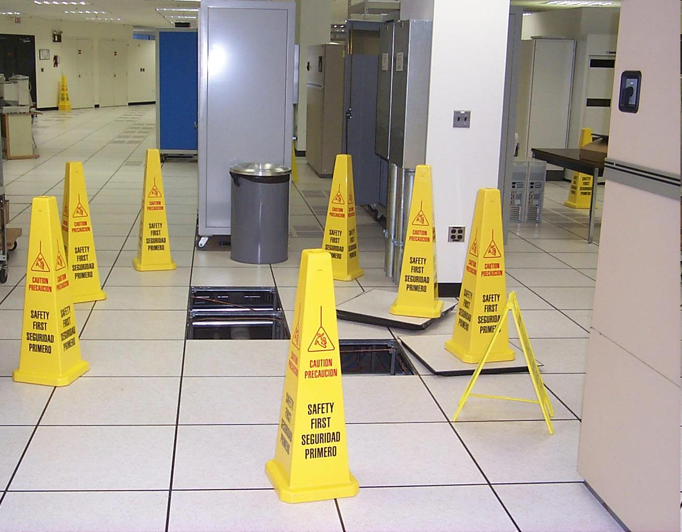
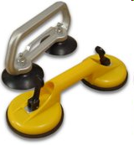
Fire Detection and Prevention (2)
Fire‑resistant raised floors
Suction cups handy

Slide 16
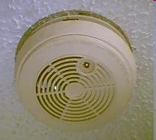
Fire Detection and Prevention (3)
Detectors in suspended ceilings
Systems approach integrates
information from multiple sensors
HALON systems forbidden because
of laws on environmental protection
passed in 1990s
Keep combustibles (e.g., paper) out of computer room
Best system in world is useless without trained staff: practice fire drills

Slide 17
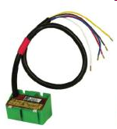
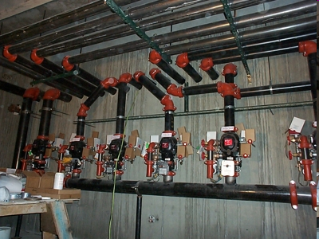
Water Damage
Install water detectors below raised flooring
Link water detectors to building's central alarm systems
Use dry‑pipe sprinkler systems (see also large picture next page)
Floors above computer
room to be waterproof
Install rolls of non‑
flammable plastic sheets
ready to cover equipment
against water

Slide 18
Dry-Pipe Sprinkler Valves
http://www.apigroupinc.com/headlines/images/union-plaza/dry-pipe-valves.jpg
Valves

Slide 19
Selected Topics in
Facilities Security (2)
Guards, Gates and Guns
Surveillance
Access Controls
Protective Technologies

Slide 20
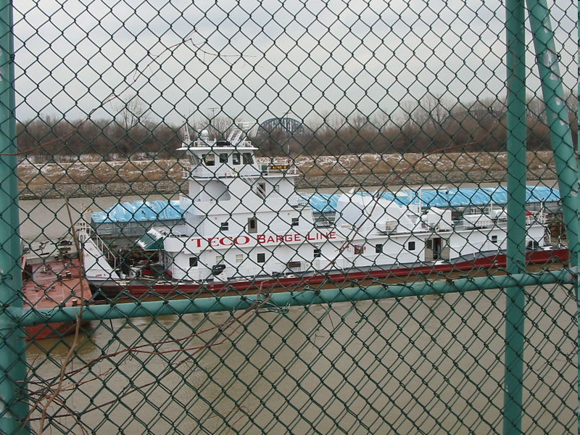
Guards, Gates and Guns

Slide 21
Guards
Usually contractors
  Choose companies with bonded employees
Define expectations / policies clearly
Train extensively & rehearse emergencies
Monitor performance – no exceptions, no tailgating
Teach to examine outbound equipment
  Become aware of high-density storage media such as flash drives

Slide 22
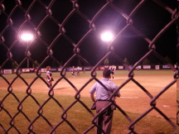

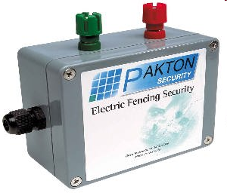
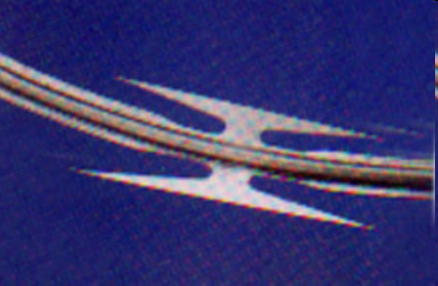
Fences
Primarily for delay
Psychological barrier
Serious assailant not deterred
Improvements: barbed wire,
razor wire, electrification
Surveillance essential (see later)

Slide 23
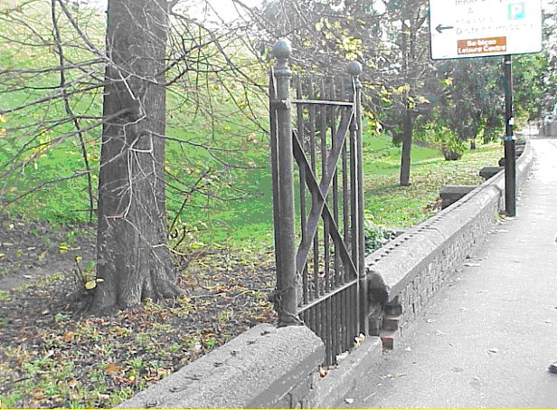
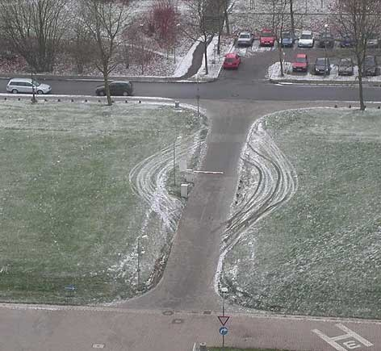
Gates
Gates cannot compensate for weak perimeter:
Some secure installations have double gates (external and internal)

Slide 24
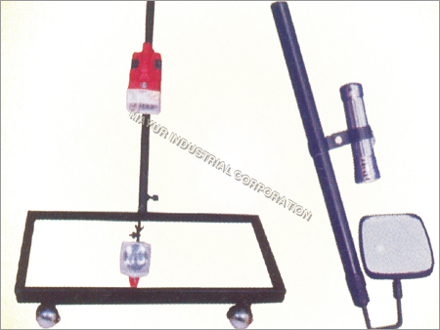
Other Barriers
Obstruct penetration by bombers
  Concrete pillars in front of entrances or other weak points (as mentioned in part 1)
  Prevent stopping / parking in front of buildings (seal off access roads)
Slow down attack vehicles – zig-zag barriers
High-security installations have guards who check vehicles inside and out
  All passengers out for
  positive ID and verification
  of authorized business
  Mirrors to look under
  vehicles
Mayur Industrial Corp.
Under-Vehicle Bomb Search Mirrors
http://preview.tinyurl.com/nz2jhe

Slide 25

Weapons
Armed guards require special
training & licensing
  Much more expensive than ordinary guards
High-security government installations use military forces
  High-powered
  personal weapons
  (e.g., machine guns)
  Artillery
  (armored vehicles,
  RPGs)

Slide 26
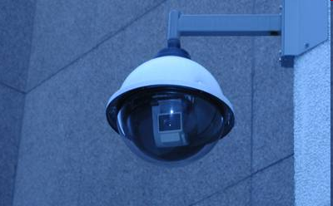

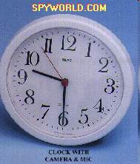
Surveillance
Cameras more
effective than
watchmen alone
  Motion detectors + digital recorders
  Must protect recording equipment
  Archive tapes/disks safely and for
  > 1 month
Guards must monitor activity carefully
Ethical and legal issues about concealed cameras
May use dummy cameras among real ones
  Deception is tool of good security
Dummy
camera

Slide 27
Continued on Wednesday

Slide 28
Access Controls
Principles
Mechanical Locks
Keypads
Features of Electronic
Access Control Systems
Cards
Biometric Methods

Slide 29
Access Control Principles
Normally only one controlled, monitored access point
Audit trail is valuable
Staff responsibilities
  Wear badges in restricted areas
  Accompany visitors
  Challenge unbadged people and call security at once
Put in positive light: protect employees against trouble, disruption, loss of business, loss of employment
Apply rules even handedly and consistently to avoid doubts about individual's integrity

Slide 30
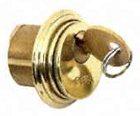
Mechanical Locks
Appropriate only for small sites
Infrequent use (2‑3 times/day)
Beware wedges and tape
blocking
doors open
Keys easily duplicated
  Many unregistered locksmiths
  (e.g., hardware store clerks) ignore DO NOT DUPLICATE warnings
Cannot be individually
inactivated from control
center
Loss of a master key can cost
$1000s to replace ALL keys in set for everyone
Special locks (e.g., Abloy) more secure
Michael Zemanek 2012:
Key covers can obscure
DO NOT DUPLICATE warning

Slide 31
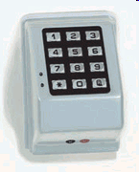
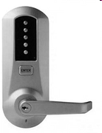
Keypads
Fixed keypads must be secured against observation (e.g., by sleeve over keypad)
Be sure you can set multiple‑
key combinations
Variable‑position keypads
harder to read by observers
Watch out for patterns of wear
that would give away smaller keyspace

Slide 32
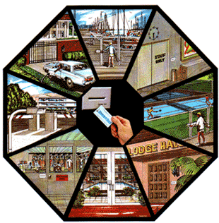
Features of Electronic Access-Control Systems
Antipassback (system remembers who's in area)
Time‑open limit (alarms for
doors kept open)
Duress signal (e.g., Putting in
card upside down)
Degraded mode (if CPU goes
down)
Audit features (records of
movements, violations)
Computer‑room alarms linked
to building alarms
Building alarms audible in
computer room
Image used with permission of
United Security Systems Inc.
http://www.ussinational.com

Slide 33
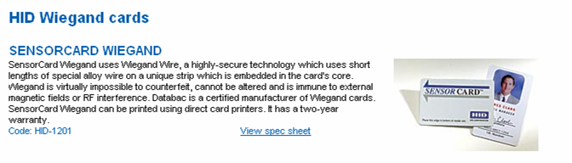
Cards
Wiegand: wires generate magnetic pulses
Barium ferrite: polarized magnetic fields
Bar codes
Infrared‑readable embedded bar codes
Magnetic stripe
Proximity (radio frequency signatures)

Slide 34
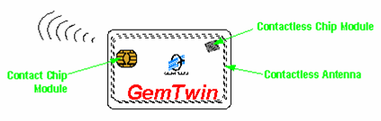



Smart Cards
Include microprocessor
Can serve as I&A unit
Also for digital signatures
Interact with software
Many form factors
  Cards
  Cards with keypads for PINs
  Calculators
  USB keyfob

Slide 35
Biometric Methods
Hand geometry
Fingerprints
Retinal scan
Iris scan
Face recognition
Voice verification
Signature dynamics
Keystroke dynamics
Weight/height cabinets
Combinations even more effective

Slide 36
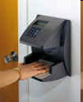
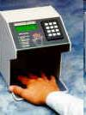
Hand Geometry
Easy to use
No need for tokens, cards
Extremely low errors
  Few false positives (allowing wrong person in)
  Few false negatives (preventing right person from entering)
Contrary to movies, does NOT respond to dead hands!

Slide 37
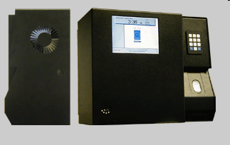
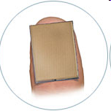
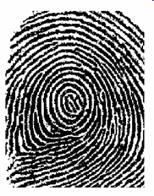
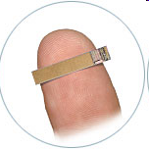
Fingerprints
High accuracy*
Sensors available for static image (middle image) and also for dynamic swipe (lower image)
*But Japanese scientists showed that fake fingers easy to create from fingerprints
  Used crazy glue to enhance ridges
  Gummy Bears candy
  Fooled sensors 80%

Slide 38
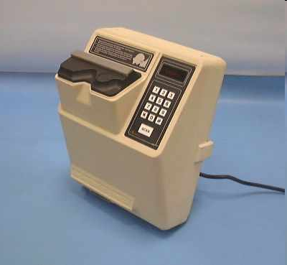
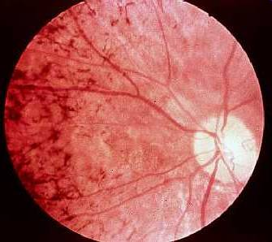
Retinal Scan
Viewed with suspicion by
general public
Hygiene issues due to
physical contact with
sensor sleeve
Highly reliable
As with all biometric
systems, data generally
stored in one-way
encrypted form

Slide 39

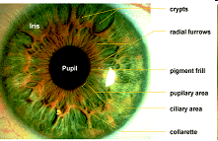

Iris Scan
Highly reliable
Easy enrolment process
Non-invasive readers
  No direct contact required
Enrolment unit
Remote unit

Slide 40
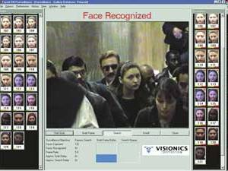
Face Recognition
Two distinct applications:
  Recognizing authorized personnel for I&A
  Recognizing unregistered people using photos*
*Developing bad
reputation for high
error rates; e.g.,
Tampa PD dropped
sample system
in Aug 2003
after > 2 year
trial w/out single
capture of a
criminal

Slide 41
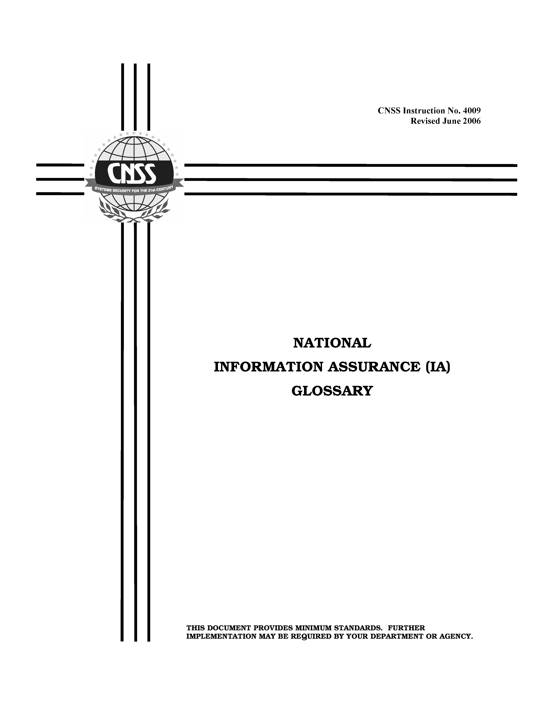
Protective Technologies
“Special tamper-evident features and materials employed for the purpose of detecting tampering and deterring attempts to compromise, modify, penetrate, extract, or substitute information processing equipment and keying material.”
  CNSS Instruction 4009 (Glossary)
  http://tinyurl.com/na6yab
E.g.,
  Tapes
  Special screws
  Seals
  Photographic Logs

Slide 42

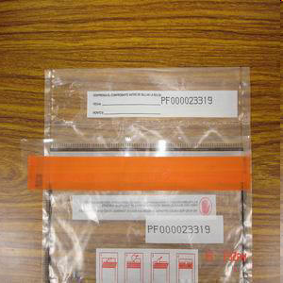
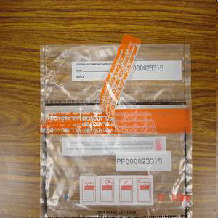
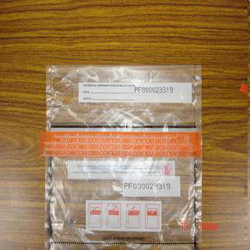
Tapes
Detecting opening of equipment or containers
Used in forensic work for chain of custody
Tape splits into two parts when opened
Courtesy J&S Industrial (HK) Co.
http://www.j-n-s-ind.com.hk/security.htm Used with permission.

Slide 43







Special Screws
Can substitute screws or bolts requiring special drivers with restricted distribution
E.g., Tamperproof Screw Co, Inc. of New York
  http://www.tamperproof.com/index.cfm?fuseaction=products
Images used by kind permission of Tamperproof Screw Co.

Slide 44
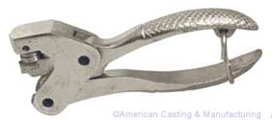

Seals
Use soft metal (e.g., lead) or plastic units to prevent opening containers or exclosures without discovery
  Use serial numbers or unique patterns
  E.g., everyone will have seen seals
  on electric utility boxes and meters;
  E.g., from American Casting & Manufacturing, http://www.americancasting.com
Images used by kind permission of AC&M

Slide 45
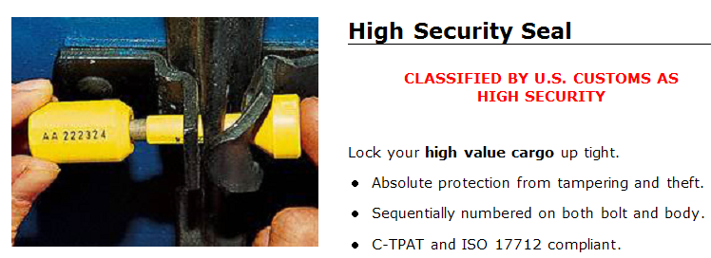
Seals (cont’d)
Examples from ULINE Shipping Supply Specialists http://www.uline.com/Group_47
http://www.uline.com/Browse_Listing_2302.asp
Image used by kind permission of ULINE Shipping Supply.

Slide 46
Photographic Logs (1)
Use process of careful photography of computer equipment before allowing it to be taken overseas
Record details such as
  Exact distances of movable
  parts
  Scratches, nicks especially
  around screws
  Wipe fingerprints from inner
  components that should not have to be removed such as batteries and memory chips
  Orientation of screws and bolts
  (see next slide)

Slide 47
Photographic Logs (2)
Philips Head screw has rotated:
Notice how rotation has shifted contact points with alignment lines
Vertical
Contact
Center line
Horizontal
Contact
Before trip
After trip

Slide 48

DEFCON 17: Invisible Access
Electronic Access
Control, Audit Trails,
and “High Security”
47 minute discussion
of physical access
control device
vulnerabilities
http://www.youtube.com/watch?v=wsvQtIuM5a4

Slide 49
Now go and study

