Slide 1
Operating System Security
CSH6 Chapter 24
“Operating System Security”
William Stallings

Slide 2

Topics
Information Protection and Security
Requirements for
Operating System
Security
Protection
Mechanisms
File Sharing
Trusted Systems
Windows 2000
Security
Windows 7 Security*
* Not in chapter:
added by M. E. Kabay

Slide 3
Information Protection & Security (1)
Overall protection policies
No sharing
  Every process completely isolated
  Virtualization illustrates this approach
Sharing originals of program or data files
  Read-only access to program
  Sharing data requires locking mechanisms
Confined, or memoryless, subsystems
  No transfer of protected information across boundaries
  E.g., server and client are partitioned from each other
Controlled information dissemination
  Security classes for data and users determine access
  Widely used

Slide 4
Information Protection & Security (2)
Operating security concerns grouped
Access controls
  Regulating user access to total system, subsystems, data
  Regulating process access to resources & objects in system
Information-flow control
  Within system &
  To users
Certification
  Proving that access & flow control perform to specification
  Demonstrating that measures actually enforce data protection and security policies

Slide 5
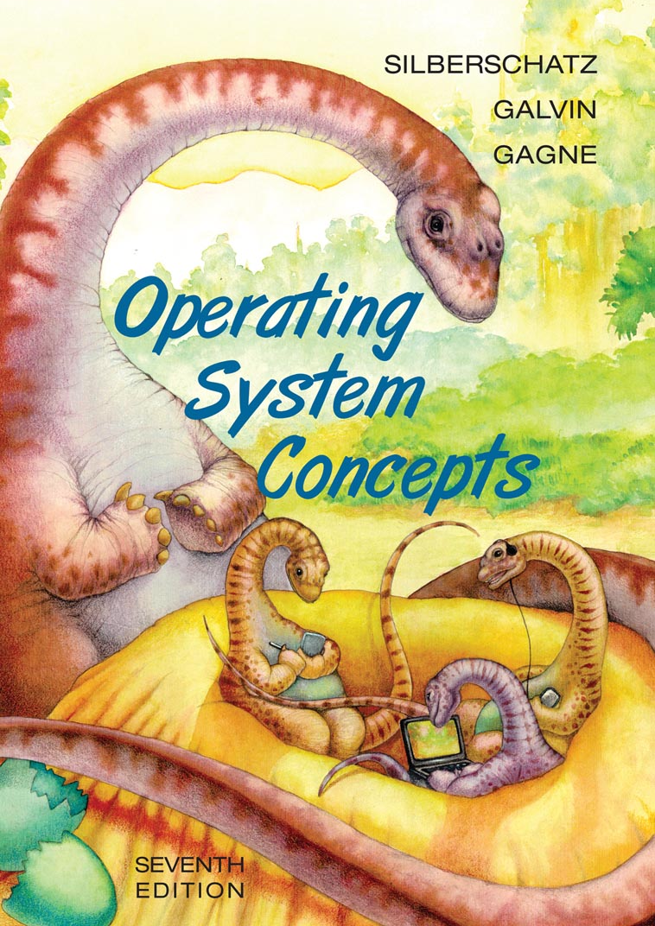
Requirements for Operating System Security
Requirements
Computer System Assets
Design Principles

Slide 6
Requirements
Confidentiality
  Restrict access to authorized parties
  Prevent disclosure even of existence of data
Integrity
  Control over who can make which changes to what system assets
  RWALX (read, write, append, lock, execute) including save, delete, changing
Availability
  Timely access to resources with authorization
Authenticity
  Verify identity of user
C P
I Au
Av U

Slide 7



Computer System Assets
Hardware
  Accidental & deliberate damage or alteration (e.g., switches, hardware settings)
  Theft
Software
  Availability – deletion, disabling
  Corruption – changing functionality (malware, accidental write)
  Control – preventing unauthorized copying
Data
  Unauthorized access for reading or writing (especially personally identifiable information)
  Data integrity & data destruction
  Inference (data mining and data correlation)

Slide 8
Design Principles
Least privilege
  Default no access; explicit granting of permissions
Economy of mechanisms
  Small, simple security tools
  Include in initial design, not as add-ons
Acceptability
  Meet functional requirements AND
  keep overhead to minimum
  Do not interfere unreasonably with operations
Complete mediation
  All access must be checked by security processes
Open design
  Do not depend on secrecy of the design or implementation (Kerkhoffs’ Principle)
  Allow for expert review, open discussion

Slide 9
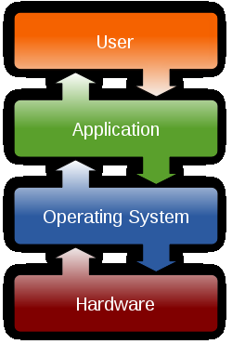
Protection Mechanisms
Overview
Protection of Memory
User-Oriented Access Control
Data-Oriented Access Control
Protection Based on an OS Mode

Slide 10
Overview of Protection Mechanisms
Resources being shared in multiprogramming environments
  CPU, Memory, I/O devices, Programs, Data
Spectrum of OS protections
  No protection – run sensitive procedures
  at different times
  Isolation – all processes completely
  separate, with no shared resources
  Share all or share nothing – public or
  private
  Share via access limitation – every
  access verified for specific user & specific object
  Share via dynamic capabilities – allow dynamic creation of sharing rights for objects
  Limit use of an object – functional limitations (read, write, print, statistical measures vs individual data)

Slide 11
Protection of Memory (1)
Protection main memory crucial for multiprogramming environment
  Processes must not overwrite each other’s data
  Must not read private data
Virtual memory supports protection
  Memory segmentation or paging
  basis for defining objects to be
  protected
  Segmentation allows applications to
  declare segments as sharable or nonsharable
  Segments have defined length in addition to base address: can enforce bounds restrictions
  Paging more difficult because memory management data not available to programmer

Slide 12
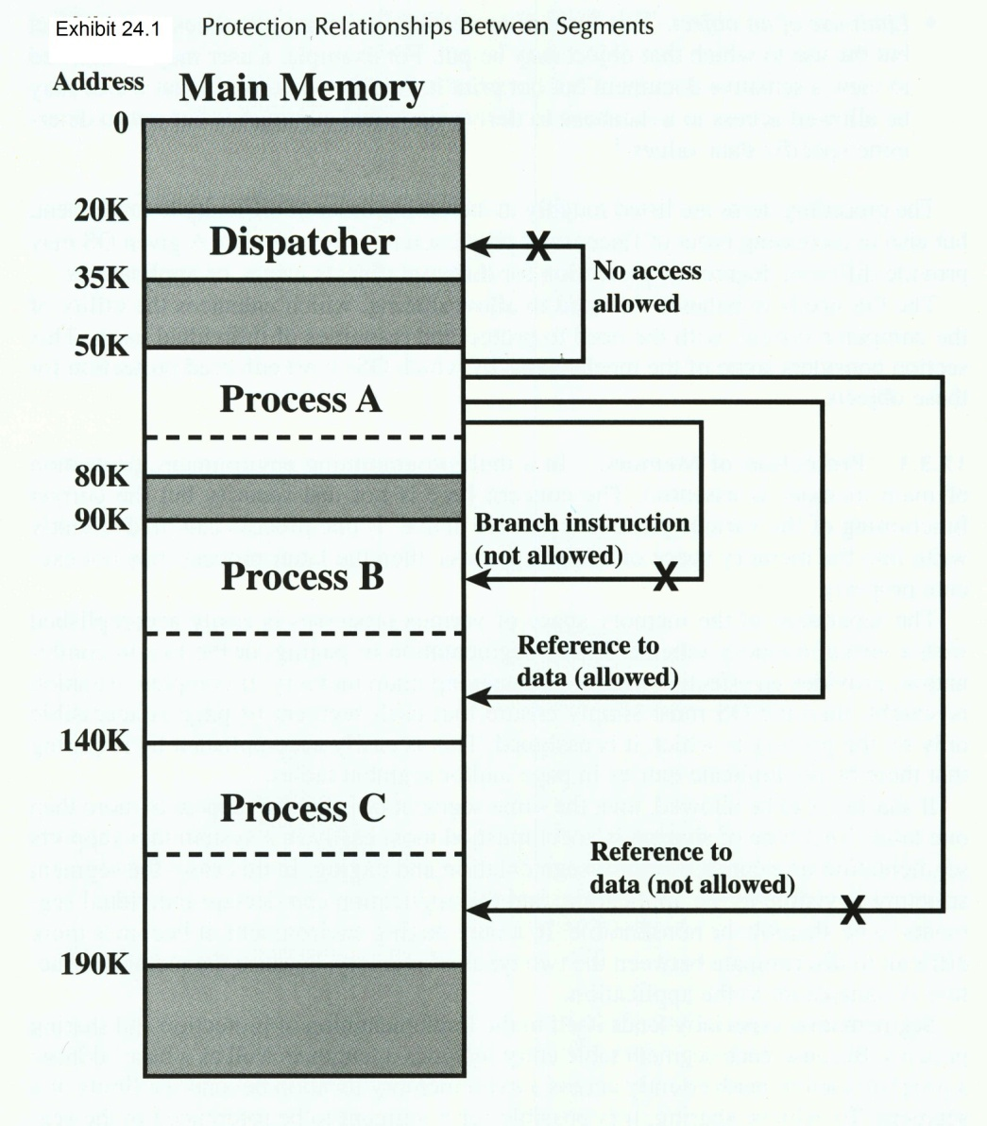
Protection of Memory (2)
Fig 24.1 (➔) shows how OS can control access in paged memory
Hardware can implement memory protection
  E.g., IBM S370 under OS/390
  Every page has 7-bit storage control key
  OS checks key for allowed operations

Slide 13
User-Oriented Access Control
Karlheinz
Stockhausen
(identifier)
Distinguish between
  Identification: provision
  of an identifier (e.g., userID)
  Authentication: ascertaining binding
  between identifier & user of identifier
User logon is I&A
  Identification (provide userID) &
  Authentication (provide some other
  bound information – see later
  chapters on I&A)
Once process(es) established for user,
can use data-oriented access control
I&A
Karlheinz
Stockhausen’s
passport
(authentifier)

Slide 14

Data-Oriented Access Control (1)
Assign access profile to userID once logon complete on specific system
OS can restrict / grant access to objects on system as function of profile
Access matrix model includes
  Subject (e.g., user ID that
  creates a process and
  conveys its privileges to
  the process)
  Object (anything definable to which access can be controlled; e.g., files, records, fields, programs, hardware, memory structures, …)
  Access right (how specific subject can interact with particular object; e.g., RWALX)

Slide 15
Data-Oriented Access Control (2)
Most frequent implementation of data-oriented
access control uses access control lists (ACLs)
  For each object, list users & allowed
  access modes
  Can specify groups of users
  Usually includes default mode for unlisted users
Capability tickets apply to users
  For each user, list authorized objects
  & access modes
  Users may lend or give them to other
  users (delegation)
  But dispersal increases need for
  authenticity of the tickets
  Therefore OS often holds ticket in central store

Slide 16

Protection Based on an OS Mode (1)
Processors support multiple (at least 2) modes of operation
  More privileged mode
    System, control, or kernel* mode
    Permits R/W of control registers, direct I/O, memory management, process control
  Less privileged mode
    User mode
    Normal mode for
    user processes
*Kernel is part of OS
w/ critical functions

Slide 17
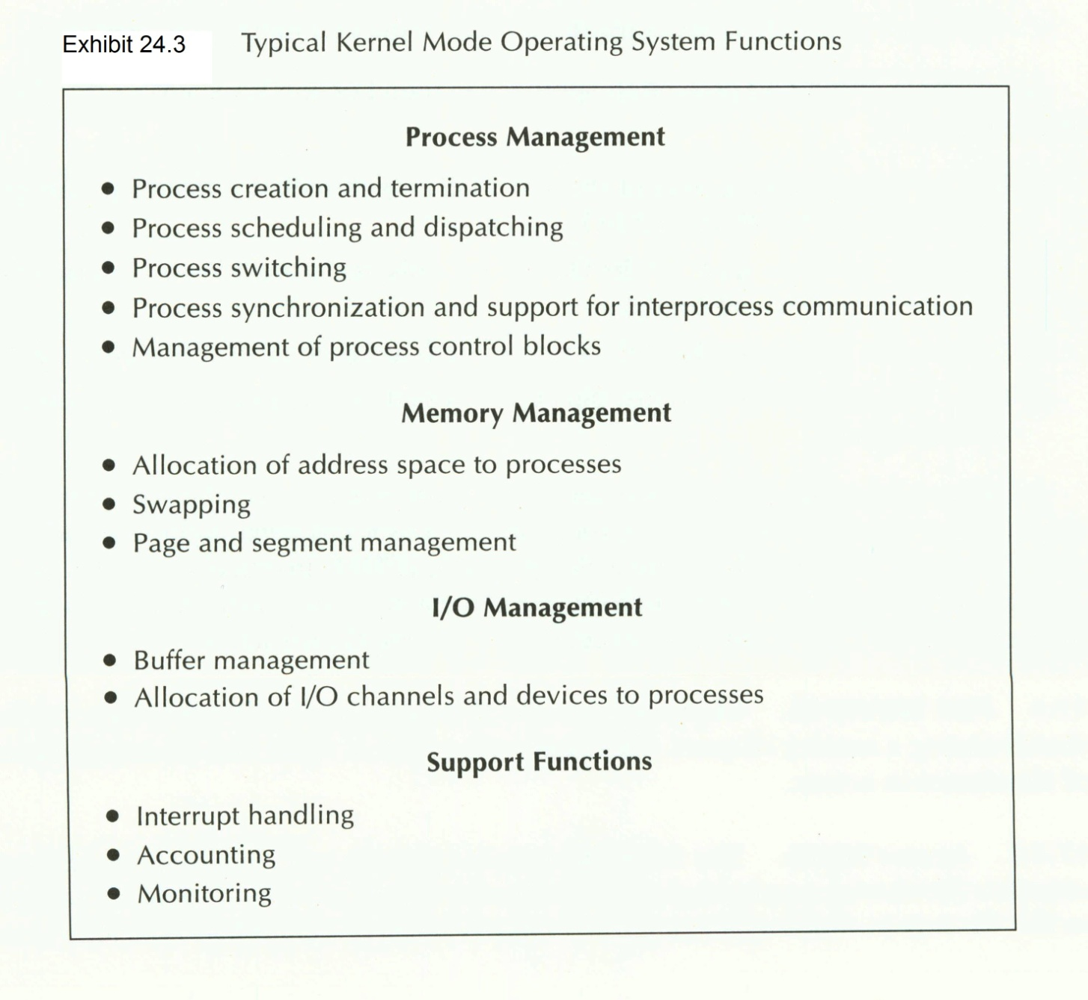
Protection Based on an OS Mode (2)

Slide 18


Protection Based on an OS Mode (3)
How does the processor know which mode to use?
  Bit in process control block (or equivalent)
How is the mode changed?
  Execute instruction to flip mode bit
  Switch into privileged mode upon entering system routine
  Switch into user mode at end of system routine

Slide 19
Ring-Protection Structure
Many OSs implement a ring-structure for privileges
Process may access
  Data in same ring or lesser
  Services in same ring or
  higher
Example from VAX VMS
  Kernel: memory
  management, interrupt
  handling, I/O
  Executive: file, record
  management
  Supervisor: command interpreter
  User: normal program execution
Kernel
Executive
Supervisor
User

Slide 20

File Sharing: Access Rights
Can control access to range of file information and functions; e.g.,
  None: not even knowledge of existence
  Knowledge: file exists, owner
  Execution: run program
  Read: input from file
  Append: output to end of file
  Update: modify existing records
  only*
  Write: add, change, delete records**
  Change protection: usually owner only
  Delete: destroy file
  Lock: flag for concurrency control***
NOTES:
*In text, author does not
limit “update” to this
function only.
** Author refers to write
function as part of
“update”
***Not mentioned in text

Slide 21

Trusted Systems: Multilevel Security
Categories of security requirements; e.g.,
  Top Secret, Secret, Confidential, Unclassified
  Corporate-officers-only, Company-confidential, General-release
Fundamental: higher-classification data must not be released to lower-classification group without reclassification
Rules
  No read up (simple security property): read only at equal or lower level
  No write down (*-property): write only at equal or higher level
See CSH5 Chapter 9
for more details on
security models

Slide 22
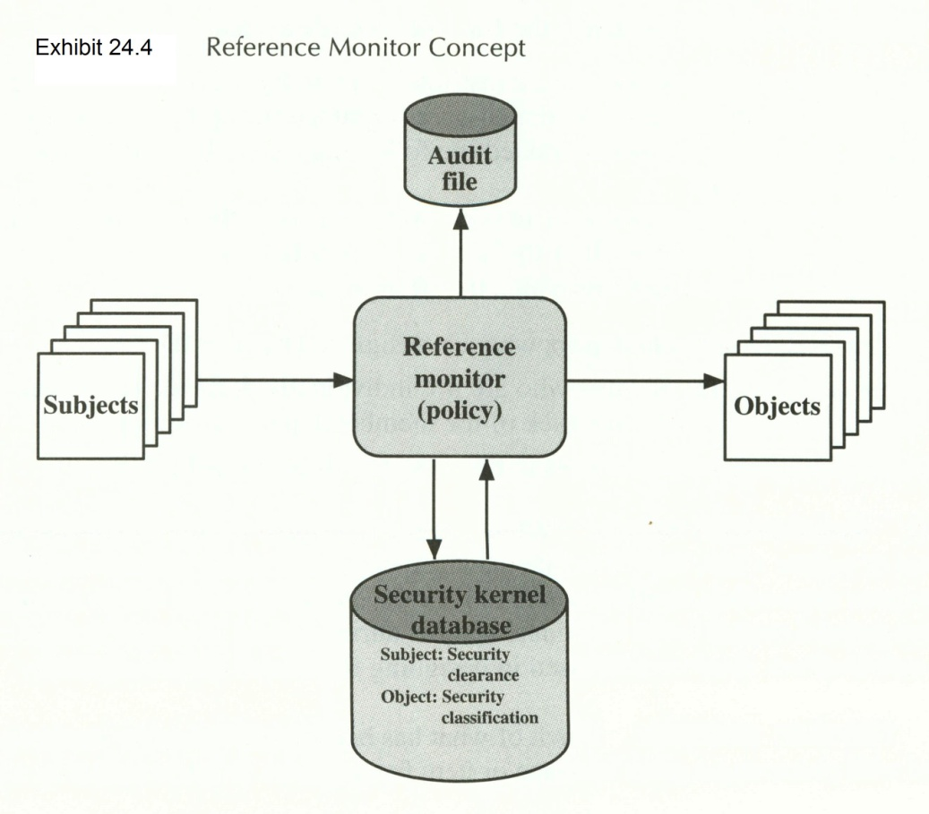
Trusted Systems: Reference Monitor
Enforces security rules
Properties
  Complete mediation: all accesses
  Isolation: protected against unauthorized modifications
  Verifiability: provable correctness
Computer Security Center of National Security Agency established to help evaluate and certify trusted systems
See CSH5 Chapter 51
for more details on
trusted systems evaluation

Slide 23
Trusted Systems: Trojan Horse Defense
Trojan horse programs attempt to subvert security by tricking higher-privilege user into executing harmful code
Some Trojans such as keyloggers attempt to store privileged information in files that can be accessed by unprivileged users
But a reference monitor can prevent write-down (*-property) and thus stymie the Trojan data collection

Slide 24
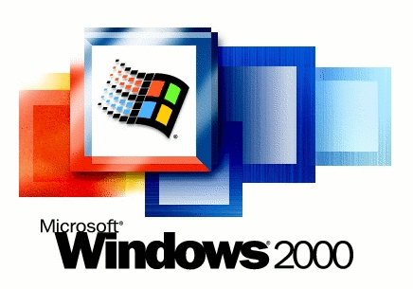
Windows 2000 (& Later) Security
Introduction
Access-Control Scheme
Access Token
Security Descriptors

Slide 25
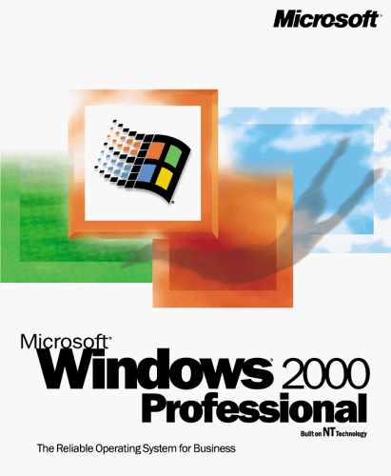
Introduction to W2K Security
Windows 2000 (W2K) OS
  Released Feb 2000
  Successor to NT
  Followed by XP,
  Server 2003, Vista, 7
Access control
uniformly applied
  Processes, files,
  flags, windows….
Uses 2 entities
  Access token for each process
  Security descriptor for each object

Slide 26


W2K Access-Control Scheme
User logs on with userID/
password
User process has access token
created
  SecurityID (SID)
  Child processes inherit SID
Functions of access token
  Consolidates all security information for fast validation
  Lets process modify own security
  parameters without interfering with
  other processes
Security descriptor
  Associated with each object
  Includes ACL

Slide 27
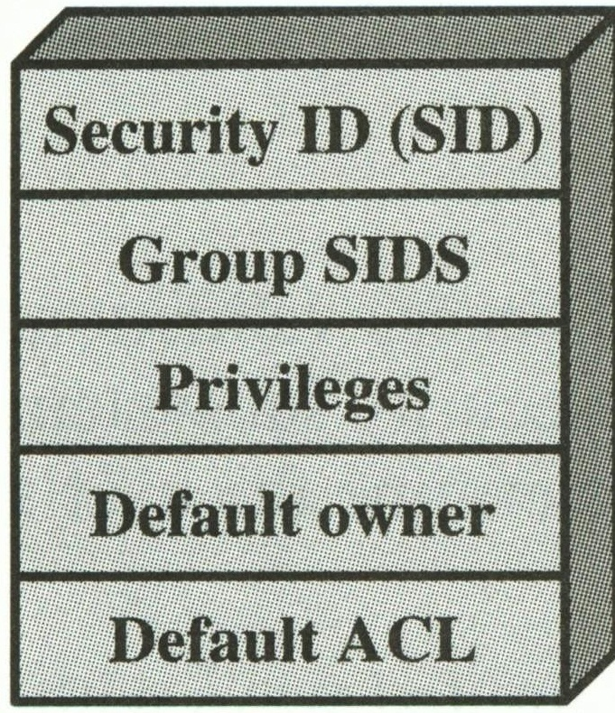
W2K Access Token
SecurityID: unique identifier
Group SIDs: list of groups to which user belongs
Privileges: list of services available
Default owner: who owns a new object created by user
Default ACL: access control list available by default to new object
created by this user

Slide 28
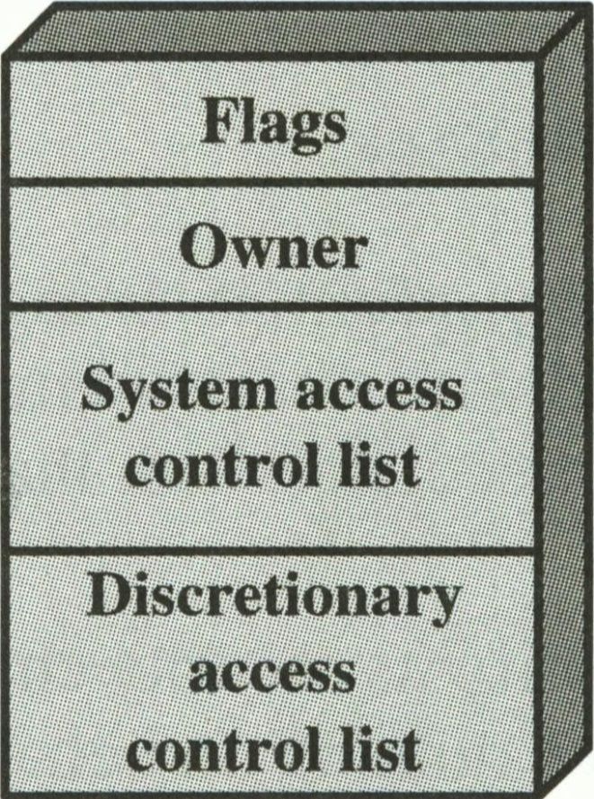
W2K Security Descriptors
Flags: what’s in the SD
Owner: SID
System ACL (SACL): which operations generate audit records
Discretionary ACL (DACL): which users and groups can access object for which operations
Any new process can receive SID of creator

Slide 29
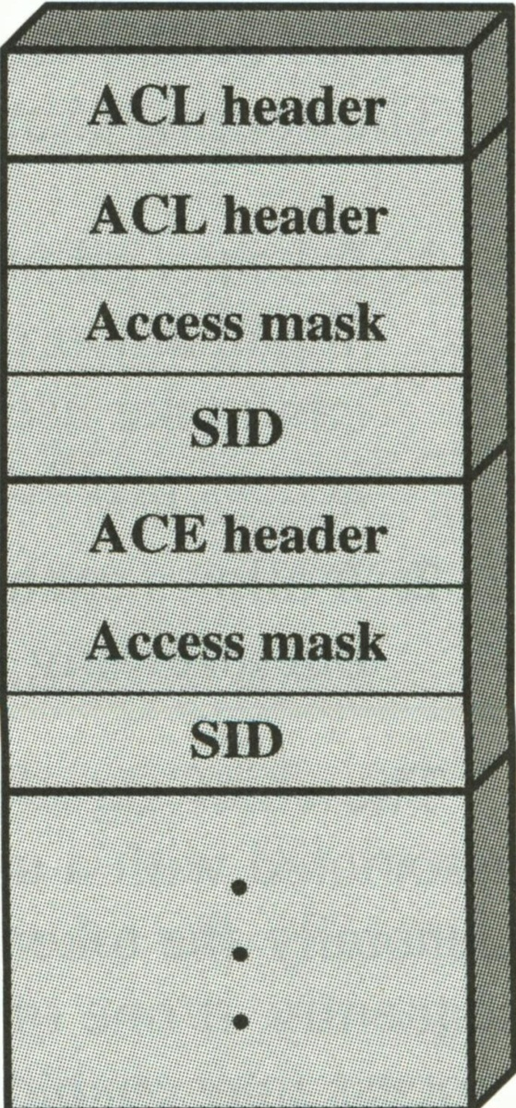
W2K ACLs
Overall header defines structure
Access Control Entries (ACEs)
  Specific SID (or group SID)
  Access mask defining rights
Object manager reads SID & scans object’s DACL for match
  Match shows right for process to access object

Slide 30

W2K Access Mask Standard Access Types
Access mask bits define allowable modes
  Synchronize: can make object part of wait
  Write_owner: modify owner of object
  Write_DAC: modify protection
  Read_control: get the security data for object
  Delete: destroy object
See Exhibit 24.7
for additional bits
in Access Mask

Slide 31
W2K Access Mask Generic Access Bits
Define general-purpose access modes
Can be applied to any object
Types are
  Generic_all: allow all access
  Generic_execute: run code
  Generic_write: any form of output to object
  Generic_read: input from object

Slide 32
W2K Access Mask Special-Purpose Bits
Access_System_Security
  Allows process to modify audit & alarm control
  Access token must have appropriate privilege enabled
Maximum_allowed
  Alters algorithm for granting privilege to user
  If off, security monitor scans entire list to locate privilege requested or end of list
  If on, monitor limits privilege to a defined maximum

Slide 33

W2K Options for Access
Attempt to open object for all possible accesses
  But may be denied
  Even though enough access available for needs
Open object with specific access every time required
  Reliably get access
  Increase overhead due to extra table entries
Open object with maximal access allowed for object
  But may grant more than needed
  Can lead to security issues with bad code

Slide 34



Application-Level Usage of W2K Security
Applications can apply W2K security to specific objects; e.g.,
  Database server can attach descriptors to elements of DB
  Add special DB-specific functions such as JOIN
OS checks access rights as usual

Slide 35

Windows 7 Security
ASLR
DEP
BitLocker-to-Go
IE8
UAC
Crypto improvements

Slide 36

Windows 7 Security (1)
ASLR
  Address Space Layout Randomization
  Unpredictable location of DLLs in RAM
  Much harder for malware to target code
DEP
  Data Execution Prevention
  Restrictions on buffer overflow attacks
BitLocker-to-Go
  Encryption for any kind of data storage
  Includes removable media
[ref 1]

Slide 37

Windows 7 Security (2)
Internet Explorer 8 SmartScreen
  Anti-phishing / anti-malware feature
  Blocks known bad sites
  Highlights actual URL of links in
  address bar (warning against phishing)[ref 1]
UAC
  User Account Control
  Distinguish between admin and normal user
  Set domain environment to “Always notify” so “users will be prompted to input their passwords to perform high-risk administrative actions”[ref 2]

Slide 38

Windows 7 Security (3)
Crypto improvements
  Swap file easily encrypted
    XP and earlier allowed swap file erasure
    But could add 10 minutes to shutdown
    W7 allows swap-file encryption
  All modern encryption methods supported
    Suite B: AES, ECDSA (Elliptic Curve Digital Signature Algorithm), ECDH (Elliptic Curve Diffie-Hellman, SHA2)
    See < http://tinyurl.com/3xs28uz >
  Encrypting File System improved
    Control user actions – keylengths, ciphers, force backups of keys
[ref 2]

Slide 39


Windows 7 Security
References:
[1] Bradley, T. (2009). “Pros and Cons of Windows 7 Security.” PCWorld (Nov 23, 2009). < http://tinyurl.com/yfarf6z >
[2] Grimes, R. A. (2010). “Expert’s Guide to Windows 7 Security.” Infoworld (Sep 30, 2010). < http://tinyurl.com/37zkskp >

Slide 40
Now go and study

