Slide 1
Local Area Networks
CSH6 Chapter 25
“Local Area Networks”
Gary C. Kessler &
N. Todd Pritsky

Slide 2
Topics
Policy and Procedures
Physical Site Security
Physical Layer
Network Operating System Issues
Chapter 25 should be read in conjunction with Chapter 24 on Operating
System Security. Chapter 25 includes commentary on operating
systems commonly used on workstations configured on LANs.

Slide 3
Policy and Procedures
Without framework of
policy and procedures,
technology cannot be
selected appropriately
Extensive list of
suggestions available in
many texts and online
  Many chapters in CSH6
  RFC 2196:
  Site Security Handbook
  http://www.ietf.org/rfc/rfc2196.txt

Slide 4
Physical Site Security
Physical access to LAN equipment is the single most dangerous vector for attack
Protect equipment and transmission media against physical damage
  Accident
  Intentional attack
  Denial of service
Business continuity planning & disaster recovery planning
  Require consideration of networks
See CSH6
Chapters 22 and 23
See CSH6
Chapters 58 and 59

Slide 5
Physical Layer Issues
ISO OSI Model
Sniffers and Broadcast LANs
Attacks on the Physical Plant
Modems, Dial-Up Servers, Telco
Wireless LANs

Slide 6
ISO OSI* Model
The 7 layers
Application (7)
Presentation (6)
Session (5)
Transport (4)
Network (3)
Data Link (2)
Physical (1)
}
UPPER
LAYERS
LOWER
LAYERS
}
*International Organization for Standards
Open Systems Interconnect

Slide 7
OSI Data Transfer
OUTPUT
INPUT

Slide 8
IBM's TCP/IP Redbook http://www.redbooks.ibm.com/pubs/pdfs/redbooks/gg243376.pdf
Part I. Core TCP/IP protocols
Chapter 1. Architecture, history, standards, and trends
Chapter 2. Network interfaces
Chapter 3. Internetworking protocols
Chapter 4. Routing protocols
Chapter 5. Transport layer protocols
Chapter 6. IP multicast
Part 2. TCP/IP application protocols
Chapter 7. Application structure and programming interfaces
Chapter 8. Directory and naming protocols
Chapter 9. Remote execution and distributed computing
Chapter 10. File related protocols
Chapter 11. Mail applications
Chapter 12. The World Wide Web
Chapter 13. Multimedia protocols
Chapter 14. Wireless Application Protocol (WAP)
Chapter 15. Network management
Chapter 16. Utilities
Part 3. Advanced concepts and new technologies
Chapter 17. IP Version 6
Chapter 18. Multiprotocol Label Switching (MPLS)
Chapter 19. Mobile IP
Chapter 20. Integrating other protocols with TCP/IP
Chapter 21. TCP/IP security
Chapter 22. Quality of Service
Chapter 23. Availability, scalability, and load balancing

Slide 9
Sniffers and Broadcast LANs
Most LANs use broadcast packets / frames
Normally nodes read only designated packets / frames by destination address
Nodes in promiscuous mode read all frames
Sniffers capture and analyze all packets
  Older models were hardware –
  obvious
  Software sniffers practically
  invisible on network
Countermeasures
  Cryptography the most obvious: IPSec, SSH
  Can put servers on switches to avoid broadcasts
  Special software can test timing of networks to detect sniffers

Slide 10
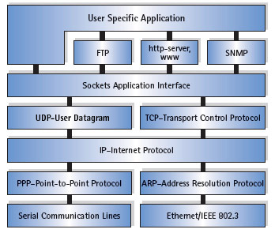
TCP/IP Sniffers
BUTTsniffer (Windows NT)
Ethereal (Windows, Unix)
Network Monitor (free with, and for, Windows NT)
Sniffit (Linux, SunOS, Solaris, FreeBSD, Irix)
snort (Unix)
Solsniff (Solaris)
tcpdump (Unix)
WinDump (Windows 9x/NT)
Image used with kind permission of IXXAT, Inc.
http://www.ixxat.com/introduction_tcp_ip_en.html

Slide 11
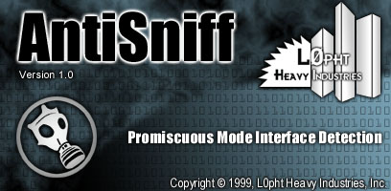
Sniffer Detectors: AntiSniff®
L0pht Heavy Industries – hackers
Released AntiSniff in 1999
  Notes below from Nomad review at http://www.nmrc.org/pub/review/antisniff-b2.html
Pro
  Accurate detection of
  promiscuous mode
  Ethernet cards
  Alerts sent via email –
  also includes visual and audio alerts
  AntiSniff sessions can be stored for later use/analysis

Slide 12

Limitations of AntiSniff®
Comments from Nomad:
NT version runs at high priority and is resource-intensive – need dedicated machine
Can only work properly checking Ethernet cards on the same segment as the system running AntiSniff
  Again, this is not a flaw, but due to the nature of networking in general.
  It will work in a switched environment with a smart hub
No SNMP support

Slide 13
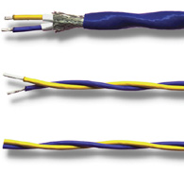
Attacks on the Physical Plant
Wiretapping cables (use shielding, testing)
Van Eck phreaking (use TEMPEST standard for shielding or obfuscation)
Removal of end-of-cable resistors (causes noise and DoS)
Twisted-pair LANs (10BaseT Ethernet) susceptible to tapping at punch-down junction boxes
Generally protect cabling against tampering
Protect servers against unauthorized physical access

Slide 14
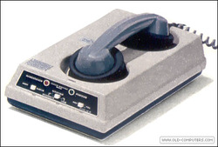
Modems, Dial-Up Servers, Telco
Modems can bypass perimeter protection
  May be installed without authorization
  Users often have modems on laptops linked into network
  Bypass firewalls etc.
  Allow easy outbound a
  ccess
Auto-answer modems allow
inbound access across firewalls
Dial-up servers allow centralized
control of modem communications
Modems becoming less important today because of high-speed Internet connectivity
300 baud modem c. 1980

Slide 15
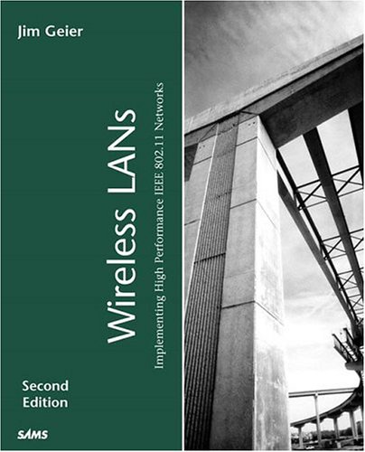
Wireless LANs
Overview of Wireless LANs
Wired Equivalent Privacy (WEP)
Web for Authentication
Notes:
Aboba, B. (2003). The Unofficial 802.11 Security Web Page
http://www.drizzle.com/~aboba/IEEE/
Klaus, C. W. (2002). Wireless LAN Security FAQ
http://www.iss.net/wireless/WLAN_FAQ.php

Slide 16
Overview of Wireless LANs
Data carried on radio-frequency radiation more easily intercepted than data on physical wires
  Typical range measured in meters or more
  Infrared transmission doesn’t go through walls
IEEE 802.11 Standards for Wireless Networking
  Direct-Sequence Spread Spectrum (DSSS)
  Frequency-Hopping Spread Spectrum (FHSS)
  Without codes/patterns, seems like noise to eavesdropper
See CSH6
Chapter 5

Slide 17
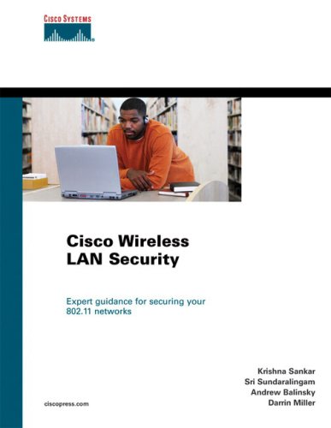
Wired Equivalent Privacy
Optional encryption
  40-bit RC4 by default (inadequate
  today)
  128-bit version available for some
  products
Vendors have defined additional
encryption similar to virtual private
networks (VPNs)
  Use public key cryptography (PKC)
  & support public key infrastructure
  (PKI)
  E.g., MS Point-to-Point Encryption
  used in Point-to-Point Tunneling
  Protocol (PPTP)
Some provide authentication
  E.g., RADIUS (Remote Access Dial-In User Service)
  Not generally interoperable

Slide 18
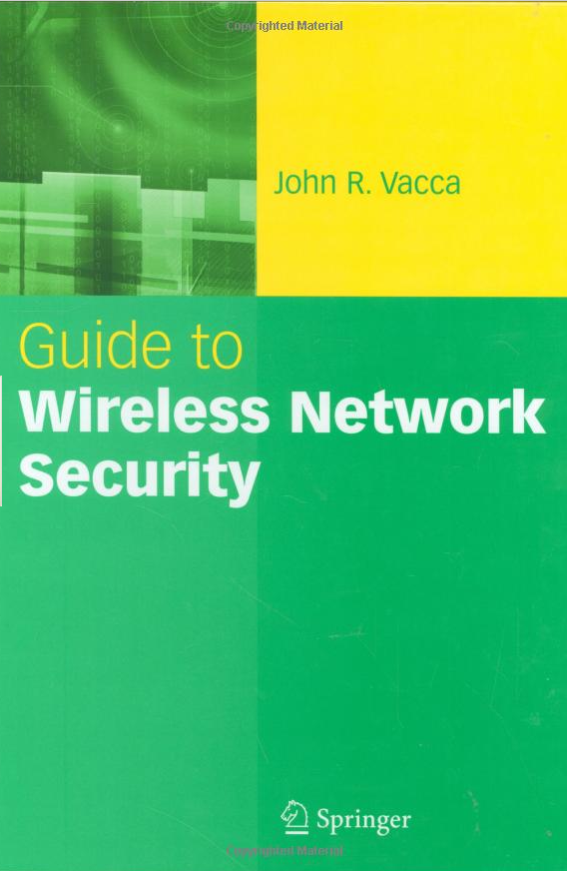
WEP for Authentication
Adds extra layer to userID/password normally used
Wireless device must have same encryption key as LAN’s access point
Wireless access points (WAPs) usually also able to
  Define access control lists (ACLs) based on
  Media access control (MAC) addresses

Slide 19
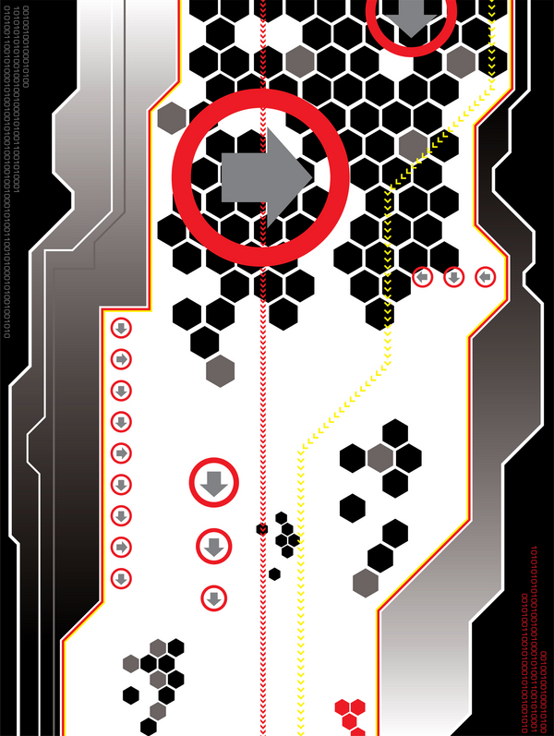
Network Operating System Issues
Overview of Network OS Topics
Windows 9x
NT/2000, XP, Vista, 7
UNIX
MacOS

Slide 20
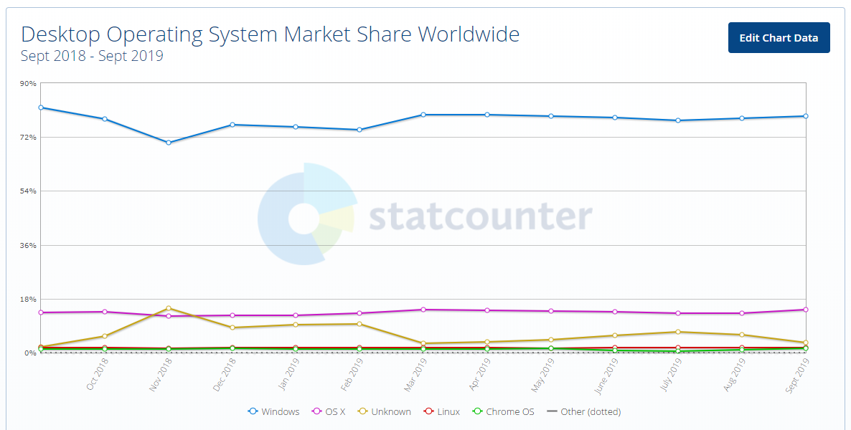
OS Desktop Market Shares
https://gs.statcounter.com/os-market-share/desktop/worldwide

Slide 21
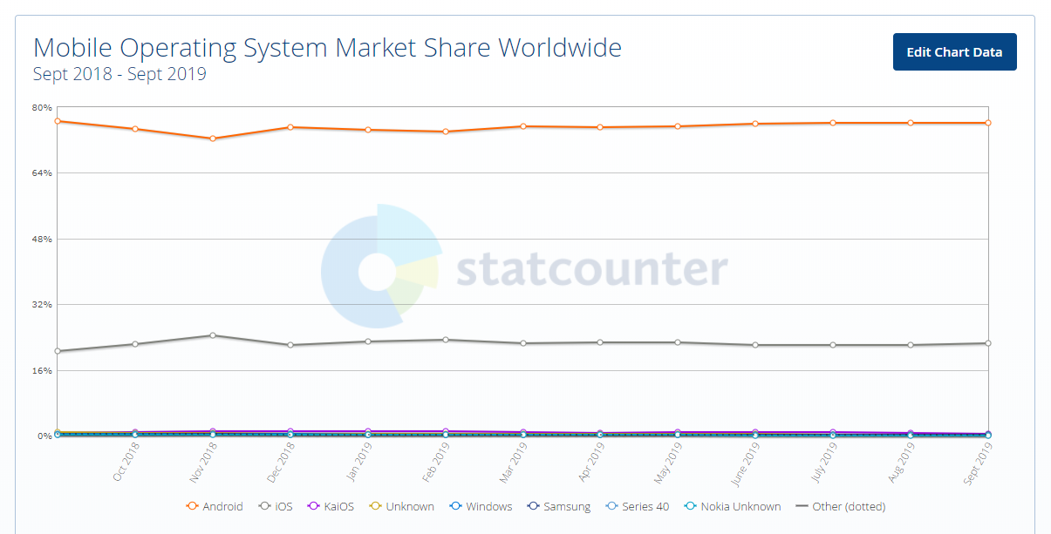
OS Mobile Device Market Shares
https://gs.statcounter.com/os-market-share

Slide 22
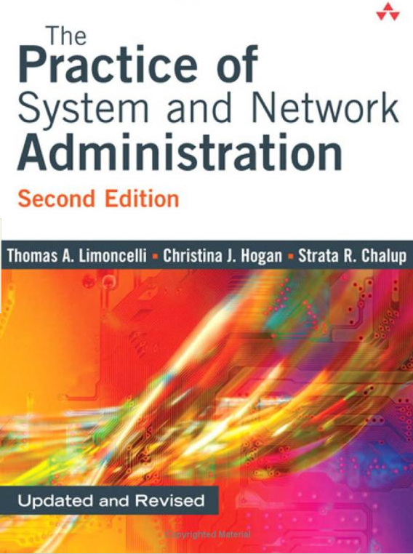
Overview of Network OS Topics
LAN environment has changed since 1990s
  At that time, desktops ran applications under Windows
  Network ran Novell Netware for file sharing
By late 2000s, networking commonplace for all desktop OSs (Windows, *nix, MacOS…)

Slide 23

General Considerations for NW Security (1)
Strong passwords & effective password policies
Disable/uninstall unused services
Keep OS up to date by version & patches
Define users, groups, domain trust
relations
Secure running applications
Limit use of root logon to need – and local only
Limit guest, demo, anonymous accounts
Put boot/system files on separate
partitions, drives, I/O controllers from
application programs and data
Audit servers
I
II
III
IV
V
VI
VII
VIII
IX

Slide 24
General Considerations for NW Security (2)
Monitor log files
Remove floppy, CD, DVD drives from servers after use
Implement industry best practices for securing OS
Use vulnerability assessment tools regularly
Use intrusion detection tools
When using SNMP, block external access to SNMP
Don’t make your OS version & processor type public info
X
XI
XII
XIII
XIV
XV
XVI

Slide 25
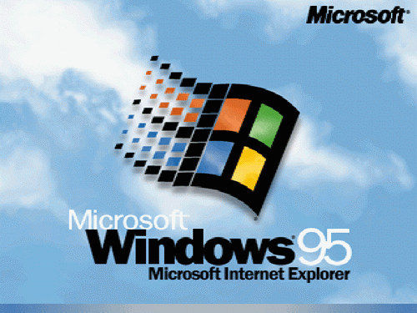
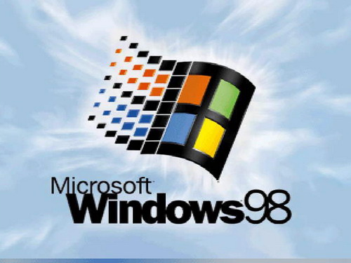
Windows 9x
Windows OSs susceptible to
  Exploitation of NETBIOS file & print sharing
  Abuse of resource sharing through
  TCP/IP when network has Internet access
Windows challenge-handshake authentication protocol (CHAP)
  Used for sending passwords
  But same challenge used for 15 minutes
  Thus possible capture/replay by intruder with physical access & sniffer
BackOrifice & NetBus: remote-control tools
Password crackers can break .PWL
password files
PW-protected screensaver? Reboot!
Use 3rd party secure bootlocks

Slide 26
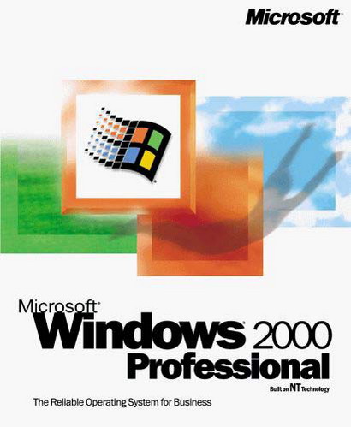
NT/2000
Windows 2000 Millennium Edition has same weaknesses as 9x
Stronger:
  Windows NT Server
  NT Workstation
  2000 Server
Many hacking tools available for
these versions as well
Vulnerabilities in Internet Explorer
(IE) & Office products weaken OS
Ideally, disable all Active Scripting and ActiveX options in Restricted Sites Zone of IE

Slide 27
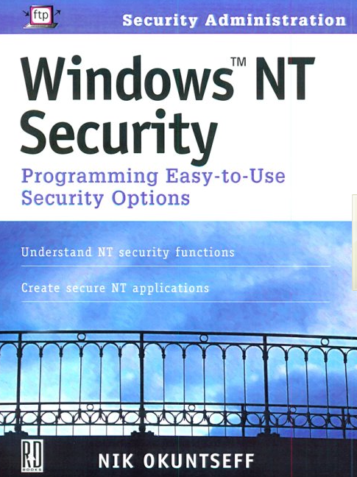
NT/2000 (2)
NT/2000: Simple recommendations for basic security
  Format drives using NTFS, not
  FAT
  Use long file names & disable
  DOS 8.3 naming
  Disable Everyone group
  Rename administrator account
  Turn auditing on (off by default)
W2K: Enable Encrypting File
System (EFS)
  Automatic encryption of disk
  data
  Should enable recovery of keys

Slide 28

Windows NT Audit Tools (1)
netstat examines open ports
Event Viewer examines application, security, and system logs.
net start, net user, net group, net local group display running services, users, groups, and local groups
dumpel converts Event Viewer logs to ASCII files
NetMon displays network traffic
netsvc displays local and remote running services and drivers
addusers displays users and groups
findgrp displays local and domain groups
for a user

Slide 29

Windows NT Audit Tools (2)
local and global show all members of specific local or global groups
dommon displays trusted domains
xcacls examines the file Access Control Lists (ACL)
perms examines the ACLs associated with a user
sysdiff displays changes in the Registry and file system
regdmp creates an ASCII version of the Registry
ralist lists a domain's Remote Access
Servers (RAS)
rasusers lists users authorized for dial-in
access

Slide 30
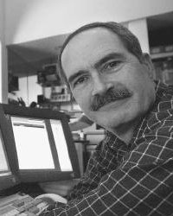
Windows XP: Better Security
EFS, firewall, Data Execution Prevention
But original release included raw sockets
  Permits program to manipulate TCP/IP communications directly
  Without use of normal application
  program interfaces (APIs) that apply
  security
  Allowed external control
  Steve Gibson warned (2001) of serious risk from script kiddies for denial of service applications
  See http://www.informit.com/articles/article.aspx?p=27289
MS removed raw sockets in Service Pack 2 (SP2)
Steve Gibson
http://www.grc.com

Slide 31
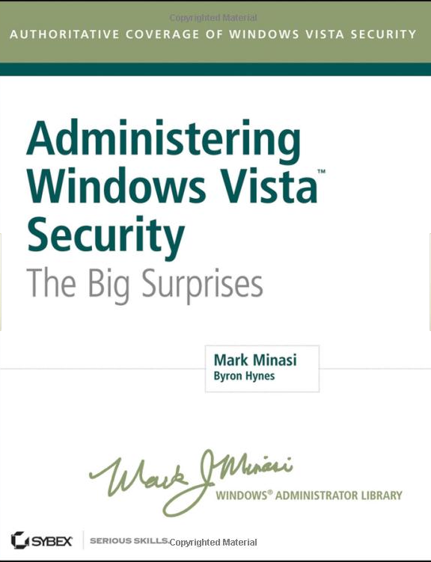
Vista: Child of Trustworthy Computing Initiative
Vista released Jan 2007; but by end of July 2009,
  22% market share (360M users)
  70% market share for Windows XP (1.1B users)
Major security change is User Account Control (UAC)
Requires user response to allow action requiring admin privileges
  Run as admin
  Changing files in root and program
  files folders
  [Un]Installing apps, drivers, ActiveX
  Changing settings for Firewall, UAC,
  Update, user accounts, Parental
  Controls, Task Scheduler
  Restoring system files from backups
  Viewing or changing other user’s data

Slide 32

Vista: Stepchild of the NSA?!?
Alec Klein & Ellen Nakashima
  Washington Post (January 9, 2007)
  NSA “participated” in creation of
  Vista security elements
Unclear extent of involvement
NSA acknowledged helping to protect OS against “worms, Trojan horses and other insidious computer attackers….”
Microsoft made NSA involvement public
Authors Kessler & Pritsky comment, “It is left as an exercise for the reader to decide whether having a spy agency working on a premier OS is a good thing or not.”
What do you think?

Slide 33
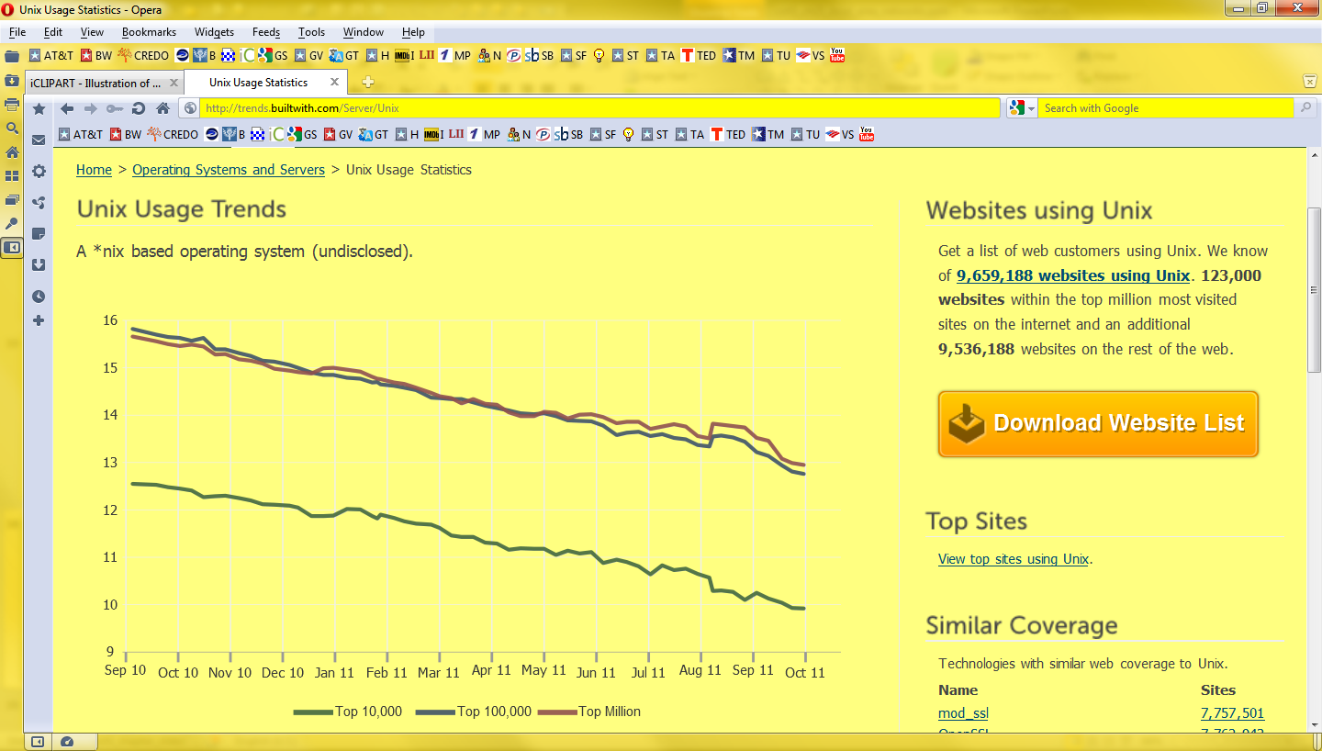
UNIX (1)
*NIX (UNIX variants) usage falling on servers:
Percentage of scanned systems using *nix OS variants
(Note that the ordinate should have started at zero);
this graph overemphasizes the decline by omitting the bottom of the Y-axis.
http://trends.builtwith.com/Server/Unix

Slide 34
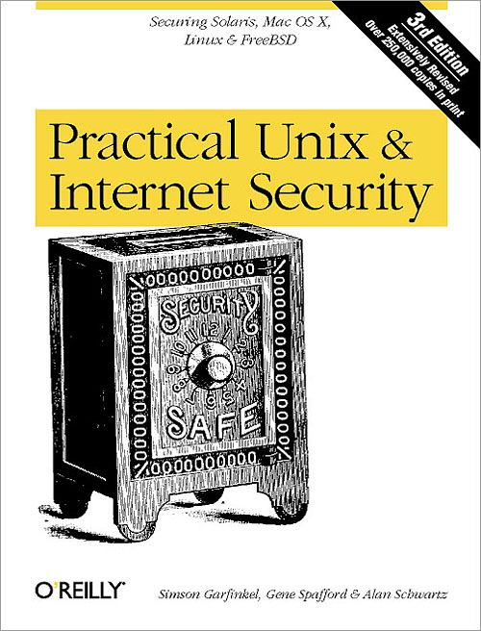
UNIX (2)
UNIX security architecture
  Developed originally for use in trusted community – security not paramount
  Usual list of normal security functions
  Enormous list of services
Extensive literature on *NIX security
Apply proper security audits, vulnerability assessment to *NIX systems

Slide 35

MacOS (1)
Mac OS originally designed with little concern for security
Every user is admin
Sharing capabilities more
complex than on Windows
  Therefore more risk of naïve
  user error
Little user-level protection
  No default requirement for
  password at logon
  No standard password-equipped screen saver

Slide 36
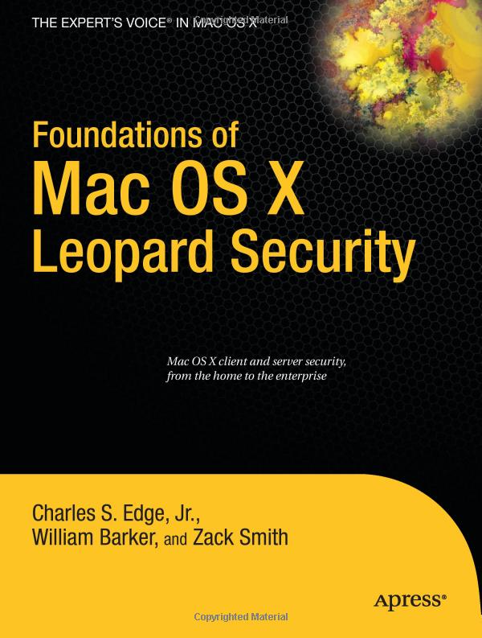
MacOS (2)
Malware attacks fewer
  But MS Office malware works
  DoS attacks work
  Use anti-malware package!
Other tools
  DiskLocker: password-protection of entire HD
  FileLock: locks on individual files
  Empower: applications & files
  MacPassword, Sesame: multilevel passwords

Slide 37
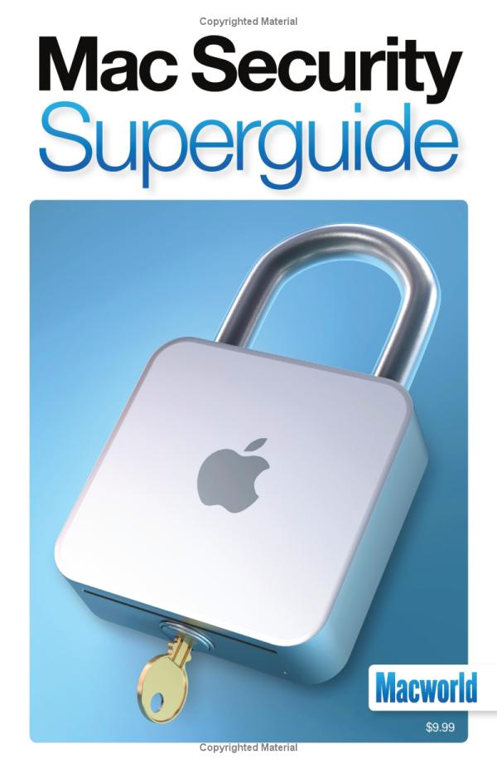
MacOS (3)
Mac-oriented security tools for networking include
  Intermapper: SNMP tool for
  AppleTalk & IP
  MacRadius: RADIUS for dial-in
  servers
  NetLock: encryption for
  sessions, passwords, logins
  Network Security Guard:
  vulnerability scanner
Update versions and apply patches
promptly
Criminal hackers still not as
frequently attacking Macs
  Fewer targets, less familiarity

Slide 38
Now go and study

