Slide 1
Gateway Security Devices
CSH6 Chapter 26
“Gateway Security Devices”
David Brussin & Justin Opatrny

Slide 2
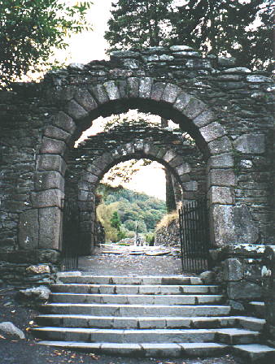
Topics
Introduction
History & Background
Network Security Mechanisms
Deployment
Network Security Device Evaluation

Slide 3
Introduction
Overview
Changing Security Landscape
Rise of Gateway Security Device
Application Firewall: Beyond the Proxy

Slide 4
Overview
What is a Firewall?
Firewall rapidly accepted as perimeter security device
Even CEOs know about firewalls
Original conception
Allow explicitly allowed communications
Deny all others
Allowed paths became weakest links
Involve different (and insecure) protocols
Firewalls evolved to compensate for weak security in allowed protocols
Successful use of firewalls depends on proper configuration

Slide 5
What is a Firewall?
A firewall is any network-security device that implements security policies by restricting the ingress and egress of TCP/IP packets according to specific rules.
Image from Computer Desktop Encyclopedia. Reproduced with permission. (c) 1981-2014 The Computer Language Company Inc.

Slide 6
Changing Security Landscape (1)
Pervasive changes in network architectures
Applications & work patterns require more open interactions
Perimeter less clearly defined
Increased centralization (e.g., servers)
Increased scrutiny of protocol traffic
Borders dissolving
Outsourcing, hosted applications (e.g., CRM, e-mail, external storage, Web apps, cloud computing)
Enterprise applications linked to customer & 3rd party applications

Slide 7
Changing Security Landscape (2)
Mobility (physical and logical)
Employees work from home, while traveling
Use kiosks, home systems, phones
Opens networks to attacks via compromised client systems
Regulatory compliance
Increased demands for security
In USA, laws such as Gramm-Leach-Bliley (GLB), Health Information Portability and Accountability Act (HIPAA), and Sarbanes-Oxley (SOX) force protection of personally identifiable information (PII)

Slide 8
Rise of Gateway Security Devices (GSDs) (1)
Firewalls originally defined allowed paths for access (ports)
Evolved into GSD to provide many security functions as shown below
Gateway security device capabilities:
Processing power has increased
Now see multifunction platforms; e.g., role-based access controls (RBAC)
Enterprise directory integration:
Lightweight Directory Access Protocol (LDAP) infrastructure for authorization

Slide 9
Rise of GSDs (2)
Unified threat management:
Perimeter-based antivirus, antimalware, antispyware, antispam
Intrusion detection & intrusion prevention
Content control
Content control & data leakage prevention:
Deep inspection of packets in protocols such as HTTP, SMTP, IM
Dictionary-based and URL-list filters
Requiring encryption for sensitive data
Archive & discovery
Message security & records for legal compliance

Slide 10
Application Firewall: Beyond the Proxy
Most significant allowed paths for most firewalls: Web access
HTTP & HTTPS (HTTP with SSL)
Increased complexity
Rich-client applications; e.g., using AJAX
Asynchronous JavaScript & XML
AKA remote scripting
Allows user to interact a field at a time instead of a page at a time
Firewall now has to guard against misconfiguration & vulnerability in custom Web applications running over allowed HTTP

Slide 11
History & Background
Changing Network Models
Mainframe
Client/Server
Web
Firewall Architectures
Firewall Platforms
Cross References in CSH6:
• Overview of computing and security history, see Chapter 1.
• Introduction to data communication basics, see Chapter 5.
• Introduction to local area networks, see Chapter 25.

Slide 12
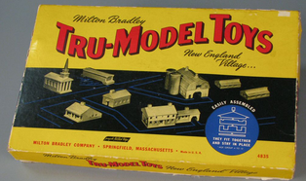
Changing Network Models (1)
Shift from mainframe-centric to LAN-centric to Internet-centric computing through 1980s through 1990s & 2000s
Mainframe architectures
Glass house approach
Solitary systems with hardwired dumb or smart terminals (green screens)
Multiple mainframes linked within single data centers
WANs used leased lines (telephony)
Virtualization began on mainframes
IBM MVS/VM
Strict partitions, mandatory access control

Slide 13
Changing Network Models (2)
Client/Server (1980s, early 1990s)
Midrange servers running Unix, NetWare, OS/2, Windows NT
Rapid increase in # & type of connections
Switch to PCs with local processing
Security perimeter expanded
Out of data center to desktop
WANs expanded beyond enterprise
Application security expanded across systems
Multiple allowed paths
Multiple possible attack paths

Slide 14
Changing Network Models (3)
Web
HTTP/HTML started expanding 1989
Commercial Internet exploded starting in 1993 when .com opened in big way
Web applications replaced fat clients
Mobile code complicated security issues
Asynchronous JavaScript & XML (AJAX)
Many customized & ad hoc protocols carry data over http
Firewalls increasingly focused on HTTP traffic

Slide 15
Firewall Architectures
Access Control List
Packet Filtering
Stateful Inspection
Application-Layer Gateway
Multifunction Hybrid
Host Environment Context

Slide 16
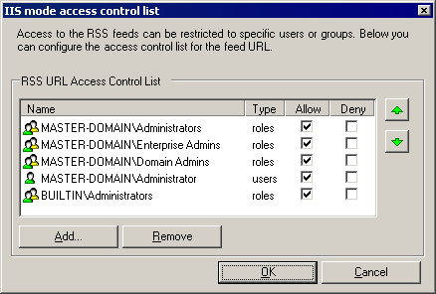
Access Control List (ACL)
First FW were routers
Dedicated appliances
UNIX-based bastion hosts
Routing appliances w/ ACLs
Still widely used
Decide on whether to allow packet into or out of network strictly one packet at a time
Examine packet data
Source, target addresses
Port, packet flags (e.g., SYN flag)
Vulnerable to misconfigured packets
Fix problems using patches

Slide 17
Packet Filtering
Pure packet-filtering FWs no longer common
Appliance or host-based
Use ACLs to apply policies
Typically provide logging
Support user-based authorization
Include intrusion detection & alerts
Strengths
Ideally suited to load-balanced, high-availability environments
Can automatically share load among devices
Weaknesses
Lack context information
Underlying operating system vulnerabilities affect security of FW
Packet filtering has moved to non-security appliances such as load balancers, Web caches, switches

Slide 18
Stateful Inspection
HTTP is a connectionless protocol
A communications architecture that does not require the establishment of a session between two nodes before transmission can begin. [Computer Desktop Encyclopedia]
Stateful-inspection FW maintain connection information locally
Table in memory stores packet header data
Compare current packet info to session
Identify some abnormal packets used in attacks
But attacks that use uninspected portions can succeed
Fast mode reduces inspection once connection opened successfully – strongly discouraged
Performance can be good
Provide load balancing & failover with out-of-band data synchronization among devices running in parallel

Slide 19
What is a Proxy Server?
“[An] application that breaks the connection between sender and receiver. All input is forwarded out a different port, closing a straight path between two networks and preventing a cracker from obtaining internal addresses and details of a private network.”
Image and text from Computer Desktop Encyclopedia. Reproduced with permission. (c) 1981-2014 The Computer Language Company Inc.

Slide 20
Application-Layer Gateway
Proxy servers
Receive packets from outside
Inspect and approve according to rules
Discard unused portions of received packets
REBUILD new packets for internal network
Effective against unknown attack types
Analogous to air gap in network topologies
Heavy processing loads
Typically configure load-balancing at system startup – not dynamically changed
Failover more disruptive – interrupt connections in progress

Slide 21
Multifunction Hybrid
Most commercial firewalls today are hybrids
Apply stateful inspection techniques to most protocols
Use application-layer gateway proxies for specific protocols (e.g., HTTP, SMTP)
Can shift to fast mode for stateful inspection once connection established

Slide 22
Host Environment Context
Host-based security more granular than perimeter-based devices
Define specific applications / services
Regulate types of data allowed per process
Use sandbox or virtual machine to test code
FWs can run on host or communicate with host
Use protocols such as Universal Plug and Play (UPnP) for data exchange
E.g., evaluate processes running when packet inspection being performed
Open and close specific ports as function of need

Slide 23
Firewall Platforms
Routing
Host Based
Appliance
Personal and Desktop Agent
Virtual
Embedded

Slide 24
FW Platforms: Routing
Router
Heart of TCP/IP networks
Forwards packets from one network to another
Internal routing tables allow determination of where to forward each incoming packet
Destination address determines where outgoing packets are sent
Current load on different connections determine which line to use for each packet or group of packets
ACL allow / deny statements restrict packets
Hardware modules (blades) can share processing to increase throughput (bandwidth)

Slide 25
FW Platforms: Host-Based
Dedicated server-based firewalls provide additional functions
Protocol traffic inspection
Contextual traffic inspection
Comprehensive logging & alerts
Air-gap proxy servers
Typically run on Unix or Windows
Often have special hardening (security features) such as modifications of network stack
Consequences of increased complexity include increased bugs, vulnerabilities
Sorry, folks: entry forbidden

Slide 26
FW Platforms: Appliance
Extension of host-based FW: put FW into its own specialized processor w/ no other functions
Total control of operating system
Control versions, patches specifically for functionality of FW
Prevent unauthorized, unwanted changes
Soft appliances
Vendor specifies exact characteristics of hardware for user to buy & install
Provides full software – boot from vendor-supplied disk

Slide 27
FW Platforms: Personal and Desktop Agent
Software FW
Host-based systems
Commonplace today
Running on workstations
Integrated systems often include antivirus functions
Evolve into host intrusion- prevention system (H-IPS)
Require more maintenance than network-based FW
Constant signature updates
Regular patches of client software
Difficulties for management in wide-area networks

Slide 28
FW Platforms: Virtual
FW running on virtual machines under hypervisor (e.g., VMware, Xen)
Protect virtual & physical networks
Complex management issues
Mapping virtual networks
Virtual appliances require exact compliance with vendor specifications

Slide 29
FW Platforms: Embedded
Web-server-based plugins
Create customized application FWs
Scale to support consumers, small/medium business requirements
Integrate tightly with Web server
Use downloaded signatures
Develop specific protection for specific applications
Allows contextual scanning unavailable to application gateways
Often become all-in-one security appliances
Integrate FW, network intrusion-prevention, antivirus….

Slide 30
Network Security Mechanisms
Recognition of value of network security mechanisms
IT managers have increased expertise
Increasingly recognized need
Often have unrealistic expectations
Next slides:
Basic Roles
Personal & Desktop Agents
Additional Roles

Slide 31
Basic Roles
Allowed Paths
Intrusion Detection
Intrusion Prevention/Response

Slide 32
Allowed Paths
GSDs create physical perimeters
Also create logical perimeter extending within protected networks
Constitute least-privilege gateway
Mechanisms for regulating access
Tunneling: Transmitting data structured in one protocol within the format of another.” (Computer Desktop Encyclopedia)
Antispoofing: preventing forged network addresses (e.g., blocking inbound packets with internal addresses and vice versa; blocking packets with originating addresses in reserved address-space)
Network Address Translation (NAT): see following slide

Slide 33
Network Address Translation (NAT)
Masks address of internal nodes
Private address space accessed by internal tables
Limits determination of internal network size & topology
Restricts access to specific endpoints
Static NAT
Manual, permanent assignment of IP address to each internal node
Dynamic NAT
Pool of addresses assigned as required
Port Address Translation (PAT)
AKA Nat overloading
Different TCP port # used for each client session

Slide 34
Intrusion Detection
Alerts may be good or bad
Appropriate deployment of alarms over new attacks & actual intrusions good
Torrent of excessive information about routine attempted attacks → shutoff
Internet hosts probed & attacked within hours of being put online
Observing which GSDs are reporting attacks can signal failure of upstream devices (more external perimeter defenses)
Can provide early warning of impending security system failure

Slide 35
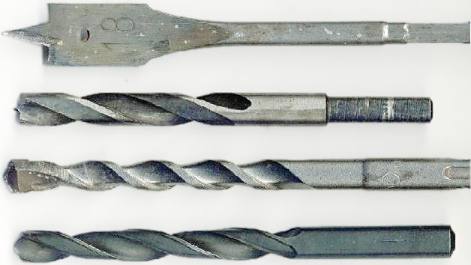
Intrusion Prevention & Response (1)
Several types of reaction to intrusions:
Connection termination:
Stop traffic using RST (connection reset)
On User Datagram Protocol (UDP), can use packet dropping to terminate connection
Good for known attacks on allowed paths
Can allow denial of service
Not useful in preventing unknown types
Dynamic rule modification
Target specific originating addresses
But opens even more to denial of service

Slide 36
Intrusion Prevention & Response (2)
System-level actions
Monitor for compromise
Firewall deactivation
But be sure that shutting down FW STOPS traffic, not leaves it open!
Application inspection
Check for known protocol-specific exploits
E.g., use signatures to spot HTTP-specific attacks such as cross-site scripting (XSS) & SQL query injection attacks
Antimalware
Spot malware in transit
Hijack Web session to divert download to quarantine

Slide 37
Personal & Desktop Agents
Individual hosts (workstations)
Must be protected individually
Can use sophisticated contextual scanning
End Point Protection
Mobile devices (laptop, phone) become extensions of network protection profile
Network location: Rules may vary depending on whether device is inside or outside perimeter
Application access: restrict inbound and outbound access depending on which program is running
Hybrid protections: spot particular patterns tied to known attack scenarios

Slide 38
Additional Roles
Encryption
Acceleration
Content Control
IPv6

Slide 39
Encryption (1)
Many GSDs support encryption
Important because encrypted packets could contain dangerous payload
Inspection
Termination: packet decrypted at perimeter
Contents inspected
May be re-encrypted for transmission to internal end-point
Alternative is passive (simultaneous) decryption using escrowed keys
But original encrypted packet continues to target while FW decrypts contents
Thus there are issues of synchronization

Slide 40
Encryption (2): VPNs
Virtual Private Networks
Extend security perimeter to include remote systems
Increasingly popular
But should consider special rules for VPN clients
May not be owned by organization
Need to establish clean operating environment
Especially important to prevent malware from entering corporate systems
See CSH6 Chapter 32 for more about VPNs

Slide 41
Acceleration
SSL (Secure Sockets Layer)
Most frequently used encryption protocol
Defines HTTPS
Widely used on Web for e-commerce
Many high-volume servers equipped with dedicated encryption appliances
Manage throughput
Avoid letting encryption/decryption become bottleneck on processing

Slide 42
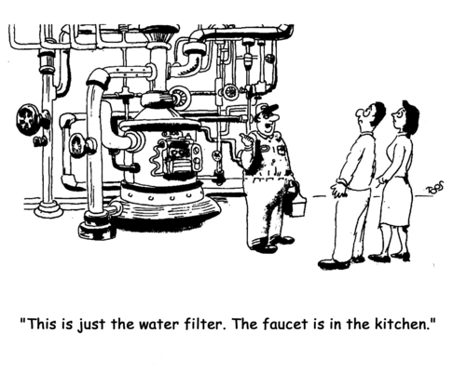
Content Control (1)
Content filtering
Policy enforcement
Address-based filtering can block some sites (sometimes by mistake)
Keyword scanning has many false positives
Antimalware
Pervasive element of all networks and workstations
Includes scans for harmful e-mail attachments, spam
Often uses appliances on network side to speed throughput

Slide 43
Content Control (2)
See CSH6 Chapter 17 for more about mobile code
Active Content
Flash, QuickTime, ActiveX, VBScript, JavaScript
Many GSDs scan for and block such code
Others use signatures and sandboxes to screen hostile code
Caching
Proxy servers keep copies of frequently-used items
Typically for HTTP, FTP, streaming media
Policy Enforcement
Can scan e-mail for sensitive keywords
Can require encryption for specific communications

Slide 44
IPv6 (1)
Successor to IPv4 (current standard)
Support & compatibility
GSDs must support appropriate protocols
Neighbor discovery (ND)
Router solicitation/advertisement (RS/RA)
Multicast listener discovery (MLD)
Stateless autoconfiguration
IPv6 nodes may assign their own addresses
Can discover their own routers using NS, RS/RA – but may break user/address audit trail (use MAC addresses for hardware nodes)

Slide 45
IPv6 (2)
Address shortage resolved
IPv4 address space = 2³² ≈ 10⁹
IPv6 address space = 2¹²⁸ ≈ 10³⁸
Ratio is IPv6:IPv4::solar system:stamp!
Be careful about IPv6 traffic tunneling through IPv4 infrastructure
E.g., antispoofing benefits of IPv6 lost when using IPv4-to-IPv6 gateways

Slide 46
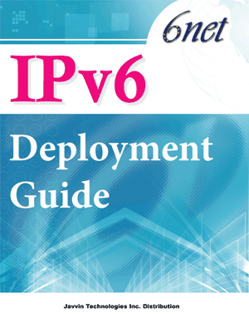
IPv6 (3)
NAT not intended to survive transition
IPv6 may expose IPv4 nodes when NAT removed
Single IP address associated with specific device (node)
Can carry address from internal network to external network
Example: laptop starts session in office but moves to café – same IP address
Will need new developments to cope with device-specific IPv6 addresses

Slide 47
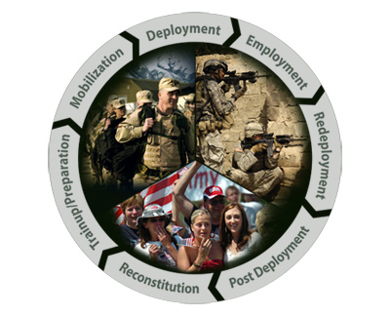
Deployment
Screened Subnet FW Architectures
Gateway Protection Device Positioning
Management & Monitoring Strategies

Slide 48
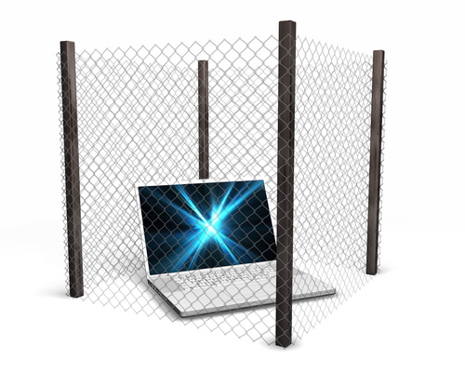
Screened Subnet FW Architectures
Service Networks
New design strategy: don’t lump Web, DNS, e-mail into single network (NW)
Break functional components into separate, protected NW
Defines service NW with their own security configurations, policies
Redirect Back-End Traffic Through FW
Just because FW decrypts packet doesn’t mean it’s necessarily safe
Reroute decrypted packet through FW before allowing it to reach internal destination

Slide 49
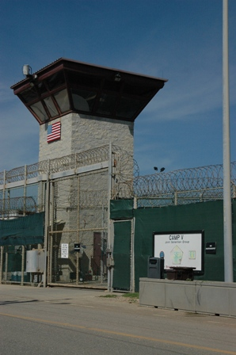
Gateway Protection Device Positioning (1)
Encrypting protocols (e.g., SSL & IPSec) can pose problems
Bandwidth chokepoints due to processing requirements
Ideally, deploy GSDs where there is little encrypted traffic
Two major approaches (details on following slides):
Put GSDs inline
Avoid encrypted traffic

Slide 50
Gateway Protection Device Positioning (2)
Inline
Configure span port to replicate data from one or more switch ports to monitoring port
Problems
Can overload the monitor (too many inputs)
Passive devices don’t offer protection, only alerts (so dangerous packets already gone)
Thus should put GSD inline with traffic
Provides choke point (but device can have wire speed bandwidth)
Allows active prevention (blockage)
But be sure to configure properly to avoid DoS

Slide 51
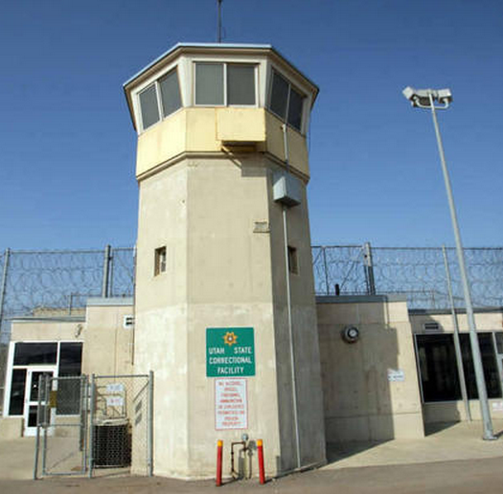
Gateway Protection Device Positioning (3)
Avoid encrypted traffic
Encrypted packets defeat GSDs
Therefore GSD must evaluate packets on unencrypted side of encrypted connection
E.g., on backside of SSL terminator
On unencrypted side of VPN connection
Implies likelihood of more than one GSD

Slide 52
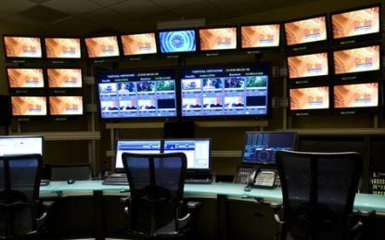
Management & Monitoring Strategies
Monitoring
Policy
Auditing/Testing
Maintenance
Logging & Alerting
Secure Configurations
Disaster Recovery

Slide 53
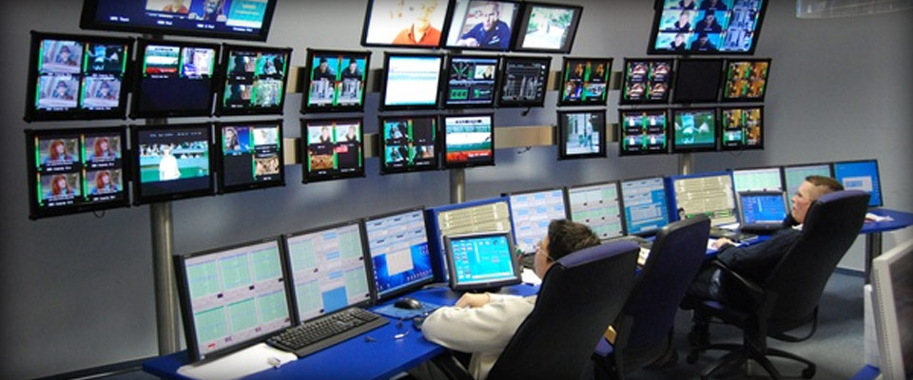
Monitoring
Device Health (may be part of GSD system)
Processor utilization
Available RAM
Number of connections
May have to use SNMP, RMON tools
Restrict access by monitoring tools
Examine trends
Availability
Periodically test functionality
ping, traceroute
Integrity
Ensure that operating code cannot be / has not been modified without authorization
Checksums, utility scanner….

Slide 54
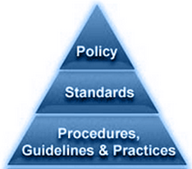
Policy (1)
GSDs instantiate policy!
Look for centralized management consoles
Firewall-allowed paths
Every allowed path must relate to specific required external service
Start with deny-all basis and add allowed paths
To degree possible, identify endpoints in rules
Keep track of direction of connections (inbound vs outbound)

Slide 55
Policy (2)
Complexity of GSD policies
Standard FW rules are simple Boolean logic
But GSDs may require multistage rules
Origination addresses
Message contents
Attachments virus-free
Change management
Must control & track policy changes & implementation
Can thus backout mistakes
Audit trail important for security incident analysis

Slide 56
Policy (3)
Secondary validation
Making changes can be easy
But complex systems can result in unexpected errors
Having second network / system admin check proposed change helpful
Avoid errors
Share knowledge
Enforce security principle of shared responsibility, checks-and-balances
Image from http://www.policynl.ca/policydevelopment/images/policy-development-life-cycle.png

Slide 57
Auditing/Testing
How do we know our GSDs are working?
Auditing: do the actual rules comply with the rules we claim to want according to policy?
Assessment: are the rules working as we want / expect?
Vulnerability assessment (VA)
Walkthrough, tools for examining parameters
Penetration (“Pen”) testing Actually trying to break through the GSD
See CSH6 Chapter 46 for VA/Pen Testing & Chapter 54 for audits

Slide 58
Maintenance
Patching – see CSH6 Chapter 40
Pattern updates
Automatic updates a must to get files promptly
But production environment cannot automatically trust patches
Have monitor-mode to see if new signatures work properly & safely
Then enable for action as approved by QA team
Alternative is to install on completely separate non-production systems for testing

Slide 59
Logging & Alerting
Logging essential
Must be able to access data on allowed / denied packets
Record of system changes
Alert mechanisms
Configurable
Whom to alert?
How (e-mail? IM? Phone w/ robot voice?)
Log files
Can eat up disk space
Plan for backups to cheaper media
May configure to exclude safe traffic
Need log file utilities to extract & format data

Slide 60
Secure Configurations
Ensure that GSDs are themselves secure against tampering, error
Define baseline secure configurations
Default configuration may be inadequate
Implied rules
Must be made explicit & examined
May modify or disable as required
Ancillary exposures
Administrative console can reveal unsuspected functions, services
Can disable unused functions, services

Slide 61
Disaster Recovery
See CSH6 Chapters 56-59
FW or GSD outage can cripple system or leave it wide open to attack
Fail-over/high availability
May need to configure active/standby units
Instant cutover
Load-balancing configurations
Provide better throughput
Also serves for business continuity
Backup/restore
Be sure all configuration scripts are backed up
Be able to re-establish known-good configuration ASAP

Slide 62
Network Security Device Evaluation
Current Infrastructure Limitations
New Infrastructure Requirements
Performance
Management
Usability
Price
Vendor Considerations
Managed Security Service Providers
§26.5 provides checklists for evaluating GDSs

Slide 63
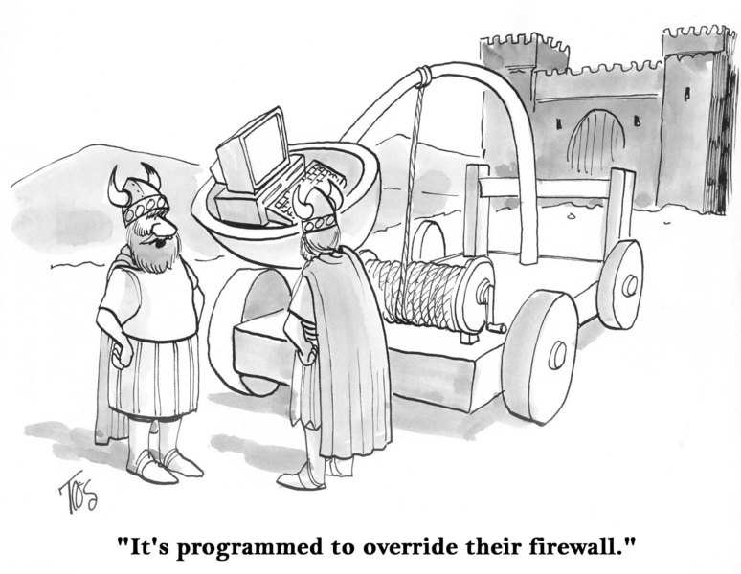
Will Firewalls Ever Be Perfect?

Slide 64
Now go and study

