Slide 1
I&A
CSH6 Chapter 28
“Identification & Authentication”
Ravi Sandhu, Jennifer Hadley, Steven Lovaas, & Nicholas Takacs

Slide 2
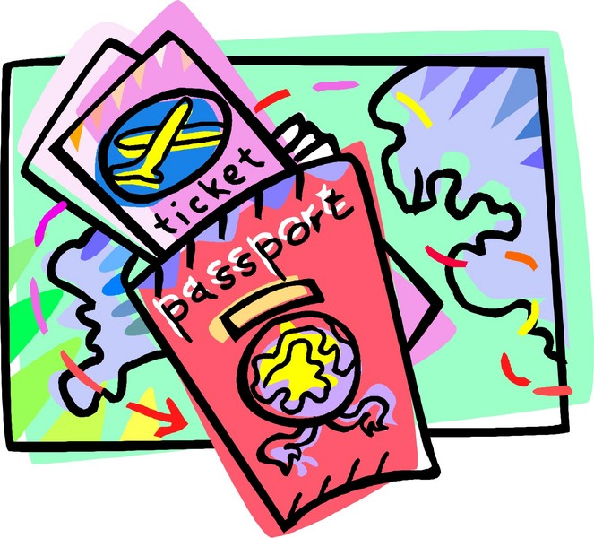
Topics
Introduction
Four Principles of Authentication
Password-Based Authentication
Token-Based Authentication
Biometric Authentication
Cross-Domain Authentication
Relative Costs of Authentication Technologies
Concluding Remarks

Slide 3
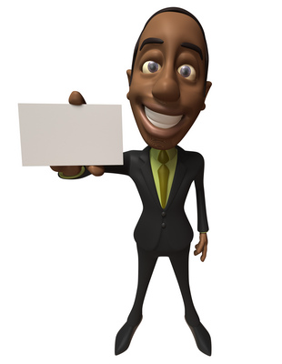
Introduction (1)
Identification
Assigning specific code to user or device
User identifier, aka user ID, aka userID
Authentication
Binding or linking specific human being (or device such as computer) to specific ID
Authorization
Granting specific permissions for particular actions on particular data; e.g.,
Read, Write, Append, Lock, Execute
Create new file, save old file, rename file
Define check amount, payee, OK payment

Slide 4
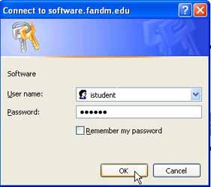
Introduction (2)
Focus of chapter is person-to-computer authentication
Also need computer-to-person authentication
Prevent spoofing of services on network
Phishing e-mails send victims to fake Web sites that look legitimate
Computer-to-computer authentication
Essential to safeguard critical transactions
E.g., interbank transfers, B2B e-commerce

Slide 5
Introduction (3)
Historically, mainframes authenticated users
Within single enterprise
Allowed centralized, controlled assignment of user IDs
Identifiers have never necessarily been unique
Not usual to have 1:1 relation between userID and person: usually at least N:1
But may have several people who use one userID
May have controls to prevent simultaneous multiple uses of same userID
And one person may have several userIDs
May become difficult to maintain authentication methods for multitude of IDs

Slide 6
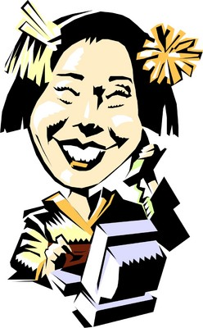
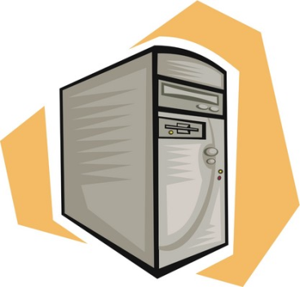
Introduction (4)
Single sign-on
Goal of today’s I&A research
Arrange to identify and authenticate once for entire network
I&A also used in physical security
See CSH6 Chapter 23
Acctg Web Inventory

Slide 7
Four Principles of Authentication
What You Know (that others don’t know)
What You Have (that others don’t have)
What You Are (that is different from others)
What You Do (differently from others)
Assumptions:
No one else but authorized user can qualify for authentication
Can combine methods (two-factor authentication, multi-factor authentication)
E.g., ATM requires card (token) and password (PIN*)
*DO NOT SAY “PIN NUMBER”
Why not?

Slide 8
What Only You Know
Password- or passphrase-based authentication
Widely used – most people know many PWs
Problems
Often poorly administered
Relatively insecure
Frustrating for users & administrators
But can be deployed better than the norm
Many IA professionals hope to see PWs phased out – but does not look likely soon
Guessing PWs invalidates authentication of userID (spoofing)
Many naïve users (e.g., executives) share their passwords, especially with assistants
But should arrange proxy privileges instead
http://dilbert.com/strips/comic/2004-12-05/

Slide 9
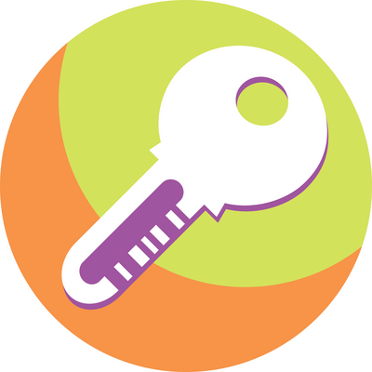
What Only You Have
Possession of token authenticates possession of the token, not identity of user
But if user safeguards token, can increase security compared to passwords
Often have 2-factor authentication (PW too)
Note that copying the token invalidates security function (WHY?)
Typical token is physical key for physical lock
Soft tokens store data only
May require PW for access

Slide 10
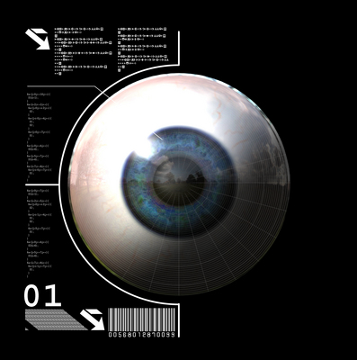
What Only You Are
See CSH6 Chapter 29
Static biometrics look at relatively fixed characteristics of person
Fingerprint
Hand geometry
Iris pattern
DNA
Require specialized readers
Susceptible to
Replay: capture data, use later
Tampering: breaching perimeter of reader or software to effect man-in-the-middle attacks or data corruption of comparison data

Slide 11
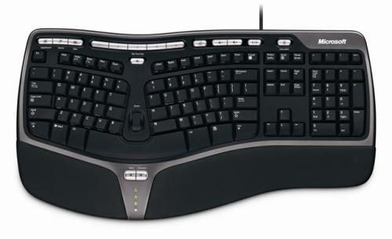
What Only You Do
Dynamic biometrics use characteristic actions
Signature dynamics
Speed, acceleration of hand/pen during signature
Extremely hard to copy/simulate
Voice dynamics
Keystroke dynamics
Speed, gaps between letters
BUT susceptible to capture/playback attacks
Encryption helps to fight data capture from storage for all forms of authentication systems

Slide 12
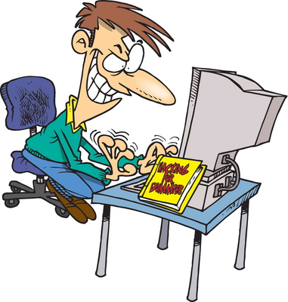
Password-Based Authentication (1)
Pervasive technology for authentication today
Estimated 1B password-based authentications/day worldwide
Internet users
Multiple PWs per user
Problems
Users must remember / store too many userIDs & PWs
Many users choose easily- guessed PWs
E.g., many passwords stolen in public Internet-access sites
Particularly in China, other countries with government surveillance
Areas with high computer-crime rates

Slide 13
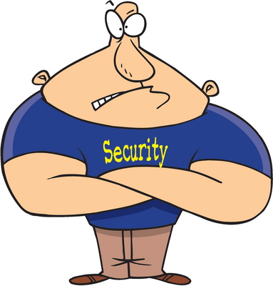
Password-Based Authentication: Further Topics
Access to User PW by System Administrators
Risk of Undetected Theft
Risk of Undetected Sharing
Risk of Weakest Link
Risk of Online Guessing
Risk of Off-Line Dictionary Attacks
Risk of Password Replay
Risk of Server Spoofing
Risk of Password Reuse
Authentication Using Recognition of Symbols

Slide 14
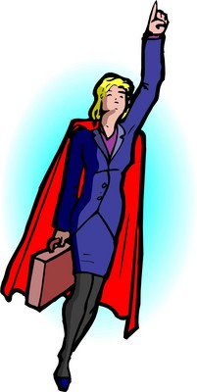
Access to User PW by System Administrators
Major danger – letting admins read PWs
Should not permit access to plaintext PWs by anyone
Badly designed systems store unencrypted PWs
Poorly administered systems have sys admins assign (and write down) initial passwords
But OK if used ONLY for one initial logon
User must change to secret PW immediately
Allowing access to PW by anyone other than assigned user destroys non-repudiation
Critical PWs may be written, stored in tamper-proof containers, and locked away with 2 signatures in a register from authorized personnel needed for access

Slide 15
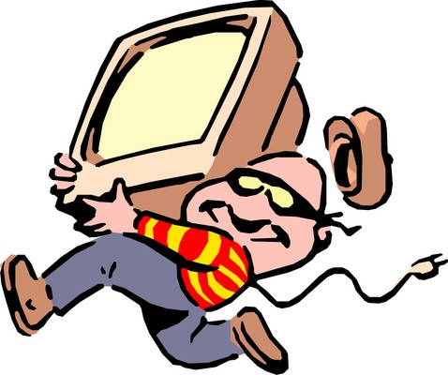
Risk of Undetected Theft (1)
Impossible to know immediately that a PW has been compromised
Shoulder-surfing can leak a PW
Social engineering can trick someone into divulging PW (e.g., “technician” can ask)
Loss of physical token can eventually be discovered
But loss of control over a PW discovered only by
Unauthorized use
Finding it in possession of unauthorized person

Slide 16
Risk of Undetected Theft (2)
User education & changes in behavior
Entering PWs discreetly
Trojan horses
Writing PWs down in exposed places (e.g., sticky notes under keyboard)
Discovery of misuse should be real-time
Unauthorized simultaneous use of userID
Audit trails coordinated over multiple systems
PW management
Users must be able to change PWs themselves
Do not impose limits such as 24-hour delays
Typical lifetime 30-90 days
Discuss whether you agree with frequent PW changes

Slide 17
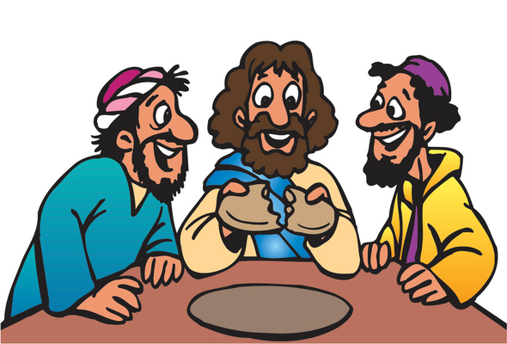
Risk of Sharing
Too easy to share passwords
Executives with secretaries
Physicians with office staff / nurses
Professors & students
Coworkers
Cause
Lack of effective delegation / proxy privileges
Should allow specific functions but not others
E.g., secretary should read boss’s e-mail but should answer only using own identity (proper authentication)
Prevention
Integrate sensitive data into PW
Use one-time PWs generated by tokens*
*E.g., CITIBANK, BankAmerica

Slide 18
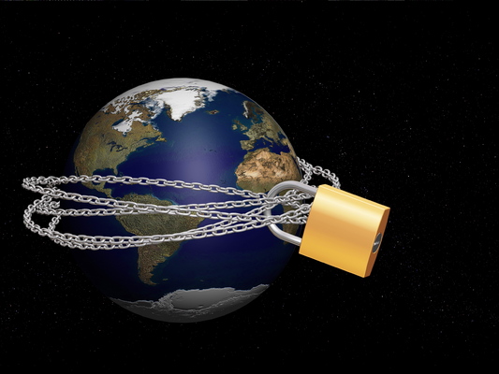
Risk of Weakest Link
Users have many PWs
Tend to repeat them on multiple sites
Exposure of 1 PW on poorly-defended site exposes many PWs
Alternative: PKI
Public Key Infrastructure
Generate certificate at logon
Use certificate for other sites
E.g., BankAmerica VISA offers one-time “credit-card number” online for use online
Alternative: centralized secure payment with 1 logon
E.g., PayPal

Slide 19
Risk of Online Guessing
User tests guesses on actual authentication system
Users often choose bad passwords related to personal information (family, pets, sports)
Classic: “password”
UserID itself (“Joe” accounts) or userID backwards
Canonical or standard passwords
Same (or same pattern) on all accounts
Must enforce PW complexity rules

Slide 20
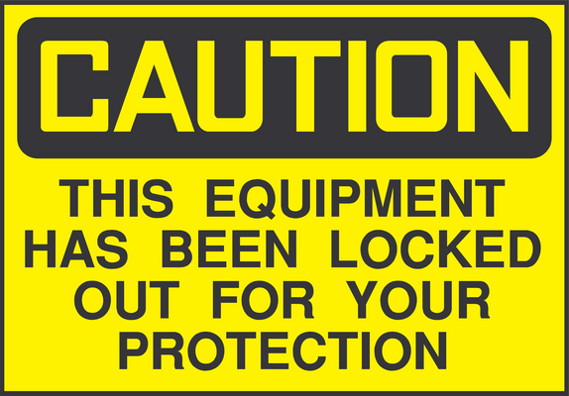
Response to Multiple Bad PW Entry
Lockout after n tries (e.g., n = 5)
Common response
May be based on ATM rules
But opens system to denial of service (DoS)
Anyone knowing account list can block entire system
Just try dummy password several times on all accounts = system lockup
Slowing down entry more effective
E.g., 2 or 3 minute delay after max errors
Suffices to make brute-force guessing ineffective*
Configure alerts to initiate investigation
*Why?

Slide 21
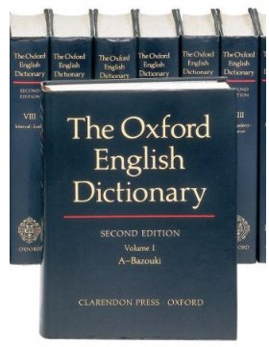
Risk of Off-Line Dictionary Attacks
Copy PW file onto different computer
Normally one-way encrypted
Compare encrypted forms of all possible PWs with file
Any match good enough to use for that PW
Use dictionary of likely PWs in order of likely use for PW-cracking program
E.g., ElcomSoft tools (see later slides)
Give an example of what this attack could look like

Slide 22
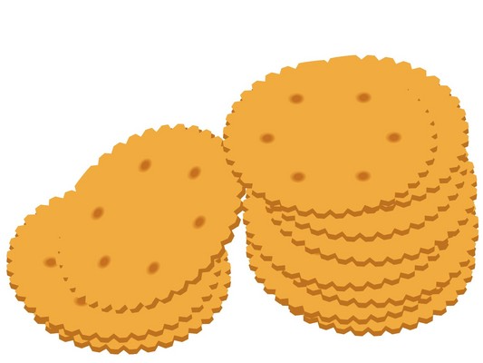
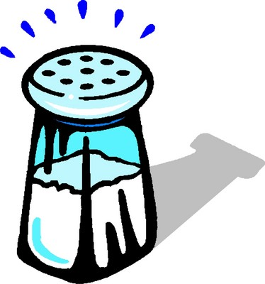
Defensive Strategies Against Offline Dictionary Attacks
Try to stop use of PWs in dictionary
But ineffective – crackers more advanced than admins
Stop crackers from getting info needed for attack
Long-established practice to store hashed PWs
But knowledge of hashed versions is enough
So UNIX systems made PW files harder to read
UNIX uses salt
Specific random number hashed with PW
Salt stored on server – must remain secret
Every hashed PW in attack must be extended by every possible salt value (e.g., 12-bit salt → 4096 salt values)
http://ophcrack.sourceforge.net/

Slide 23
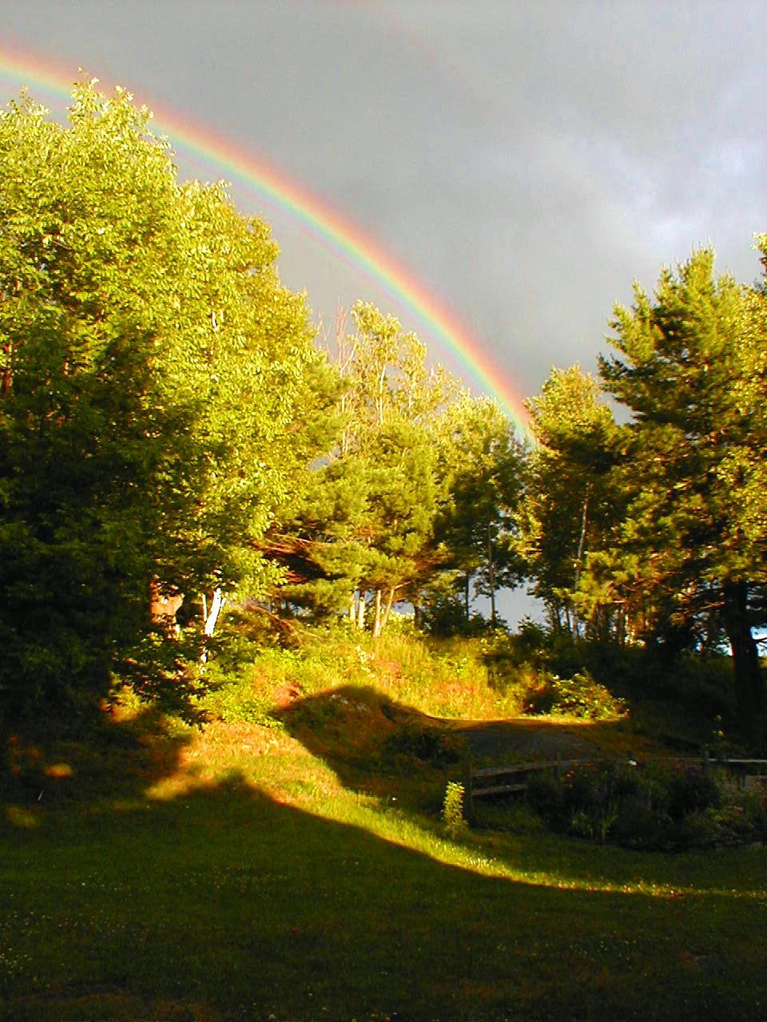
Rainbow Tables
Computing all possible hashed values of passwords + hash values can be lengthy
Rainbow table
Pre-compute all the values
Store them to be able to locate rather than compute hashed value on the fly
Tradeoff
Rainbow tables can be very large
Thus tradeoff is of CPU time vs memory and disk space req’ts
Password-cracking products use rainbow tables
See next slide

Slide 24
Password Cracking Programs
Search on “password cracker” for many programs
ElcomSoft Advanced Office Password Breaker http://www.elcomsoft.com/aopb.html
John the Ripper http://www.openwall.com/john/
Ophcrack http://ophcrack.sourceforge.net/
Rixler Software http://www.rixler.com/
Top 10 Password Crackers list http://sectools.org/crackers.html
But many password crackers from criminal hackers are Trojan horses
Rootkits / RATs
Malware droppers

Slide 25
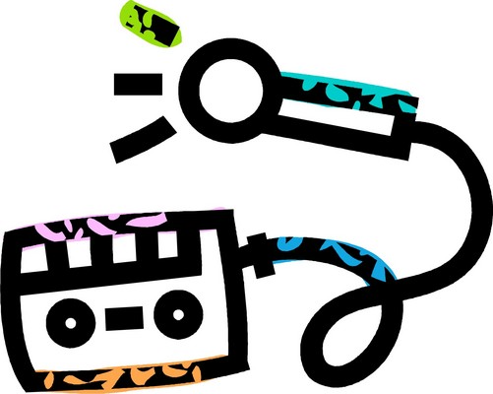
Risk of Password Replay
Password sniffing captures cleartext PWs from client to server
Then re-use the captured PW
Some systems transmit simple hash
No salt
But hash is good enough for replay attack
Encryption
Server-side Secure Shell (SSH)
Server-side Secure Sockets Layer (SSL)
Kerberos
See next slide
Zero-knowledge PW proofs (see below)

Slide 26
Kerberos
User PW becomes secret key on server & on client system
User requests authentication
Kerberos server generates session key
Encrypts session key with user’s secret key (password)
Sends ciphertext to user
User decrypts using secret key
Problems
Vulnerable to dictionary attacks
Any machine can pretend to be any user & obtain encrypted session key
Does not use salt

Slide 27
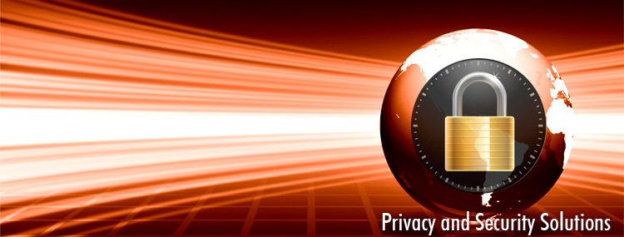
Zero-Knowledge PW Proofs
Demonstrate knowledge of PW without revealing it
Conceptual model
Both server and user “mark” a data value corresponding to PW
Cannot see each other’s choices
List of values randomized & records examined
If a single value shows that both server & user marked it, both know the right value
Standard illustration uses deck of cards analogy
Permission requested from Zero-Knowledge Systems for use of their image. < http://www.zeroknowledge.com/ >

Slide 28
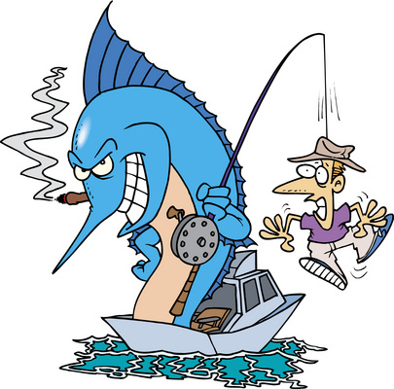
Risk of Server Spoofing
SSL depends on authentication of server
Public-key certificate for server authenticates it to client machine
But a fake Web site could fool user into revealing PW
Phishing & pharming
Web sites starting to authenticate themselves to users
E.g., display specific image & strings
“Archie’s Favorite Critter” for hippopotamus

Slide 29
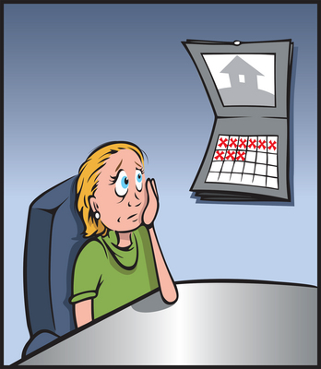
Risk of Password Reuse
What is reasonable frequency for PW change?
Excessively frequent changes frustrate users
End up writing down complex, unfamiliar PWs
Machine-chosen PWs
Can be user-unfriendly
Exposure over time
Risk of password capture
Inadvertent disclosure
Trojan horse keylogger
PW history prevents reuse
But be careful about delaying change – must cope with compromised PWs

Slide 30
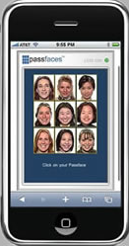
Authentication Using Recognition of Symbols
Recognition of particular faces
Highly developed skill for normal people
Passfaces® software < http://www.passfaces.com >
Array of faces provided
User (or admin) adds familiar faces to pool
SW produces 3x3 grid of random selections
User picks out familiar face in 3 grids in row
Advantages
Cannot be written down, copied, shared, guessed
Uses cognitive skills, not memory
Permission received from Passfaces to use image.

Slide 31
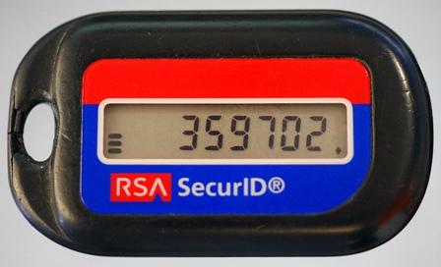
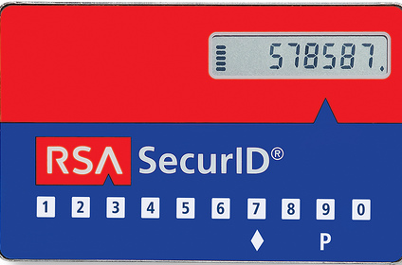
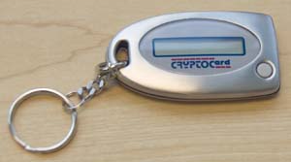
Token-Based Authentication
One-Time Password Generators
Smart Cards and Dongles
Soft Tokens

Slide 32
One-Time Password Generators
Microprocessor-equipped device
Card or key-fob
Generates PW (e.g., 8 numbers) that changes
Every time button pushed
Or after certain time
PW is ciphertext based on encrypting time of day (TOD) and unit number
Server decrypts PW and checks against TOD to compute unit number
Anti-tampering measures common
Epoxy-resin to destroy circuits
Light-sensitive components
Examples
SecurID from RSA http://www.rsa.com/node.aspx?id=1156
CryptoCard http://www.cryptocard.com

Slide 33
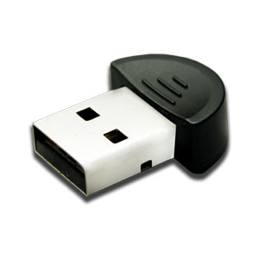
Smart Cards and Dongles
Microprocessor-equipped card or USB device
Fit into special reader or other I/O port
Typically stores private key for user
Often require PIN for access (2-factor authentication)
Interacts with client or server
Benefits
Something the token knows
Stronger authentication than user PWs
Loss usually obvious – can disable token
Problems
Accidental damage
Physical attack on card or token

Slide 34
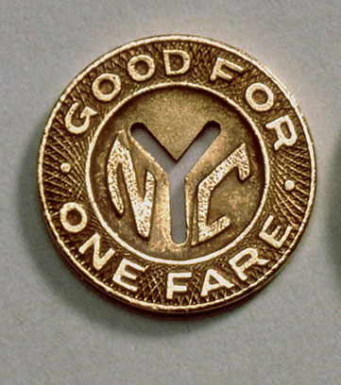
Software Tokens
AKA soft tokens
User’s private key encrypted & stored on storage device
Originally floppy disks
Now USB flash drives
But some people storing soft tokens on network servers
Reduces to a stored password
Some systems working on splitting keys
Others store user’s private key on server
Enables user spoofing

Slide 35
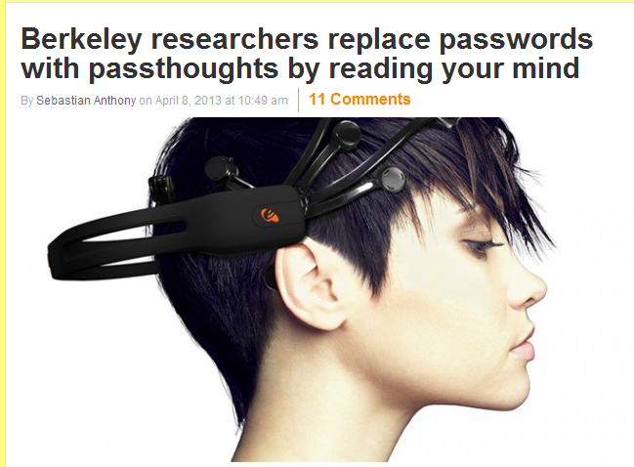
Pass-thoughts using Neural I/F
$100 EEG from Neurosky
Bluetooth headset
Variety of mental activities sufficiently distinct for I&A
Foresee unlocking smartphones & computers with this technique
http://www.extremetech.com/computing/152827-berkeley-researchers-authenticate-your-identity-with-just-your-brainwaves-replace-passwords-with-passthoughts

Slide 36
Cross-Domain Authentication
Users expect easy access to everything once they have authenticated to a single system
E.g., multiple sites within intranet or even on Internet
Sharing user authentication & authorization information across domains
Security Assertion Markup Language (SAML)
Shibboleth uses SAML for middleware
https://cwiki.apache.org/DIRxSBOX/shibboleth.html
http://shibboleth.internet2.edu/
Extensive use of PKI (see CSH6 Chapter 37)

Slide 37
Biometric Authentication
See CSH6 Chapter 29

Slide 38
Relative Costs of Authentication Technologies
$
Common belief: password are free
FALSE
Study by RSA Data Security
Initializing each userID = $12
Maintenance for 3 years = $660/user
Fundamentally weak authentication method
Tokens & biometrics
Demonstrably less expensive
More effective

Slide 39
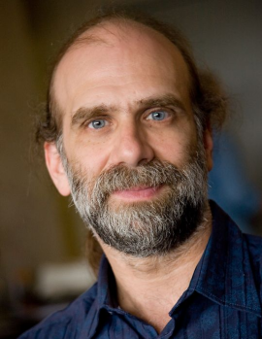
Concluding Remarks
Biometrics & tokens likely to replace PWs for high-end security
IA experts should dispel misconception that I&A are sufficient for improving public safety
Identifying someone ≠ trusting someone
Closed populations (e.g., employees) allow for background checking
But unscreened population (e.g., air passengers) provides no assurance of trustworthiness
Should criticize security theater (Bruce Schneier’s term) for security measures as substitute for effective public policy

Slide 40
Now go and study

