Slide 1
Biometrics
CSH6 Chapter 29
“Biometric Authentication”
Eric Salveggio, Steven Lovaas, David R. Lease, & Robert Guess

Slide 2
Topics
Introduction
Importance of I&A
Fundamentals & Applications
Types of Biometric Technologies
Types of Errors & System Metrics
Disadvantages & Problems
Recent Trends in Biometric Authentication

Slide 3
Introduction
Biometrics = automated recognition of people
Static or physical (fingerprint, face, iris,…)
Dynamic (physiological or behavioral) (voice, speech, typing patterns, gait, brain waves …)
Growing acceptance
Improvements
Security
Convenience
Portability
Costs
Authentication is based
On something you
Know
Have
Are (static biometrics)
Do (dynamic biometrics)
that others don’t / aren’t / cannot.

Slide 4
Importance of I&A
Prerequisite to security & efficiency
Exclude intruders
Allocate resources
Authorize access modes
Identification by person not scalable for computing systems
Voice, appearance, gait…
Inefficient & inaccurate
Foolable using social engineering
Impossible to manage remote access

Slide 5
Fundamentals & Applications
Overview & History
Properties of Biometrics
IA&A
Application Areas
Data Acquisition & Presentation

Slide 6
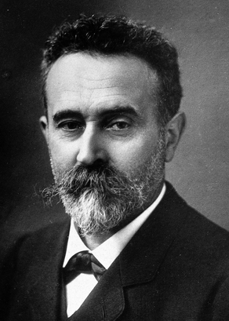
Overview & History
Non-automated biometrics
Biological systems recognize others as individuals or as members of species/group
Human beings routinely recognize each other using face, voice, body appearance…
Potters in Assyria used thumbprints (300 BCE)
Handwritten chops (signatures) in China
Fingerprints used in Tang Dynasty (618-906 CE)
Alphonse Bertillon introduced anthropometry (1882)
Edmond Locard proposed fingerprint analysis (1918) using 12 specific points –
still used today
Alphonse Bertillon

Slide 7
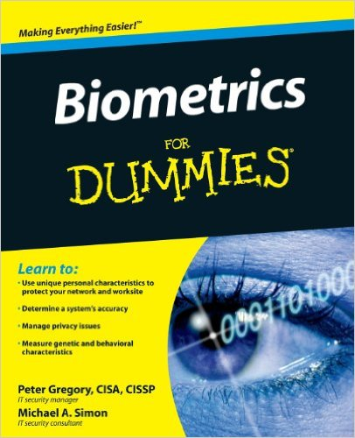
Properties of Biometrics (1)
Focus on “automatic identification of a person based on his or her physiological or behavioral characteristics.”
Biometric can be noun or adjective
Currently using unique characteristics of
Fingerprints
Hand geometry
Face
Iris
Voice
Signature
Biometrics difficult to circumvent through deceit
But gummy bears are a problem!

Slide 8
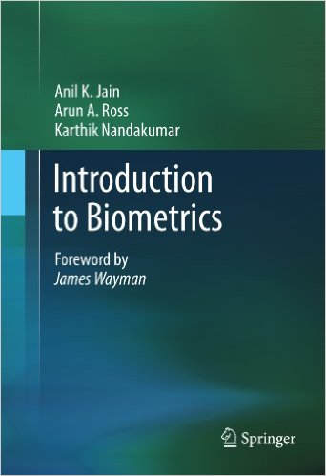
Properties of Biometrics (2)
Requirements:
Universality
Uniqueness
Permanence
Collectability
Acceptability
Additional factors in evaluation of biometrics
Performance
Circumvention

Slide 9
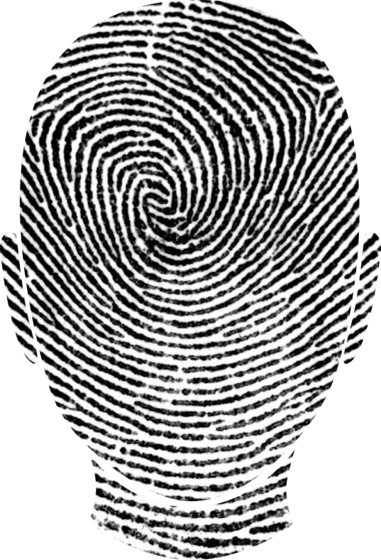
IA&A
Identification is allocation of a unique identifier to a person or a system
Authentication is the binding of identifier to user of that ID
Verification is process of establishing whether authentication offered is correct
Biometrics can serve for identification & authentication in one process
Identification through a biometric automatically leads to authentication
Except in case of identical twins or other identical ‘tuplets (effectively genetic clones)

Slide 10
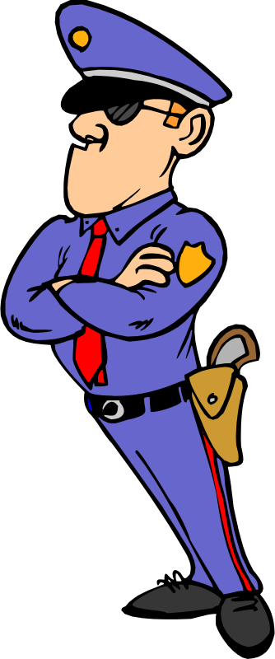
Application Areas
Security (logical access systems)
Access to computer systems, networks, data storage…
Facilities access (physical access systems)
Access to buildings, rooms, cabinets, safes…
Ensuring uniqueness of individuals
Prevent double-dipping in public sector
Public identification systems
Identifying terrorists, criminals
Or forensic applications such as dental records
Data acquisition and presentation (see next slide)

Slide 11
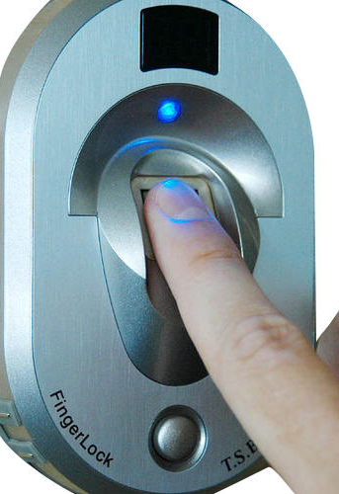
Data Acquisition & Presentation
Enrollment
Initial data collection and processing
Templates are mathematical representation of biometric information
Think of it as a kind of hash function
Little interoperability among systems
Presentation
How user provides system with new data for comparison with template
E.g., scanners, cameras, microphones
Typically do not store original data (e.g., face images) but only template

Slide 12
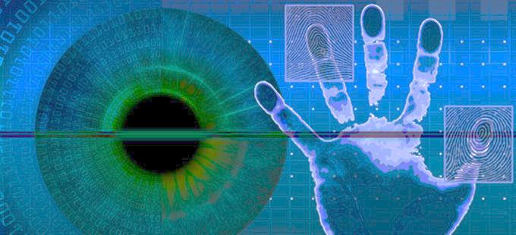
Types of Biometric Technologies
Finger Scan
Facial Scan / Recognition
Hand Geometry
Iris Scan
Voice Recognition
Other Biometric Technologies

Slide 13
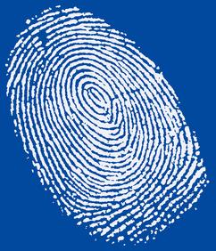
Finger Scan (1)
Most widely deployed technology
Even excluding police fingerprinting
Typically scan a single finger on one hand
But can enroll more than one finger in case there’s a Band-Aid™ in the way – or no finger after an amputation(!)
Advantages
Costs low
Easy to use
Low error rates
Quick to process
Easy to deploy (but some resistance due to association with law enforcement)

Slide 14
Finger Scan (2)
Wide access to methods for defeating biometric finger scanning technology
Dummy latex finger
Gummy Bears™ with fingerprints etched on surface
Manipulation of scanner to raise latent print of previous user
Use of detached real amputated finger (eeeeuuuuwww)
Countermeasures
Force use of more than one finger
Use thermal and moisture sensors to discount fake or dead fingers
Problems with dry/wet fingers

Slide 15
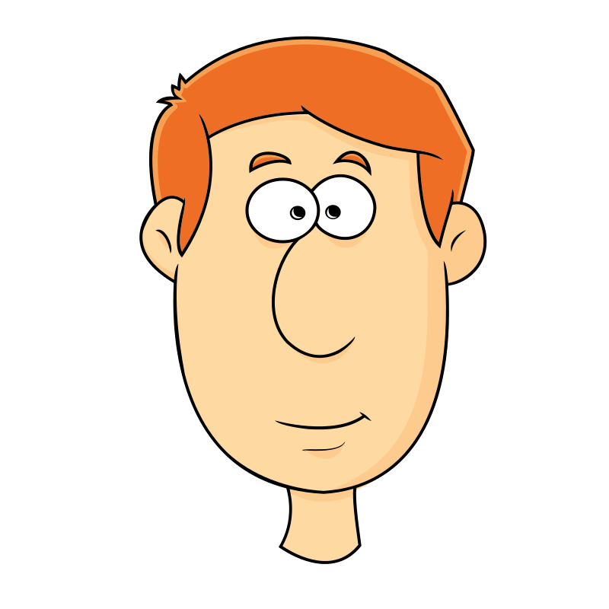
Facial Scan / Recognition (1)
Used by most people every day – naturally
May be more acceptable than other biometrics to some non-technical subjects
Acceptance of individual, open recognition & authentication
Well-established database + controllable input conditions = low error rates
Covert use for recognition
Airport scanners
Crowd scanners
Strongly opposed by much of public
Accuracy can be terribly low; e.g., >50% error rate in trials at Palm Beach FL Intl Airport

Slide 16
Facial Scan / Recognition (2)
Weaknesses
False matches (acceptances)
Common for identical twins
May be exploited by impersonators
False non-matches (rejections)
Facial expressions
Hairstyle, makeup, facial hair, eyeglasses
Changes in body weight
Age-related face changes
Perceived threat to privacy
Public dislike concept of covert facial recognition
Most people do not know that pictures are not stored – only templates

Slide 17
Hand Geometry (1)
Distinctive aspects of hand
Height & width of hand & fingers
Recognition Systems Inc (RSI) scanner
90 different measurements
3-4 enrollments
Length, width, thickness, surface area
Anti-exploit methods against fakes and amputations
Temperature sensors
Used exclusively for verification, not identification
Mostly for physical access & time/attendance

Slide 18
Hand Geometry (2)
Strengths
Resistant to environmental stresses
Established & reliable
Easy to use
Difficult to defeat
Small template size (store lots of them)
Stable characteristics
High user acceptance / low stigma
Weaknesses
Limited accuracy
Relatively large scanner
Resistance to touching surfaces (clean freaks)
Difficulties for disabled people
Relatively expensive

Slide 19
Iris Scan
Unique patterns of color in iris
Even left/right irises of same person differ
Ideal to enroll both eyes – more difficult to spoof
Both I & A
Stable over time – but affected by age & disease
Highly accurate
Lowest error rate
Highest accuracy
Weaknesses
Moderately demanding enrollment & acquisition
Some resistance to have eyes scanned
Physical & psychological
Affected by lighting conditions
Problems with eyewear
Expensive

Slide 20
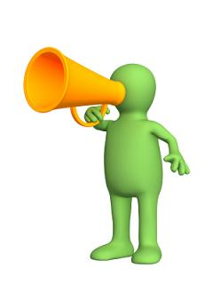
Voice Recognition
Distinctive aspects of voice
Pitch
Waveform
Dynamics (amplitude, inflection)
Phonetics (accent)
Advantages
Can use telephone equipment
Inexpensive & easy to use
Can speak passwords
No stigma – generally accepted
Disadvantages
Replay attacks
Low accuracy
Ambient noise
Low-quality capture
Accuracy variable
Soft/loud speech
Hoarseness, stuffed nose
Illness, aging, smoking…

Slide 21
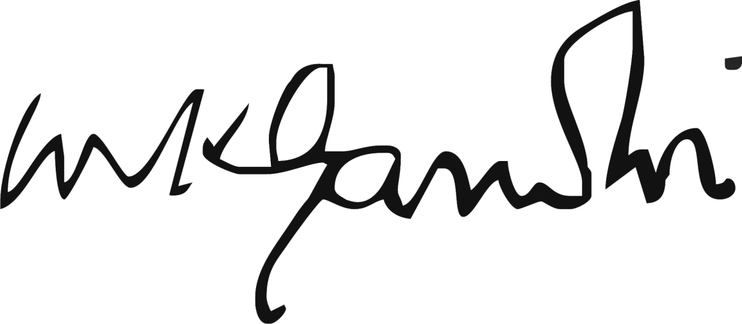
Other Biometric Technologies
Signature scanning
Typing (keystroke) dynamics
Interval between keystrokes on passphrase
Gait patterns
Lip movements
Retinal scanning
Lack of user acceptance
High cost
Difficult / painful acquisition
Expense
Future possibilities
Body odor (☹)
Skin reflectance
Ear shape
Brain waves

Slide 22
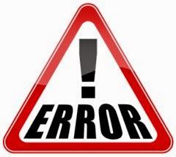
Types of Errors & System Metrics
False Accept
False Reject
Crossover Error Rate
Failure to Enroll
Transaction Time

Slide 23
False Accept
Imposter will be accepted
AKA
False match
False positive
Type 1 error
Importance depends on context
Bank / root access – high concern
Facial recognition in casinos vs card-counters – low concern

Slide 24
False Reject
Legitimately enrolled user NOT accepted
AKA
False nonmatch
False negative
Type 2 error
Typically lock user / employee out of system / facility
Can occur because of
Changes in user’s biometric data
Environmental changes
Problems with sensors
Biometric systems typically more susceptible to false rejects than to false accepts

Slide 25
Crossover Error Rate (CER / EER)
The rate at which Type 1 and Type 2 errors become equal is called the CER or EER
Power of the test: Rates of Type 1 & Type 2 errors are inversely affected by change
As we reduce the probability of false accept (Type 1 error), we tend to increase the probability of false reject (Type 2 error)
As we reduce the probability of false reject (Type 2 error), we tend to increase the probability of false accept (Type 1 error)
Used as a measure of strength: the lower the rate, the stronger the authentication
Generally used to compare biometric systems

Slide 26
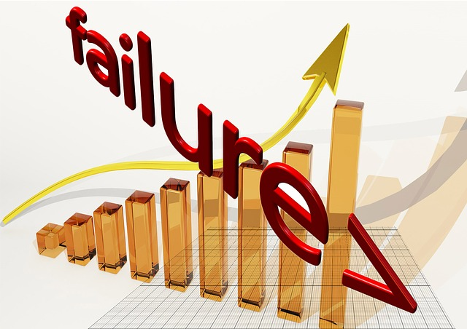
Failure to Enroll (FTE)
User cannot complete enrolment into biometric authentication system
Physical disability
Static or dynamic biometric profile less distinctive than required by system
Can be significant problem
“Internal, employee-facing deployments”
Increased security risks
Increased system costs

Slide 27
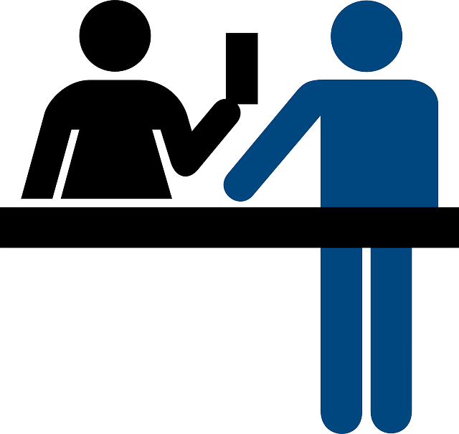
Transaction Time
How long it takes to match data input to reference sample
Long delays problematic
Processing queues of employees through chokepoint
Small delays can add up to significant pile-ups & delays for entire queue
Leads to employee resistance
Security guards can waive identification & authentication if lines become intolerable

Slide 28
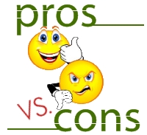
Disadvantages & Problems
General Considerations
Health & Disability
Environmental & Cultural
Cost
Attacks on Biometric Systems
Privacy Concerns
Legal Issues

Slide 29
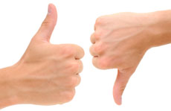
General Considerations (1)
Errors inevitable
False accept / match / positive (Type 1 error)
Particularly serious
Threatens security by admitting unauthorized personnel
False reject / nonmatch / negative (Type 2 error)
Reduce productivity & efficiency
Increase costs

Slide 30
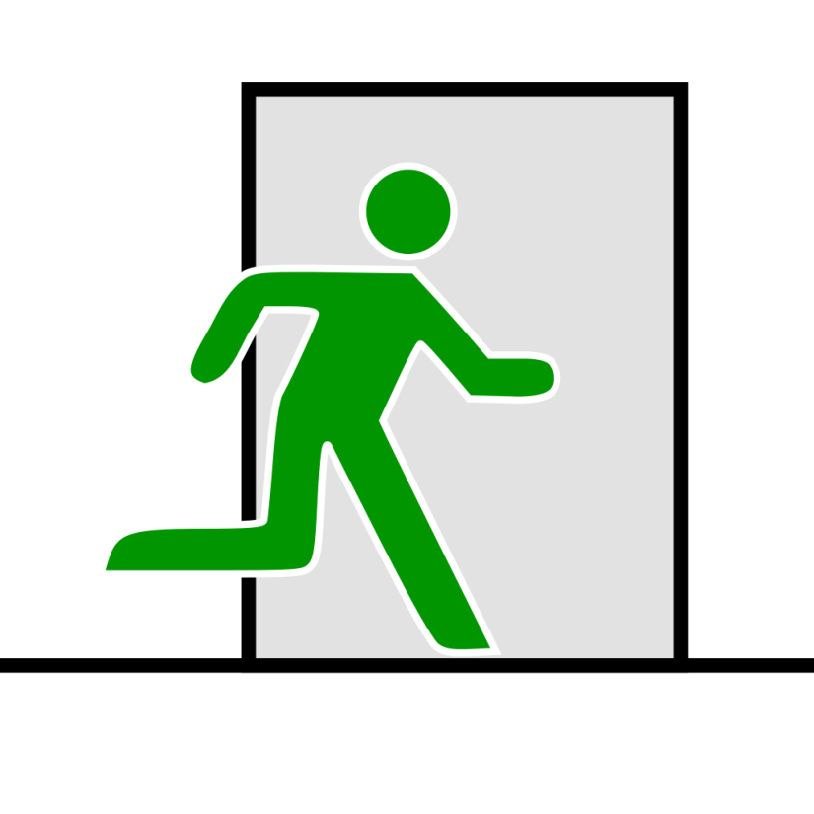
General Considerations (2)
Define acceptable (reasonable) error thresholds
Some systems almost impervious to fraud
Iris scans
Others easy to defeat
Face: makeup, glasses, hairstyle
Fingerpints: gelatin/rubber fake fingers
Increased training required cf badges/passwords
Hypersensitivity to nonstandard data capture

Slide 31
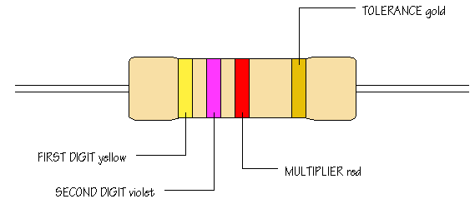
General Considerations (3)
Resistance to biometric I&A
Privacy
Intrusiveness
Safety/cleanliness
Fear of eye scans
Religious objections
Some cultures do not permit photographs
Some see eye as special soul-related organs
Have backup methods available to avoid serious personnel problems

Slide 32
Health & Disability
Arthritis, other deforming disease
Interfere with data capture in enrolment
E.g., hand geometry
May prevent effective physical positioning for data entry during I&A
Neck injuries, back problems, broken limbs/hands
Sensitivity to environmental stress
Bright light of iris/retinal scans may be intolerable for photophobic people
Tremor can interfere with many biometrics (both enrolment and data entry)
Variations in physical size can interfere
Too big, too small, too tall, too short….
Speech: too slow/fast, loud/soft, laryngitis,…
Excessive skin moisture/dryness,…

Slide 33
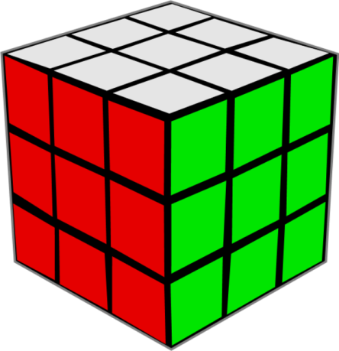
Biological Variations
Fingerprints
Missing
Damaged (calluses)
Chemicals
Scarring
Iris scans
Dark irises
Retracted pupils (e.g., drug use)
Aging effects
Skin
Face shape
Voice
Preventing discrimination
American with Disabilities Act precludes adverse effects on
Disabled
Ill
Ethnic minorities
Elderly
….
Resentment if
Takes much longer
Causes repeat scans
Be sure to have backup I&A methods on hand

Slide 34
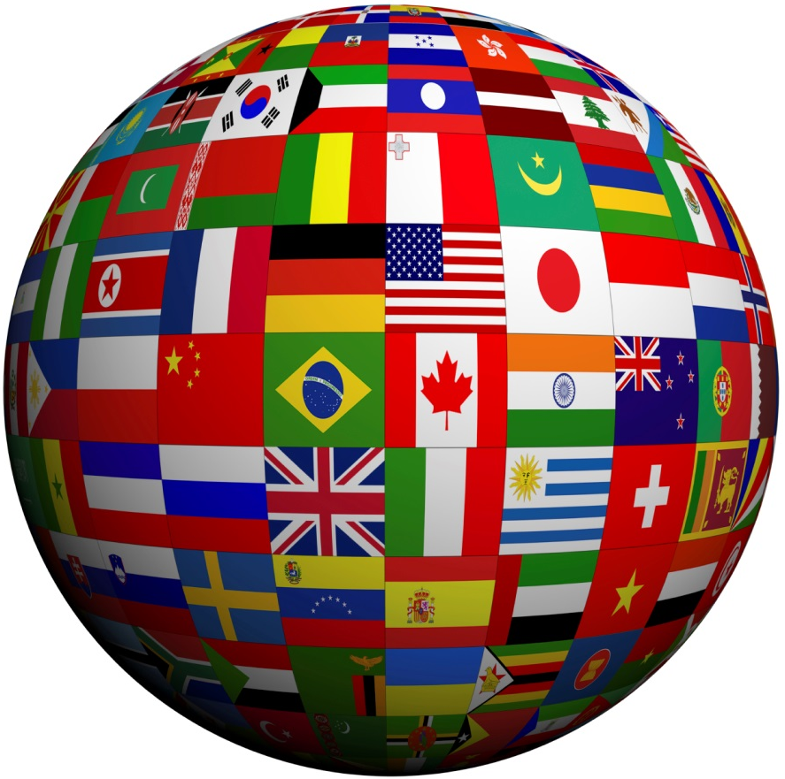
Environmental & Cultural Factors
Changes in appearance can influence face recognition
Hairstyle
Facial hair
Headwear
Weight gain / loss
Voice recognition – ambient noise, sore throat
Fingerprints: frequent hand-washing – e.g., health-care staff
Ambient light
Face
Iris

Slide 35
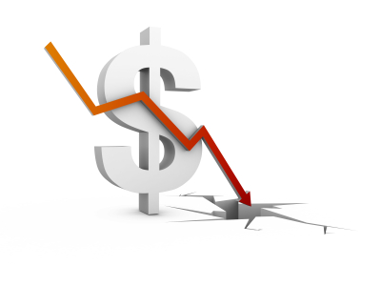
Cost
Cost falling dramatically in recent years
Fingerprint scanners $50 or less
But voice-recognition >$50K
Minimum costs
~$200/user
$150K or more for medium- sized business
Still major barrier for many organizations
Lack of widely-accepted standards
Poor interoperability
May cope with problems through
Better training
Combination with other I&A methods

Slide 36
Attacks on Biometric Systems
Less vulnerable to attack than other I&A systems
Stolen biometric identity serious problem
Cannot easily be canceled & replaced
Difficult to revoke
Long-term usability of stolen identifier
Current work on cancelable biometrics
Would include a repeatable modification of the biometric data at each enrolment
Thus limit damage to 1 system only, not all others

Slide 37
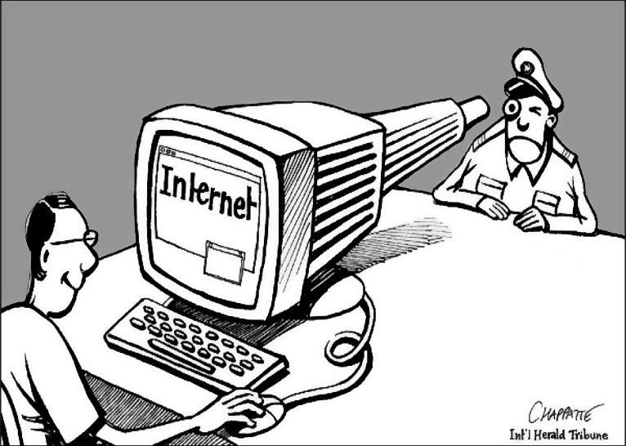
Privacy Concerns
Biometrics combine I & A
Facial recognition (FR), for example, can run covertly
2001 Super Bowl – Tampa Police deployed FR
But wider acceptance at airports after 9/11 attacks
Finger scanning associated with police work & criminals
Concern over using biometrics for nationwide identification
Summary of concerns:
Loss of anonymity & privacy
Unauthorized use of biometric data
Unauthorized disclosure
Reduced expectation of privacy
Abuse by government agencies

Slide 38
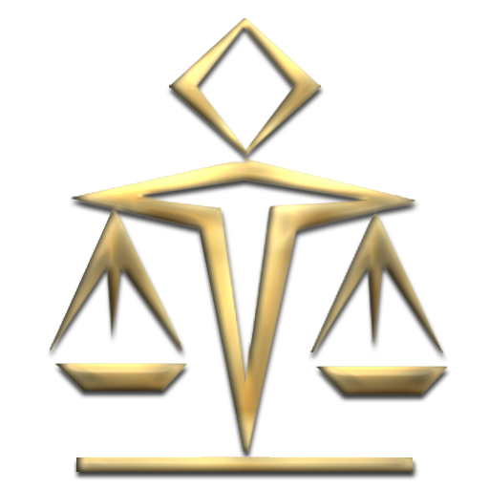
Legal Issues
In US, 4 categories of invasion of privacy
Intrusion into private life
Public disclosure of private facts
Impersonation
Publication putting victim in false light (defamation)
Biometrics generally involve (1) and (2)
Storing hashed version of recognition templates may resolve these issues
One-way encryption (like passwords)
Can recognize match with data but not store original data

Slide 39
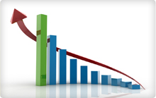
Recent Trends in Biometric Authentication
Government Advances
Face Scanning at Airports & Casinos
Deployment in Financial Industry
Healthcare Industry
Time & Attendance Systems

Slide 40
Government Advances
US government major user of biometrics
DoD – Common Access Card (smart card with biometric data)
DHS
US-VISIT (face, fingerprint)
TWIC (Transportation Worker Identity Credential)
INS
DoT

Slide 41
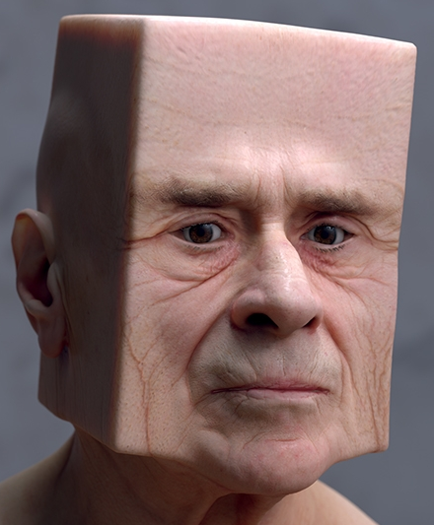
Face Scanning at Airports & Casinos
Airports moving to include face- scanning
Studies show high error rates
Low accuracy rates
Casinos
Identify intelligent people who win more than casinos want them to
Spot frauds
Networked 100s of casinos to share info on whom they want to exclude
International law
Question of whether these systems violate UN Universal Declaration of Human Rights, Article 12

Slide 42
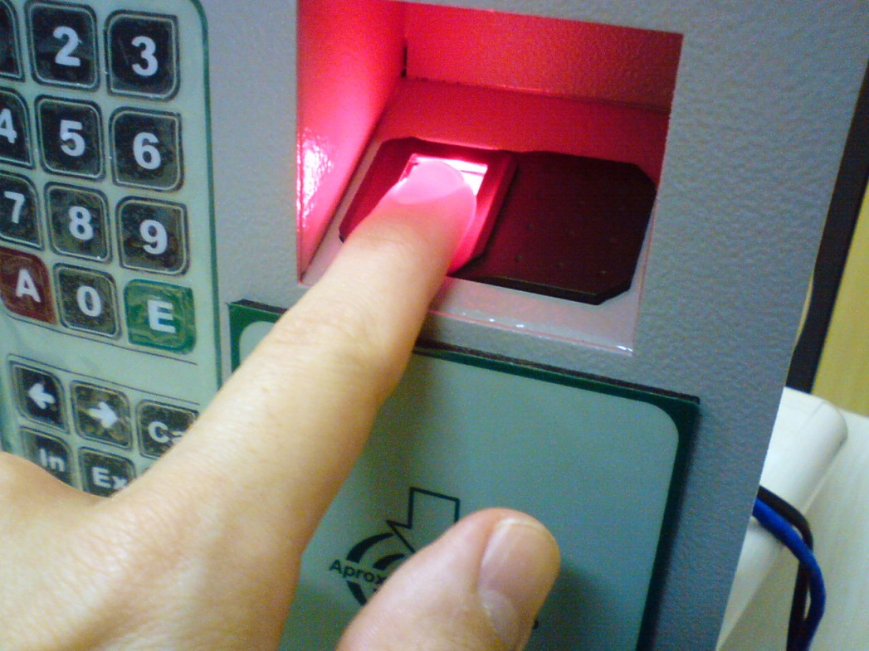
Deployment in Financial Industry
Facial recognition at ATMs
Fingerprint scanners for brokers
Iris scanning for high-security points
United Bankers’ Bancorporation (UBB)
Fingerprint recognition
Employees
Customers
Others:
Wells Fargo
Bloomberg Financial
Janus Capital Management

Slide 43
Healthcare Industry
HIPAA regulations force better privacy & security for patient data
E.g., Mayo Clinic – fingerprint ID 2002
Slower adoption than in financial industry
Physical contact with fingerprint reader
Error rates higher & accuracy lower than expected
May be affected by chronically dry hands from repeated hand-washing and repeated use of disinfectants
High costs of implementation in hospitals

Slide 44
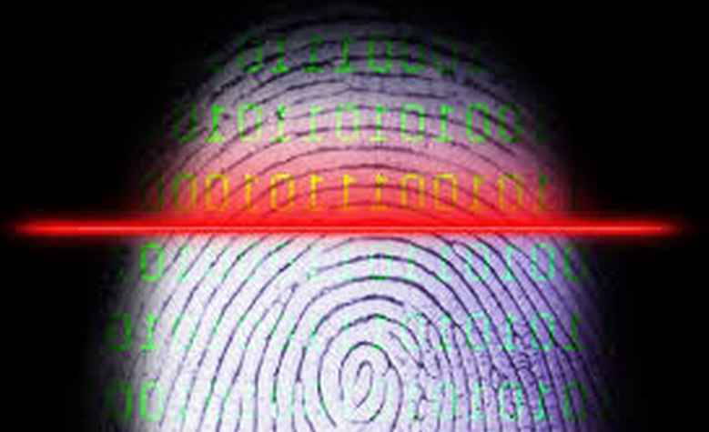
Time & Attendance Systems
Biometric systems
Originally implemented in factories
Extending to white-collar workers
Mostly using finger-scanning systems

Slide 45
Racial Bias in Facial Recognition
Lohr, S. (2018). “Facial Recognition is Accurate, if You’re a White Guy.” New York Times (Feb 9, 2018). < https://www.nytimes.com/2018/02/09/technology/facial-recognition-race-artificial-intelligence.html >
Disturbing results of study
Lighter-skinned men: 99% accuracy
Lighter-skinned women: 93% accuracy
Darker-skinned men: 88% accuracy
Darker-skinned women: 65% accuracy
Possible reasons:
Data samples widely used for AI in facial recognition are as high as 75% male & >80% white
Very little government regulation of this technology

Slide 46
Now go and study

