Slide 1
E-Commerce & Web Servers
CSH6 Chapter 30
“E-Commerce & Web-Server Safeguards”
Robert Gezelter

Slide 2
Topics
Introduction
Business Policies & Strategies
Rules of Engagement
Risk Analysis
Operational Requirements
Technical Issues
Ethical & Legal Issues
VERY LONG SLIDE DECK:
USE FOR PREPARATION BEFORE AND REVIEW AFTER READING ENTIRE CHAPTER.

Slide 3
Introduction
E-commerce becoming ubiquitous
Desire for efficiency may harm security
Should not use same systems for brick-and-mortar business as Web-enabled
Don’t use wireless access from kiosks & cash registers into accounting systems
TJX case (2007) early example
Inadequately secured corporate network & back-office systems hacked by criminals
Breach compromised >94M credit cards
Payouts of $40.9M in damages

Slide 4
Business Policies & Strategies
Best practices evolve constantly
Must consider & secure B2C & B2B systems
Framework proposed:
Define Information- Security Concerns
Develop Security- Service Options
Select Security-Service Options
Ensure Ongoing Attention to Changes
Using Security Services Framework
Framework Conclusion
B2B = business-to-business
B2C = business-to-customer

Slide 5
1. Define Information Security Concerns
Study impact of security breaches on business
Use transactional follow-the-flow diagrams
Tracks transactions & data through servers & networks
Functional & logical view (what happens & how)
Identify data sources, interfaces
Define processing (changes)
See Exhibit 30.1 (p 30.4) as example

Slide 6
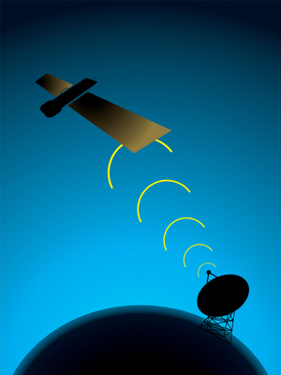
Define Information Security Concerns (2)
Usually have to study and include
Clients
PCs, thin clients, PDAs, WAP-compliant phones
Servers
Web, application, DB, middleware, back-end
Network devices
Switches, routers, FW, network interface cardsd (NICs), codecs, modems, hosting sites
Network spaces
DMZs, intranets, extranets, Internet

Slide 7
2. Develop Security Service Options (1)
Consider possible security options for each component and all data types
Factors affecting requirements
Industry
Company’s tolerance for risk
Maturity of security group/function
Organizational structure ([de]centralized)
Past security incidents
Internal organizational issues
Politics
Regulations
Perceived strategic value of INFOSEC

Slide 8
Develop Security Service Options (2)
Services to consider include
Policy & procedures
Confidentiality & Encryption
Identification & Authentication
Authorization
Authenticity
Monitoring & Audit
Access Controls & Intrusion Detection
Trusted Communication
Antivirus
System Integrity Controls
Data Retention & Disposal
Data Classification

Slide 9
3. Select Security Service Options
Cost-benefit & risk-management analysis
Final selection of security service options
Distribute along continuum of importance
See Exhibit 30.2, p 30.8
Four additional factors in option selection
Implementation risk or feasibility
Cost to implement & support
Effectiveness in increasing control
Data classification

Slide 10
Implementation Risk or Feasibility
Feasibility of implementing option
Factors affecting ease of implementation
Product maturity
Scalability
Complexity
Supportability
Skills available (capabilities, prior experience)
Legal issues
Integration required
Limitations of technology

Slide 11
Cost to Implement & Support
HW & SW
Implementation
Support
Administration
High-level support of security service vital to success

Slide 12
Effectiveness in Increasing Control
Reduction of risk
Impact & likelihood of harmful event
Compare before & after implementation of security service / mitigating strategies
Example: theft of credit-card #s from DB
Losses to consumers (data subjects)
Negative public relations
Decrease future business

Slide 13
Data Classification
Criticality & sensitivity of information
Protection against
Misuse
Disclosure
Theft
Destruction
Throughout lifecycle
Creator usually considered responsible
Classification
Identification
Labeling

Slide 14
4. Ensure Ongoing Attention to Changes
Threats evolve
Therefore defenses must evolve
Changes inevitable
Compliance
Regulation
Technological advances
New attacks
“Security is a process, not a product.”*
… or a static end-state
_____
* Schneier, B. (2000). “Computer Security: Will We Ever Learn?” Crypto-Gram Newsletter (May 15, 2000). < http://www.schneier.com/crypto-gram-0005.html#1 >

Slide 15
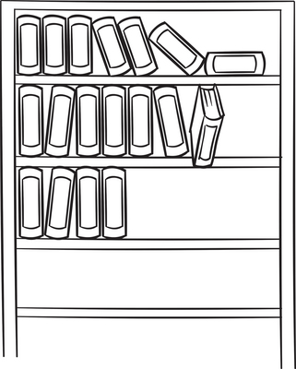
Using Security Services Framework
Detailed examples of analyses are provided in text for
B2C Security Services
B2B Security Services
However, these examples are not discussed in this slide presentation
Will serve as examples for reader’s / student’s own analyses
Case studies may be used as basis for exam questions; e.g., “Using the case studies in Chapter 30, analyze the different security requirements for Norwich University’s public Web site (www.norwich.edu) and for its intranet site (my.norwich.edu)”

Slide 16
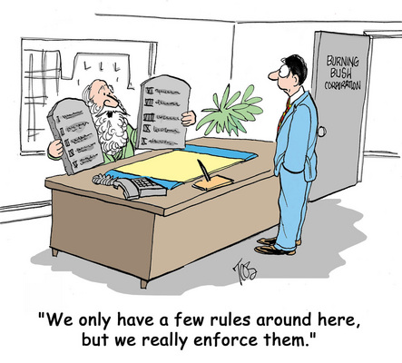
Rules of Engagement
Web Site-Specific Measures
Defining Attacks
Defining Protection
Maintaining Privacy
Working with Law Enforcement
Accepting Losses
Avoiding Overreaction
Appropriate Responses to Attacks
Counter-Battery
Hold Harmless

Slide 17
Website-Specific Measures
Website may be most important element of interaction with outside world
High availability: 24x7x365 due to expectations & potentially worldwide market
Accuracy and confidentiality required
Perturbations may profoundly affect customers, cash flow, long-term reputation
Most Website problems caused by inside technical glitches, not glamorous hacker attacks
External events can wreak havoc; e.g., 9/11
Best practices & scale important
Small organizations may succeed with less formal solutions than large ones

Slide 18
Defining Attacks
Large numbers of repeated attempted connections may be attack – or not
Customer with technical problem
Problem on network
Attack on server

Slide 19
Defining Protection
Web sites ⊂ Internet-visible assets
Internet-visible not intended for public use
Easier to anticipate usage, traffic
Web site activity varies
Potentially worldwide public
Surge could be due to attack or to popularity
Some protective measures have unexpected consequences; e.g.,
Requiring visitor computers to have entry in inverse DNS instead of only DNS
But not all legitimate sites have inverse DNS entries
Becomes a policy issues, not just technical
means
“proper subset” (part of but not the whole)

Slide 20
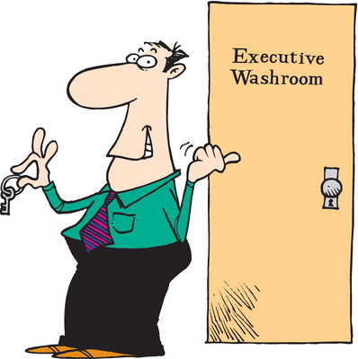
Maintaining Privacy
Logging interactions
Privacy policy
Managerial
Legal
Customer relations
Technical staff must respect laws, regulations
Always consult corporate privacy policy
Discuss with corporate counsel if necessary
See CSH6 Chapter 69
Privacy in Cyberspace: US & European Perspectives

Slide 21
Working with Law Enforcement
Complexity depends on type of attack
Frauds easier than attacks
Attacks require more consideration of policy
Status of Website
Easier: Local server in control of organization
Harder: server at hosting facility
Hardest: server owned by third-party
What information can / should be logged?
When?
See CSH6 Chapter 61
Working with Law Enforcement

Slide 22
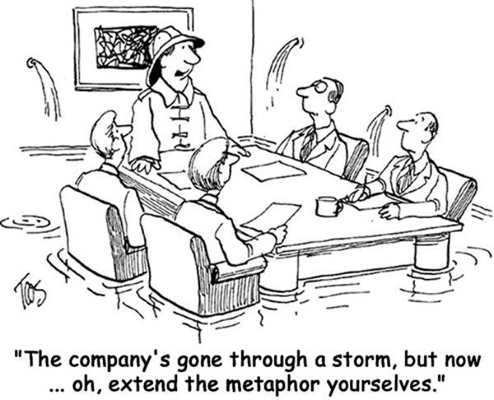
Accepting Losses
Security breaches should be prepared for as if inevitable despite best efforts of all
Increasing complexity of site content
Growing application code
Reaction plans important
Similar to discussion of Web-based vulnerabilities
Difference is greater effect on customers
Prepare & refine computer security incident response team and plans
See CSH6 Chapter 21: Web-Based Vulnerabilities
& CSH6 Chapter 56: Computer Security Incident Response Teams

Slide 23
Avoiding Overreaction
Some reactions may cause more problems than attack
Define decision-making authority & guidelines
Decide in advance what conditions will force Website to be taken offline
Key principles:
Defensive actions almost always permissible
Offensive actions of any kind almost always impermissible
Transparency (invisibility) to customer best

Slide 24
Appropriate Responses to Attacks
International law recognized attacks on naval vessel = act of war
Fire if fired upon
Similar rules give citizens right to defend themselves in absence of law enforcement personnel
“Rules of engagement”
Information technologists do not have legal standing for counterattack
Focus on appropriateness to situation
Political, legal, business issue
Policy, legality, public relations, feasibility
National security vs private property

Slide 25
Counter-Battery
Targeting system that has attacked
But counter-battery is illegal in most jurisdictions
No legal standing for attack against a computer system
Practical problems
Malefactor may not be correctly identified
Effects of attack may spill over to innocent victims
Example: Canter & Siegel (1994)
Spammers in Arizona (2 lawyers)
Retaliation (protest e-mails) crashed their ISP servers
Innocent victims: customers of spammers’ ISP

Slide 26
Hold Harmless
Need fast responses
Employees must be protected against retaliation
Acting in good faith
According to responsibilities
Within documented policy & procedures
Errors
Lead to procedural correction
Not punishment of individual employee

Slide 27
Risk Analysis
Business Loss
PR Image
Loss of Customers & Business
Interruptions
Proactive vs Reactive Threats
Threat & Hazard Assessment
See CSH6 Chapter 62: Risk Assessment & Management
& CSH6 Chapter 63:
Management Responsibilities & Liabilities

Slide 28
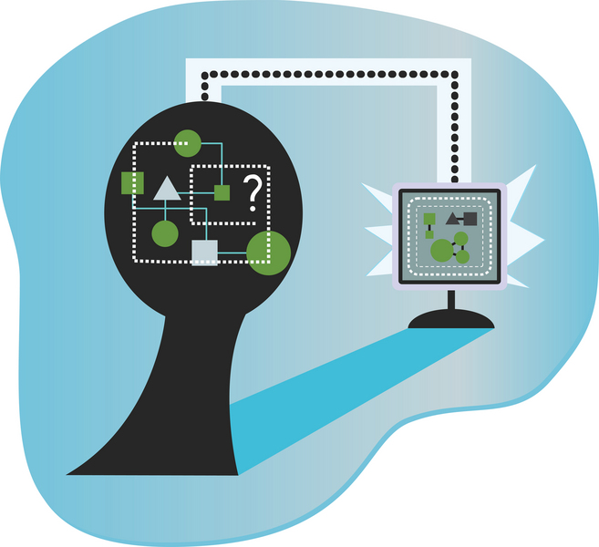
Business Loss
Customers should be considered as both…
Outsiders accessing Internet presence
Insiders using intranet-hosted applications

Slide 29
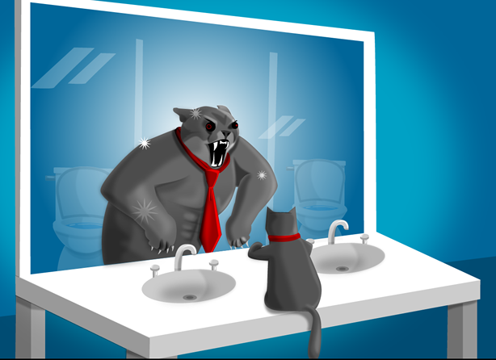
PR Image (1)
Web site = public face 24/7/365
Prime target for attack
Many examples of hostile activity
US Congress “Thomas” site
US Dept Justice
Government sites around world
Activity often surges after major public events
Hacking contests
Defamation by angry consumers
Random targeting

Slide 30
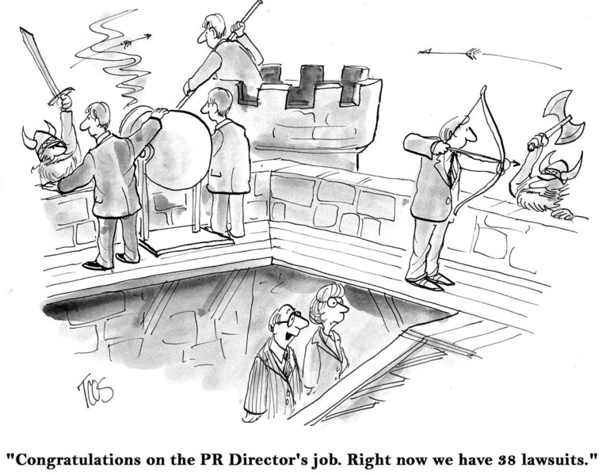
PR Image (2)

Slide 31
Loss of Customers & Business
Internet customers highly mobile & impatient
May switch to competitor quickly
Even momentary delay may cause switch
Competitors usually abound
Functional degradation may cause switch
E.g., problems with shipment tracking

Slide 32
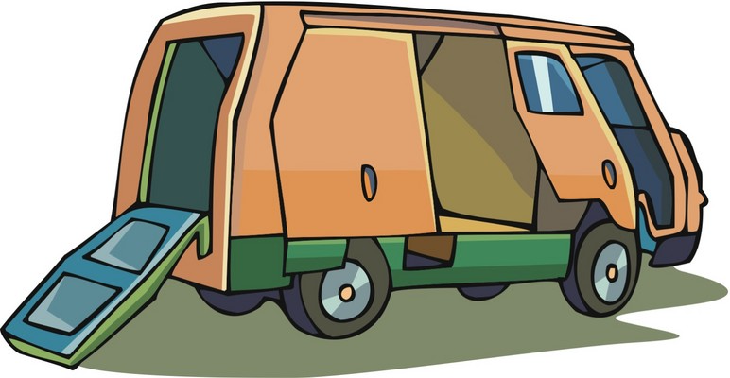
Interruptions
Just in Time (JIT) delivery
Production
Disruption may be disastrous to entire operation
Supply chain
Service-oriented architecture (SOA)
Delivery chain
Tracking status
Information delivery
Banks, brokerages, utilities… provide services online
Offer reports on demand

Slide 33
Proactive vs Reactive Threats
Some defensive tactics open up new potential for availability problems
E.g., common strategy: multiple name servers for translating IP address to domain names
Must define ≥ 2 name servers for DNS zone
But updating DNS zones can cause problems
Error in providing name servers makes site unavailable
Most sites make ISP responsible for resolution of domain names
Increases complexity of architecture
Must be remembered during problem analysis & resolution

Slide 34
Threat & Hazard Assessment
Threats may be universal or specific
Threat analysis
Deliberate vs accidental
Acts of G-d
Acts of clod
In risk analysis & planning, deliberate attacks may be equivalent to acts of G-d
No enterprise is immune to accident or attack

Slide 35
Operational Requirements (1)
Protection not purely technical issue
Degree of exposure to Internet: risk-management issue
Cannot set technical solutions without business context
Cannot evaluate risks without knowledge of technical issues
Outsourcing introduces additional complexity
Protecting Web site is lifecycle process
Ongoing system evolution
Monitoring, detection, correction
Analysis, changes in underlying causes

Slide 36
Operational Requirements (2)
Ubiquitous Internet Protocol Networking
Internal Partitions
Critical Availability
Accessibility
Applications Design
Provisioning
Restrictions
Multiple Security Domains
What Needs to Be Exposed
Access Controls
Site Maintenance
Maintaining Site Integrity

Slide 37
Ubiquitous Internet Protocol Networking
Switch from locally controlled networks to Internet greatly increased exposure to attack
Wider range of connected equipment
VoIP telephones
FAX
Copiers → network printers
Soft drink dispensers (!) etc.
Conflict between ease of access & security
Safest: unconnected to world
Easiest to use: no security restrictions
Must balance issues

Slide 38
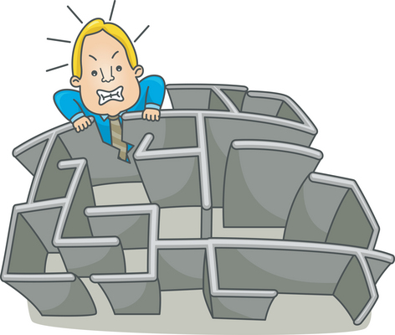
Internal Partitions
Complex corporate environments
Often best protected by including partition
Define separate security domains
Own legal, technical, cultural needs
E.g., medical records, CRM, SCM, ERP
Often require separate policies for firewalls, access controls….
Damage control improved by partitions
E.g., malware attack may be contained
Defense in depth
CRM: customer relationship management
SCM: supply-chain management
ERP: enterprise resource planning

Slide 39
Critical Availability
Different sectors may have different needs for availability
Second-to-second (e.g., real-time production controls, SCADA)
Minute-to-minute (e.g., customer Web functions, Help desk)
Hour-to-hour (e.g., shipping, scheduling)
Day-to-day (e.g., line management reports, billing)
Week-to-week (e.g., regulatory reporting, management accounting)
Poorly planned shutdowns can cause more problems than attack
SCADA:
supervisory control
and data acquisition

Slide 40
Accessibility
Users must be involved in defining rules
But users need awareness & education
E.g., university faculty often insist on removal of all security rules
Some individuals & functions do not need Internet access for their work
Individuals may resent being blocked
But need to define business case for access or exclusion

Slide 41
Applications Design
Site processing confidential information
Must support HTTPS
Typically through port 443
Requires valid digital certificate
In case of uncertainty about security requirements, err on side of security
Enable HTTPS anyway
Encryption best/only way of protecting potentially sensitive traffic
Use encryption within organization too
E.g., for sensitive transactions involving employee information
Suppress display of confidential info
E.g., full credit-card numbers
Be sure not to vary in parts that are suppressed
Prevent inference by collecting parts from different screens

Slide 42
Provisioning
Plan for disruption
Use redundancy
High-availability public-facing Web site may need 2 geographically separated facilities
Evaluate degree of functional duplication required by applications / services
Costs of unavailability may be orders of magnitude > cost of redundancy
See CSH6 Chapter 58: Business Continuity Planning
& CSH6 Chapter 59: Disaster Recovery

Slide 43
Restrictions
Web servers must be behind firewall
Incoming / outgoing services restricted using specific protocols (e.g., HTTP, HTTPS, ICMP)
Disable unused ports
Block disabled ports by firewalls
Store customer information on separate systems (not Web server)

Slide 44
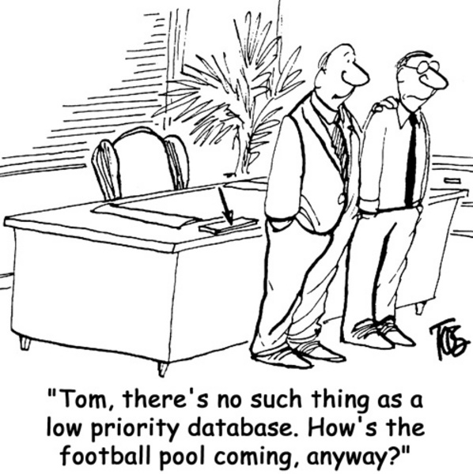
Multiple Security Domains
Web servers ≠ database servers
Link Web server to DB
Dedicated & restricted-use protocol
Prevents hijacked Web server from allowing access to DB
Segregate DB servers behind additional firewalls

Slide 45
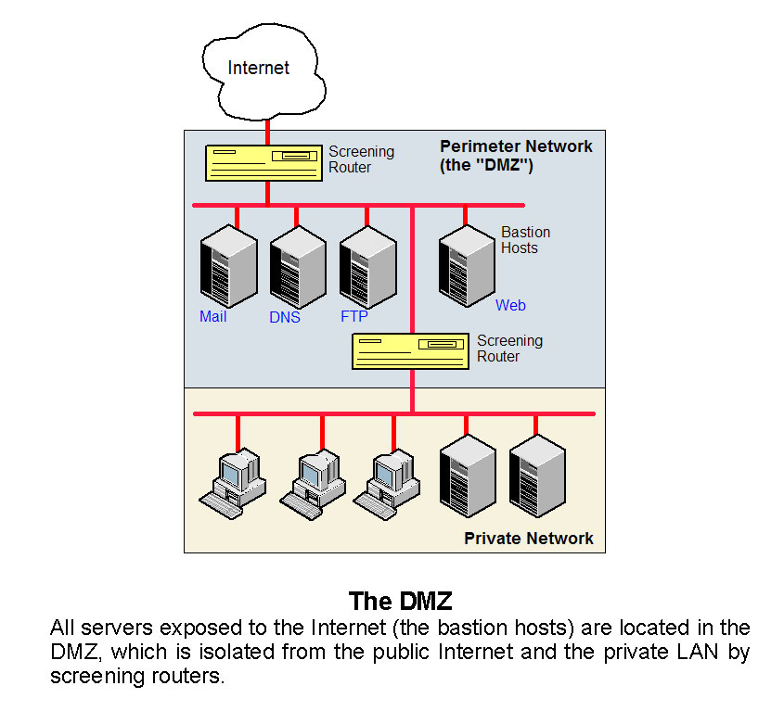
What Needs to Be Exposed (1)
Despite public access to Web server, must prevent exploitation for subversion
All connections to Internet go through firewall
Firewall restricts traffic to Web-related protocols only
DMZ: demilitarized zone (devices with firewalls in front of and behind them)
Reprinted from Computer Desktop Encyclopedia
V 22.3 (3rd quarter 2009) with permission
Copyright © 2009 Computer Language Company.
http://www.computerlanguage.com

Slide 46
What Needs to Be Exposed (2)
Exposed systems
Minimize
Consider roles, not just machines
May prefer to have several different servers rather than one larger server
Impact of downtime grows
But new trend of virtualization pushes towards single server with multiple functions
Hidden Subnets
Hide servers supporting Web site from visibility
Can use private Internet IPv4 & IPv6 addresses
See RFC 1597 http://www.ietf.org/rfc/rfc1597.txt

Slide 47
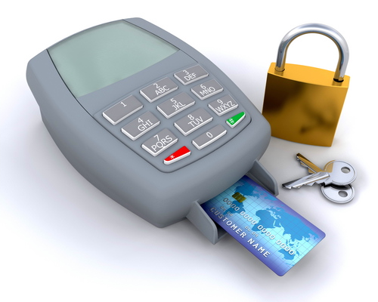
Access Controls
Restrict # individuals with access to Web server
Apply controls
Analyze reports
Monitor
Cleared individuals need individual accounts (IDs)
Not generic functional account
Essential for audit trail
Immediate termination of access upon
Change of responsibilities within organization
Termination of employment

Slide 48
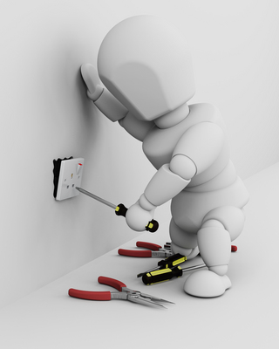
Site Maintenance
Even single-character error in public Web site can harm function and reputation
E.g., in link
Content changes move through Web in minutes
Search engines
Archival capture
Change-control procedures essential
See
CSH6 Chapter 40: Managing Software Patches & Vulnerabilities
CSH6 Chapter 47: Operations Security & Production Controls
CSH6 Chapter 52: Application Controls

Slide 49
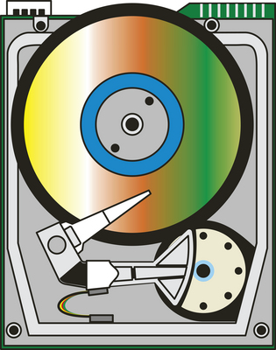
Maintaining Site Integrity
Restrict write-access to Web server
Use secure methods for accessing servers
Do not use unsecured access via Web
Secure mechanisms for update:
Secure FTP
FTP from specific node within inner firewall
KERMIT on directly wired port
Logins & file transfers via SSH
Physical media transfers (air gap)
KERMIT: A file transfer protocol developed at Columbia University, noted for its adaptability to noisy lines, enabling transfers to succeed under the worst conditions. Kermit supports streaming over the Internet, sliding windows for links with long round-trip delays, record and character conversion of text files, restart/recovery from point of failure and platform-independent transfer of directory trees with a mix of text and binary files.
Computer Desktop Encyclopedia v22.3 (3rd quarter 2009). Copyright © Computer Language Company. Used with permission.

Slide 50
Technical Issues
Inside / Outside
Hidden Subnets
What Need be Exposed?
Multiple Security Domains
Compartmentalization
Need to Access
Accountability
Read-Only File Security
Going Off-Line
Auditing
Emerging Technologies

Slide 51
Inside / Outside
Fundamentals
Inside: trustable systems
Outside: untrustworthy systems
But not absolute distinction
May be trustworthy for one application or context but not another
Majority of harm done by authorized users
Incompetence or malfeasance
Router tables must prevent IP spoofing
Inside to outside
Outside to inside

Slide 52
Preventing IP Spoofing
Inbound packets from outside cannot have originator addresses within target
Outbound packets to public network must have originator addresses within originating network
Outbound packets to public network must not have destination addresses within originating network
Exception: stealth internal networks
Internal addresses correspond to external addresses

Slide 53
Hidden Subnets
Firewalls funnel network traffic through 1 or few chokepoints
Likelihood of security breach of entire NW rises with # independent access points
If p = P(access point will fail) then
P(access point will not fail) = (1 - p) and
If n = # access points then
P(all access points will not fail) = (1 - p)^{n}
P(at least one access point will fail) = 1 - (1 - p)^{n}
Use RFC 1918 internal addresses
For IPv4 within protected networks
Never occur in public Internet
Similar to addresses used in NAT (dynamic network address translation)

Slide 54
What Need be Exposed?
Air gaps (total disconnection) can be useful
Industrial real-time control systems
SCADA
Life-critical systems
High-confidentiality systems
Publishing information to Web servers
Media exchange
Controlled one-way transfers
Restrictions on protocols
E.g., library can allow HTTP but block FTP
Beware of tunnels through firewalls
Or convert LAN to untrusted network
Use VPNs to connect internal corporate systems

Slide 55
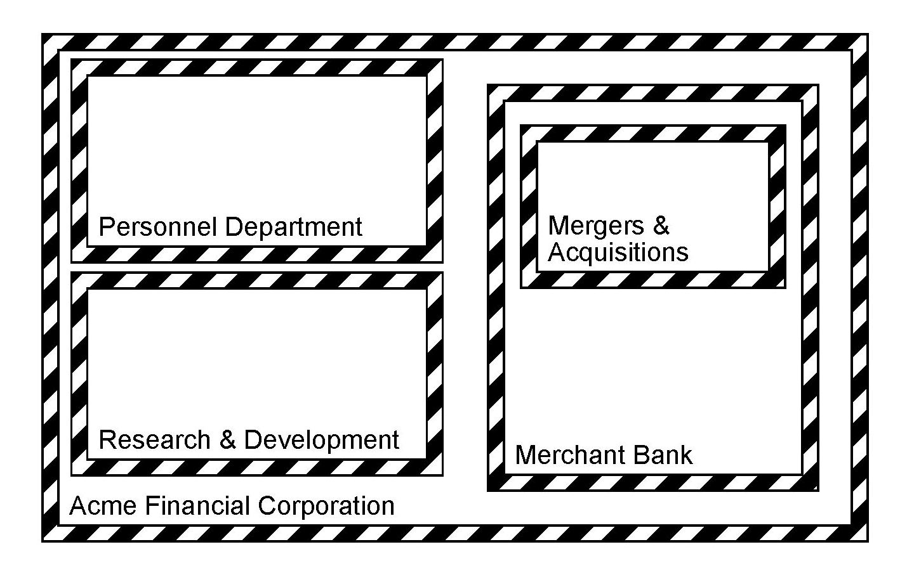
Multiple Security Domains (1)
Monolithic firewall defines only outside & inside
But better is Outside / DMZ / Inside
Can also attach DMZ to single port on outer firewall
May find internal compartmentalization useful

Slide 56
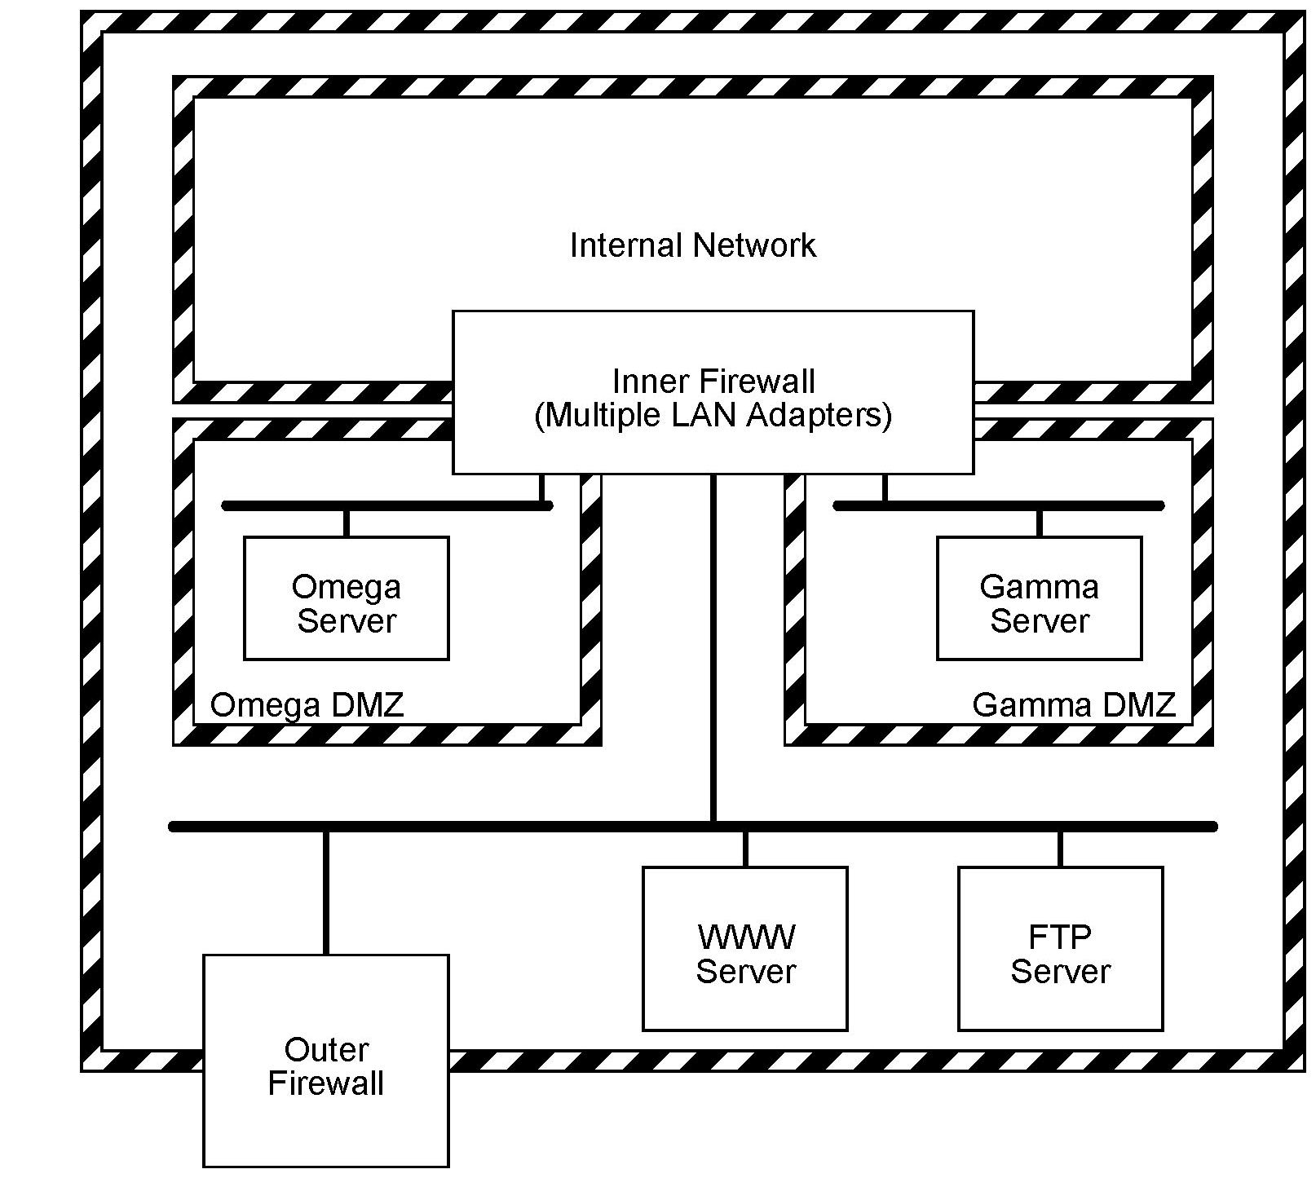
Multiple Security Domains (2)
Brokerage with 2 trading networks, Ω & Γ
Each gateway could
Monitor communications with Web server
Monitor traffic with competing trading NW
Attack other gateway
Disrupt communications with other gateway
Attack brokerage’s internal network

Slide 57
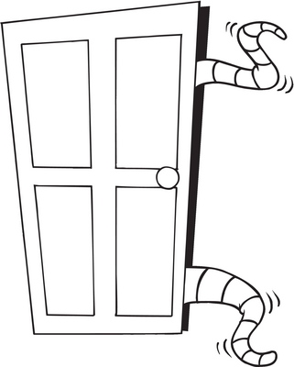
Compartmentalization
Reduces potential for complete network meltdown
Prevent accidents from cascading
Prevent infection by malware
Portable storage devices
Including USB memory / disks
Make situation worse
Increase value of compartmentalization

Slide 58
Need to Access
Careful analysis required for determining need to access to which resources
Physical & logical access controls
Needed to protect Internet-accessible systems
Must be understood, respected & enforced
Regular audits necessary
Internal communications should also be secured
Encryption (e.g., SSL, VPNs)
Access by employees outside organization must be secured using VPNs
See CSH6 Chapter 32: Virtual Private Networks & Secure Remote Access

Slide 59
Accountability
No perimeter is likely to be perfect
Encourage employees to report security vulnerabilities & accidents
Avoid pressures to hide such problems
Want early warning
Fix problems before they are exploited
Analyze root causes & resolve
Do not punish people for false alarms

Slide 60
Read-Only File Security
Many sites permit downloads (HTTP, FTP) of forms, manuals, instructions, maps, service guides
Must ensure that
Servers supporting FTP are secure
Contents of public file store are read-only & have change-control procedures
Entire contents can be restored quickly if compromised
Designated (named) party responsible for maintaining, protecting & restoring public store

Slide 61
Going Off-Line
Out-of-service costs critical to determine
Loss of business
Waste of professional time (e.g., salaries)
Damaged PR
Lowered morale
Disconnection may be rational & required
E.g., FORD cut connection to Internet during May 2000 ILOVEYOU attack
Must establish WHO can disconnect for what reasons
Have written procedures & delegation of authority

Slide 62
Auditing
Monitoring (logging) provides essential information on
Normal (baseline) behavior
Peaks (design for maximum expected needs)
Trends (plan for expansion before problems hit)
Audit & analysis should include
Physical communications infrastructure
Firewalls, router tables, filtering rules
Host security
File security
Traffic patterns on backbones, DMZ, etc.
Physical security of systems & comm infrastructure

Slide 63
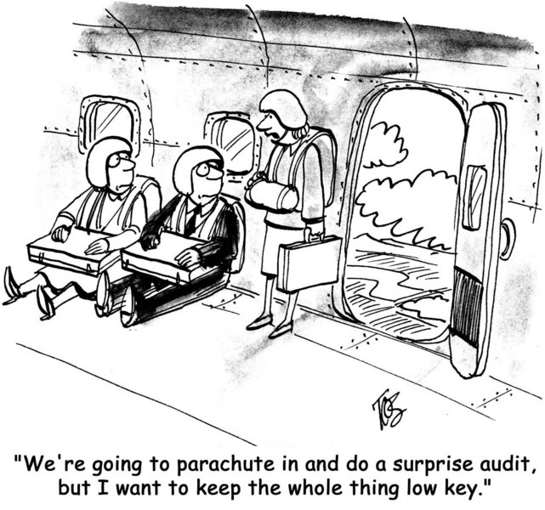
Audits

Slide 64
Emerging Technologies
New technologies alter challenges
E.g., HTTPS for encrypted tunnels
Useful to authorize use of TCP port 443
Allow connection to Web sites needing secure information
BUT HTTPS for tunneling also creates vulnerabilities
Compromised desktop can monitor network
Send data to system outside network using SSL
IDS may need to spot HTTPS connections that do not fit profile of normal Web access

Slide 65
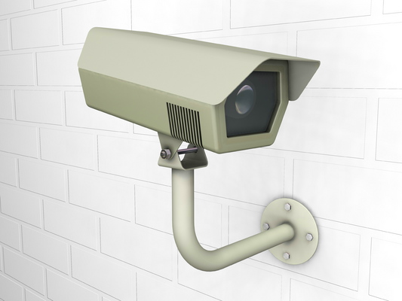
Ethical & Legal Issues
Liabilities
Customer Monitoring, Privacy & Disclosure
Litigation
Application Service Providers

Slide 66
Liabilities
Many laws affect disclosure of personally-identifiable information (PII)
Web sites increasingly manage sensitive information
E-mail also carries confidential data
Must establish practice of due diligence
Show reasonable steps
Ensure integrity, safety, confidentiality

Slide 67
Customer Monitoring, Privacy & Disclosure
Customer monitoring a sensitive subject
Can accumulate spending profiles
May show interesting products
But could assemble dossier for blackmail
Turn over data to hostile / paranoid government agencies
Many organizations fail to encrypt PII on servers
Data mining may lead to incorrect conclusions
Do not confuse casual associations with superficial interpretations
E.g., businessman who meets young woman in hotel – his daughter!

Slide 68
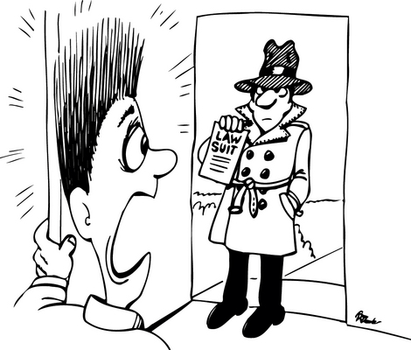
Litigation
Increasing volumes of Web-related litigation
Civil: be prepared for discovery procedures
Regulatory: verify compliance with records retention requirements for all appropriate agencies
Criminal: safeguard evidence, cooperate with law enforcement & courts
Logs, Evidence, Recording Facts
Key to success
Accurate, complete, accessible (right software available!)
Be sure you know which records are stored where

Slide 69
Application Service Providers (ASPs)
External organizations providing specific applications (e.g., accounting, manufacturing)
Enterprise, not ASP, bears responsibility for security failures
Due diligence
Choosing ASP
Defining contracts
Monitoring quality of service (QoS)

Slide 70
Now go and study

