Slide 1
Web Monitoring & Content Filtering
CSH6 Chapter 31
“Web Monitoring and Content Filtering”
Steven Lovaas

Slide 2
Topics
Introduction
Terminology
Motivation
General Techniques
Implementation
Enforcement
Vulnerabilities
The Future
2019-10-30
Started inserting cartoons!

Slide 3
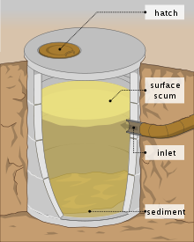
Introduction
Internet = cesspool?
Objectionable content for some people
Choice to monitor and/or control access
Controversial
Privacy
Free speech
“Censorware” vs “content filtering”
Chapter avoids taking sides in arguments

Slide 4
Terminology
Proxy: intermediary computer in access path
Anonymizing Proxy: proxy that conceals identity of original user
Privacy-enhancing technologies (PET): maintain privacy of network access
Encryption: concealing content
Mixing networks: encrypted content sent to intermediary server to extract origin
Onion routing (TOR): strip ID info from originating router at multiple steps

Slide 5
Motivation
Preventing Dissent
Protecting Children
Supporting HR Policies
Enforcing Laws
National Security

Slide 6
Preventing Dissent
Repressive governments (e.g., PRC, N. Korea)
Deprive citizens of information
Stifle questions about doctrine
Repress challenges to authority
Constitutional rule of law
US 1st Amendment
Cultural bias against repression
Resistance to public libraries’ use of filtering

Slide 7
Protecting Children
US government limits access by children to certain types of information
“Adult” materials
Public schools & libraries
In loco parentis
Segment of population opposes exposing children to material to which the parents object
SCOTUS ruled many implementations unconstitutional
Child Internet Protection Act (CIPA) applies to schools receiving certain government funding
Also try to shield children against violating laws

Slide 8
Supporting HR Policies
Avoid waste of time by employees
Although some studies show freedom to be positive influence on productivity
Prevent hostile work-environment
Equal Opportunity Employment laws
But many types of material potentially offensive
Complicates task of determining rules
Avoid legal liability for filtering
Pop-up warnings instead of blocks
AKA “Monitor & Notify”

Slide 9
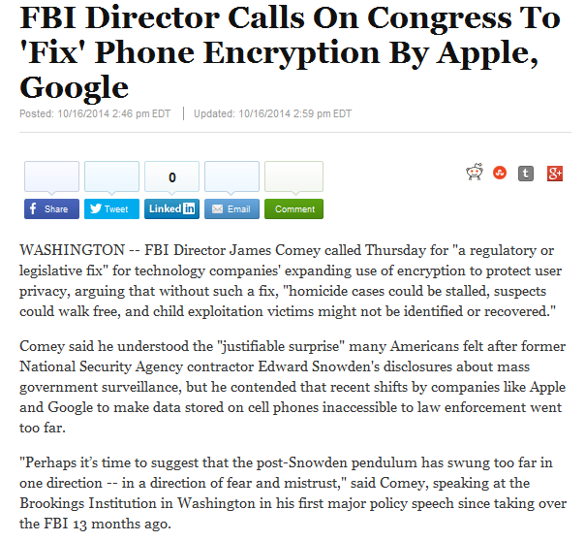
Enforcing Laws
Law-enforcement organizations (LEOs) rarely block access
May monitor (surveillance)
PET* a serious problem
2014: FBI Director warns that phone encryption without back doors = serious problem for LEOs
*Privacy-enhancing technology
http://www.huffingtonpost.com/2014/10/16/james-comey-phone-encryption_n_5996808.html

Slide 10
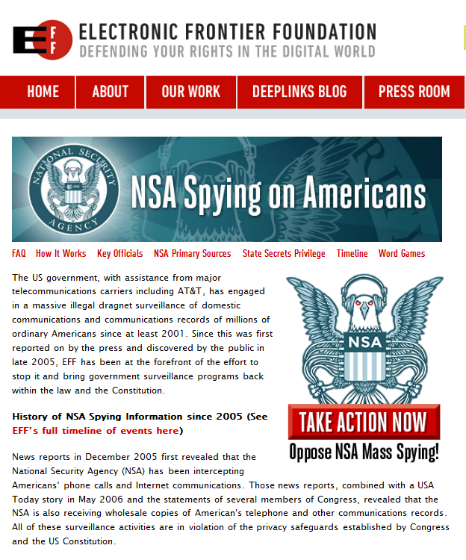
National Security
NSA surveillance debate
PRISM & Edward Snowden
Terrorism
Constitutional law issues: 4th Amendment
https://www.eff.org/nsa-spying

Slide 11
General Techniques
Matching the Request
Matching the Host
Matching the Domain
Matching the Content

Slide 12
Matching the Request
Web request format:
Protocol://server.organization.tld/path-to-file.file-format
Lists of keywords to examine
Protocol
Server
Organization
Top-level-domain (tld)
Path-to-file
File-format
Whitelist: to allow
Blacklist: to reject

Slide 13
Matching the Host: Servers
Block list of servers
By IP address
May not be permanent
Block could affect innocent sites later
IP address may be shared by innocent sites
By name
Must update Domain Name System (DNS) mappings regularly
But organizations may use multiple names
Again, multiple organizations can share server name

Slide 14
Matching the Host: Intermediaries
Many ways of locating site or page
Search tools (Google, Bing, etc.)
Portals (organized listings of sites for specific purpose – e.g., IA)
Few organizations block search engines and portals
Too useful to block
Dictatorships have blocked them
Some countries block specific engines that violate local laws (e.g., Nazi stuff in France)

Slide 15
Matching the Domain
Internet Corporation for Assigned Names and Numbers (ICANN)
Governs definition of new TLDs
Long-standing requests for .xxx pornography domain
Make filtering easier
Comply with laws against access by children
Conservative religious groups feared legitimizing pornography
Porn providers disagreed on benefits
Accepted in 2011

Slide 16
Matching the Content (1)
String matching easy
But false +s & false –s are problems
Exact matches (e.g., word “sex”) can miss related terms (“sexy,” “sexual”…)
Generic matches (e.g., string “sex”)
Can block harmless content (e.g., “Essex,” “Sussex,” “asexual”…)
Easily block legitimate use in context; e.g.,
Survey asking for sex of respondent
Scientific or technical text (biology, law…)
Misleading URLs (phishing, pharming)
Whitehouse.com was porn site
Jumbled random text (2sfh.com/7hioh)

Slide 17
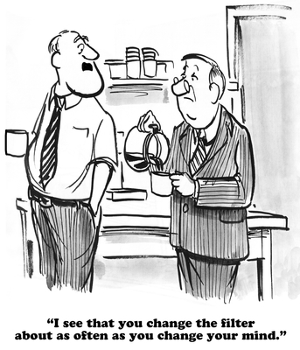
Matching the Content (2)
Metastudy (2010)
Web-filtering effectiveness
2001-2008 studies
Average accuracy 78%
Some improvement in 2007-2008: 83%
Some products analyze content of Web pages
But HTTPS causes difficulties
Textual analysis doesn’t work well
Graphics analysis
Reference images
Anti-sex: skin tones, manual review, matching to known-bad images

Slide 18
Implementation
Manual “Bad URL” Lists
Firewalls usually allow lists for blocking
Does not scale well
Third-Party Block Lists
Huge number of Web pages
Proprietary databases
Some blockers try to conceal their rules
But some have been found to impose political or religious views (e.g., blocking birth-control or abortion sites)
Parental controls developed to allow finer control of content blocking

Slide 19
Enforcement
Proxies
Firewalls
Parental Tools

Slide 20
Proxies
Proxy intercepts request and redirects to destination if necessary
Often used to share commonly accessed sites or pages to reduce bandwidth utilization
Browsers can be configured to check proxy first
Ideal locus for filtering requests

Slide 21
Firewalls
More sophisticated firewalls implementing Unified Threat Management (UTM)
Being called
Service gateways
Security gateways
Integrate multiple security functions
Antivirus
Intrusion detection
Filtering Web and email content
Effective control requires funneling traffic through device
Block alternatives such as WAPs

Slide 22
Parental Tools
Some large ISPs provide filtering
AOL, MSN
Stand-alone products for parental controls
Net Nanny
CYBERsitter
CyberPatrol
Installed on individual (family, child) computers
Multiple security functions available

Slide 23
Vulnerabilities
Spoofing
Tunneling
Encryption
Anonymity
Translation Sites
Caching Services

Slide 24
Spoofing
Modifying incoming packets’ origination IP address
Consequence of poor security policies on routers
Fail to check legitimacy of inbound packets’ origination addresses
Defeat spoofing through reverse-path filtering
Configure routers to check their routing tables
Drop packets when source address differs from actual origin

Slide 25
Tunneling
Protocol tunneling = dynamic application tunneling
Applications send data on specific, commonly allowed ports
E.g., encrypt data through SSH
TCP port 22
Difficult to detect encrypted data from unauthorized source
Some sites allow tunneling IPv6 traffic through IPv4 connections
Application tunneling = static application tunneling
Reconfigure client application program
Redirect requests through different port

Slide 26
Encryption
Encrypted traffic from forbidden sites cannot be analyzed
But origination and destination IP addresses still available
Can therefore still block access to forbidden IP address
Even VPN connections still show IP addresses
Steganography (see Ch 7)
Far more difficult to detect
Store forbidden/secret content inside files
E.g., in images or documents

Slide 27
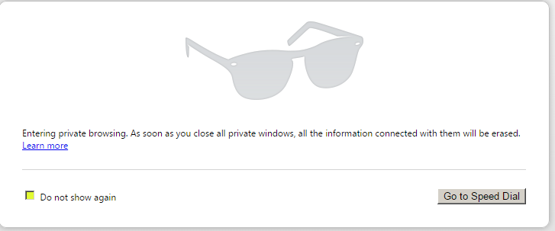
Anonymity
Some organizations block access to forbidden sites for subsets of users
E.g., schools → students
But anonymity interferes with control
Users may access anonymizing services to conceal traffic
E.g., The Onion Router (TOR)
Or private browsing settings on browsers

Slide 28
Translation Sites
BabelFish < http://www.babelfish.com/ >
Google Translate < https://translate.google.com/ >
May allow escape from site blocking
Translation page acts as proxy
Can evade content blocking
If data converted to non-English, content filters may fail
“Translating” English-language site from foreign language to English passes original content without alteration
But evades filtering

Slide 29
Caching Services
Proxy servers typically cache much-used content
So accessing data through Google may show wrong origination IP address
Historical records (archives) on search engines also have different source addresses
Google’s “safe search” feature not a control
Cannot be password protected
Simply method for individual user to filter sexually objectionable material

Slide 30
The Future
Major home-filtering products already improving
Net Nanny & McAfee Parental Controls
Allow secure limitation to safe-search options
Object recognition for data typical of porn sites
Strong political / ideological conflicts
“Protection of the innocent” vs
“Rights of free speech”

Slide 31
Now go and study

