Slide 1
VPNs
CSH6 Chapter 32
“Virtual Private Networks & Secure Remote Access”
Justin Opatrny & Carl Ness

Slide 2
Topics
Introduction
Remote-Access VPNs
Site-to-Site VPNs
Extranets
OH NO!
49 SLIDES!!!
(MUST TALK LIKE SOMEONE ON LOTS OF COFFEE)

Slide 3
Introduction
Borders Dissolving
Secure Remote Access
Virtual Private Networks
VPN Technology Concepts

Slide 4
Borders Dissolving (1)
Before Internet access, security → internal networks
After ~1993, explosion in Internet connections
Perimeter firewall reduced access by digital predators
How to maintain network security for employees using mobile technology?
Laptop computers, cell phones
Home, traveling
How to define extranets for business partners?

Slide 5
Borders Dissolving (2)
Competitive advantage requires
Employee network & information access
From outside workplace
Coping with inclement weather, disruptions
Geographic dispersion of workforce
B2B requirements growing
Vendors, suppliers, partners
Outsourcing
Support
B2C demands
Growing expectations from consumers

Slide 6
Secure Remote Access
Require extensive planning & review
Must not jeopardize safety of critical information & information systems
Primary tools
Virtual Private Networks (VPNs)
Secured connection
Encrypted tunnel
Extranets
Encrypted connection to Web application server outside internal NW
Usually need connections from server to internal NW for data exchange

Slide 7
Virtual Private Networks
Basic idea
Create stream of encrypted data through firewall
“Encrypted tunnel”
Goals
Securely extend internal network
Protect data during transmission
Maintain security of system
Two categories
Remote-Access VPNs
Site-to-Site VPNs

Slide 8
VPN Technology Concepts
See other chapters in CSH6 for background concepts, terminology, details & readings
Chapter 5: Data Communications & Information Security
Chapter 6: Network Topologies, Protocols & Design
Chapter 7: Encryption
Chapter 26: Gateway Security Devices
Chapter 37: PKI & Certificate Authorities

Slide 9
Remote-Access VPNs
IPSec
Transport-Layer Security
User-Authentication Methods
Infrastructure Requirements
Network-Access Requirements

Slide 10
IPSec
Basics
Suite of Internet Protocol (IP) layer protocols
Establish & protect VPN transmissions
Usually uses client-resident application
Create encrypted VPN tunnel into internal network
Topics
Key Exchange & Management
Authentication Header vs Encapsulating Security Payload
Transport vs Tunnel Mode

Slide 11
IPSec: Key Exchange & Management
Must establish and manage Security Association (SA) between client & server
IPSec uses Internet Key Exchange (IKE)
Good reference: NIST Guide to IPSEC VPNs (SP 800-77)
2 phases in establishing SA
Phase 1 creates initial IKE SA
Can use 2 modes:
Main mode
Aggressive mode
Phase 2 establishes IPSec SA
More details on
following slides

Slide 12
IKE Phase 1 Main Mode
Most commonly used
3 pairs of packets
1st pair negotiates 4-parameter protection suite
Encryption algorithm (e.g., 3DES, AES)
Integrity protection algorithm (e.g., HMAC-SHA-1)
Authentication method (e.g., shared key, PKI certificate)
Diffie-Hellman group* (category of keylength & type of encryption algorithm)
2nd pair exchanges encryption keys using D-H
3rd pair authentications each side of connection to other
*See SP800-77
pp 3-11 & 3-12
HMAC: hashed message authentication code

Slide 13
IKE Phase 1 Aggressive Mode
3 packets (not pairs of packets)
1st & 2nd packets
Negotiate all IKE SA parameters
Perform key exchange
2nd & 3rd packets
Authenticate end-points to each other

Slide 14
IKE Phase 2
Quick mode to establish IPSec SAs
Each side maintains IPSec SA in SAD (Security Association Database)
Initiating device creates & sends SA proposal to VPN server
VPN server replies with SA selection & hash to authenticate connection
Initiating device replies with hash generated from prompt received from server
If server matches received hash with sent hash, server adds SA to SAD & connection proceeds

Slide 15
IPSec: AH vs ESP
Authentication Header (AH)
Protects integrity of packet header & payload
Uses cryptographic hashing
Encapsulating Security Payload (ESP)
More common implementation today
Encrypt entire packet
Create new IP header
Protects both integrity & confidentiality

Slide 16
IPSec: Transport vs Tunnel Mode
Transport mode
Preserves original IP header
Provides confidentiality & integrity protection for payload
Incompatible with Network Address Translation (NAT)
TCP integrity checks fail
NAT alters IP address during transmission – therefore IPSec hash will be incorrect
Tunnel mode
Protects both header and payload
Primary method today for host-to-gateway & gateway-to-gateway VPNs

Slide 17
Transport-Layer Security (TLS)
TLS provides protection of client/server links
Most common implementation: SSL (Secure Sockets Layer) → HTTPS
Basics
128-bit encryption
Widely available on browsers & servers
Client* provides SSL-related parameters for establishing HTTPS connection to server
Server responds with its SSL parameters + digital certificate
Client authenticates server

Slide 18
User-Authentication Methods
Simplest method: user name & password
Other methods
RADIUS: Remote Authentication Dial-In User Service
LDAP: Lightweight Directory Access Protocol
Kerberos: access control system
Developed at MIT in 1980s
Accepted by IETF in 2003
See http://www.ietf.org/rfc/rfc1510.txt
Diagram from CDE on next slide

Slide 19
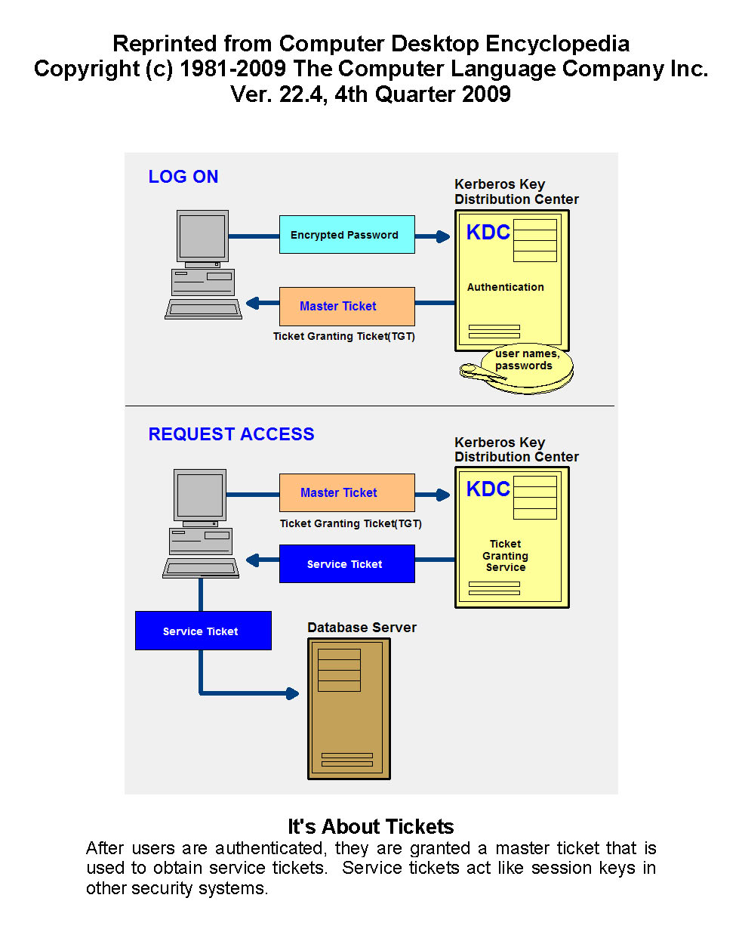
Kerberos
Login: user PW encrypted & sent to KDC
KDC
Authenticates PW
Sends master ticket (a kind of session key) to user
User sends master ticket to KDC when requesting service
Used by kind permission of the author.
Copyright © 2010 Computer Language Corporation
http://www.computerlanguage.com

Slide 20
Infrastructure Requirements
VPN should be outside firewall
Connection to internal networks protected by firewall
Restrict all external connections to internal network
Allow encrypted connections to VPN server to be relayed through firewall

Slide 21
Network-Access Requirements
IPSec
Can use split tunneling for better throughput
Enforce encryption on inbound traffic
Allow outbound traffic to Internet to be treated normally (not through encrypted tunnel)
But lose ability to inspect outbound traffic
TLS/SSL
Dashboard allows administrator to control settings
Current implementations similar to IPSec flexibility

Slide 22
Site-to-Site VPNs
VPNs mostly used for client remote access
But also used for secure internal communications
Can create equivalent of secure WAN (Wide Area Network)
Reduce complexity of physically-wired WAN
Topics in next slides relating to Trusted VPNs
MPLS
Site-to-Site VPNs
Information Assurance Considerations

Slide 23
MPLS: Multiprotocol Layer Switching (1)
Not traditional encrypted VPN
Similar service
Complex issues in deployment
Service providers differ in offerings
Topics on next slides:
Purpose
Requirements

Slide 24
MPLS (2): Purpose
Typical WAN topologies = star, ring or mesh (or combinations)
MPLS creates
Meshed
Routed
Virtual network at
Service provider level
MPLS free to route packets from 1 WAN endpoint to another in virtual network
Eliminates hub as single point of failure
Can provide multiple QoS (quality of service) levels
Prioritize traffic
Allow specific protocols more bandwidth at times

Slide 25
Site-to-Site (S2S) VPNs
Purpose
Extend WAN concepts to areas where traditional direct connections (T1, frame relay…) are too expensive
Leased lines be too slow
Alternative WAN
Use / share Internet connection
Higher bandwidth, lower cost
Backup
Redundancy at relatively low cost
Requirements
Internet, VPN end-points (routers)
Possibly VPN-enabled gateway security device (firewall)

Slide 26
IA Considerations
Remote-access VPN Considerations
Fidelity of Mobile Device
VPN Client Management
Protection of VPN Device
Cryptographic Options
Traffic Inspection
Processing Power
Interception
Site-to-Site VPN Considerations
Implications of Elusive VPNs
Impact of IPv6

Slide 27
IA Considerations
Remote-access VPN Considerations
By nature of VPN, assuming hostile environment for data transmission
Fidelity of Mobile Device
Essential to protect laptops, phones…
Firewall, antivirus, patches, encryption
Status may change during connection
Network Access Control (NAC)
Interrogate connecting device at login
Verify security status
Complex management issue

Slide 28
VPN Client Management
IPSec requires client-side app or embedded OS
Need to maintain up-to-date configuration
Avoid user involvement
Push updates rather than pulling
TLS/SSL VPN less complex to administer
Automatic downloads of small Java applets or ActiveX controls
Code can remain resident – avoid delay at re-initiation of sessions

Slide 29
Protection of VPN Device
Configure firewall to stop access to all unused ports
Remove unacceptable cryptographic modes
Limit access to network management protocols such as ICMP & SNMP using ACLs
Don’t allow insecure protocols such as FTP or HTTP for administration
Use strong I&A (e.g., token-based, two-factor)

Slide 30
Cryptographic Options
Selection of cryptographic protocol
During IKE negotiation
Cipher suite determines what is available
Remove unacceptably weak protocols from cipher suite
Prevents incompatible clients from connecting

Slide 31
Traffic Inspection
Encrypted traffic on VPN interferes with content inspection
Limit inspection to post-decryption packets inside network after VPN device processes data stream
Some VPN systems do provide administrative dynamic decryption of packets for content inspection

Slide 32
Processing Power
VPN can easily become a bottleneck
Monitor processing power required to maintain bandwidth
Increase dedicated VPN devices as number of connections increases
Can sometimes add hardware encryption accelerators

Slide 33
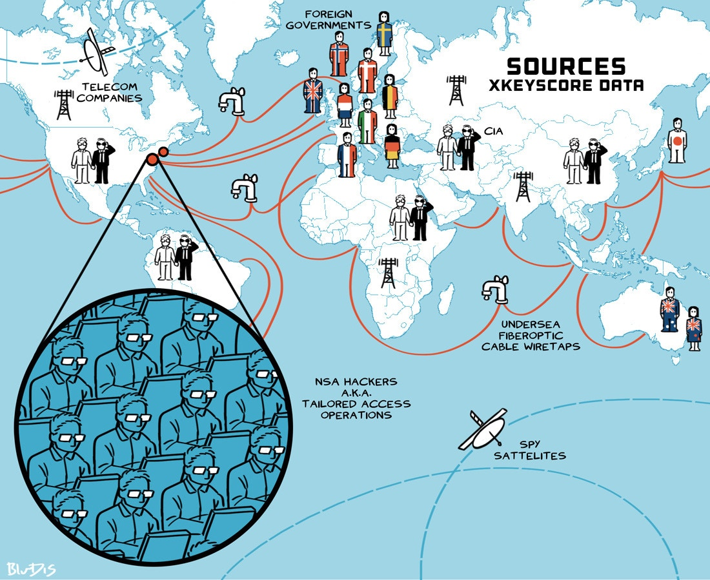
Interception (1)
Possible to capture packets
Datagram Protocol spreads packets over multiple routes
Thus end-point interception only practical approach
Massively parallel computational power can crack encryption
Person-in-the-middle (PITM) attack
While VPN session being established
Address Resolution Protocol (ARP) poisoning to redirect traffic to attacker’s system

Slide 34
Interception (2)
IPsec MITM vector: preshared key
Group name & password
Authenticate IPsec connection
Fiked emulates VPN termination & collects user credentials
Can defend using client or computer certificate for IPsec authentication
SSLStrip (2009)
ARP-poisoning to intercept client request for TLS/SSL
Establishes valid TLS/SSL session with server
Creates HTTP session with user but puts fake lock icon into browser window
Can reduce risk by forcing use of direct TLS/SSL connections, not redirection from HTTP to HTTPS

Slide 35
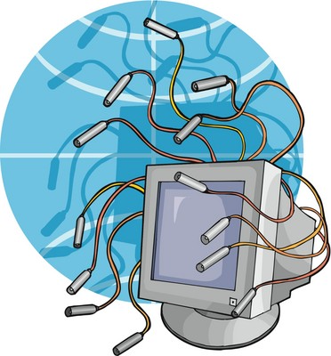
Site-to-Site VPN Connections
Infrastructure Design
Cost
Availability

Slide 36
Site-to-Site VPNs: Infrastructure Design
Multiprotocol Layer Switching (MPLS) changes WAN administration
Can provide any-to-any connectivity
More difficult to troubleshoot than hub/spoke topology
Increased number of security devices
Maintain Border Gateway Protocol (BGP) routing security
Both sides must authenticate before being added to routing table
VPN naturally puts Internet in contact with internal networks
Implement gateway security devices (GSD)

Slide 37
Site-to-Site VPNs: Cost
New / converted circuits
QoS (quality of service) monitoring
Support for MPLS and routing
Time for redesigning network routing infrastructure
Site-to-site (S2S) VPNs require high processing power
May need code upgrades ($$)
Higher administrative costs for managing increased number of devices

Slide 38
Site-to-Site VPNs: Availability
VPNs quickly become necessity
Mobile workforce may be severely impaired if VPNs go down
Can load-balance across redundant systems
Ideally, connections in process will not be dropped
Must have redundant (independent) infrastructure elements
Internet links
Power
Other network components

Slide 39
Implications of Elusive VPNs
More VPNs in use than administrators may be aware of
GotoMyPc
Malicious VPNs such as botnet control channels
Laplink™ software could allow unauthorized access to work PC
Bypass normal administrative controls
Peer-to-peer (P2P) networks use VPN-like features
Skype can encrypt voice calls and file transfers
Must plan for these in defining policies

Slide 40
Impact of IPv6
We are running out of IPv4 address space (or have already)
Yet migration to IPv6 still not evident in real world
Verify that VPN infrastructure is IPv6 compliant
Expect to have to translate IPv6 into IPv4 for foreseeable future
IPv6 does provide support for IPSec automatically

Slide 41
Extranets
Information Assurance Goals
Extranet Concepts
Types of Extranet Access
Information Assurance Considerations

Slide 42
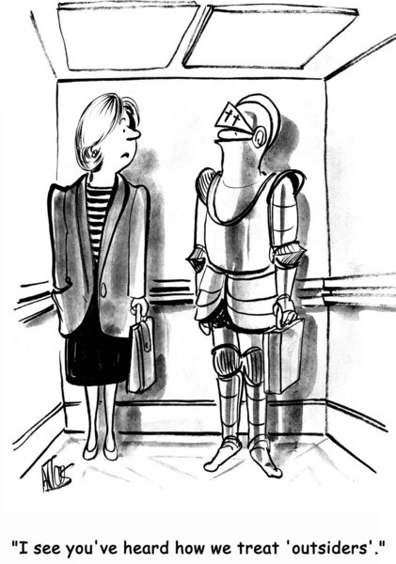
Extranets: Information Assurance Goals
Protecting shared information assets
Increased security issues with external accessors
Competitive advantage, regulatory requirements
Preventing information exposure
Principle of least privilege
Identity management
Access management
Minimizing ancillary risks
Restrict outsiders’ access to non-essential services

Slide 43
Extranet Concepts
Service NW vs DMZ
Don’t count on DMZ (weak security) for extranet services
Define specific firewall architecture with particular settings for extranet servers
N-Tier Architecture
Distribute functions across multiple servers
E.g., separate front-end user-server from back-end database server
SSL Encryption
Enforce HTTPS Secure Sockets Layer traffic
Verify that padlock icon is implemented correctly

Slide 44
Types of Extranet Access
Norwich University extranets * owa for e-mail
* my.norwich.edu
* BannerWeb
Vendor/Partner Information Sharing
ERP (enterprise resource planning)
SCM (supply chain management)
E-Commerce
EDI (electronic data interchange)
CRM (customer relationship management)
B2B (business to business)
B2C (business to client)
Employee Self-Service
E-mail
Benefits systems
Access to intranet systems

Slide 45
Extranets: Information Assurance Considerations (1)
Technical Security
Cannot secure using only a single point
Need security at multiple layers
Traffic Inspection
Difficult between nodes
May have to inspect traffic on extranet server before encryption
Increases processing load on server CPU
Or may terminate SSL upstream and send cleartext data to extranet server
Relieves extranet server of need for decryption / encryption processing

Slide 46
Extranet IA Considerations (2)
Internal Network Exposure
Compromise of extranet server must not allow breach of inside resources
Ensure appropriate firewalls to shield internal networks from extranet
Server
Harden servers by removing vulnerable unused services
Configure for minimum functionality required
Close attention to patches
Intrusion prevention/detection devices
Virtualization has additional complexities

Slide 47
Extranet IA Considerations (3)
Application
Many systems susceptible to common attacks
Buffer overflows
SQL injection
Cross-site scripting (XSS)
Developers must keep security in mind throughout process
Use best practices
Stay current on threat landscape
BO: failure to prevent data outside bounds of a buffer from being accepted in input and then used.
SQLI: DB query sw doesn’t test query statement for correctness.
XSS: Browser executes hostile script; e.g., hiding code in bogus URL for non-existent page.

Slide 48
Extranet IA Considerations (4)
Policies
Provide written policies about requirements for access & use
Establish expectations
Useful for legal proceedings
Access & Identity Management
I&A support access controls
But passwords a poor authentication method
Better: issuing digital certificates
Availability: critical issue – plan for it!
Impact of IPv6: infrastructure support issues

Slide 49
Now go and study

