Slide 1
Securing VoIP
CSH6 Chapter 34
“Securing VOIP”
Christopher Dantos & John Mason

Slide 2
Topics
Introduction
Regulatory Compliance & Risk Analysis
Technical Aspects of VOIP Security
Protecting the Infrastructure
Encryption
Concluding Remarks

Slide 3
Introduction
Terminology:
Voice over Internet Protocol – VoIP
Internet Protocol Telephony – IPT
Shift to Unified Messaging Systems (UMS)
Instant messaging
Text messaging (to phones)
Voice communications
Video conferencing
E-mail
Network connectivity
Significant benefits
Telework
Cost reductions

Slide 4
Regulatory Compliance & Risk Analysis
Key Federal Laws & Regulations
Other US Federal Laws & Regulations
State Laws & Regulations
International Laws & Considerations
Liability
Risk Analysis

Slide 5
Key Federal Laws & Regulations
Sarbanes-Oxley Act (SOX)
Health Insurance Portability & Accountability Act (HIPAA)
Gramm-Leach-Bliley Act (GLBA)
Regulations from
Securities & Exchange Commission (SEC)
Health & Human Services (HHS)
Federal Trade Commission (FTC)
General requirements
Mandated protection for consumer & patient personally identifiable information (PII)
Periodic management testing of internal controls
Continuous process improvement (policies, tests, reports)

Slide 6
Other US Federal Laws & Regulations: E911
Enhanced 911 (E911)
Federal Communications Commission (FCC)
Mobile phones must process 911 calls
Allow geolocation
Phase I: report location of antenna receiving 911 call
Phase II: report location of phone ±50-300m
Not required for VoIP used for internal business only

Slide 7
Other US Federal Laws & Regulations: CALEA (1)
Communications Assistance for Law Enforcement (CALEA)
Interception of call content (wiretap)
Discovery of call-identifying information (dialed-number extraction)
Requires telecoms to support legal demands for info
Packet Technologies & Systems Committee (PTSC)
Lawfully Authorized Electronic Surveillance (LAES) for VoIP Technologies
Part of Wirelines Telecommunications Networks, V2 (Rev T1.678-2004)

Slide 8
CALEA (2)
Telecommunications Industry Association (TIA)
Standard J-STD-025-B
Surveillance of CDMA2000 broadband access
Wireless Technology & Systems Committee (WTSC)
Alliance for Telecommunications Industry Solutions (ATIS)
Standard T1.724
Surveillance of GPRS/UMTS broadband access

Slide 9
CALEA (3)
FCC’s role
§102: FCC has authority to identify communications services subject to CALEA
§103: carrier must ensure compliance with access
§105: FCC must define security & integrity regulations
§109: FCC must refine reasonable achievability of goals
Key issue: who is responsible for compliance?
CALEA refers to common carriers for hire
What about internal VoIP service for 1 organization?
Some interpretations (still under debate) suggest that even internal networks subject to CALEA
Discuss with attorneys specializing in FCC law

Slide 10
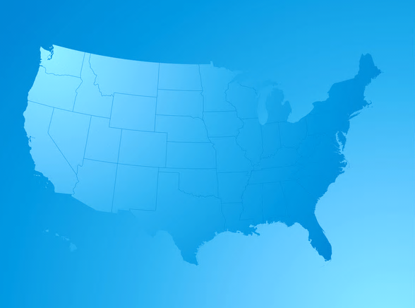
State Laws & Regulations
All US states have laws governing surveillance
31 address computers
14 address mobile phones
Organization & legal departments must consult experts in network law for specific jurisdiction(s)
National Conference of State Legislators (NCSL)
Links to applicable laws of each state
Summary of coverage
See “Electronic Surveillance Laws” for table of links
http://www.ncsl.org/default.aspx?tabid=13492
(checked 31 Oct 2011)

Slide 11
International Laws & Considerations
International picture varies extensively
Consult local attorneys specializing in communications law for specific jurisdictions
European Privacy Directive
http://ec.europa.eu/justice/data-protection/index_en.htm
“Everyone has the right to protection of personal data”
“Under EU law, personal data can only be gathered legally under strict conditions, for a legitimate purpose.”
“Furthermore, persons or organisations which collect and manage your personal information must protect it from misuse and must respect certain rights of the data owners which are guaranteed by EU law.”
Text of EPD at < http://tinyurl.com/3d5hup2 >

Slide 12
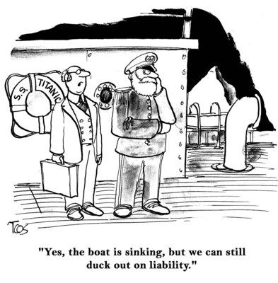
Liability
Criminal penalties & civil penalties possible in US
Federal prosecution takes precedence over state
Fines >$500 per violation
Max ($100/day of violation or $10K)
Violations of SOX, GLBA, HIPAA
≤ $250K
Imprisonment
Adverse findings on SOX annual control assessment
Stock delisting (SOX)
Additional regulatory reviews (SOX)
Additional SOX-related attestations

Slide 13
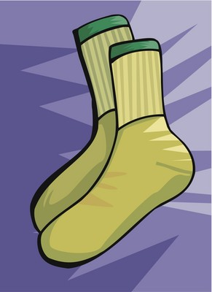
Risk Analysis (1): SOX
Most important: effect on financial statements
Threshold uncertain: e.g., 5% of net income
Resolve differences quickly among external & internal financial auditors
Risk control matrix
Identify & describe key / primary controls
Segregation of Duties (SoD) matrix
Employee activities / roles / functions
Acceptable / not acceptable
Stimulate thinking about VoIP management

Slide 14
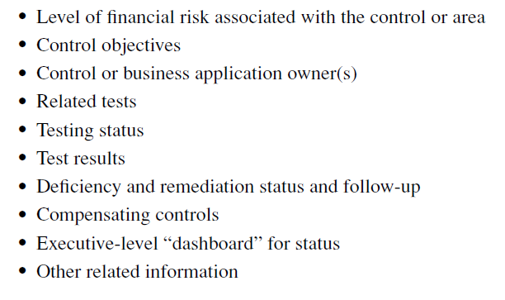
Risk Analysis (2): SOX cont’d
Sample matrix for monitoring VoIP (and other) technologies (P 34-7):
Be aware that SOX testing may rule any error a failure in VoIP implementation

Slide 15
Risk Analysis (3): HIPAA*
HIPAA applies to more than healthcare organizations
Any records of employee benefits
Generally, applies to SOX-regulated organizations too
SOX & HIPAA evaluations have degree of overlap
Can use results on 1 for both
Compliance with general privacy laws supports both HIPAA & SOX compliance
*NOT “HIPPA”!

Slide 16
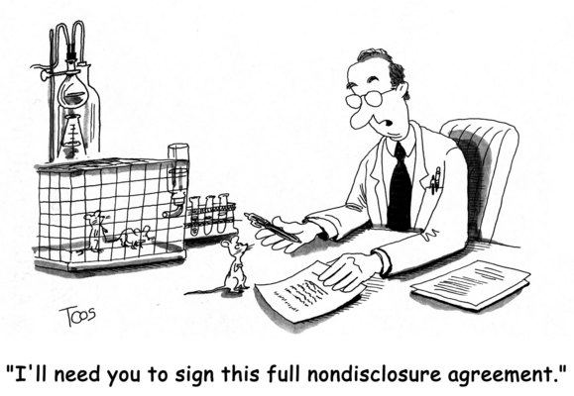
Risk Analysis (4): Privacy Laws
Particularly well-known:
GLBA
California SB1386
Emphasis
Unauthorized access or disclosure
Consumer information
Encryption for VoIP
Safe harbor under CA statute for encrypted info
But no mandated level of encryption
Transmission encryption not required
Assess issues at time of implementation
Continue to monitor regulatory environment

Slide 17
Technical Aspects of VOIP Security
Protocol Basics
Audio Stream Protocols: RTP & UDP
Signaling Protocols: SIP & H.323
VoIP Threats
SPIT
Eavesdropping
Theft of Service
PITMA

Slide 18
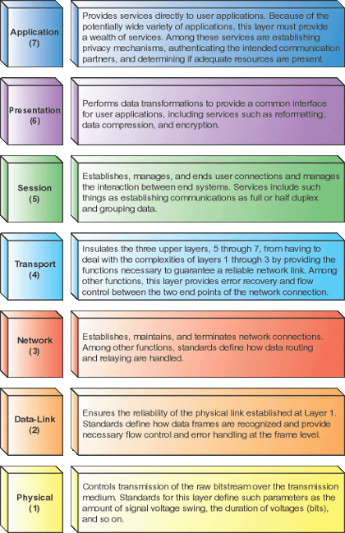
Audio Stream Protocols
RTP: Real-time Transport Protocol
Base for almost all VoIP
UDP: User Datagram Protocol
Similar to TCP: layer-4 network communications
Less overhead (delay) than TCP
But loses more packets
Up to 10% packet loss undetectable by users

Slide 19
Signaling Protocols
SIP: Session Initiation Protocol
Interactive multimedia sessions between users
VoIP, video conferencing, online games
Most commonly used protocol for VoIP
H.323
Supports older, analog telecommunications gear
Used in enterprise installations for VoIP & video calls
Call initiation
VoIP sets up call using SIP or H.323
Exchange control parameters (e.g., encryption, compression algorithms)
RTP packetizes voice data
UDP packet add addressing & sequencing data
Receiver uses “jitter buffer” to assemble packets

Slide 20
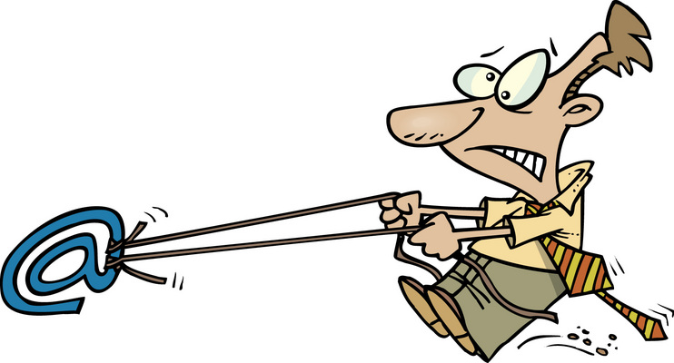
VoIP Threats (1)
SPIT: SPam over Internet Telephony
Not yet major issue
No obvious method for sending e-mail to multiple VoIP targets
Eavesdropping
Easy for unsecured communications using tools such as Ethereal
But only with access to terminators of connection (initiator / receiver)
Theft of Service
Routing long-distance calls through VoIP equipment
Owners liable for telecommunications charges

Slide 21
VoIP Threats (2): PITMA
Person-in-the-middle attacks
VoIP vulnerable if without encryption
Harm
Impersonate victim in fraud calls
Transfer inbound calls to wrong destination
Introduce fraudulent content in call
Including collecting phonemes & generating fake but realistic impersonation with fraudulent information
Could be serious problem for 911 calls

Slide 22
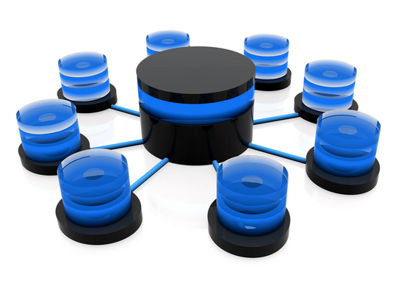
Protecting the Infrastructure
Real-Time Antivirus Scanning
Application Layer Gateways & Firewalls
Logical Separation of Voice & Data
Quality of Service
Device Authentication
User Authentication
Network Address Translation & NAT-Traversal

Slide 23
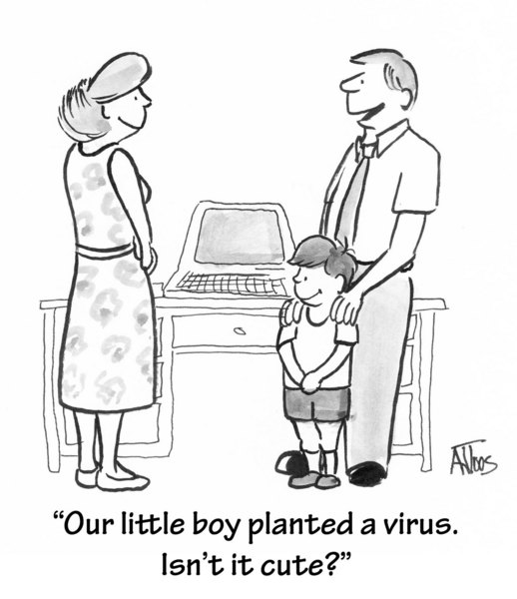
Real-Time Antivirus Scanning
Problem: normal AV measures may slow down packet processing
RTAV may introduce jitter into voice-stream
Do not allow VoIP admins to disable RTAV

Slide 24
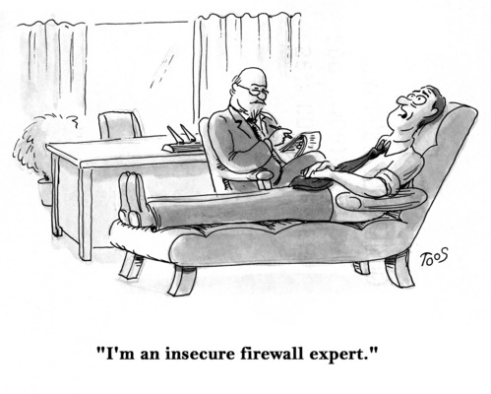
Application Layer Gateways & Firewalls
VoIP systems may have connections to important (and vulnerable) servers
E-mail & central authentication
RADIUS*
Active Directory
Database systems
Call logging
Call recording
Apply application layer gateways (ALGs) to segregate VoIP servers from rest of production systems
Some firewalls are SIP/VoIP-aware
*Remote Authentication Dial-In User Service

Slide 25
Logical Separation of Voice & Data
Ideally, VoIP system completely separate from other production systems
But expense may be too high
Separate cables (!)
Separate network equipment
But define VoIP subnet
DHCP* request from user process or handset
Distribute IP addresses using hardware ID
Distinct addresses allow effective firewall screening
*Dynamic Host Configuration Protocol

Slide 26
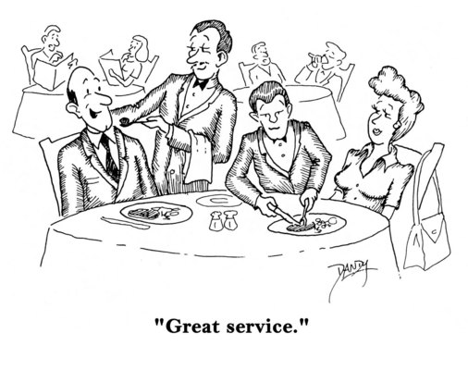
Quality of Service (QoS)
Define acceptable packet delay / loss
Can prioritize VoIP packets for fastest processing
Some VoIP- enabled firewalls keep packet buffers
Retransmit lost packets
IEEE 802.1p & 802.1q provide QoS standards
See http://ieee802.org/1/

Slide 27
Device Authentication
Store MAC addresses on VoIP server
Authenticate all SIP requests using list
Configure VoIP devices automatically
Connect VoIP phone handsets without configuration
Apply image of proper configuration through network

Slide 28
User Authentication
User management
Track calls, usage
Assign users to functional groups
Allow restrictions / privileges for destinations
Technical
Usually connect VoIP infrastructure to LDAP* or Active Directory
Central authentication of users
Facilitate forwarding voicemail to computer or mobile phone
Problems:
Authentication interval should be ~24 hours
Be sure to disable default accounts & passwords!
*Lightweight Directory Access Protocol

Slide 29
Network Address Translation & NAT-Traversal
NAT
Used by firewalls & routers
Allow multiple devices to share single IP address
Firewall translates internal address into single IP address
Return packets interpreted by firewall to reach right device
Problem: SIP reads translated address as real
Return stream using RTP/UDP can’t get through firewall
Workarounds
Configure NAT to support VoIP
Use unsecured (open) ports (but watch out for glitches)
VoIP proxy servers

Slide 30
Encryption: Critical Role
Secure SIP
Secure Real-Time Protocol
Session Border Control

Slide 31
Secure SIP
Transport Layer Security (TLS)
IETF
Secure & encrypt data communications
On public networks
Replace Secure Sockets Layer (SSL)
Protocol
Handshake & record
Secure SIP (SSIP)
Sends signaling messages over encrypted TLS channel
SIP proxy requests TLS session
Proxy returns certificate to SIP client for authentication
Client & proxy exchange encryption keys

Slide 32
Secure Real-Time Protocol (SRTP)
Enhanced RTP
Encryption uses AES for stream cipher
Authentication
Integrity
Blocks replay attacks
HMAC-SHA1*
MAC calculated using SHA hash + private key
Complies with Federal Information Processing Standards (FIPS)
*Hashed Message Authentication Code – Secure Hash Algorithm 1

Slide 33
Session Border Control (SBC)
Services addressing VoIP
Security issues
QoS (Quality of Service)
NAT traversal (NAT-T)
Network interoperability
Functions
Real-time bandwidth statistics
Can use to allocate network resources for QoS
Supports NAT-T algorithms for use of public networks with anonymity of internal resources
Accommodates SIP & H.3232

Slide 34
Concluding Remarks
Architecture must protect against
Interception
Deception
Denial of service
Continue to monitor field for new attack methodologies

Slide 35
Now go and study

