Slide 1
Securing Data at Rest
CSH6 Chapter 36
“Securing Stored Data”
David J. Johnson, Nicholas Takacs, & Jennifer Hadley

Slide 2
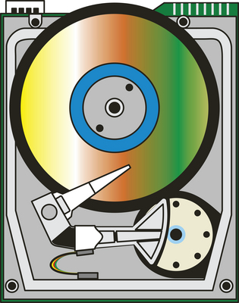
Topics
Introduction to Securing Stored Data
Fiber Channel Weakness & Exploits
NFS Weakness & Exploits
CIFS Exploits
Encryption & Data Storage
Data Disposal
CSH6 Chapter 36 covers nonvolatile media: magnetic disks, CDs, DVDs, flash drives.
Does not include RAM (or ROM, PROM, EPROM).

Slide 3
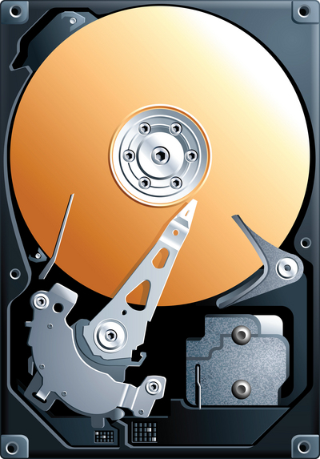
Introduction to Securing Stored Data
Security Basics for Storage Administrators
Best Practices
DAS, NAS & SAN
Out-of-Band & In-Band Storage Management
File System Access Controls
Backup & Restore Controls
Protecting Management Interfaces

Slide 4
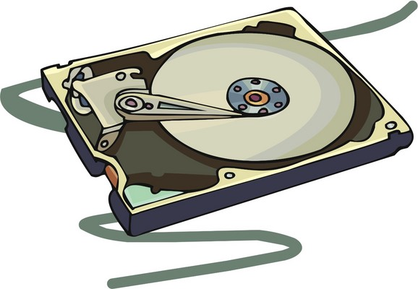
Security Basics for Storage Administrators
Data storage security often ignored by security planners
Relegated to infrastructure design
Particularly strong conflicts between availability and other aspects of Parkerian Hexad
Should be considered with other central elements of overall security planning
Differentiated security appropriate
Data classification helpful (see CSH6 Chapter 67, “Developing Classification Policies for Data”)
Backup copies particularly important to protect (see CSH6 Chapter 57, “Data Backups & Archives”)

Slide 5
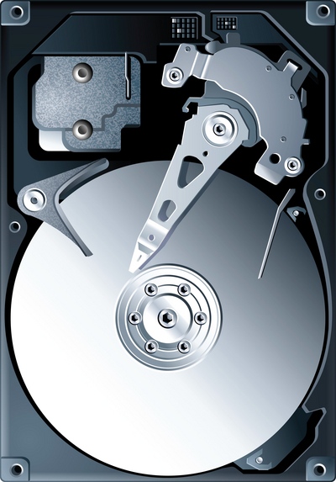
Best Practices (1)
Audit & risk assessment on storage infrastructure
Authentication across storage network
RBAC (role-based access controls) & need-to-know assignment of rights
Data encryption & data classification
Strong security features & practices from storage vendors
Securing SAN (storage area network) at switch (or fabric) level
Policies for safely discarding media, devices
Evaluating retention policies

Slide 6
Best Practices (2)
Making retention policies comply with functional, legal & regulatory requirements
Isolating storage management NW from organization-wide functional NW
Access-log monitoring
Employee & contractor background checks
Physical controls to restrict access to data centers, lock cabinets & racks, lock servers, protect building/site perimeter (see CSH6 Chapters 22 & 23 on information infrastructure)
Secure backup-medium handling, tracking

Slide 7
DAS, NAS & SANs
3 main methods for storing data
Direct attached storage (DAS)
Part of or directly connected to computer
Peripheral Component Interconnect (PCI), Small Computer System Interface (SCSI) or other standard
Network attached storage (NAS)
Specialized systems with DAS, dedicated processors & pared-down operating systems
Generally connected to TCP/IP NWs
Network File System (NFS) for Unix
Server Message Block (SMB) or Common Internet File System (CIFS) for Windows
Storage area networks (SANs) – see next slide

Slide 8
SANs
RAID: Some people define
acronym using “Inexpensive”
or “Drives”
Storage Area Networks: centralized disks accessible to many servers
Can add disks easily
Facilitate centralized backups
Often integrate RAID
Redundant Arrays of Independent Disks
Different levels from RAID 0 to RAID 6
Allows for data duplication, performance improvements
Connections
TCP/IP
Fiber Channels (see later in these notes)

Slide 9
Out-of-Band & In-Band Storage Management
In-band management
Same NW as data transfers
Cleartext signaling
DoS attacks on management interfaces
Access to excessive information about devices & controllers
Set/Reset commands available for abuse
Out-of-band management
Separate NW for control functions
Must ensure restricted access – only administrators
Ideally, use secure channels

Slide 10
File System Access Controls
Operating systems include file systems
File systems generally provide for access controls
Data ownership
Access control lists (ACLs)
But security through file system assumes proper user I&A
For more information on these topics, see CSH6 Chapters
24 – Operating System Security
25 – Local Area Networks
28 – Identification & Authentication
67 – Developing Classification Policies for Data

Slide 11
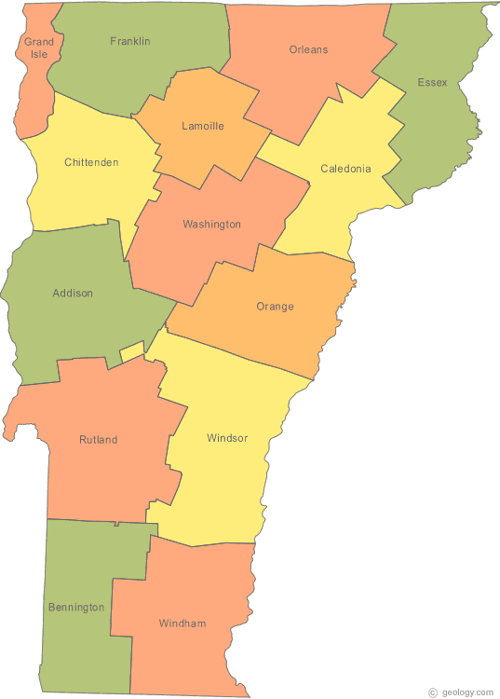
Backup & Restore Controls (1)
Backup/restore systems critical for BC & DR
Typically written to tertiary storage
Tape, cassettes, optical media
Offsite storage (often run by supplier)
Electronic transfer
Recovery site
Electronic storage service
Offsite storage needs
Secure: authorized personnel only
Geographically distant (not subject to same disaster)
Audit security, hiring policies

Slide 12
Backup & Restore Controls (2)
Media longevity
Verify longevity > archival requirements
Interpolation of spoofed BU system
Writes would be to unauthorized drive
Insertion of spoofed data storage system
Could request RESTORE to unauthorized system
Authentication of systems essential
Manual: login to authenticate BU request
Auto: certificate exchange
Data encryption valuable
See CSH6 Chapter 57 “Data Backups & Archives” for more information on these topics

Slide 13
Protecting Management Interfaces
Management Interfaces (MI) among greatest threats to security
Admin access to entire data store
Manipulate data, update acct security, rearrange architecture
2-factor authentication a minimum
Complex password requirements
Regular PW changes or one-time PW token
Separation of duties
Storage managers ≠ security managers
Audit logs to detect policy violations
Use log-analysis software (manual inspection inadequate)

Slide 14
Fiber Channel Weakness & Exploits
Introduction to Fiber Channel
Man-in-the-Middle Attacks
Session Hijacking
Name Server Corruption

Slide 15
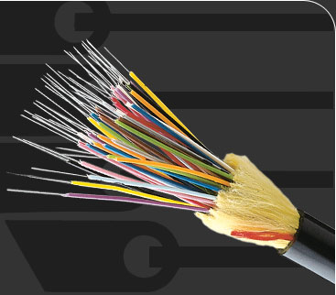
Introduction to Fiber (Fibre) Channel
ANSI/INCTS* T11 Committee standard
Optical fiber cabling; or
Twisted-pair copper wiring
Weaknesses
All traffic is unencrypted
No native support for authentication or data integrity checks
Vulnerabilities
Attackers can use IP-based attacks
Cleartext traffic can be sniffed
Message insertion (MITM) possible
*American National Standards Committee accredited
International Committee for Information Technology Standards

Slide 16
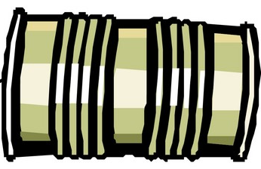
Man-in-the-Middle Attacks
Method
Attacker intercepts communications
Copies or changes data
Inserts modified frame (like a packet) back into data stream
Exploits weakness in protocol
Sequence ID & sequence count are predictable
Thus attacker can predict next values & insert spoofed frame before authentic frame is sent

Slide 17
Session Hijacking
Sequence ID & sequence count used to trick receiver into treating attacker as original sender
So hijacked session allows complete control
Mitigation requires authentication to be added to protocol

Slide 18
Name Server Corruption
Similar to DNS spoofing in IP
Every fiber channel registers name
WWN (World Wide Name) service
Fabric Login (FLOGI)
Port Login (PLOGI)
Corruption typically occurs during PLOGI
Attacker registers bad host using spoofed address
No authentication process
So real host connection denied
Traffic misdirected to rogue host

Slide 19
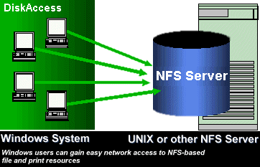
NFS Weakness & Exploits
Introduction to NFS
User & File Permissions
Trusted Hosts
Buffer Overflows
NFS Security

Slide 20
Introduction to NFS
Network File Systems
User on client machine accesses NW-based resources as if local to user
Built on RPCs (remote procedure calls)
Generally used in high-bandwidth systems
LANs & other NW with nonsensitive data
NFS does not inherently provide encryption
Dangerous to use with exposed NW connected to Internet
Following slides introduce key security issues

Slide 21
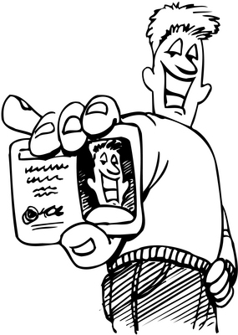
User & File Permissions
Access rights granted by host ID
So any user on authorized host has access to NW resources
Some admins therefore impose read-only rights to all shared data
But then shared drives are not as useful for collaboration
If volumes mounted with RW capability
Then all users on same host share all files by default
Restrictions have to be imposed file-by-file
Becomes unscalable as #files & #users grow

Slide 22
Trusted Hosts
Hosts do not authenticate themselves
So rogue host could request NFS volume mount
Access, modify data without authorization
Could also compromise DNS server
Upload bad data to point to rogue host
Then connections would go to spoofed host
And users on bad host would be authorized to mount volumes, access data

Slide 23
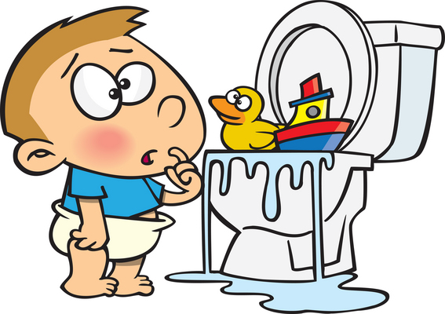
Buffer Overflows
Classic programming error
Inputs not checked before processing
So long inputs overflow input buffers and overwrite areas of stack
Data can be interpreted as parameters or commands (see CSH6 Chapter 38, “Writing Secure Code”)
NFS server does not check length of directory-removal request
So overflow can include malicious instructions
Executed with root privilege

Slide 24
NFS Security
Recent implementations include Kerberos
Authentication scheme
Can validate users & hosts
But buffer overflow exploits continue to be developed
Should not assume that NFS can be adequately secured on its own

Slide 25
CIFS Exploits
Overview
Common Internet File System
Internet-enabled Server Message Block (SMB) protocol
Significant improvements over SMB
Encryption
Secure authentication
But problems remain
Topics discussed in next slides
Authentication
Rogue or Counterfeit Hosts

Slide 26
CIFS Authentication
Authentication schemes
Passwords
Challenge-response
But all unencrypted
Recent improvements use Kerberos
Some provide share-level security model
Instead of user-level security model
So only one set of credentials
Shared by all users on host
Same weaknesses as all other shared accounts
Vulnerable to dictionary & brute-force attacks on credentials
Chosen plaintext attacks
Online & offline dictionary attacks

Slide 27
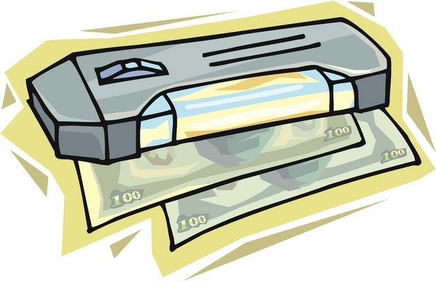
CIFS Rogue/Counterfeit Hosts
MITM & trusted host attacks apply to CIFS
CIFS clients may be tricked into supplying PW instead of using challenge-response
Support MITM attacks
CIFS must enable session- and message-authentication measures
Otherwise open to MITM / spoofing attacks
CIFS share vulnerabilities similar to NFS share weaknesses
But enabling CIFS authentication helps
Be sure to check configuration

Slide 28
Encryption & Data Storage
Introduction to Data Storage Encryption
Recoverability
File Encryption
Volume Encryption & Encrypted File Systems
Full Disk Encryption
Vulnerability of Volume, File System & Full Disk Encryption
Database Encryption

Slide 29
Intro to Data Storage Encryption
Encrypting data-in-motion common
Encrypting data-at-rest equally important
Breaches of stored data more common than interception of data in transit
Considerations
Choose appropriate algorithm & key length
Aim at delaying brute-force decryption long enough to make data useless
See CSH6 Chapters for more information:
7 “Encryption”
37 “PKI & Certificate Authorities”

Slide 30
Recoverability
Ciphertext without key is lost
Must plan for loss of encryption key by primary user
Key escrow essential
Store key with trusted party
Remove key from escrow under controlled conditions when required
Public Key Cryptosystem (PKC)
Allows additional decryption keys (ADKs)
Either key can decrypt data
E.g., Prof Kabay encrypts PGP disk volumes using own public key and that of Prof Peter G. Stephenson (by arrangement)

Slide 31
File Encryption
Individual files may be encrypted
But puts onus on user to decide in every case
Operating system files cannot be encrypted by users
Thus may expose sensitive data
Application code files not executable without decryption
Not practical to decrypt file-by-file
So proprietary code may be exposed
Much better to use whole-disk encryption

Slide 32
Volume Encryption & Encrypted File Systems
Volume encryption & encrypting file systems better for encrypting / decrypting data than file encryption
Automatic encryption of all files in volume, partition or directory (folder)
Both systems decrypt dynamically
Driver-level code decrypts blocks on way to RAM and back
Never decrypt entire file
So no copy of cleartext for whole file anywhere on disk or in memory
But system files usually not encrypted
If user stores copy of sensitive file in unencrypted area, may compromise security

Slide 33
Full Disk Encryption
Encrypt entire hard drive
By far preferred mode of encryption for normal use
Especially important for laptop computers
Leaves only small boot portion of disk in clear
Simply enter special PW at bootup
Benefits
Complete protection in case of loss or unauthorized access if system is locked or off
Including protection of swap files
Completely transparent to (naïve) users
Only modest performance penalties
Slightly longer startup & shutdown
Full compliance with legal & regulatory requirements for protection of sensitive data

Slide 34
Vulnerability of Volume, File System & Full Disk Encryption
System equally vulnerable to attacker once authorized user has started system
Must stress to users that encryption does NOT protect against penetration of live system
Must configure usual access controls
May also configure timeout on encryption
Disables access after defined period of inactivity
User need merely reenter passphrase or provide token
E.g., 60 minute inactivity for automatic dismount of PGP volumes

Slide 35
Database Encryption (1)
DBs often contain critical, sensitive data
Can protect by placing on encrypted volumes
May also encrypt fields & tables
Offers flexibility in protecting specific classes of data against unauthorized access by users authorized for DB usage; e.g.,
Managers/supervisors might access more of customer record than clerks
Current care-givers might access more of patient record than accounting staff
But application / DB designs constrain use of encryption (see next slide)

Slide 36
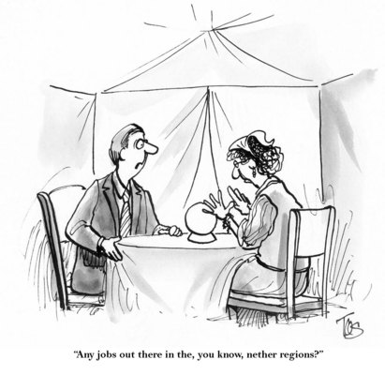
DB Encryption (2)
Recommendations on DB encryption (James C. Foster writing in SearchSecurity.com)
Do not encrypt foreign keys or super keys
Used for structural linkages among tables
Therefore should not contain PII or sensitive data
Encryption keys must be tightly protected
Provide complete access to all data
Full DB encryption may affect performance
High-volume R/W activity may require wire-speed data access for effective processing
Consider encryption only sensitive data
Can you get me that decryption key?!?

Slide 37
DB Encryption (3)
Improving vendor-provided options
Microsoft SQL Server 2005 offers improved encryption management
Oracle 10g Release 2
Transparent Data Encryption (TDE)
DB Admin can specific encryption for specific columns (fields)
No programming required
Implementation considerations
Avoid encrypting key fields
May have to redesign DB association if key is sensitive
Monitor performance issues

Slide 38
Data Disposal
Never discard any magnetic, optical, electronic or paper media containing sensitive data without sanitizing
Methods that do NOT delete data
File system Delete or Erase commands
Formatting
DoD standards define secure wipe
Repeated erase/random-write cycles
Degree adjustable by setting number of cycles
Magnetic, optical, paper media should be physically destroyed
For more details, see CSH6 Chapter 57 “Data Backups & Archives”

Slide 39
Now go and study

