Slide 1
PKI & CA
CSH6 Chapter 37
“PKI & Certificate Authorities”
Santosh Chokhani, Padgett Peterson, & Steven Lovaas

Slide 2
Topics
Introduction
Need for PKI
Public Key Certificate
Enterprise Public Key Infrastructure
Certificate Policy
Global PKI
Forms of Revocation
Rekey
Key Recovery
Privilege Management
Trusted Archival Services & Trusted Time Stamps
Cost of PKI

Slide 3
Introduction
Overview
Symmetric Key Cryptography
Public Key Cryptosystem
Advantages of PKC over SKC
Combination of the Two

Slide 4
Overview
Early days of encryption across Internet
Individuals
Pretty Good Privacy (PGP)
Web of trust
Today’s encryption much more complex
Formalized
Organizational
Fundamentally concerned with trust relationships
Key applications include
Data in flight (networking)
Data at rest (storage)
See CSH6 Chapters
7: Encryption
32: VPNs & Secure Remote Access

Slide 5
Symmetric Key Cryptography

Slide 6
Public Key Cryptosystem

Slide 7
Advantages of PKC over SKC
PKC requires fewer keys to manage
Total keys 2n (Cf SKC with ½n(n-1) ≈ ½n²)
Can focus on authenticating only public keys
No secret keys transmitted over networks
Not susceptible to compromise even if public keys must be changed
Public keys can be used to encrypt temporary session keys for one-time use
Session keys allow PKC to encrypt message for multiple recipients easily

Slide 8
Combination of the Two
Usual implementation of PKC uses symmetric algorithm for session key
Computationally less onerous
Encrypt session key with asymmetric key
Digital signing uses similar method
Encrypt secure hash of document
Decrypt encrypted hash to verify data integrity and authenticity of text

Slide 9
Need for PKI
Everything in PKC depends on trustworthiness (authenticity) of the public key (certificate)
If someone posts a public key in victim’s name, can
Intercept encrypted content intended for spoofed victim
Issue fraudulent content in victim’s name
Similar problems with Secure Sockets Layer (SSL) v2
Develop chain of trust for certificates (value signed by public keys)

Slide 10
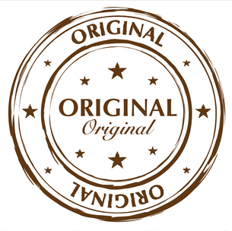
Public Key Certificate (1)
Certification authority (CA) issues signatures for public keys
Standard is ANSI X.509 (IETF RFC 5280)
Described in Abstract Syntax Notation (ANS.1)
Often encoded in MIME (Multipurpose Internet Mail Extensions) to use only ASCII characters
Trust the root & you can trust the issued keys

Slide 11
Public Key Certificate (2)
Every CA’s certificate has list of key info:
Version #
Certificate serial #
Algorithm
CA name
Validity period for certificate
Subscriber name
Subscriber public key, PK algorithm, parameters
CA unique ID (optional)
Extensions (optional)
CA’s digital signature

Slide 12
Certificate Revocation List
CRL is list of revoked certificates
Must check CRL before trusting public key
X.509v2 CRL contains
Version # of CRL standards
Algorithm & parameters for CA signature
CA name
CRL issuance time
Next CRL issuance time (optional)
List of revoked certificates with each
Certificate serial #
Time CA notified of revocation
Extensions (optional)
Extensions related to CRL (optional)
CA’s digital signature

Slide 13
Enterprise Public Key Infrastructure

Slide 14
Certificate Policy (1)
Private keys must be
Kept confidential
Used only by owners of keys
Trust anchors’ public key integrity must be assured
Initial authentication of subscriber
Must be strong
Must prevent identity theft at time of certificate creation
CA & RA (Registration Authority) computer systems must be protected against tampering
Requirements for level of trust must be defined

Slide 15
Certificate Policy (2)

Slide 16
Global PKI
Levels of Trust
Proofing
Trusted Paths
Choosing a PKI Architecture
Cross-Certification
PKI Interoperability

Slide 17
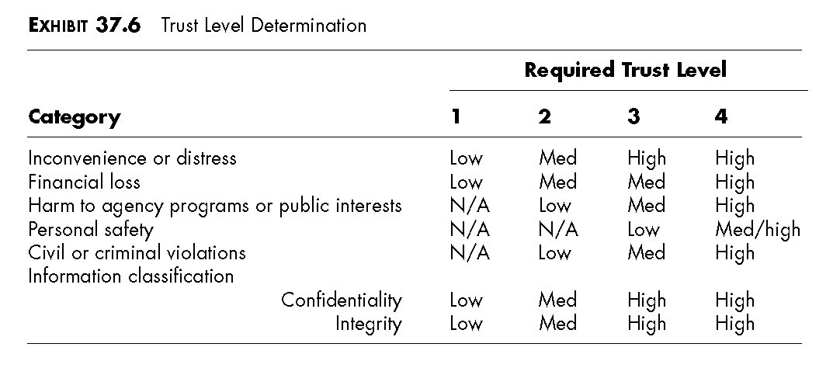
Levels of Trust
OMB M04-04 §2.1 basic levels of trust:
Level 1: Little or no confidence in asserted identity’s validity
Level 2: Some confidence
Level 3: High confidence
Level 4: Very high confidence

Slide 18
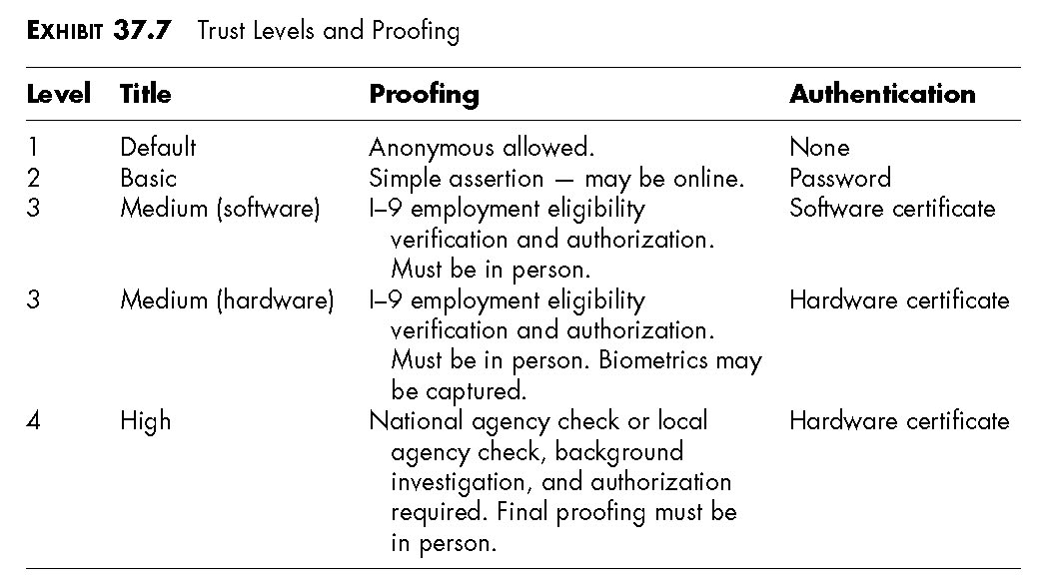
Proofing
Vetting (proofing) requires increasingly thorough background checking of identity

Slide 19
Trusted Paths

Slide 20
Choosing a PKI Architecture
Strict Hierarchy
Hierarchy
Bridge
Multiple Trust Anchors
Mesh (Anarchy, Web)
Making a Choice

Slide 21
Strict Hierarchy

Slide 22
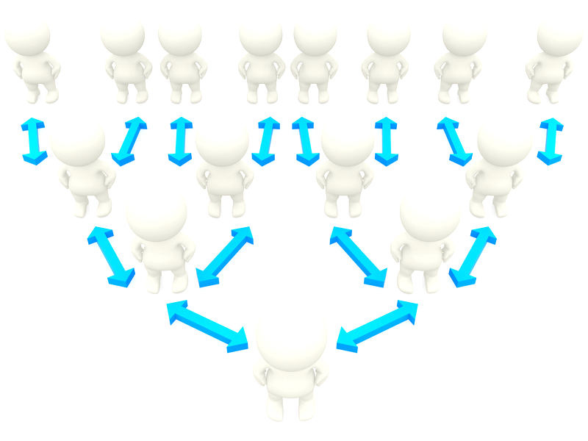
Hierarchy
Strict hierarchy requires public key of common ancestor as trust anchor
Thus single root is trust anchor
Nonstrict hierarchy allows any CA to be trust anchor
Usually local CA becomes trust anchor
Local CA is CA that issued certificate to a relying party

Slide 23
Bridge

Slide 24
Multiple Trust Anchors
Relying party obtains public keys of many CAs
Must use secure method
Each key becomes a trust anchor
Helpful for situations where CAs cannot cross-certify each other

Slide 25
Mesh (Anarchy, Web)
Web of trust
Any CA can trust any other
Original concept underlying PGP
Not scalable (WHY NOT?)

Slide 26
Making a Choice
Factors
Management culture
Organizational politics
Certification path size
Subscriber population size
Subscriber population distribution
Revocation information
Often end up with multiple CAs

Slide 27
Cross-Certification (1)
Simplest case:
Two CAs grant the other a certificate
Problems
Incompatible PKI products
Incompatible certification policies
Must review policies
Need equivalent, not identical policies
Use name constraints extension in X.509v3 certificates
Trust each others’ domain names

Slide 28
Cross-Certification (2)

Slide 29
Cross-Certification (3)

Slide 30
PKI Interoperability
Factors
Trust Path
Cryptographic Algorithms
Certificate & CRL Formats
Certificate & CRL Dissemination
Certificate Policies
Names

Slide 31
Forms of Revocation
Types of Revocation-Notification Mechanisms
Certificate Revocation Lists & Variants
Server-Based Revocation Protocols
Summary of Recommendations

Slide 32
Types of Revocation-Notification Mechanisms
Concerns about CRLs have led to variations for checking validity of certificates
Online Certificate Status Protocol (OCSP)
RFC 2560
Directory-based verification & revocation
B-tree revocation lists

Slide 33
Certificate Revocation Lists & Variants
Most versatile, effective & recommended
Variations
Full & complete CRL (rare)
All certificates, revoked and valid
Most CRLs have only recent revocations
Authority revocation list (ARL) – usually short
Revocations only for CAs
Don’t use X.509v1 ARL – only X.509v2, which distinguishes between CRL & ARL
Distribution-point CRL: allows partitions for shorter lists
Delta CRL: changes only since last CRL
δ

Slide 34
Server-Based Revocation Protocols
Servers provide revocation info; e.g.,
On-Line Certificate Status Protocol (OCSP)
Simple Certificate Validation Protocol (SCVP)
Flaws
Need to secure channel to server
Computationally intensive digital signature generation makes system difficult to scale
Need trusted servers
Useful when need to
Have thinnest possible PKI clients
Generate revenue for CA services
Check changing credentials
Update changing credentials

Slide 35
Summary of Recommendations for CRLs
Use combination of
CRLs
Replication of CA directory entry for fast access
ARLs & their consolidation
Consolidation of reason-codes of key compromise in a domain
Use Distribution Point extension
Issue CRL frequently
Partition routine revocation info using Distribution Point CRLs if CRLs become too large
Store plaintext CRLs for fast searching
Eliminate private information to eliminate need for authentication when searching CRLs

Slide 36
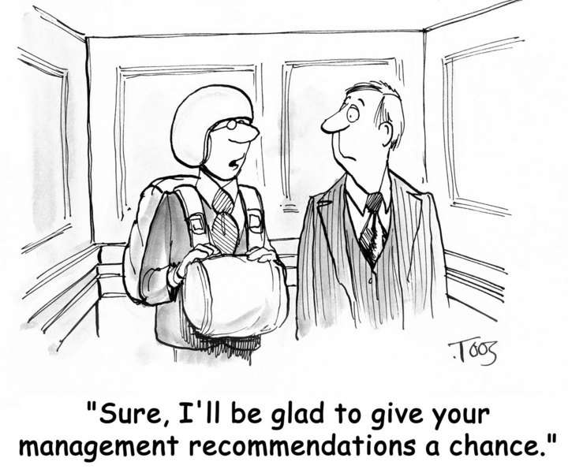
Recommendations

Slide 37
Rekey
Public key certificates eventually expire
Thus need new PK certificates
Don’t use PKs longer than estimated time for brute-force cryptanalysis
Cryptanalysis threat period
Shortens all the time as computational power increases
Current estimates
1024 bit RSA key → 25 years in 2009 & 1.5 now
Therefore worthwhile recertifying keys
Reduce number of keys necessary to access or validate older files/messages
Why?

Slide 38
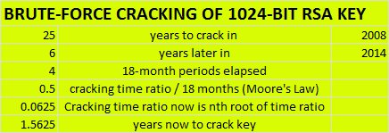
Estimating Brute-Force Cracking time

Slide 39
Key Recovery (1)
Distinguish between signing keys & data encryption keys
Signing keys must never be subject to key recovery!
Data encryption keys may be protected by key recovery
Key escrow
Provide private decryption key to key recovery agent (KRA)
Key encapsulation
Encrypt private decryption key using KRA’s public key

Slide 40
Key Recovery (2)
Avoiding giving KRA control
May not want KRA to have unfettered access to decryption key
So can
Superencrypt
Encrypt using 2 keys
Requires collaboration to get key
Split the key: Shamir’s n out of m rule
Send parts of key to m recipients
Require at least n recipients to collaborate in restoring key

Slide 41
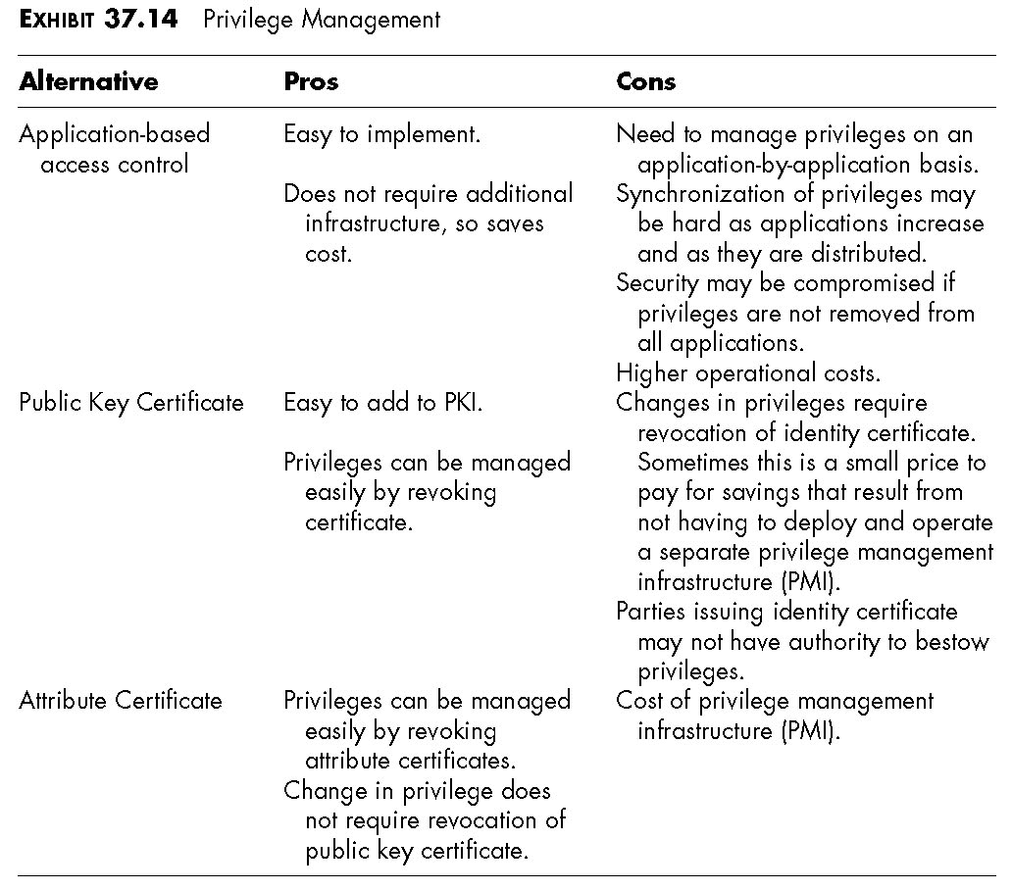
Privilege Management

Slide 42
Trusted Archival Services & Trusted Time Stamps
PKI does not prevent alteration or spoofing
Merely detects them
Could also challenge digital signature after expiry of cryptanalysis threat period
But can use trusted archival services
Need to provide storage of signed materials
Trustworthy assurance of error-free transcription from medium to medium over time as media degrade & technologies change
Can add functions of trusted time stamps

Slide 43
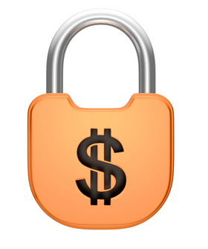
Cost of PKI
Compare costs of PKI with costs of not having PKI!
Scalability is key factor: n vs n² keys
Consider consequences of untrusted digital communications
Continued dependence on trust
M. E. Kabay’s question sent in 2001 to Norwich University authorities who resisted digital signatures on documents sent by e-mail:
How is depending on pigment smeared through a hole
in the end of a stick onto compressed fibers from dead plants
supposed to engender more trust in the authenticity and integrity of a document than cryptographically sound digital signatures?

Slide 44
Prof Kabay’s Notes on HR v IT for CA
IT
Can support software for issuing and revoking certificates
But have no information about new hires, changes of position, authorization as CAs, deauthorization or firing
HR
Equipped to handle all employee-related issues
Issuing/revoking certificates run by software
Therefore appropriate CAs

Slide 45
Now go and study

