Slide 1
Patches
CSH5 Chapter 40
“Managing Patches & Vulnerabilities”
Peter Mell & Karen Kent Scarfone
Notes:
M. E. Kabay, PhD, CISSP

Slide 2

Topics
Introduction to Patch & Vulnerability Management
Why Use Automated Patching Solutions?
Patch & Vulnerability Management Process
Patch & Vulnerability Management Issues
Summary of Major Recommendations

Slide 3

Introduction to Patch & Vulnerability Management
Vulnerabilities
  Flaws
  Can be exploited by malicious entities
  Obtain unauthorized access / privileges
Patches
  Code to fix flaws / bugs
  Can add functionality
  Or repair flaws
  May lag behind vulnerability disclosures
Patch & vulnerability management
  Systematic processes to prevent exploits

Slide 4
Why Use Automated Patching Solutions? (1)
*http://nvd.nist.gov/
Vulnerabilities increasing rapidly
  Jan – Dec 2007: US National Vulnerability Database* – 6691 new vulnerabilities (557/mo, 18/day)
  Jan – Dec 2008: 5632
  Jan – Dec 2009: 5773
Damage can be severe: denial of service, data loss, loss of reputation, loss of business….
Cost of not mitigating damage = WTR
  W = workstations
  T = time spent fixing problems or lost productivity
  R = cost/hour of T

Slide 5
Why Use Automated Patching Solutions (2)
Manual monitoring for new patches and applying may be labor intensive
  E.g., 10 min/day
  10 min/patch per workstation
  … and these costs may add up…
  Yet still remain cheaper than disaster
However, automated patching can be more cost effective
  Automatically attend to new patches
  Deploy them across entire network
  Also more reliable and quicker than manual

Slide 6

Examples of Automated Patch Management Tools
PatchEasy
Symantec Altiris Suite
Desktop Central 7
Shavlik NetChk Protect
These are examples,
not endorsements.

Slide 7
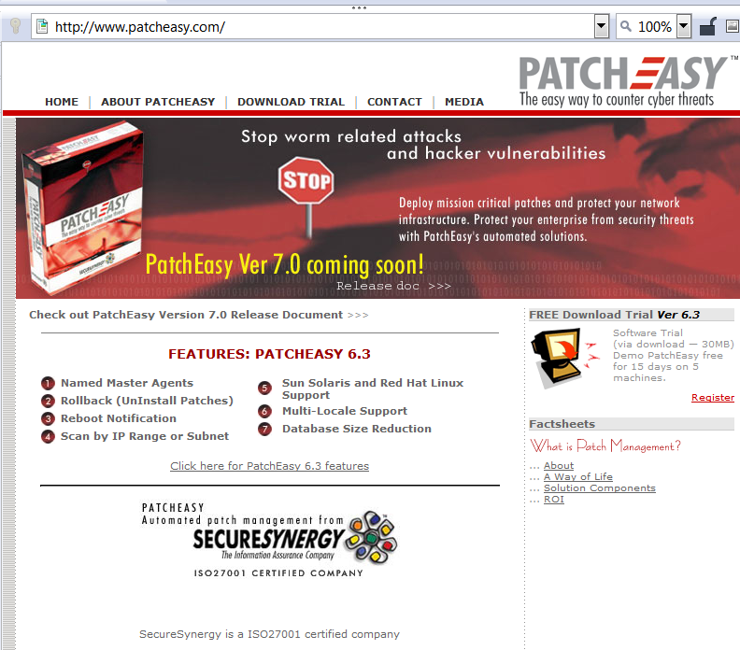
Patch Easy

Slide 8
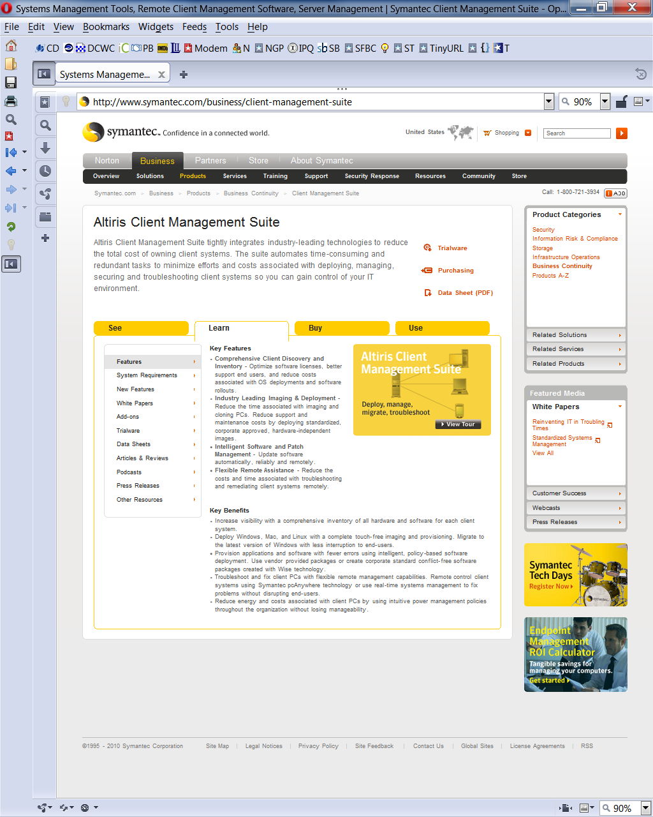
Symantec Altiris Suite

Slide 9

Desktop Central 7

Slide 10
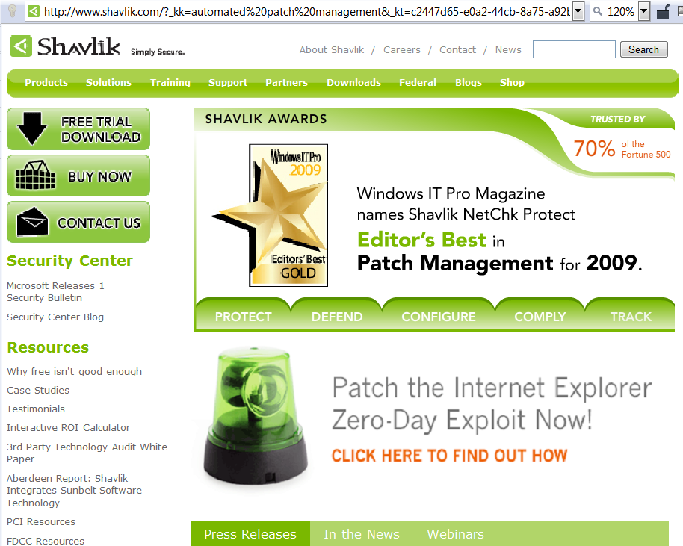
Shavlik NetChk Protect

Slide 11
Patch & Vulnerability Management Process
Recommended Process
Creating a System Inventory
Monitoring for Vulnerabilities, Remediations & Threats
Prioritizing Vulnerability Remediation
Creating Organization-Specific Remediation DB
Testing Remediations
Deploying Vulnerability Remediations
Distributing Vulnerability & Remediation Info to Admins
Verifying Remediation
Vulnerability Remediation Training

Slide 12

Recommended Process
Overview
Patch & Vulnerability Group (PVG)
System Administrators (Sysadmins)

Slide 13
Overview of Process
Create central, autonomous group for managing patches and vulnerabilities
May have single PVG or several in hierarchy
Shift patch administrators from sysadmins to PVG
  Reduce duplication of effort
  Save money
  Reduce errors
Use standardized configurations for workstations and servers to degree possible
Keep careful track of inventory and topology

Slide 14
Patch & Vulnerability Group (PVG)
Define PVG to include INFOSEC + OPS
  Sysadmin
  Intrusion detection
  Firewall management
  Operating systems experts
  Vulnerability scanners
May be full- or part-time depending on size, complexity of organization & systems
May rotate staff into group to spread knowledge

Slide 15
PVG Duties
Create system inventory
Monitor for vulnerabilities, remediations & threats
Prioritize vulnerability remediation
Create organization-specific remediation database
Conduct generic testing of remediations
Deploy vulnerabilities remediations
Distribute vulnerability & remediation information to local system administrators
Perform automated deployment of patches
Configure automatic update of applications wherever possible & appropriate
Verify vulnerability remediation through NW & host vulnerability scanning
Vulnerability remediation training

Slide 16

System Administrators (Sysadmins)
Responsible for ensuring that IT resources follow standard configuration defined for organization
Ensure that resources participate in automated patching system
Or if using manual patching, coordinate with PVG
Handle exceptions
  Trial systems
  Experimental configurations
  Prototypes under development

Slide 17
Creating a System Inventory
Essential to know exactly what needs protection
IT Inventory
  Update constantly / real-time
  Usually prefer organization-wide DB
  Suggested fields on p. 40-7
  Preferably use automated inventory agents
  Also use bar codes on all components
    Systems, peripherals….
    Cabling
    Network elements (routers, switches…)

Slide 18
Grouping & Prioritizing IT Resources
Elements in inventory need priority levels
Reflect degree of criticality
  Impact of compromise
  Dependencies – critical patch for recovery
Can use FIPS PUB 199
  Standards for Security Categorization of Federal Information and Information Systems
  See next slide

Slide 19
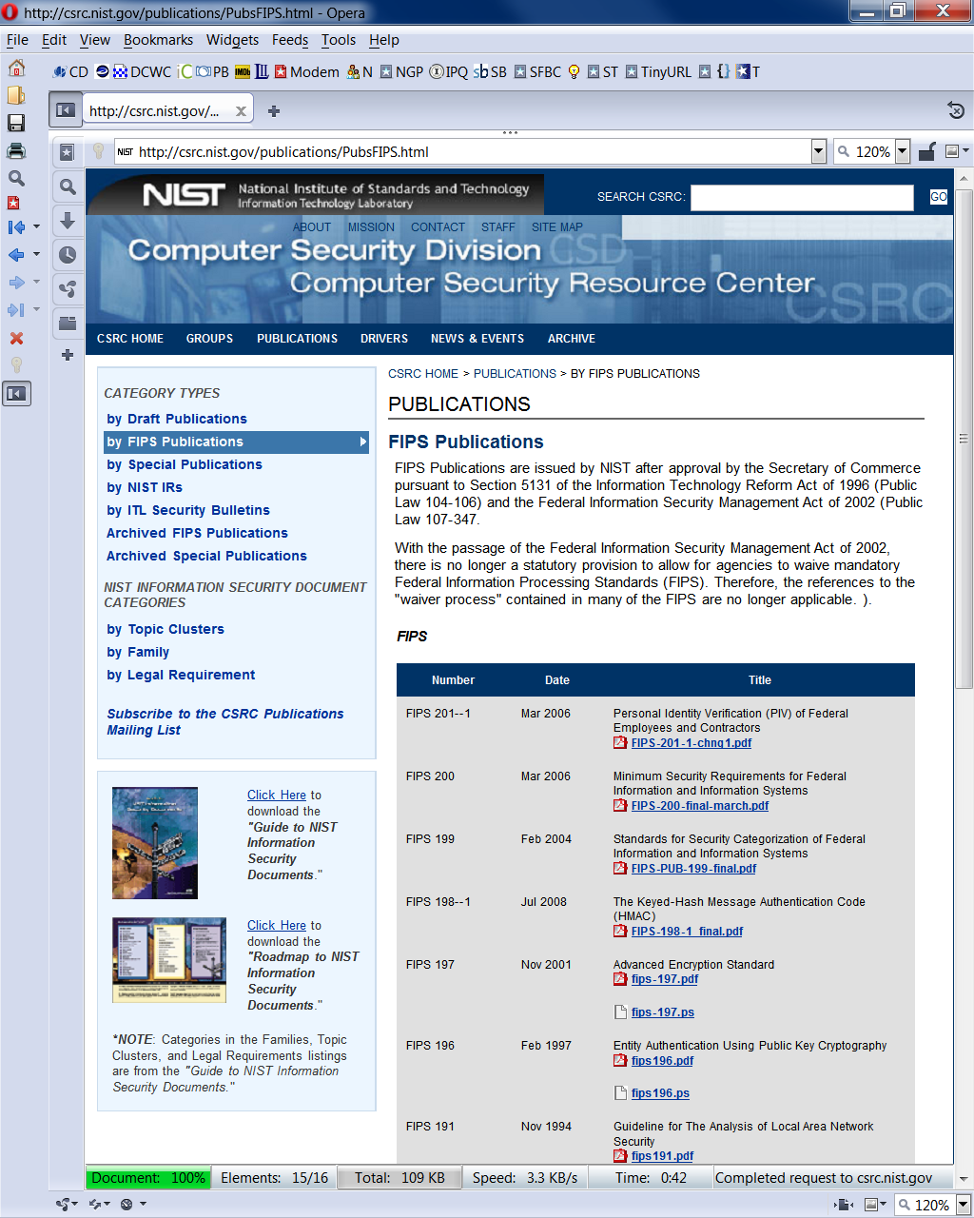
Get to Know the NIST CSRC

Slide 20
NIST CSRC: FIPS 199

Slide 21
Use of IT Inventory & Scope of Related Duties
Inventory is foundation of PVG operations
  Ensure PVG knows which vulnerabilities to look for & to respond to
  Checklist for ensuring that all vulnerable systems remediated
Publication allows sysadmins to spot missing or incorrect components & fix DB
Managers, security personnel can also use information productively
  But restrict access according to permissions as appropriate
  E.g., division / department / workgroup

Slide 22

Monitoring for Vulnerabilities, Remediations & Threats
Types of Security Concerns
  Vulnerabilities
  Remediations
  Threats (exploits,
  malware)
Be on lookout for
unauthorized…
  Hardware
  Software
  Configurations

Slide 23
Tools for Monitoring Vulnerabilities, Remediations & Threats
Vendor Websites & mailing lists (product-specific newsletters)
Third-party Web sites (e.g., SANS, CERT-CC®, various alert newsletters)
Vulnerability scanners
Vulnerability databases
  National Vulnerability Database
Enterprise patch management tools
Other notification tools

Slide 24
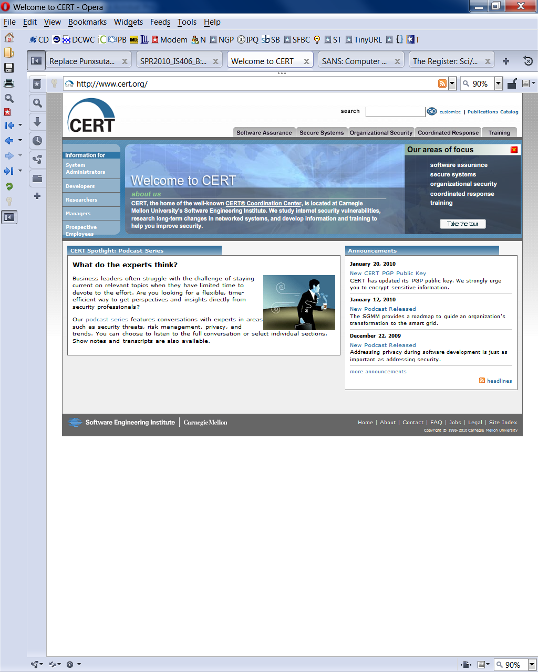
CERT-CC®

Slide 25
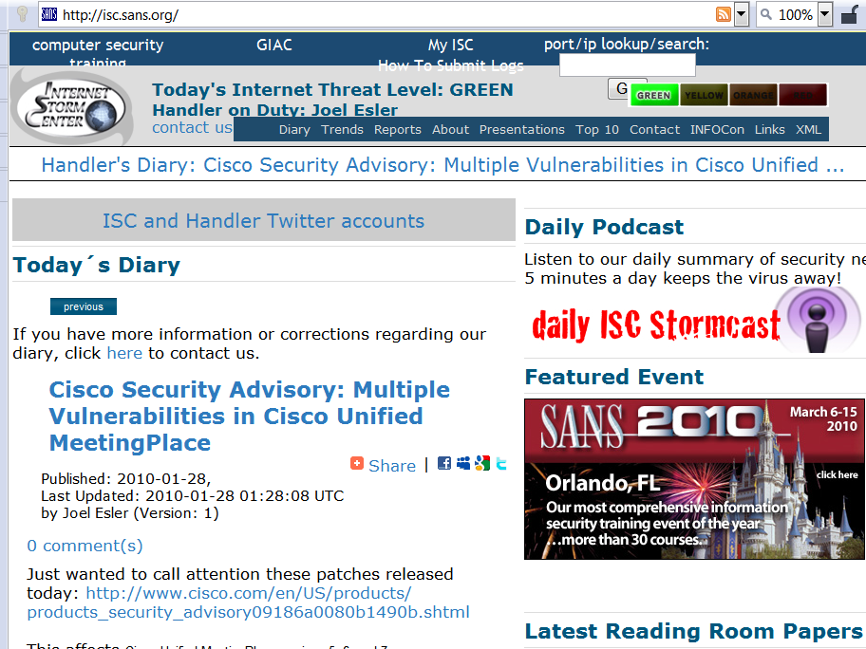
SANS Internet Storm Center

Slide 26

The Register

Slide 27

Prioritizing Vulnerability Remediation
Determine significance
of threat or vulnerability
Determine existence,
extent & spread of
related malware &
exploits
Determine risks involved in applying patch or nonpatch remediation
  Use external sources of information
  PVG is not a research group

Slide 28
Creating Organization-Specific Remediation DB
Enterprise patch-management tools establish DB for known inventory in organization
May have to maintain own small DB or manual list of exceptions
Include threat assessment information
  Useful in business-continuity (BC) & disaster recovery planning (DRP)
Include copy of every patch used or planned
  Can avoid problems of rush on Website

Slide 29
Testing Remediations
Standardized configurations allow easy testing of patches on isolated systems
  Keep standard for test & development only
  Avoid danger of installing bad patch on production systems
Eliminate need for redundant, costly testing on all local systems
But critically important to maintain validity of system image so that patches really going to standard configs!
See extensive list of precautions for testing on pp 40.12 – 40.13 of text

Slide 30

Deploying Vulnerability Remediations
3 primary methods of remediation
Applying security patch (“fix” or “hotfix”)
  Modifies defective code
  Be sure to download only from safe sites – vendor site usually safe
Configuration adjustment
  Change parameter(s); e.g.,
    Disabling services
    Changing firewall settings
    Altering router settings
    Modifying registry settings
Software removal
  Generally advised to run only essential processes / services on production systems

Slide 31

Delaying Patch Installations
Some patches have been discovered to be defective
  Caused more problems than they solved
  Therefore some admins are gun-shy: delay installation of patches by reflex
PVG should document, analyze & discuss deviations from recommended installations
  Threat level
  Risk of compromise
  Consequences of
  compromise

Slide 32

Distributing Vulnerability & Remediation Info to Admins
Primary mechanism: automated patch management software (PMS)
Emergencies (e.g., failure of PMS) may require alternative channels
  Plan for these backup channels in advance
  Maintain security
  Establish authenticity of patch instruction
  Establish authenticity & integrity of patch itself

Slide 33

Verifying Remediation
Must be sure patches have in fact been installed
  Correctly &
  On all appropriate targets
Performing Vulnerability Scanning
  Automated systems can locate
  unpatched vulnerabilities
  independently
  Also map network topology to
  identify undocumented systems
Reviewing Patch Logs
  Useful in detailed forensic-level analysis
  Help identify installation problems, aborts
Checking Patch Levels
  NAC* can check for patch levels (e.g., CISCO Clean Access Agent)
*Network Access Agent

Slide 34
Vulnerability Remediation Training
Corporate policy may allow software other than what the PVG controls to be used
  Thus PVG will have to train local sysadmins in patching process
  Must identify which software requires manual monitoring for patches
Centralized patch distribution may not apply to all systems
  Then users may be involved in collaboration to update systems
  Critically important to convince users & sysadmins of value of cooperation

Slide 35
Patch & Vulnerability Management Issues
§40.4 is beyond the
level expected for
an undergraduate
IA mgmt course.
Enterprise Patching Solutions
  Types of Patching Solutions
    Nonagent Patching Solutions
    Agent-Based Patching Solutions
    Advantages & Disadvantages
  Integrated SW Inventory Capabilities
  Integrated Vulnerability Scanning Capabilities
  Deployment Strategies
Reducing Need to Patch by Smart Purchasing
Using Standardized Configurations
Patching After Security Compromise

Slide 36
Summary of Major Recommendations (1)
Create patch & vulnerability group
Continuously monitor for vulnerabilities, remediations & threats
Prioritize patch application & use phased deployments as appropriate
Test patches prior to deployment
Deploy enterprise-wide automated patching solutions
Use automatically updating applications as appropriate
Create inventory of all IT assets

Slide 37
Summary of Major Recommendations (2)
  8. Use standardized configurations for IT resources as much as possible
9. Verify that vulnerabilities have been remediated.
10. Consistently measure effectiveness of organization’s patch & vulnerability management program and apply corrective actions as necessary
11. Train applicable staff on vulnerability monitoring and remediation techniques
12. Periodically test effectiveness of organization’s patch and vulnerability management program.

Slide 38
Now go and study

