Slide 1
Antivirus Technology
CSH6 Chapter 41
“Antivirus Technology”
Chey Cobb & Allysa Myers

Slide 2
Topics
AV Terminology
AV Issues
History of Viral Changes
Antivirus Basics
Scanning Methodologies
Content Filtering
Deployment
Policies & Strategies

Slide 3
AV Terminology
1 virus, 2 viruses – don’t use “viri” or “virii” ☹
AV = antivirus; AVP = antivirus product
AVPD = AVP developer
Prevalence statistics
In the wild – THOUSANDS (3405 in Nov 2014)
Joe Wells’ WildList
In the zoo – > 1M for Windows
ICSA Labs Anti-Virus Product Developers (AVPD) Consortium *
Coordinates scientific work of AVPDs
http://www.wildlist.org
http://tinyurl.com/3yhfcsn
* http://www.icsalabs.com/technology-program/anti-virus

Slide 4
AV Issues
New viruses appear frequently
Out-of-date scanners cannot stop new viruses or variants
Although heuristic scanners help a lot
AV products often misconfigured
Don’t scan right file types
Some are not enabled for auto-update – critically important!
Resistance to AV
Upper management don’t like them
Constant demands for upgrades, costs of subscriptions
Paradox of success: if it works, no evidence of need

Slide 5
History of Viral Changes (1)
Early viruses were not much of a problem
Simple code, functions
Spread via floppy disks – slow
Very few in existence
Fewer in the wild
Early AV products often focused on specific viruses
Became impossible to maintain systems
Moved to signature-based and heuristic scanning (see later)

Slide 6
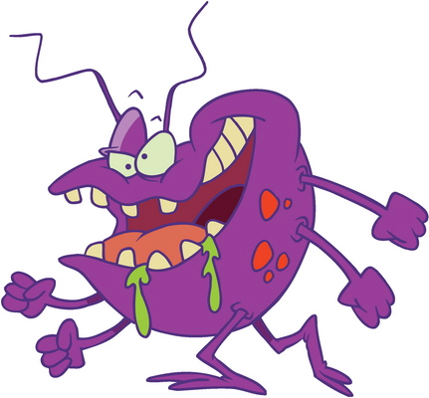
History of Viral Changes (2)
~1995 MS-Office introduced Visual Basic Script (VBS)
Allowed sophisticated macro programming
Auto-execution was vigorously opposed by security experts (including MK)
Potentially converted office documents into programs…
…and that’s what happened
Majority of today’s viruses are VB macros
Easy to spread through infected documents and Web sites
Instant messaging (IM) & peer-to-peer (P2P) networks also exploited to spread malware

Slide 7
Antivirus Basics
Introduction
Virus detection inexact
Still see false positives (Virus!!! – but not)
& false negatives (A-OK – but not)
CPU & I/O load can become noticeable
Topics
Early Days of AV Scanners
Validity of Scanners
Scanner Internals
AV Engines & DBs

Slide 8
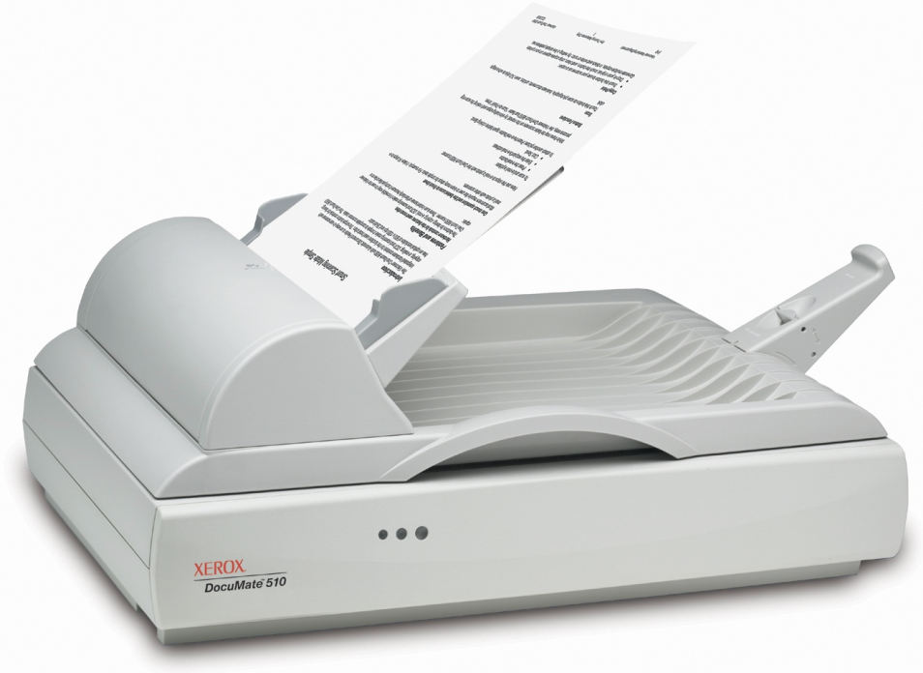
Early Days of AV Scanners
AV makers disagreed on how to name viruses
No central facility for counting unique viruses
AV vendors used wildly different virus-counts in their advertising
Users confused / frustrated by conflicting information
Charlatans marketed ineffective products
None of early scanners could catch all known viruses

Slide 9
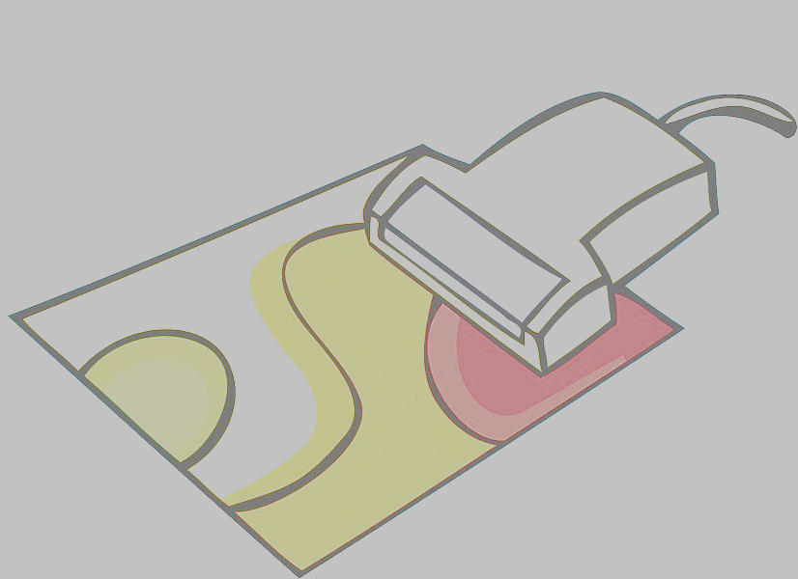
Validity of Scanners
NCSA* started AVPD Consortium 1991
Established testing criteria
Created the zoo – AVPs shared viruses
Raised standards for required detection levels every quarter
Dr Richard Ford established testing standards
AVPs disagreed on strategies
Look only for new viruses?
Look for all known viruses?
Joe Wells founded WildList in 1993
Cooperative effort to list & name all known viruses
Distinguish between those found on user systems & those found only in laboratories
______________________ *NCSA = National Computer Security Association M. E. Kabay was Director of Education from 1991 to 1999
NCSA ⇒ ICSA ⇒ TruSecure ⇒ CyberTrust ⇒ Verizon Business Security

Slide 10
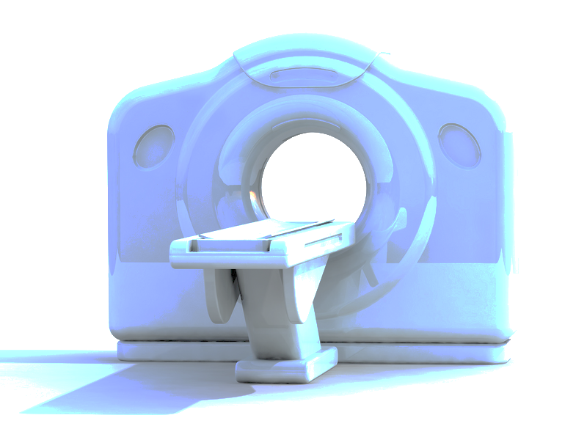
Scanner Internals
Fundamental problem was that Windows and Mac OS lacked security kernel
Every process runs as if it has root privilege
AVPs compensate for this design decision
Functions include
Specific detection – looking for infections by known viruses
Generic detection – looking for variants of known viruses
Heuristics – finding unknown viruses by spotting suspicious behavior or code/file structures
Intrusion prevention – monitoring known-suspicious systems changes and behaviors to prevent unknown infections

Slide 11
AV Engines & DBs
Engine is the expert system that looks for malicious software
Signature database (DB) includes
Fingerprints of known viruses
Rules for heuristic scanners
Code sequences characteristic of specific viruses
Must update both signatures and engines
Used to recommend monthly, then weekly updates
Now (2009) essential to allow at least daily updates – or hourly or minute-by-minute
Enable automatic updates – update whenever necessary by communicating with servers
Software looks for change in checksum – indicates change

Slide 12
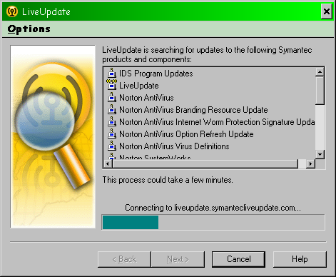
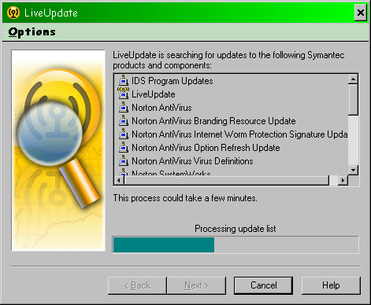
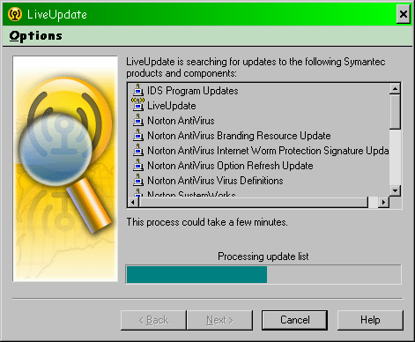
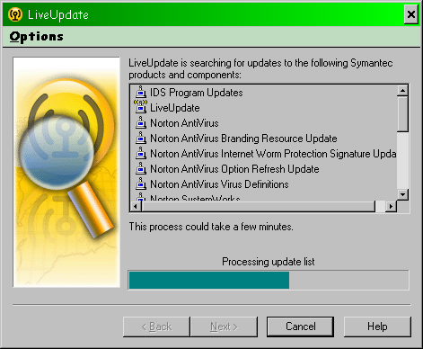
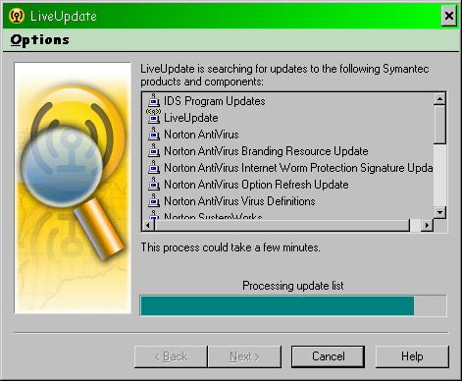
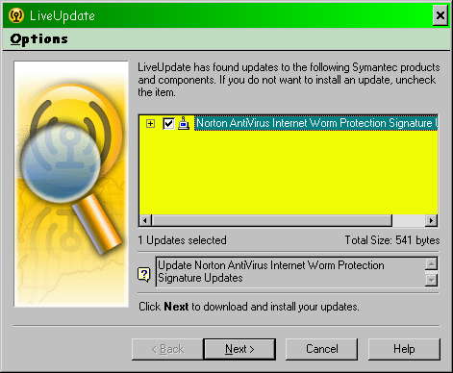
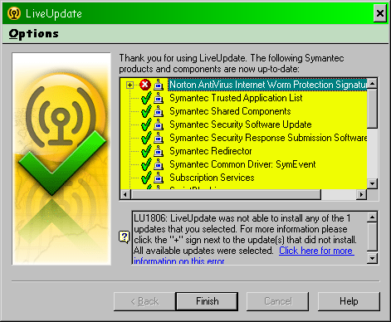
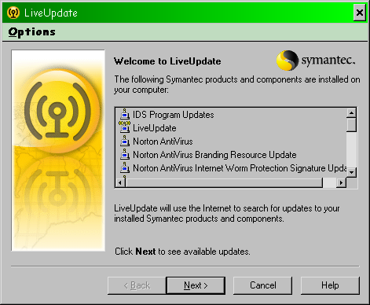
Updating: “LiveUpdate”

Slide 13
Scanning Methodologies
When to scan?
Ideally, on every file open (“on access scan”)
Continuous monitoring of new files
May be performance issues on old systems but not today
Functions of scanning (see next slides)
Detection
Generic Detection
Heuristics
Intrusion Detection & Prevention

Slide 14
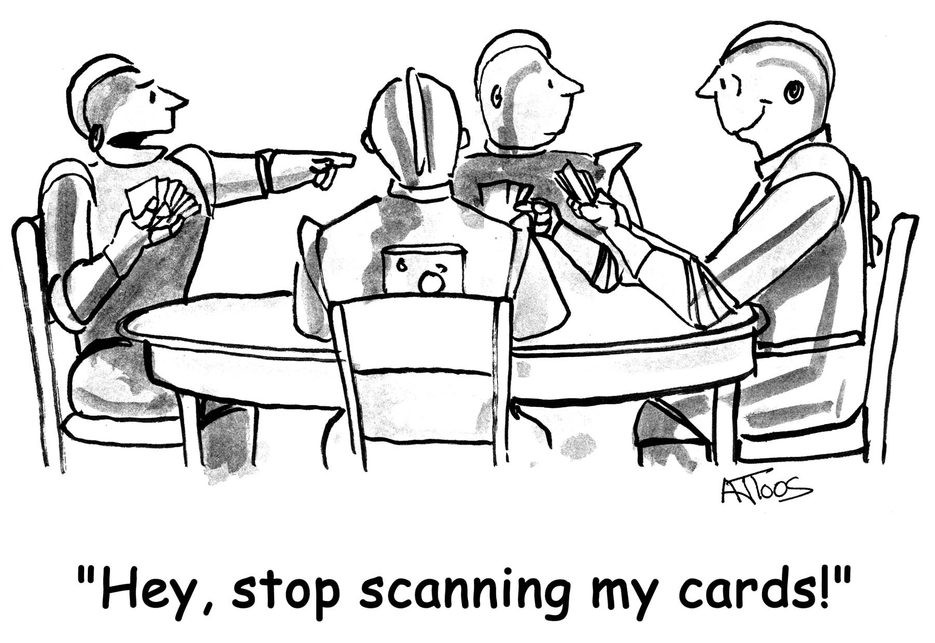
Scanning

Slide 15
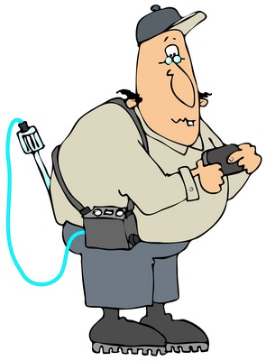
Specific Detection
Look for characteristic signature strings
Most scanners use selective screening
Look for virus code in general areas of programs
Saves time but risks false negatives
Power of the test
The higher the success rate in spotting viruses (the lower the false-negative rate),
The higher the frequency of false positives (falsely claiming that uninfected files are viruses)
Generally offer disinfection routines
Fix
Quarantine
Delete

Slide 16
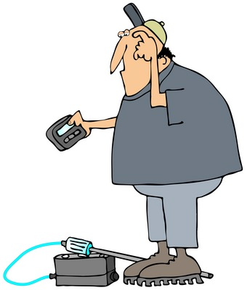
Generic Detection
Many malware authors & distributors are trying to make money
Therefore use open-source code
Malware widely distributed and updated by criminals
Therefore modern AVPs scan for common properties
Widely-known viruses, Trojans…
In early days of file-infectors, concern about potential damage of cleaning infected programs
But today’s malware typically installs discrete files and registry entries
Easier to fix without danger

Slide 17
Heuristics
Rule-based expert systems
Static heuristic scanners
Identify most likely places where viruses reside
Look for known styles of viral code
Examines programmatic logic of suspect regions
Assign probabilistic score based on many clues from structure
Dynamic heuristic scanners
Similar methods to spot potential problem-code
Emulate execution of the code
Virtual environment = sandbox
Identify harmful actions
Remove virus
Widespread distribution & use of heuristic scanners have led to rapid discovery of new viruses
Heuristic from
Greek ηευρισκειν
– to find

Slide 18
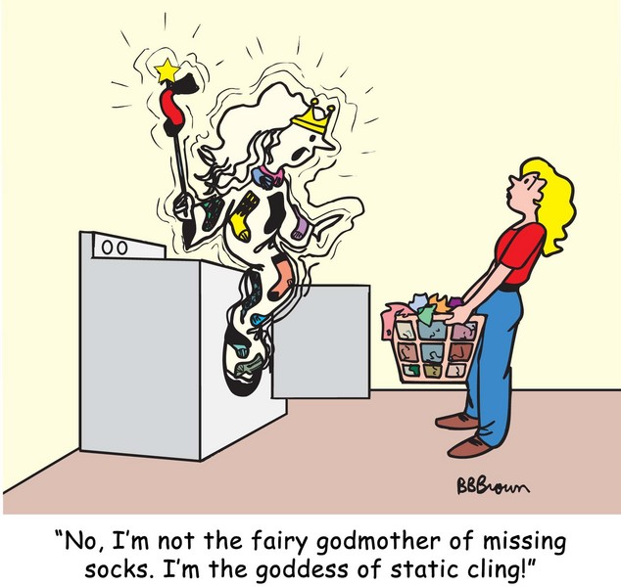
Static

Slide 19
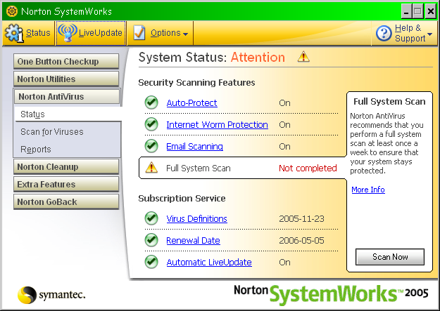
Example: NAV

Slide 20
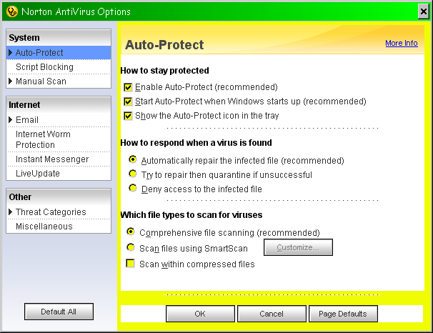
NAV Auto-Protect

Slide 21
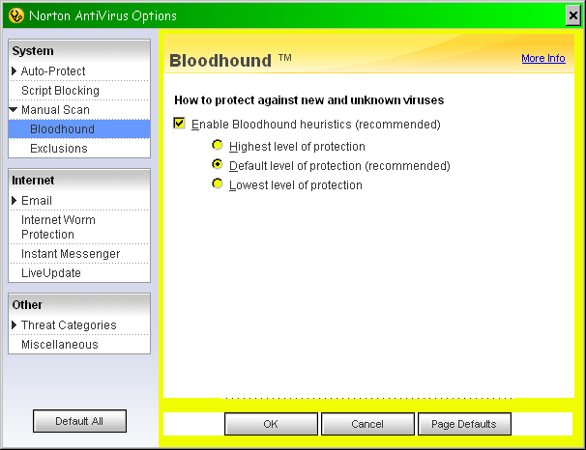
NAV Heuristics

Slide 22
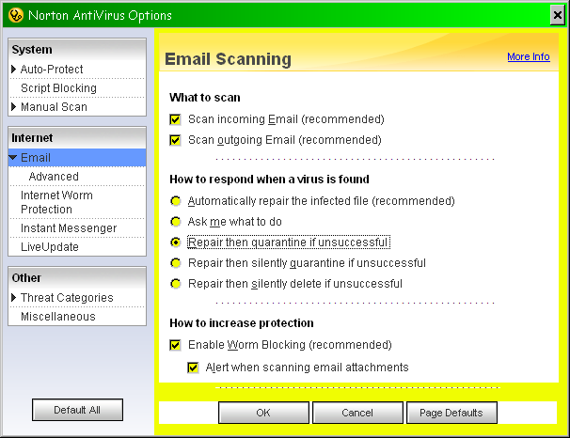
NAV E-mail Options

Slide 23
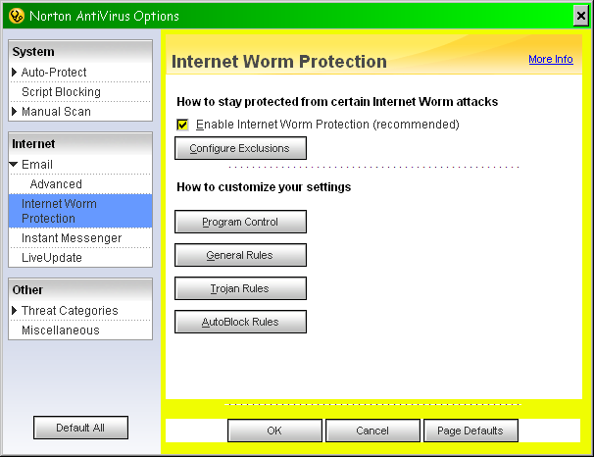
NAV Anti-Worm Measures

Slide 24
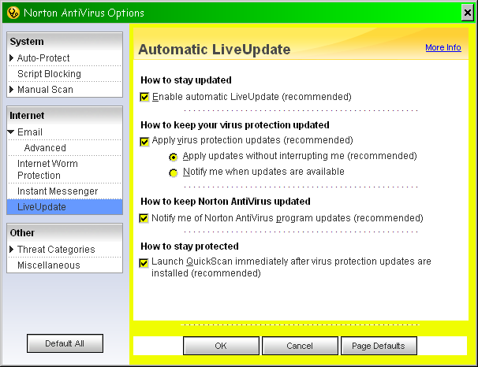
NAV LiveUpdate Settings

Slide 25
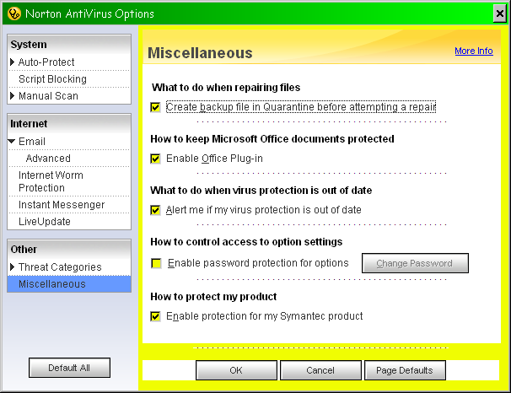
NAV Alert Settings

Slide 26
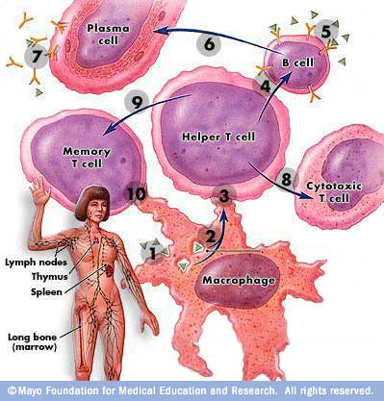
Immune Systems
Ideal: spot infection, fix infection, heal system
Use network access to additional resources as required
Monitor behavior of connected workstations
Send suspect files to central server
Install suspect code on testbenches
Analyze virus, generate signature
Send out to all connected computers (push vs pull)
Don’t bother people unless necessary

Slide 27
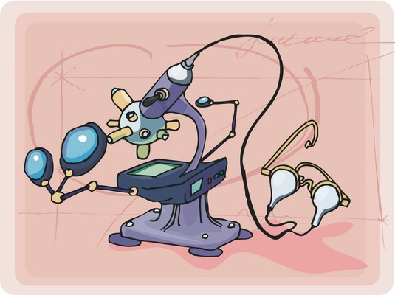
Intrusion Detection & Prevention
1st line of defense: spot incoming virus
Particularly effective by scanning incoming e-mail
Also helpful to scan outgoing e-mail
But some polymorphic viruses encrypt their code – defeat scanners
Some AVPs use CRCs to spot changes in programs
All changed programs will have a CRC different from that recorded originally
Investigate changed programs further
Special emphasis on spotting abnormal behavior

Slide 28
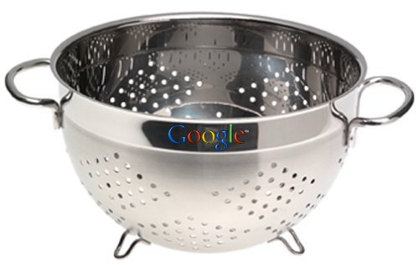
Content Filtering
Early years – “no viruses from documents”
Then macro viruses became prevalent
“No viruses from e-mail”
Then e-mail enabled worms appeared
“No viruses from unopened e-mail”
So viruses written that activate when preview pane shows content
HTML code being used for harmful purposes
Content filtering scans for suspect code and attachments – prevents receipt by users

Slide 29
How Content Filters Work
Scan all incoming data on specific ports
Compare traffic using rules and strings
Can forbid all or types of attachments
Interact with AVPs
Send suspect files to AVP
But all of this requires stated policies

Slide 30
Efficiency and Efficacy
Operations run on mail server – can see performance issues
Scanning all incoming & outgoing e-mail raises privacy issues if policies not established to remove expectation of privacy
May have to limit size of e-mail attachments
Problems with quarantine – may pile up false positive e-mail, frustrate users & administrators
Need to establish response procedures for e-mail abuse
Consider not only technical issues
Also include legal & HR departments

Slide 31
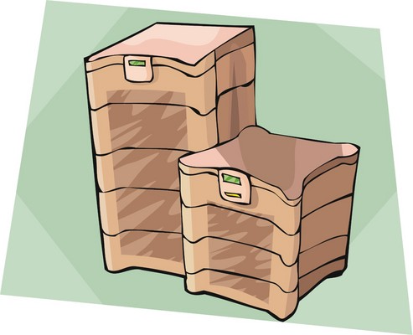
AV Deployment
Desktop systems
Must prevent users from disabling scanners
Use reasonable full- system scan freq
Schedule off-hours only
Definitely require scan-on-open
Include removable devices (flash drives, DVDs, CDs)
Can set passwords on configuration of AVP
Must maintain up-to-date coverage of ALL connected systems in network
Push updates from server to desktops
Servers – focus on downloads, high traffic

Slide 32
Policies & Strategies
Detail user responsibilities
End-user AV awareness important
Specify specific tasks for different roles
Monitor compliance
Ensure upper management compliance / support
Incident Response Team and emergency plan
Analyze every virus infection
Requires report from every infected workstation
Identify holes in current procedures & policies
Keep records – spot trends, trouble spots

Slide 33
Now go and study

