Slide 1
Protecting Digital Rights: Technical Approaches
CSH6 Chapter 42
Robert Guess, Jennifer Hadley, Steven Lovaas, and Diane E. Levine

Slide 2
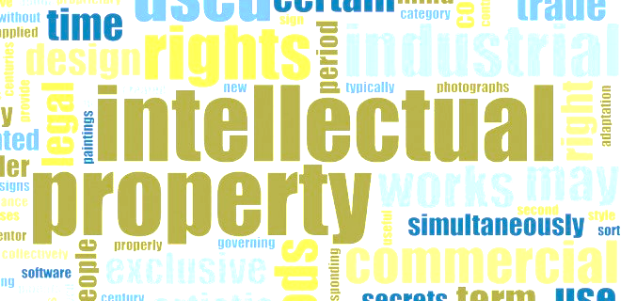
Topics
Introduction
Software-Based Antipiracy Techniques
Hardware-Based Antipiracy Techniques
Digital Rights Management
Privacy-Enhancing Technologies
Political and Technical Opposition to DRM
Fundamental Problems

Slide 3
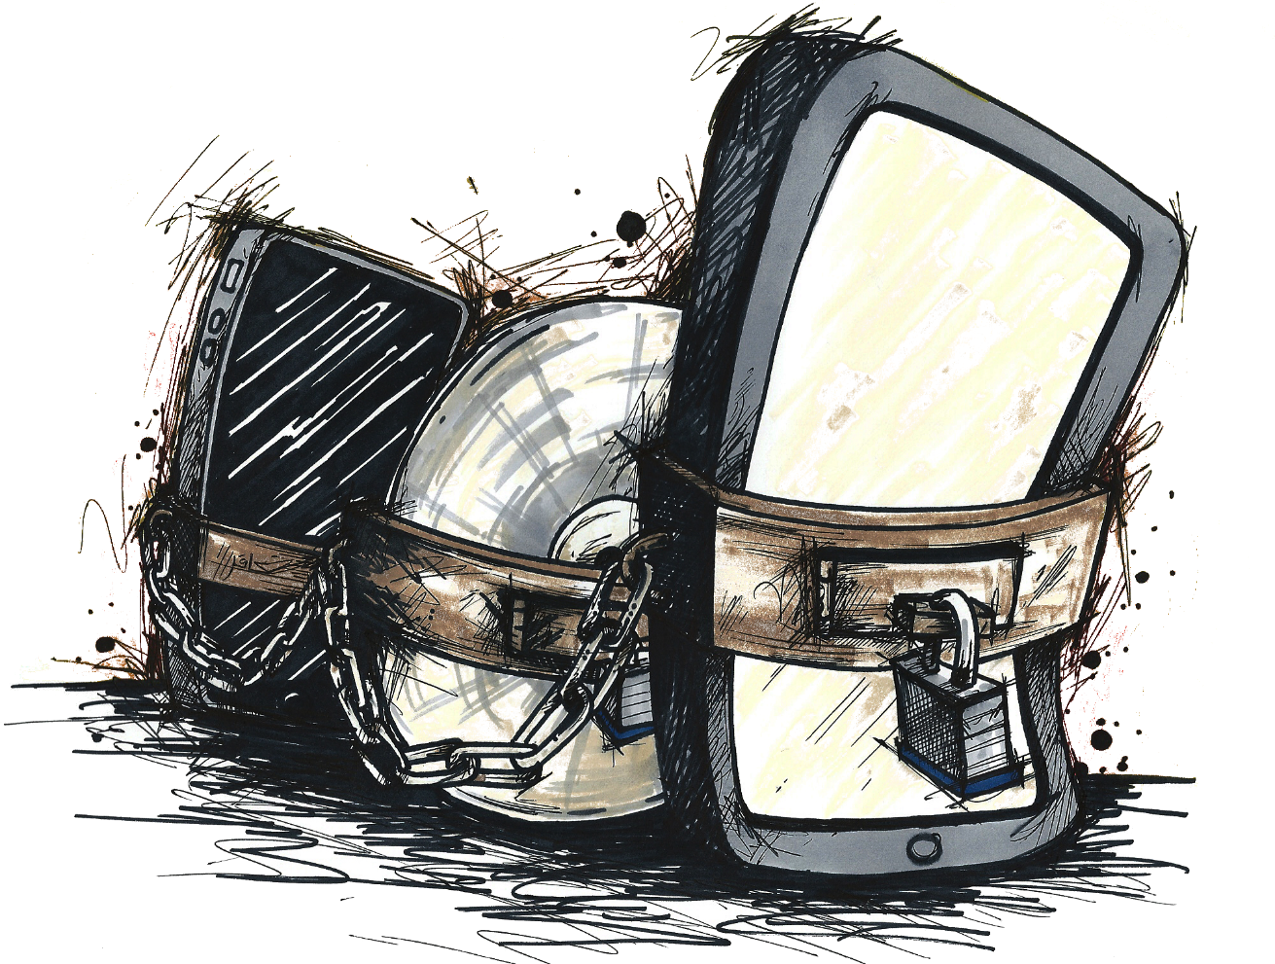
Introduction
The Issues
Digital Rights
Patent, Copyright, and Trademark Laws
Piracy
Privacy

Slide 4
The Issues
Continued exploitation of intellectual property
July 2015: FBI reported 53% annual rise in theft of US trade secrets – 95% by China
2014: US Dept Commerce est. total losses ~225B/yr in US alone; OECD est. ~$638B/yr globally
Effects of piracy
Lost jobs, wages, tax revenue
Potential barrier to success for startups
Privacy increasingly difficult to protect
Rising identity theft
Anti-piracy efforts can reduce privacy

Slide 5
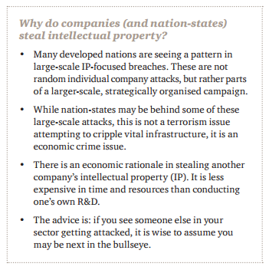
Theft of Trade Secrets
https://www.pwc.com/gx/en/economic-crime-survey/pdf/GlobalEconomicCrimeSurvey2016.pdf

Slide 6
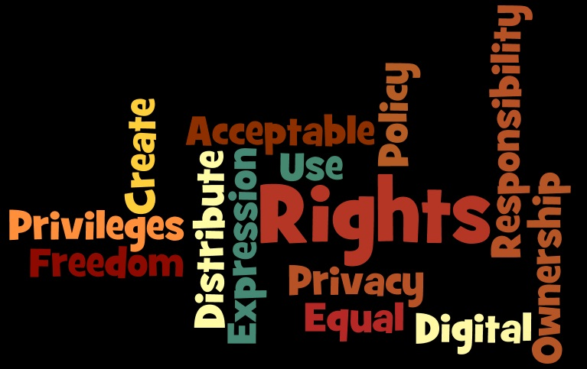
Digital Rights
Ambiguous term
Producers mean intellectual-property rights
Privacy advocates mean personal privacy rights when using online services

Slide 7
Patent, Copyright, and Trademark Laws
Patent: exclusive 20 year license to license & use ideas / materials
Copyrights: exclusive rights to
Create derivative works
Make copies
Display, distribute
Paintings, photographs, drawings, writing, music, videos, software….
Trademarks: distinctive marks
Restrict use
Avoid confusion in marketplace

Slide 8
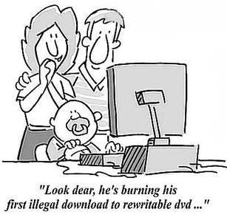
Piracy
Originally thought of as copyright infringement
Expanded w/ changes in technology
Medium irrelevant
Now any unauthorized copy
Types of piracy
End-user
Reseller
Internet / BBS piracy
https://issitgsg12.wikispaces.com/file/view/bd_-_piracy.jpg/256360326/307x294/bd_-_piracy.jpg

Slide 9
Privacy
Widespread ability to share personal data without even being conscious of problem
Digital Rights Management (DRM) can collect information in effort to reduce piracy
Web-browsing habits
Types of files created and accessed
Number of uses of specific programs
IP address of user’s computer
Presence/absence of license for specific program

Slide 10
Software-Based Antipiracy Techniques (1)
Organizational policy may already limit ways to make illegal copies
Operating-system controls
Encryption
Policies may include
Restrictions on allowable software installations
Encryption of confidential data including media files
Software installations with lowest available privileges
Disabling active content (Java, ActiveX) where possible
Network security restrictions to block disallowed sharing of content or licenses

Slide 11
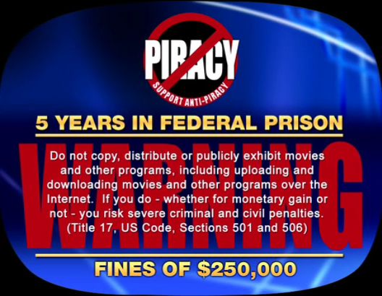
Software-Based Antipiracy Techniques (2)
Software-Usage Counters
Software usage counters
Controlling concurrent installations
Controlling concurrent usage
Examples
2000: Office 2000 shut down after 50th use without registering license
CD-ROM keys
Mandatory registration (“activating”)

Slide 12
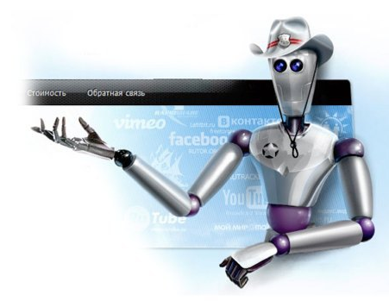
Hardware-Based Antipiracy Techniques
Dongles
Specialized Readers
Evanescent Media
Software Keys
http://i0.wp.com/www.ewdn.com/wp-content/uploads/sites/6/2011/07/Websheriff-vs-Websheriff1.jpg

Slide 13
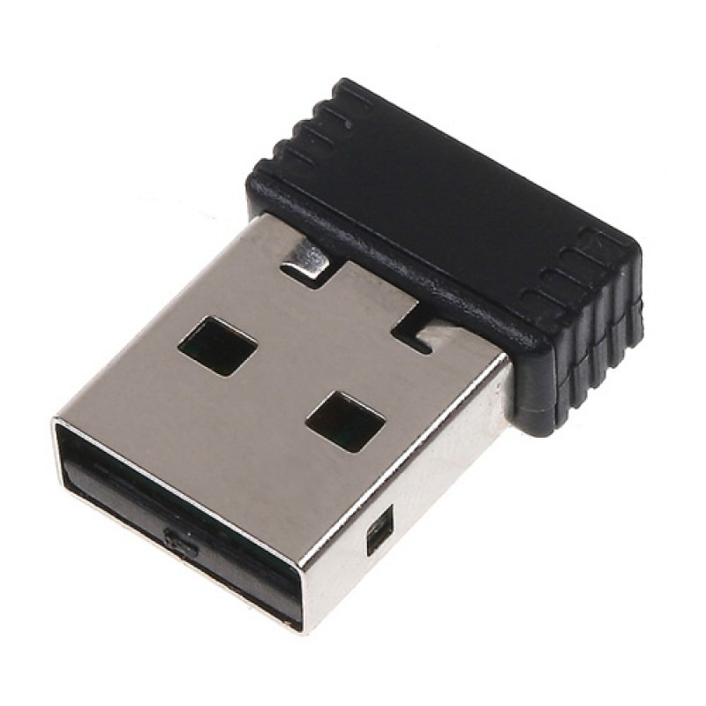
Dongles (1)
Hardware like USB flash drive
Communicates with operating system
Can provide authentic hashed identification
History
Originally used for printing – needed dongle to allow output
Now can product all kinds of devices including recording (CD, DVD etc)

Slide 14
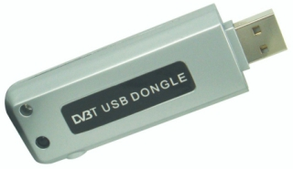
Dongles (2)
Pro
Easy to use
Can require registration
Can support encryption – need key
Con
Consumers hate having to use them
Can be lost / stolen / fail
May not be compatible with system
Delays in replacement not good for high-availability uses
Ending support for dongle can ruin software usability
Encryption restricted in some countries

Slide 15
Specialized Readers
Manufacturers tried to restrict copying by limiting distribution of hardware
But current technology for copying data near-universal
Audio theft widespread problem
Video easily copied, uploaded & downloaded
TV shows being stored and shared
HDTV uses encryption
Descramblers readily available
Consumers resisting specialized readers
But accessible & inexpensive legal sources will help (e.g., iTunes, Spotify, Amazon Music)

Slide 16
Evanescent Media
Attempts to make data evanescent
Not lasting long
Disappearing soon
E.g., Snapchat®
“Snaps” can be viewed for 10 seconds or less
But can be kept
Screenshot
External camera

Slide 17
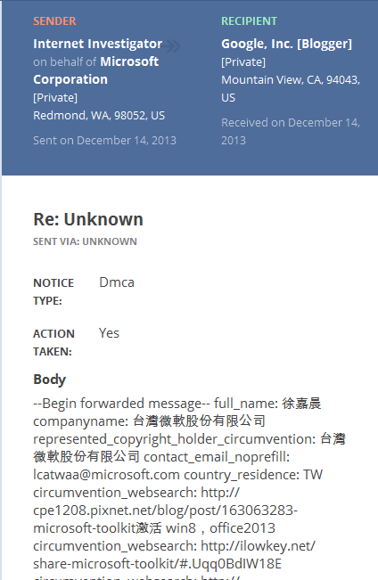
Software Keys (1)
String to unlock / activate software or equipment
Malfunctions can cause trouble
Some Websites provide cracked keys
IP owners send DMCA Takedown notices

Slide 18
Software Keys (2)
Videocassettes vs copy machines
Embedded codes interpreted by copying equipment to block copying
DVD area encoding
Region codes read by players
Can switch to different region only once
Watermarks
Steganographic insertion of codes into data
Identify origins / ownership
Allow identifying illegal copies
Issues of false positives / false negatives

Slide 19
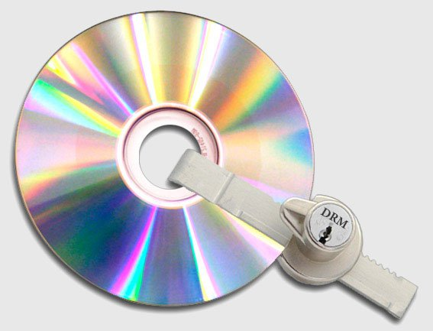
Digital Rights Management
Purpose
Protect any/all digital content at will
Customized encryption
Individual key allows viewing / use
No agreement on standards
Application
Payment provides key
May limit type of use (e.g., # views)
Examples
IBM Electronic Media Management System
Microsoft software to embed metatags in audio files

Slide 20
Privacy-Enhancing Technologies
Network Proxy
Redirect request through other server(s)
E.g., TOR
The Onion Router
Anonymizing proxies
Strip originating IP addresses
Discard records quickly to prevent tracking
Hidden Operating Systems: segregate data from main OS
Virtual machines
Bootable systems

Slide 21
Political and Technical Opposition to DRM
Political Opposition
EFF – Electronic Frontier Foundation
Arguments against unreasonable limitations on use of IP
FSF – Free Software Foundation
Defective by Design campaign
Stop DRM in HTML5
Stop DRM Now!
Technical Countermeasures
Reverse engineering
Published attacks
Tools for cracking DRM

Slide 22
Fundamental Problems
Schneier:
Encryption systems for DRM must decrypt to plaintext at some point
Accessible in RAM or disk
Side channels
Even if system prevents copying or printing, can use external devices to capture images or sound
E.g., camera, recorder
Today’s cell phones almost all have photography & sound recording integrated

Slide 23
Now go and study

