Slide 1
Security Policy Guidelines
CSH6 Chapter 44
“Security Policy Guidelines”
M. E. Kabay & Bridgett Robertson
Notes:
M. E. Kabay, PhD, CISSP

Slide 2

Selected Topics in CSH6 Ch 44
Terminology
Resources for Policy Writers
Writing the Policies
Organizing the
Policies
Presenting the
Policies
Maintaining the
Policies

Slide 3
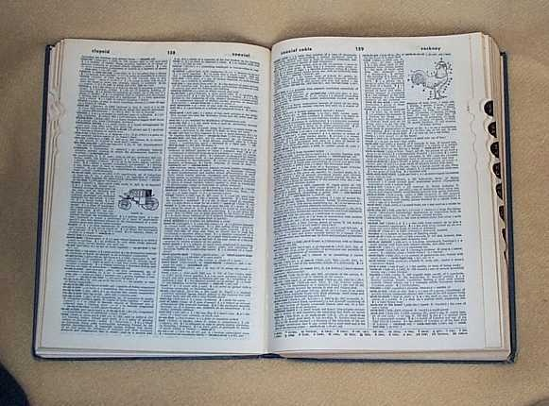
Terminology
Policy
Controls
Standards
Procedures

Slide 4
Terminology (1)
Policy
  Rules and regulations set by the organization
  Laid down by management
  Mandatory, require compliance
  Failure to follow policy results in disciplinary action
  Policies focus on desired results, not on means for achieving them
Controls – measures used to protect systems against specific threats

Slide 5
Terminology (2)
Standards
  Accepted specification for hardware, software, or human actions
  De facto or de jure
  Technical choices for
  implementing particular
  policies
  Change more rapidly than
  policies
Procedures
  Prescribe how people are to behave in implementation policies

Slide 6
Resources for Policy Writers
ISO/IEC 27000
COBIT
Informal Security Standards
  CERT-CC® Documentation
  NSA Security Guidelines
  US Federal Best Security Practices
  RFC 2196
  German Federal
  IT Baseline Protection
  Manual
Commercially Available
Policy Guides

Slide 7
ISO 27000 (1)
History
  BS7799:
    UK Dept. of Trade and Industry Feb 1995
    Proprietary and expensive
  BS7799 v2: May 1999
ISO 17799 built on BS7799 – published 1999
ISO 17799:2005 revised & published 2005 (duhhh)
ISO/IEC 27000 replaced 17799:2005 in 2009
  Popular worldwide
  Costs of individual components ~100CHF (~€82, U$109)
  Overview 27000 available free < http://tinyurl.com/ye3rwro >

Slide 8
ISO 27000 (2)
Control objectives & controls for information security management
ISO/IEC 27000 — Overview and Vocabulary
ISO/IEC 27001 — Requirements
ISO/IEC 27002 — Code of Practice
ISO/IEC 27003 — Implementation Guidance
ISO/IEC 27004 — Measurement
ISO/IEC 27005 — Risk Management
ISO/IEC 27006 — Certification Body Requirements
ISO/IEC 27007 — Audit Guidelines
ISO/IEC 27011 — Telecommunications Organizations
ISO 27799 — Health Organizations

Slide 9
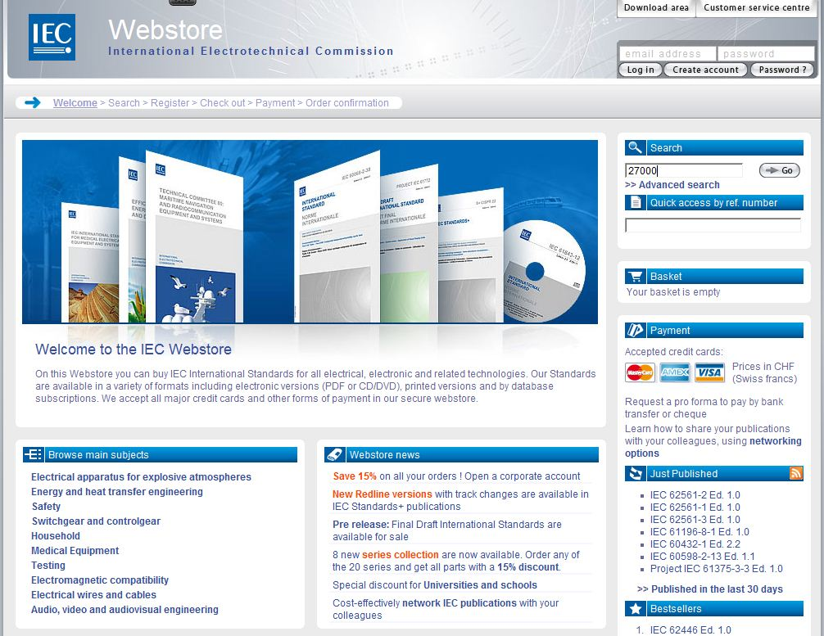
ISO 27000 (3)
http://webstore.iec.ch/

Slide 10

COBIT (1)
Control Objectives for Information and Related Technology (ISACA)
Business-oriented set of standards for guiding management in sound use of IT
COBIT Overview
  Executive summary
  Framework
    IT objectives
    Control functions in IT
  Business requirements for information

Slide 11
COBIT (2)
Control objectives
  Planning and organization
  Acquisition and implementation
  Delivery and support
  Monitoring
Audit guidelines
Implementation tool set
  Executive overview
  Guide to implementation
  Case studies describing COBIT implementation
  FAQs
  Slide presentations for implementing/selling COBIT
Management guidelines

Slide 12
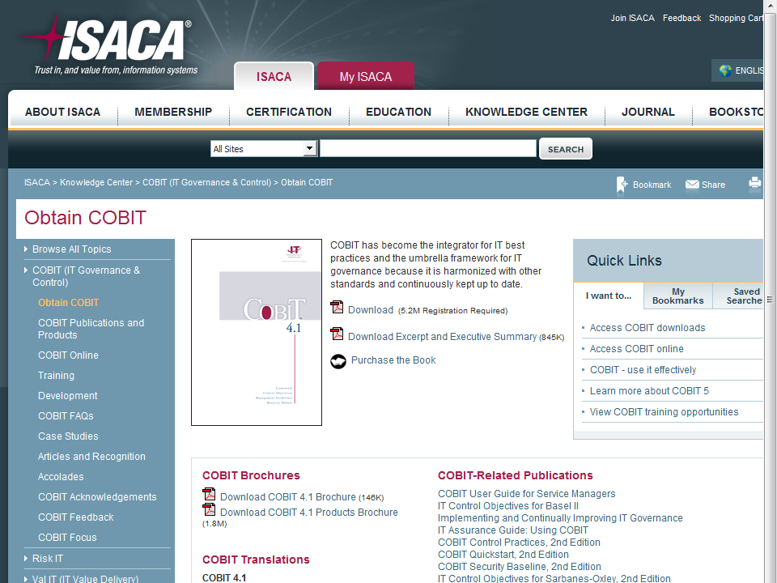
COBIT (3)
http://tinyurl.com/6x96tca

Slide 13

CERT/CC® Documentation
Computer Emergency Response Team Coordination Center® of the Software Engineering Institute at Carnegie Mellon University in Pittsburgh, PA
Security for IT
Service contracts
Securing desktop
workstations
Responding to intrusions
Securing network servers
Deploying firewalls
Securing public Web servers
Detecting signs of intrusion

Slide 14
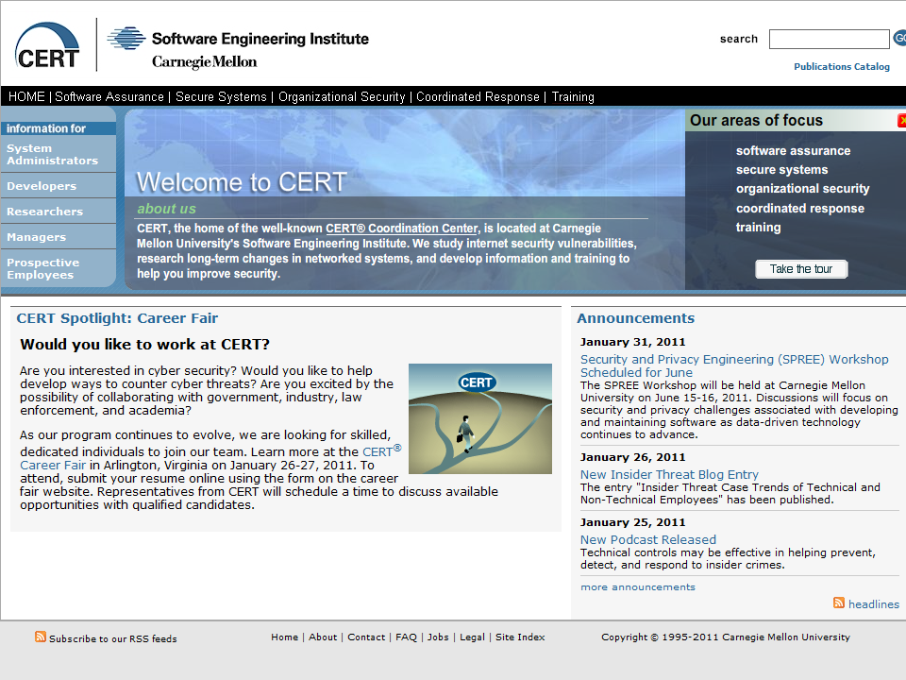
CERT-CC (2)
http://www.cert.org/

Slide 15


US Government Documents
NIST Special Publications
  http://csrc.nist.gov/publications/PubsSPs.html
  Or http://tinyurl.com/23jst6
NSA Security Guidelines Handbook
  http://www.tscm.com/NSAsecmanual1.html
  Or http://tinyurl.com/6g3g2ch
  Initial security responsibilities
  General responsibilities
  Helpful information
Federal Information Processing Standards (FIPS)
  http://www.itl.nist.gov/fipspubs/index.htm
  Or http://tinyurl.com/agmwvl

Slide 16
US Federal Best Security Practices (1)
Federal Chief Information Security Officers (CISO) Council
  Best Practices Committee (BPC)
  Sharing best ideas/practical experiences
Many useful PDF documents available free; e.g.,
  Best Practices
  Enterprise Architecture
  IT Security/Privacy
  GAO (Government Accountability Office) Reports
  IT Related Laws & Regulations

Slide 17
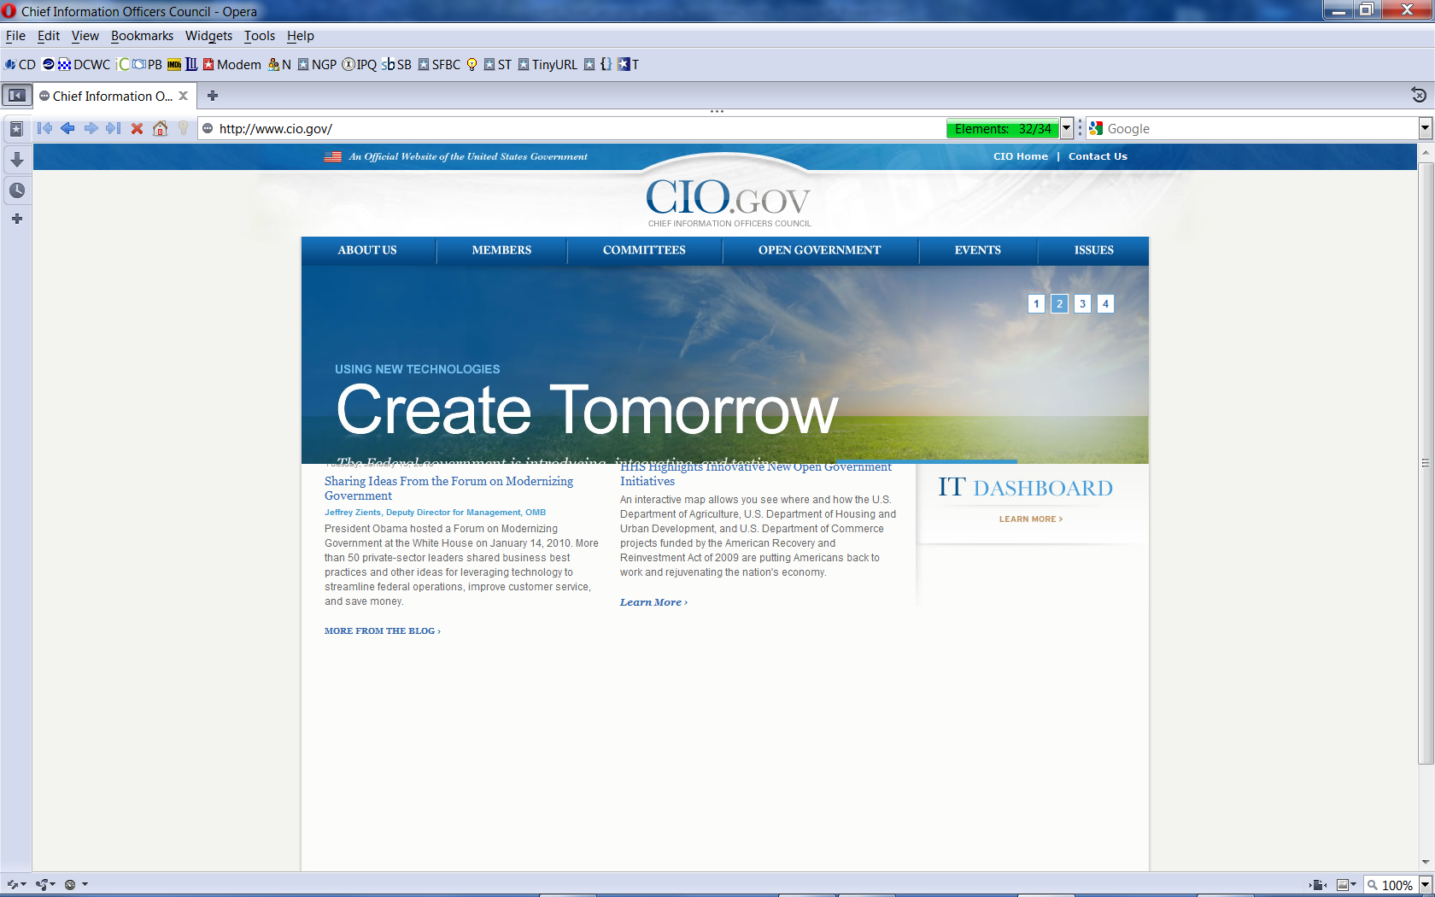
US Federal Best Security Practices (2)

Slide 18
RFC 2196 – from IETF (1)
Classic document (1997)
  Replaced RFC 1244 (1991)
  Still useful!
  IETF: Internet Engineering Task Force
Introduction
Security Policies
Architecture
Security services and procedures
  Security incident handling
  Ongoing activities
  Tools and locations
  Mailing lists and other resources
  References
http://www.ietf.org/rfc.html

Slide 19
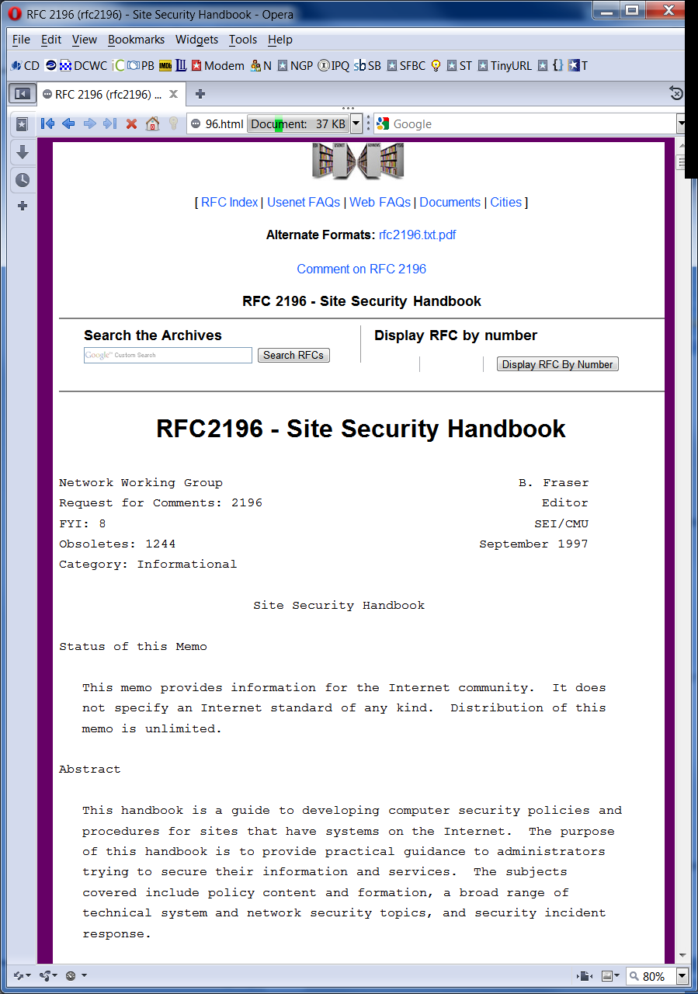
RFC 2196 (2)
http://datatracker.ietf.org/doc/rfc2196/

Slide 20
RFC 2196 (3)
http://www.faqs.org/rfcs/rfc2196.html
Also avail in PDF & plain text

Slide 21


IT Baseline Protection Manual (1)
German Information Security Agency
English version updated 2005
Stand-alone systems
Networked systems
Communications
Infrastructure
Methodologies

Slide 22
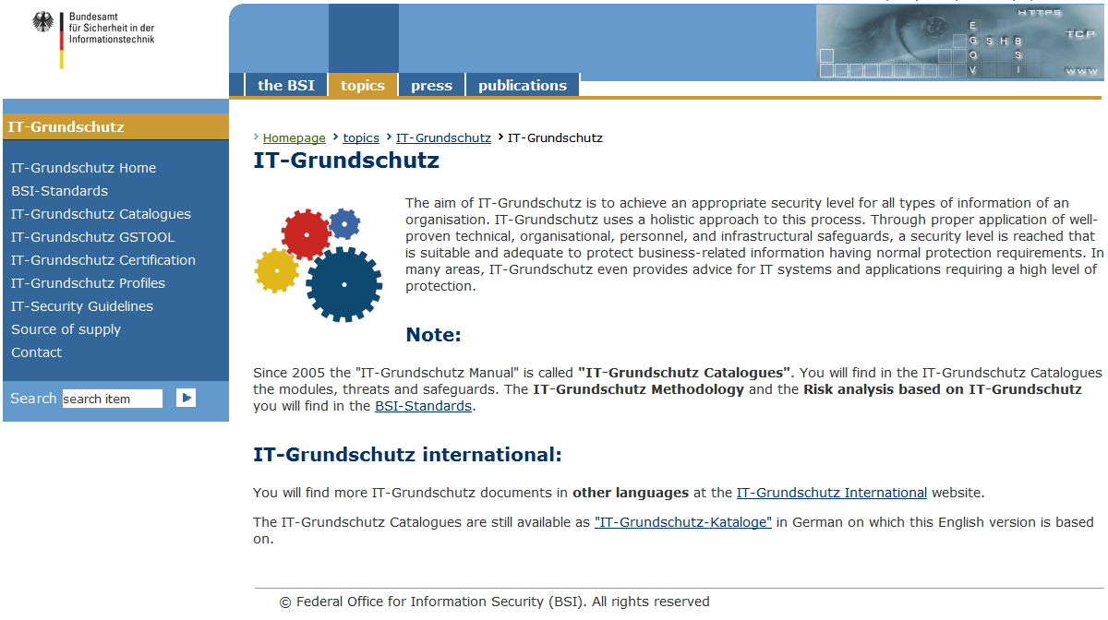
IT Baseline Protection Manual (2)
http://tinyurl.com/6kyorl5

Slide 23
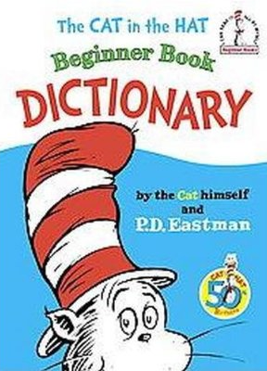
Commercially Available Policy Guides
ISPME
Tom Peltier’s Text
SANS Resources

Slide 24
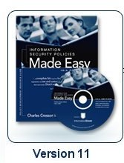
ISPME (Charles Cresson Wood)
http://www.informationshield.com/ispmemain.htm
Best in the field
$800 and worth every
penny
Given to every graduating
MSIA student in 2004* at
Norwich University as
graduation gift!
_____
* First year that MSIA students graduated

Slide 25
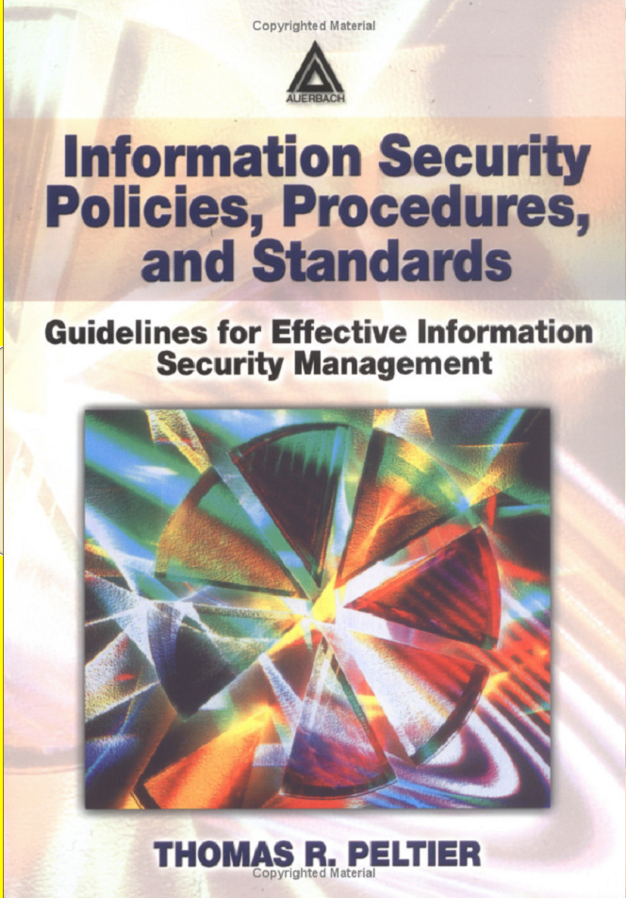
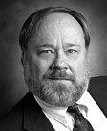
Tom Peltier’s Text
Useful
Inexpensive
Well-respected industry
expert
Professor in NU MSIA

Slide 26
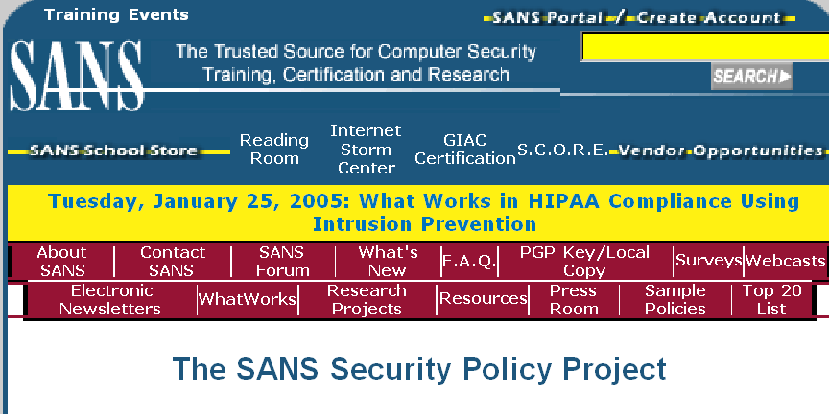
SANS Resources
http://www.sans.org
Security Essentials courses
Step-by-step guides
SANS Security Policy Project (free)
  http://www.sans.org/resources/policies/
  Collaborative compilation of policies

Slide 27





Policy Style
Why Does Style Matter?
Writing the Policies
Organizing the Policies
Presenting the Policies
Maintaining the Policies

Slide 28
Why Does Style Matter?
CLASS DISCUSSION

Slide 29

Writing the Policies
Orientation: prescriptive and proscriptive
  Clear, definite,
  unambiguous
Writing style
  Short, simple
  declarative sentences
Reasons
  Explain why policies
  make sense
  Optional explanations
Indexing
  Many different ways of locating specific policies

Slide 30

Organizing the Policies
Topical organization
  Sequence corresponding to model of perception of security; e.g., outside-in
Organizational
  Create special-purpose documents aimed at particular groups
Hierarchical
  Learn from military standards
  Increasing detail at lower levels

Slide 31

Presenting the Policies
Printed text
  Huge loose-leaf binders; or
  Short paper documents; or
  Reference cards, summary
  sheets, stickers, posters
  Updating a headache
Electronic one-dimensional text
  E-mail updated versions
  periodically
Hypertext
  HTML and XML
  RTF and word processor files
  PDF, help files

Slide 32

Maintaining the Policies
Review process
  Employees suggest improvement
  Committees update policy
Announcing changes
  Circulate drafts for input – sense of policy ownership for employees
  Major changes announced by high-level staff with explanations
  Distribute changes automatically through electronic access

Slide 33
Review Questions
Distinguish among policies, controls, standards, procedures and give an example of each.
What are the advantages and disadvantages of using industry-standard guidelines such as CobiT or RFCs in creating policies?
Why is the writing-style of policies important for effectiveness?
Why can it be useful to give reasons for policies?
What are the benefits and costs of providing different views of policy for different sectors of the organization?
What are the pros and cons of electronic vs paper distribution of policies?
Who should be involved in reviewing and modifying policies and policy documents? Why?

Slide 34
Now go and study

