Slide 1
Vulnerability Assessment
CSH6 Chapter 46
“Vulnerability Assessment”
Rebecca Gurley Bace
Notes:
M. E. Kabay, PhD, CISSP

Slide 2

Topics in CSH6 Chapter 46
Scorekeeper of Security Management
Taxonomy of VA Technologies
Penetration Testing

Slide 3

Scorekeeper of Security Management
Introduction to Vulnerability Management
What is Vulnerability Management?
What is Vulnerability Assessment (VA)?
Where does VA Fit into Security Management?
History of VA

Slide 4

Introduction to Vulnerability Management
Information security tightly integrated into risk management
Vulnerability management critical component of risk management
Significant evolution from 1960s through 2000s

Slide 5

What is Vulnerability Management?
Assessing deployed IT
systems
Determine security status
Determine corrective measures
Manage application of
corrections
Vulnerability assessment (VA):
critical element in vulnerability
management
Synergy between VA & other elements of security
Four key functions (see next slide)

Slide 6
Four Key Functions of Vulnerability Management
Inventory
  Identify all systems in domain of interest
  Operating systems, platforms, topology
Focus
  Determine data required for assessment
  Tune vulnerability assessment tools
Assess
  Run automated & manual trests
  Evaluate (assess) results to judge risk
  Use security policy + best practices
Respond
  Execute changes as required by assessment
  Fix specific weaknesses

Slide 7

What is Vulnerability Assessment (VA)?
Analysis of security state of system
  Gather data sample (e.g.,
  parameters on selected firewalls)
  Store data for future reference
  Compare with reference standards
  Identify discrepancies between
  current state & recommended
  standards or goals
Examples of tools
  MS Baseline Security Analyzer
    For Windows 2000/XP & NT4
    See http://www.techspot.com/tweaks/mbsa/index.shtml
  Server VAM http://www2.stillsecure.com/products/svam/svam1.html

Slide 8
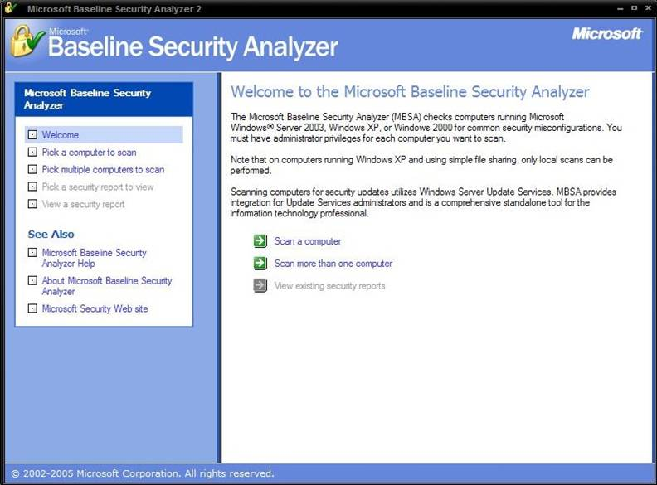
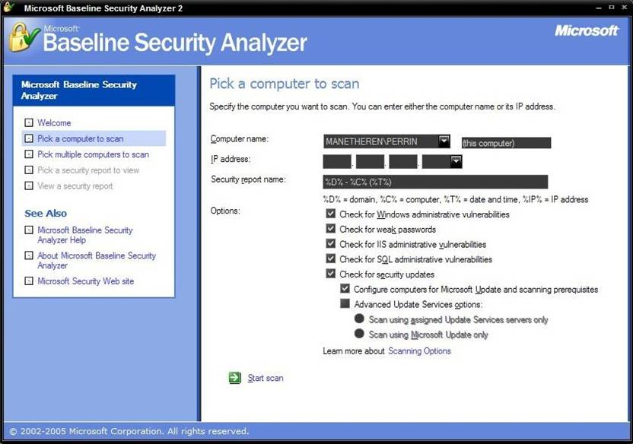
Sample Screen Shots from Baseline Security Analyzer

Slide 9
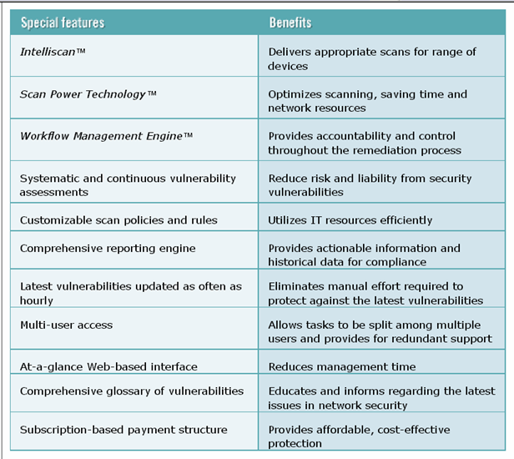
FAB (Features and Benefits) of a VAS (Server VAM)
http://www2.stillsecure.com/products/svam/svam1.html

Slide 10

Where does VA Fit into Security Management? (1)
When systems 1st deployed, can
establish baseline security state
When security breaches suspected, can focus on likely attack paths
May be able to see if vulnerabilities have been exploited
VA can identify areas where newly reported vulnerabilities should be patched
Records of VA scans can be archived
  Serve for audits
  Compliance with certifications

Slide 11

Where does VA Fit into Security Management? (2)
Support auditability
  Independent review of system records
  Determine adequacy of controls
  Ensure compliance with policy & procedures
  Detect breaches of security
  Recommend changes or guide recommendations
Auditability in turn supports
  Incident handling & recovery
  Adjustment of security policies to meet needs

Slide 12



Brief History of VA (1)
Manual security audits established
in 1950s
Auditability defined 1970s for USAF
study
Eugene Spafford and Dan Farmer
(Purdue)
  COPS VAS for UNIX
  Late 1980s
Internet Security Scanner (ISS) – early 1990s
  http://www.cert.org/advisories/CA-1993-14.html
Spaf
Dan
Weitse
Some Famous Security Experts

Slide 13



Brief History of VA (2)
SATAN (Security Administrator Tool
for Analyzing Networks)
  Farmer & Wietse Venema
  Posted 1995
  http://www.porcupine.org/satan/
  http://www.cerias.purdue.edu/about/history/coast/satan.php
NESSUS
  http://www.tenable.com/products/nessus
  Free for individual use http://www.tenable.com/products/nessus/nessus-homefeed
NMAP
  NetMAPper
  http://nmap.org/
See “Alphabetical List of Vulnerability Assessment Products”
http://www.timberlinetechnologies.com/products/vulnerability.html

Slide 14

Taxonomy of VA Technologies
VA Strategy & Techniques
Network Scanning
Vulnerability Scanning
Assessment Strategies
Strengths & Weaknesses of VAS
Roles for VA in System Security Management

Slide 15

VA Strategy & Techniques
Network scanning
Vulnerability scanning
Password cracking
Log review
Integrity checking
Virus detection
War dialing
War driving
Penetration testing

Slide 16

Network Scanning
Port scanner
  ICMP feature
  Identify hosts in network address range
  E.g., GRC ShieldsUP!
  (see next slide)*
  Identify visible & open ports
  Can spot undocumented
  equipment on network
* https://www.grc.com/x/ne.dll?bh0bkyd2

Slide 17
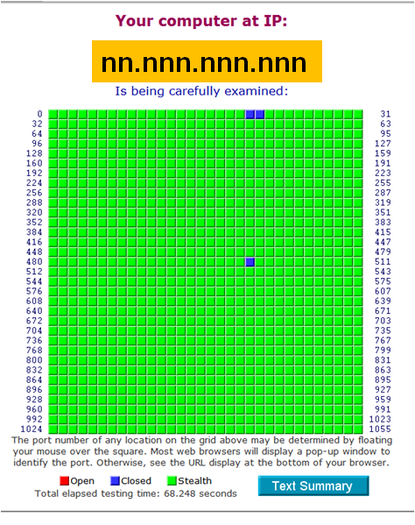
GRC ShieldsUP! Port Scanner
Explanations of each visible (blue) port available
  Risky because can be seen by attackers
Open ports shown in red
  Dangerous
  May be exploited

Slide 18

Vulnerability Scanning (1)
Heart of VA systems
Beyond port scanning
  Analyze data to recognize known vulnerabilities
  May also attempt to
  correct problems
Identifies deeper details
  Software versions
  Applications
  Configurations
Current DB of known
vulnerabilities especially
valuable

Slide 19
Vulnerability Scanning (2)
Typically slower than simpler port scanners
Some scanning / testing may disrupt operations; e.g.,
  DDoS testing
False positive rates
  May be high
  Require more human
  judgement
Vulnerability DB must be
updated frequently

Slide 20

Assessment Strategies
Credentialed monitoring
  System data sources
    File contents
    System configuration
    Status information
  Nonintrusive
  Host-based
Noncredentialed monitors
  Simulate system attacks
  Record responses
  “Active” approaches superior for network-related vulnerability assessment

Slide 21

Strengths & Weaknesses of VAS (1)
Benefits
Save time & resources
Training novices
Updated for new info
Address specific problems
Benchmark security of systems to document progress toward goals
Systematic & consistent
  Serve as quality assurance measures
  Routinely applied after making changes

Slide 22
Strengths & Weaknesses of VAS (2)
Weaknesses
Not sufficient to secure system
May diagnose, not fix
If not up to date, may mislead users
May reduce performance of operational / production network or system
May be abused for malicious purposes

Slide 23
Roles of VA in Security Management
When new programs are installed
After significant changes
During or after security incidents

Slide 24
Penetration Testing
Introduction to Pen Testing
Penetration Test Goals
Attributes of Pen Testing
Social Engineering
Managing Pen Testing

Slide 25

Introduction to Pen Testing
VAS offer partial evaluation of
vulnerabilities
Actually testing for vulnerabilities
by penetrating barriers is useful
adjunct
Penetration testing aka “pen testing”
Pen testers aka “Red Team”
from US Government parlance in capture/defend computer games
Pen tests must be carefully planned & executed
ALWAYS and ONLY with full authorization!

Slide 26

Penetration Test Goals
Model real-world attacks closely
  Break out of policy bounds
  Out-of-the-box thinking
  Criminal-hacker techniques
Test simultaneous security measures
Identify potential access paths missed by VAS
BUT
  Must not compromise production
  Should produce unambiguous
  results for management

Slide 27

Attributes of Pen Tests
Testing models
  Zero knowledge
  Full knowledge
Scope
  Physical
  Communications
  Systems
  Social engineering
Sophistication
  Wide range of techniques

Slide 28
Social Engineering
Trickery & deceit applied to employees
  Often used by real criminals
  But may have serious legal, psychological, & morale implications
Obtain legally binding authorization
STRONGLY RECOMMEND that organization’s staff be fully prepared to defend against social engineering attacks
  Otherwise will waste resources (too easy)
  Cause guilt, embarrassment, anger, and distress in tricked employees

Slide 29

Managing Pen Testing
Document & approve scenarios in advance
Minimize damage to production / operations
Do not cause distress
Do not target / humiliate
employees who have been
involved in security failures!
Don’t strive to “win” at all
costs:
  “To leave a tested
  organization in worse
  condition than the test team
  found it is a hollow victory
  for all involved.”

Slide 30
Review Questions
Distinguish between an IDS and a VAS.
If you wanted to check a system to see if it were protected against known attacks, would you use an IDS or would you use a VAS?
How do VAS support security audits?
In which decade were the first automated VAS developed?
Explain why the data store and analytical engine of an IDS should be situated off the system being monitored.
Compare and contrast credentialed vs. noncredentialed VAS monitoring.
Why should pen testers be careful in their use of social engineering?

Slide 31
Now go and study

