Slide 1
OPSEC &
Production Controls
CSH6 Chapter 47
“Operations Security and Production Controls”
M. E. Kabay & Don Holden, and Myles Walsh
Notes:
M. E. Kabay, PhD, CISSP

Slide 2

Topics in CSH6 Ch 47
Introduction
Operations Management
Ensuring a Trusted Operating System
Protection of Data
Data Validation

Slide 3
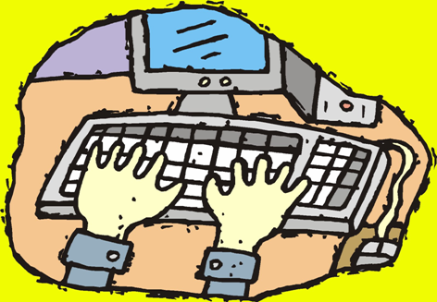
Introduction
Production system – one upon which enterprise depends critically
Operations – requirements for control, maintenance, support of production systems
Computer program – a set of instructions that tells a computer what to do to perform a task
Procedures – sets of statements that tell a computer what to do in certain situations
Data files – files that store information

Slide 4
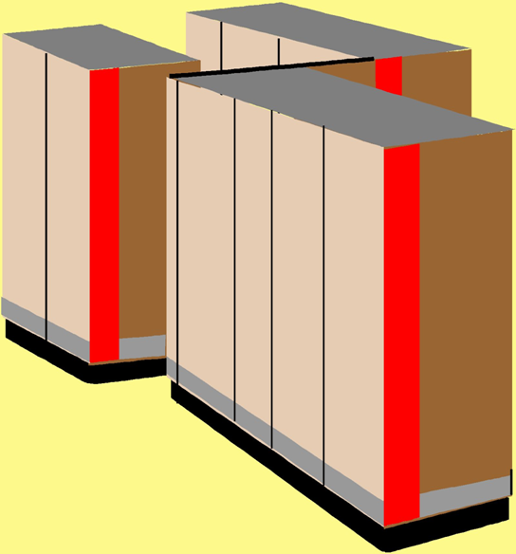
Production Systems
Mission-critical
  Essential
  Required
  Authorized
  Official
Contrast with:
  Development
  Test
  Experimental
  Personal

Slide 5
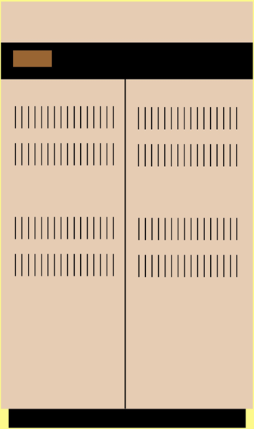
Operations
Control
  Integrating new programs
  Running jobs
  Managing access
Maintenance
  Updating versions
  Running diagnostics
  Doing backups
Support
  Responding to emergencies
  Mounting required media
  Managing networks

Slide 6

Computer Programs
Stored instructions determining computer actions
Sources
  Internal – from developers
  External – from suppliers
Libraries of code
  Source code
  Executables (object code, load modules)
Developers send code to quality assurance (QA)
QA send approved code to operations (OPS)
Changes to production code can be as patches

Slide 7
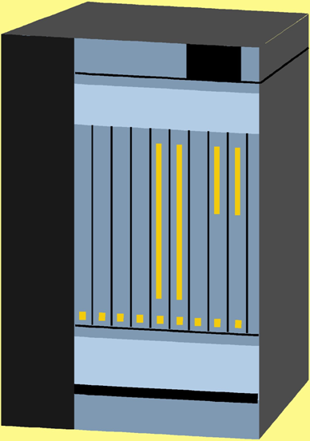
Procedures
In general discussion:
  Policy sets goals
  Procedures define how to achieve goals
In OPS,
  Procedures may be specific automated routines
  Batch systems use JCL to control sequence of program execution
    Job Control Language (JCL) is a procedural language for controlling operations of computer
    Can branch on conditions

Slide 8
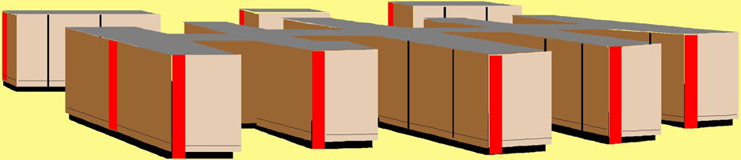
Data Files
OPS work with files
  All operational data reside in files
  Most modern system work with databases
Some files are temporary (transient)
  Work files created during jobs
  Most production files are essential
    Must be protected
      Access-controls
      Backups
Log files keep records of system activity

Slide 9
Operations Management
Separation of Duties
Security Officer / Administrator
Limit Access to OPS Center
Change-Control Procedures
Externally-Supplied Software
QC vs QA

Slide 10

Separation of Duties
Applied to development and production of programs
Operations staff participate in functional analysis and requirements definition phases
Programmers modify code under development
Managers sign off on updates
OPS staff implement changes in production

Slide 11

Security Officer / Administrator
Responsible for securing enterprise systems
Applies security policies
Modifies account privileges

Slide 12
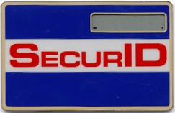

Limit Access to OPS Center
Need, NOT Status, determines access
Identification and authentication for access
  What one has
  What one knows
  What one is
  What one does
Log in and badge visitors
Accompany visitors
  No unaccompanied visitors
  Not even to bathroom! (high-security)

Slide 13

Change-Control Procedures
Moving new version of S/W to production
  Identify software
  Authorize change
  Schedule update
  Backup old data
  Log update
  Back out and recover older versions
Using Digital Signatures to Validate Production Programs
  Date, timestamp, checksum, keys

Slide 14

Externally-Supplied Software
COTS software
  Trojan Horses and Easter Eggs
  Verify digital signatures of COTS
  Compile from source when possible
If resources allow, consider full QA testing
  Verification of code execution using test-coverage monitors
Open-source software pro/con
  Full access to source code
  May be many programmers improving code
  But may be no technical support at all

Slide 15
QC vs QA
Definitions
Service Level Agreements (SLAs)
Monitoring Performance
Monitoring Resources
Monitoring Output Quality

Slide 16
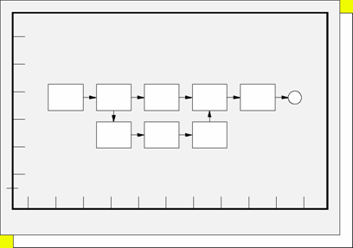

QA / QC Definitions
QA: processes for ensuring and verifying validity of production programs
QC: verifying quality of output

Slide 17

Service Level Agreements (SLAs)
No absolute standard of quality for computing operations
Define suitable balance of quality and cost
Determine agreements on acceptable performance = SLAs
  Performance
  Resource utilization
  Response time
    Not necessarily simple to define
Use statistical measures
  Confidence limits; e.g., “< x seconds in 95% of cases…”

Slide 18
Monitoring Performance
Computer-system performance depends on
  CPU
  DISK
  RAM
  Application design
Network performance also depends on bandwidth and traffic
Monitor performance constantly
  Develop statistical base for spotting trends
  Watch out for inflection points
  Analyze outliers

Slide 19
Monitoring Resources
Same principles of monitoring apply to resource utilization
Must be capable of predicting resource exhaustion in advance
  Take action to forestall disaster
  E.g., reduce demand, increase efficiency or increase resources
  Pay special attention to sudden changes and to outliers
Chargeback systems help to increase user attention to resource utilization

Slide 20
Monitoring Output Quality
Always include meticulous attention to output quality
Identify causes of problems and rectify them
Keep track of error rates and be alert to increases

Slide 21
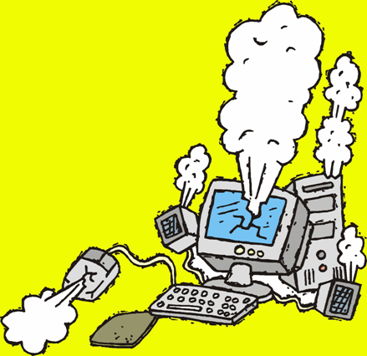
Ensuring a Trusted Operating System
Trusted Computing Base (TCB) includes all aspects of system including hardware and software
Trusted operating system is essential; methods of ensuring it include
  Known-Good Boot Medium
  New Versions of the OS
  Patching the OS

Slide 22

Known-Good Boot Medium
OS usually most expensive and important software on the production system
Critically important to ensure that OPS have trustworthy, undamaged copy of OS at all times
Especially important when applying changes (patches)
Define “Known-Good” boot medium
  Never exposed to possible corruption from other software
  Copied from previous version of KG medium

Slide 23
New Versions of the OS
Reinstall KG version of current OS before installing new OS version
Create copy of KG version of new OS immediately
Thus no other programs are run between time of installation and time of copy

Slide 24


Patching the OS
Patches make required changes to the OS
Reinstall the KG version of the current OS
Install the patches
Make a copy of the patched OS at once to create the KG copy of the patched version

Slide 25
Protection of Data
Access to Production Programs
Separating Production / Development / Test Data
Controlling User Access to Files & DBs

Slide 26



Access to Production Programs
Three classes of people need access
  Users
  Programmers
  Operations staff
Users access appropriate data through programs; they cannot modify production programs
Programmers access development versions of programs and test data; they do not access production data except for purposes of repair
OPS staff control and use production programs but do not access production data except for maintenance purposes (e.g., backups, diagnostics)

Slide 27
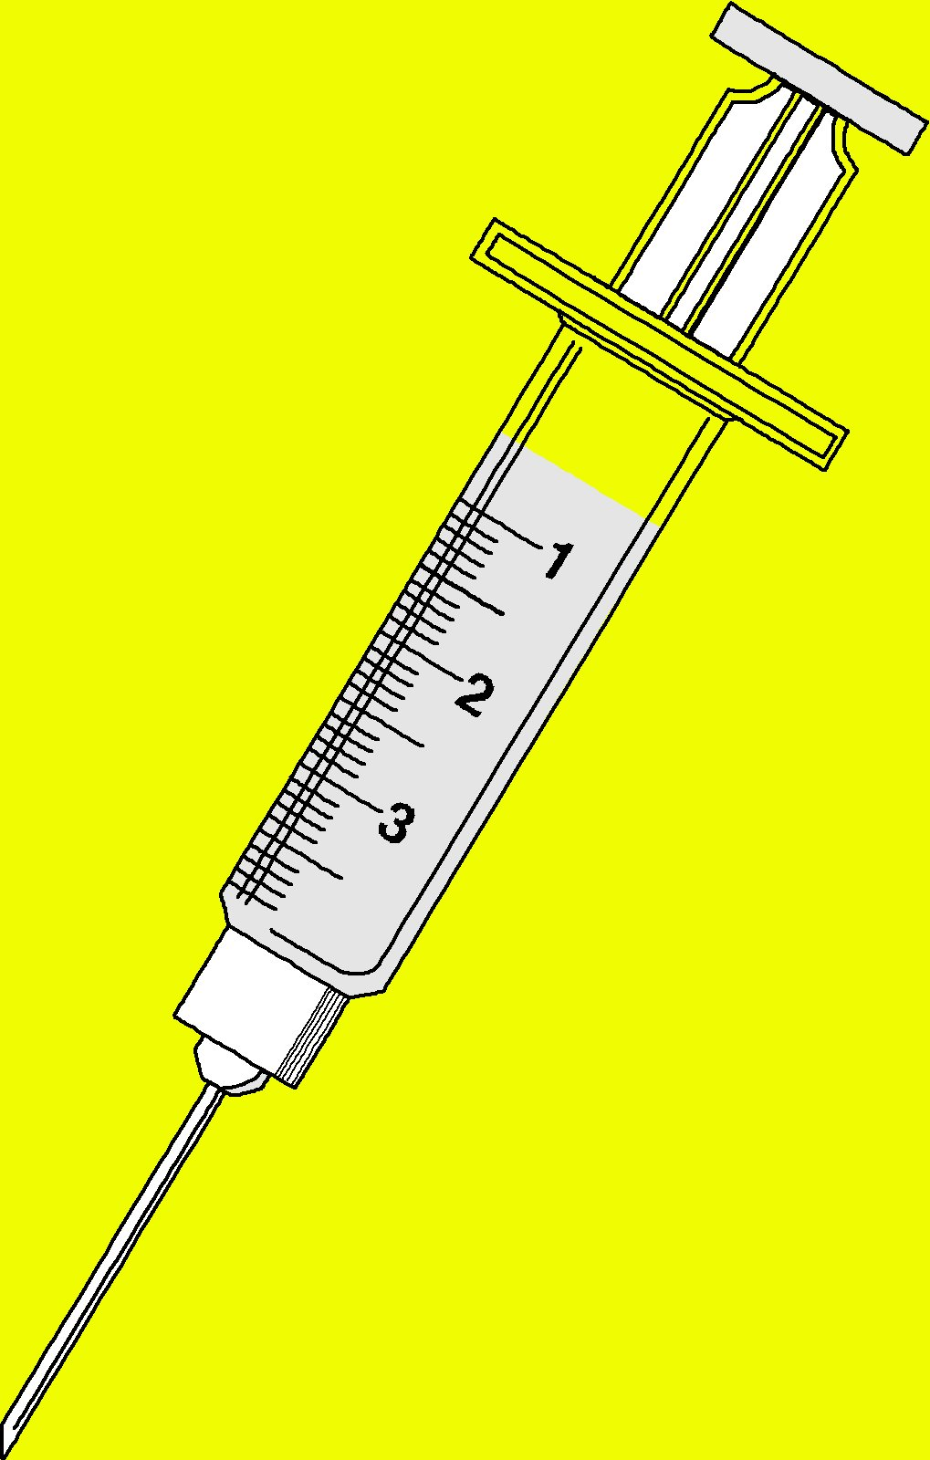
Separating Production / Development / Test Data
Unacceptable to test programs using the production data files
  Dangers of data integrity
  Issues of confidentiality and privacy
  Interference with availability for users
Can extract sample data
  Anonymize sensitive fields
QA group can authorize transfer of programs between testing and production

Slide 28

Controlling User Access to Files & DBs
Some information is confidential
  Thus specific users may have access only to specific columns (attributes) or rows (instances) of the data
Some files are auditable
  Must keep accurate record of all transactions
  Cannot allow any modification of
  sequence or content
  E.g., general ledger

Slide 29
Data Validation
Validation controls are normal part of OPS job
Techniques include
  Edit Checks
  Check Digits & Log Files
  Checks when Handling External Data
Log files

Slide 30
Edit Checks
Many diagnostic programs available for file integrity checking
  E.g., database programs check pointers
  Identify orphaned records, broken chains
Application systems include special diagnostics
  Check business logic rules
  E.g., verify that sum in order header matches total of extended prices in order detail

Slide 31
Check Digits & Log Files
Generate check digits or hash totals based on contents of records during transactions
Only authorized applications create proper cryptographic hash
  Use public key cryptosystem for digital signatures
Verify that records have correct check digits during diagnostic routines
  Error indicates unauthorized change
High security applications can use chaining
  Each record calculates hash by including previous record’s hash

Slide 32

Handling External Data
Data can originate outside corporate control
Use diagnostic procedures
  Analyze data before accepting into production databases
  Check business rules, integrity, safety
Input of bad data can corrupt entire production system

Slide 33
Review Questions (1)
Give examples of production and non-production systems in
  a. A library
  b. A factory
  c. A hospital
Using reading and research if necessary, determine whether the following personnel are usually considered to be part of the operations group:
  Software developers
  Quality assurance personnel
  Computer operators
  System managers
  Network managers
  Information security officers

Slide 34
Review Questions (2)
Explain why a software engineer who has written the BigAccounting.EXE program and knows it inside out should no longer be able to change her own program once it has been moved into production.
Why does the President of Xyzcorp not normally have root access to the production system?
Why does it make sense to ensure that all visitors and staff wear badges at all times in a production environment? Why can’t you just ensure that visitors wear badges?
Why can’t the programmers simply install the new versions of their software into production libraries whenever the changes are complete?
How can digital signatures help to prevent problems in production code?

Slide 35
Review Questions (3)
What is an Easter Egg? What are the implications of finding Easter Eggs in production code from your shop?
What’s an SLA and how does it fit into the Parkerian Hexad?
Why and how should one monitor computer performance from a security standpoint?
Why and how should one monitor computer resource utilization from a security standpoint?
What does it mean to “provide a known-good boot medium” and how does this bear on security?
How can programmers test their data effectively if they don’t have full access to production data?
If QA personnel have access to samples of production data, how can confidentiality of private data be assured?

Slide 36
DISCUSSION

