Slide 1
Email & Internet-
Use Policies
CSH6 Chapter 48
“Email and Internet-Use Policies”
M. E. Kabay & Nicholas Takacs
Notes:
M. E. Kabay, PhD, CISSP

Slide 2

Plan for Today
Video:
The Plugged-in Mailbox
Discussion
Chapter Review

Slide 3

Topics in CSH6 Ch 48
Damaging the Reputation
of the Enterprise
Disseminating and Using Incorrect Information
Hoaxes
Threats
Viruses and Other
Malicious Code
Junk Email
Chain Letters and Ponzi Schemes
Get-Rich-Quick Schemes
Mail Storms
Stolen Intellectual Property
Plagiarism
Criminal Hacking and Hacktivism
Online Auctions
Online Gambling
Buying on the Web
Games
Spyware
Internet Addiction
Online Dating
and Cybersex
Hate Groups
Pornography
Pedophiles

Slide 4
Training Video
The Plugged-In Mailbox
Commonwealth Films
Followed by
Class Discussion

Slide 5
Damaging the Reputation of the Enterprise
Principle:
  The USENET is forever
  Email is almost forever
Violating netiquette
Violating laws
Ill-advised email
  Creating hostile work environment
  Libeling people or organizations
Inappropriate use of corporate identifiers
  Corporate email = corporate letterhead

Slide 6
Disseminating and Using Incorrect Information
Disintermediation and quality
Libel
Practical guidelines
  Judge credibility of source
  Do not pass on information without checking validity
X

Slide 7

Hoaxes
Urban myths
Virus myths
Clues
  Style
  No date
  No authoritative source
  Demand to disseminate widely
  Claims of prizes / money
  Threats of bad consequences for failing to circulate

Slide 8

Threats
Do not take lightly
  NEVER destroy email of this type
  Need evidence
Should usually contact internal security
  Security personnel will
  call law enforcement according to established procedures
Threats of terrorist action (bombs, poison) particularly serious and may require immediate action as part of incident response plan

Slide 9

Viruses and Other
Malicious Code
Policies forbid all voluntary involvement with malware
  No Vx sites
  No writing, exchange, distribution
  No disabling of AV software
Safety guidelines known to all
  Automatic updates
  Don’t use illegal / rogue software
  Don’t accept executable attachments to email

Slide 10
Junk Email
The SPAM®* skit
(Monty Python)!
Major problem –
80% of all email in world
Guidelines
  No employee to create /
  send spam
  Never allow response to
  spam
  Never buy anything from
  spammers
  Don’t click on addresses in
  spam
  Make sure your SMTP
  server forbids spam relay
* SPAM® is a registered TM. Use Spam or spam but not SPAM for junk email.

Slide 11

Chain Letters and Ponzi Schemes
Pyramid fraud
  Send money to people higher (earlier) on list
  Amounts increase as long as new victims recruited
  When no more new victims, pyramid collapses
  Last in lose all their money
  Originators run away rich
Illegal in USA (USPS regs)
No employee should be allowed to participate

Slide 12
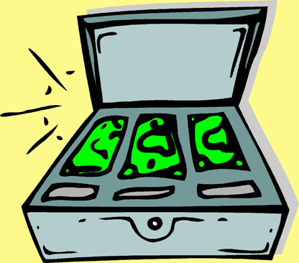
Get-Rich-Quick Schemes
Infinite variety of schemes for suckers
Too good to be true = not true
Nigerian 4-1-9 (advance-fee) scams a plague
  I have lots of stolen/unclaimed money
  “I’ll give you some if you help me steal it”
Policy: constant awareness
  Ensure employees know
  about scams
  Make fun of scams in your
  newsletters
  Tell employees about
  gullible (stupid) victims

Slide 13
Mail Storms
Autoforwarding between 2 email addresses
List servers that allow autoresponse to entire list
  Full mailboxes
  Out-of-office replies
Reply to entire list instead of to single person
Quoting entire messages instead of extracts
  Especially quotations
    Of quotations
      Of quotations
        Of quotations….

Slide 14
Stolen Intellectual Property
Serious legal issues for employers
  RIAA has threatened companies, universities with lawsuits
  SPA / BSA have sued organizations
Webmasters get employers into trouble by posting materials without permission
  Embarrassing, risky
  Politicians have found stolen text on competitors’ Websites
Must train employees to respect legal restrictions for software, music, text

Slide 15




Stolen Intellectual Property
Production software can never be allowed to be stolen versions!
  Serious legal liability
  Vulnerability to blackmail
  Public humiliation
  Expensive penalties
Undermines credibility of management principles
Demoralizing to honest employees

Slide 16
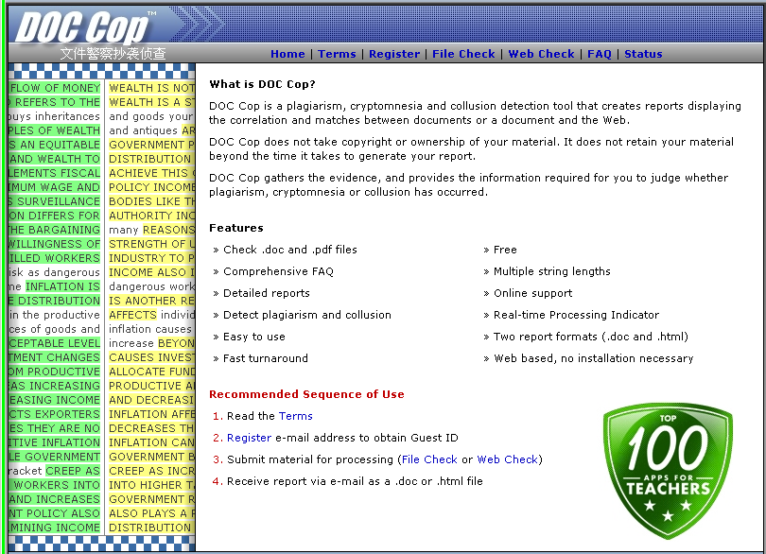
Plagiarism
Unattributed / misattributed information
Copyright violation
Extreme
embarrassment
Discredits
organization
Policies
  Absolutely forbidden
  Check materials using GOOGLE etc.
  Tools available for automated checking
    E.g., < http://doccop.com >
See next page

Slide 17
DocCop

Slide 18
Criminal Hacking and Hacktivism
Duhhh…

Slide 19

Other Risks to Employees and Families
Online Auctions
Online Gambling
Buying on the Web
Games
Spyware
Internet Addiction
Online Dating and
Cybersex
Hate Groups
Pornography
Pedophiles

Slide 20
Review Questions (1)
Why should an organization expend any effort at all in teaching employees how to protect themselves and their families against Internet & Email dangers? What does this have to do with information assurance?
How can something as minor as violating customs in discussion groups cause harm to an organization?
Why do we say that USENET and corporate email have a potentially permanent lifespan?
Should corporate email be used for non-professional messages? Why or why not?
How can someone reasonably decide whether to forward an email containing alarming information?
What does “disintermediation” mean in discussions of information quality on the Internet?

Slide 21
Review Questions (2)
What are some key signs that message is a hoax?
How can you check a message to find out if it is a hoax?
How should employees respond to threats of violence received in email?
What are the most important principles to teach employees about preventing virus / worm infections?
How should employees respond to junk email?
What is a Ponzi scheme and how should employees respond to one?
Explain how mail storms can arise from autoreplies and mailing lists.
Why should organizations ban the use or exchange of pirated music, software and text?

Slide 22
DISCUSSION

