Slide 1
Social Psychology
& INFOSEC
CSH6 Chapter 50
“Using Social Psychology to Implement Security Policies”
M. E. Kabay, Bridgitt Robertson,
Mani Akella, and D. T. Lang

Slide 2
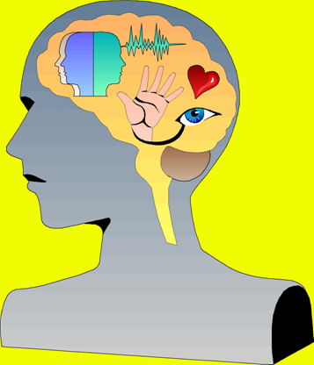
Topics in CSH6 Ch 50*
Rationality is Not Enough
Getting Your Security Policies
Across
Encouraging Initiative
Group Behavior
_________
* NOTES:
1) Detailed, narrated lectures on organizational psychology are available at http://www.mekabay.com/courses/academic/norwich/msia/index.htm
as a complete lecture (15.7MB Zipped) or in parts.
2) This presentation goes beyond Ch 50 in some respects.

Slide 3
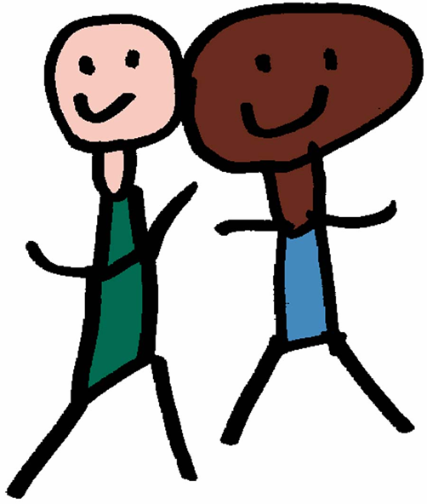
Rationality is Not Enough
The Schema
Theories of Personality
Attribution Theory
Social Cognition: Forming Judgments
Intercultural Differences
Framing Reality

Slide 4

The Schema
Cognitive framework
What allows observations to make sense
We interpret observations
in context
  Imagine that your colleague appears at work dressed like this:
  But what if your colleagues is at the company swimming pool?
  Results in radically different interpretation from schema for the business meeting. . . .
In security, schema for normal politeness conflicts with schema for secure behavior

Slide 5
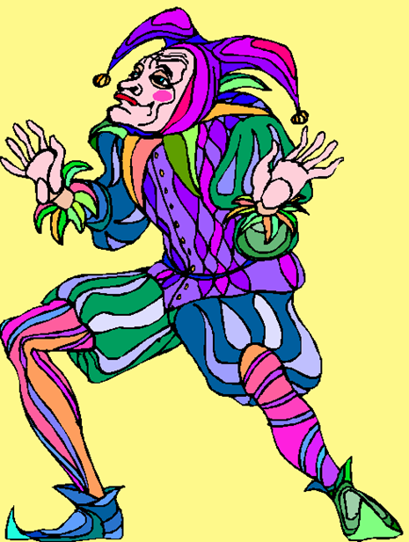
Theories of Personality
Interpersonal conflicts can interfere with security policy
Beware rigid categories for framing behavior in terms of fixed personality patterns
  Extroversion / agreeableness etc.
Especially important not to value one personality style above another
  People of all styles can contribute constructively to organization
  Perceptions and expectations account for many conflicts
Role-playing exercises very helpful
Listen carefully to people’s expressions of feelings as well as of opinions

Slide 6
Attribution Theory (1)
How people explain their own and others' behavior
Weiner's classification:
Stable
Unstable
Dispositions;
traits; level of
ability or
intelligence
Effort;
mood;
physical state
Internal
External
Good/bad luck;
opportunity;
transient
situations
Degree of task
difficulty; env
helps/hindrance
Notes:
This conceptual framework is useful in making sense of the advice given
on the following pages.

Slide 7
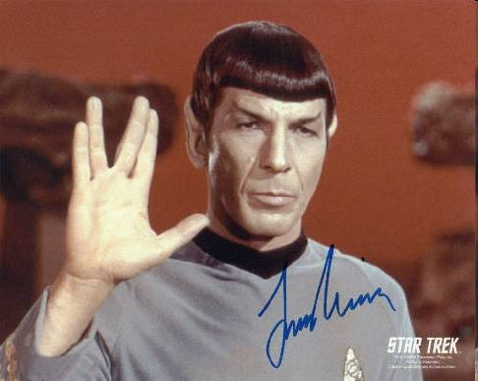
Attribution Theory (2)
How we explain behavior
Fundamental Attribution Error
  Star Trek's Leonard Nimoy is really like the character he portrays (Mr Spock)
Actor-Observer Effect
  What I do is a reasonable response to the situation but what you do is in your nature
Salience
  What stands out is perceived as most important even if it isn't
Notes:
An example of the F.A.E. is to take first impressions as a permanent index
of a person’s behavior.
However, the F.A.E. is much broader than first impressions; it occurs in all kinds
of contacts at any time in a relationship.

Slide 8
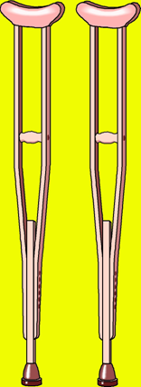
Attribution Theory (3)
Self-Serving Bias
  If I succeed it's because of how good I am, but if I lose it's not my fault
Self-Handicapping
  If I expect to fail I'll make sure there's a good excuse
Depressed People
  If I lose it's because of how bad I am, but if I succeed it's not to my credit

Slide 9
Attribution Theory: Implications
Leader and others: remember not
to pigeon-hole someone
  E.g., “He’s always _______”
Reverse situation – think about explanations for perplexing or objectionable behavior
  “If I were behaving that way, it would be because __________”
Challenge unthinking reliance on salience – question assumptions about causality
  “Why should the fact that he limps make a difference to _________?”

Slide 10
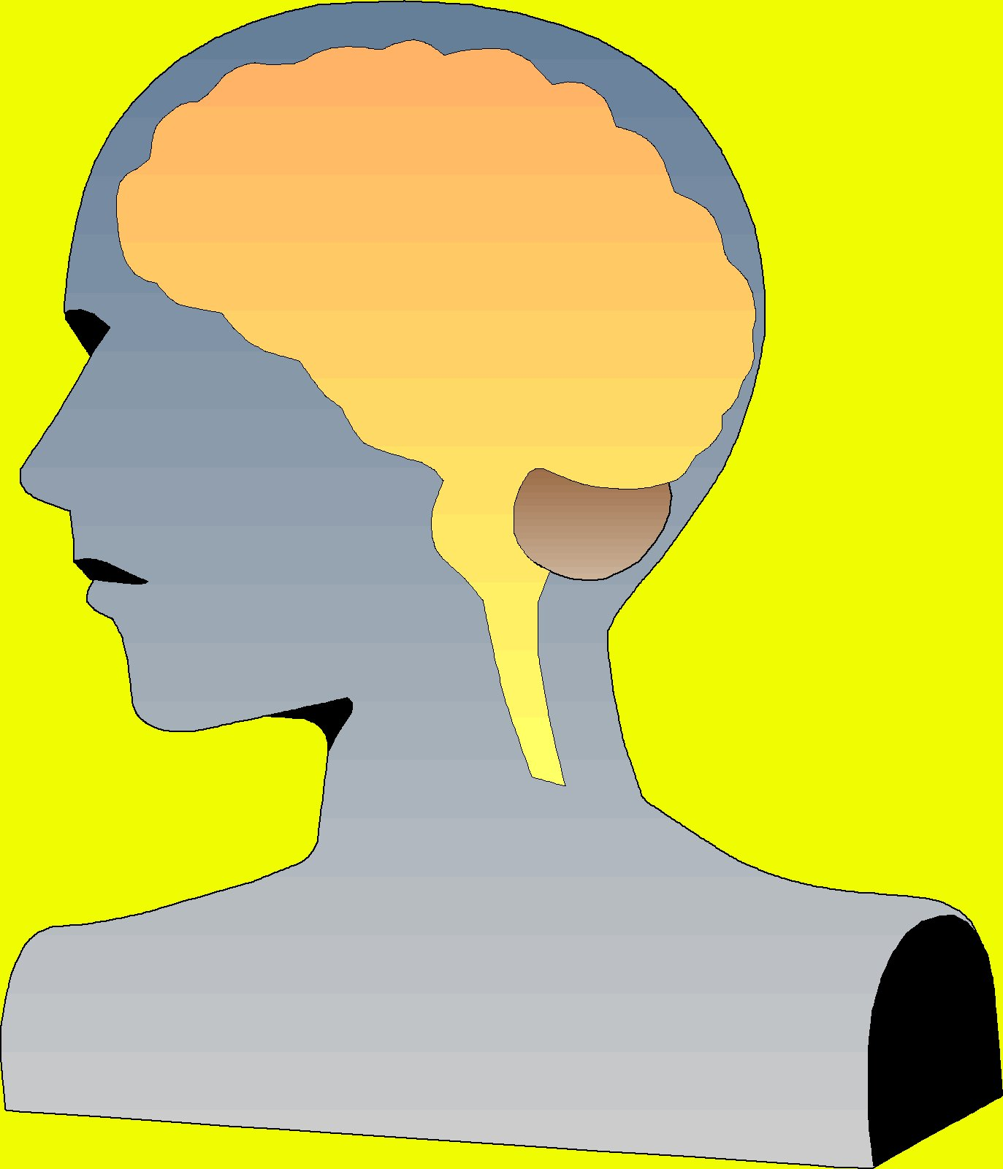
Social Cognition: Forming Judgements
Schemas influence perception
Decision-making usually includes only a small subset of available information
Language influences
perception
Reasoning is only a small
part of forming judgments
or opinions

Slide 11

Inadequate Sampling
Judgments are often based on inadequate samples
Early, negative, information weighted heavily
The availability heuristic can lead to errors in judgment
  What’s easy to remember weighs too heavily in decision
  Anecdotal evidence inappropriately strong

Slide 12
Inadequate Sampling (cont’d)
THEREFORE
Provide decision makers with powerful arguments first
Ensure there’s lots of striking, memorable evidence in presentation
Explicitly challenge incorrect intuition, preconceptions, conclusions

Slide 13
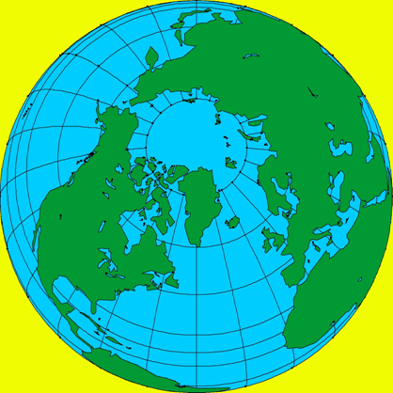
Intercultural Differences
International differences can lead to
  Misunderstandings
  Conflicts
History, interpretation can be
different; e.g.,
  Afghani Taliban forced
  non-Muslims to wear badges
  in public
  So how might a particular
  Hindu refugee from
  Afghanistan feel in the USA
  being forced to wear a badge
  to work?
DISCUSS such problems rather than dismissing them

Slide 14

Framing Reality
Shift perception of reality
Expand range of experience
Give real-world examples
Provide opportunities for role-playing
Take time necessary to shift corporate culture
Keep security at forefront of awareness
Address feelings of participants

Slide 15
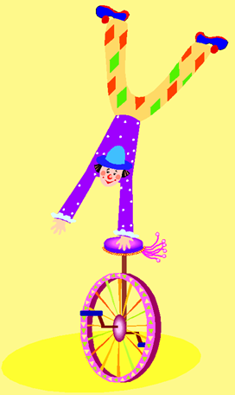
Getting Your Policies Across:
Effective Communication
What influences pace of change:
Audience/Listener variables
Channel variables
Communicator/Presenter variables
Message variables
For narrated lectures on effective communications, see
LEADERSHIP parts 3 and 4 on
http://www.mekabay.com/msia/public/index.htm

Slide 16
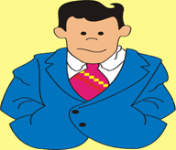


Beliefs and Attitudes
Belief: cognitive information without affect (feelings)
  “The operators are responsible for tape mounts.”
Attitude: evaluation or emotional response
  “The */$&/! operators are supposed to be responsible for tape mounts!”
Cognitive dissonance: incompatible beliefs, attitudes or behavior
  “I am an honest person – but I have taken home three dozen blank CD-RW disks this month from the company stockroom.”

Slide 17
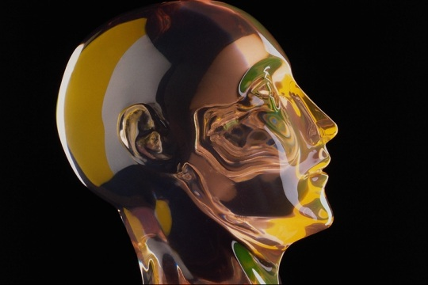
Beliefs and Attitudes
Before attempting to change beliefs and attitudes, study what they are
  Interviews
  Focus groups
  Surveys
Use language carefully
  Positive terms for
  desired end-point
Encouragement is
effective
  Even minor praise, smile can shape beliefs and attitudes
Allow time for change – weeks at least

Slide 18

Beliefs and Attitudes (cont’d)
Suggestions for security group:
Explore current beliefs and attitudes towards security
  Identify areas of conflict, negative affect
  Correct erroneous beliefs fast
  Explore why some policies are successful
Provide consistent pro-security messages to avoid dissonance
  E.g., managers should not ignore polices
Rewards more effective than punishment
  Encouraging positive attitudes & behavior

Slide 19
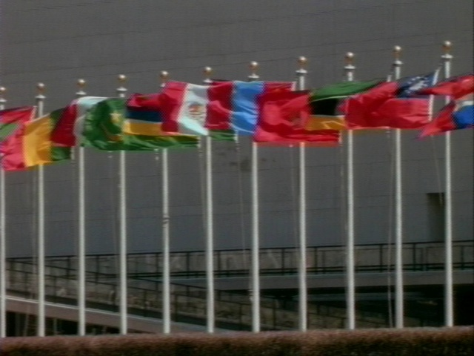
Prejudice
Stereotypes – simple models of others;
  e.g., racial profiling, assumptions about security officers
Roots of prejudice are many – historical, social, familial, psychological, personal
Authoritarian personality includes prejudice
Minimal-group research – easy to generate inter-group hostility and prejudice simply by grouping
Group competition exacerbates prejudice
  Creating common goals and projects for hostile groups mitigates prejudice
Favorable depictions improve inter-group relations

Slide 20
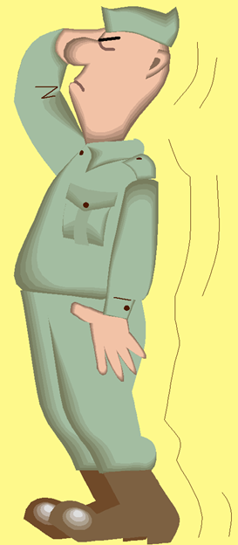
Encouraging Initiative
Prosocial Behavior
Conformity,
Compliance and
Obedience

Slide 21

Pro-Social (Helpful) Behavior
Acting helpfully requires 4 steps:
Notice problem
  Need awareness
Recognize as emergency
  Need training
Take responsibility for action
  Need climate for responsible action
  No worry about looking foolish
Decide on action
  Sound training, good policies

Slide 22
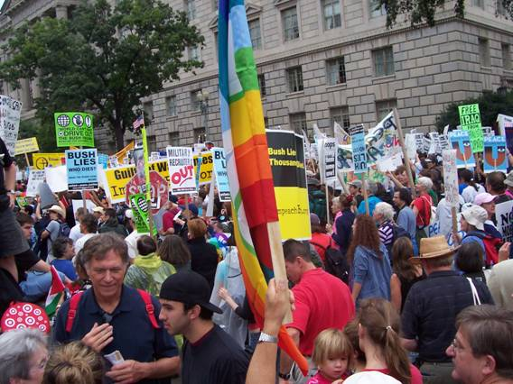
Pro-Sociality (cont’d)
Bystander Effect
  Larger groups have slower reaction time
  Diffusion of responsibility
  Uncertainty about social climate
Counter bystander
effect using rewards
for responsible
behavior
  E.g., reporting
  security violations
  Challenging
  unbadged
  strangers

Slide 23
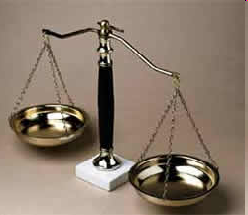
Pro-Sociality (cont’d)
Cost-benefit analysis
  Make prosociality low cost / high gain
  Provide hotline for security violations
  Allow anonymity in reports
Make failing to support policy expensive
  Personnel policies: clear sanctions
  Performance review
  Possible dismissal

Slide 24
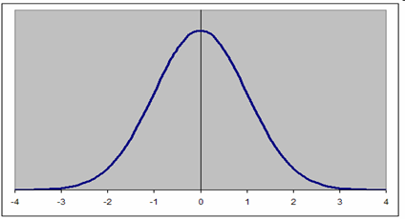
Conformity, Compliance and Obedience
Shift normative values towards goal
  Express expectation of cooperation – “We”
Group solidarity increases conformity
  Group exercises, games, teamwork
  If using contests, mix up the teams
Outliers are especially important
  Both enthusiasts and resisters
Norm of reciprocity
  Give a little, get a little
Foot in the door
  Get a little, get more

Slide 25
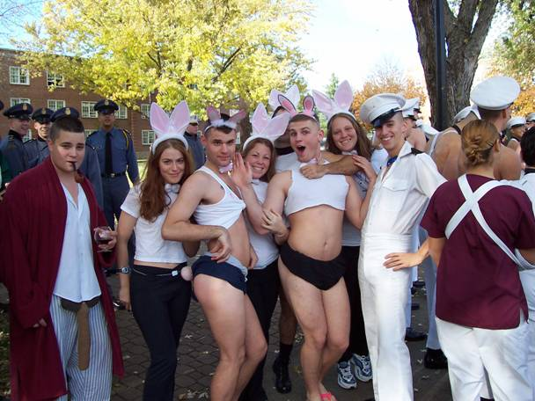
Group Behavior
Social Arousal
Locus of Control
Group Polarization
Groupthink

Slide 26
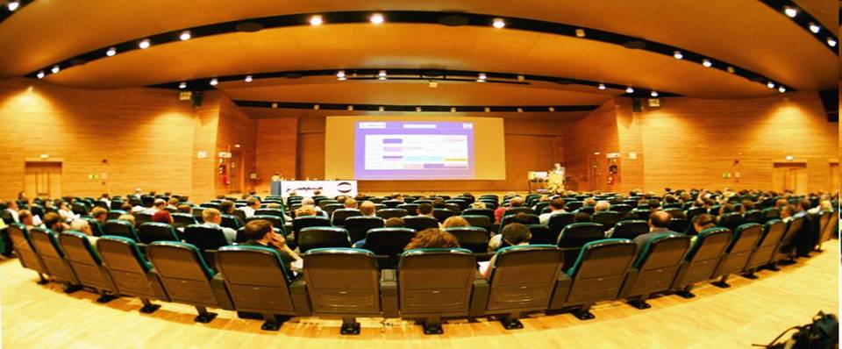
Social Arousal
Large groups cause “social arousal”
  Increased awareness of self and others
  Facilitates well-learned habits
  Interferes with poorly-learned habits
Therefore avoid large groups for early security training
Provide individualized learning as major tool

Slide 27
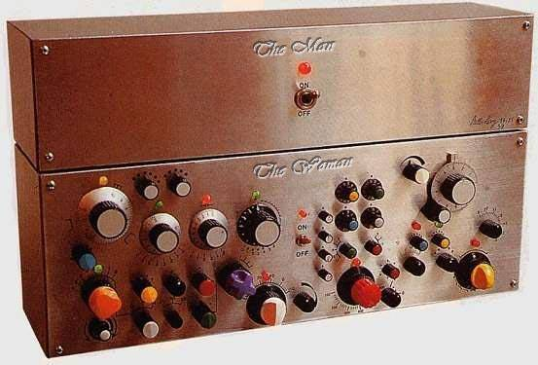
Locus of Control
People work better when they feel in control
  Able to affect outcomes
  Considered by decision-makers
  Listened-to
Experimental evidence
  Teams working in noisy environment
  Patients in convalescence homes

Slide 28
Locus of Control (1)
Locus of Control Group 1

Slide 29
Locus of Control (2)
Locus of Control Group 2
STOP

Slide 30
Locus of Control (3)

Slide 31
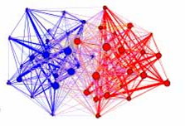
Group Polarization
Groups take on more extreme positions than any one member would
E.g., can decide to take more risks (or fewer) than reasonable
Emphasize one-on-one discussions to counter polarization
Re-evaluate group
decisions after
enthusiasm has
cooled
Group Polarization in the Blogosphere
From http://www.zonaeuropa.com/ 20050312_1.htm

Slide 32
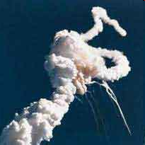
Groupthink
Desire for social cohesion can lead to flawed thinking
  Reject contrary evidence
  Condemn anyone questioning consensus
  Protect leader against “disturbing” views
Factors increasing likelihood of groupthink
  Authoritarian leader
  Pre-existing agenda
  Rejection of debate
Should fight groupthink at all levels
Challenger:
January 28, 1986

Slide 33
Review Questions (1)
How does the schema affect information assurance?
How can faulty interpretations of personality interfere with IA practitioners’ ability to work effectively in an organization?
How do unsophisticated explanations of behavior interfere with effective security administration?
What is meant by “making security part of the corporate culture”?
Discuss three key elements for changing employees’ schemas to improve receptivity to security policies.
Why is it valuable to evaluate current beliefs about security issues (explain with respect to cognitive theory).

Slide 34
Review Questions (2)
What are the most effective mechanisms for motivating better attitudes toward security and greater compliance with security policies?
Analyze the case of the Hershey’s Kisses on the keyboard.
Name and define the four types of variables affecting the effectiveness of communications designed to change attitudes.
Explain how each of the four communications variables can be optimized for effective attitude change in security training.
How can one encourage employees to take the initiative in responding to security breaches and reporting questionable behavior?

Slide 35
Review Questions (3)
How does team spirit influence the work of IA trainers?
Why should IA trainers and security personnel pay attention to outliers?
How does the norm of reciprocity play a role in security policy efforts?
What is the significance of the “foot-in-the-door” technique for security training and awareness efforts?
When should security training be offered to large groups and when to small groups? Why?
What is the meaning of “locus of control” for security efforts?
How can one avoid the dangers of group polarization and groupthink in security training and awareness efforts?

Slide 36
Optional Homework
For 5 points, submit an essay of 100-200 words
  Bring to light an article illustrating any principle in the chapter on Social Psychology and INFOSEC
  Do some research in the Kreitzberg Library databases, Google Scholar, and the WWW
  Put your summary in NUoodle Class Discussion forum
  You may refer to a page number in the chapter or to a slide number in the PPT file to point out where the topic is mentioned.
  Be sure to provide a complete reference to your source so others can find and read it.
For up to 5 points per response, comment constructively on other students’ postings on these social-psychology illustrations.

Slide 37
Now go and study

