Slide 1
Standards for Security Products
CSH6 Chapter 51
“Security Standards for Products”
Paul J. Brusil and Noel Zakin
Notes:
M. E. Kabay, PhD, CISSP

Slide 2


Selected Topics in CSH6 Ch 51
Introduction
Security assessment standards and security implementation
Establishing trust and managing risk
Common criteria paradigm
Conclusion
These notes are deliberately limited
to focus on highlights of the chapter
suitable for the introductory-level
undergraduate course IS342 on
management of information assurance
taught at Norwich University

Slide 3

Introduction
IT is vast; security standards essential
Standards stipulate security needs and requirements
Standards specify conventions
Standards ensure interoperability
Customers can specify level of security
and assurance with standards
Customers can assess products
from different vendors with
standards

Slide 4
Security Assessment Standards and Security Implementations
Security Technology and Product Assessment Standards
Standards for Assessing Security Implementers
Combined Product and Product Builder Assessment Standards

Slide 5
Security Assessment Standards and Security Implementations (1)
Security Technology and Product Assessment Standards
Informal, consortium-driven (e.g. IETF)
Security Proof of
Concept Keystone
(SPOCK) –
NSA sponsored
product-specific tests
VPN consortium –
conformance testing of a
VPN to IETF IP security
standard

Slide 6
Security Assessment Standards and Security Implementations (2)
Standards for Assessing Security Implementers
Capability Maturity Model (CMM) family
  Systems Security Engineering CMM (SSE-CMM) – framework of accepted security principles
Quality (ISO 9000) – broad assessment of system quality

Slide 7
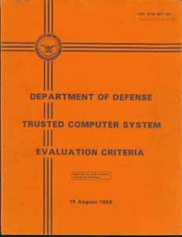


Security Assessment Standards and Security Implementations (3)
Combined Product and Product Builder Assessment Standards
Competing National Standards
  TCSEC (Trusted Computing System Evaluation Criteria) – Orange Book,
  US
  ITSEC – EU
  CTCSEC – Canada
Common Consolidated Criteria
Standard – New international
standard Common Criteria (CC)

Slide 8
Establishing Trust and Managing Risks Topics
Why Trust and Risk Management are Important
Alternative Methods of Establishing Trust
  Nonstandard Trust Development Alternatives
  Standard-Based Trust Development Alternatives

Slide 9
Establishing Trust and Managing Risks (1)
Why Trust and Risk Management are Important
New technology, new business models – players need confidence
Trust against cyber-terrorism
Presidential Decision Directive (PDD 63; May 22, 1998) on Critical Infrastructure Protection*
Trust + Risk mitigation = more revenue
Need Common Criteria paradigm
* https://www.fas.org/irp/offdocs/pdd/pdd-63.htm

Slide 10
Establishing Trust and Managing Risks (2)
Alternative Methods of Establishing Trust
Nonstandard Trust Development Alternatives
  Vendor self-declarations
  Proprietary in-house assessments e.g. Smart Card Security Users Group
  Hacking (uncertain, unmeasurable)
  Open Source e.g. Linux code
  Trade press (reviews, recommendations)
  Initial Commercial Approaches e.g. ICSA labs

Slide 11
Establishing Trust and Managing Risks (3)
Alternative Methods of Establishing Trust contd..
Standard-Based Trust Development Alternatives
  Common Criteria (CC) paradigm

Slide 12
Common Criteria Paradigm
Topics
CC paradigm is a scheme based on formal international standards
Standards that shape Common Criteria (CC)
Details about the CC
Using CC to define security requirements and solutions
Defining common text methodology
Mutual recognition of testing and national testing schemes
CC evaluation and validation
scheme (CCEVS) of the US

Slide 13
Common Criteria Paradigm Topics (cont’d)
Accredited testing
Testing validation
Recognizing validated products and profiles
Summary of CC

Slide 14

Common Criteria Paradigm (1)
Standards that Shape CC Paradigm
CC for Information Technology Security Evaluation
Common Evaluation Methodology
Mutual Recognition Agreement (MRA)
CC Evaluation & Validation Scheme
(CCEVS)

Slide 15

Common Criteria Paradigm (2)
Details about the CC Standard
Models for Security Profiles
  Protection Profile (PP)
  Security Target (ST)
Security Functional Requirements
Catalog
  11 classes
Security Assurance Requirements Catalog
  10 classes
Requirements catalogs are comprehensive

Slide 16
Common Criteria Paradigm (3)
Using CC Standard to Define Security Requirements and Solutions (1)
Constructing a protection profile (PP) - PP states security problem that product will solve.
Steps involved in constructing PP
  Identify threats, vulnerabilities
  (use CVE* & NVD**)
  Describe operational
  environment
  Enumerate policies
  Set security objectives for
  product and environment
* http://cve.mitre.org/cve/
** http://nvd.nist.gov/

Slide 17
Common Criteria Paradigm (4)
Using CC Standard to Define Security Requirements and Solutions (2)
Steps involved in constructing a PP (cont’d)
  Refine security requirements from CC catalogs
  Select assurance requirements from assurance catalog
  Give rationale for all decisions and choices made in constructing a PP
  Reuse existing PP if possible

Slide 18
Common Criteria Paradigm (5)
Using CC Standard to Define Security Requirements and Solutions (3)
Security Targets (ST) – to document product security information
Steps involved in constructing an ST
  Describe environment of product
  Enumerate threats, policies, laws etc.
  Delineate security objectives
  Enumerate security
  requirements addressed
  Give rationale for all decisions
  and choices
  So far, STs are like PPs

Slide 19
Common Criteria Paradigm (6)
Using CC Standard to Define Security Requirements and Solutions (4)
STs go beyond PPs because they:
  Specify security functions offered
  to meet security requirements
  Specify assurance measures taken
  to meet assurance requirements
  Can conform to more than one PP
STs beneficial – complete,
unambiguous
PP/ST development tools available

Slide 20
Common Criteria Paradigm (7)
Defining Common Test Methodology
Common Evaluation Methodology (CEM)
  Two-part standard
  Part 1: general model,
  evaluation process, roles of
  stakeholders
  Part 2: complete methodology
  information on general
  evaluation tasks
Benefits of CEM
  Common base for product assessment
  Common floor of operational confidence

Slide 21

Common Criteria Paradigm (8)
Mutual Recognition of Testing and National Testing Schemes
Mutual Recognition Arrangement
(MRA)
  Identifies conditions for
  mutual recognition of testing,
  validation, and certification
  among countries
  Rooted in use of CC and CEM
National schemes
  Countries agreeing to the MRA have their own schemes

Slide 22
Common Criteria Paradigm (9)
Common Criteria Evaluation & Validation Scheme of the United States
Purpose
  Establish and maintain quality of CC-based security testing, validation, certification infrastructure
  Define policies, procedures, processes for CC-based, MRA-recognized security testing, validation, certification
See next slide for screen shot
http://www.niap-ccevs.org/

Slide 23
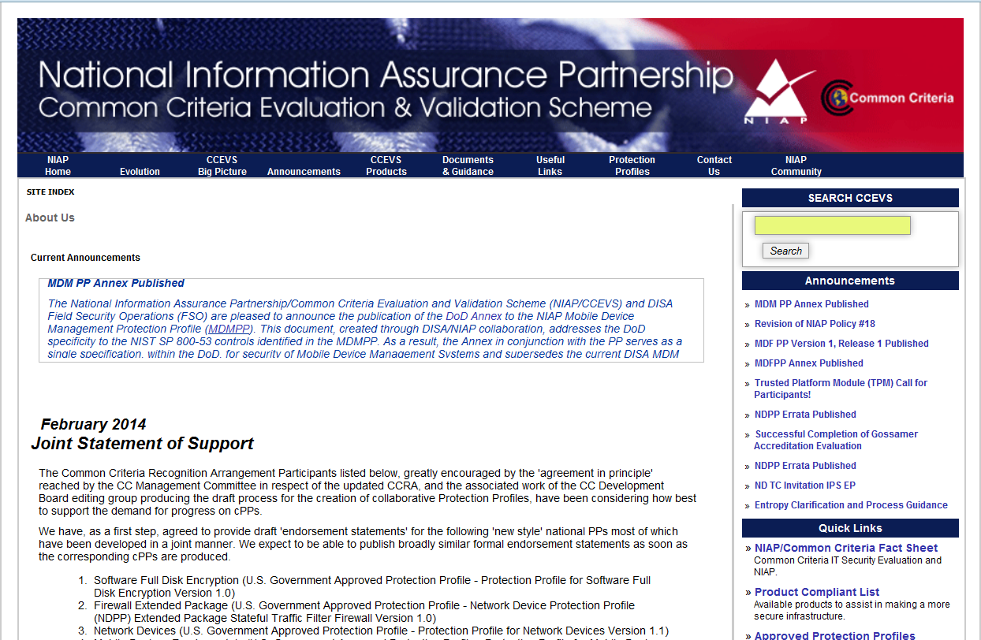
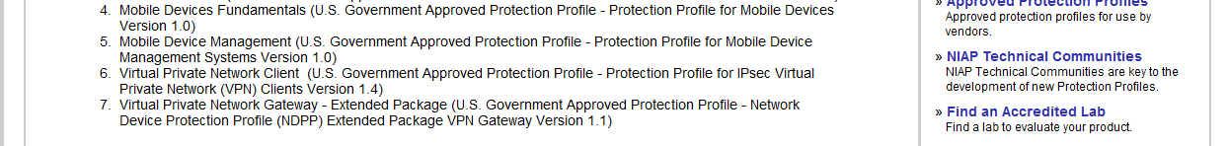
http://www.niap-ccevs.org/

Slide 24
Common Criteria Paradigm (10)
Accredited Testing
Testing products and profiles
  Benefits of accredited
  testing and evaluation
  Helping customers
  Preparing for testing
  Conducting testing
  Testing oversight
Accrediting security testing
laboratories
  What is accreditation?
  Benefits of accreditation

Slide 25
Common Criteria Paradigm (11)
Testing Validation
Validating test results
  Security assessment conforms
  to CCEVS
  Conclusions follow from
  evidence
  CC and CEM applied correctly
Operating and maintaining the
validation service
  NIAP validation body conducts validation
  Develops report
  Bestows validated product status

Slide 26
Common Criteria Paradigm (12)
Recognizing Validated Products and Profiles
Issue CC certificates to confirm evaluation
Posting validations – validated profiles placed in a national registry of PPs

Slide 27

Common Criteria Paradigm
Summary
CC paradigm a powerful, flexible, standards-based mechanism
Facilitates defining IT security and confidence requirements
Facilitates stipulating IT product security specifications
Facilitates testing and test verification
Provides cost-effective value
Helps users understand risks, vulnerabilities
Assures better-engineered, more acceptable products

Slide 28
Review Questions: Extra credit for posting responses to NUoodle Discussion Board
Why do we use standards for security products?
Compare and contrast alternatives to formal standards for security certification of products.
Outline the history of security standards leading to the Common Criteria
Summarize the components of the CC framework.

Slide 29
Extra points available
For 10 extra points added to your quiz-points total
Use the Kreitzberg Library, Google Scholar, and the WWW to research current industry views about the Common Criteria
Write a 1 page report (500 ± 50 words) on findings
  Single-spaced, following guidelines for essays
  Put following in UPPER RIGHT CORNER of report:
    Your Name
    Common Criteria Today
    IS342
Upload the DOCX, DOC, RTF or ODT file to NUoodle in the upload function available in this week’s section. No TXT or PDF files.
  Submit by the deadline shown in NUoodle

Slide 30
Now go and study

