Slide 1
Application
Controls
CSH6 Chapter 52
“Application Controls”
Myles Walsh
Notes:
M. E. Kabay, PhD, CISSP

Slide 2
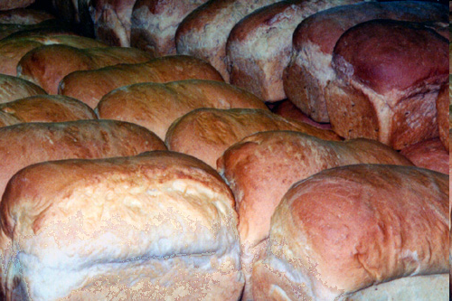
Topics
Protection in Development
Protecting Databases
Protecting Batch Files
Ensuring that Information
in the System is Valid

Slide 3
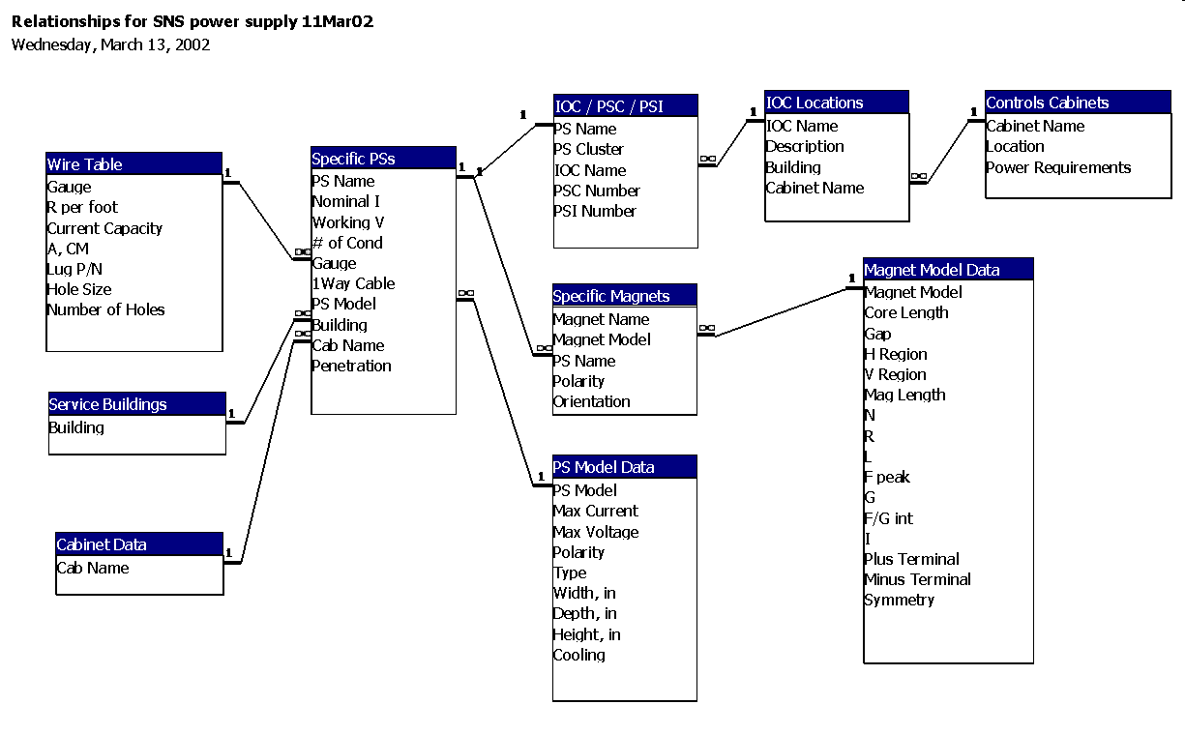
Protection in Development
Software Quality Assurance (QA)
  Focuses on methods for preventing, catching and correcting errors in source code and other operational instructions
Application Controls
  Specific subset of methods for preventing data corruption in production systems
Databases
  Primary mechanism for
  storing and manipulating
  data in today’s systems
Batch vs Online
  Live interaction (online)
  Automated processing
  (batch)

Slide 4
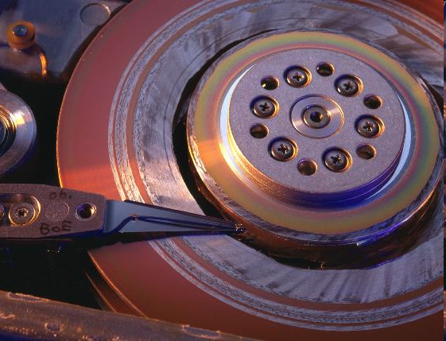
Types of Data Corruption
Physical
  Caused by hardware
  failures
  Errors do not correlate
  with (respect)
    Applications
    Files / datasets /
    databases
    Why not?
Logical
  Caused by software failures
  Errors may correlate with
    Applications
    Files / datasets / databases
  Why only “may”?

Slide 5
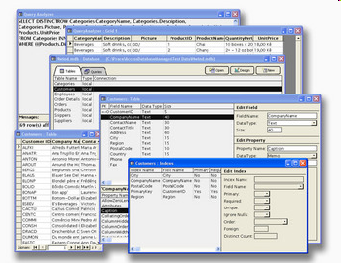
DBMS Controls
Referential Integrity
Uniqueness Constraints
Locking
Transaction Controls
Database Recovery
For those who have completed IS240, this section should be a review.

Slide 6
Referential Integrity
In designing databases, may stipulate that certain records may not exist without pre-existing indexes
E.g., cannot normally enter
  Order-detail without entering order-header
  Prescription data without entering
    Patient data
    Doctor data
    Pharmacist data
    Drug data
    Admission data

Slide 7
Referential Integrity (cont’d)
DBMS will prevent deletion of records when others are dependent on them
E.g.,
  Cannot delete order-header if there are orders with the order-number of that header
  Cannot delete patient-master record if there are admission records for that patient

Slide 8
DBMS Controls
Referential Integrity
Uniqueness Constraints
Locking
Transaction Controls
Database Recovery

Slide 9
Uniqueness Constraints
In relational DBMS (RDBMS), every record in a table (dataset) must be unique
  If there is no natural key or index field (or combination of fields) that guarantees uniqueness, can create one automatically
DBMS can enforce uniqueness of specific fields in records using the unique key characteristic
E.g.,
  Order-number
  Patient-ID
  Student-ID….

Slide 10
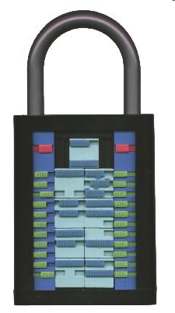
DBMS Controls
Referential Integrity
Uniqueness Constraints
Locking
Transaction Controls
Database Recovery

Slide 11
Locking
Concurrency Control
Basic Concepts of Locking
Serializable Transactions
Deadlock (Deadly Embrace)
Locking Strategies

Slide 12
Concurrency Control
Multi-Step Transactions
Resource Locking
Consistent Transactions
Transaction Isolation Level
Cursor Type

Slide 13
Multi-Step Transactions Are Fragile
Think about order-entry system
Create order-header
  Includes total of cost of line-items (details)
    Updated at END of detail data entry
Begin entering line-items
  Enter 3 records … have not yet finished
  System crashes
What is the value in the order-header’s total field?

Slide 14
Concurrency Causes New Problems
E.g., The Lost Update Problem:
User A reads inventory: finds 20 widgets.
User B reads inventory: also finds 20 widgets.
User A subtracts 10 widgets from 20, writes total ____ widgets back into inventory
User B subtracts 5 widgets from ____, writes total ____ widgets back into inventory
But actually, there are only ____ widgets left in the real inventory
A
B
20 widgets
20 widgets

Slide 15
Atomic Transactions
We want to complete
  All the steps of a transaction or
  None of the steps
ATOMIC
  Greek “a” for “not” & “tomos” for “cut”
  Thus “atomic” means “can not be cut.”
We mark atomic transactions with boundaries
  Start transaction
  Commit transaction
If necessary, can reverse steps taken
  Rollback transaction
ατομος

Slide 16
Resource Locking
Basic Concepts of Locking
Lock Terminology
Serializable Transactions
Deadlocks
Optimistic vs Pessimistic Locking
Declaring Lock Characteristics

Slide 17
Basic Concepts of Locking
Locking is used in inter-process communication (IPC)
A lock is a form of semaphore (signal)
Locks allow processes to
  Coordinate their access to resources
  Prevent inconsistencies
In DBMS, primarily used to serialize data access
  One process gets control of data at a time

Slide 18
Lock Terminology
Implicit vs explicit
  Automatic locks placed by DBMS: implicit
  Programmatically ordered: explicit
Lock granularity
  Large: database, dataset
  Fine: records
Exclusive vs shared locks
  Exclusive:
    One process READ/WRITE
    No other processes allowed at all
  Shared:
    One process has R/W
    Other processes can only READ

Slide 19
Conditional vs Unconditional Locking
Conditional locking
  Process 1 locks resource A
  Process 2 locks resource A
    Receives error condition
    Lock fails and process 2 continues
Unconditional locking
  Process 1 locks resource A
  Process 2 locks resource A
    Does not receive a condition report
    Process 2 waits in suspense (hangs) until lock is granted

Slide 20
Serializable Transactions
Prevent transactions affecting same records from overlapping
Two-phase locking
  Can accumulate locks
  But once any lock is released, cannot get more until all are released
  Defines growing phase and shrinking phase
More restrictive (and more common) strategy
  No locks released until COMMIT or ROLLBACK

Slide 21
Deadlock (Deadly Embrace)
Process 1 locks resource A unconditionally
Process 2 locks resource B unconditionally
1
2
A
B
1 locks B
unconditionally
1 locks B
unconditionally
2 locks A
unconditionally

Slide 22
Preventing Deadlocks
Deadlock is example of a race condition
  Will not necessarily occur
  Occurs by chance when specific events happen at specific time
Always ensure that processes in applications
  LOCK RESOURCES IN SAME ORDER
  UNLOCK RESOURCES IN REVERSE ORDER
Apply these principles to example on previous slide to see how they absolutely prevent deadlock

Slide 23
Pessimistic Locking Strategy
Assume collisions will occur and prevent conflicts
  Lock records
  Process transaction
  Release locks
But very dangerous for performance if processing involves human interaction
  Not controllable
  Operator can leave resources locked and hang system
    Operator could go to lunch!
DO NOT LOCK AROUND HUMAN INTERVENTION!

Slide 24
Optimistic Locking Strategy
Assume collisions will be rare and recover if they happen
  Read original data records
  Process transaction using buffers
  Lock original data records
  Check to see if original data have changed
    If no change, commit transaction & unlock
    If change, unlock & start over

Slide 25
Optimistic Locking (1)
DB
Data buffers
Process
Value1
Value1
Same?
Value2
Value1
Value1
Observe events when
there is no change
in initial data
during processing
Value2

Slide 26
Optimistic Locking (2)
DB
Data buffers
Process
Value1
Someone else changed the data
Value1
Same?
Value2
Value3
Value3
If data change
while process is
preparing new buffer,
start over.

Slide 27
Optimistic vs Pessimistic Strategies
Optimistic locking advantages
  Does not lock resources around human intervention
  Appropriate for Web / Internet transactions
  Especially important if lock granularity is large (e.g., entire DB or entire tables)
Optimistic locking disadvantages
  If specific resource is in high demand (much contention for specific records) then can cause repeated access (thrashing)
  Can degrade individual and system performance

Slide 28
Declaring Lock Characteristics
Older programs often used specific calls to locking routines
  E.g., “DBLOCK”
  Passed parameters to set exact type of lock
    Conditional or not, granularity etc.
Modern programming using DBMS uses transaction markers
  BEGIN, COMMIT, ROLLBACK
  Allows global definition of locking strategy
  DBMS handles details
  Can thus change locking globally without reprogramming

Slide 29
DBMS Controls
Referential Integrity
Uniqueness Constraints
Locking
Transaction Controls
Database Recovery

Slide 30
ACID Transactions
Transactions sometimes described as ideally ACID
  Atomic: all changes in the multi-step transaction are committed or none is
  Consistent: all records involved in the transaction are changed or none is
  Isolated: concurrency does not harm integrity
  Durable: not reversible once committed except through normal transaction processing of a new transaction

Slide 31
Consistency
Statement-level consistency
  If change is supposed to apply to group of records, then no changes to any of those records will be permitted until all records have been changed
Transaction-level consistency
  Same principle applied to multiple steps
  Not always easy to achieve
  If locking applied around very long processes, will see performance / throughput degradation for other users
  May want to limit long updates to batch processing during off-hours

Slide 32
Transaction Isolation Level
Can have difficulties / inconsistencies when concurrent processes access intermediate results during transactions
Dirty read: access a record changed by another process but not yet committed
Nonrepeatable read: some other process has altered the original record (e.g., during optimistic locking)
Phantom read: a new movie by George Lucas – NO NO – means new records inserted or deleted since last read

Slide 33
ANSI SQL Isolation Levels
Can specify degree of protection desired

Slide 34

DBMS Controls
Referential Integrity
Uniqueness Constraints
Locking
Transaction Controls
Database Recovery

Slide 35
Database Recovery
Transactions
Application Logging
Transactions and Log Files
Backups & Log Files
Recovery from Backups
Recovery from Log Files

Slide 36
Transactions
What are transactions?
Why should we care if a transaction were interrupted by a DBMS failure or a system failure?
CLASS DISCUSSION

Slide 37
Application Logging
Benefits of logging
  Audit trail for security / investigations
  Performance data
  Debugging
What might a logging process write into the log file when a process is
  Adding a record?
  Changing a record?
  Deleting a record?
CLASS
DISCUSSION

Slide 38
Transactions and Log Files
Why would it matter to anyone that a log file keep a distinction among different types of transactions?
How does a log file mark completion of an atomic transaction?
CLASS DISCUSSION

Slide 39
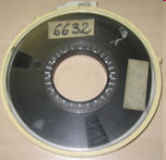
Backups & Log Files
Distinguish among the following types
of backups:
System vs application
Full (everything)
Differential (aka “Partial”) (everything changed since last full)
Incremental (everything changed since last incremental) (aka “Partial”)
Delta (only changed data) (aka “Partial”)
Log files (only the information about the changes)

Slide 40
Backup Types
Do not use the term “partial backup.”

Slide 41
Recovery from Log Files
Roll-backward recovery
  Use log file to identify interrupted (incomplete) transactions using checkpoints
    Look for start marker without end marker
  Remove all changes that are part of those incomplete transactions
Roll-forward recovery
  Start with valid backup
  Use log file to re-apply all completed transactions
  Leave out the incomplete transactions
Which kind of recovery is faster?

Slide 42
Protecting Batch Files
Batch processing as defined in Computer Desktop Encyclopedia:
(1) Performing a particular operation automatically on a group of files all at once rather than manually opening, editing and saving one file at a time. For example, graphics software that converts a selection of images from one format to another would be a batch processing utility.
(2) Processing a group of transactions at one time. Transactions are collected and processed against the master files (master files updated) at the end of the day or some other time period. Contrast with transaction processing.

Slide 43
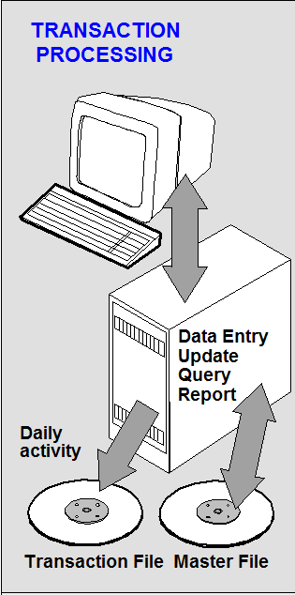
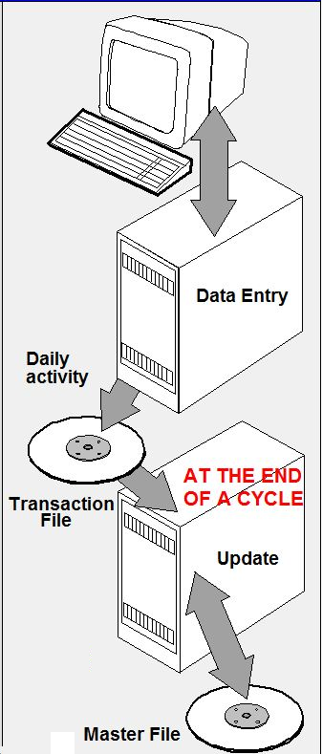
Batch Processing (2)
© Computer
Desktop
Encyclopedia

Slide 44
Batch Processing (3)
Normal batch processing automatically keeps original files as default backups
Process master file + transaction file(s)
  Copy unchanged records into new file
  Copy modified records from transactions
  Don’t copy deleted records
End up with
  Original master file
  New master file
  Transaction (activity) files
Typically keep several generations of masters

Slide 45

Assuring that Information in the System is Valid
Validation Controls: catching data input errors
  Check digits in input stream
  Hash totals
  Digital signatures
  Range checks
  Table lookups (including combinations)
Diagnostic Utilities: catching data corruption or tampering
  Edit checks
  Business rules
  Exception reports
  Statistical Quality Control (SQC) methods (anomaly detection)

Slide 46
Review Questions (1)
Distinguish between SQA and application controls.
Why should we pay attention to applications when planning our security procedures?
Why are databases of such concern in application security discussions?
Name and distinguish between the two fundamental types of data corruption (by cause).
Explain the concept of referential integrity using examples.
How do DBMSs enforce uniqueness constraints?

Slide 47
Review Questions (2)
Why do concurrently-accessed databases require locking strategies?
What’s a transaction?
What is meant by atomic transactions?
How is a transaction marked in a log file?
Which has finer granularity, locking an entire dataset or locking a set of records?
Distinguish between exclusive and shared locks.
Distinguish between conditional and unconditional locks.
What’s a deadlock and how can you prevent it?

Slide 48
Review Questions (3)
Distinguish between pessimistic and optimistic locking strategies.
What does ACID mean in discussions of transactions? Explain each of the components.
Why do production applications normally include log files as part of their design?
Explain how roll-backward recovery works.
Explain how roll-forward recovery works.
Discuss the security features of batch processing.
Explain how applying each of the validation controls described in slide 45 could help check the validity of stored information in a database.

Slide 49
Now go and study

