Slide 1
Monitoring & Control Systems
CSH6 Chapter 53
“Monitoring and Control Systems”
Caleb S. Coggins and Diane E. Levine
Notes:
M. E. Kabay, PhD, CISSP-ISSMP

Slide 2
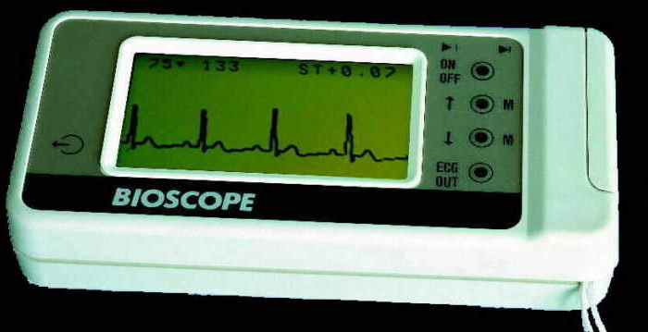
Topics in CSH6 Ch 53
Introduction
Change & Security Implications
System Models
Targets & Methods
Log Management
Data Aggregation & Reduction
Notifications & Reporting
Monitoring & Control Challenges

Slide 3
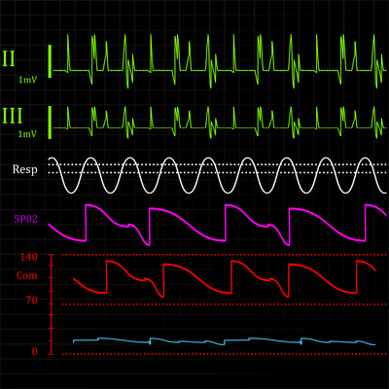
Introduction (1)
M&C systems involve
Prevention
Detection
Response
Topics
Prevention, Detection & Response
Controlling vs Monitoring
Control Loop
Defining Scope & System Requirements

Slide 4
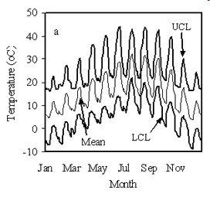
Introduction (2)
Monitoring systems provides basis for
Quality control
Anomaly detection
Key elements
System log files
Data reduction programs
Additional resources
Application program log files
Statistical analysis tools and knowledge

Slide 5
Prevention, Detection & Response
Cost-effective solutions to mitigate risks
IDS (intrusion detection systems, CSH6 Ch 27)
IPS (intrusion prevention systems, CSH6 Ch 26, 27)
UTM (unified threat management)
Anti-malware systems (CSH6 Ch 16, 17, 41)
Detection: identifying problem
Response
Monitoring system: logging, alarms
Control system: change parameters
Failure to detect & respond may have business & legal implications (lack of due diligence)

Slide 6
Purpose of Monitoring & Control Systems
Who is doing what when?
Can contribute to self-regulation
Knowing that actions are monitored can reduce harmful behavior
Increases self-awareness
Provide information for controlling system
Limiting access in response to observations
Changing conditions in response to trends
Serve forensic investigations
http://tinyurl.com/2o9frb

Slide 7
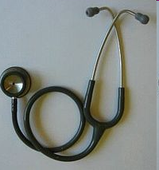
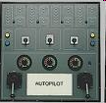
Controlling vs Monitoring (1)
Monitoring
Periodically checking aspects of operating environment
Encourages constant awareness and vigilance
Spot anomalies or trends
Predict and prevent problems and attacks
Control
In this context, refers to comparing observations with policies and standards
May be referred to as audits or assessments

Slide 8
Controlling vs Monitoring (2)
Monitoring modalities
Continuous Mode
Real-time
Firewalls, IDS, IPS, Anti-malware
Batch mode
Periodic analysis
Assessments and audits
Controls
CobiT* (CSH6 Ch 44, 49, 53, 54, 67)
Based on well-defined policies
*Control Objectives for Information and Related Technology

Slide 9
Control Loop
Humans usually remain in control loop
Controller
Target system
Bidirectional communication path
Transmitted data
Some systems require automated response
E.g., dangerous breaches (gas pipeline) cannot wait for human intervention
But others should be open loop and require supervisory decisions (e.g., patch management)

Slide 10
Defining Scope & System Requirements
Management must define
Extent of application (scope)
Capabilities required for success (requirements)
Technical requirements depend on specific systems
Often require
Hardware
Software
Intellectual property rights
Training
Personnel

Slide 11
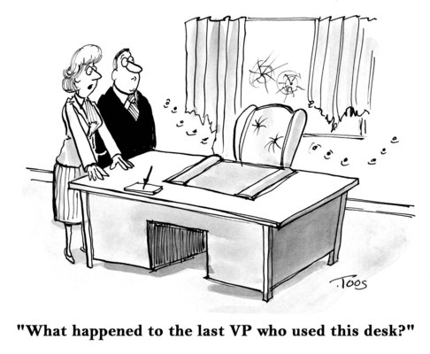
Change & Security Implications
Regulations, Policies & Frameworks
Change Management
Configuration Protection
Performance Considerations

Slide 12
Regulations, Policies & Frameworks
Compliance requirements may determine specific needs; e.g.,
HIPAA (CSH6 Ch 71)
GLB (CSH6 Ch 64)
SoX (CSH6 Ch 54, 64)
Frameworks support M&C; e.g.,
CobiT
CobiT: Control Objectives for Information & Related Technology
GLB: Gramm-Leach-Bliley Act
HIPAA: Health Insurance Portability & Accountability Act
SoX: Sarbanes-Oxley Act

Slide 13
Change Management
Immediate awareness of changes in operational status valuable
Can identify tampering with production code & data
Or can lead to identification of malware, attacks
Records serve for diagnosis, analysis & prediction

Slide 14
Configuration Protection
Changes in (production) systems require careful attention to detail
Checklists
Approved equipment & specific parameters
Approved software & specific patches
Monitoring / logging systems simplify task of spotting unauthorized or incorrect changes
E.g., installation of unauthorized WAP (wireless access point) may generate unusual traffic (and threaten confidentiality)

Slide 15
Performance Considerations
Addition of monitoring hardware, software may affect performance
Some systems run on host being monitored – may use system resources
Process-table related
CPU, RAM
Others connect to network
May affect throughput
Avoid implementing new systems without performance trials
Don’t install during full production period
Performance Evaluation Time

Slide 16
Volume Considerations
Decide how often to close log files
Disk space not much of an issue now
In 1980, a 120 MB hard disk cost U$25,000
Approx U$100,000 in 2013 value
U$833/MB
In 2015, a 3 TB Western Digital external hard disk cost $90
~U$7.6294E-5/MB ($0.000076294/MB)
~40% drop per year compounded over 35 years)
Main issue today is preventing data loss if system or logging process crashes
Especially important to fight ransomware
Image shows HP7925 120 MB drive c. 1980 (1980 cost U$25,000)

Slide 17
System Models
Internal, 1:1, 1:N, Distributed
Automation & HMI
Snapshots vs Real Time
Memory Dumps

Slide 18
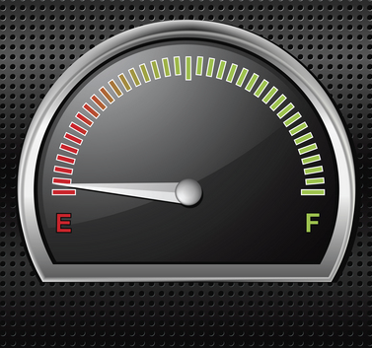
Internal, 1:1, 1:N, Distributed
Internal – monitor/control itself
1:1 – 1 system monitors another; e.g., firewall, fault-tolerant parallel systems
1:N – central M&C system for many systems; reduces costs, improves efficiency (more centralized logging, review, audit)
Distributed – sensors & controls dispersed; central logging collector; ideal for heterogeneous systems

Slide 19
Automation & HMI
24-7-365 systems need automated M&C
High volumes make manual inspection/response to alerts impractical
Human-machine interface (HMI) allows operator to communicate with and control system
Typically intervene for highly unusual events or patterns
IPS can interact to defend against dispersed attacks (e.g., worms, DDoS)

Slide 20
Snapshots vs Real Time
One-point-in-time records useful for
Auditing
Problem diagnosis
Incident response
Forensic analysis
Real-time monitoring & control
Continuous sensing & response
E.g., industrial processes & systems such as gas pipelines or manufacturing systems
On Web sites, include IDS & IPS
Real-time log analysis → intelligent pattern recognition

Slide 21
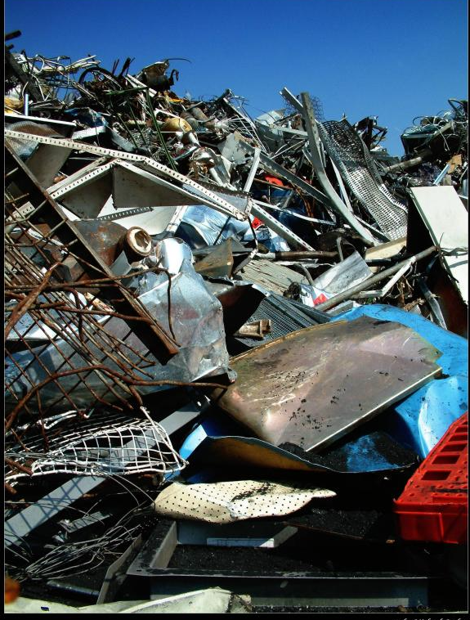
Memory Dumps
Overview
Diagnostic Utilities
Output to Magnetic Media or Paper
Navigating the Dump Using Exploratory Utilities
Understanding System Tables
Security Considerations for Dump Data

Slide 22
Overview of Memory Dumps
Files containing entire contents of RAM
Useful for debugging and forensics
Two types
Obtained through diagnostic utilities (debuggers) in real time
Captured after system shutdown from copies made to other media

Slide 23
Memory Dumps
Copy contents of RAM (main memory)
Typically taken after system failure
Useful in forensic research/analysis
Methods
Diagnostic Utilities (debug)
Read RAM without file- system restrictions
Often include facilities for interpreting / representing system tables
Output to magnetic media or paper
Printing difficult with large amounts of RAM
Generally no longer print to paper

Slide 24
Navigating the Dump Using Exploratory Utilities
RAM too large to explore “manually”
I.e., by inspecting everything
Suppose we use 256 characters x 88 lines = 22,528 bytes/page
Then 1 MB would take ~46.55 pp
So 2 GB would take 95,325 pp
If inspection rate were 1 minute per page (FAST), would take 66 days to read the dump once
Use utilities to navigate through tables at will
Search for strings

Slide 25
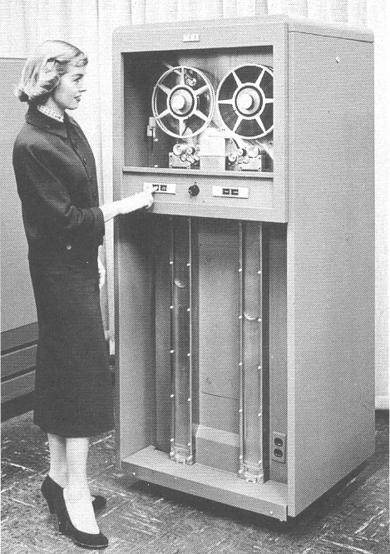
Output to Magnetic Media or Paper
Early systems allowed printing contents of RAM to paper; e.g., 2 MB filled stack a few inches thick
Today’s capacities cannot reasonably be printed in totality
Even PC RAM of 2GB on paper could be several feet high
More reasonable to write to disk, DVD
Analyze from those media
Especially valuable in forensic examination
Non-volatile, non-writeable media preferred
http://www.columbia.edu/acis/history/701-tape.html

Slide 26
Diagnostic Utilities
System-level DEBUG utilities give complete access to RAM
Thus allow total bypass of system security
Extremely powerful = dangerous tools
Can copy or alter any portion of memory
Usually access system tables by name, make changes
Stop processes, alter priorities etc.
Critically important to control access to these tools
Separation of duties – approval, supervision

Slide 27
Memory Dumps
Security important for dumps
Much sensitive information in clear
Passwords, keys
Confidential data from databases etc.
Classified data
Therefore must safeguard physical and electronic access
Label clearly and unambiguously to prevent accidental usage
Store securely in physically-restricted facilities
Vault, safe
ID & signature required for acces

Slide 28
Security Considerations for Dump Data
Be aware that dumps can be major security vulnerability
Contain cleartext versions of vast amounts of confidential and encrypted data
Includes I/O buffers such as input from keyboards and files or output to displays and files
Can be disaster to release dump
Serious question about whether vendor should be permitted to see memory dump

Slide 29
System Tables
Examples of Critically Important System Tables
Process control block (PCB) – pointers to all the running processes (“Task Manager” listing in Windows)
Process tables – all current details for every process
Data stacks – variables for each process & stack markers showing trail of execution
I/O Buffers – data in transit
Memory-management tables
Inter-process communication (IPC) tables
Flags, semaphores, status fields

Slide 30
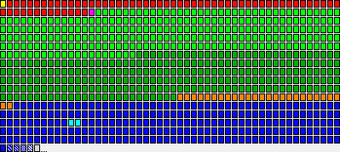
Understanding System Tables
Operating systems differ in detail
Basic concepts similar
Key tables include
Process control table
Process tables
Data stacks
Buffers
Memory management tables
IPC tables

Slide 31
Targets & Methods of Logging
Overview
Process Flow & Job Scheduling
Network Connectivity
Environmental Concern
System State
System Components
Process Activities
File System
Access Controls

Slide 32
Overview of Targets & Methods
Choices depend on specific context
Consider mission-critical operations / systems; e.g.,
Process flow
Job scheduling
Network connectivity
Environmental measurement
System states
System components
Process activities
Configuration settings
File system information
Access control

Slide 33
Process Flow & Job Scheduling
Batch job scheduler tracks jobs
Ideally, use centralized job scheduler/logger
May have to connect to remote systems
If necessary, plan for incremental, gradual migration
Allow for adaptation, learning
Reduce stress on mission-critical production systems

Slide 34
Network Connectivity
Devices, protocols, media
Network operations center (NOC) monitors
Status of links
Status of key devices
Bandwidth utilization
Zigbee standard
IEEE 802.15.4 standard
Local, ad hoc network connectivity usually applied to M&C
Need to plan for distributed systems to interconnect

Slide 35
Environmental Concerns
Physical factors
HVAC: Temperature, humidity
Electrical power: voltage, amplitude (spikes, brownouts), continuity
Fire, smoke, water threats
Perimeter breaches (breakins, intruders, vandalism)
Critical for business continuity (see CSH6 Ch 58)
Ideally monitoring & trend analysis provides early warning
Allows preemptive action to stop problem or initiate emergency responses

Slide 36
System State
Critical variable on target system
E.g., M&C system for electrical power grid looks at electricity flow & individual components of network (generators, transformers, transmission lines)
Software agents run on target (host) system & report to monitoring hub
Host intrusion prevention systems (HIPS) monitor nodes in network
Centralized reporting
Attack correlation
Useful data for postmortem analysis

Slide 37
System Components
Track usage of specific elements
CPU
RAM
Storage
Operating systems may include resources
Specialized software available
Data support trend and anomaly analysis

Slide 38
Process Activities
Process in particular execution of specific piece of code on specific CPU by specific user at particular time
Process = {code X CPU X user X time}
Every process should be
Known
Authorized
Antimalware products monitor for unauthorized processes
May also monitor processes for chargeback systems
Organizational users pay for their share of resource investment & operational costs
Plus: useful in anomaly detection

Slide 39
File System
Who is doing what to which data when?
Helps in diagnosing system / application errors
Log files have different types of records corresponding to different type of file activities
More later….

Slide 40
Access Controls
Recording who asks for and receives (or doesn’t receive) access to resources
Critically important for security management
May identify malefactors before they can do damage
Also generally supports resource management
Identify anomalies
E.g., “Nurse Betty” has been logged on to terminal for 72 hours….

Slide 41
Log Management
Log Generation
Types of Log File Records
Automation & Resource Allocation
Log Record Security

Slide 42
Log Generation
Log files are records of events
Basic building block for M&C systems
Digital audit trail
Often not enabled by default
Many different types typically available
Must configure logging appropriately
May ignore some events; e.g., opening utility file of no sensitivity
Transaction logs
Often store copies of original records
Plus copies of change instructions or images of changed records (takes more space)
Must define policies for log retention

Slide 43
Types of Log-File Records
Log file = audit trail
Many types (not discussed in detail in this presentation – see 53.5.2.1-18)
System boot | System shutdown | Process initiation
Process termination | Session initiation | Session termination
Invalid logon attempt | File open | File close
Invalid file access attempt | File I/O | System console activity
Network activity | Resource utilization | Central processing unit
Disk space | Memory

Slide 44
Data Aggregation and Reduction
Centralized Data Stores
Filtered Queries
Analyzing Log Records

Slide 45
Automation & Resource Allocation
Keeping logs defined, organized and available contributes to effective & efficient system management
Data retention requirements growing
Include log files in policies
Weigh retention policies and centralization / consolidation policies
Scalability important
Estimate operational / financial costs of collecting, analyzing & storing logs from disparate systems in central repository

Slide 46
Log Record Security
Protect log records against unauthorized access
Methods
Access control lists (ACLs)
Checksums
Encryption
Digital signatures
Chain of custody important
Track all transfers
Use secure off-site repositories

Slide 47
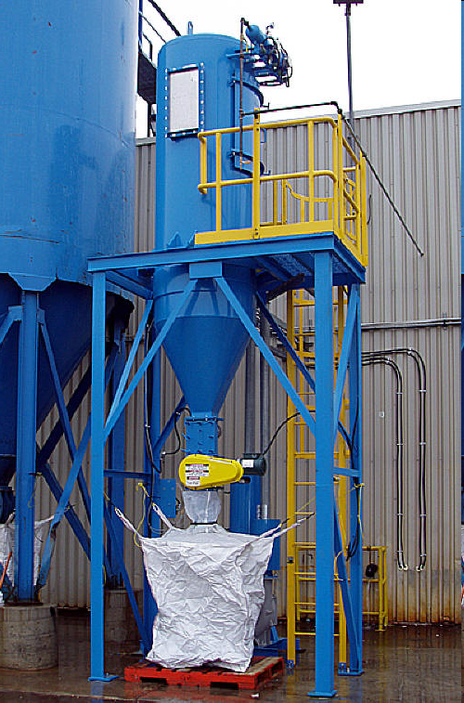
Analyzing Log Files
Volume Considerations
Archiving Log Files
Platform-Specific Programs for Analysis
Exception Reports
Artificial Intelligence
Chargeback Systems

Slide 48
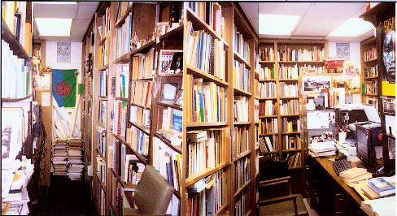
Archiving Log Files
Decide how long to keep log files
Usually legal requirements
Establish definite policies
Monitor and enforce
Safeguard archives (environmentally-sound and secure storage facilities)

Slide 49
Platform-Specific Programs for Analysis
Each operating system can have particular variations in log file structure
Look for log-file analysis tools specific for your environment
GOOGLE provides wealth of references with keywords “operating system log file analysis”
AWStats – GNU GPL
Argus – Sun Solaris, UNIX variants
Sawmill – Web-related files

Slide 50
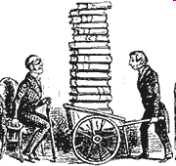
Exception Reports
Often impossible to examine all records
May be millions of events in single log file
Need to break out unusual events
Can set filters to scan for unusual conditions
Systems define baselines events (the norm) and spot unusual ones
Human beings often scan the exception reports
Sophisticated systems use AI to spot patterns and anomalies
http://www.thehousehistorians.co.uk/Images/Books.gif

Slide 51
Artificial Intelligence
AI systems can be based on statistical quality control (SQC)
Spot multi-sigma deviations; e.g.,
No more than one user logon in a thousand has used an ID from the accounting department between the hours of midnight and 06:00
So why is “Ralph” trying to logon at 03:30?
What’s more, “Ralph” has not had to try his password more than twice in 1523 logons
So why is “Ralph” trying his 18th password at this time in the morning?
Can handle more sophisticated patterns

Slide 52
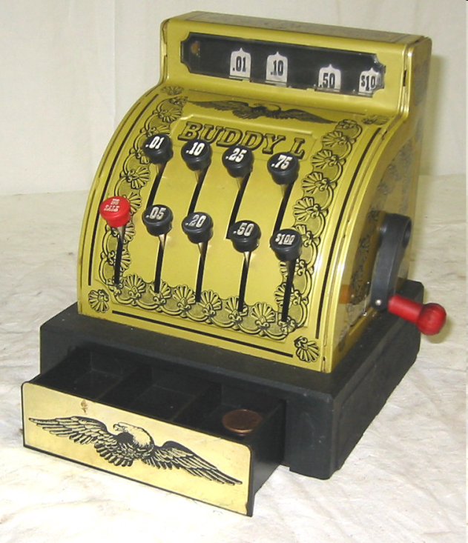
Chargeback Systems
Log files used to allocate costs to all possible resource utilization; e.g.,
$0.00001 /disk I/O;
$0.00002/process initiation; etc.
Users receive itemized bills (e.g., monthly) showing resource utilization
Promotes optimization with help of users
Can alert user to unusual events or misuse: “Why is our bill 3 times higher this month??”
Because there’s a serious error in your code; or
Because you’ve been hacked!

Slide 53
Protecting Log Files Against Alteration
Checksums
Digital Signatures
Encryption
Physically Sequestering Media

Slide 54
Checksums
Can generate hash total and append to each record
Any change that does not use the right algorithm to change the checksum will be identified
If checksum includes data from previous record, chaining makes changes very difficult for attacker
Attacker has to recreate entire chain of records starting at modified or deleted one

Slide 55
Digital Signatures
Can sign an entire file using public key cryptography (PKC)
Create checksum
Encrypt using a private key
Check by decrypting using public key
Check validity by recomputing signature and comparing value against decrypted original signature
See next slide for reminder of how PKC works
-----BEGIN PGP SIGNATURE-----
Version: PGP 8.1
Comment: Digitally signed by M. E. (Mich) Kabay, PhD, CISSP-ISSMP

Slide 56
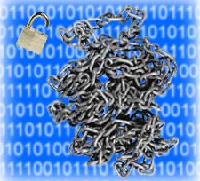
Encryption
Can also just encrypt the entire file
Then an attacker who lacks the appropriate key can do nothing with the file at all except delete it

Slide 57
Physically Sequestering Media
Same principles apply to log files as to any other form of valuable data
Can make backups
Store media in secure, safe storage facilities
Access controls
Environmentally stable
Fire-resistant
E.g.,
Iron Mountain
ArchiveAmerica
Many others….

Slide 58
Notifications and Reporting
Alerts
Trend Analysis and Reporting

Slide 59
Alerts
Crying “wolf” not good – don’t overwhelm operators with stream of minor alerts
Judge operational value of information
Out-of-band monitoring can detect errors undetectable by monitored system itself
Alerts: email, pager, phone, SMS
Human Machine Interface (HMI)
Situational awareness
Virtual buttons, meters, graphs
Management dashboard to report on ignored alerts

Slide 60
Trend Analysis and Reporting
Analyze pace of security improvements
Consistency of internal controls
Peaks in violation of security policies between audits – danger sign
Chargeback (discussed earlier) can spark serious examination of trends
Exception reports identify anomalies

Slide 61
Monitoring and Control Challenges
Industrial Control Systems
Mobile Computing
Virtualization

Slide 62
Industrial Control Systems (ICS)
Distributed Control Systems (DCS)
Relatively autonomous, little human interaction
E.g., oil refineries
Supervisory control and data acquisition (SCADA)
Extensive HMI
Direct communication with programmable logic controllers (PLCs)
Increasing use of networking
Often unsecured logically and physically

Slide 63
Mobile Computing
Data in transit
To/from PCs, laptops, tablets, phones & radio-frequency identification (RFID) systems
Often over unsecured channels
Must move to virtual private networks (VPNs)
Data at rest
In PCs, laptops, tablet and phones
Often unsecured
Must move to data encryption
BYOD: Bring Your Own Device
Increasing complexity for sysadmins
Wide range of hardware & software to monitor & control

Slide 64
Virtualization
Virtualization supports hardware sharing
Physical hardware
Virtualization interface (VI)
Virtual machines (VMs)
Entire operating systems or
Specific applications
Hypervisors can support different VMs
Migration
VMs can move from hardware device to device
Must define and monitor security policies
E.g., could prohibit hypervisor from managing internal, high-security systems & public, low-security systems on same hosts

Slide 65
Review Questions (1)
How can monitoring system data contribute to information assurance?
Which type of log file record includes information about the following events and how can you use these records for IA purposes?
When the system started?
When the system stopped?
Who launched a process and when?
Total amount of various system resources (CPU, I/O, swaps of VM, maximum priority, etc.) used by a process during its lifetime?
Who started a session on the system and when?
Total system activity carried out by a user during a session?
Number of bad passwords entered during logon attempts?
Who opened which file at what time for which purposes?
How much I/O a specific file was involved in while it was open?
Who tried to access files in unauthorized ways?
Detailed records of exactly what information was written into a database?
What messages were sent to the system operator?
Data about Internet connections?

Slide 66
Review Questions (2)
Why do most sites no longer worry about the disk space consumed by log files?
Whom should you consult when deciding on how long to keep log files? Why?
What are exception reports and why do we need them?
How can chargeback systems help us improve IA?
What mechanisms are there to protect log files against tampering?
Why are memory dumps highly sensitive from an IA perspective?
Why do we need special diagnostic utilities to navigate through today’s memory dumps?

Slide 67
Now go and study

