Slide 1
Auditing
Computer Security
Supplement to CSH5 Chapter 54
“Security Audits, Standards and Inspections”
Notes by M. E. Kabay, PhD, CISSP-ISSMP
Assoc Prof Information Assurance
School of Business & Management
Norwich University
Notes:
M. E. Kabay, PhD, CISSP -ISSMP

Slide 2
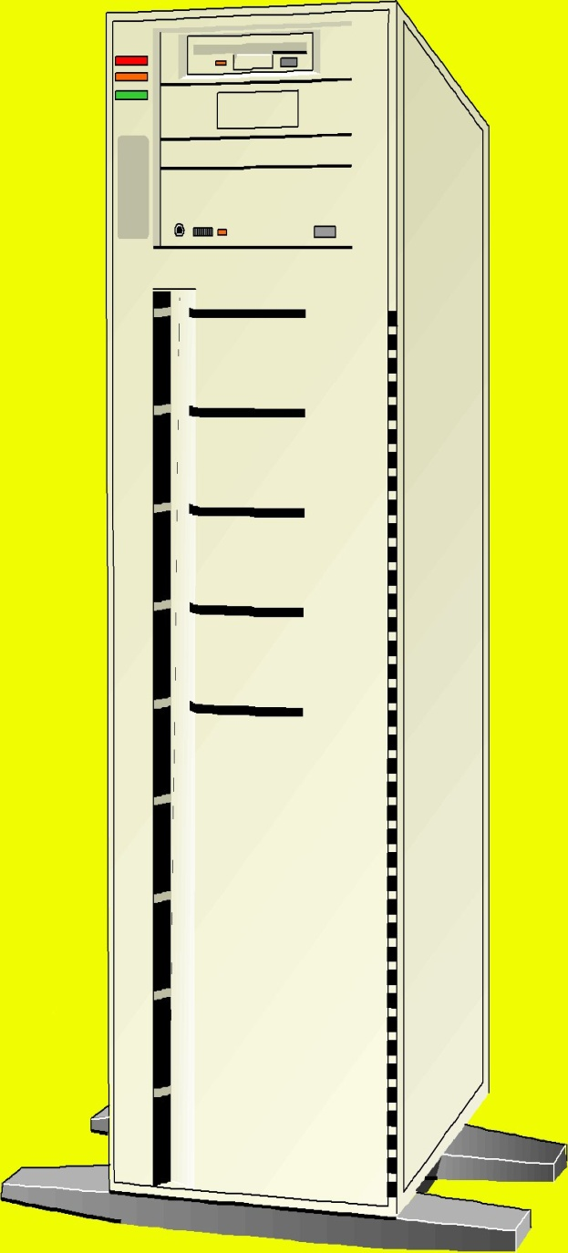
Topics
Introduction to Auditing
EDP System Controls
Responsibility for Control of EDP
Auditing Computer Applications
Reporting Audit Results

Slide 3

Introduction to Auditing
Controls
Auditors
External & Internal Auditors
EDP Auditors
Scope of Computer Security
Security Audits vs Security Assessments
Psychological Aspects of Audits and Assessments

Slide 4
Controls
Traditional financial controls
  Financial records
  Accuracy – correct representation of reality
  Integrity – resistance to unauthorized modification or destruction
  Authenticity – correct attribution of information
Internal controls
  Protection of assets
  Reliability of information

Slide 5

Auditors
Auditors are independent assessor of internal controls
Reports to stakeholders
  Management
  Regulatory authorities
  Shareholders
  Employees
  Clients
  Suppliers
  Public

Slide 6

External & Internal Auditors
Internal auditors report to board of directors
  Safeguard assets
  (physical, data, $$)
  Ensure accuracy and
  reliability of data
  Promote operational
  efficiency
  Enforce adherence to
  policies
  Compliance with
  regulatory/legal
  requirements
External auditors hired
for completely independent evaluation
  Potential problems if external auditors see their interests too closely tied to those of management

Slide 7
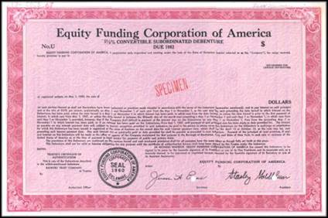
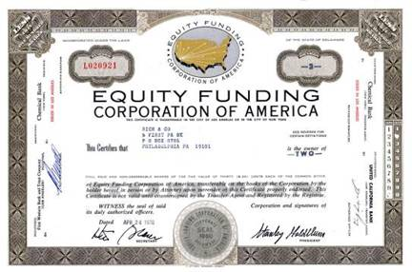
The Equity Funding Fraud (1)
Public Offering 1964
Earnings ~ $390,000
Revenues ~ $3 Million
1973
> Half of 99,052 policies – fake
I.e., > 49,526 policies with an estimated worth of $2 Billion
By the end of 1972
Earnings > $22 Million
Revenues of 152.6 Million
Assets of $750 Million
Net Worth of $143.4 Million
Of $117 million in loan receivables
$62 Million did not exist
(Thanks to G. Will Milor for images and factual details)

Slide 8
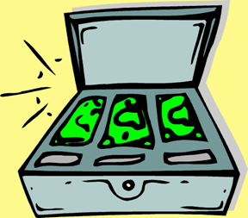
The Equity Funding Fraud (2)
Auditing firm accepted unusual delays in providing factual underpinnings for non-existent insurance policies
  Executives would create dossiers overnight
Fees for 1970*
  Equity Funding - $300,000 / year
  Next biggest - $75,000 / year
  Next biggest - $25,000 / year
ALL other accounts together did
not equal half of the yearly
revenue from EFCA
*Thanks to G. Will Milor, MSIA for factual details

Slide 9
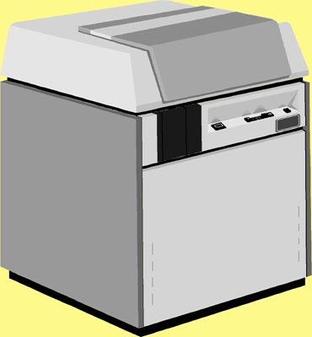
EDP Auditors
Early computers used mostly for accounting
Financial accountants audited computer systems by focusing on output
With wider applications and greater complexity, new field developed:
EDP auditing
Includes operational controls,
programming issues
Work with development,
operations, security personnel

Slide 10
Scope of Computer Security
Wide range of issues affecting six fundamental aspects of information in Parkerian Hexad:
  Confidentiality
  Control or possession
  Integrity
  Authenticity
  Availability
  Utility
Many aspects of data processing are interesting to EDP auditors

Slide 11
Security Audits vs Security Assessments
Distinction often made between audit and assessment
Audit determines compliance with stated policies
Assessment can go beyond policies and assess compliance with industry standards
  Best practices
  Formal standards such as ISO17799
  Consultant’s own experience and judgement

Slide 12

Psychological Aspects of Audits and Assessments
Auditors can be viewed as threats
  Staff may perceive audit
  as blame game
  “Failure” of audit leads
  to punishment
  Auditors are “the enemy” or “spies”
Work to defuse negative
feelings
  Meet staff at start of audit
  Encourage cooperation
  Part of continuous process improvement
  Not intended to blame or punish individuals
  Everyone can suggest and benefit by improvements

Slide 13
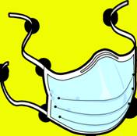

EDP System Controls
Apply controls to two spheres
  Overall EDP Controls
  Individual Application Controls
Focus on 3 types of controls
  Preventive
  Detective
  Corrective
Distinguish between types of controls
  Discretionary
  Mandatory

Slide 14
Overall EDP Controls
Separation of Duties
System Development Controls
Operations Controls
Change Control
Quality Assurance
Telecommunications
Program Libraries
Data Libraries
Hardware & Software Systems

Slide 15


Separation of Duties
Make crime more difficult by requiring collusion
Restrict computer-room access
Supervise visitors at all times
Restrict program & file access on need-to-know basis
Require at least 2 independent approvals for disbursements or operational changes
Segregate program development team from quality assurance personnel and from operations
Assign security responsibilities to separate chain of command

Slide 16
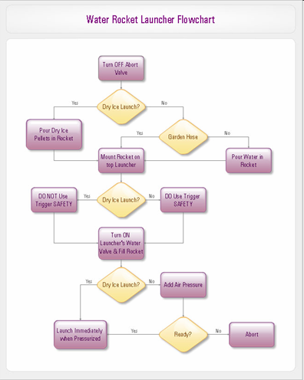
System Development Controls
Use formal system development methodology
Maintain proper documentation throughout system development
Integrate quality assurance throughout SDLC
Integrate security engineering throughout
Establish rigorous controls for maintenance (change management)
Establish documented operational procedures

Slide 17
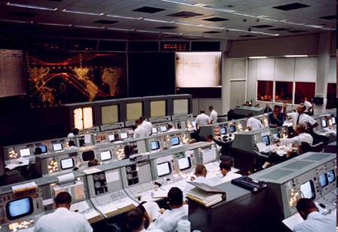
Operations Controls
Involve operations in SDLC from start
Develop and document SOP (standard operating procedures)
Verify adherence to SOP
Keep logs showing all
exceptional conditions
Verify logs for
completeness and accuracy
Require all production
code to pass quality
assurance (QA) procedures
before implementation
Proper management of all data media
Contribute to BCP and DRP (Business Continuity and Disaster Recovery Planning)
http://www.jsc.nasa.gov/history/jsc40/gallery/lores/S65-42424.jpg

Slide 18
Change Control
Written authorization from users and programming management
Document all changes
Document all regression testing
Complete and up-to-date revisions of all user and operational documentation

Slide 19
Quality Assurance
Specific people assigned to QA
QA part of SDLC at all stages
QA collaborate with operations

Slide 20

Telecommunications
Control access to reduce risks of unauthorized use
  Insiders and outsiders
Separate production from development networks
Use proper I&A methods
Encrypt data in flight and at rest
Monitor datacomm lines for abnormal events
Prevent misuse of corporate resources (piracy etc.)
Prevent physical access to network gear

Slide 21
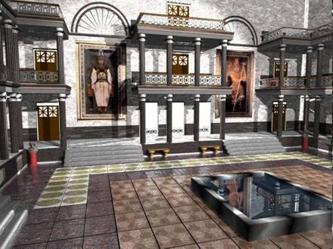
Program and Data Libraries
Product code to be stored in libraries
  Only authorized development personnel to make changes for specific reasons
  Only production personnel to use these libraries
Databases restricted
  Access strictly limited by need; e.g., accounting, engineering, personnel…
  Can further protect using selective views of data (only certain rows or columns for specific users)
  May also encrypt specific rows or columns
http://home.intekom.com/rylan/art/alexandria.jpg

Slide 22


Hardware & Software Systems
Access to physical
computer equipment
dangerous
Operating software must
be maintained in pristine
condition
  Known-good software
  used for reinstallation
Reduce risk of downtime
  Deliberate attack (sabotage,
  vandalism, extortion)
  Accident (oversight, error)

Slide 23
Individual Application Controls
Inputs
Processing
Output Controls

Slide 24

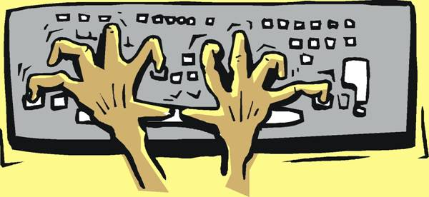
Inputs
Verify key entry
  Check digits
  Preprocessing edits
Batch controls
Master file references
Edit programs

Slide 25
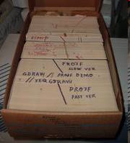
Processing
Test-decks with known outputs
Batch or total controls integrated into data stream
Cross-footing tests compare totals for consistency (e.g., sums of rows vs sums of columns)
Application reruns (with automated comparison of results in 1st and 2nd calculations)
http://tinyurl.com/22ek8q

Slide 26
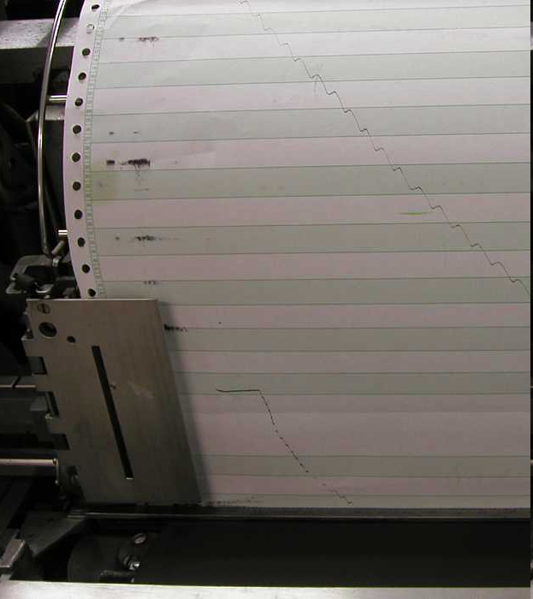
Output Controls
Verify quality of all output
  Files
  Tapes
  Disks
  Paper
For users, can be single most important metric of quality and service
http://ed-thelen.org/1401Project/1403PaperMovementRGOct05-.jpg

Slide 27


Responsibility for Control of EDP
Senior Management
EDP Management & Staff
Auditors

Slide 28

Senior Management
Create positive attitude towards control and security
Establish & communicate policies
Provide adequate funding for monitoring and awareness
Establish security steering
group

Slide 29
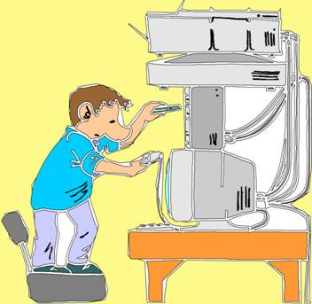
EDP Management & Staff
Assign specific person with responsibility and authority for controls; e.g.,
  Chief Information Security Officer (CISO)
  Information Systems Security Officer (ISSO)
  Data Security Manager . . .
Define staff functions; e.g.,
  Data classification
  Risk assessments
  Security awareness and
  training
  Data collection for cost
  justification. . .

Slide 30
Auditors
Internal auditors should not report to the managers whose systems they audit
  Ideally, should have a Director of Internal Audit who reports to the Board of Directors
  Same level as other “C” executives (CEO, COO, CFO, CIO, CISO….)
Collaborate with colleagues to improve controls and security
Non-adversarial stance more effective than punitive attitude

Slide 31

Auditing Computer Applications
Audit During Development
Work Papers
Data Audit Programs
Source Code Comparison Programs
Other File Comparison Programs
Computer-Assisted Audit Techniques
Special PC Issues
Backup & Recovery

Slide 32
Audit During Development
Work closely with Software Quality Assurance (SQA) personnel
Strive to identify and help correct flaws before they enter production
Cost of correction rises by 10x with every stage of the System Development Life Cycle (SDLC)

Slide 33
The System Development Life Cycle (SDLC)
Costs of
correction
Define Requirements
Design Specifications
Code Software
Fix Defects

Slide 34
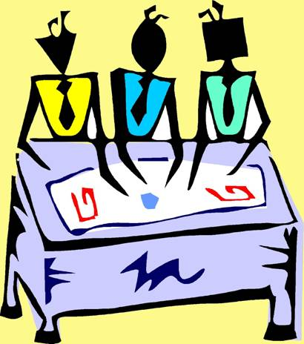
Work Papers
Detailed audit trail of all aspects of the investigation
  Meetings
  Reports
  Documents
  Correspondence
  (including e-mail)
  Checklists
  Test methods and results
  Responses to missing
  controls or data
Conclude with summary
evaluation of adequacy of
controls

Slide 35
Data Audit Programs
Special programs for investigating data
Diagnostic routines for databases
Verification of backup validity
Reading & interpreting audit logs
Auditing software licenses for piracy
Checking for pornography on workstations
Random sampling of data
Repeat calculations
Check for violation of business rules

Slide 36
Source-Code Comparison Programs (1)
Track all changes to source code for production programs
Compare compiled programs with source code ostensibly used to create them
Especially important for open-source programs
May not be possible for proprietary COTS software (no source code available without special contractual arrangements -- difficult)
See next page for example of comparison tool

Slide 37
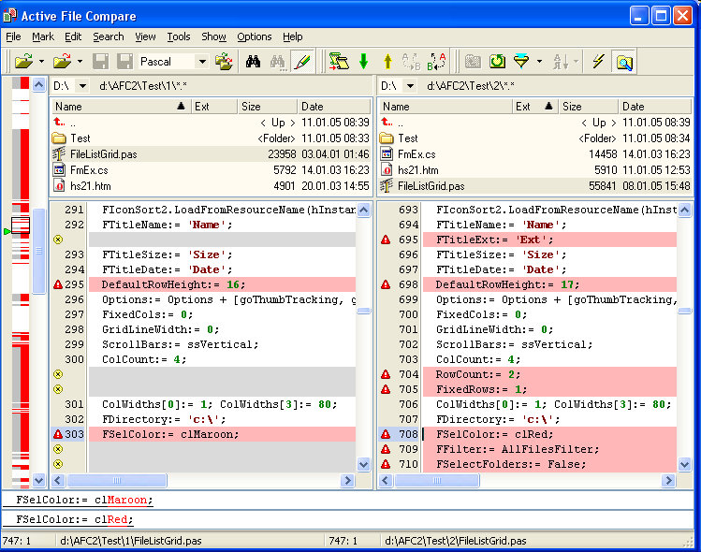
Source-Code Comparison Programs (2)
http://www.formulasoft.com/img/afcmain.png

Slide 38
Other File-Comparison Programs
Byte-for-byte comparison possible
Especially useful when comparing output of test run against production run
  Write output to spool files on disk
  Compare spool files
  Much used in system acceptance testing (QA)
Auditors can order a duplication of a production run and compare results to previous output

Slide 39
Computer-Assisted Audit Techniques
Wide range of tools available; e.g.,
  Generalized audit software
  Embedded audit data collection
  System utilities

Slide 40

Special PC Issues
PCs typically have fewer
security controls
Can serve as vector for
release of confidential
data
Some people develop ad hoc methods on their PCs that insensibly become production methods – but have no documentation or controls
Be on guard against unauthorized encryption of corporate data
Unauthorized use of PCs for disallowed functions (gambling, pornography, harassment, piracy, etc.)

Slide 41
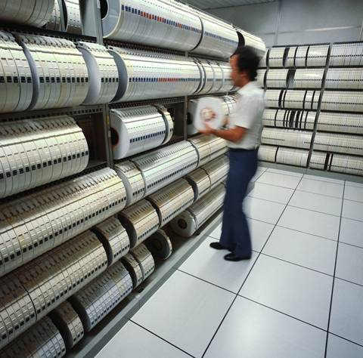
Backup & Recovery
All systems should have adequate BU and recovery in place
Verify that these methods are actually used
Verify that BU media are readable
  Some operators disable verification to “save time”
  Can result in disasters
Ensure that contingency plans are
  In place
  Tested
  Updated

Slide 42

Reporting Audit Results
Executive Summary (1 page)
Objectives
Methods
Results
Analysis
Discussion and
Recommendations
Graphical representation
of results often useful
(see following diagrams)

Slide 43
Summary of Status
1 Year Ago
1-year goals
Diagram copyright © 2005 George Mills
http://www.tribridge.com
Used with permission.

Slide 44
Summary of Current Status
1-year goals
Diagram copyright © 2005 George Mills
http://www.tribridge.com
Used with permission.

Slide 45
Goals for
6 Months From Now
Diagram copyright © 2005 George Mills
http://www.tribridge.com
Used with permission.

Slide 46
Long-Term Goals
Diagram copyright © 2005 George Mills
http://www.tribridge.com
Used with permission.

Slide 47
Review Questions (1)
What do you think are the advantages and disadvantages of internal vs external auditors?
Explain why separation of duties is important for security and give examples of what auditors look for in evaluating the quality of controls involving separation of duty.
What kinds of questions would an auditor ask about the system development practices in an organization being audited?
What does an auditor look for in program revision controls?
If you were doing an audit, how would you tell if telecommunications were being properly controlled?

Slide 48
Review Questions (2)
Make up an example to illustrate each of the four methods of input controls described in the text.
Why should an audit team keep careful written records of their methods and findings? Who cares about such things?
What are key elements an auditor looks for in operations security?
How do auditors verify that data processing is being carried out properly by application programs?
What are some of the special considerations auditors look for in evaluating PC policies and management?
Where do backups fit in the audit scheme?

Slide 49
DISCUSSION

