Slide 1
Cyber Investigation
CSH5 Chapter 55
Peter R. Stephenson

Slide 2
Topics
Introduction
End-to-End Digital Investigation
Applying Framework & EEDI
Using EEDI & Framework
Motive, Means, & Opportunity: Profiling Attackers
Some Useful Tools
Concluding Remarks

Slide 3
INTRODUCTION
Cyber Investigation Evolves
Defining Cyber Investigation
Distinguishing Between Cyber Forensics & Cyber Investigation
DFRWS Framework Classes

Slide 4
Cyber Investigation Evolves
Cyber investigation aka digital investigation
Early phases (before 2000) used term as equivalent to computer forensics
  “The investigation of a computer system believed to be involved in cybercrime.” – Computer Desktop Encyclopedia
  But cyber investigation now distinct discipline, not just a set of techniques
  American Academy of Forensic Science recognizes forensic computer-related crime investigator

Slide 5
A Note on Etymology
(added by Kabay)
fo·ren·sic [fə rénssik, fə rénzik] adjective
crime-solving: relating to application of science to decide questions arising from crime or litigation; forensic evidence
of debating: relating to debate & formal argumentation; forensic oratory
[Mid-17th century. < Latin forensis "of legal proceedings" < forum "forum" (as a place for discussion)]
Microsoft® Encarta® 2008. © 1993-2007 Microsoft Corporation. All rights reserved.

Slide 6
Defining Cyber Investigation (1)
Rogers, Brinson & Robinson establish cyber forensics as an ontology [on tólləjee] (plural on·tol·o·gies). noun
  1. study of existence: most general branch of metaphysics, concerned with nature of being
  2. theory of existence: a particular theory of being
[Early 18th century. < modern Latin, "study of being" < Greek ont- "being" (see onto-)]
Microsoft® Encarta® 2008. © 1993-2007 Microsoft Corporation. All rights reserved.
Stephenson’s ontology focuses on defining unique aspects of computer-related crime that can be studied

Slide 7
Defining Cyber Investigation (2)
Cyber investigation relies on taxonomy (tax·on·o·my) [tak sónnəmee] (plural tax·on·o·mies) noun
grouping of organisms: science of classifying plants, animals, & microorganisms into increasingly broader categories based on shared features. Traditionally, organisms were grouped by physical resemblances, but in recent times other criteria such as genetic matching have also been used.
principles of classification: practice or principles of classification
study of classification: study of rules & practice of classifying living organisms
[Early 19th century. < French taxonomie < Greek taxis (see taxis)]
Microsoft® Encarta® 2008. © 1993-2007 Microsoft Corporation. All rights reserved.

Slide 8
Rogers’ Taxonomy (1)
Two major classes
  Profession – structure of human endeavors
  Technology – subjects of investigation
Benefits
  Supports understanding of concepts
  Each additional sub-category supports more detail in analysis
  Framework encourages thorough attention to details
  Can serve as a checklist to avoid overlooking evidence
  Supports analysis of cyber crime

Slide 9
Rogers’ Taxonomy (2):
Exhibit 55.1 (revised)

Slide 10
Distinguishing Between
Cyber Forensics &
Cyber Investigation
Clarification:
“Cyber investigation
uses tools of
cyber forensics
as part of
investigative procedures.”

Slide 11
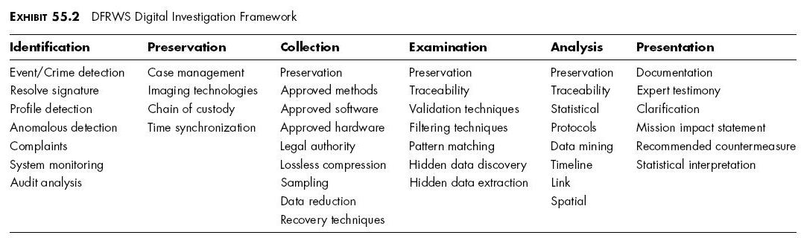
DFRWS Framework Classes
Digital Forensics Research WorkShop (2001)
Framework for digital investigation
Supports end-to-end digital investigation (EEDI)
Each class comprises elements

Slide 12
DFRWS Class: Identification
How investigator is notified of potential incident
  ~half of reports of possible security breaches turn out not to be crimes
Framework classes in Identification
  Event/crime detection: direct evidence (e.g., discovery of unauthorized access)
  Resolve signature: intrusion detection/prevention systems, gateway security devices using pattern recognition
  Profile detection: heuristic pattern recognition; attack scenarios, attack profiles
  Anomalous detection: deviation from observed norms
  Complaints: person reports event or results of event
  System monitoring: situational awareness processes
  Audit analysis: analysis of log files

Slide 13
DFRWS Class: Preservation
Management of evidence ensuring integrity
Case mgmt: notes, process controls, quality controls, procedural issues
Imaging tech: making bit-for-bit image copies of evidence
Chain of custody: preventing unauthorized access to & modification of evidence – preservers evidentiary value
Time synchronization (normalization):
  Ensuring that all time records use a common base time
  No evidence modified
  Determine offsets from a baseline (e.g.,
  “- 0:00:07.6 GMT-5” for 7.6 seconds behind GMT-5)

Slide 14
DFRWS Class: Collection (1)
Approved methods:
  General acceptance by courts
  E.g., qualifying under Daubert rule for admission of technical information – see CSH5 Ch 73
  Or qualified under current case law
Approved software: source code identical to that of tool that has qualified in courts (see above)
Approved hardware: same principles as above
Legal authority: policy (e.g., for owner of equipment), subpoena, warrant
Lossless compression: provable fidelity

Slide 15
DFRWS Class: Collection (2)
Sampling: demonstrated validity & safety for data
Data reduction:
  Valid, repeatable, provable results
  Applied only to copies of evidence
Recovery techniques
  Extraction of useful data from data repositories
  Comply with all court-permitted techniques
  Forensic investigators must keep up to date with current case law

Slide 16
DFRWS Class: Examination (1)
Traceability or chain of evidence
  Clear documentation of reasoning linking evidence to other evidence (not conclusions)
  Traceability & continuity of chain of evidence crucial to credibility of conclusions
  Distinct from chain of custody!
Validation techniques
  Corroboration
  May involve demonstration of internal consistency
  Resistance to claims that evidence has been modified or fabricated

Slide 17
DFRWS Class: Examination (2)
Filtering techniques
  Sometimes source filtering (e.g., IDS) eliminates some data in stream
    Must supply courts with evidence of techniques used
    Demonstrate validity of remaining records
  Also refers to extraction of relevant data types (e.g., images) from data
    May include comparison using hashes
    All such tools & techniques must be understood by investigator / examiner
    Understanding includes clear grasp of appropriate usage & a reasonable grasp of underlying principles (see Daubert Rule)

Slide 18
DFRWS Class: Examination (3)
Pattern matching
  Finding potential events by matching signatures & other patterns
  E.g., Intrusion-detection & anti-malware systems
Hidden data discovery
  Deleted but recoverable
  Stored outside a file system’s control
  (e.g., slack space)
  Encryption
  Steganography
Hidden data extraction
  Getting reliable data from sources described above

Slide 19
DFRWS: Analysis
“Fusion, correlation & assimilation of material for reasoned conclusions.”
Tying together evidence into coherent & probably correct scenario of events
Ideally use accepted standards for processes of deduction & induction
  Deduction: reaching a conclusion by applying rules of logic
  Induction: forming a generalization based on observed evidence

Slide 20
DFRWS: Presentation
Reporting facts with organization, clarity, conciseness, & objectivity
  Organization: using a comprehensible structure
  Clarity: unambiguous, easily understood communication
  Conciseness: using fewest words possible to supply necessary information
  Objectivity: free from bias, not trying to convince anyone of a particular interpretation
See CSH5 Ch 73 for recommendations on being an expert witness in court

Slide 21
END-TO-END DIGITAL INVESTIGATION
Collecting Evidence
Analysis of Individual Events
Preliminary Correlation
Event Normalizing
Event Deconfliction
Second-Level Correlation
Timeline Analysis
Chain of Evidence Construction
Corroboration

Slide 22
Collecting Evidence
Approved tools & techniques
Trained technicians
Time sensitive
Incidents must be considered in context of prior, concurrent & following events
  Events are most granular element of incident
  Incidents are collection of events that lead or could lead to a compromise
  Incident becomes a crime when laws are broken
Critical data collection includes
  Images of affected computers
  Logs of intermediate devices (esp. Internet)
  Logs of affected computers
  Logs & data from intrusion detection systems, firewalls etc.

Slide 23
Analysis of Individual Events
Events may leave records in multiple places
Analysis assesses value of events to investigation
Tie events into each other
Aim to understand incident
  Put events into coherent narrative

Slide 24
Preliminary Correlation
Correlation distinguishes among
  Evidence that stands alone (unique events)
  Evidence recorded in different ways & located in different places
  Evidence that supports other information located elsewhere
Corroboration supports formulation of chain of evidence
  Consistent description of incident
  Time sequences are called timelines
  Causal sequences impute causes & effects

Slide 25
Event Normalizing
Combine evidentiary data from multiple sources
Eliminate duplications to ensure each unique event is correctly represented once in timeline & causal sequence

Slide 26
Event Deconfliction
Some events have multiple repetitions of identical or near-identical steps
  E.g., denial-of-service attacks may have 1000s of similar or identical packets flooding perimeter
  These may be defined as subevents
If reasonable, may define multiple subevents
    e.g., probes
  that occur in a defined time period
    e.g., 48 seconds
  as a single event
    e.g., “Denial-of-service”

Slide 27
Second-Level Correlation
Normalization & deconfliction should support creation of a coherent picture of events
Second-level correlation of remaining data establishes a basis for building chains of evidence

Slide 28
Timeline Analysis
Use normalized, deconflicted data to create a sequence (timeline) of events
Expect to update constantly
Iterative process
  Event analysis
  Correlation
  Deconfliction
  Timeline analysis

Slide 29
Chain of Evidence Construction
Ideally
  Each link in chain supported by evidence
  Leads to next link
In reality
  Often gaps in chain
  Must infer links
    Not evidence: a lead
    May point to legitimate evidence
  May also corroborate missing or dubious link
    If all corroboration points to same link, may be acceptable

Slide 30
Corroboration
Match every element of chain of evidence
  With other, independent evidence
  Using correlated & uncorrelated data
Best evidence
  Developed using digital methods
  Corroborated using traditional investigative methods
Final evidence chain
  Digital & traditional evidence
Similar process in investigation vs postmortem analysis

Slide 31
APPLYING THE FRAMEWORK & EEDI
Overview
Supporting EEDI Process
Investigative Narrative
Intrusion Process
Describing Attacks
Strategic Campaigns

Slide 32
Overview
Evidence management is paramount
DFRWS Framework & EEDI
  Help manage evidence
  Not substitute for good investigation
Incident may be crime – or not
  Even if crime, might not be prosecuted
  E.g., corporation may decide not to pursue civil complaint

Slide 33
Supporting EEDI Process
Traditional investigators often resist process
Prof Stephenson’s research finds practice conforms to his recommendations
Thus DFRWS Framework & EEDI can serve traditional investigators entering world of cyber investigation
Provide guidance on sequence of actions in investigation

Slide 34
Investigative Narrative
Investigator’s detailed notes
EEDI supports construction of investigation using framework(s)
DFRWS Framework helps focus attention on all elements of situation
E.g., DFRWS Collection class refers to authorized/approved methods
  Therefore must be careful to use accepted, standard software, hardware & methods
  Basis is case law – acceptance by courts

Slide 35
Intrusion Process
Details of specific attacks vary – increasingly blended
But in general, attacks include
  Information gathering: research, locating IP addresses, superficial scans
  Footprinting: scanning IP addresses for visible devices
  Enumerating: probes/scans to document operating systems & other details of exposed systems
  Probing for weaknesses: vulnerability scans or social-engineering attacks
  Penetration: obtaining unauthorized access
  Backdoors, Trojans, rootkits: payload deposited for immediate or later exploitation
  Cleanup: wiping tools, altering logs, generally covering tracks

Slide 36
Describing Attacks (1)
Various attack taxonomies available
  But no generally accepted language
Howard’s Taxonomy (CSH5 Ch 8)
  Simple, concise
  Good starting point

Slide 37
Describing Attacks (2)
Description of attack: events, targets, vulnerabilities
Type of attack: exploit, denial-of-service, reconnaissance
Attack mechanism: how accomplished
Correlations: comparison with other attacks, current attacks
Evidence of active targeting: generic or specific
Severity = Target Criticality + Attack Lethality – System countermeasures – Network Countermeasures
  Rough guesses
  Usually lowest 1 to 5 highest
  Heuristic purposes only – not analytical or rigorous

Slide 38
Describing Attacks (3)
Informal template for early interviews
Nature of incident?
How to be sure there really was an incident?
What was/were entry point(s) to system?
What kind of evidence are we looking for in this context?
What monitoring systems may have collected evidence?
What legal issues are relevant?
Who could have caused or allowed incident?
What security was in place at time?
What nontechnical (business) issues may have affected attack?
Who knew about attack – & when?

Slide 39
Strategic Campaigns (1)
Attack may be isolated
But may be a tactic in a larger strategy; e.g.,
  Spam
  Identity theft
  Hacktivism
  Cyber war
Differences between tactical attack & strategic campaign
  Single objective vs ongoing objectives
  Low-hanging fruit vs sustained efforts
  Trivial vs complicated targets & objectives

Slide 40
Strategic Campaigns (2)
Distinct phases
Mapping & battle space preparation
Offensive & defensive planning
Initial execution
Probes & skirmishes
Adjustment & sustainment
Success & termination

Slide 41
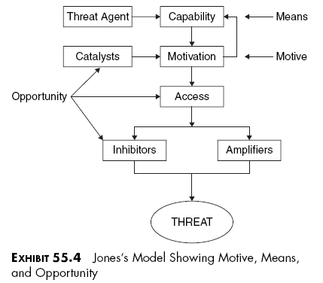
MOTIVE, MEANS, & OPPORTUNITY: PROFILING ATTACKERS (1)

Slide 42
MOTIVE, MEANS, & OPPORTUNITY: PROFILING ATTACKERS (2)
Threat agents deliver a threat
What are benefits of attack? (motive)
Does agent have capability for attack? (means)
  Access
  Inhibitors vs amplifiers affect planning
  When is best time to attack? (opportunity)
    Catalysts are variable factors that affect decision

Slide 43
Motive (1)
Understanding motive may help
  Understand/analyze attack
  Narrow down field of possible attackers
  Identical attacks may have different motives
Outcomes may differ significantly
  Seeking revenge: embarrass victim
  Seeking profit: extort money from victim
Groups may behave differently from individuals

Slide 44
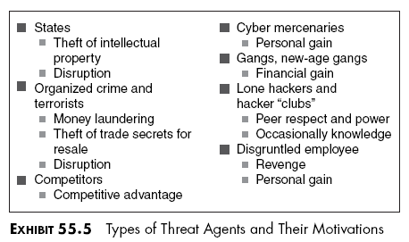
Motive (2)
Adversarial matrix can help refine picture of motives

Slide 45
Motive (3)
Jones’ motivation taxonomy:
Political
Secular
Crime
Personal gain
Revenge
Financial
Knowledge / information

Slide 46
Means (1)
Tools & techniques used in attack
Relate means to skill of attacker
  Potential divergence between sophistication of attack tools & competence of attacker
  Script-kiddies classic example
More productive to exclude suspects who cannot be attacker

Slide 47
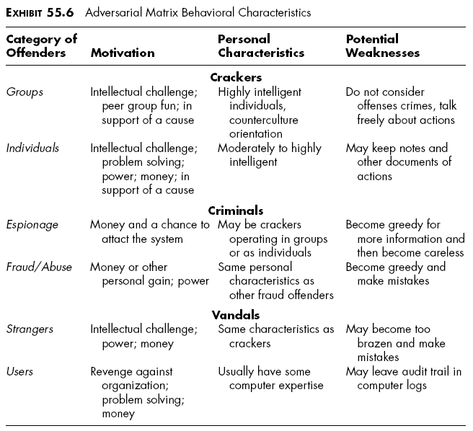
Means (2)

Slide 48
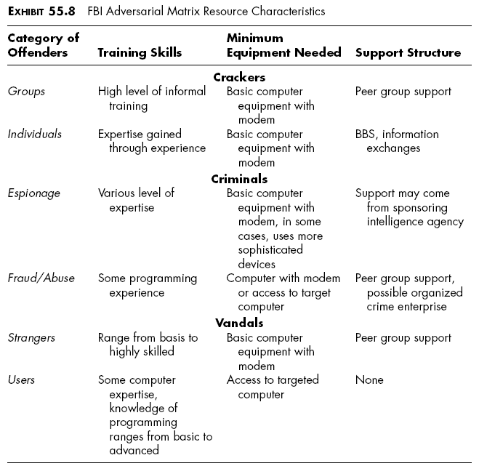
Means (3)

Slide 49
Opportunity
Opportunity helps determine if suspect is credible perpetrator
Includes knowledge of victim system
Insiders or confederates of insiders should be examined
External groups may be involved
  E.g., Anonymous or LulzSec

Slide 50
SOME USEFUL TOOLS
The Usual Toolkit
Link Analysis
Attack-Tree Analysis
Modeling
Statistical Analysis

Slide 51
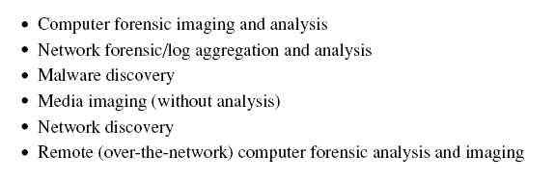
The Usual Toolkit
CSH5 p 55.20
Well known & accepted
See product evaluations; e.g., in SC Magazine
  May 2011 edition in particular
  http://www.scmagazine.com/lets-go-analyze-something/article/200541/ or
  http://tinyurl.com/6unu4ab

Slide 52
Link Analysis (1)
Link analysis immensely useful
  Analyze large data sets
  Find non-obvious relationships
  Applied to fraud, drugs, terrorism, organized crime
Core theory
  Pairs of related items; e.g.,
    People/address
    Source/destination IP addresses
    Alias/realname
  Pairs can lead to further linkage

Slide 53
Link Analysis (2)
Example: linking data about cyber attacks
  Hacker alias / realname
  Alias / group
  Alias / attack
  Group / attack
Clusters
  Group of entities bound more closely to each other by links than to surrounding entities
  Cluster analysis simplifies link maps

Slide 54
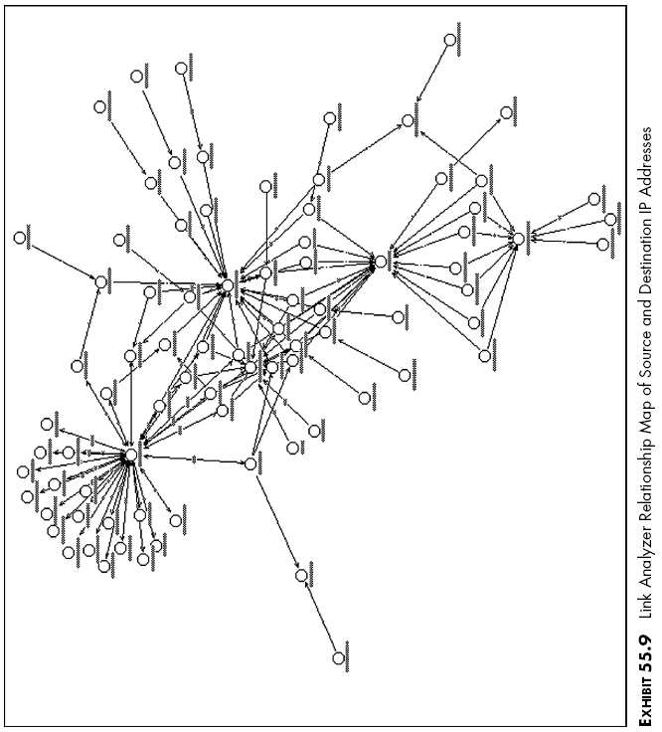
Link Analysis (3)

Slide 55
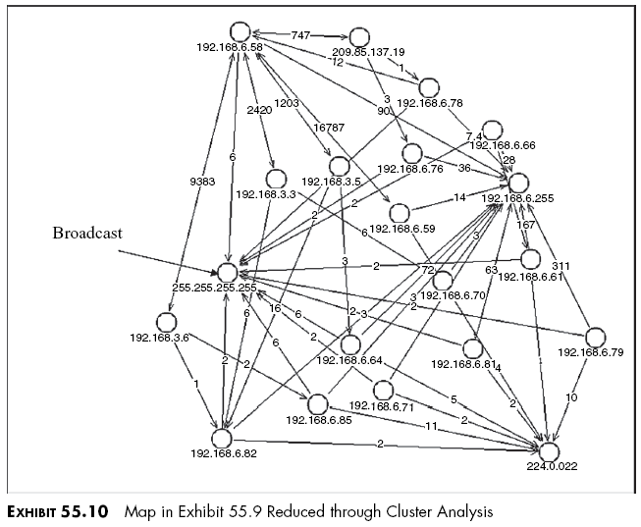
Link Analysis (4)

Slide 56
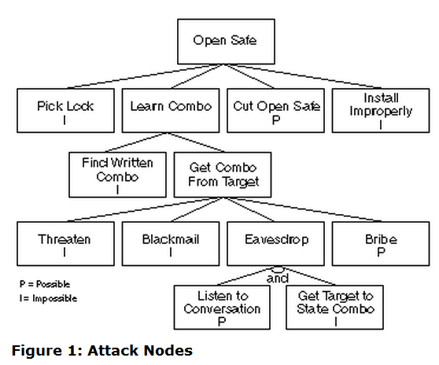
Attack-Tree Analysis (1)
Method for analyzing possible attack scenarios
  Define goal as root
  Hypothesize attack method as leaves
  Look at probabilities of scenarios
  Eliminate impossible sequences
See Schneier, B. (1999). “Attack trees.” Dr Dobb’s Journal.
< http://www.schneier.com/paper-attacktrees-ddj-ft.html >

Slide 57
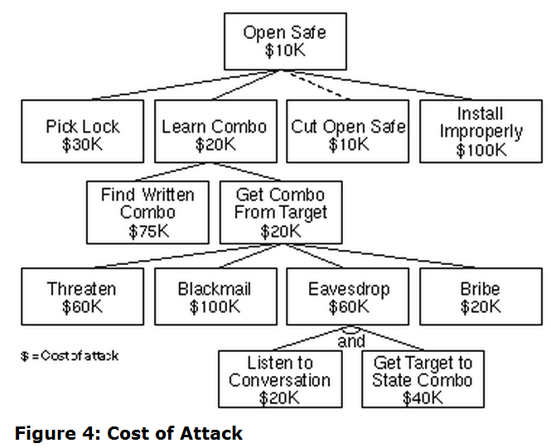
Attack-Tree Analysis (2)
Can assign any Boolean (logical) value to nodes; e.g.,
  Easy/difficult
  Legal/illegal
  Special equipment
  req’d/not-req’d
Even quantitative variables
can be assigned; e.g., cost

Slide 58
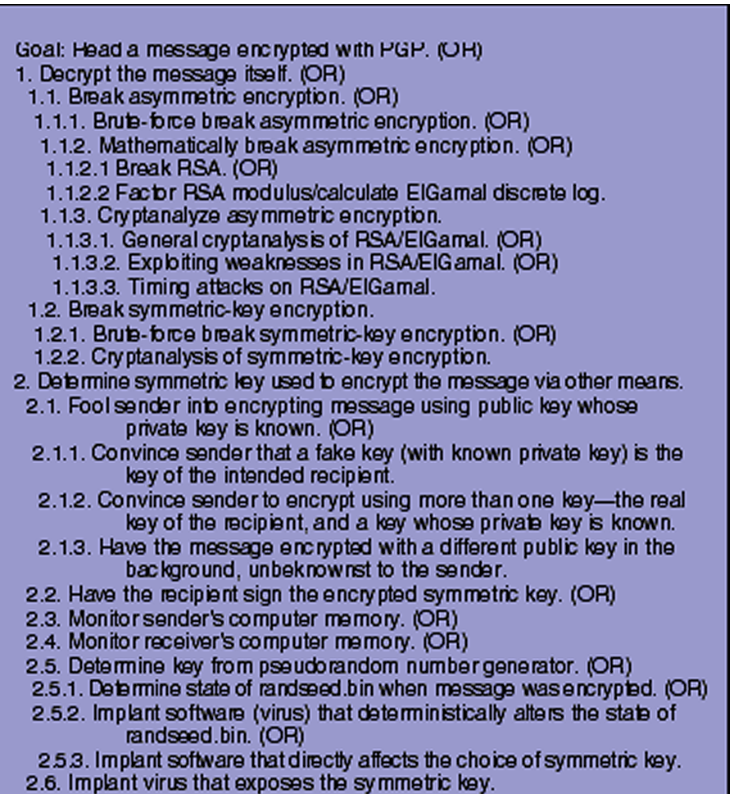
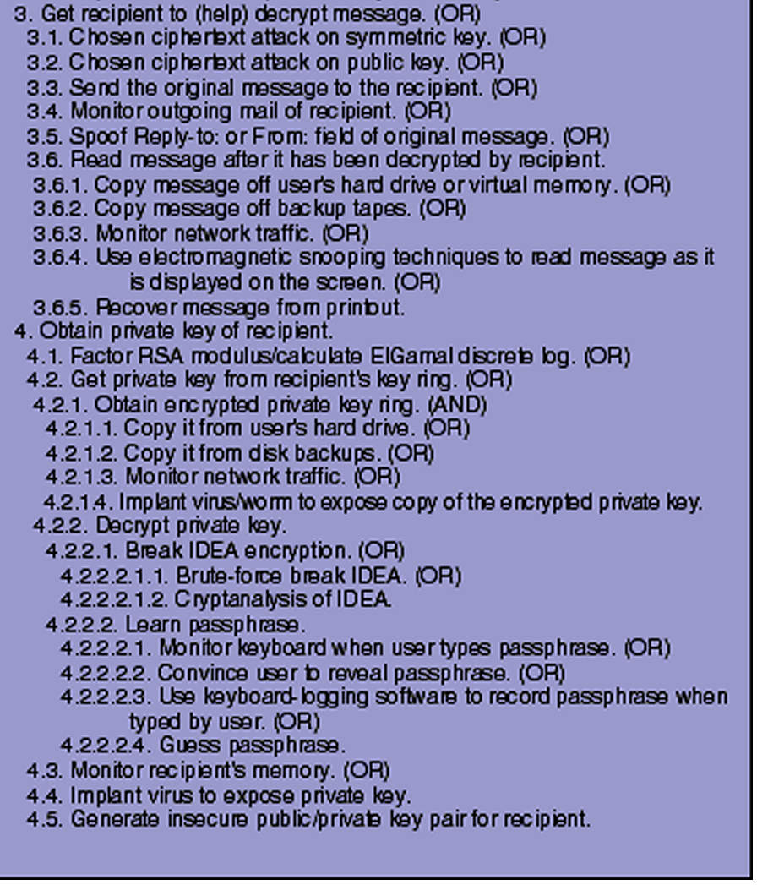
Attack-Tree Analysis (3)
Schneier’s Figure 7: Attack Tree Against PGP

Slide 59
Attack-Tree Analysis (4)
“Attack trees provide a formal methodology for analyzing security of systems & subsystems. They provide a way to think about security, to capture & reuse expertise about security, & to respond to changes in security. Security is not a product -- it's a process. Attack trees form basis of understanding that process.”
Schneier’s Conclusion to Attack-Tree article

Slide 60

Modeling: CPN (1)
Simulating attack behavior
Coloured Petri Nets (CPN) useful language
  Invented by K. Jensen at Aarhus University in Denmark
  Transferred to Eindhoven University of Technology, The Netherlands (2010)
  Good overview at
  < http://cs.au.dk/CPnets/ >
  See brief paper by Jensen:
http://www.gsic.uva.es/wikis/yannis/images/c/c4/CP-net.pdf
or
http://tinyurl.com/8352ehy

Slide 61
Modeling: CPN (2)
Graphical language -- constructing models of concurrent systems & analyzing properties
Foundation of graphical notation & basic primitives for modeling concurrency, communication, & synchronization
Standard ML -- definition data types, describing data manipulation, & creating compact models
Typical application domains: communication protocols, data networks, distributed algorithms, embedded systems, business processes, workflows, manufacturing systems, & multi-agent systems
Simulation-based performance analysis – delays, throughput, & queue lengths in system are investigated
http://cs.au.dk/CPnets/

Slide 62
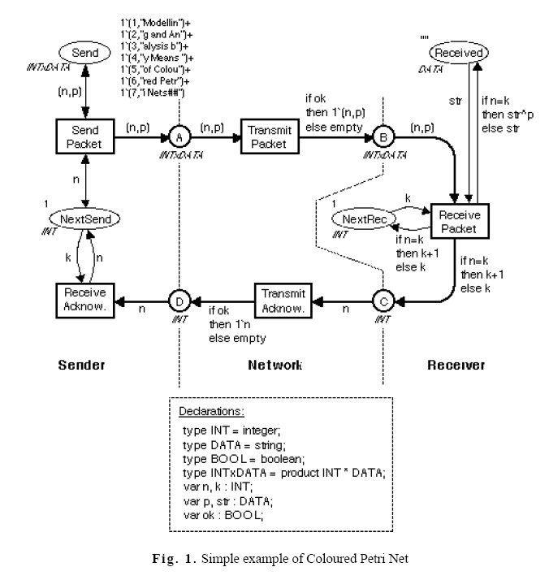
Modeling: CPN (3)
http://www.gsic.uva.es/wikis/yannis/images/c/c4/CP-net.pdf
or
http://tinyurl.com/8352ehy
Simple?!?

Slide 63
Statistical Analysis
Statistical methods & probability analysis of great value
Look for anomalies – events with low probability if not related to crime & high probability if related
Calculate probabilities of sequences of events; e.g., if faced with n events, each with probability p_{i},
    Probability that all events would occur simultaneously or in sequence by chance alone: P{all} = Πp_{i} → p^{n} for identical p_{i}
    Probability that at none of events would occur simultaneously or in sequence by chance alone: P{none} = Π(1 - p_{i}) → (1 – p)^{n} for identical p_{i}
    Probability that at least one of events would occur simultaneously or in sequence by chance alone: P{>=1} = 1 - Π(1 - p_{i}) → 1 – (1 – p)^{n} for identical p_{i}

Slide 64
DISCUSSION

