Slide 1
CSIRTs
CSH5 Chapter 56
“Computer Security Incident Response Teams”
Michael Miora, M. E. Kabay and Bernie Cowens

Slide 2

Topics
Forming a Team
Handling Computer Security Incidents
Managing a Team

Slide 3


Synonyms
CERT: Computer Emergency Readiness Team (or also generically computer emergency response team)
CSIRTs = Computer Security
Incident Response Teams
CIRTs (computer incident response teams)
Computer emergency quick-response teams

Slide 4
DISA CIRTM CD-ROM
Assigned for individual study:
Computer Incident Response Team Management*
Topics
  Forming a Team
  Handling Computer Security Incidents
  Managing a Team
Permission granted by DISA for free duplication
May download entire CD-ROM in ZIP file:
http://www.mekabay.com/infosecmgmt/disa_cirtm_cdrom.zip
See also CSIRT Management monograph:
http://www.mekabay.com/infosecmgmt/csirtm.pdf
From Defense Information Systems Agency.
Distributed at all possible
opportunities to get rid of them!

Slide 5

Forming & Constituting a CSIRT
Overview
Incident Response Arena
Typical Network Attack
Services
Service Levels
Policies and Procedures
Staff

Slide 6
Overview of this Section
The incident-response arena: why do we need a CSIRT?
Steps in typical network attack
Reactive and proactive CSIRT services
Factors to consider in determining services
Policies and procedures for managing incident response team
Knowledge, skills & abilities of personnel – considerations when hiring staff

Slide 7
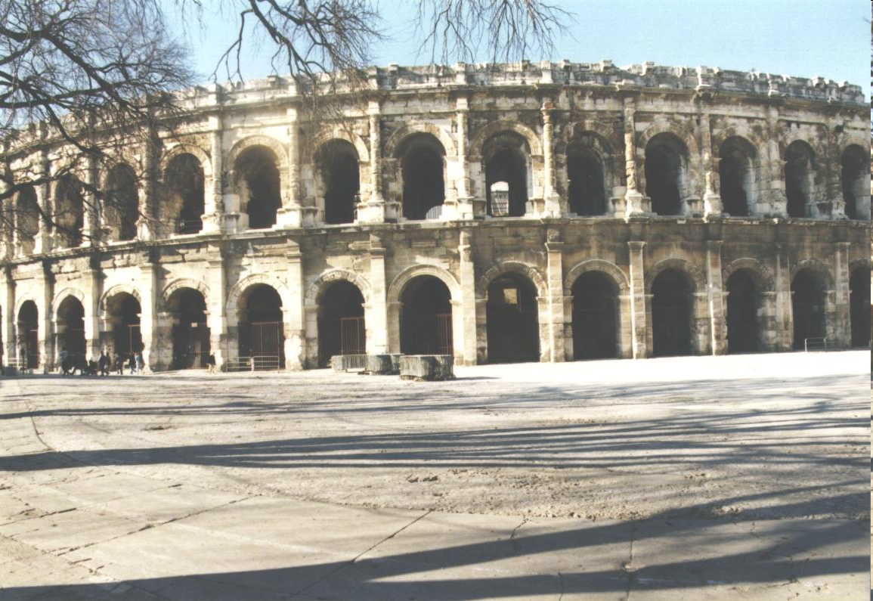
Incident Response Arena
Internet a global network with hundreds of millions of potential attackers
IPv4 has limited provisions for security
Vulnerabilities & exploits change constantly
  Systematic vulnerability scanning
  Automated attack vectors
  Protocol flaws
  Buffer overflows….

Slide 8
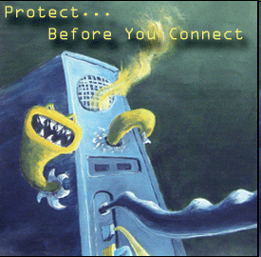
Typical Network Attack
Motives vary; economic motivation growing
Intruders often study system to obtain root
Conceal evidence by tampering with log files
Install rootkits to allow later access
Add to botnets for spam or denial of service
http://tinyurl.com/3dd2vq

Slide 9


Services
Computer Security Incident Response Teams (CSIRTs)
Some organizations use “Computer Emergency Response Teams” (CERTs)
CERT-CC® http://www.cert.org/
  Computer Emergency Response Team Coordination Center
  Software Engineering Institute (SEI)
  Carnegie-Mellon University (CMU)
  Created in Dec 1988 in response to problems in coping with Morris Worm disaster of Nov 2, 1988
Must define services clearly to avoid wrong expectations

Slide 10

Service Levels
Decide when CSIRT will be available
  Normal work hours
  Extended hours
  24/7 coverage
Don’t announce
services until you can
actually provide them
Setting false
expectations will lead
to disaster

Slide 11

Policies and Procedures
Need written policies & procedures (P&P)
  Team can support CSIRT mission
  Set expectations for confidentiality
  Framework for normal operations
  Maintain consistent, reliable service
Need leadership approval and visible support

Slide 12

Staff Requirements
People are central to success
Good customer-service skills
  Strong desire to resolve
  problems
  Handle distraught persons
  calmly – get maximum info
  Communicate clearly
    Good oral/written
    communication skills
  Team work
  Technical knowledge
    Formal training in computer science
    Related work experience
    Coding skills

Slide 13

Screening Job Candidates
As discussed in Chapter 45 of CSH5
Interview
  Position overview
  Customer service orientation
  Character
  Pager, travel requirements
  Flexibility in scheduling
Orientation and formal training
  Mission
  Policies & procedures
  Specific problem-tracking tools
  Diagnostic tools

Slide 14
Topics
Forming a Team
Handling Computer Security Incidents
Managing a Team

Slide 15

Handling Computer Security Incidents
Types of Attacks
Computer Security Tools
Triage Process
Technical Requirements
Tracking System
Information & Response Needs
Telephone Hotline

Slide 16

Types of Attacks
As discussed in CSH5 Chapter 8
Extent of damage can vary
  Annoying to life-threatening
  Evaluate costs of different types of incident
Types of attack
  Penetration
  Denial of service
Means
  Automated attack
  tools
  Trojans
  Viruses
Not possible to have a rigid framework in advance

Slide 17

Computer Security Tools
Learn about specifics available to your CSIRT
General classes
  I&A and related attack-tools (e.g., cracks…)
  Firewalls vs scanners for vulnerabilities
  Protocol-related attacks
Diagnostic tools
  Debug
  Dump analysis
  Disk-editors
  Sniffers

Slide 18
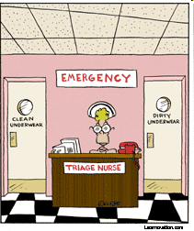
Triage Process
Must be able to allocate limited resources wisely
Triage name applied in medicine
  Means “sorting” in French
Rapidly decide
  Where to send callers for help
  Which resources to assign to
  specific problems
Identify critical-path relations
  Look for problems that
  potentially risk most severe
  consequences
  Functional analysis that must take into account characteristics of each organization

Slide 19

Prioritizing Incidents
Sensitivity and/or criticality of the data affected
Amount of data affected
Which host machines are involved
Where and under what conditions
the incident occurred
Effects of the incident on mission
accomplishment
Whether the incident is likely to
result in media coverage
Number of stakeholders affected
Possible relationships to other
incidents currently being investigated
The nature of the attack
Economic impact and time lost
Number of times the problem has recurred
Who reports the incident
Mission-critical

Slide 20

Technical Requirements
Assign least-skilled staff to triage stage – enough skill to
  Identify nature of problem
  Collect basic information
  Decide quickly to whom to send caller
  Let more experienced staff avoid clerical functions
Information requests: low to medium skill levels
Incident response: medium skill levels
Vulnerability handling: high skill levels
http://www.summum.us/images/jpg/pyramid3.jpg

Slide 21
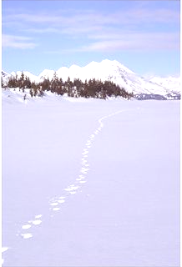
Tracking System (1)
Critically important to track information
Use formal tracking system (many products available) to ensure
  Easy notes
  Availability to entire group
  Keyword and full-text retrieval
  Status settings
May play crucial role in solving problems
For course notes on a course taught in the 1980s and 1990s about managing technical-support issues, see
http://www.mekabay.com/courses/academic/jac/TSP/index.htm
http://tinyurl.com/3xsued
Used with permission of the photographer,
Mike Robinson. See catalog at
http://tinyurl.com/3dm33c

Slide 22
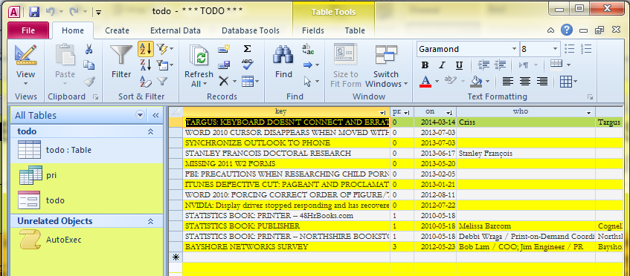
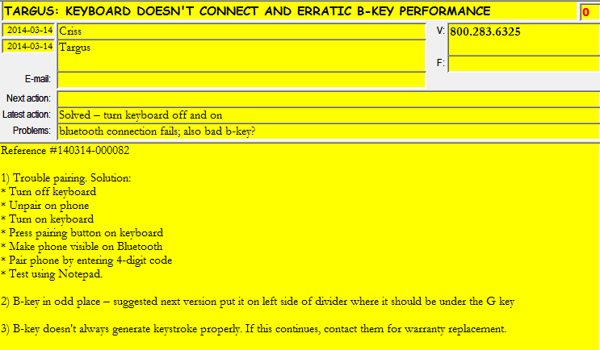
Tracking System (2)
See
http://www.mekabay.com/methodology/Todo_empty.mdb

Slide 23
Information & Response Needs for Every Incident Report
??
?
?
?
?
Who is the reporting organization?
What other organizations are involved or need to know about the incident?
What is the date and time of the incident?
What type of incident is it?
What is the name or ID of the information system or systems affected?
What is the mission impact of the incident?
What are the technical details or the who, what, when, where, why, and how of the incident?
What actions have been taken?
Has there been any coordination with other commands on the incident?
Are there any other clues or is any information missing?

Slide 24
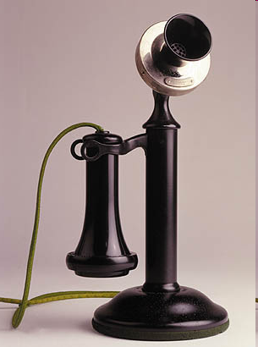
Telephone Hotline
Must handle phone calls at all times of day/night
  Call-forwarding to agent on duty
  Pagers
  Message service
  SMS to cell phones
  Answering machine / voicemail(☹)
Define rules for taking details and
then transferring calls to right person
  MOST IMPORTANT:
  Never drop the caller! Always monitor the transfer and ensure there is a live person (not voicemail) on the other end of the line to take control of the situation
  Always provide direct-line phone #
  & case # for use in case of interruption
Define procedures to handle cranks/pranks

Slide 25
Topics
Forming a Team
Handling Computer Security Incidents
Managing a Team

Slide 26

Managing a Team
Securing Your CSIRT
Using a Code of Conduct
Prioritizing Incidents
Balancing Workload

Slide 27
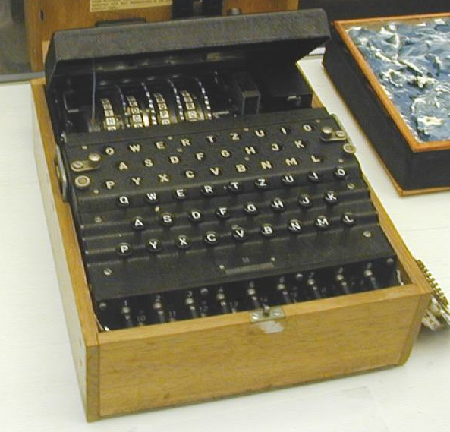
Securing Your CSIRT
CSIRT itself an attractive target for
attackers
Operational and legal repercussions to compromise
Must protect
  Incident reports,
  Electronic mail,
  Vulnerability reports,
  and even
  Briefing notes and
  slides.
ENCRYPT ENCRYPT ENCRYPT…
BACKUP BACKUP BACKUP…
ENIGMA
http://www.swehs.co.uk/docs/photos/bletchley03.jpg

Slide 28
Using a Code of Conduct
Code of Conduct can determine reputation of team
Clear explanations
Define technical terms
Clarify work you plan to do
Never emit bovine fecal material: instead, try “I don’t know but I’ll find out” – perfectly acceptable response to a question
Establish continuous process
improvement by welcoming
constructive criticism and
suggestions for improvement
Maintain confidentiality
Support ethical behavior at all
times by all staff members

Slide 29
Balancing Workload in Triage
Handling new calls
Periodic rotation:
  All new incidents are assigned to a designated triage coordinator
  At set intervals, incidents are rotated to new triage coordinators
Equal distribution
  Team leader reviews all new reports
  Distributes them evenly to staff members
Combination approach
  New reports distributed equitably during regular hours
  Outside regular hours rotate periodically among coordinators
Dispatch
Primary
Escalation

Slide 30

Balancing Workload (cont’d)
Approaches to ongoing incidents
Single coordinator for entire incident
  Develop stronger rapport with client
  No lag time for turnover to next coordinator
Periodic hand off
  Open incidents handed off to a new lead person at regular intervals
  Lag time but fresh perspective with each hand-off
Combination approach common
  Single coordinator takes lead for a given case
  Hand it off to another team member when necessary

Slide 31
Review Questions (1)
What is a computer security incident?
Why do we need a CSIRT?
When was the CERT-CC® formed and in response to what incident?
Why should we define the working hours for our CSIRT unambiguously?
How do written policies and procedures support the functions of the CSIRT?
Why should we staff the CSIRT with people who are NOT classic stereotyped geeks?

Slide 32
Review Questions (2)
Why (i.e., how) is triage a critically important element of incident response team planning?
Why (i.e., how) are tracking systems valuable for CSIRTs?
Why should the telephone hotline include instructions that no caller is to be sent to another resource without ascertaining that the transfer has actually taken place (e.g., “Sally, this is Joe. He will take over from this point. Here you go, Joe.”)
Explain how a clear code of conduct can support the functions of the CSIRT.

Slide 33
DISCUSSION

