Slide 1
Lessons from Hurricane Andrew
Supplement to
CSH5 Chapters 57 & 58
BCP & DRP
M. E. Kabay, PhD, CISSP-ISSMP
Notes:
This slide show was originally created in October 2011 to be part of a Webinar on behalf of the MPA program in the School of Graduate and Continuing Studies at Norwich University. For more information, see < http://mpa.norwich.edu >.

Slide 2
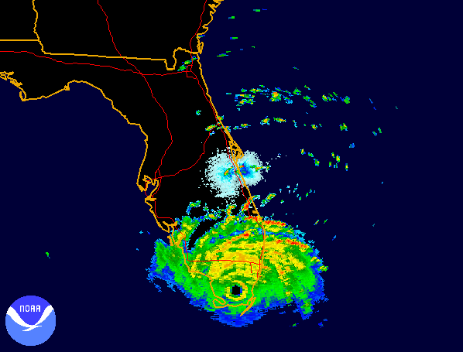
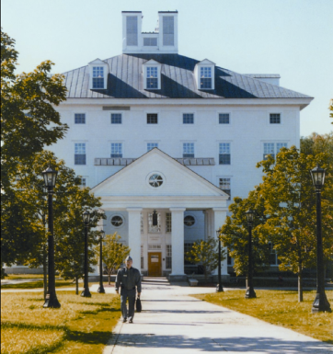
U.S. Preparedness: Lessons Learned from Hurricane Andrew
U.S. Preparedness: Lessons Learned from Hurricane Andrew
Bruce R. Lindsay
Notes:
Hello everybody! I’m Mich Kabay, former Program Director for the Master of Science in Information Assurance in the School of Graduate and Continuing Studies at Norwich University. I’ve been invited to present an analysis of the lessons learned from the disastrous hurricane of 1992 that led to a radical rethinking of how the United States should respond to public emergencies.

Slide 3
Chronology (1)
August 1992: low pressure near West Africa
Aug 16: upgraded to tropical depression
Aug 17: 1st named storm of season
Florida: emergency agencies paid attention
General public showed little awareness
Last big storm had been Betsy in 1965
Aug 22: upgraded to hurricane status
Marsden, W. E. (1993). “Andrew and Iniki.” Collier’s Year Book 1993. Accessed using Microsoft Encarta Premium 2008.
Notes:
The tropical storm that was to become Andrew was noticed in early August of 1992 and by August 17th, had been upgraded to the first named storm of the season. Because the last major hurricane that had struck Florida was more than a generation before – in 1965 – few members of the public seemed concerned about it. But By August 22nd, Andrew was definitely a hurricane.

Slide 4
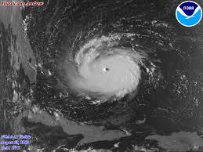
Chronology (2)
Aug 23: hit Eleuthra Island in Bahamas
Winds of 150 mph
Huge tidal surge “wiping out roads, bridges, and resort hotels and uprooting thousands of trees.”
Notes:
By the time it passed the Bahamas, it was running at 150 mph.

Slide 5
Chronology (3)
Aug 23:
700K residents of S. Florida fled north
Highways clogged
Hurricane Andrew reaches Class 4 status
Windspeed 130-155 mph
Aug 24:
05:00 eye passes over Homestead, FL
Gusts to 164 mph recorded at Natl Hurricane Ctr in Coral Gables (near Miama) before shutdown
Notes:
The reaction in Florida was disorganized panic. Nearly a million Floridians clogged highways in a desperate attempt to escape. In the meantime, Andrew reached extraordinary wind speeds near Miami – one recording topped out at 164 mph.

Slide 6
Chronology (4)
Aug 24 05:00-08:00
Andrew moves across FL
Serious damage in Miami
Billboards
Light posts
Palm trees
Devastation in Homestead area
22 miles SW of Miami
Near Homestead AFB
Destroyed most of 27,000 population town
Notes:
Miami was damaged, but there were even worse results in the Homestead and Florida City area a few miles to the southwest near the Everglades National Park.

Slide 7
Devastation (1)
Notes:
These are pictures of what was left of Homestead after the hurricane.

Slide 8
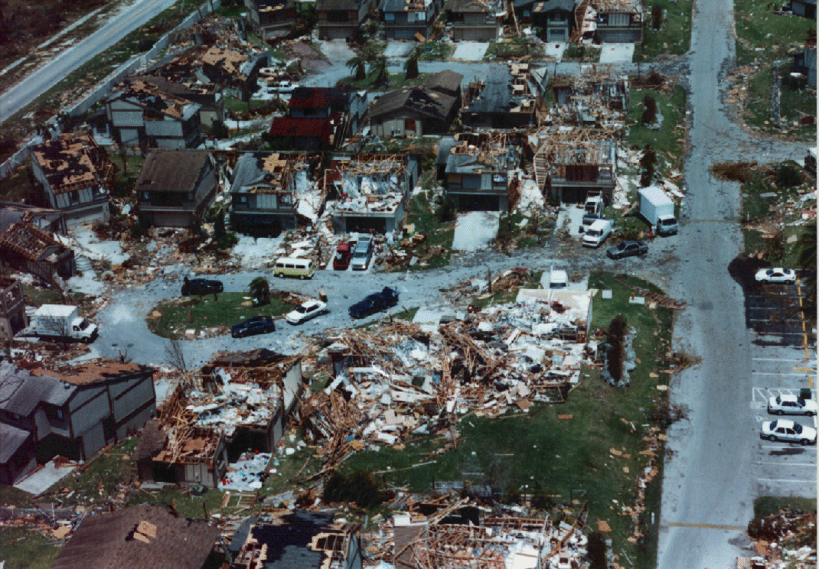
Devastation (2)
Notes:
It was appalling. This picture is from Lakes by the Bay, which is now part of Cutler, a small town south of Miami.

Slide 9
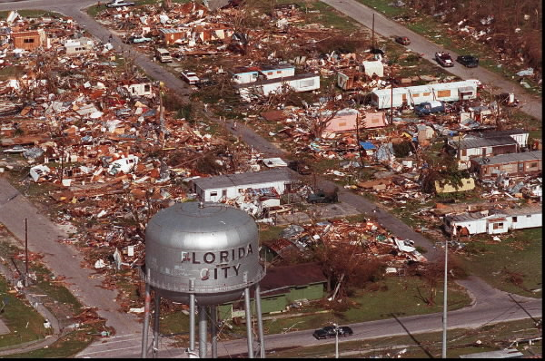
Devastation (3)
Notes:
People lost everything.

Slide 10
Chronology (4)
Aug 25: moves into Gulf of Mexico
Massive damage
80K dwellings destroyed or badly damaged
250,000 people homeless
1M people without clean drinking water
Power outages for 1.5M people
Notes:
Infrastructure was badly damaged, leaving residents in serious danger from exposure, lack of food and contaminated water.

Slide 11
Chronology (5)
Aug 26: 140 mph winds reach LA coast
Major damage along US 90
Destroyed much of sugarcane crop
Aug 27-28
Generated tornados throughout LA, AL, GA, TN
LA: 10K dwellings destroyed & 30-50K homeless
Notes:
The storm moved onward toward Louisiana, Alabama, Georgia and Tennessee, although by that time it was losing much of its force.

Slide 12
Recovery Slow, Disorganized
Basic services absent
“…electricity, telephones, water supply, sewage disposal, banks, gasoline stations, and grocery stores….”
Days & weeks of disruption
Social breakdown
Looters
National Guard & Army deployed
Pres George Bush & Gov Lawton Chiles blamed each other for delays
Increasing levels of domestic abuse & family breakdowns
Notes:
Government agencies and the private sector were faced with a massive cleanup. Unfortunately, recovery operations did not meet the expectations of the residents. Bickering among government officials irritated many observers and there were even outbreaks of looting. Although 8,000 National Guard troops and 27,000 active-duty US military personnel were eventually deployed, critics argued that the response had been poorly planned and executed. Government agencies, businesses and private citizens had simply not contemplated the need for advance planning and practice to cope with a storm of this magnitude.

Slide 13
Lessons Learned (1)
Aug 13, 2004: Hurricane Charley hit FL
But FEMA & state, local officials generally praised
Immediate (day 1) distribution of ice, water, food door to door
Emergency communications up and running
Immediate search-and-rescue operations
1st 24 hours: emergency toilets, A/C, tents, showers, medical emergency rooms in place
AP (2004). “FEMA learned from Hurricane Andrew in 1992.” USTODAY (2004-08-26). http://tinyurl.com/5db7ef
Notes:
A couple of years later, Hurricane Charley found victims being supported quickly and efficiently by agencies such as the Federal Emergency Management Agency (FEMA).

Slide 14
Lessons Learned (2)
Recovery affected by insurance policies
Institutions & individuals unfamiliar with terms
Scope of coverage critical
Many exclusions of critical equipment
Electrical fixtures
Appliances
Air conditioning & heating
Water heaters
Built-in cabinets
Poliakoff, G. A. (2004). “Lessons from Hurricane Andrew.”
See http://www.becker-poliakoff.com/practice_areas/areas_disasterrecovery.html
Notes:
One of the key lessons from Andrew was that the insurance industry needed to be better prepared to cope with widespread damage. In the aftermath of the 1992 hurricane, policy holders discovered in too many cases that they did not understand the limitations of the policies they had been paying for – sometimes for years. Many found that insurance payments covered only a fraction of their recovery costs. As a result, government agencies worked with insurance providers to improve coverage and clarity – sometimes with regulations imposed by appropriate agencies.

Slide 15
Lessons Learned (3)
Buildings were poorly built – codes ignored by contractors & FL government officials
Many insurance companies went bankrupt, leaving policy holders unprotected
Insurance rates climbed so steeply that thousands of homeowners could not afford insurance
1M homes lost all insurance coverage
See US Natl Weather Service (1993). Hurricane Andrew: South Florida and Louisiana: August 23-26, 1992. Available as e-book and on paper. http://tinyurl.com/6lg3nmc
Notes:
Another failing that was uncovered – sometimes literally – by Hurricane Andrew was that slipshod construction causes terrible damage in storms like Andrew. Apparently some government regulators had fallen into cozy arrangements with local builders and failed to enforce even the limited standards that might have helped reduce damages and costs. The decisions by many insurance companies to declare bankruptcy or to terminate coverage for undamaged homes infuriated residents.

Slide 16
Hurricane Preparedness Checklist
Disaster Plan
Evacuation Routes
Emergency Generators & Supplies
Backup Computer Files
Secure the Premises
List of Owners & Employees
Photograph or Video Premises
Building and Facilities Plans
Insurance Policies & Agent Details
Bank Account Details & Signatories
Mitigation of Damages
Debris Removal
Poliakoff, G. A. (2004). “Lessons from Hurricane Andrew.”
See http://tinyurl.com/6g4qmch
Notes:
So what are some of the lessons that have become standard thinking in the wake of Andrew? The Master’s of Public Administration program at Norwich University includes two courses that bring students into detailed discussions of today’s standards.

Slide 17
BC511 Continuity of Government Operations
Organizational analysis
Risk and threat analysis
Mitigation and control strategy development
Implementing organizational structure
Sustain program
Notes:
The BC511 Continuity of Government Operations course is the first of two dealing with these essential matters.

Slide 18
Organizational Analysis
Map people to functions
Discover & establish
How people will collaborate
On priority issues
Regardless of organizational status
Notes:
A necessary component of all business continuity programs is to understand clearly who does what and why in each organization. A culture of inclusion and free exchange is essential for successful planning and implementation.

Slide 19
Risk & Threat Analysis (1)
Identify critical infrastructure, equipment and services
Agriculture & Food
Banking & Finance
Chemical Industry
Communications
Critical Manufacturing
Dams
Defense Industrial Base
Emergency Services
Energy
Government Facilities
Healthcare & Public Health
Information Technology
National Monuments & Icons
Nuclear Reactors, Materials & Waste
Postal & Shipping Services
Transportation Systems
Water
See http://www.dhs.gov/files/programs/gc_1189168948944.shtm
Notes:
Risk and threat analysis allows us to allocate resources rationally. Evaluate which components of the critical infrastructure your organization must coordinate with. Get to know the people in your areas of responsibility. Learn their priorities.

Slide 20
Risk & Threat Analysis (2)
Compile types of threats to continued functioning
E.g., hurricane, tornado, flood, earthquake, insurrection, terrorism
Identify types of failure
E.g., electrical-grid failure, road blockage, rail blockage, communications failures
Establish approximate probability of specific types of threat
Historical records, best-guess estimates
Notes:
Look at a variety of threats and evaluate how each could affect the critical components of the systems for which you are responsible. Although you may not be able to derive precise probabilities for different types of damage, you can still get a sense of likelihood from published or historical records. Don’t worry about imprecision – these probabilities are just part of a method for setting priorities.

Slide 21
Risk & Threat Analysis (3)
Compute Annualized Loss Expectancies (ALE)
for each component and threat
ALE(failure) = pc
ALE(prevention) = (1-p)c’
where
p = probability of failing
c = cost of failure
(1 – p) = probability of not failing
c' = cost of prevention
Notes:
The annualized loss expectancy, or ALE, is a useful tool for estimating (that is, doing better than just guessing wildly) at the level of investment appropriate to protect different components of the systems you are including in the business continuity and disaster recovery planning. There’s not enough time to discuss the ALE in detail, but these slides will give you at least a sense of what it’s about.

Slide 22
Mitigation & Control Strategy Development
Use ALEs as heuristic for discussing strategies; e.g., suppose (illustration only)
Cost of failure of communications infrastructure ~$100M
Probability(failure)/year = 0.01
So ALE(failure) = $100M*0.01 = $1M
But probability of not failing in 1 year = 0.999
Then what is the breakeven point where we spend enough to balance out possible loss?
ALE(prevention) = 0.999c’ and so for breakeven,
c‘ = $1M/0.999 = $1.001M
In other words, spending around $1,001,000 a year gives us a breakeven point IFF the probabilities and costs are correct
Notes:
This example shows a $100 million estimated damage from failure of a communications infrastructure with a 1% probability of failure (high, but this is just an illustration). So the expected loss per year is about a million dollars. If the probability of NOT failing is 99% (100% minus 1%) then we can estimate that a reasonable expenditure for a breakeven would be just a bit more than a million dollars a year to prevent $100 million in damages. One could then adjust the expenditures around that figure instead of just stabbing wildly at any old number that popped out of one’s head.

Slide 23
Implementing Organizational Structure
Don’t impose new structures without discussion
Need to convince colleagues to collaborate
Create open environment for free contributions of ideas, criticisms, suggestions
Establish needs, benefits
Listen carefully to objections and discuss in detail
Notes:
Whenever you are planning on changes to the usual way of doing business, remember that all organizations – including public agencies – are collections of people who have their own ideas, expectations and comfort zones. Don’t just order people to change – discuss the issues and gain their support. Listen honestly and openly to what they have to say – after all, they are experts in their own work and actually know much more about the details than a manager from several levels above or from a different agency.

Slide 24
BC521 Public Sector Incident Management & Emergency Response
Developing response plan
Emergency operations centers
Emergency communications
Working with first responders
Best practices for
Developing off-site backups
Offsite work areas
People and equipment for continuing operations
Notes:
The second of the two courses in the MPA concentration in Continuity of Government Operations is BC521 on Incident Management and Emergency Response.

Slide 25
Developing Response Plan
Critical path analysis
What must be done first?
Establish priorities for functional recovery
Continuous Process Improvement
Test and refine repeatedly
Use video recording throughout exercises
Analyze mistakes, reasons for errors, and fixes
Adopt non-punitive, collaborative culture
Notes:
You can’t plan for what you don’t understand. And you can’t expect to wait until you are perfect to have a plan! The critical path analysis tells you what absolutely has to be done first and what gets done second and third. Politics has nothing to do with it (we wish): putting something first has to reflect absolute need, not feelings of worth. Make that clear to everyone – and listen to everyone’s suggestions.

Slide 26
Emergency Operations Centers
EOCs critical element of response
AKA command centers, situation rooms, war rooms, crisis management centers
Coordination of all responses to ensure smooth, effective delivery
Fixed-position EOCs:
Built to withstand appropriate level of stress
No good if destroyed during emergency!
Can serve multiple uses outside emergency
Mobile EOCs – local command and control
Notes:
One of the key tools we use is the Emergency Operation Center or EOC. Sometimes we can build permanent EOCs, but sometimes we have to bring mobile EOCs into a disaster area to provide on-the-spot coordination. Both types must be built or manufactured to the highest standards of robustness available given our resources. It’s no good skimping on EOC construction if they just collapse or blow away.

Slide 27
Emergency Communications
Incident Command System
Software supported by hardware (radio above all; mobile phones & wireless networks if available)
Supports management of all operations
Coordinate daily operational activities
Communications with EOC & personnel on ground
Event Information Tracking
Audit trail of all actions / events
Notifications, activations, tasks, resource allocation, performance, status reports
Notes:
Communications are central to success in all emergencies. Emergency radio systems are already in use by police and emergency response teams; remember that landline phones and often mobile phones may be severely disrupted in national disasters. Another tool is the incident command system, which should provide easy, rapid communications to all appropriate centers and personnel without forcing long delays as people try to figure out how to reach each other. And an audit trail gives us the data we need for after-incident analysis, an essential part of continuous process improvement.

Slide 28
Working with First Responders
Official responders will be highly trained & equipped with communications tools
EMTs, fire-fighters, National Guard, Red Cross, police canine units, doctors, nurses, electrical power workers…
BUT must plan for volunteers
Searchers for survivors
Builders, contractors, demolition experts,
Truckers bringing supplies
May be disorganized, without communications
Notes:
Be aware that although trained first responders will be an essential and much-valued part of the plan, you will inevitably find volunteers – sometimes even from other countries – flying and driving in to help. Be prepared to use them wisely: the emergency is no time to have to stop and figure out what to do with these resources.

Slide 29
Developing Off-site Backups
Data & software must be copied to remote storage
Daily, weekly, monthly – depends on needs
Adapt schedule to each application & site
3 types of operational backup site
Cold: all infrastructure but no computers, networks
Warm: cold + computers, networks
Hot: warm + all software & data
Hot sites can be used for sharing normal load
Notes:
As for planning for your own agency’s continued operations, you need backups of your data and your software that are kept away from the site you are protecting. You should think about storing such data in a different region from the area that could be affected by an emergency such as Hurricane Andrew. Some recovery sites are hundreds of miles away from the protected agencies. You will have to think about what type of recovery site you need: cold sites are cheaper, but they take longer to get up and running. In contrast, hot sites may actually be usable for normal processing. The stock exchanges, for example, use all the computers in both their normal and their hot sites for processing – but each part can handle the full load without difficulty in case of emergency.

Slide 30
Offsite Work Areas
Plan for critical operations to be completely ready for immediate occupancy & use
Some older, little-used or unused sites may serve in emergency
Immediate need for safety & acceptable working conditions, not luxury
Some try able to share resources with other agencies
But where will THEY get their work done?
Generally does not work well
Notes:
Finding places for office workers is tricky. If you can afford to build spare work areas, great – but you may have to settle for searching out – in advance – alternate sites that will still support the level of electricity use, water, and communications you need. As for sharing resources with separate agencies, it’s tough to implement. How are you going to fit two offices of people into a single office if both are heavily used at all times? Can you work split shifts? If not, you’re going to get into trouble.

Slide 31
People & Equipment for Continuing Operations
Budget for contingencies
Use older but serviceable equipment where possible
Provide safety for families / loved ones of employees
Ensure time for communications with families
Provide emergency sleep accommodations, food, water, washing facilities….
Notes:
How are you going to pay for emergency equipment? Maybe you can use some older stuff that still works. But be sure that you actually test all of this setup to be sure it actually meets your operational needs. And don’t forget to plan for the human side: your employees are not going to want to come to work if their families aren’t safe. They won’t be able to work well if they are exhausted, dirty and hungry, either.

Slide 32
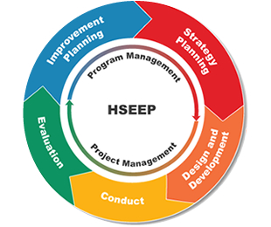
Systems Approach: FEMA
https://hseep.dhs.gov/pages/1001_HSEEP7.aspx
Notes:
In general, you can follow the guidelines from the Homeland Security Exercise and Evaluation program in testing and refining your business continuity and disaster recovery plans. I’ve provided you with a good reference here.

Slide 33
Hurricane Irene: August 2011
Aug 20: Lesser Antilles – organization of cylconic circulation – Natl Hurricane Center issues advisories
Aug 21: Virgin Islands
Aug 22: severe damage in Puerto Rico
Aug 23-26: severe damage in Bahamas
Aug 27: veers past FL & hits NC Outer Banks
Aug 28: 2nd landfall in NJ, moves NE through NY
Notes:
Well of course, you have heard all about our most recent hurricane of the season: Irene.

Slide 34
Irene Hits Vermont
Aug 28-29: downgraded to tropical storm
Moves through VT – worst flooding in century – 6 feet in main streets several towns
Several towns completely isolated when roads washed out (e.g., Killington, Pittsfield)
Many classic covered bridges washed away
Damage to crops in low-lying areas
Notes:
By the last days of August, Irene was pouring water into Vermont, causing massive flooding – some say the worst since the famous floods of 1927.

Slide 35
Emergency Response Excellent
Immediate shelter sites in several areas
Vermont & Maine National Guard on scene at once
Politicians, FEMA responded quickly
Spontaneous coordination through radio, TV, Internet
Strong community outpouring of financial support and goods (clothing, food)
Norwich University students pitched in
See http://vem.vermont.gov/
Notes:
However, the consensus is that FEMA and other government agencies really did learn from Hurricane Andrew. Response was rapid and well organized. We are particularly proud that our Norwich students volunteered to help residents of our college town, Northfield, who were badly affected by the flooding of the Dog River.

Slide 36
Some Resources for Further Study
CDC “Emergency Preparedness & Response” http://www.bt.cdc.gov/
DHS “Critical Infrastructure” http://www.dhs.gov/files/programs/gc_1189168948944.shtm
FEMA “Are You Ready?” http://www.fema.gov/areyouready/
FEMA “Emergency Management Guide for Business & Industry http://www.fema.gov/business/guide/index.shtm
FEMA “National Response Framework Resource Center” http://www.fema.gov/emergency/nrf/
MIT WORLD “Emergency Response” topics http://mitworld.mit.edu/searches?term=emergency+response
MIT WORLD “Disaster Recovery” topics http://mitworld.mit.edu/searches?term=disaster+recovery
Ready.gov http://www.ready.gov/
Notes:
This slide show was originally created to be part of a Webinar on behalf of the MPA program in the School of Graduate and Continuing Studies at Norwich University. For more information, see < http://mpa.norwich.edu >.

