Slide 1
Backups
CSH5 Chapter 57
Backups
M. E. Kabay & Don Holden

Slide 2
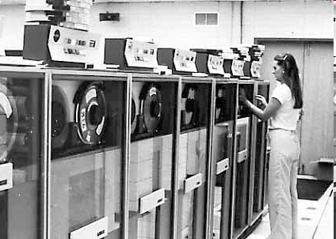
Topics
Backup Bloopers
Definitions and Needs
Strategies
Archives, Maintenance
and Retention
Storage
Disposal
Costs
Optimizing Frequency

Slide 3

Backup Bloopers
BerkshireNet
Margot Kidder
Digital Technologies Group
Amtrak Reservations
Newcastle University Prof
Sun Valley Ski Resort
Stanford University Grad School of Business
McAfee’s QuickBackup 2.04
US Customs
US National Archives
MIT “Cheating Scandal”
Office of the Vice President of the USA
Norwegian Banks
Swisscom Mobile GSM Network Failure
Macomb County (Michigan) Sheriff’s Dept
Electronic Voting Machines

Slide 4
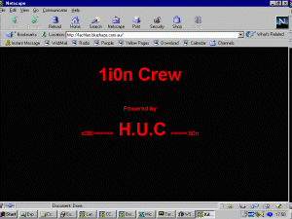
BerkshireNet
Feb 96 -- RISKS 17.83
BerkshireNet, Pittsfield, MA
  Swastikas and racist messages
  Masqueraded as provider's administrator
  Erased data on two computers
  Shut down system
Down 12 hours
  no current backup
  older deleted files restored
  but several days of data lost

Slide 5

Margot Kidder
Sept 96 -- People Online via RISKS 18.46
Computer virus was last straw
Led to nervous breakdown
Unidentified virus apparently destroyed only copy of her book
No backup
Notes:
MK has long predicted that one day a dead computer user will be found with a scary virus message on his/her screen. The shock of the payload will have caused a heart attack.

Slide 6
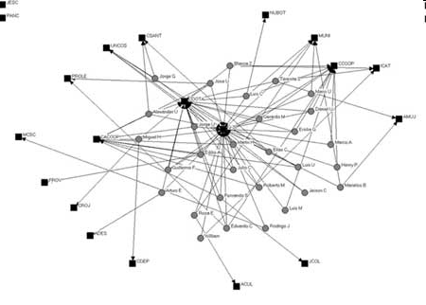
Digital Technologies Group
Oct 96 -- AP
Digital Technologies Group lost all computer files and backups
  U$17,000 direct costs
  loss of months of work
  1-week shutdown
  seriously damaged
  credibility as ISP
Disgruntled ex-employee
Alleged perpetrator
arrested

Slide 7

Newcastle University Prof
1997-08
Prof. David Newell
School of Clinical & Laboratory
Research
Expert in cancer research and
anti-cancer drugs
Computer + 5 floppy disks stolen
Contained only copy of his research data
Thieves kindly returned his disks

Slide 8
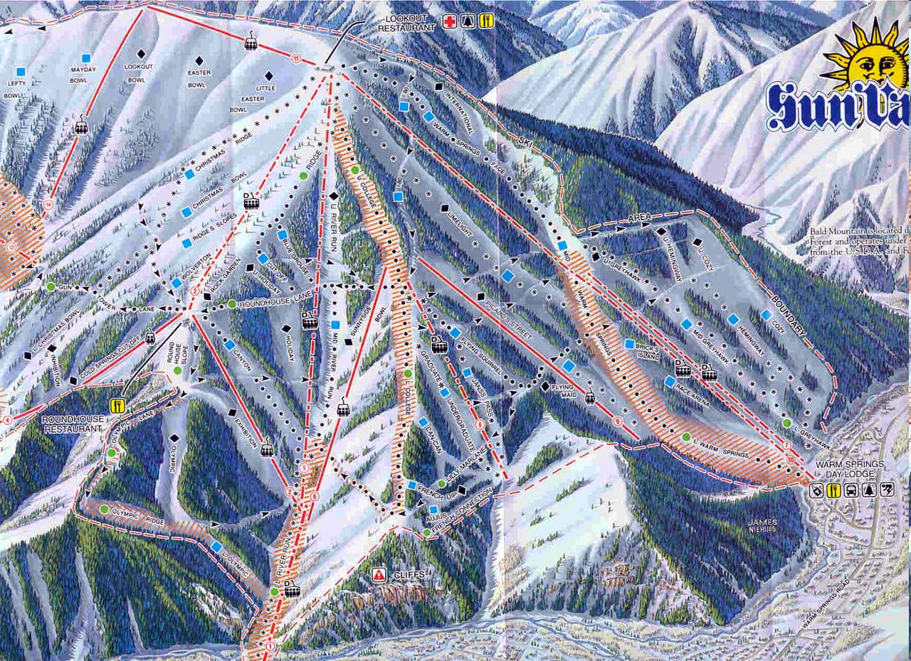
Sun Valley Ski Resort
1997-12
Computer-based ID for skiers to use lifts
Hard disk crash wiped records
No backups
Thousands of users had to re-register

Slide 9
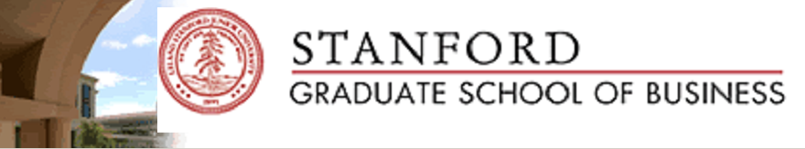
Stanford University Grad School of Business
1998-03
Installed additional disk capacity on servers
Reloaded files from a corrupt backup tape
All faculty and student files destroyed
Many faculty and graduate students lost research data – because they didn’t keep their OWN backups!

Slide 10

US Customs
1998-10
Hard disk failure
Chain of system failures
6 hour downtime
  80,000 requests backlogged
Sys admins shut down modem lines
  Importers had auto-redial
  Each redial counted as new request
Customs Service deleted 45,000 import requests
Required resubmission from importers

Slide 11
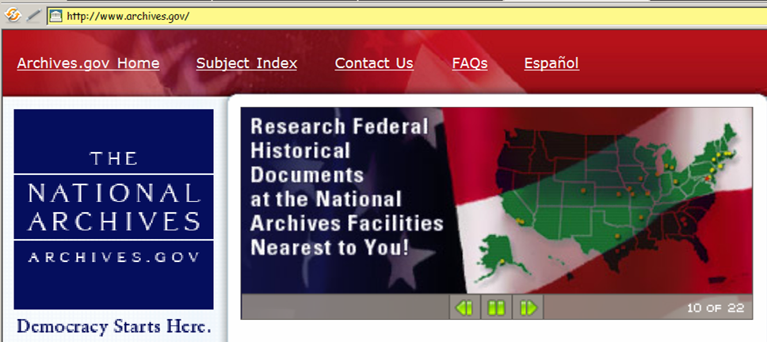
US National Archives
1999
System problem wiped 43,000 messages from e-mail system
But contractor responsible for backups had made no backups
Someone had also turned off system logging
Assistant Archivist said, “Safest way to save important messages is to print them out.”

Slide 12

MIT “Cheating Scandal”
2000-03
Boston Globe reported “cheating scandal”
  22 students in cell bio class had wrong grades
Turned out a grad student had sorted the names but not included the grades. . . .
No backups, so no records of correct grades
No logs, no tracking, no nothing

Slide 13

Office of the Vice President of the USA
1998-04
  Migrated e-mail server to Windows NT4
  Moved e-mail files to a new partition
  Forgot to include that partition in backup schedule
1999-05
  Staffers discovered zero backups for e-mail for over a year

Slide 14




Macomb County (Michigan) Sheriff’s Dept
2002-05: RISKS 22.08
Lost 50,000 photos of criminals
  Hard drive crashed
Had some pictures printed out as backups
But had made no electronic backups at all on any medium
D. L. Smith
MELISSA
J. L. Parson
W32.Blaster.B
R. E. Rutkowski
Ur-spammer
T. C. Cowles
Ur-spammer

Slide 15



Electronic Voting Machines
2004 election period saw growing concern about electronic voting machines
  Entirely proprietary (secret) code
Most had no audit trail of any kind
  Trust the electronic counts without
  means of verification
  Documented cases of votes being
  switched to opposite party
Demands growing for paper trail
  Print ticket to allow user to see vote
  supposedly registered by machine
  Place tickets in ballot box as
  backup measure in case of recount

Slide 16
Definitions
Backups – copies of data files or records
  Should be on different device
    Tape, hard disk, CD, DVD…
  May be on same disk (*.wbk, *.bak etc.)
Units & abbreviations
  KB = kilobyte = 1024 bytes (characters)
  MB = megabyte = 1024 KB = 1,048,576 bytes
  GB = gigabyte = 1024 MB = 1,073,741,824 bytes
  TB = terabyte = 1024 GB = 1,099,511,627,776 bytes
  PB = petabytes = 1024 TB = 1.126 E15 bytes
  EB = exabytes = 1.153 E18 bytes
Notes:
According to a 1998 proposal from the International Electrotechnical Commission (IEC), the prefixes above should be KiB for kibibytes, MiB for mebibytes, GiB for gibibytes, and TiB for tebibytes to distinguish them from the powers-of-ten notations using kilo (10³), mega (10⁶), giga (10⁹) and tera (10¹²), but this suggestion has been widely met with ridicule by the technical community, many of whom argue that the prefixes sound like names from the TeleTubbies TV show.

Slide 17
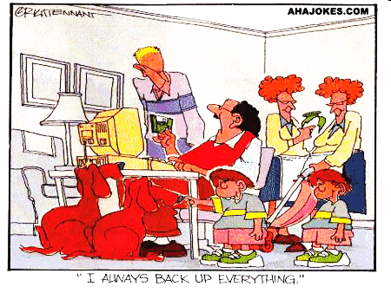
Backups

Slide 18
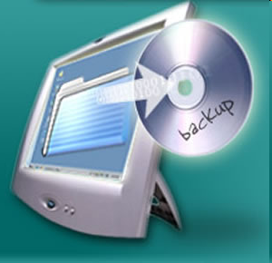
Needs
Provide valid information in case of data corruption or loss
Satisfy legal requirements for access to storable data, as for audit purposes;
In forensic examination of data to recognize and characterize a crime, and to identify suspects;
For statistical purposes in research;
To satisfy requirements of due care and diligence in safeguarding corporate assets;
To meet unforeseen requirements.

Slide 19
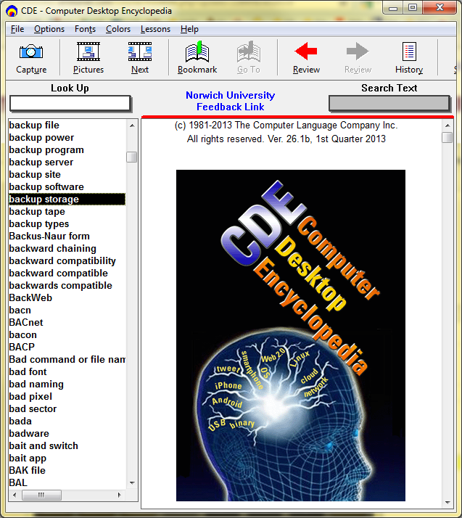
Backup Media
Following slides are built using information and images from the
Computer Desktop Encyclopedia v 26.1b.
Copyright © 2013 Computer Language Corp. All rights reserved.
Used with permission.

Slide 20
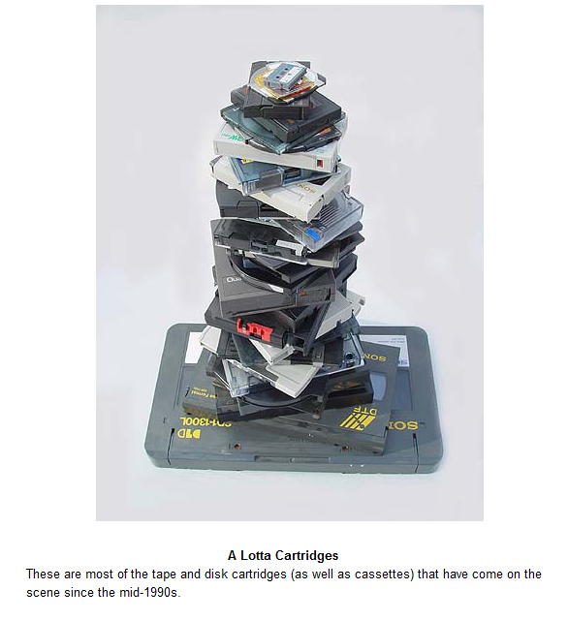
Mag Tape Cartridges
Capacities range from a few GB to 100 GB per unit (2013)

Slide 21
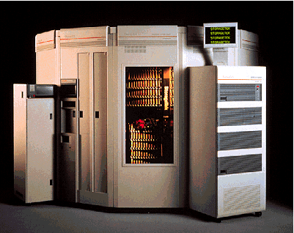
Tape Libraries (PB total)
From CDE; courtesy Iomega Corporation and Storage Technology Corporation

Slide 22

Optical Disks
CD (compact disk)
  650 MB capacity
  ~3 Mbps transfer rate
DVD (“digital videodisk” → “digital versatile disk” → “DVD”
  4.7 GB single-side single-layer
  8.5 GB single-side double-layer
  9.4 GB double-sided single-layer
  17 GB double-sided double-layer
  Transfer rates ~200 Mbps

Slide 23
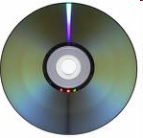
DVD Types
Standards from the DVD Forum
DVD-R: DVD-Recordable
  Write-once, read-many
  “DVD-dash-R” or “DVD-minus-R”
  4.7 GB standard
DVD-RW: DVD-Read-Write
  Write many, read many
  “DVD-dash-RW” or “DVD-minus-RW”
  4.7 GB standard
  Rewrite 1,000 times

Slide 24
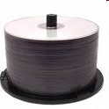
DVD Types (cont’d)
Standards from the DVD+RW Alliance
DVD+R: DVD+Recordable
  Write-once, read many
  4.7 GB
DVD+RW: RVD+ReadWrite
  Write many, read many
  4.7 GB
  Supports CAV recording format especially good for data random access
  DVD+RW drives typically read DVD-R media as well

Slide 25
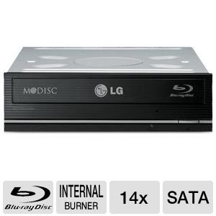
Blu-ray Disks for Backups
Developed in 2002 by Sony, Hitachi, Philips…
  Same size as CDs and DVDs
  Single-layer: 25 GB
  Dual-layer: 50 GB
Blu-ray Burners
  Internal
  External
  In 2013, about $60
Blu-ray software
  E.g., WinDVD, PowerDVD,
  Handy Backup
  25 - 128 GB/disk depending on layers (1, 2, 3, 4)
  Speeds up to ~288 Mbps (may increase in future)

Slide 26
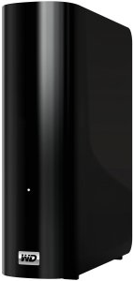
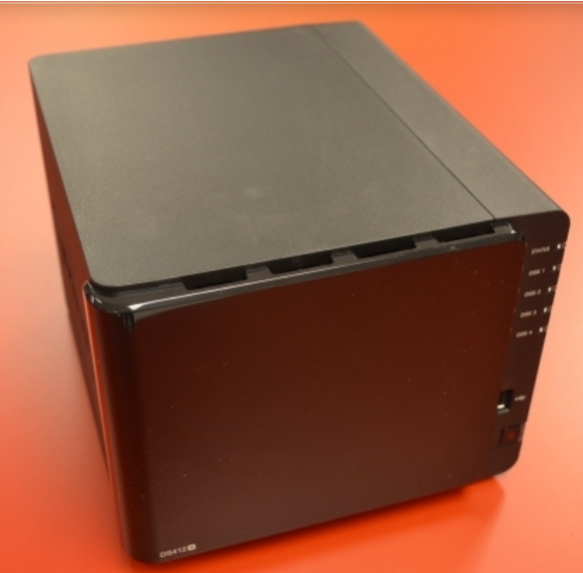
Hard Drives for Backups
For consumers: small external drives
USB 2.0/3.0, Firewire
  Maxtor, Seagate, Western Digital, ….
  In Mar 2014, ~$30/TB for 3 TB drive
For corporate servers
  Network Attached Storage (NAS)
  More expensive (2-10x)
  Fail-safe engineering
  RAID technology
  Specialized processors
  Rack-mounted or standalone
  Install disk drives to suit
Transfer rates ~3Gbps
WD MyBook 3 TB
$125
Synology DS412+
$1159 for 16 TB

Slide 27
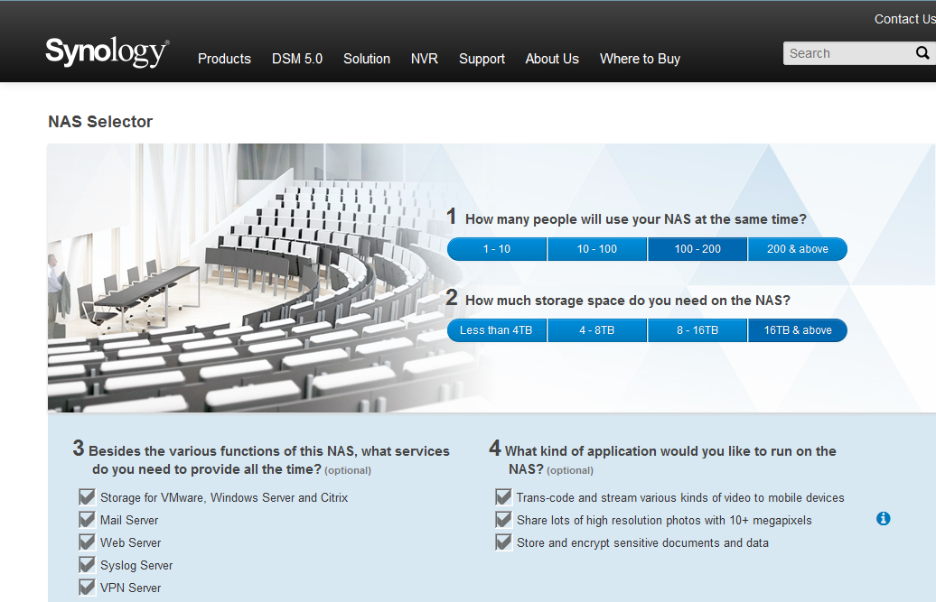
Browsing NAS Options (1)
https://www.synology.com/en-us/support/nas_selector

Slide 28
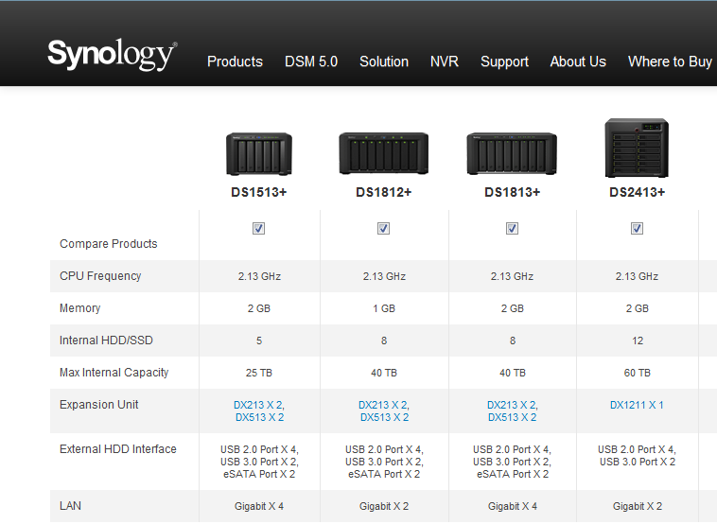
Browsing NAS Options (2)
DISKLESS (Mar 2014): ~$800 ~$1,100 ~$1,200 ~$1,700
Mar 2014:
5TB hard disks cost ~500 each

Slide 29
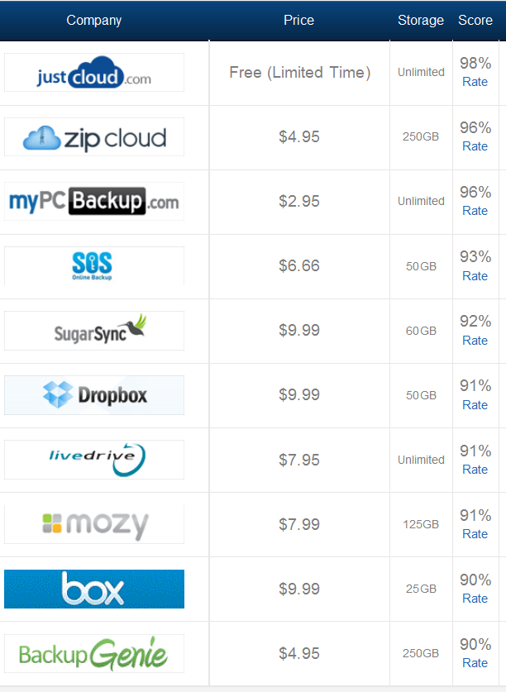
Cloud Backup (1)
Once connected to ‘Net
  Backup from anywhere
  Retrieve from anywhere
Warnings:
  Confidentiality
  Shared folders may result in accidental deletion or sabotage
  Xfr rate depends on ‘Net bandwidth
http://www.thetop10bestonlinebackup.com/cloud-backup

Slide 30
Cloud Backup (2)
Consider for organizations too
See “Why Cloud Backup: Top 10 Reasons”*
  Achieve disaster recovery with secure offsite cloud backup
  Freedom from manual and complex tape backup tasks
  Predictable costs for simpler budgeting
  Reliable and guaranteed data recovery
  Minimized risks and costs of downtime
  Fast data restores
  Take advantage of service provider’s expertise and resources
  Offload regulatory compliance requirements to service provider
  Well-managed cloud more secure than your own
  Ease of setup and use, set-and-forget, no training required
* http://www.ironmountain.com/arma/docs/top_ten_reasons.pdf

Slide 31
Strategies
Everything
Everything changed since the last full BU
Exclusive access
Types by coverage
  Full
  Differential
  Incremental
  Delta
Types by target
  System
  Application
Testing
Everything changed since the last BU of any type
All the records that have changed since the last BU
WARNING:
Always ask for a definition of
“Daily “or “Partial” BU

Slide 32

Archives, Maintenance and Retention
What to keep?
How long?
Retention policies
Rotation of media
Media longevity and technology changes
  Media degradation
  (e.g., fungus*)
  Software and hardware
  changes
    Application programs
    Operating systems
    Transport mechanisms
    Data encoding schemes
* See Mendham, S. (2005). A little care goes a long way. PC World.
http://www.pcworld.idg.com.au/index.php/secid;3;id;461315701

Slide 33
Storage
Humidity 40-60%
Temp 50-70F
Environmental protection
Onsite
Offsite
  Care during transport
  Homes
  Safes
  Banks
  Data vaults
  Online backups
Location
Storage Type
Bad idea
Access?

Slide 34

Offsite Storage
Document Management Solutions
Health Information Management
Digital Archiving
eDiscovery
Online Backup
Records Management and Storage
Secure Shredding
Data Backup and Recovery
Disaster Recovery
Technology Escrow Services
Consulting and Professional Services
Records Management Compliance
Marketing Production and Fulfillment Services
Film and Sound Archiving
These functions are copied
verbatim from Iron Mountain’s
list of services.
http://www.ironmountain.com/services/

Slide 35
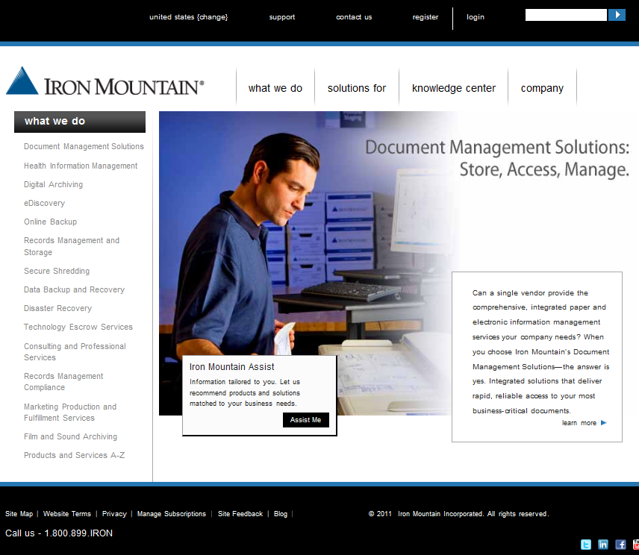
Iron Mountain

Slide 36

Disposal
Scavenging
  Dumpster® Diving
  Scratch tapes
  Diskettes, cartridges
Data and media destruction
  Erase ≠ destroy
  Reformatting inadequate
  Degaussers inadequate
  Random overwrites
    Military-grade = 7 passes
http://tinyurl.com/6dhnu2y
Stop data remanence!
“Wipe”

Slide 37
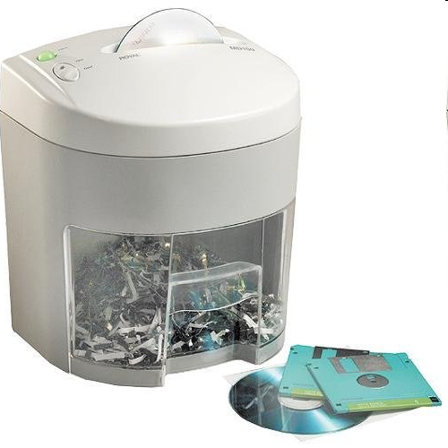
Disposal (cont’d)
Physical destruction works
  Recommended: specialized shredders
  Incineration (special types)
Secure collection points
  Lockbox magnetic garbage
Mobile data destruction services
  Paper shredders
  Special facilities for tapes
Royal Media Shredder
http://tinyurl.com/24mwtb

Slide 38


Secure Data Destruction
Equipment for destroying documents:
  Paper shredders (crosscut ONLY – see oval)
  See “Cross Cut Shredders – 5 Reasons Why They Are Better” < http://tinyurl.com/65cuw52 >
Considerations when evaluating
services
  Costs
  Types of media processed
  Onsite vs offsite
  Chain of custody
  assurance
  Regulatory compliance
  Environmental
  protection

Slide 39
Costs
Tape costs
  Tapes / BU
  Cost/tape
Time costs
  Hours/BU
  Operator cost/hour
Fixed costs
  Storage space, racks, insurance, transport, hardware rental/maintenance, software. . .

Slide 40
Optimizing Frequency
E(x) = P(u)*C(u) - P(n) *C(n)
Where
x is particular strategy
E(x) is the expected value or cost of the strategy
P(u) is the probability of having to use the backup within a single day
C(u) is money saved by not having to redo all the work
P(n) is probability of not having to use the backups at all
C(n) is cost of making and storing BU

Slide 41
Personal Notes on Kabay BUs
Two ~identical computers: MAIN & SPARE
2 1-TB portable USB drives for alternate-day use
ViceVersa synchronization software (MS)
AM:
  Synch MAIN → USB (including Backups)
  Synch USB → SPARE
PM
  Synch SPARE → USB
  Synch USB → MAIN
Daily incremental BU 23:00 → MAIN HD & MAIN Flashdrive
Monthly FULL BU MAIN → TB drives in fire safe
Since 2014: more extensive use of Dropbox for active files

Slide 42
Now go and study

