Slide 1
Business Continuity Planning
CSH5 Chapter 58
Business Continuity Planning
Michael Miora
Notes:
M. E. Kabay, PhD, CISSP

Slide 2
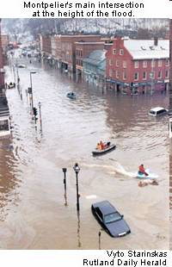
Topics
Basic Concepts
Defining Goals of BCP
The BIA
BIA Matrix Analysis
Justifying Costs of BCP
(1992)

Slide 3
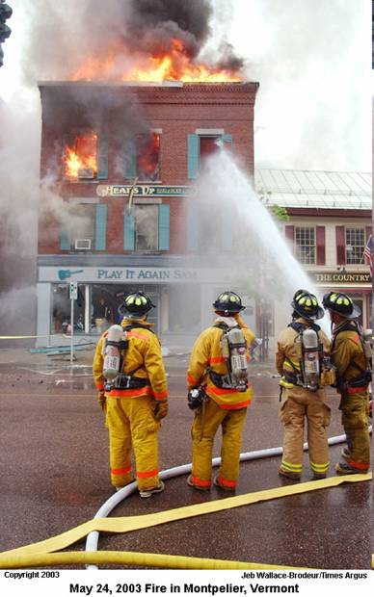
Basic Concepts of BCP
BCP and DRP
Overview
Enterprise Risks and Costs
Types of Disasters
Recovery Scenarios

Slide 4

BCP and DRP
Business Continuity Planning
  Identifying critical functions
  Developing the critical path for recovery
  Evaluating costs
  Gaining management approval
Disaster Recovery Planning
  Preparing specific strategies for recovery
  Defining specific tasks (steps) needed to implement those strategies
  Testing and revising

Slide 5
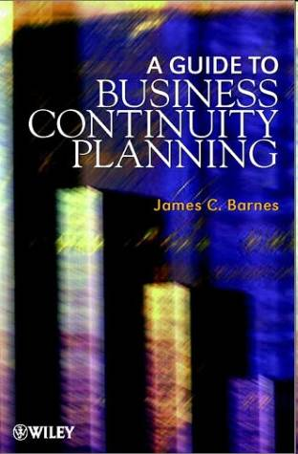
Overview
Increasing dependence on technology
  Mission-critical systems (production)
  Development
  Management
Business Continuity Planning (BCP)
  Protecting organizations against consequences of unavailability of such systems
  Focus on enterprise operations, not just IT
Must define “fast enough”
  In each context of the business

Slide 6

Enterprise Risks and Costs
Fundamental risk is to survival of organization
  Case of La Ferme St Laurent
  Clients of Mathema in Montréal in 1980s
  Failed in 1986 when computer error caused them to stamp milk products with wrong expiry dates

Slide 7
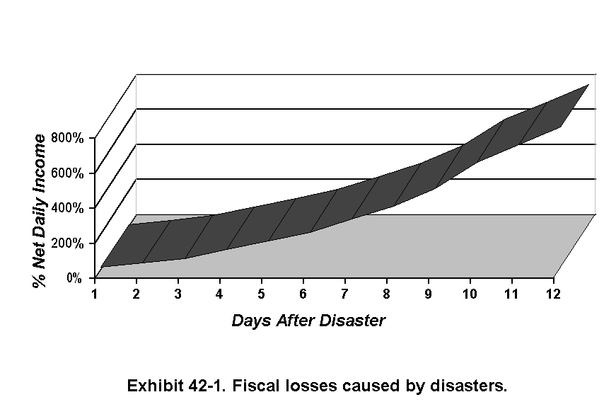
Enterprise Risks and Costs (cont’d)
Exhibits are from Michael Miora’s Chapter 42 in CSH4.

Slide 8
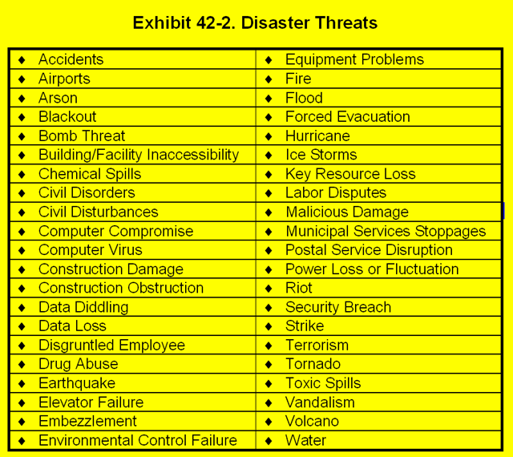
Types of Disasters

Slide 9
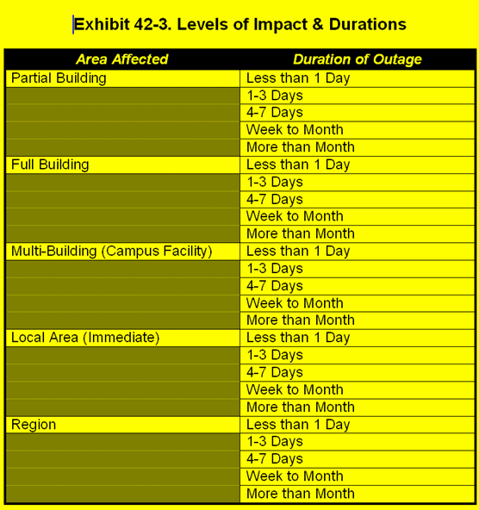
Types of Disasters (cont’d)
The specific disaster scenario is not as important as the recovery process and recovery time
Group disasters into types to facilitate planning
Break BCPs into modules to activate as appropriate

Slide 10
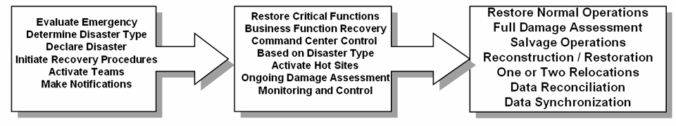
Recovery Scenarios
Recovery scenarios have 3 phases
Exhibit 42.4
Determine the effect of the emergency
Major recovery steps
Restore normal ops

Slide 11

Topics
Basic Concepts
Defining Goals of BCP
The BIA
BIA Matrix Analysis
Justifying Costs of BCP

Slide 12

Defining Goals of BCP
Overview
Scope
Correlating Objectives to Corporate Missions and Functions
Validating Goals
Mapping Goals to Recovery Phases
Emergency Issues

Slide 13

Overview of Setting Goals
Setting goals a multi-step process
Define minimum service levels required for acceptable performance
  Define specific goals for specific sectors
  Gain approval and support of steering committees of appropriate sector
  Gain overall approval of upper management
Goals are defined in business terms not in terms of means and systems
Process may be iterative

Slide 14

Scope
Define environment to be protected
  Who and what are to be included?
  Will protect specific
    systems,
    equipment,
    procedures,
    locations, and
    support capabilities
Expect to refine and redefine scope during planning process
May have to define stepwise (phased) implementation plan for BCP

Slide 15
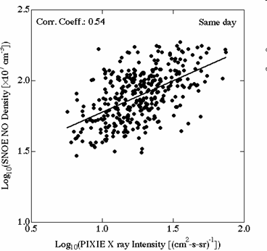
Correlating Objectives to Corporate Missions and Functions
IT often (usually) develops BCP
  Systems engineering disciplines help
  IT infrastructure critically
  important
  May already have contacts
  throughout organization for
  functional support
Must expand beyond IT
  Need business perspective
  CIO is only one C-level exec
Much may depend on
processes outside scope of IT function
  Must not overlook non-IT-dependent systems
  SCM and CRM go beyond automated systems

Slide 16
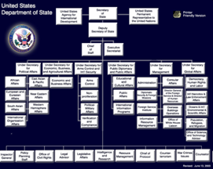
Corporate Missions and Functions (cont’d)
Examples of often-overlooked functions
  Mail room
  Facilities support
    Especially important in emergencies and for recovery
  Security forces
Work from 3 main documents
  Organization chart
  Corporate phone directory
  List of corporate operations budget line items

Slide 17
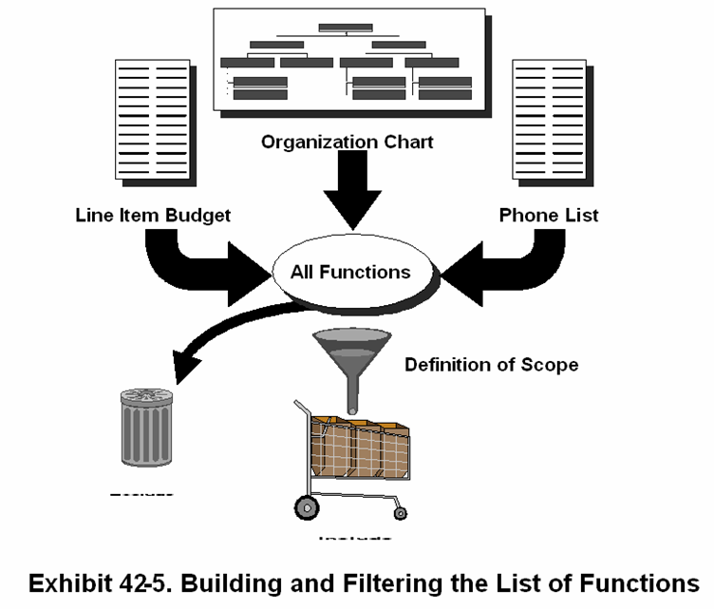
Missions and Functions (cont’d)
Exclude
Include

Slide 18

Validating Goals
Distinguish between importance of a function
  To the overall corporate goals
  To BCP / disaster recovery goals
Mostly a matter of timeline
  Determine how long function can be suspended (or running at minimal levels) without harming organization
  May change depending on circumstances
    E.g., corporate tax function may be long-term goals at mid-year yet more critical at tax-filing time
Need top-management sign-off on fundamental goals – affects everything else

Slide 19
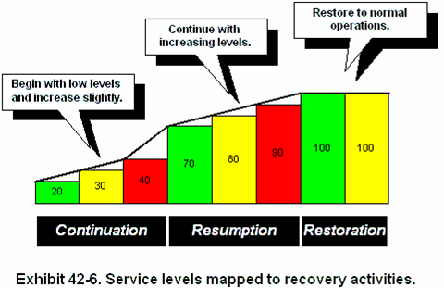
Mapping Goals to Recovery Phases

Slide 20

Emergency Issues
Ensure safety of employees and others potentially affected by disaster
  Health protection (gas masks, hazmat suits, etc. as appropriate)
  Safety preparedness (fire extinguishers, training, CPR…)
  Shelter & care for employees involved in disaster or in recovery
  Search & rescue teams
Effective public relations may keep a problem from becoming a disaster
  Honest, timely, accurate and controlled release of information

Slide 21

Topics
Basic Concepts
Defining Goals of BCP
The BIA
BIA Matrix Analysis
Justifying Costs of BCP

Slide 22

Establishing Scope of BIA
Inventory equipment & capabilities to be protected or recovered
Will change over time
Must be kept up-to-date
Remember communications infrastructure
Establish documentation
Office equipment may also be critical
Include security systems

Slide 23
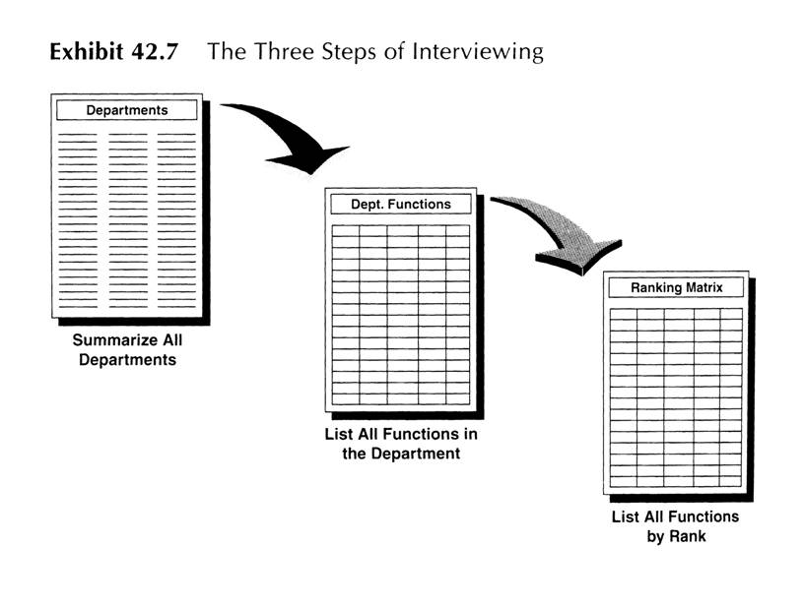
Interviews

Slide 24
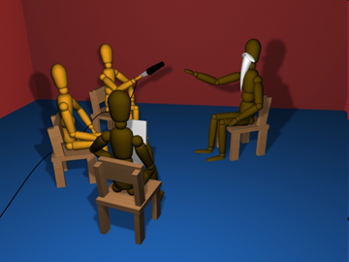
Interviews (cont’d)
People who do the work are the best sources of information about those functions
Determine whom to interview
  List departments
  Select individual in each
  dept as 1° interviewee
  Determine functions within
  each department
    Avoid excessive detail
    Group means into functional goals
      E.g., specific forms for SEC = “SEC reporting”

Slide 25
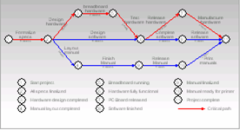
Interviews (cont’d)
Goal: develop chart showing relative importance of different functions
Will be important in determining critical path (timeline) for recovery

Slide 26
Describing Functions
Must include summary information about each function listed
  1 or 2 ¶
  Reduce confusion
  Focus discussions
Use functional matrix as shown below to represent functions
Ops

Slide 27
Definition of Departments & Functions
Ops
Survival Days
  How long can organization survive without this function before significant damage?

Slide 28
Definition of Departments & Functions (cont’d)
Criticality
  What happens when the damage starts?

Slide 29
Definition of Departments & Functions (cont’d)
Operational Impact
  Convert criticality to Operational Impact
  4 levels instead of 10
  Reduces granularity of criticality

Slide 30
The Ranking Factor
Ops
Combines survival time and operational impact
Low number is most important
Multiply survival time (days) x operational impact
  E.g., 1 day survival x op impact critical (1) = 1
  10 day survival x op 1 = 10
  3 day survival x “some op impact” (3) = 9

Slide 31
Category
Ops
Sort by Ranking Factor in ascending order
Category groups functions with similar recovery periods

Slide 32
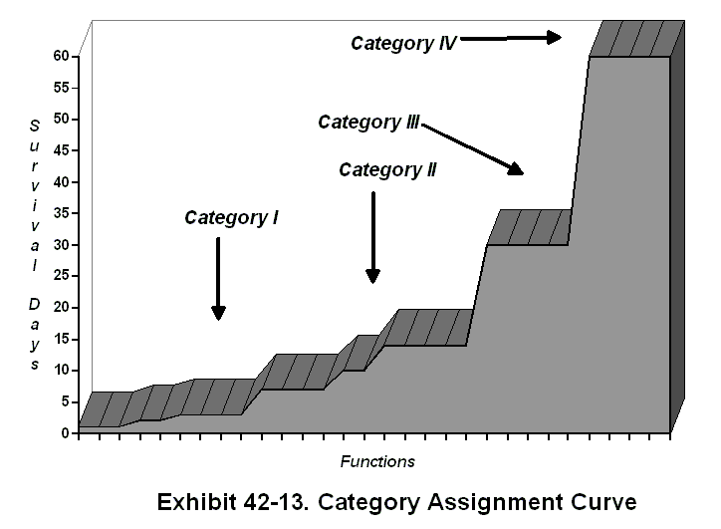
Category (cont’d)

Slide 33

Topics
Basic Concepts
Defining Goals of BCP
The BIA
BIA Matrix Analysis
Justifying Costs of BCP

Slide 34
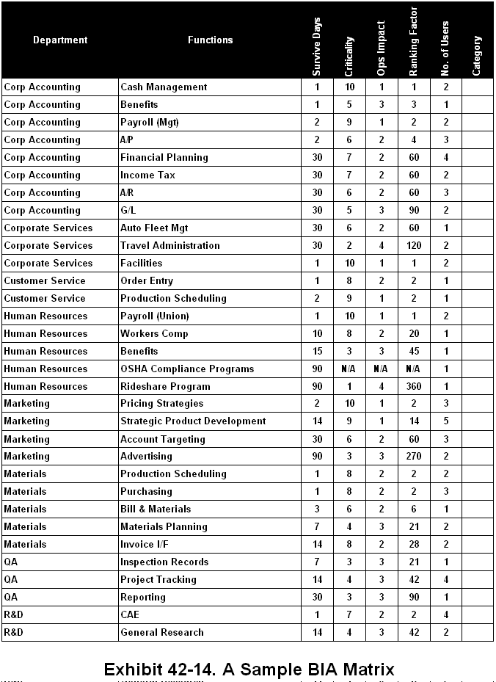
BIA Matrix is Heart of BIA
Basic information needed to
  Establish recovery requirements
  Timelines
  Estimate costs of outages
Useful in
  Translating business
  objectives into BIA
  objectives

Slide 35
Listing the Functions Organizationally
. . .

Slide 36
Finding Cross-Department Functions
Emphasize similar functions in different departments
Titles may differ but functions same
or almost
Especially important to resolve
different estimates of parameters
(Survival days, criticality,
impact, ranking factor….)
Must adapt to irreconcilable
perspectives

Slide 37
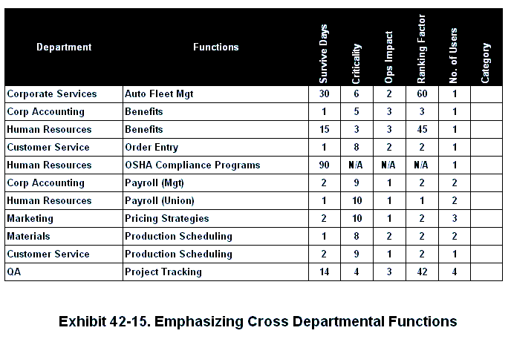
Cross-Department Functions
. . .

Slide 38
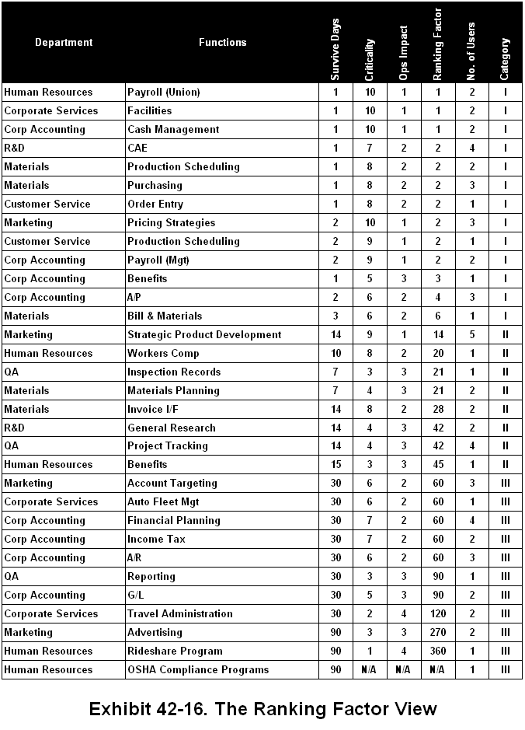
Using the Ranking Factor
. . .

Slide 39
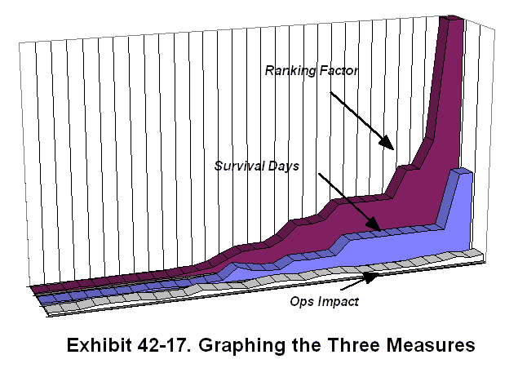
Ranking Factor (cont’d)
Critically important functions that must be restored first

Slide 40

Topics
Basic Concepts
Defining Goals of BCP
The BIA
BIA Matrix Analysis
Justifying Costs of BCP

Slide 41
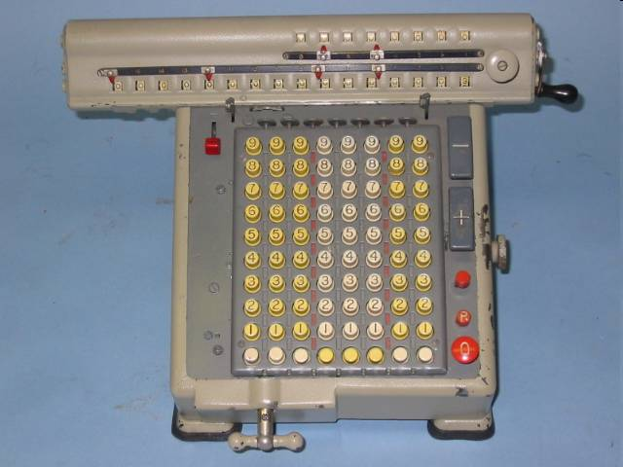
Quantitative Risk Model (QRM)
Annualized Loss Expectancies
  ALE = Σp_{i}c_{i}
  p_{i} is probability of event or strategy i
  c_{i} is cost (or gain) of event or strategy I
E.g., in roulette (gambling game),
  Probability p₁ of winning $1 bet on a single number on 1 roll of wheel is 1/38 and gain c₁ is 36 times the bet = $36
  Losing: p₂ = 37/38 with c₂ = -$1
  So ALE for this bet is p₁c₁ + p₂c₂
  = 0.0263*$36 + 0.9737*(-$1)
  = $0.9468 - $0.9737 = -$0.0269 per bet

Slide 42
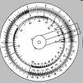
Problems of the QRM
Costs depend on level of loss
  E.g., costs will rise as outage lengthens
  Complicates calculations
Most important: exact probabilities
difficult to determine
  Some events have extensive data
  base
  Actuaries keep records for insurance companies – fire, flood, etc.
But IT-related probabilities difficult to find
  Huge variations in infrastructure, configuration, exposure to threats
  Operational standards affect vulnerabilities

Slide 43
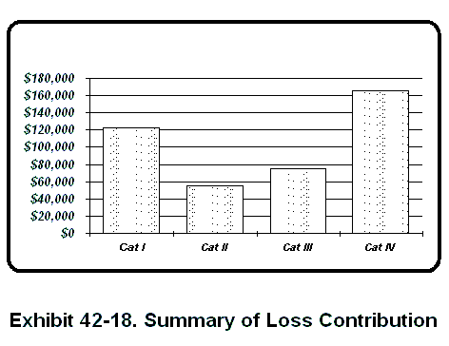
Generalized Cost Consequence Model (GCC)
Estimate cost of damage for each function
  When does the loss begin?
  What are the monetary consequences?
Apply cost when appropriate
Collect costs by category

Slide 44
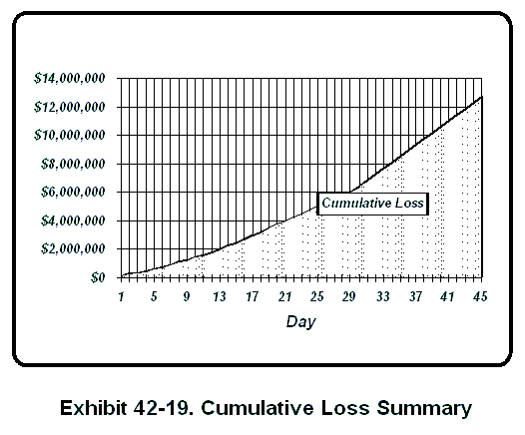
GCC (cont’d)
Evaluate total losses day-by-day

Slide 45
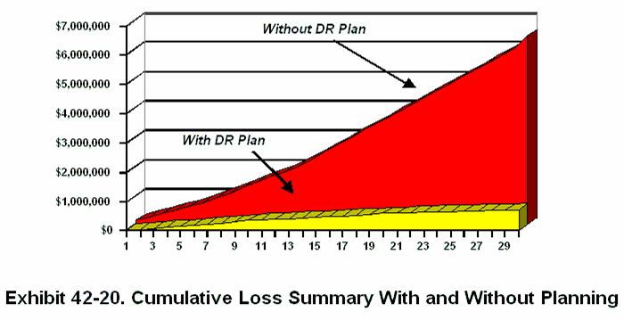
GCC (cont’d)
Estimate costs with Disaster Recovery Plan in place and compare to costs without DRP

Slide 46
Review Questions (1)
Distinguish between BCP and DRP
Why is BCP important to IT today?
What is the advantage of grouping disasters into types in BCP?
What are the three phases of recovery scenarios?
Why do you need BCP steering committees for different sectors of the organization? Why can’t a BCP expert simply define the goals of the process herself?
How does defining the scope of the BCP support the planning process?
Why does the IT sector so often get the responsibility for coordinating BCP?

Slide 47
Review Questions (2)
What are the 3 main documents recommended by Prof Miora as the basis for identifying key corporate functions?
In the description of functions for the functional matrix, what does the criticality score signify?
What is the relation between the operational impact score and the criticality score in the functional matrix?
In the functional matrix, how is the ranking factor calculated? What is the ranking factor used for?
In the functional matrix, what is the relation between the category and the ranking factor? What is the category used for?
What’s the benefit of listing functions organizationally in the BIA matrix?

Slide 48
Review Questions (3)
How does sorting by ranking factor in the BIA matrix serve BCP needs?
A fire-insurance policy costs Megahard Corp $10,000 per year for the Miora Complex on the Northfield Campus to cover the $8,000,000 cost of rebuilding it were it to burn down. Actuaries inform the risk managers at Megahard that the probability of a catastrophic fire is 0.001 per year. Calculate the ALE of the insurance policy and then calculate the ALE of total destruction of the building; compare the two numbers. Is the insurance policy cost-effective? (Hint: in the insurance contract, Megahard bets the insurance company that they will have to pay out $8,000,000 and the insurer bets that they will not pay anything).
Why is it so difficult to apply the quantitative risk model to BCP?
How does the Generalized Cost Consequence model support BCP?

Slide 49
DISCUSSION

