Slide 1
Disaster Recovery Planning
CSH5 Chapter 59
Disaster Recovery Planning
Michael Miora
Notes:
M. E. Kabay, PhD, CISSP

Slide 2
Topics
Introduction
Identifying Threats and Disaster Scenarios
Developing Recovery Strategies
Designing Recovery Tasks
Implementation and Readiness

Slide 3
Scope of DRP
BIA* determines key functions
Establishes sequence for recovery
Builds economics of case for recovery
DRP focuses on detailed recovery strategies
Analyze and test critical path to recovery
May begin while disaster in progress
Establish essential services
Continue through to normal operations
*Business Impact Analysis – see CSH5 Ch 58

Slide 4
Topics
Introduction
Identifying Threats and Disaster Scenarios
Developing Recovery Strategies
Designing Recovery Tasks
Implementation and Readiness

Slide 5
Threats
Compile extensive list of threats to operations
Rely on cooperation of emergency services
Fire
Police
Flood district managers
Compiling lists is useful in itself
Define levels of impact
Helps develop risk-mitigation plans

Slide 6
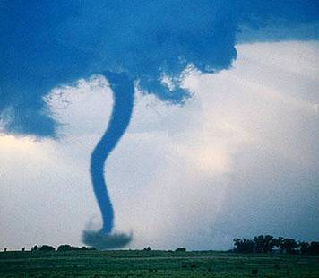
Examples of Threats to Consider (from Ex. 59.1)
Accidents
Acts of G-d
Aircraft accidents
Alchohol abuse
Area evacuation
Arson
Boiler explosion
Bomb threat
Brownout
Bldg inaccessible
. . . .
. . . .
Sabotage
Sand storm
Snow storm
Strike
Terrorism
Tornado
Utility failure
Volcano
Water damage
Water supply failure

Slide 7
Disaster Recovery Scenarios
Apply survivable technologies to mission-critical functions
E.g., eliminate single points of failure where practical
E.g., invest in remote location for part of corporate data processing
Escalation scenarios
Establish timelines for increasing application of recovery measures
Must plan carefully
Avoid ambiguity in decision points

Slide 8
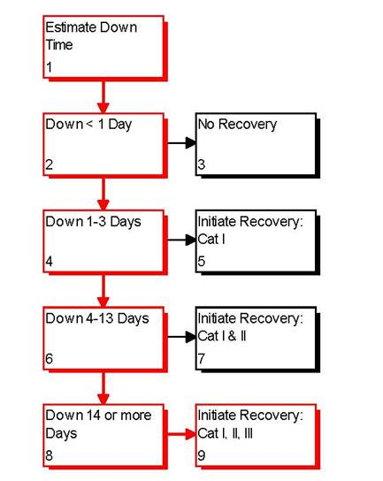
Escalation Timelines
Illustrates how DRP specifies decisions and actions
Must identify who makes the decision
Everyone has to know exactly who has authority to move to next phase
Cannot argue about decision while disaster is in progress
Must be practiced repeatedly (see later)
Escalation Timeline

Slide 9
Classifying the Damage
. . . .

Slide 10
Simplifying the Scenarios
Use complete listing to identify major scenarios of concern
Establish key scenarios; e.g.,
Systems only
Partial building unusable
Full building unusable
Expect radically different DRPs for these types of disasters
Everything depends on specifics of the situation – no boilerplates

Slide 11
Categories of Functionality
Category I
Essential, mission-critical and time-sensitive
Category II
Essential, mission-critical but later in sequence
Other
Necessary but not immediately critical

Slide 12
Topics
Introduction
Identifying Threats and Disaster Scenarios
Developing Recovery Strategies
Designing Recovery Tasks
Implementation and Readiness

Slide 13
Recovery Phases
Expect to identify 3 basic phases
Continuation of critical functions (Continuation)
Recovery of critical functions (Recovery I)
Recovery of other functions (Recovery II)
See Figure 59.4 on next slide

Slide 14
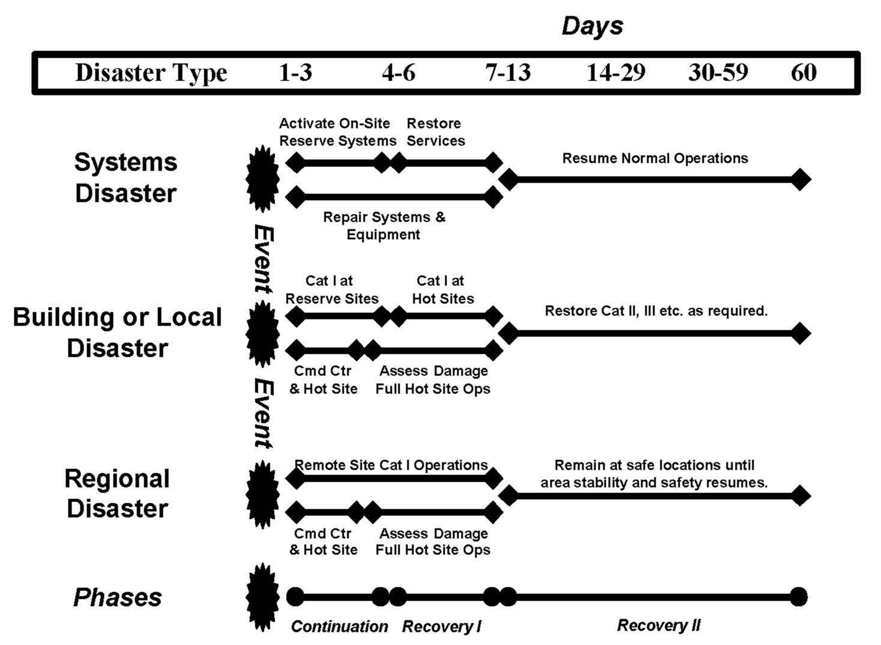
CSH5 Exhibit 59.4

Slide 15
Continuation
Begins immediately at time of disaster
Support Category I functions as best as possible
Respect time frames defined by BIA
Consider possible alternate task assignments for people whose regular duties are impossible

Slide 16
Recovery I
Restore nearly full functionality to Category I functions
Can start shortly after Continuation Phase has stabilized
But usually starts quickly during Continuation Phase
Minimize period of degraded functions for Category I
Use overlapping recovery to degree possible

Slide 17
Recovery II
Continue recovery of lesser, later functions
All of these timelines are planned
Do not assume that you can play it by ear
No time to debate and discuss critical path during recovery phases

Slide 18
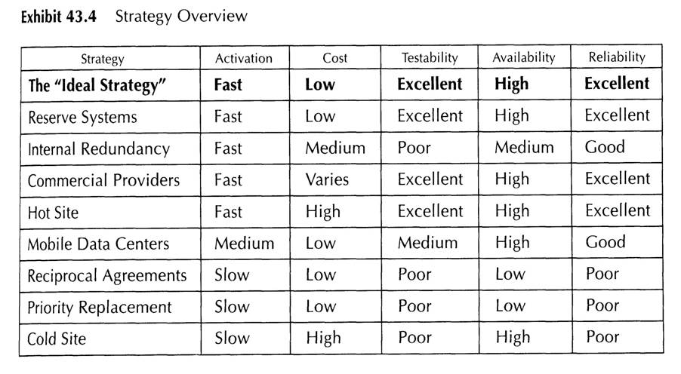
Range of Strategies for DRP

Slide 19
Data Backup Scenarios
“Data backup is a key function in all system installations. The best recovery strategy, chosen to meet recovery timelines according to the BIA, is useless without a backup from which to restore and resume operations. Data backup is perhaps the single most critical element of a disaster recovery plan, yet only 31 percent of U.S. companies have backup plans and equipment.” – Michael Miora, CSH5 59

Slide 20
Topics
Introduction
Identifying Threats and Disaster Scenarios
Developing Recovery Strategies
Designing Recovery Tasks
Implementation and Readiness

Slide 21
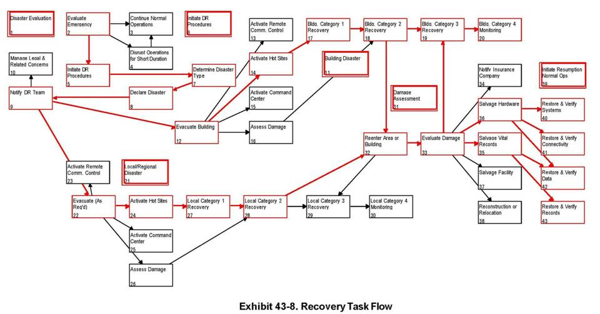
The Overall Plan

Slide 22
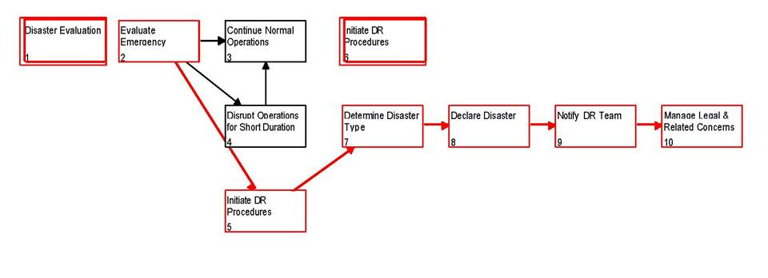
Beginning Sequence

Slide 23
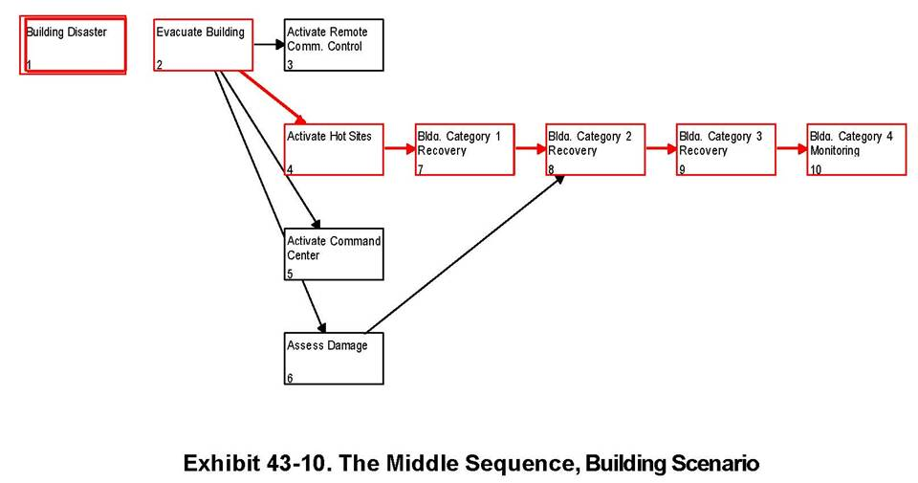
Middle Sequence

Slide 24
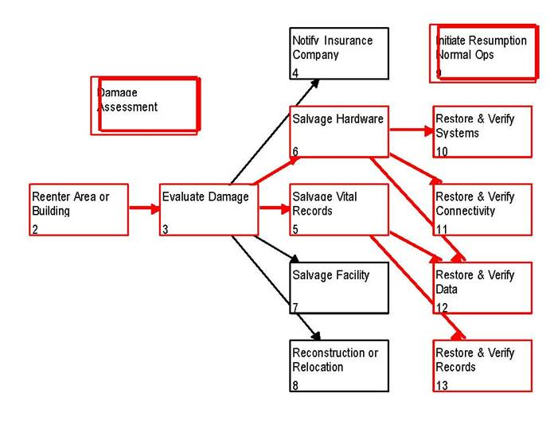
End Sequence

Slide 25
Topics
Introduction
Identifying Threats and Disaster Scenarios
Developing Recovery Strategies
Designing Recovery Tasks
Implementation and Readiness

Slide 26
Rehearsals
Phased testing
Bottom-up approach
Limited tests in restricted areas
Integrate tested procedures in larger aggregations
Ideally, use separate test facilities
Involve real users

Slide 27
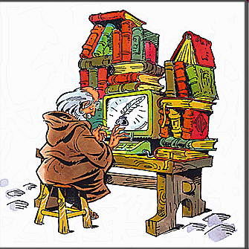
Intensive Record-Keeping
Assign scribes who observe and take notes in rehearsals
Have time-keepers with stop-watches to help scribes
Use video-cameras where possible (use time-stamps)
Useful for intensive analysis of errors
Leads to rapid corrections and improvements

Slide 28
Walk-Through or Post-Mortem for Rehearsals AND Real DRP
Analyze cases with all concerned
Not for assigning blame!
Constructive discussions as teams
Egoless work essential
Everyone benefits from identifying problems
Analyze causes, not just symptoms
"St Jerome and the Angel" by Simon Vouet 1620s, National Gallery of Art, Washington

Slide 29
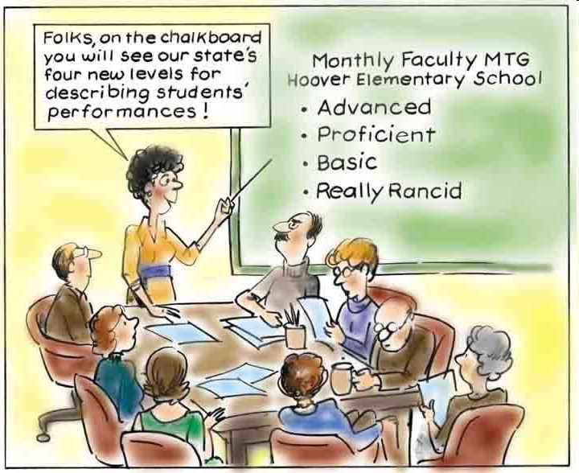
Testing
As plans mature, need increasingly real tests
Schedule tests during off-time
Involve people from all sectors
Practice responses, decisions
Invent unexpected scenarios to stress the plans
MEASURE the results and analyze

Slide 30
Live Tests
Most difficult to arrange
DO NOT TRY TO SURPRISE PEOPLE
Can themselves result in disaster if not carefully planned
Ideally, use sectional tests with unannounced times (but with advance notice of general plans)
If possible, plan for simulated tests on weekends
Should schedule at least one full test per year

Slide 31
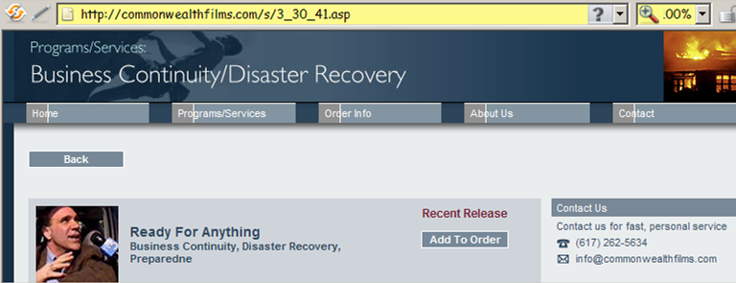
Training Film
Ready for Anything (used in BCP)
Commonwealth Films
You can use this film for extra points (see later)

Slide 32
Review Questions (1)
Why is compiling lists of possible threats helpful in DRP?
What is an escalation scenario in DRP? What are the required attributes of the escalation scenarios?
How can one simplify an extensive list of possible disasters for the purpose of DRP?
What are Miora’s three categories of functionality in DRP?
What are Miora’s three phases of recovery in DRP?
Why are reciprocal agreements so badly rated in the range of recovery strategies discussed in CSH4 Chapter 43?

Slide 33
Review Questions (2)
What are the characteristics of the ideal DRP strategy (one that may not be attainable in practice)?
Which of the strategies for DRP rates the highest in attaining the ideal?
Why is data backup such an essential component of DRP?
Why are rehearsals such an important element of DRP?
What are the essential ground rules of a walk-through in a DRP analysis of a rehearsal or test?

Slide 34
DISCUSSION

