Slide 1
Working with
Law Enforcement
CSH5 Chapter 61
David Land
Notes:
M. E. Kabay, PhD, CISSP

Slide 2
Topics
Introduction
Relevant Laws
Plan Ahead
Memorandum of Agreement
Handling Evidence & Chain of Custody
Issues of Liability
Ask Law Enforcement to Give Back
The Knock at the Door
Keeping Your Operation Running During and Investigation
Nonelectronic Records and the Insider Threat
Information Sharing (The Human Factor)

Slide 3

Introduction
Collaborating with law enforcement (LE) important element of security
Prepare good relations before incident
  Know what information to collect & organize
  Know whom to call in emergency / incident
  Recognition by LEOs based on prior discussions
  Rapid response from LE for known & trustworthy people
  Memorandum of agreement (MOA)
  Join InfraGard (see later)
Private sector are not LEOs – must know when to call in professionals

Slide 4
Relevant Laws (1)
Work with corporate counsel
  Identify state and federal
  laws applying to jurisdiction
What must be reported
(Exhibit 61.1)
  Intrusions / attacks on major
  networks
  Intrusions / attacks resulting in $$$$ losses
  Suspected state-sponsored / industrial espionage
  Child pornography
  Email or other digitally transmitted threats
  Suspected terrorist activities
  Internet fraud may be reported to various agencies but does not have to be reported

Slide 5
Relevant Laws (2)
What not to report to LE
  Port scanning & other non-intrusive activities
  Malware (viruses, Trojans, worms, spyware….)

Slide 6

Plan Ahead
Checklists
FBI
USSS & Other Agencies
USPIS

Slide 7
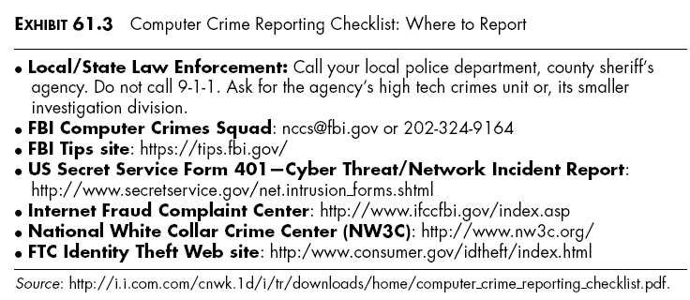
Checklists
CSH5 Chapter 61 p 61.4

Slide 8

FBI
Lead LE agency for investigating foreign cyberattackers
Fights criminals, sexual
predators, fraudsters
Jurisdiction over national
security investigations

Slide 9

USSS & Other Agencies
US Secret Service
  Counterfeiting, identity theft,
  computer fraud
  Attacks on Treasury Dept
  Attacks on other targets not
  covered by FBI
Other agencies may be involved
  Customs
  Commerce
  Naval Criminal Investigative
  Service
  US Army Intelligence
  US Army Criminal Investigation Division

Slide 10

USPIS
US Postal Inspection Service
Enforce > 200 laws
affecting or using postal
system
  Auction fraud
  Multilevel marketing
  scams
  Payment or delivery
  via US mail
    Work from home /
    money laundering

Slide 11
Memorandum of Agreement
MOA with appropriate law-enforcement authorities
Prudent measure
  Both sides know what to expect
  Specific points for details
  Discuss public disclosure in advance
DoJ computer-crime resources (see next slide)

Slide 12
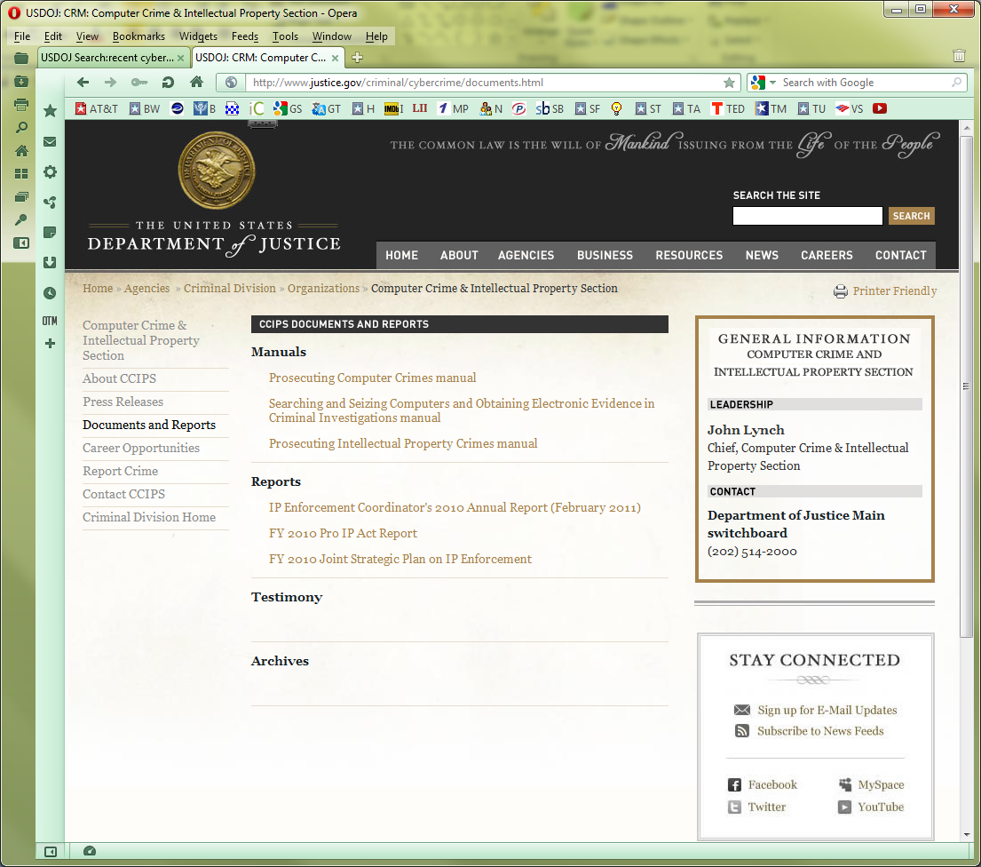
DoJ Computer-Crime Resources
http://www.justice.gov/criminal/cybercrime/documents.html

Slide 13

Handling Evidence & Chain of Custody
Examine media systematically
Keep detailed notes about possible evidence
Document all procedures and processes
  Especially note variations/deviations
  from standards
Mark (label) all output from exploratory
processes
  Unambiguous
  Consistent with law-enforcement agency’s
  standards
Note resources on previous screen shot
  Searching and Seizing Computers and Obtaining Electronic Evidence in Criminal Investigations
  Prosecuting Computer Crimes
  Prosecuting Intellectual Property Crimes
http://www.justice.gov/criminal/cybercrime/documents.html

Slide 14

Issues of Liability
Keep track of discovery, theft or damage of
Proprietary information
Business-sensitive information
Export-controlled information*
Downloaded copyrighted music/videos
National-defense information
*Export Administration Regulations (EAR)
Bureau of Industry and Security, US Department of Commerce
http://www.bis.doc.gov/policiesandregulations/ear/index.htm

Slide 15
Ask Law Enforcement to Give Back
LE may ask for all conceivable evidence
Can also provide services
  Training for key personnel
  Information on crimes
  Suggestions for
  combating crimes

Slide 16
The Knock at the Door
Prepare for unannounced appearance of LE with warrant
Stay cool
Express willingness to comply/
cooperate
Read warrant carefully
Inform upper management &
legal counsel
Help officers to secure evidence;
try to get backups if possible/
necessary for business continuity
If servers to be searched/seized, get
sysadmins involved to prevent data loss &
operational damage
Rarely is entire network brought down
Retain “officer’s return” listing all seized property
Work on business continuity after officers leave

Slide 17
Keeping Your Operation Running During an Investigation
Schedule meetings for continuity of operations & test plans before anyone knocks on your door with a warrant
See if outages can take place after peak processing hours
Be sure logs/audit files easily accessible for LEOs
Never allow removal of data without backup! Arrange BU strategies to include possibility of removal by LEOs
Limit discussion among uninvolved personnel (reduce wasted time, worry, disruption)
Maintain open communications with LEOs – establish good relations before incident
Encourage on-site bit-for-bit copies of data in real time at all times or at least schedule for non-peak hours (thus avoiding loss of data when the primary disks removed)

Slide 18

Non-electronic Records and the Insider Threat
More than half of computer crimes
thought to be committed by insiders
Maintain careful archives of
surveillance data
  Paper sign-in sheets, surveillance
  video, proximity-card records,
  access-control
  Anomalies may highlight collusion or
  other criminal activity
    Theft of user credentials
    Unauthorized transfer of data-storage devices
Some crimes are cold cases discovered [long] after incident occurred – records valuable

Slide 19

Information Sharing
(The Human Factor)
Improved cybercrime training in many LE agencies
InfraGard
  Information-sharing organization
  Industry/academia/government
  & LE
  Many open meetings
  Some member-only
  discussion groups & meetings
  Background check for formal
  membership
  >60 chapters across USA (Mar 2014)
  54,677 members (2013-03-12 – couldn’t find later data)
See next slides
http://www.infragard.net/about.php?mn=1&sm=1-0

Slide 20
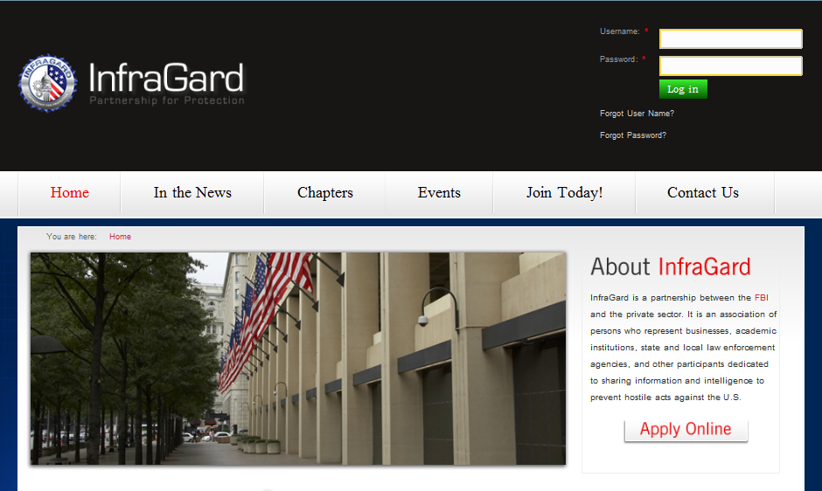
InfraGard (1)
https://www.infragard.org/node

Slide 21



InfraGard (2)
https://www.infragard.org/node

Slide 22
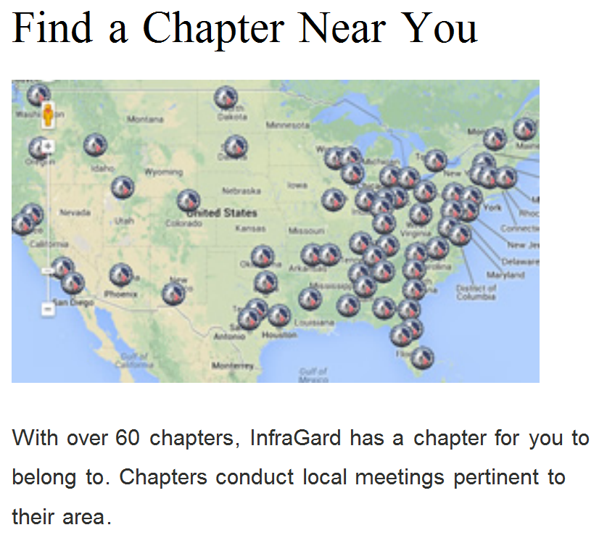
InfraGard (3)
http://preview.tinyurl.com/l9y826d

Slide 23
Paranoid Conspiracy Theories About InfraGard
Try < infragard conspiracy > using Internet search engine for lunatic beliefs:
  InfraGard members have shoot-to-kill authorization (!) [not true]
  Special privileges (!!) [not true]
  Early warnings in emergencies (!!!) [not true]
  InfraGard members snoop on neighbors(!!!) [not true]
See M. E. Kabay’s “InfraGard is not a deodorant”
< http://www.mekabay.com/nwss/406_infragard.pdf >
  [Originally published in 2005 in Network World Security Strategies]

Slide 24
DISCUSSION

