Slide 1
Risk Assessment & Risk Management
CSH5 Chapter 62
Risk Assessment and Risk Management
Robert V. Jacobsen
Notes:
M. E. Kabay, PhD, CISSP

Slide 2
Topics*
Definitions
Objectives of Risk Assessment
Limits of Questionnaires
A Model of Risk
Risk Mitigation
Risk Assessment Techniques
____________________________________________
* Based on Robert Jacobson’s chapter in
CSH5 (Bosworth, Kabay & Whyne’s Computer Security
Handbook, 5th edition – Wiley, 2009) with additions
by M. E. Kabay
Students should note that this Quantitative Risk Management
approach is strongly rejected by many security experts,
including Donn Parker in particular.

Slide 3
Definitions
Risk: possibility of suffering
harm or loss
Risk Management
  Risk assessment
  Risk mitigation
  Security management
  Security auditing
Feedback ensures corrective actions back into process – continuous process improvement
Security is a process, not a state*
Feedback
loops
* Attributed to Bruce Schneier

Slide 4
Objectives of Quantitative Risk Assessment (QRA)
Help to select subset of security measures given limitations on resources
Every system will have unique security requirements
Risk assessment must provide appropriate information about
  Possible losses (costs of damage and of recovery)
  Estimated probability* of specific events or classes of events
* Fundamental difficulty for QRA

Slide 5
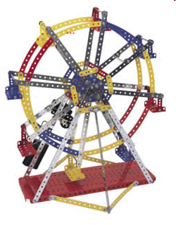
A Model of Risk
Fundamental Risk Model
Two Inconsequential Risk Classes
Two Significant Risk Classes
Real-World Risks & the ALE

Slide 6
Fundamental Risk Model
“Jacobson’s Window”
Consequences
Low
High
Low
Occurrences
High

Slide 7
Two Inconsequential Risk Classes
Consequences
Low
High
Don’t
care
Low
Occurrences
Doesn’t
happen
High

Slide 8
Two Significant Risk Classes
Consequences
Low
High
Major fire,
long power outage,
flooding,
cash fraud,
….
Low
Occurrences
Power transient,
minor sw bug,
keystroke error,
….
High

Slide 9
Real-World Risks & the ALE
To compare risks, we use the annualized loss expectancy (ALE):
E(x) = Σp_{i}c_{i}
Where
  E(x) = ALE of strategy x
  p_{i} = probability of occurrence i
  c_{i} = cost of occurrence i
  Σ = add up the products
∞
i

Slide 10

Example of ALE Calculation
Keystroke errors (Jacobson’s example with slight modifications)
100 errors per
operator per hour
100 operators
2,000 hours per
operator per year
= 20,000,000 errors per year
Detection rate 99.9% at no cost
Thus p = 0.001 failure rate of missed errors
Errors corrected later @ $1 each
So E(X) = 0.001 * 20,000,000 * $1 = $20,000

Slide 11
Another ALE Calculation
Major fire (also Jacobson’s example)
Probability “p” of major fire in a year = 0.0001
Cost of major fire estimated at $100M
Therefore E(x) = 0.0001 x $100M = 10⁻⁴ x $10⁸ = $10⁴ = $10,000

Slide 12
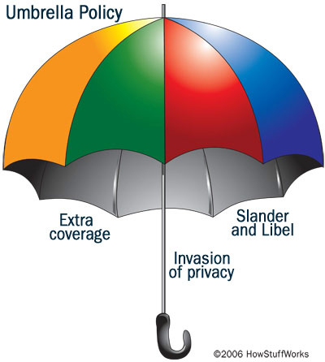
ALE of an Insurance Policy
Customer bets insurance company
he will die this year (probability 0.1%)
Bets (pays) $750 in “premium”
If customer dies, insurance company
pays $500,000 to beneficiary
Insurance company bets that
customer lives – keeps premium,
pays nothing.
  p₁ = 0.001 c₁ = -$500,000 (a gain to widow and a loss to the insurance company)
  p₂ = 0.999 c₂ = +$750 (a loss to family and a gain to the insurance company)
E(x) = Σp_{i}c_{i} = 0.001 x -$500,000
+ 0.999 x +$750 = +$249.25
(a loss to the family and a gain to the company)

Slide 13
Risk Mitigation
Difficulties Applying ALE Estimates
Risk Managers’ Goals
Mitigating Infrequent Risks
Summary of Risk-Mitigation Strategies

Slide 14
Difficulties Applying ALE Estimates
Information about information assurance risks is very poor
  Little or no mandatory reporting
  No centralized databanks
  Enormous variety of system configurations
  Therefore no actuarial statistics
Jacobson’s 30-Year Law
  People dismiss risks not personally
  experienced in last 30 years
Kabay’s Paradox of Security
  The better the security, the less direct evidence there is to support security measures in a specific organization
  UNLESS you have METRICS

Slide 15
Risk Managers’ Goals
Imagine wide range of risks
Try to estimate consequences / costs
Attempt to determine probabilities
Identify risk-mitigation strategies and their costs
Compute ALEs to estimate appropriate return on investment (ROI)
  Generally focus on loss-avoidance
  However, some loss-avoidance can reduce costs to such a point as to provide overall increase in profitability
  Also consider secondary effects such as improved customer relations, marketability, visibility in competitive marketplace….

Slide 16
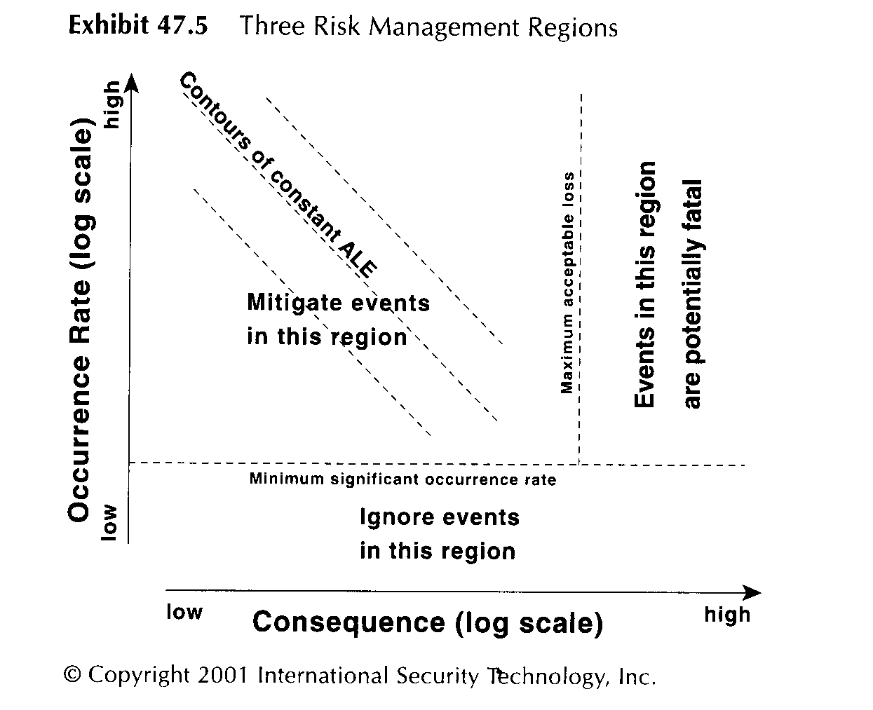
Three Risk-Management Regions

Slide 17
Where ROI-Based Risk Mitigation is Effective
Works well for high-probability, low-cost risk exposures
  Realistic appraisal by managers
  Data are credible
Does not work well for low-probability, high-cost risk exposures
  Upper management rarely understand implications of information technology risks
  “Who would have thought that….”
  is common reaction by upper
  management

Slide 18
Four Reasons for Adopting a Mitigation Strategy
Required by law or regulations
Cost trivial but significantly lowers probability of harm
Addresses low-probability, high-cost event with unacceptable SOL (single-occurrence loss); e.g., consequence that wipes out org.
Cost of mitigation is more than offset by expected reduction in ALE (i.e., positive ROI overall compared with doing nothing)

Slide 19
Mitigating Infrequent Risks
Reduce magnitude of high SOLs*
  Transfer risks using insurance
  Disperse risk exposure (e.g., multiple ops centers)
  Reduce vulnerability (e.g., BCP)
Mitigation selection process
  Choose low-cost measures
  Ignore low risks
  Use insurance
_______________
* Single-occurrence losses

Slide 20
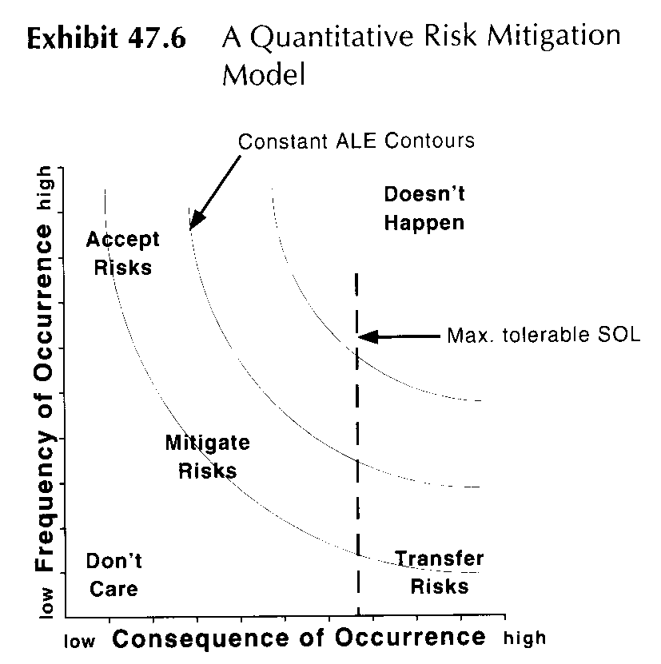
Summary of Risk-Mitigation Strategies (1)

Slide 21
Summary of Risk-Mitigation Strategies (2)
IT staff may be unable to reduce ALE of high-probability/low-consequence risks
Midrange risks can be handled using mitigation measures chosen by
evaluating their ROI using ALE
calculations
Low-probability/high-cost risks involve evaluations of SOLs and mitigation measures to reduce probabilities further or reduce costs through planning and preparation
Ideally, risk management should be
  Performed by experts
  Independent of IT management
  Reported to senior management directly

Slide 22
Risk Assessment Techniques
Aggregating Threats and Loss
Potentials
Basic Risk-Assessment
Algorithms
Loss-Potential Risk-Event
Parameters
Risk Event Parameters
Vulnerability Factors, ALE,
SOL Estimates
Sensitivity Testing
Selecting Risk-Mitigation
Measures

Slide 23
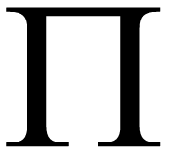
Aggregating Threats and Loss Potentials
Calculations of ALE can be increased in precision using aggregation of individual ALEs for specific components of systems
  E.g., if manufacturers provide failure rates for specific components (e.g., servers), these data can be helpful in estimating overall failure rates
One useful rule: probability P of failure of a system with independent units “i” where each has probability p_{i} of failing is
P = 1 - Π(1-p_{i}) which reduces to
P = 1 – (1-p)^{n}
for systems where all the units have
the same p_{i}

Slide 24
Loss-Potential
Loss potential can include costs of
Property damage
Liability
Service interruption

Slide 25
Risk Event Parameters
Occurrence rate estimation
  Rates often change after problems occur
  Don’t count events twice; e.g., if a power failure causes a system crash, be careful not to count both of these separately
  Look for external source of actuarial data
Outage duration affects costs
  Service interruption increasingly important with e-commerce growing
  EDI, Web purchases, multiple competitors….

Slide 26

Vulnerability Factors, ALE, SOL Estimates
Validating the estimates is important
Check all the individual data and calculations before basing decisions on math
Look for the risk event/loss potential pairs that generate ~80% of total ALE
Check assumptions – discuss with team members
Look for outliers – extraordinarily large contributors – and double-check them

Slide 27

Sensitivity Testing
Estimates of probability and costs are unlikely to be point-estimates
Can use range estimates
  Try high, medium and low
If probability distributions are available,
try Monte Carlo simulation
  Run random trials selecting
  values from parameter
  distributions
  Plot range of resulting ALEs
  to see central tendencies
  Compute expected distributions
  Look out for chaotic systems*
* System that is so sensitive to
initial conditions that it is unpredictable

Slide 28
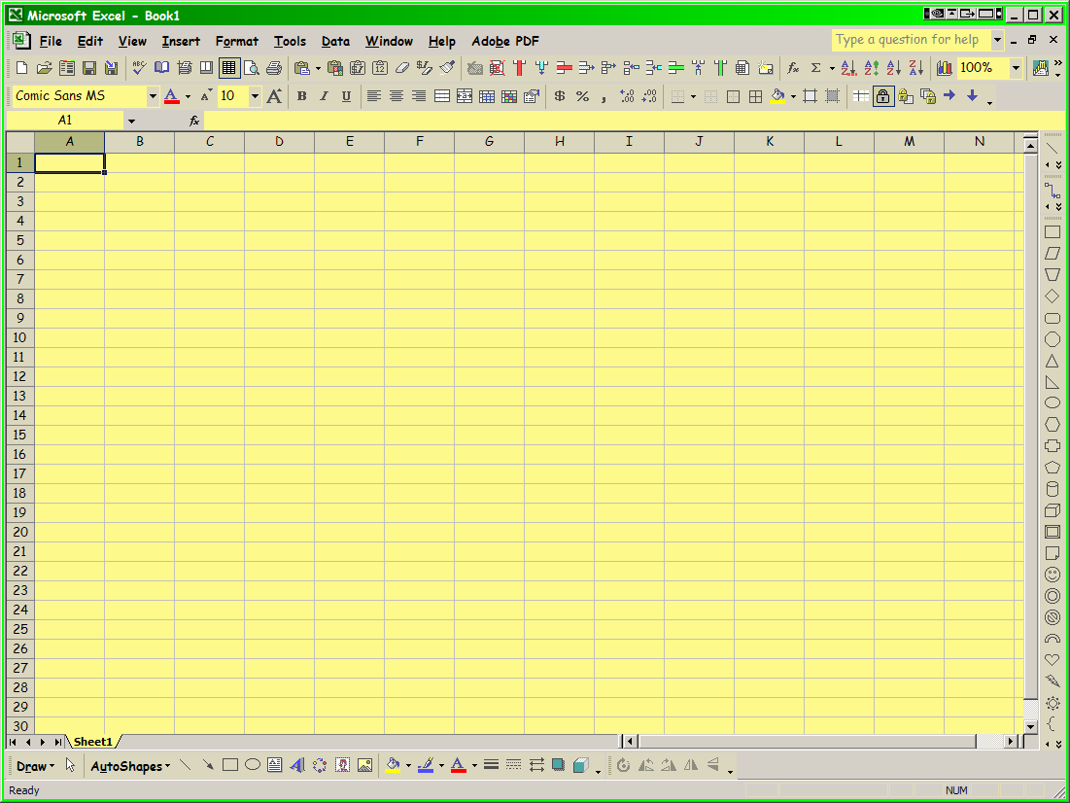
Selecting Risk-Mitigation Measures
Address intolerable SOLs
Discard mitigation with negative ROIs (but remember that insurance always has a short-term negative ROI)
Rank measures by descending benefits, costs, ROI

Slide 29
Limits of Questionnaires
Could a security questionnaire suffice as a risk assessment?
  Ask people for their opinions
  Collate the results
Problems
  Ambiguities in use of words (“serious”, “expensive”….
  Many questions prompt yes/no answers but need more subtle distinctions
  Questionnaires miss points that arise in open discussion with back-and-forth exchange of ideas
Use Computer-Aided Consensus™
  http://www.mekabay.com/methodology/cac_ppt.zip
  http://www.mekabay.com/courses/academic/norwich/msia/leadership_skills_part_5_ppt.zip
  http://www.mekabay.com/methodology/cac.pdf

Slide 30
Review Questions (1)
What are the two main components of risk as discussed in IA management?
Why can’t we apply the same risk management choices to all IT systems? How come it’s not like car safety?
What are the major problems limiting the value of questionnaires in determining IT risks in an organization?
What is Jacobson’s Window? Draw it.
What are the two classes of risk that are simply irrelevant in managing risks? Explain why each of the two has no real-world significance for risk management.
What are the two classes of risk that are critically important in real-world risk management?

Slide 31
Review Questions (2)
What is the ALE for a 100-year flood (one that occurs on average once in a century) that completely destroys a $10M building?
What is the ALE for a meteor strike equivalent to the C-T (Cretaceous-Tertiary) extinction event that killed off 99.9% of the dinosaurs and other living things and led to a decades-long global winter 65 million years ago? Assume that such an event has an occurrence rate of 1 per 100 million years and make reasonable estimates of the global domestic product if the entire human population were to be destroyed.
Calculate the Expected Value E(x) for a BCP & DRP that costs $10,000 per year, is used on average only once in a century, but saves the organization $15M if it is actually used.

Slide 32
DISCUSSION

