Slide 1
Management Responsibilities & Liabilities
CSH5 Chapter 63
Management Responsibilities & Liabilities
Carl Hallberg, M. E. Kabay, Bridgitt Robertson, and Arthur Hutt

Slide 2

Topics: Integration of Many Previous Chapters / Lectures
Introduction
Responsibilities
Liabilities
Computer Management
Functions
Security Administration

Slide 3

Introduction
Security serves corporate mission
Different balance in each organization
  Low risk, high tolerance
  High risk, low tolerance
Management provides essential framework
Heterogeneous networks complicate management task
Increased publicity about IT security failures raises visibility of internal security managers
  Helps by sensitizing colleagues
  Hurts by causing overreaction

Slide 4
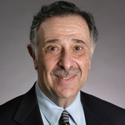
CISO
Chief Information Security Officer
  CitiBank first to name CISO
  Steven Katz (early 1990s)
  in wake of Vladimir Levin attack
  Reports at same level as other
  C-officers (CEO, CFO, COO…)
Functions include all aspects of managing and long-term planning for information security
Coordination with physical/facilities security, IT, legal department
QUESTION: why report at same level as other C-officers? Why not to CIO?
See also CSH5 Chapter 65 for further details of the role of the CISO.

Slide 5

IS & Strategic Vision
Focus on mission-critical functions
Poor security can affect all stakeholders
  Including current & potential customers
  Increasing reluctance to work with organizations w/ poor security
Security focus can improve
overall attention to detail,
planning – benefits throughout
Define roles & responsibilities
in IT-security group
Manage expectations of other
executives

Slide 6
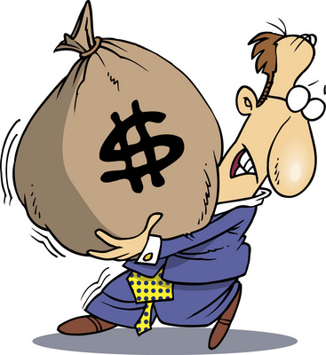
NPV (Net Present Value) of Good Security
Traditional views of security
  Risk avoidance
  Loss prevention
  Loss mitigation
Competitive marketplace puts
positive value on visible
security
  Customer confidence
  Market share
  Increased profits
In government or non-profit cases, good IA can support public confidence, use of services or donations

Slide 7

Veterans Affairs Case Study
Announcement without taking responsibility
Unencrypted mobile data – stolen
Personally identifiable information (PII) – loss of control
Systematic management failures – widespread refusal to follow established government security guidelines & standards
Contractor involvement – many
breaches traced to occasional
workers
Analysis & response – new
policies limiting portable devices,
forcing encryption, adding
security officials
See http://www.mekabay.com/infosecmgmt/vasaga.pdf

Slide 8

Responsibilities
Overall Goals of Security Management
Policy Management
Motivation
Supervision
Judgement &
Adaptation
Management Failures
Risk Management

Slide 9
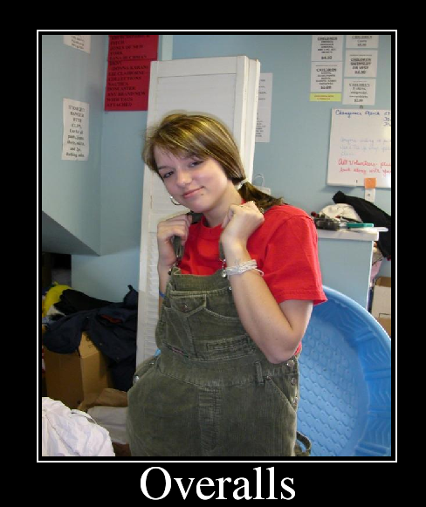
Overall Goals of Security
Modern organizations depend on information
  Confidentiality
  Control
  Integrity
  Authenticity
  Availability
  Utility
Maintain entire infrastructure
including technical and human
factors supporting these
attributes of information
Meet business needs
cost-effectively
Define metrics and standards
for security processes and
procedures
The Parkerian Hexad

Slide 10

CISO & Policy Management
People take more of managers’ time than technical issues
Hire right people using security evaluations
Train, supervise, promote, fire personnel with attention to security issues
Motivate, encourage, retain personnel to improve security
Comply with corporate policies, regulations, laws to avoid security breaches & their consequences
CISO does NOT write detailed policies such as password rules

Slide 11

Motivation Important
Security policies often perceived as nuisance
  Interfere with fundamental goals
Upper management must set example
Punishment not most effective motivator
  Theory X assumes that people need punishment to keep them up to standard because they are
    Lazy
    Unmotivated
    Dishonest
  Theory Y assumes that people
    Like to excel
    Enjoy their work if possible
    Will be honest most of the time
    Respond well to praise and reward

Slide 12
Motivation (cont’d)
Challenging staff can keep them interested in security
  Security courses
  Professional security associations
  Conferences about INFOSEC
  Contests
  Writing articles
Camaraderie can help – but only voluntary
  Outings, sports, teams, picnics….
  Journal “brown bag” lunch clubs….
  NEVER force people into such activities
  Be careful about invading private time
Knowledge-sharing
Adequate resources for assigned tasks

Slide 13

Supervision
Errors & omissions by staff major component of harm to IT systems
  Poorly-trained employees
  Bored or careless employees
Analyze all incidents that harm production
  Determine root causes
  Solve them!
Management by walking around (MBWA)
  Tremendously valuable tool
  Real-time information about mood, problems
  Absorb more than explicit details – sense atmosphere
  Try at least an hour a week

Slide 14
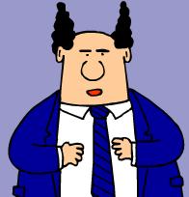
Judgement & Adaptation
Dilbert caricatures managers who
have no clue about mission-critical
functions
Listen to the employees and respond
to their concerns honestly and openly
NEVER ignore required reports from staff
Short-term perspective can ruin prospects for long-term success; e.g.,
  Insisting on cheaper solution now may cause long-term costs
  Requiring high-security measures without attention to reality may interfere with required processes
  Management stupidity may lead to rebellion and side-stepping all security

Slide 15
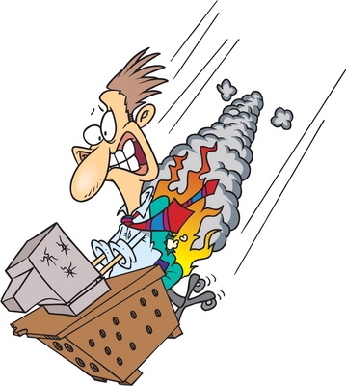
Classic Security-Mgmt Failures
Hasn’t happened here – so don’t need security
Security as afterthought
Security solely as cost with
no benefit
Using only free security systems
Novices managing computers
Tolerating illegal activities
on corporate systems
Failing to patch known
vulnerabilities
Trusting mobile code without
checking trustworthiness
Allowing automatic execution of document macros
Treating people as fungible (replaceable units)
Not sharing security-failure information

Slide 16

Risk Management
Causes of damage
  Physical hazards
  Equipment malfunction
  Software malfunction
  Human error
  Misuse of data
  Loss of data
Also classify by
  Magnitude of loss
  Probability of loss
  Permanency of damage

Slide 17

Liabilities
Summary of Liabilities
Case Study
Stakeholders
Due Diligence of Care
Downstream Liability
Audits

Slide 18

Summary of Liabilities
Loss of revenue
Loss of reputation
Loss of business-partner
confidence
Loss of consumer confidence
Loss of enterprise valuation
Failure of the entire enterprise
And all of these can result in a loss of trust.

Slide 19

Case Study: VeriSign
In 2001, VeriSign issued Microsoft cryptographic certificates to non-Microsoft crooks
Tremendous blow to VeriSign’s credibility as a Certificate Authority
Response was exemplary
  Immediate, open public
  information about failure
  of their processes
  Open process to resolve error
Did not lose public confidence
  Stock price even rose
  Still in business as leading CA for SSL (47% of global market in June 2004)*
* http://www.internetnews.com/xSP/article.php/3379001

Slide 20
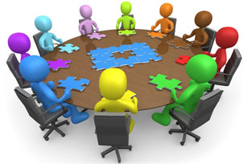
Stakeholders*
* Anyone affected by a corporate policy (or disaster)
Stockholders
Employees
Customers
Potential customers
Suppliers
Data subjects
Regulatory agencies and law enforcement
Downstream victims
Permission for use of graphic
requested from copyright owner.

Slide 21

Due Care & Diligence
Research & analysis to establish risks & appropriate defenses
Especially important in mergers & acquisitions
Slowly gaining support for standards such as ISO 17799
Compliance with local laws contributing to respect for due diligence
  European Privacy Directive
  US HIPAA, GLB, SOx

Slide 22

Downstream Liability
Theory has been popular for a decade
  Fail to protect your system against compromise
  Criminals use your compromised system to harm victims
  Victims sue you (as civil tort) for contributory negligence
No successful cases to date (2014)
The few attempts on record have been rejected by courts so far

Slide 23
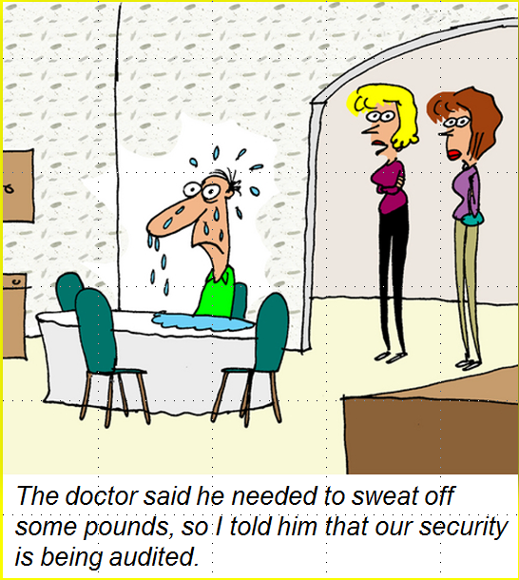
Audits
Audits important tool to demonstrate due diligence
Assess level of compliance with policy
  Distinct from assessment which can be broader in scope
  Definitely not same as penetration test
Adopt non-adversarial stance for most effective cooperation of staff
Auditors should listen to explanations for deviations from policy and include them in reports

Slide 24
Recent US Legislation
SOX
GLB
HIPAA
See CSH5 Chapter 64 for details.

Slide 25

Sarbanes-Oxley
Implemented 2002
  Enacted after the Enron and WorldCom scandals
  Developed by Paul Sarbanes (D-MD) & Michael Oxley (R-OH)
Regulates corporate financial records
  Penalties for abuse
  Defines types of records to archive
  Prohibits data falsification
For more information, see
  http://www.sec.gov/divisions/corpfin/faqs/soxact2002.htm

Slide 26
Gramm-Leach Bliley Act
“GLB” or “GLBA”
Enacted 1999; effective mid-2001
Every financial institution shall protect the security and confidentiality of its customers' confidential personal information
Data subjects must
  Be informed of privacy policies and
  Have opportunity to inspect and correct their own records
For more info, see http://www.ftc.gov/privacy/privacyinitiatives/glbact.html

Slide 27
HIPAA
Health Insurance Portability and Accountability Act of 1996
  AKA “Kennedy-Kassebaum Act”
Title I protects employees' health insurance coverage when they change or lose their jobs
Title II
  Standards for patient health, administrative and financial data interchange
  Privacy & security of health information records and transactions
Took effect 2001; compliance targets through 2004
For more information, see
  http://www.cms.hhs.gov/HIPAAGenInfo/

Slide 28

Computer Management Functions
Overview of
Management
Planning for
Computer Security
Organizing
Integrating
Controlling

Slide 29

Overview of Management
Understand that security
management is a process,
not a state
The better your security,
the less immediate
evidence there may be
of its effects
  Therefore keep records
  of attacks
  Include intrusion-detection outside your perimeter as well as inside
Define scope with clear metrics and standards to establish success or failure
  E.g., define specific service-level agreements (SLAs) for availability

Slide 30

Planning for Computer Security
Communicate constantly with upper management
  No surprises
  Never blind-side your boss
Coordinate security of IT with all other sectors (e.g., HR, PR, finance, accounting, production, research…)
Communicate goals and successes throughout the organization
  Security-awareness tools (as previously discussed)
  Newsletters, reports etc.

Slide 31

Organizing
Obtaining resources of personnel, money, and facilities adequate to accomplish assigned mission
Fitting responsibly into organizational pattern
Assigning responsibility and authority to individuals
Formulating supporting methods and procedures
Measuring organizational effectiveness

Slide 32
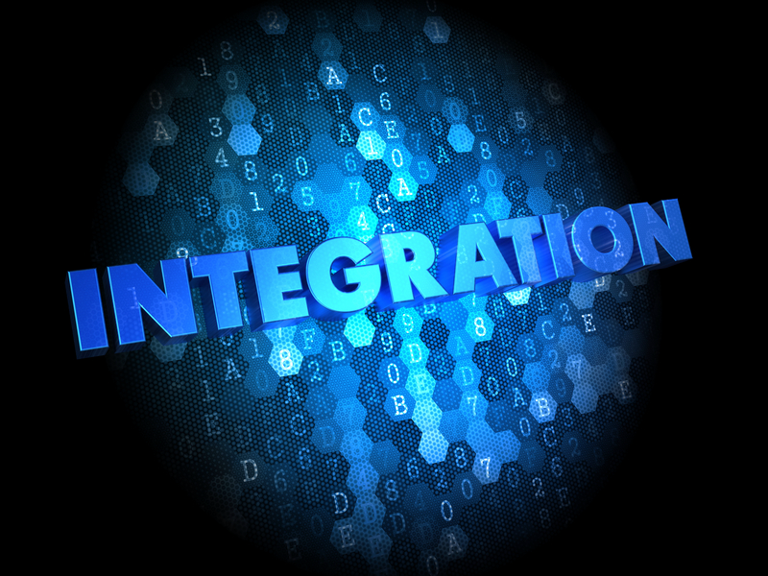
Integrating Security
Integrating security into all
areas of work from ground
up (not as retrofit)
Accountability for
security in job
descriptions
Training programs
include security
Supervisors include security compliance
Explicit responsibility for overall security
Avoid conflicts of interest (COO, CIO, CFO should not be CISO)
Policies should drive written standards and procedures

Slide 33
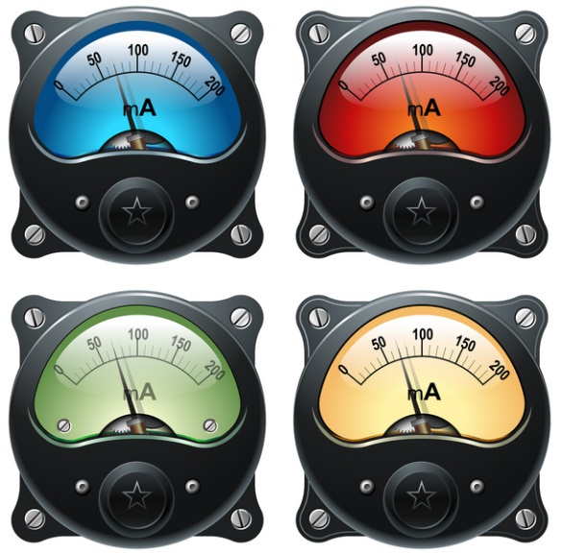
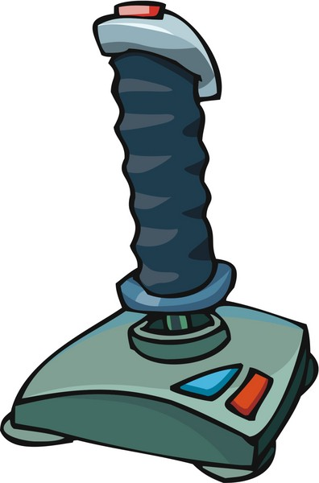
Controlling
Develop metrics tied to security goals
Define standards (objectives)
Analyze results promptly
Take corrective action at once
Avoid making these processes punitive – will result in dissimulation, falsification of data, and resentments among staff

Slide 34

Security Administration
Staffing the Security Function
Authority and Responsibility
Professional Accreditation & Education

Slide 35

Staffing the Security Function
Titles vary
  Information security administrator
  Computer security manager
  Information systems security officer
  Chief information security officer
Look for management and technical abilities
Work with both technical staff and managers
Communicate (speak, write) well
Understand cost/benefit analysis, finances
Know industry if possible

Slide 36
Authority and Responsibility
Do not separate authority and
responsibility
Essential that those charged with
the responsibility to accomplish
a job have the authority to
succeed
Some typical responsibilities
  Establish policy statements
  and guidelines for information
  protection
  Identify vulnerabilities and risks
  Recommend protective measures
  Control implementation of protective measures
  Measure effectiveness of security precautions
  Promote security awareness and security education
  Achieve professional accreditation

Slide 37
Examples of Certification
CCP (Certified Computing Professional with specialty including Systems Security) from the Institute for Certification of Computer Professionals (ICCP, www.iccp.org)
CDRP (Certified Disaster Recovery Planner) from the Disaster Recovery Institute International (DRII, www.drii.org)
CFE (Certified Fraud Examiner) from the Association of Certified Fraud Examiners (ACFE, www.acfe.org)
CIA (Certified Internal Auditor) from the Institute of Internal Auditors (IIA, www.theiia.org)
CISA (Certified Information Systems Auditor) from the Information Systems Audit & Control Association (ISACA, www.isaca.org)

Slide 38
Examples of Certification (cont’d)
CISSP (Certified Information Systems Security Professional) from the International Information Systems Security Certification Consortium (ISC)2; Web site www.isc2.org
ISSxP (Information Systems Security {Architecture / Engineering / Management} Professional) specializations of CISSP
CPP (Certified Protection Professional) from the American Society for Industrial Security (ASIS, www.asisonline.org)
MSIA (Master of Science in Information Assurance) from Norwich University; Web site www.msia.norwich.edu
See also CSH5 Chapters 74, 75 & 76

Slide 39
Review Questions
Why can’t we simply establish uniform standards of information security that can be applied to all organizations equally?
Under what circumstances could good IA be a positive factor for the profitability or other measures of success of an organization?
What are the six fundamental attributes of information that IA must protect?
What’s a security metric and how is it related to a security standard?
Why do you think that people-related issues take more time for IA managers than technical issues?
How is it that IA managers have to consider motivational psychology as part of their job?

Slide 40
Review Questions
Why do you think that MBWA could improve IA in an organization?
How can an IA manager avoid the pitfalls lampooned in Dilbert cartoons?
What were the characteristics of VeriSign’s response to its 2001 failures in the Microsoft certificate case that helped avoid a public-relations disaster for the company?
Why should we be concerned with more than just customers when considering the consequences of security failures? Who are these other stakeholders?
What is meant by exercising due care and diligence in implementing security policies?
What is meant by downstream liability in discussions of security policy?

Slide 41
Review Questions
How can you help security audits be successful?
What are the key elements for successful planning of computer security?
What are the key elements for organizing the security function?
How can you integrate security into the corporate culture?
What are some of the attributes of the ideal information assurance manager?
Why should we ensure that authority accompanies responsibility?
Expand the acronyms CCP, CDRP, CFE, CISA, CISSP, ISSMP, CPP and MSIA.

Slide 42
DISCUSSION

