Slide 1
Role(s) of the CISO
CSH5 Chapter 65
“ROLE OF THE CISO”
Karen Worstell

Slide 2

Topics
CISO AS CHANGE AGENT
CISO AS STRATEGIST
STRATEGY, GOVERNANCE, AND THE STANDARD OF CARE
RECOMMENDATIONS FOR SUCCESS FOR CISOs
Karen F. Worstell

Slide 3
CISO AS CHANGE AGENT
CIO responsibilities broad
  CISO role broadening beyond IT security
  CISO focuses on information security
CISO manages trust
  People, business processes, technology
  Enterprise & its partners – stakeholders
  Must coordinate with CIO & CSO (Chief Security Officer)
Technology has spawned new attack vectors
Legislation
  Increasingly forcing responsibility and disclosure for consumer/data subjects
  Increasing penalties for failure
  Preparing / defending against litigation growing in importance
CISO must clarify obligations, necessities & strategic spending

Slide 4
CISO AS STRATEGIST
Overview: Strategic Situational Awareness
Reliance on Digital
Information
Inherent Insecurity of
Systems
World Trends

Slide 5
Overview: Strategic Situational Awareness (1)
Information growing in value
  “Information is the business.”*
  Information applications
  determine competitive
  advantage
  Require rules-based
  protection to ensure data
  control, confidentiality,
  integrity, authenticity,
  availability & utility
* Phil Condit, former chairman of Boeing,
speaking at Intl Info Integrity Inst (I4) in 1995

Slide 6
Overview: Strategic Situational Awareness (2)
Main drivers for CISOs to define new strategy for information security
  Systems inherently insecure
    Variations in configuration
    Complexity
    Volume of vulnerabilities
  Reach of global business
  increases complexity
    Business processes
    Personnel
    Business systems
  Asymmetrical warfare
    Vastly more attackers than defenders in an organization
    Attack vectors change quickly
    Trusted insiders are most significant threat

Slide 7
Overview: Strategic Situational Awareness (3)
CISO as strategist must
  Adopt & integrate new methods
  Update current methods of
  protection
    Network defenses
    Data classification
CISO must adopt long-term business
strategic thinking
  Consider reliance on information
  Define & explain why protection is important
  Cope with fundamentally insecure systems
  Abandon risk-based security thinking

Slide 8
Reliance on Digital Information
CRITICAL INFRASTRUCTURE
Information technology
Telecommunications
Chemicals
Transportation systems
Emergency systems
Postal & shipping services
Agriculture & food
Public health & healthcare
Drinking water / water treatment
Energy
Banking & finance
National monuments & icons
Defense industrial base
Key industry/technology sites
Large gathering sites
85% of US critical
infrastructure owned by
private companies
Interconnecting systems
force a chain of trust
  Trust in systems to trust
  in information
  Trust in information to
  trust in decisions
May be forced to
demonstrate
  Digital ownership of
  intellectual property (IP)
  Chain of possession of IP

Slide 9

Inherent Insecurity of Systems
Components of systems all created / installed by (fallible/corruptible) human beings
  Hardware, software
  Utilities, scripts
  Transport media
All irretrievably flawed
  Vulnerabilities (current & future)
  cannot all be addressed / redressed
  Perfect security is myth: unattainable
  Risk-based methods don’t work
    Unscaleable
    No meaningful data for probability
    Annualized loss expectancies (ALE) impossible to verify

Slide 10
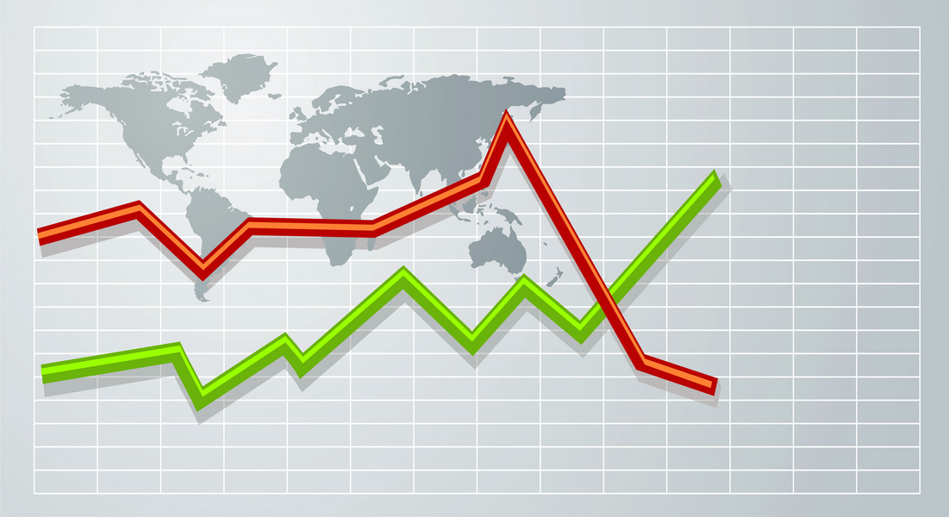
World Trends (1)
Dramatic geographic shifts in economic activity
  Supply chains & internal processes will be globalized
  Outsourcing, leasing will complicate asset protection
Increased connectivity will disrupt current security infrastructures
  Mobile devices will affect rules on inbound & outbound filters
  Huge increase in data density of storage devices must alter security processes
  Grid / cloud computing changes rules

Slide 11
World Trends (2)
New models for information processing require new rules or new models
  Cloud computing
  Software as a service (SaaS)
  Access to proprietary information over the Web
    E.g., telecommuting by employees
CISO must function at level of executive management
  Business strategist
  Participate in executive leadership team
  Enable integration of due diligence to standard of care into all business streams

Slide 12

STRATEGY, GOVERNANCE, & THE STANDARD OF CARE
Standard of Care
Governance &
Accountability
Roles &
Responsibilities
Reporting
Monitoring
Metrics
Executive Visibility

Slide 13
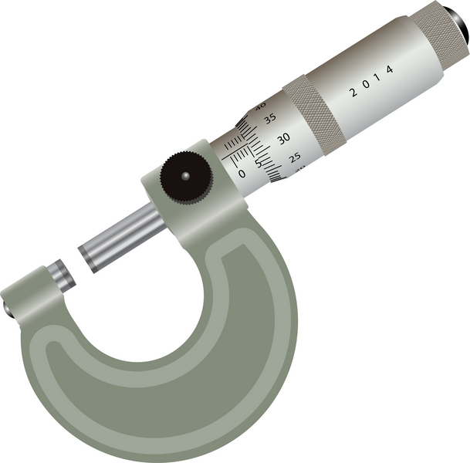
Standard of Care (1)
Key vision
  Put in place mechanisms for
  Enabling business to
  demonstrate
  Due diligence
  To appropriate standard of
  care
Basic steps
  Evaluate risk qualitatively
    High – medium – low
    NOT using quantitative methods such as ALE
  Use accepted standards as framework
  Translate high-level policy into action

Slide 14

Standard of Care (2)
Internationally accepted for standards of due care include
  ISO/IEC 17799:2005
  ISO/IEC 27001:2005
  ISO/IEC 13335-1:2004
  CobiT® – Control Objectives for IT
  ITIL® – IT Infrastructure Library
See Exhibit 65.1 & also CSH5 chapters
  44 “Security Policy Guidelines”
  54 “Security Audits, Standards, and Inspections”

Slide 15

Standard of Care (3)
Internationally accepted standards
  See CSH5 Ch 54: Security Audits, Standards & Inspections
Risk assessment
  Is not vulnerability analysis or audit
  Must identify potential areas
    That could result in exposure
    Above defined threshold
    Of business impact
  Identify critical functions/areas where failure could exceed materiality threshold
    E.g., if minimum damage $5M, will have different priorities than if threshold $500M

Slide 16

Standard of Care (4)
CISO does not micromanage
CISO assigns duties to appropriate staff
  Detailed configuration of devices role
  of security officers & other employees
CISO reviews reports
CISO ensures continuous process improvement
Bruce Schneier: “In the real world, security involves processes. It involves preventative technologies, but also detection and reaction processes, and an entire forensics system to hunt down and prosecute the guilty. Security is not a product; it itself is a process. And if we're ever going to make our digital systems secure, we're going to have to start building processes.”*
Preface to Secrets and Lies (2004).
http://www.schneier.com/book-sandl-pref.html

Slide 17
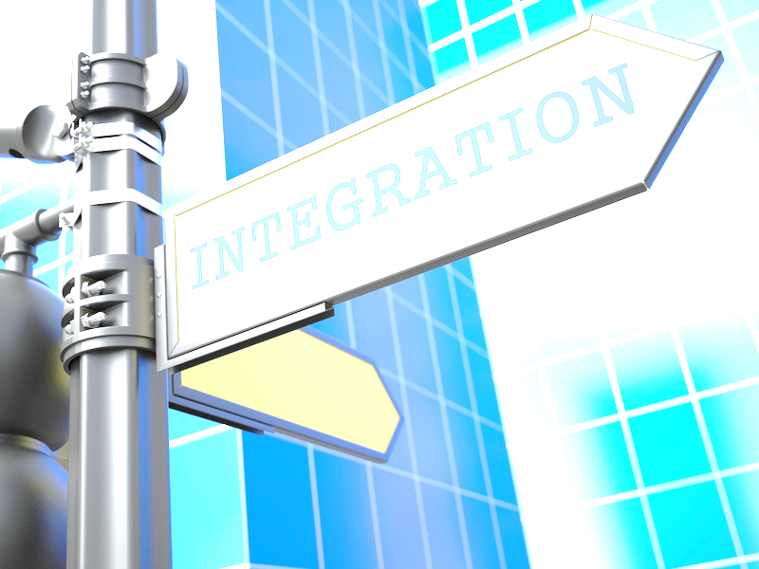
Governance & Accountability (1)
Convergence: business processes becoming increasingly integrated into security processes
CISO increasingly involved in entire life-cycle of business strategy & planning
Focus on business above all
  Coordinate security with business objectives
  Stop valuing abstract, unrealistic security above practicality and risk management
Break down organizational silos

Slide 18
Governance & Accountability (2)
Do NOT centralize ALL security under CISO
  Assign security responsibilities to all business unit executives
Benefits:
  No one security group can manage all of security by itself
  Accountability helps focus attention on security
  Interdisciplinary approach increases flexibility & responsiveness
  Involving every management unit increases security thinking during planning
  Funding for security assigned throughout organization

Slide 19
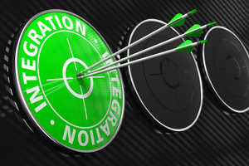
Governance & Accountability (3)
Policy-driven approach to IA/BCP/DRP governance
Senior Leadership Team
(C-level)
Authority for policy
Governance body
Program oversight
Policy
Accountability
Programs & program authority
Governance processes
Publishes under authority of entire senior leadership team
Accountability
Programs & program authority
Governance processes
Publishes under authority of entire senior leadership team
Principles
5-6 high-level statements at descriptive level
Separate from policy
Establishes guidance for business unit standards
Business Unit
Team
Staff support
Facilitates governance process
Provides technical leadership for security across business units
Representatives from each business unit + audit
CISO = chair
Coordinates policy principles for senior leadership team approvals
Standards at prescriptive level
Implements standards
Monitors effectiveness (metrics, reports)
Coordinates continuous process improvement for security across all business units

Slide 20

Governance & Accountability (4)
CISO must become agent of
change
  Move from implementation
  Move to innovation &
  responsiveness to business
  needs
Attack profiles changing
  Moving away from simple technical exploits
  Moving to targeted exploitation of business process weaknesses
  Every executive must be thinking about security as normal part of business management

Slide 21
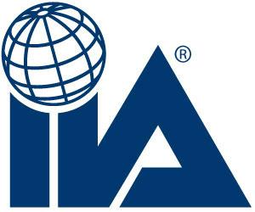


Roles & Responsibilities (1)
Convince upper management that CISO must be agent of change
  Refer to best practices
    Institute of Internal Auditors (IIA)
    Information Security and Control Association (ISACA)
    IT Governance Institute (ITGI)
  Adapt to specific needs of organization
Expect incremental change,
not instant compliance
Use 10 principles (next slides) as
discussion points

Slide 22
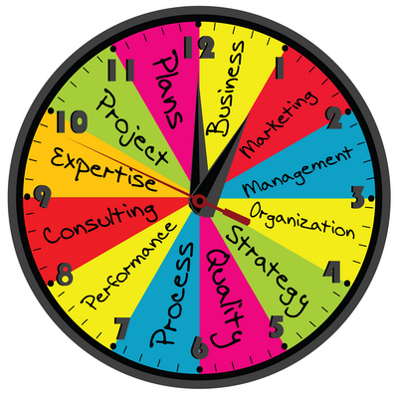
Roles & Responsibilities (2)
CISO doesn’t own/control IT assets – manages them for effective business results
Independent auditor regularly reviews implementation
IT security expenses must be justified by business value
IT security monitored by
IT governance board
  IT
  Business management
  CFO

Slide 23

Roles & Responsibilities (3)
Security, IA, cybersecurity tied to business rules
  Traceable
  Understandable
  Agreed to by organization
IT security changes must be authorized by IT management change boards
IT governance boards monitor application development
  Functionality & performance must comply with design
  All design includes appropriate security requirements
  No unauthorized code

Slide 24

Roles & Responsibilities (4)
IT security operations & processes managed tightly: standardized, documented, reviewed regularly by IT management & independent auditors
  New processes adapt to
  business change
  Existing processes regularly
  reviewed, including involvement
  by legal counsel
Information systems assets have
clear ownership / accountability
  Assets used as intended
  Assets accessed according to authorization
  Assets available and useful according to metrics (e.g., QoS*)
*Quality of Service

Slide 25

Roles & Responsibilities (5)
Appropriate & updated training & certification of IT employees, contractors, vendors to
ensure capability for enforcing
security
Final remarks:
  Major hurdle: business
  managers generally don’t
  understand IT & would
  prefer to see it controlled
  by “IT staff”
  Must convince upper
  management that IT is lifeblood
  of business: no info, no business
  Accepting responsibility / accountability for all aspects of IT & security radically changes level of cooperation

Slide 26

Reporting & Accountability
Governance structure leads to appropriate assignment of accountability
  Not if but how managers take responsibility for results
Without accountability
  Rules will not be implemented well
  Enforcement will fail

Slide 27

Monitoring
How well are we doing in meeting
our standards?
  Kabay:
  REALITY TRUMPS THEORY
Monitoring allows decisions for
specific areas
  Controls are working
  Controls are not working
Close coordination with internal audit
Standards
  Objective standards of proof
  Hearsay inadequate
  Must expect to automate data gathering

Slide 28

Metrics
Choose metrics carefully: must be essential to
  Provide performance indicators
  Be actionable: actually provide
  options for making changes
Monitoring what cannot be
changed is pointless
  Attacks on perimeter
  meaningless unless we also
  measure attacks
  penetrating perimeter
  Thus have ID* outside firewalls
  & inside firewalls
*Intrusion Detection

Slide 29

Executive Visibility
CISO executive scorecard
  Published w/ support of C-level sponsor(s)
  Helps drive behavior according to metrics reported
Quarterly reports (or more frequent)
Support continuous process improvement
Encourage executive / managerial involvement

Slide 30

RECOMMENDATIONS FOR SUCCESS FOR CISOs
Education & Experience
Culture of Security in the Business
Alliance with Corporate & Outside Counsel
Partnership with Internal Audit
Tension with IT
Organizational Structure
Responsibilities & Opportunities Outside of CISO Internal Responsibilities

Slide 31

Education & Experience (1)
Leadership skills
Wise counsel / appropriate
judgement
Big picture view
MBA degree may be helpful
Life experience of value
Studying reputable books on management & leadership helpful
Keep up to date on IT & security developments

Slide 32

Education & Experience (2)
Know your organization’s functional organization
Core stakeholders:
  Internal audit
  Legal counsel
  Business executives
  IT staff
Frequent discussions with
  Finance
  Supply chain
  Human resources

Slide 33

Education & Experience (3)
Know your company’s mission-critical objectives & processes
Company’s value chain*
Major business processes
Disclosure statements
Annual reports
Major cost concerns
Major revenue streams
Key risks (outside security)
*Value chain: sequence of activities at each of which products gain value.
Ref: Porter, M. (1985). Competitive Advantage: Creating and Sustaining Superior Performance.
Free Press (ISBN 0-684-84146-0). 592 pp. Index.

Slide 34

Culture of Security in the Business (1)
Study culture: attitudes toward
  Accepting direction
  Allowing time & resources to be
  used for security
Questions for understanding
organizational culture towards
security
  Risk appetite: materiality
  threshold for risk management?
  Norms / attitudes:
    High turnover, tolerance for change, focus on autonomy? Or
    Policy-driven bureaucracy?
    Generally use reward in preference to punishment

Slide 35

Culture of Security in the Business (2)
Questions cont’d
Relevant regulations & statutes: inventory & understanding (more complex in international organizations)
Influence / awareness of public opinion: function of public visibility; may involve marketing functions
Risk to reputation: consumer confidence; transparency acceptable / useful?

Slide 36
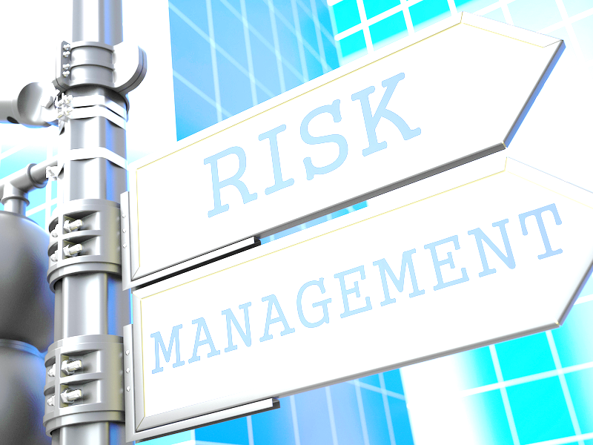
Culture of Security in the Business (3)
Who else manages risk?
  Financial
  Legal
  Corporate strategy & planning
  Marketing
  Consulting,
  Product design
  Customer support
What is your relationship with these other managers?
  Should you talk to others?
  Be sure to keep abreast of changes

Slide 37

Alliance with Corporate & Outside Counsel
Coordinate w/ counsel
  Policy
  Investigations
  Contracts
  Incidents
Intellectual property
issues must involve
counsel
Maintain close ties

Slide 38

Partnership with Internal Audit
Close partnership essential
CISO must ensure smooth collaboration
  Standard of care requires demonstration
  of effective functioning of controls
  Work together on monitoring & reporting
  Ensure full access to information security processes
  Provide support to each other in escalation
Focus on egoless work*:
  Audit results are positive contribution to continuous process improvement
  Findings never interpreted as personal attacks
  Constructive criticisms welcomed, praised & rewarded
*See Kabay, M. (2009). “On Writing” v10. Section 9, “Egoless Work.”
< http://www.mekabay.com/methodology/writing.pdf >

Slide 39

Tension with IT
Some CISOs report to CIO
(head of IT)
  Potential conflict of interest
  Scope of CISO’s work extends
  beyond IT
  Impression that CISO is IT security
  manager instead of information security manager
Mistake to fund CISO out of IT budget
  Inappropriate allocation of costs
  Can hit IT hard & cause resentment
CISO should report to Board like all other C-levels
  But important not to lose collaboration with IT
  If impossible & CISO reports to CIO, try dotted-line relationships to senior executives (difficult)

Slide 40
Organizational Structure
Reporting (discussed on previous slide)
  Note also that some CISOs report to CEO, COO or CFO
Other possibilities
  Some CISOs responsible
  for
    Physical security
    Executive protection
  Collaborate closely with
  physical security chief
Key elements of CISO role
Governance
Policy management
Compliance monitoring & reporting
Parameters for IT security operations
Information security investigations
Forensics & incident handling
Identity & access management
Business continuity
Records management
E-discovery

Slide 41

Additional Roles Beyond
Internal Responsibilities
Share what’s experienced
Codify security practice
Improve understanding of security
Participate in professional organizations
Write for professional publications
Speak to community / professional / trade organizations
Eliminate confusion
Define role in everyone’s minds

Slide 42
DISCUSSION

